Slide 1
CareNest Where Love Meets Technology Smart cradle monitoring system 25-FYP-203

Slide 2
SUPERVISED BY
Mr. Abdul Qadeer
CO-SUPERVISED BY
Miss Sana Ikram
SUBMITTED BY
Fasih Ahmad khan 21-NTU-CS-1307
Hashim bin Hafeez 21-NTU-CS-1333
Ali Hassan 21-NTU-CS-1297

Slide 3
INTRODUCTION

Slide 4



What is CareNest?
A smart baby monitoring system integrated into a cradle.
Uses sensors to track baby health and environment.
Provides real-time Notification to parents via a mobile app.

Slide 5
PROBLEM STATEMENT

Slide 6
Why is this project important?
Parents face difficulty in continuously supervising their newborns, leading to stress, reduced productivity, and potential health and safety risks for both parent and child.
Parents can’t constantly monitor their baby.
Health risks: overheating, air quality, diaper rash, loud noise.
Existing baby monitors lack multiple monitoring features.

Slide 7
Why is this project important?
Features | Technologies
 | Vtech Baby Monitor | Ellie Smart Monitor | Our Work
Temperature Sensor | Measures Temperature of the Environment | Measures Temperature of the Environment | Measures Temperature of the Infant
Noise Detector | Yes | Yes | Yes
Air Quality Check | No | No | Yes
Spoiled Diaper Detection | No | No | Yes
Live Stream | Yes | Yes | Yes
Play Lullabies | Yes, but not automated | Yes, and automated | Yes, and automated
Baby Presence Detection | No | No | Yes
Mobile Application | No | Yes | Yes
Notification Alerts | No | Yes | Yes

Slide 8
OBJECTIVES

Slide 9
Objectives of the Project
Detect baby’s presence using ultrasonic and weight sensors.
Monitor baby’s health with the sensor to avoid risks.
Play lullabies automatically when it cry.
Send real-time notifications to parents.
Live video streaming

Slide 10
SYSTEM ARCHITECTURE

Slide 11
Implementation & Working
Hardware Components:
Sensors: Temperature (Probe), Moisture, AQI, Sound, ultrasonic, Weight, Camera , Ultrasonic
Actuators: Speaker for lullabies
Microcontroller: ESP32 for processing, ESP32-Cam for live Stream
Software Stack:
Mobile App: Flutter, Figma, Dart, Android studio
Database: Firebase NoSQL
Hardware Coding: PlateformIO, Arduino IDE

Slide 12
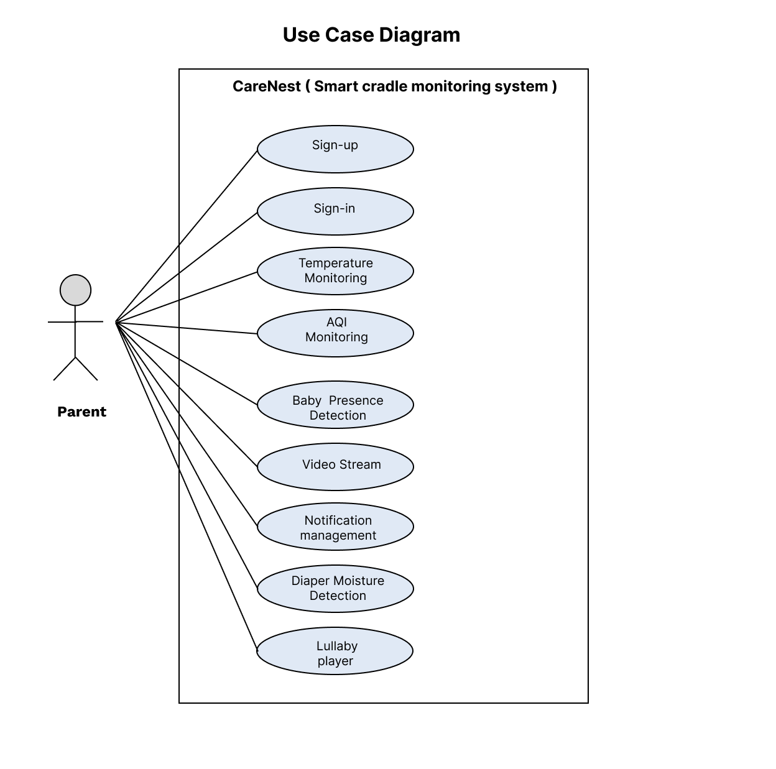
Use Case Diagram

Slide 13
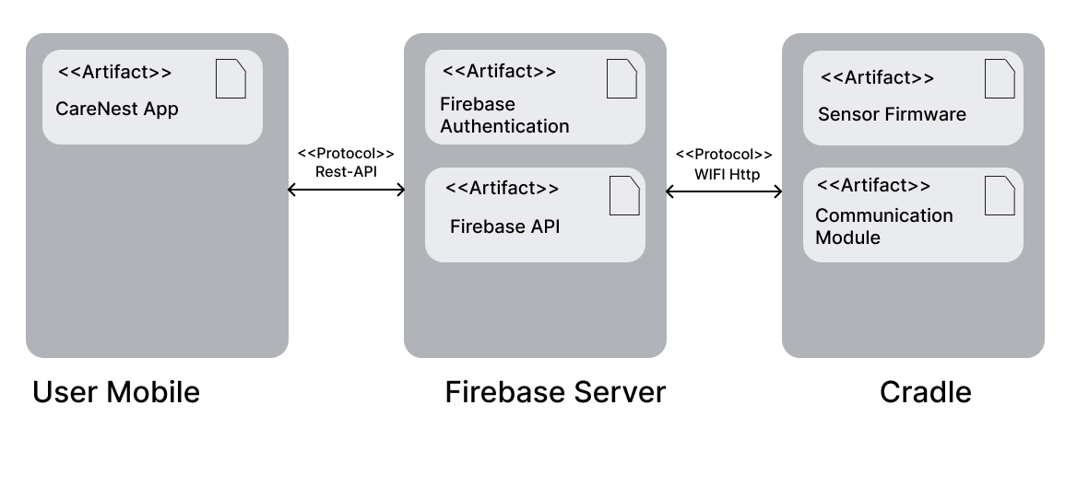
Deployment Diagram

Slide 14
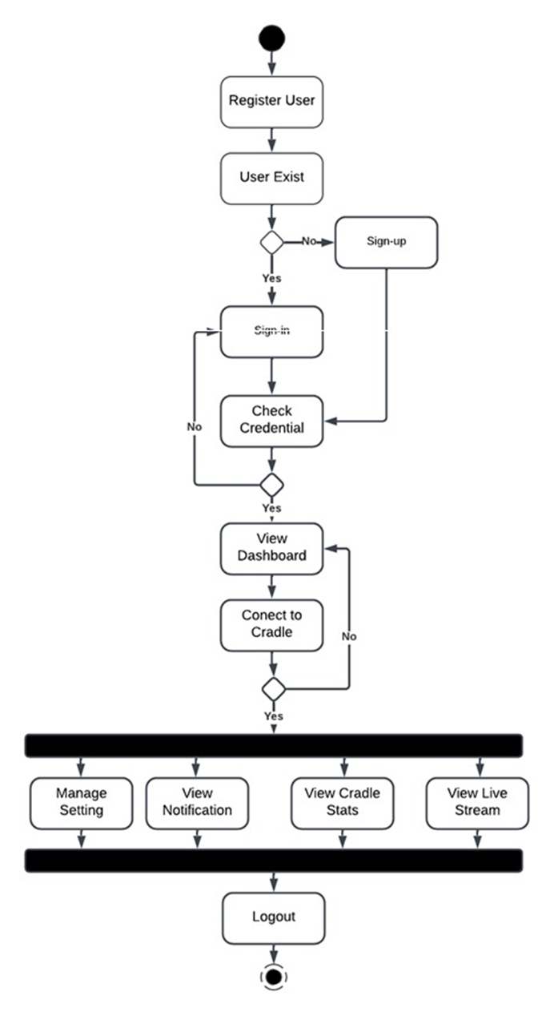
Activity Diagram

Slide 15

Data Flow Diagram (LVL 0)

Slide 16
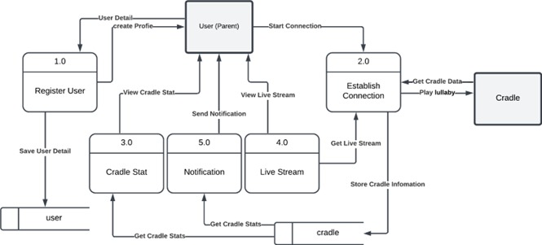
Data Flow Diagram (LVL 1)

Slide 17
SUSTAINABLE DEVELOPMENT GOALS ALIGNMENT

Slide 18
SDG Alignment & Social Impact
Supports Sustainable Development Goals (SDGs):
SDG 3: Good Health & Well-being
SDG 9: Industry, Innovation & Infrastructure
SDG 11: Smart Cities & Communities
SDG 12: Responsible Consumption

Slide 19
CHALLENGES & FUTURE ENHANCEMENTS

Slide 20
Challenges & Future Enhancements
Challenges:
Sensor Calibration Issues – Ensuring accuracy.
Optimization – optimizing processing & system load.
Future Enhancements:
AI-based Cry Detection – Recognizing baby’s cries.
Sleep Pattern Monitoring – Using machine learning.
Integration with Smart Home Systems – Google Home/Alexa.

Slide 21
COST BENEFIT ANALYSIS

Slide 22
Cost Analysis
Items | Cost
Wires | Rs 200
Sensors | Rs 1500
EPS 32 | Rs 1800
EPS 32-cam | Rs 2000
Total | RS 5500

Slide 23
Benefit Analysis
Category | Description | Estimated Value
Parental Convenience | Reduces the need for constant monitoring, sends alerts | High
Baby Safety | Detects temperature changes, diaper moisture, air quality, and excessive noise | High
Time Savings | Helps parents manage baby care more efficiently | High
Market Potential | Growing demand for baby products, potential for commercialization | High

Slide 24
CONCLUSION

Slide 25



Conclusion
CARENEST SOLVES REAL-WORLD PROBLEMS FOR PARENTS.
Uses smart monitoring, automation, and notifications.
Affordable, scalable, and impactful.
Future commercialization potential in the baby tech market.

Slide 26
Reference
GitHub Repository: https://github.com/fasih124/FYP_203
Centers for Disease Control and Prevention. (2023). Depression Among Women. www.nichd.nih.gov/ncmhep/initiatives/moms-mental-health-matters/moms
World Health Organization. (2023).Newborn health: https://www.who.int/health-topics/newborn-health/#tab=tab_1

Slide 27
The End – Thank You

