Slide 1
CareNest Where Love Meets Technology Smart cradle monitoring system 24-FYP-203

Slide 2
SUPERVISED BY
Dr. Abdul Qadeer
CO-SUPERVISED BY
Mam Sana Ikram
SUBMITTED BY
Fasih Ahmad khan 21-NTU-CS-1307
Hashim bin Hafeez 21-NTU-CS-1333
Ali Hassan 21-NTU-CS-1297

Slide 3
INTRODUCTION

Slide 4



What is CareNest?
A smart baby monitoring system integrated into a cradle.
Uses IoT sensors to track baby health and environment.
Provides real-time Notification to parents via a mobile app.

Slide 5
PROBLEM STATEMENT

Slide 6
Why is this project important?
Parents can’t constantly monitor their baby.
Health risks: overheating, air quality, diaper rash, loud noise.
Existing baby monitors lack multiple monitoring features.
High parental stress due to lack of automated Notification.

Slide 7
OBJECTIVES

Slide 8
Objectives of the Project
Develop a smart cradle with sensors for monitoring.
Detect baby’s presence using IR and weight sensors.
Monitor baby’s body temperature to avoid health risks.
Detect diaper moisture for timely changes.
Monitor air quality to ensure a safe environment.
Play lullabies automatically when noise is too high.
Send real-time notifications to parents.
Live video streaming

Slide 9
SYSTEM ARCHITECTURE

Slide 10
Implementation & Working
Hardware Components:
Sensors: Temperature (IR & Probe), Moisture, AQI, Sound, IR, Weight, Camera
Actuators: Speaker for lullabies
Microcontroller: ESP32 for processing
Software Stack:
Mobile App: Flutter
Database: Firebase NoSQL

Slide 11
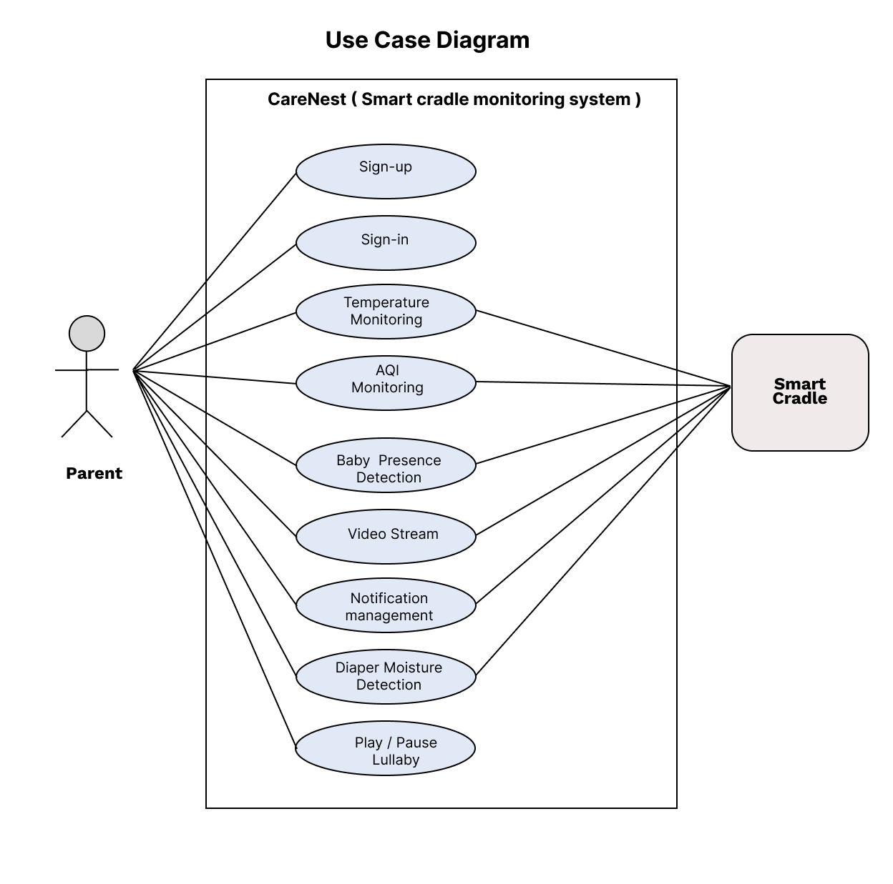
Use Case Diagram

Slide 12
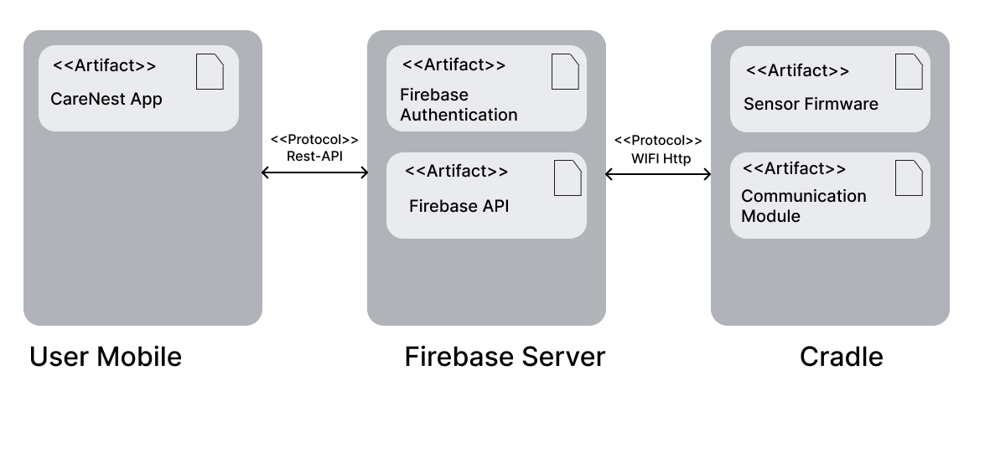
Deployment Diagram

Slide 13
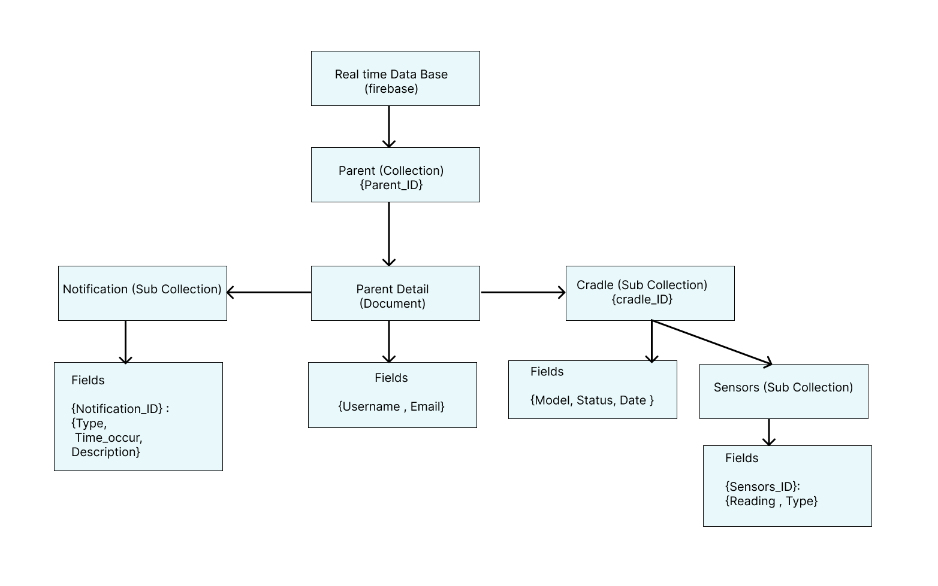
Database Diagram (NOSQL Schema)

Slide 14

Data Flow Diagram (LVL 0)

Slide 15
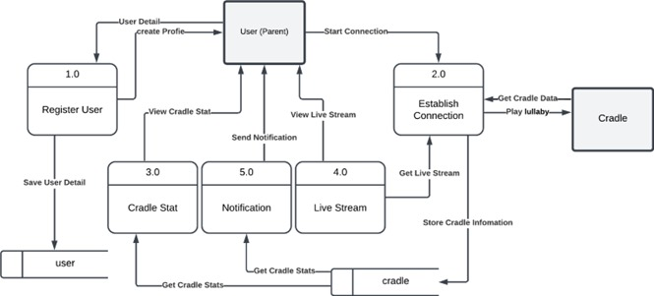
Data Flow Diagram (LVL 1)

Slide 16
SUSTAINABLE DEVELOPMENT GOALS ALIGNMENT

Slide 17
SDG Alignment & Social Impact
Supports Sustainable Development Goals (SDGs):
SDG 3: Good Health & Well-being
SDG 9: Industry, Innovation & Infrastructure
SDG 11: Smart Cities & Communities
SDG 12: Responsible Consumption

Slide 18
CHALLENGES & FUTURE ENHANCEMENTS

Slide 19
Challenges & Future Enhancements
Challenges:
Sensor Calibration Issues – Ensuring accuracy.
Power Consumption – Optimizing energy efficiency.
Network Dependency – Reducing reliance on the internet.

Slide 20
Challenges & Future Enhancements
Future Enhancements:
AI-based Cry Detection – Recognizing baby’s cries.
Sleep Pattern Monitoring – Using machine learning.
Integration with Smart Home Systems – Google Home/Alexa.
Battery-Powered Wireless Model – For greater mobility.

Slide 21
COST BENEFIT ANALYSIS

Slide 22
Cost Analysis
Items | Cost
Wires | Rs 200
Sensors | Rs 1500
EPS 32 | Rs 1800
Total | RS 3500

Slide 23
Benefit Analysis
Category | Description | Estimated Value
Parental Convenience | Reduces the need for constant monitoring, sends alerts | High
Baby Safety | Detects temperature changes, diaper moisture, air quality, and excessive noise | High
Time Savings | Helps parents manage baby care more efficiently | High
Market Potential | Growing demand for baby products, potential for commercialization | High

Slide 24
CONCLUSION

Slide 25



Conclusion
CARENEST SOLVES REAL-WORLD PROBLEMS FOR PARENTS.
Uses smart monitoring, automation, and notifications.
Affordable, scalable, and impactful.
Future commercialization potential in the baby tech market.

Slide 26
Reference
Git Hub Link
https://github.com/fasih124/FYP_203

Slide 27
The End – Thank You

