Slide 1
Data Management and Analysis with Python
Data collection through APIs

Slide 2
Trip
'Start Date'
'date_to_join'
'Start Terminal'
'End Date'
'End Station'
'End Terminal'
...
'Subscription Type'
'Start Station'
Weather
'Date'
'Max_Temperature_F'
'Mean_Temperature_F'
...
'date_to_join'
'landmark'
Landmark
'landmark'
'zip_code'
Station
'station_id'
'name'
...
'zip_code'

Slide 3
Web API
API stands for Application Programming Interface. In the context of the Web, this means that services provide programmable interfaces to other services or apps who want to build on top of their service.
Examples:
transportation systems provide APIs so that apps can make predictions about routes to take
Twitter, FB, and other online social networks allow to programmatically manage accounts and content, or download data via their API.
booking.com and other travel sites allow access to their data bases via APIs.

Slide 4


Communication with APIs
Request URL
Web Service
Client
API
Response JSON
Service using returned data

Slide 5
Request URL
https://api.instagram.com/v1/users/myUser/?access-token=ACCESS-TOKEN
https://www.google.com/maps/search/?api=1&query=CEU+campus
https://www.googleapis.com/books/v1/volumes?q=intitle:potter&maxResults=10

Slide 6
Response JSON
JSON is a data format used by any programming language. It is a way of encoding information as text. The structure is equivalent to the dictionary structure in Python which makes it easy to parse for us.
import json json.loads(json_object)

Slide 7
{
"id": "X999_Y999",
"from": {
"name": "Tom Brady", "id": "X12"
},
"message": "Looking forward to 2010!", "actions":
{
"name": "Comment",
"link": "http://www.facebook.com/X999/posts/Y999"
},
{
"name": "Like",
"link": "http://www.facebook.com/X999/posts/Y999"
}
"type": "status",
"created_time": "2010-08-02T21:27:44+0000", "updated_time": "2010-08-02T21:27:44+0000"
}

Slide 8
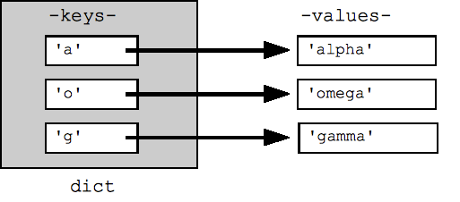
Dictionaries
Dictionaries are also an unordered set of elements, so called keys which are each associated with a value. So essentially dictionaries are a set of key-value pairs.
Values can be of any type, even more complex data structures such as a list or another dictionary.
You can think of keys as IDs or handles that let you access the associated information.

Slide 9
Dictionaries
You can use a dictionary when you have a set of unique keys that map to values, for example, usernames and associated features.
Keys of the dictionary are always unique.
Also, they are unordered, which means you might put in elements in one order but then get them back in a different order.

