Slide 1
Archi Ingest Performance
CPU vs GPU Embedding on FASRC Dev
holygpu7c0717 · Tesla V100-PCIE-32GB · 2026-08-06
fasrc/archi #215 · Dockerfile-data-manager-gpu + base-config code_suffixes fix

Slide 2
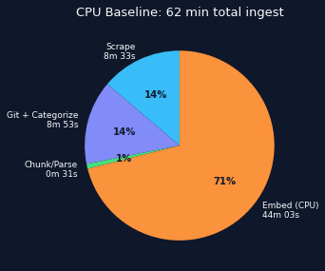
The Problem
Embedding model: all-MiniLM-L6-v2 (22M params, 384-dim)
torch 2.6.0+cpu — CPU-only PyTorch build
Container sees 1 CPU core (nproc = 1)
32 parallel_workers contending on that 1 core
817 files × 3.2 seconds/file = 44 minutes
Meanwhile: 2× idle V100 GPUs at 0 MiB
The model is 80 MB — fits 160× in one V100

Slide 3
Two Blockers Found
1. TEI Won't Run on V100
Solution
HuggingFace TEI: compiled for Ampere (sm_80)
V100 = Volta (sm_70, compute cap 7.0)
"Runtime compute cap 70 is not compatible
with compile time compute cap 80"
No official Volta tag exists
Created Dockerfile-data-manager-gpu
FROM a2rchi-pytorch-base (torch 2.6.0+cu124)
Follows Dockerfile-chat-gpu pattern
Extended base-compose.yaml template:
GPU dockerfile selection when --gpu-ids set
NVIDIA env vars + deploy.resources block
Config: device: cpu → device: cuda:0
in embedding_class_map.HuggingFaceEmbeddings
lib.sh: added GPU_IDS variable to deploy script
2. torch CPU-Only in Data-Manager
Container ships torch 2.6.0+cpu
Even with --gpus and device: cuda:0 →
"Torch not compiled with CUDA enabled"
No Dockerfile-data-manager-gpu existed

Slide 4
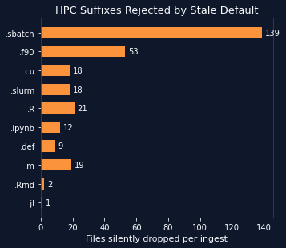
Bonus Find: code_suffixes Template Bug
Config set 23 HPC-specific code suffixes:
.f90, .cu, .R, .sbatch, .slurm, .def, .ipynb ...
base-config.yaml template rendered git block:
enabled ✓ visible ✓ schedule ✓
code_suffixes ✗ ← NEVER RENDERED
Git scraper fell back to hardcoded default:
.py, .js, .ts, .java, .go, .rs, .c, .cpp ...
(web-app-centric — no HPC suffixes)
Silent since PR #108 (loader/collector parity)
Every ingest dropped those files — 1013 warnings

Slide 5
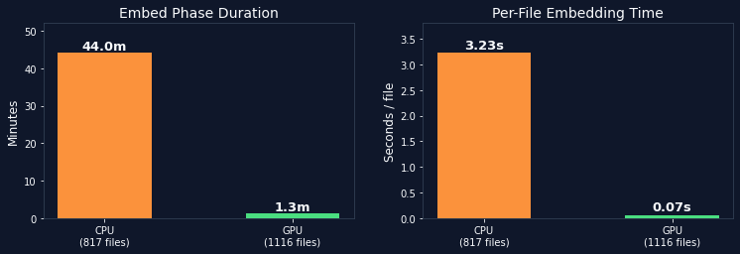
Results: Embed Phase
33× faster embed phase · 46× faster per-file · 37% more files
GPU embedded 1116 files (299 more from suffix fix) in 1/33 the time of 817 files on CPU

Slide 6
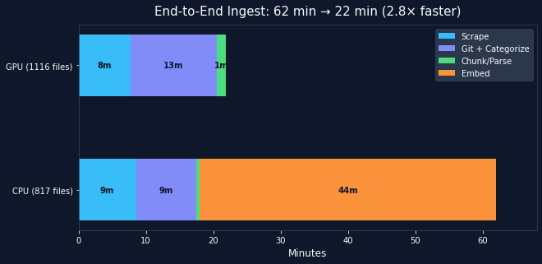
Results: Full Ingest Pipeline
Phase CPU (817 files) GPU (1116 files) Speedup ───────────────────────────────────────────────────────────────── Scrape 8m 33s 7m 42s 1.1× Git + Categorize 8m 53s 12m 51s 0.7× Chunk+Parse+Embed 44m 34s 1m 19s 33.5× TOTAL 62m 04s 21m 56s 2.8×

Slide 7
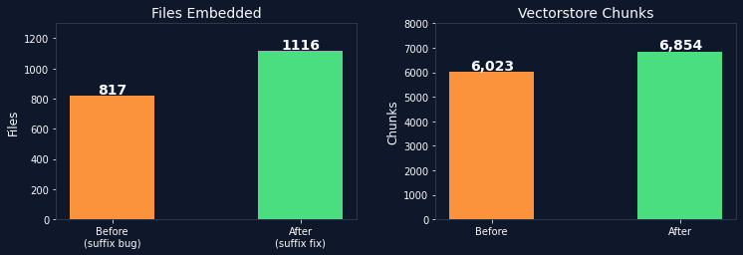
Corpus Impact
+299 files now indexed: Fortran (.f90), CUDA (.cu), R (.R/.Rmd), SLURM job scripts (.sbatch/.slurm),
Singularity defs (.def), Jupyter notebooks (.ipynb), Julia (.jl), MATLAB (.m)
+831 chunks in the vectorstore — HPC examples now retrievable for the first time

Slide 8
Configuration
GPU Embedding (deploy config)
GPU Memory Impact
# deploy/fasrc-dev/config.yaml data_manager: embedding_class_map: HuggingFaceEmbeddings: kwargs: model_kwargs: device: cuda:0 # deploy/fasrc-dev/scripts/lib.sh GPU_IDS="0"
GPU 0: 0 MiB → 824 MiB (of 32,768 MiB)
GPU 1: idle (available for future use)
GPU 2-3: vLLM Qwen 3.6 (30,260 MiB each)
all-MiniLM-L6-v2 uses 2.5% of one V100
Revert to CPU
What Changed (PR scope)
# Remove the embedding_class_map override # (template defaults to device: cpu) # Set GPU_IDS="" in lib.sh # Redeploy — uses Dockerfile-data-manager (CPU)
Dockerfile-data-manager-gpu (new file)
base-compose.yaml: GPU block for data-manager
base-config.yaml: render code_suffixes
deploy/fasrc-dev: device + GPU_IDS config

Slide 9
Next Steps
New bottleneck: Git clone + LLM categorize (12m 51s, was 8m 53s — more files)
→ Categorize scales linearly with file count; possible: batch the LLM calls
Incremental embedding: skip files whose content hash already has vectors in Postgres
→ A no-change re-ingest would be near-instant instead of 22 minutes
772 remaining 'disallowed suffix' warnings are legitimate (.png, .rst, .out, .dat, ...)
→ Not actionable, but could be quieted to WARNING → DEBUG
NLTK WordListCorpusReader race (#119): 6 files failed (was 10 on CPU)
→ Known lazy-load collision under parallel tokenization
Tracking: fasrc/archi #215

