Slide 1



Food Delivery App
RNS INSTITUTE OF TECHNOLOGY
BENGALURU - 98
DEPARTMENT OF INFORMATION SCIENCE & ENGINEERING
Presentation on
Internship
Varun Kumar
USN: 1RN18IS121
ENMAZ Engineering Services Pvt. Ltd.
Internal Guide
Mr. Ravi Kumar
Asst. Prof, Dept of ISE, RNSIT
External Guide
Mr Akshay D R
Co-founder and CEO, Enmaz engineering services

Slide 2
AGENDA
Abstract
About the Company
Introduction
Literature Survey
Requirements
System Design
Detailed Design
Implementation
Conclusion and Future Enhancements
References
Department of ISE, RNSIT

Slide 3
ABSTRACT
The labour rates are increasing steadily year on year thus making it difficult to find employees. The food industry is highly labour intensive and the biggest expense in the food industry is the cost of employing the right kind of people to do the work.
One of the ways to reduce this expense is to use modern technology to replace some of the jobs done by human beings and make machines do the work.
Here we propose an “Online Food Ordering System” that has been designed for Fast Food restaurant, Take-Out or College Cafeterias.
The system can also be used in any food delivery industry. This simplifies the process of food ordering for both the customer and the restaurant, as the entire process of taking orders is automated.
Department of ISE, RNSIT

Slide 4
About the Company
Enmaz has a simple yet robust solution that helps any Industry / Factory digitise their workfloor in no time.
The products offered will help in remote monitoring, controlling and also analysing any machinene parameter or process.
Reliable Hardware, Time tested, high quality, designed, developed and manufactured in India. 18 months of replacement warranty.
Department of ISE, RNSIT

Slide 5
INTRODUCTION
An Online Food Ordering System is proposed here which simplifies the food ordering process. The proposed system shows an user interface and update the menu with all available options so that it eases the customer work.
Customer can choose more than one item to make an order and can view order details before logging off. The order confirmation is sent to the customer.
The order is placed in the queue and updated in the database and returned in real time. This system assists the staff to go through the orders in real time and process it efficiently with minimal errors.
Department of ISE, RNSIT

Slide 6
LITERATURE SURVEY
The labour rates are increasing steadily year on year thus making it difficult to find employees. The food industry is highly labour intensive and the biggest expense in the food industry is the cost of employing the right kind of people to do the work.
Here we propose an “Online Food Ordering System” that has been designed for Fast Food restaurant, Take-Out or College Cafeterias. The system can also be used in any food delivery industry. This simplifies the process of food ordering for both the customer and the restaurant, as the entire process of taking orders is automated.
Department of ISE, RNSIT

Slide 7
Requirements
Software Requirements
  Operating System : Windows 7 and above
  Coding Language : Dart , flutter
  IDE : Visual Studio Code , Android Studio
Hardware Requirements
  8 GB ROM
  64-bit processor
  2 GB Memory
Department of ISE, RNSIT

Slide 8
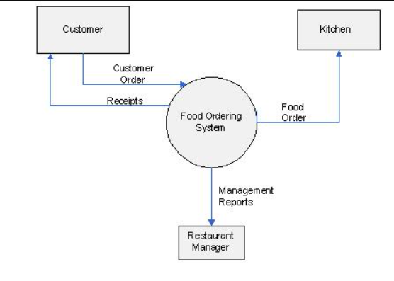
System Design
Department of ISE, RNSIT

Slide 9
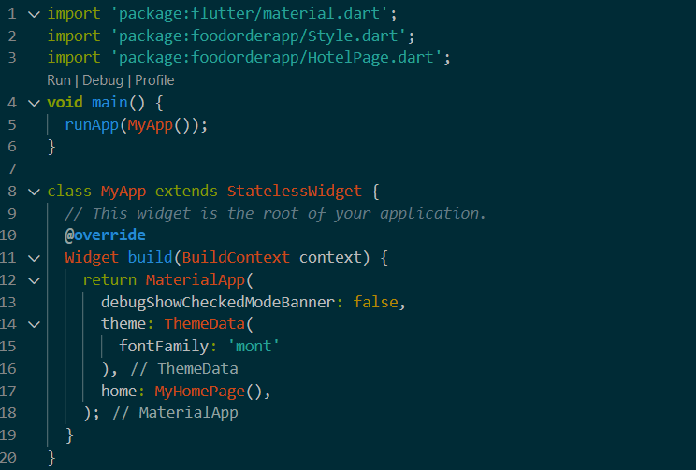
Implementation
Department of ISE, RNSIT

Slide 10
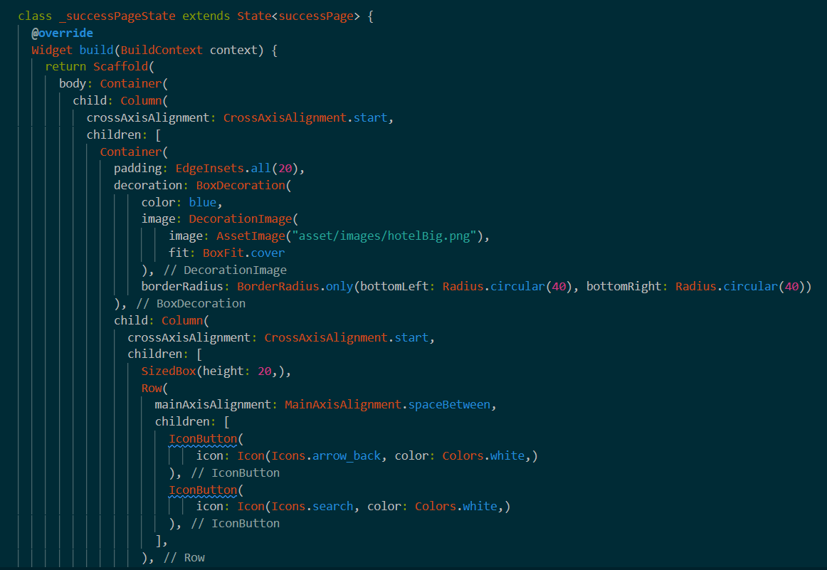
Department of ISE, RNSIT

Slide 11
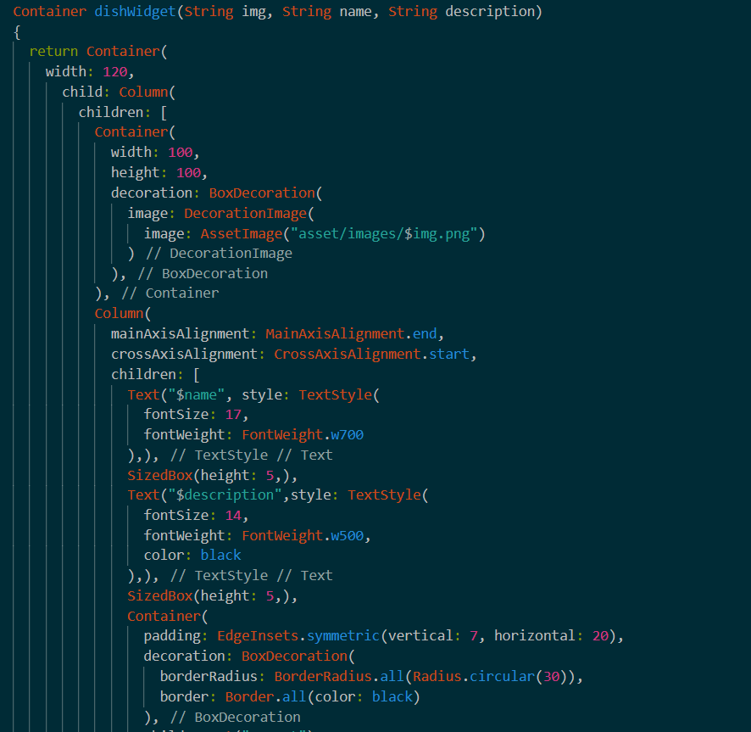
Department of ISE, RNSIT

Slide 12
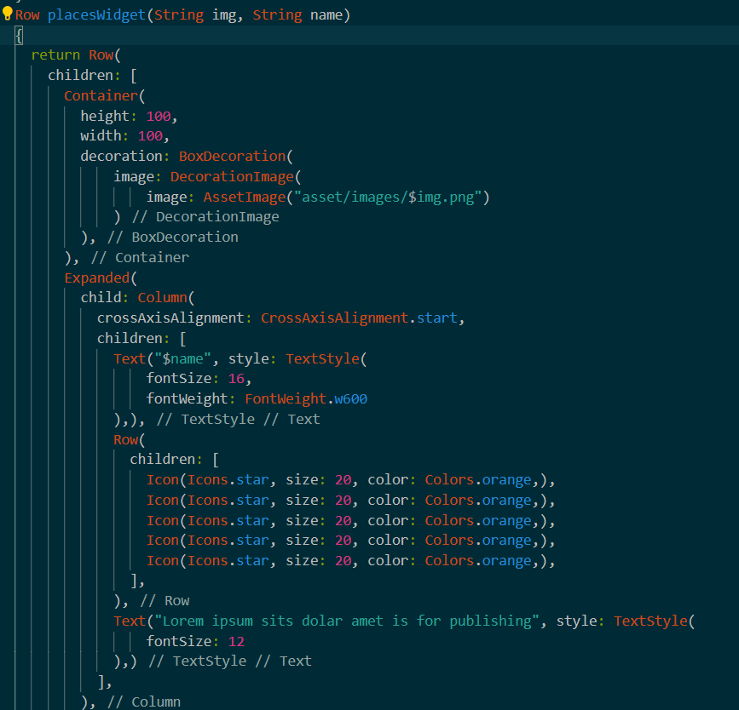

9/14/19
Department of ISE, RNSIT

Slide 13
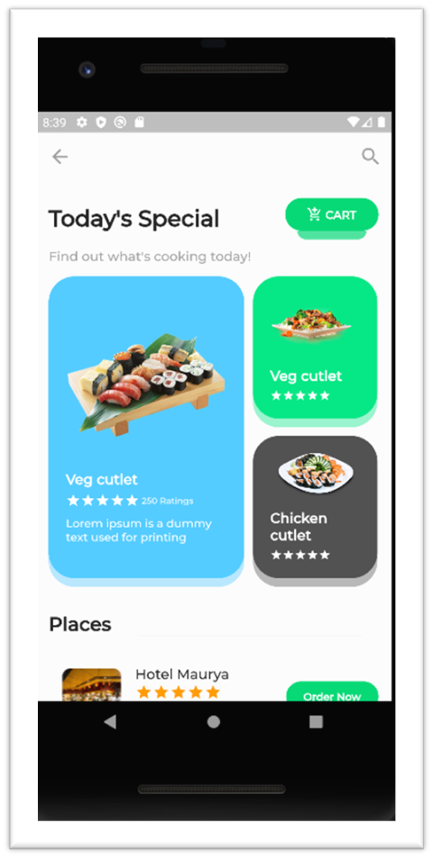
SNAPSHOTS
Department of ISE, RNSIT

Slide 14
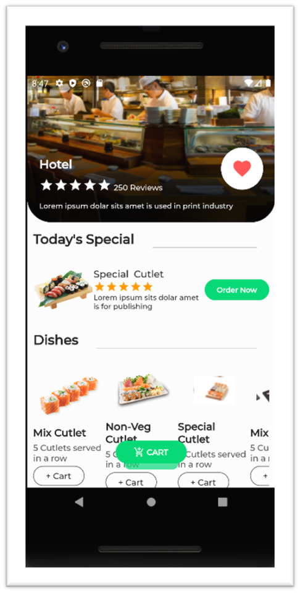
Department of ISE, RNSIT

Slide 15
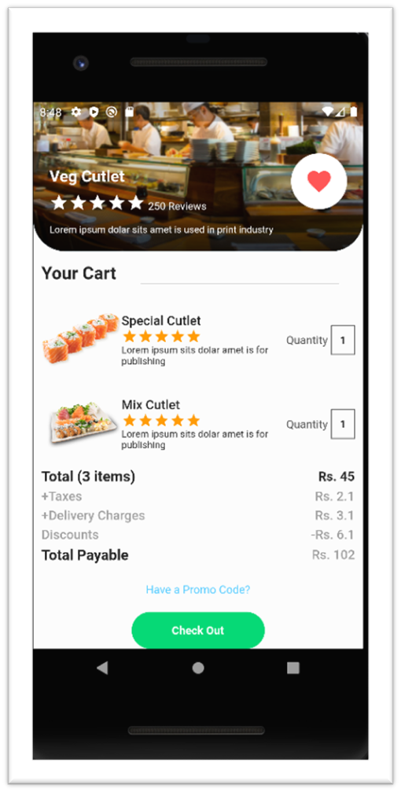
Department of ISE, RNSIT

Slide 16
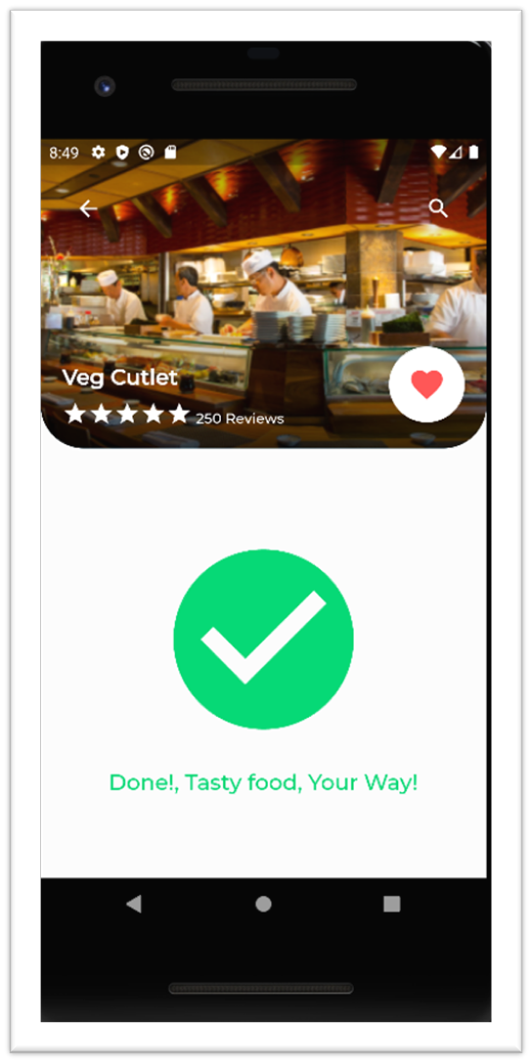
Department of ISE, RNSIT

Slide 17
CONCLUSIONS
In the conclusion of this project, food delivery app is the new necessity.
The application is user friendly and attractive thus easily usable by user of all age groups.
The variety of availability has huge appreciation at these apps.
It’s a good startup option with less failure chances.
Department of ISE, RNSIT

Slide 18
Future Enhancements
Connecting app to internet for real world usage.
Providing counter and cancel options.
Online payment gateway.
Tracking the order.
Calling the driver.
Anxiety Bot.
Having some game for waiting time.
Getting suggestion according to time and place.
Adding customer reviews to the food.
Placing party orders.
Allowing discount coupons.
Booking in restaurants for dine out.
Department of ISE, RNSIT

Slide 19
REFERENCES
Flutter : https://docs.flutter.dev/
https://stackoverflow.com/questions/tagged/flutter
The Dart Programming Language book by Gilad Bracha
https://flutter.dev/community
“Hangman Game “ : https://en.wikipedia.org/wiki/Hangman_(game)
Department of ISE, RNSIT

Slide 20
THANK YOU
Department of ISE, RNSIT

