Slide 1
A Code-First Introduction to NLP
Lesson 2: Topic Modeling With NMF and SVD
Joseph Catanzarite
21 Dec 2019

Slide 2
Github repo
https://github.com/jcatanza/Fastai-A-Code-First-Introduction-To-Natural-Language-Processing-TWiML-Study-Group

Slide 3
Set up your compute infrastructure
1. Download the Anaconda Python 3.7 distribution at
https://www.anaconda.com/distribution/#download-section
2. Install Anaconda by following the instructions at
https://docs.anaconda.com/anaconda/install/
2. Open an anaconda shell terminal (choose the Anaconda Prompt from the Start Menu in Windows)
3. Create an environment for fastai (See https://uoa-eresearch.github.io/eresearch-cookbook/recipe/2014/11/20/conda/),
then activate that environment:
conda create --name fastai
activate environment
4. Create a fastai directory and Install the fastai library:
mkdir fastai
conda install -c pytorch -c fastai fastai
5. Make a local copy of the fastai course-nlp repository:
cd fastai
git clone https://github.com/fastai/course-nlp.git

Slide 4
Running a course notebook
1. Open an anaconda shell, with the Anaconda Prompt
2. Activate the fastai environment
activate fastai
2. Go to your local copy of the course repository
cd fastai/course-nlp/
3. Run the command
jupyter notebook
A new browser tab will open, with links to the course notebooks in the repository
4. Clicking on a selected notebook link opens that notebook in a separate browser tab
5. We’ll cover the notebook 2-svd-nmf-topic-modeling next week. Click on it and verify that you can run the code blocks within it.

Slide 5
Topics covered
Topic Modeling with NMF (non-negative matrix factorization) and SVD (Singular Value Decomposition)
Sentiment classification with Naive Bayes, Logistic regression, and ngrams
Regex and tokenization
Language modeling & sentiment classification with deep learning
Translation with Recurrent Neural Networks
Translation with the Transformer architecture
Bias & ethics in NLP
See notebook0 for a complete list, and references

Slide 6
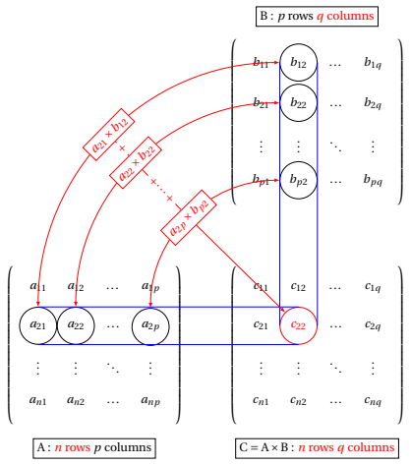
Matrix Multiplication

Slide 7
Non-negative Matrix Factorization
NMF Discussion http://www.quuxlabs.com/blog/2010/09/matrix-factorization-a-simple-tutorial-and-implementation-in-python/

Slide 8
Low-rank SVD

Slide 9
Low rank SVD
https://research.fb.com/fast-randomized-svd/

Slide 10
Matrix Factorization Examples
Refer to spreadsheet britlit.xlsx

Slide 11
TF-IDF

Slide 12
Appendix

Slide 13
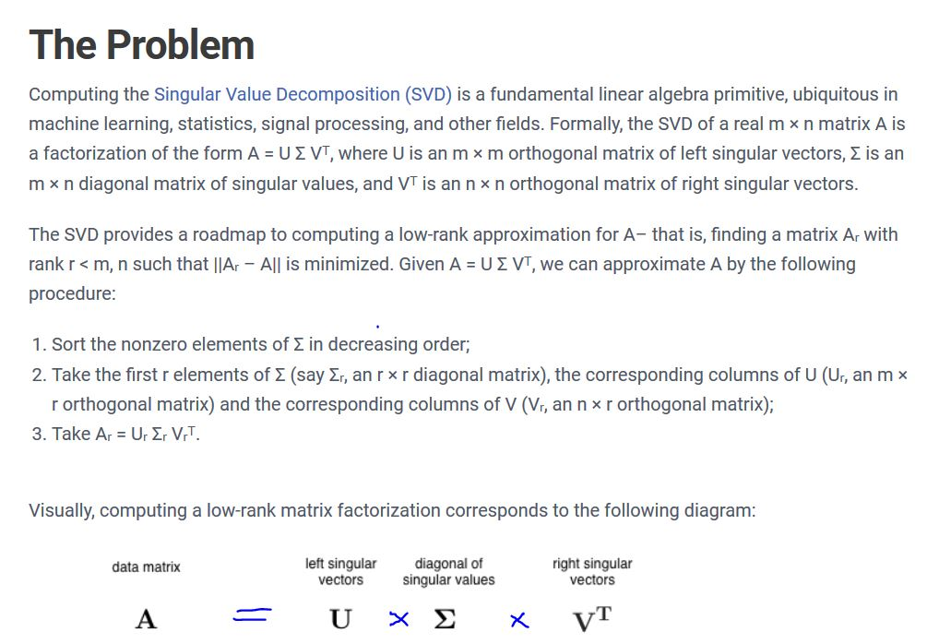
SVD Equation

Slide 14
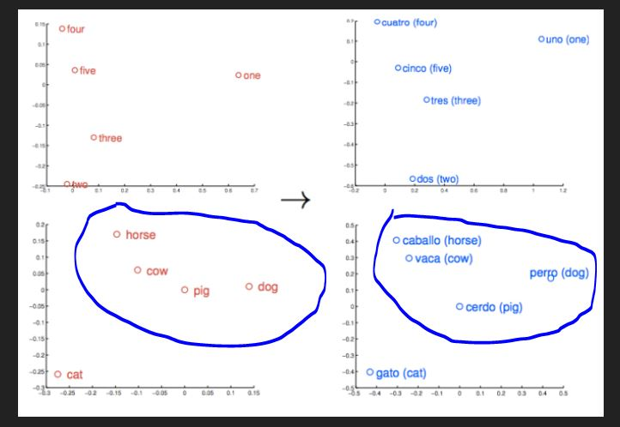
Word2vec concept

