Slide 1
Lesson 6
Practical Deep Learning For Coders (v2)

Slide 2
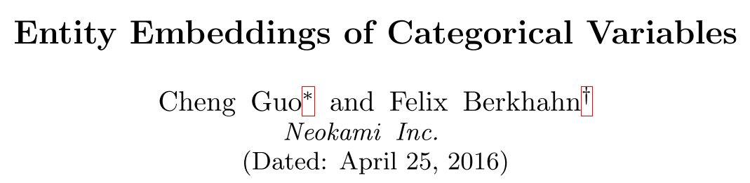
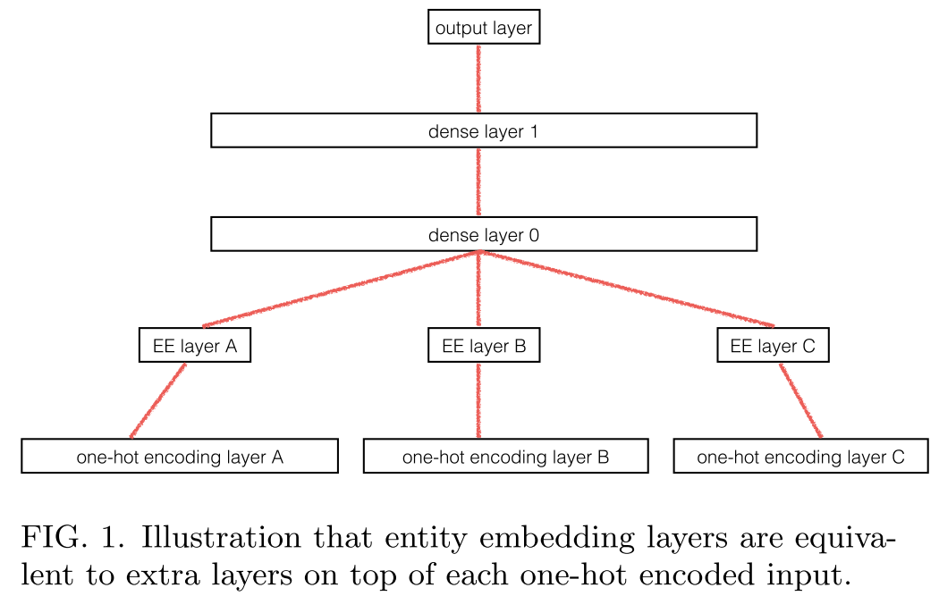

Slide 3
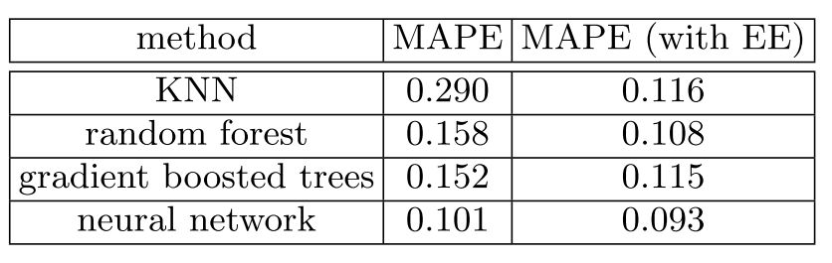

Slide 4
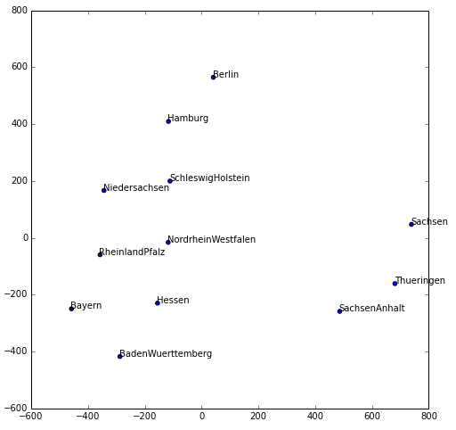
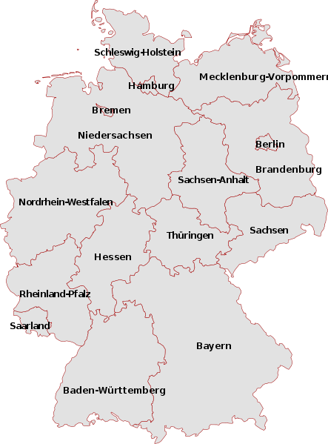

Slide 5
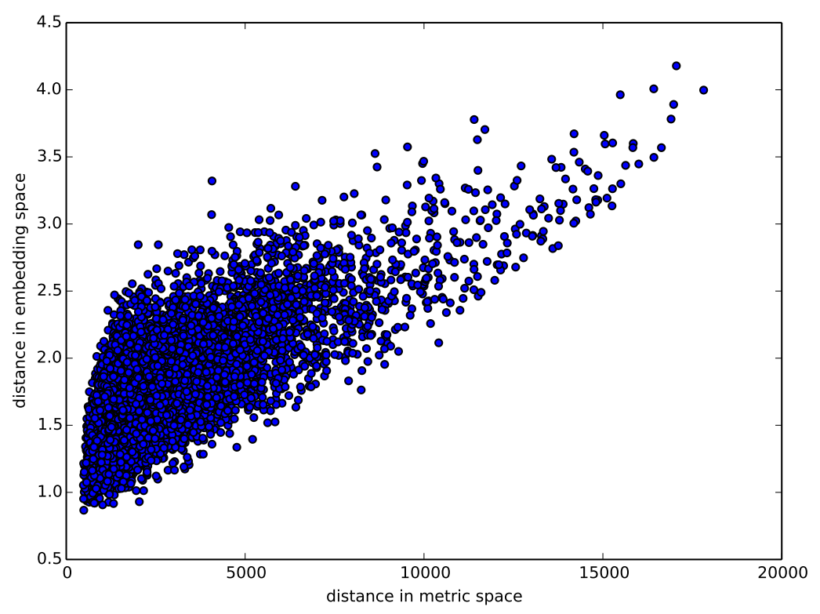

Slide 6
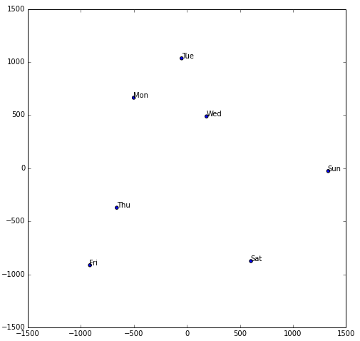
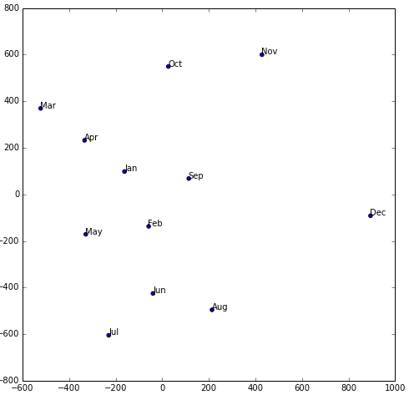

Slide 7
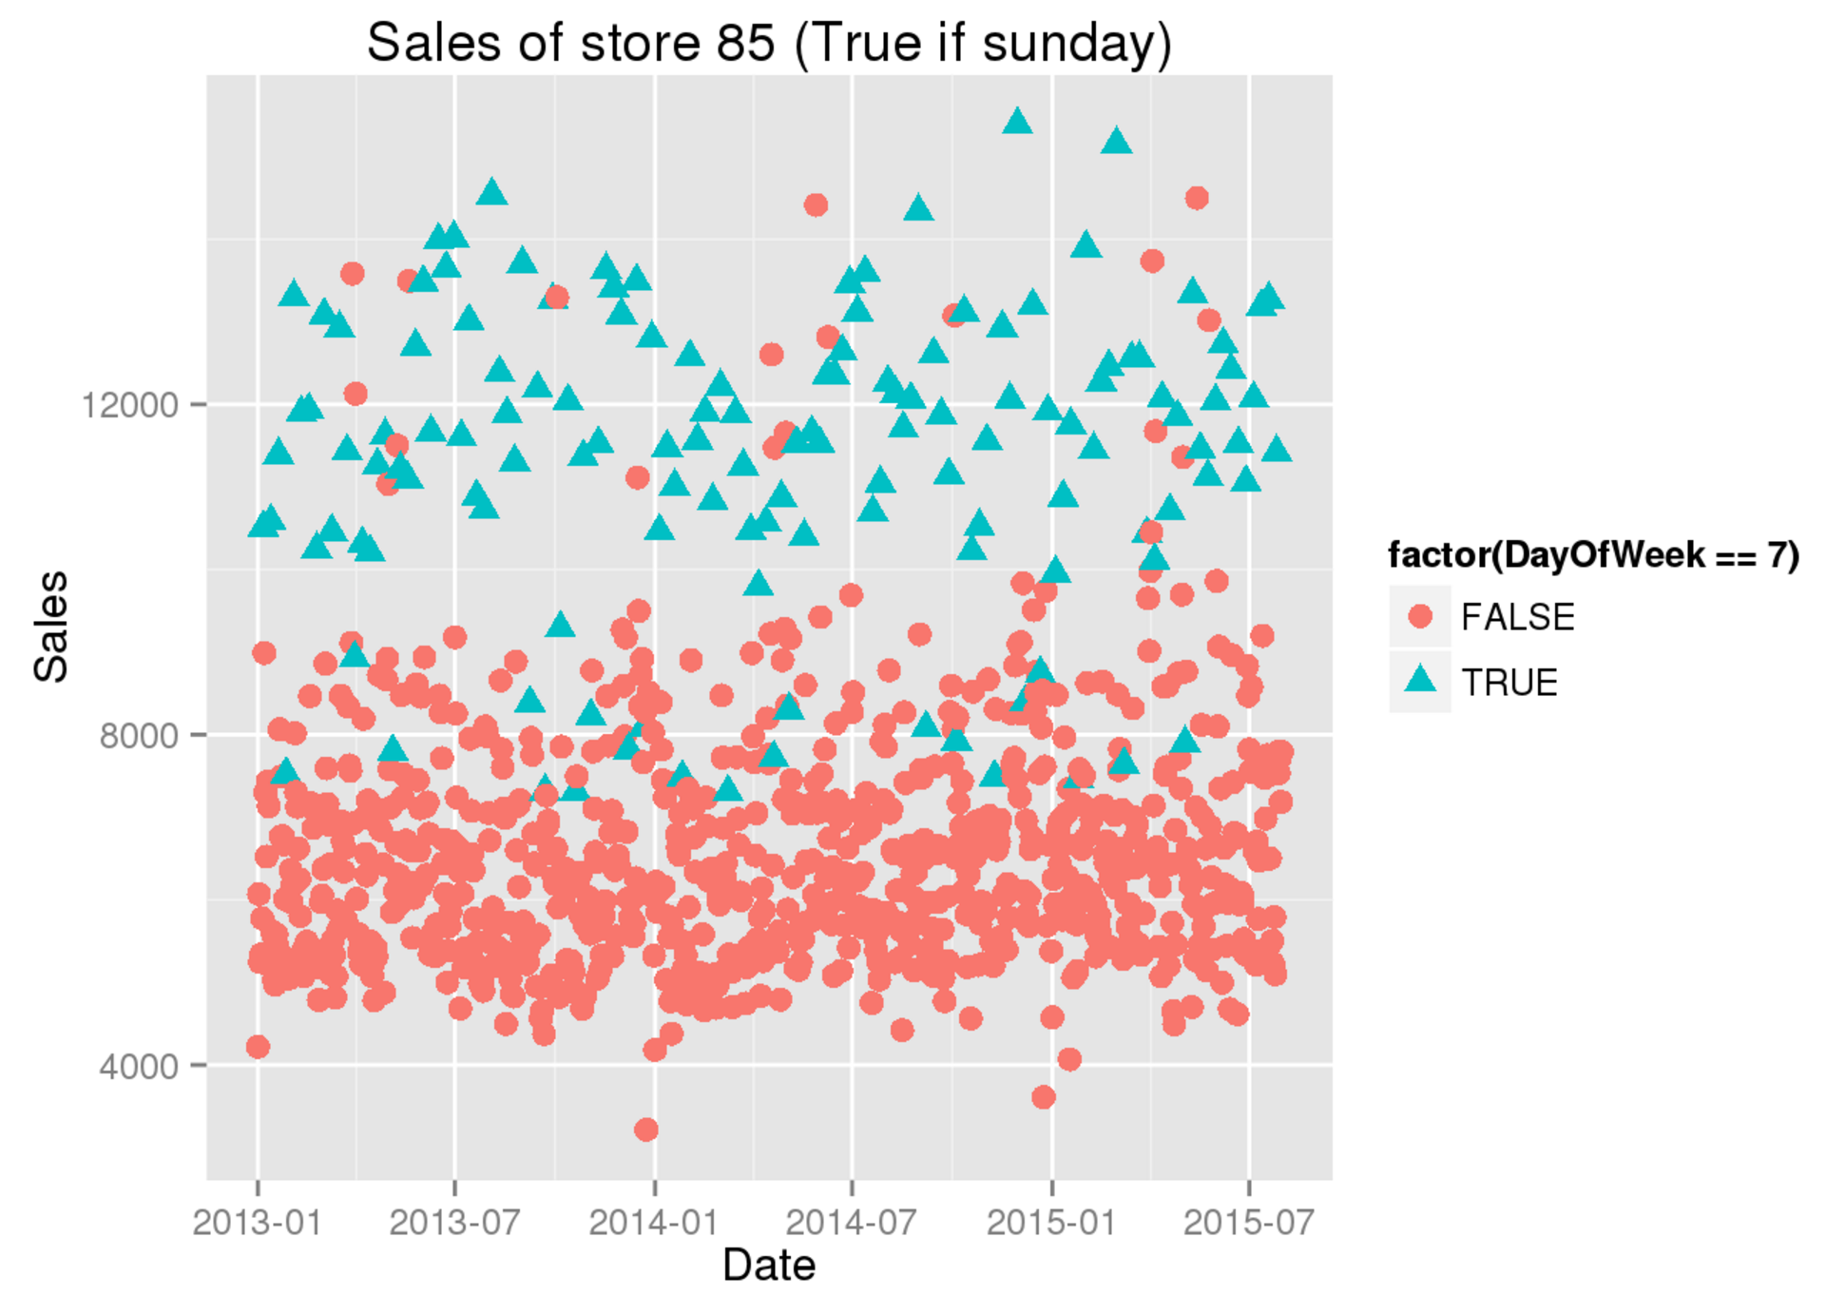

Slide 8
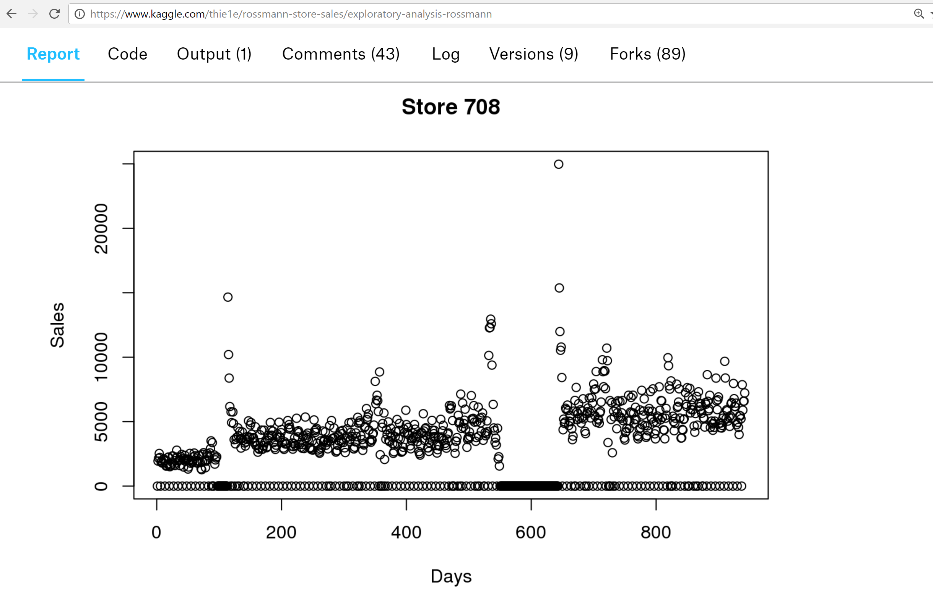

Slide 9
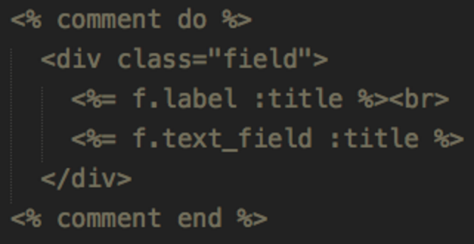
Why we need RNNs
Variable length sequence
Long-term dependency
Stateful Representation
Memory
“I went to Nepal in 2009”
“In 2009, I went to Nepal”

Slide 10
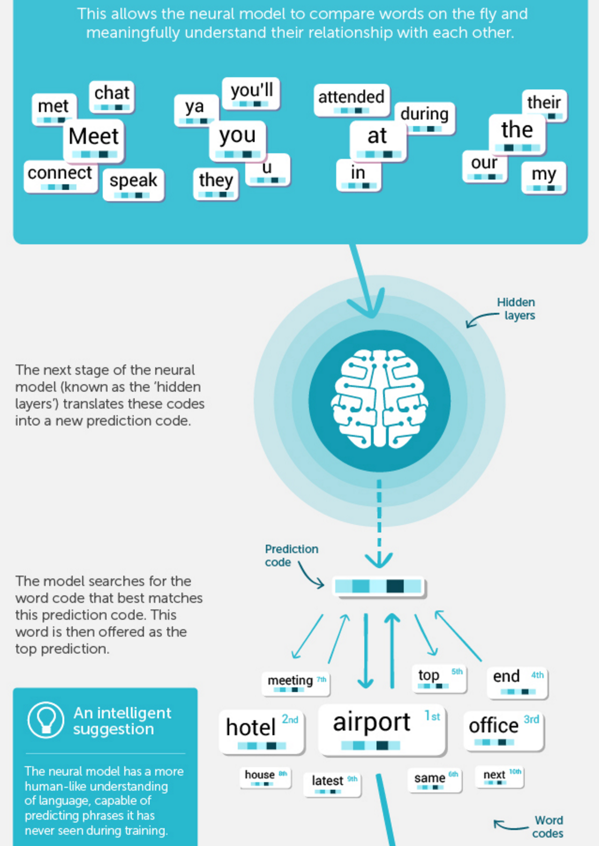
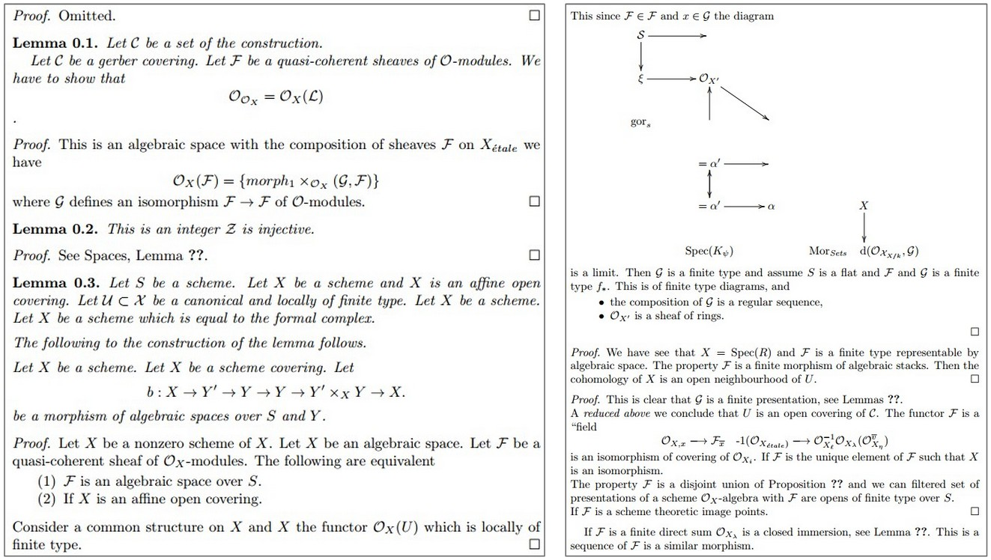
\begin{proof} We may assume that $\mathcal{I}$ is an abelian sheaf on $\mathcal{C}$. \item Given a morphism $\Delta : \mathcal{F} \to \mathcal{I}$ is an injective and let $\mathfrak q$ be an abelian sheaf on $X$. Let $\mathcal{F}$ be a fibered complex. Let $\mathcal{F}$ be a category.

Slide 11
Basic NN with single hidden layer
Output: batch_size * #classes
Matrix product; softmax
Hidden: batch_size * # activations
Matrix product; relu
Input: batch_size * #inputs

Slide 12
Image CNN with single dense hidden layer
NB: batch_size dimension and activation function not shown here or in following slides
Output: #classes
Matrix product
FC1: # activations
(Flatten); matrix product
Conv1: # filters * (h/2) * (w/2)
Output
Hidden
Convolution stride 2
Input
Input: #channel * h * w

Slide 13
Predicting char 3 using chars 1 & 2
NB: layer operations not shown; remember that arrows represent layer operations
char 3 output: vocab size
FC2: # activations
char 2 input
FC1: # activations
Output
Hidden
Input
char 1 input: vocab size

Slide 14
Predicting char 4 using chars 1, 2 & 3
Input→Hidden
char 4 output: vocab size
Hidden→Output
Hidden→Hidden
FC3: # activations
char 3 input
FC2: # activations
char 2 input
FC1: # activations
char 1 input: vocab size

Slide 15
Predicting char n using chars 1 to n-1
NB: no hidden/output labels shown
Input→Hidden
Hidden→Output
Hidden→Hidden
char n input
Repeat for 2→n-1
Output
Hidden
Input
char 1 input

Slide 16
Predicting chars 2 to n using chars 1 to n-1
Input→Hidden
Hidden→Output
Hidden→Hidden
char n input
Repeat for 1→n-1
Output
Hidden
Initialize to zeros
Input

Slide 17
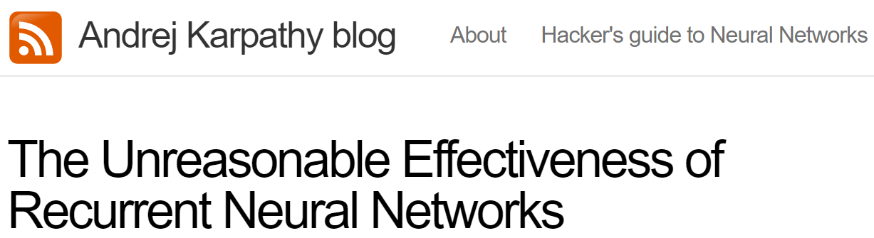
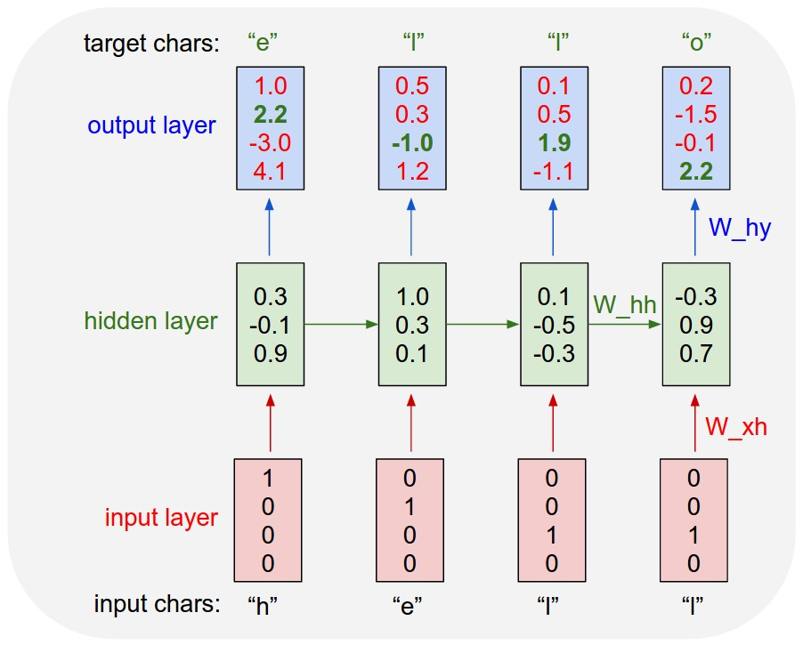

Slide 18
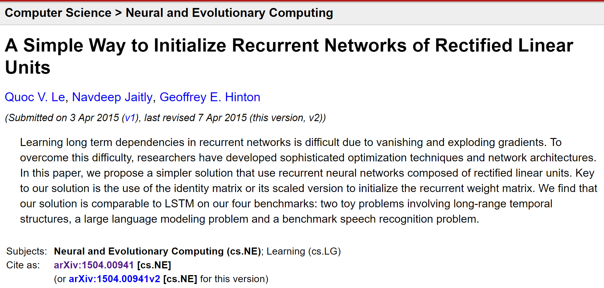

Slide 19
Predicting chars 2 to n using chars 1 to n-1 using stacked RNNs
Repeat for 1→n-1
char n input
Repeat for 1→n-1
Initialize to zeros
Initialize to zeros

Slide 20
Unrolled stacked RNNs for sequences
char 3 input
char 2 input
char 1 input

Slide 21
Backprop
Input→Hidden
Hidden→Output
Hidden→Hidden
Loss
char 3 input
char 2 input

