Slide 1



Slide 2


PHP is an acronym for "PHP: Hypertext Preprocessor"
PHP is a widely-used, open source scripting language
PHP scripts are executed on the server
PHP is free to download and use

Slide 3
PHP files can contain text, HTML, CSS, JavaScript, and PHP code
PHP code are executed on the server, and the result is returned to the browser as plain HTML
PHP files have extension ".php"

Slide 4
PHP can generate dynamic page content
PHP can create, open, read, write, delete, and close files on the server
PHP can collect form data
PHP can send and receive cookies
PHP can add, delete, modify data in your database
PHP can be used to control user-access
PHP can encrypt data

Slide 5
PHP runs on various platforms (Windows, Linux, Unix, Mac OS X, etc.)
PHP is compatible with almost all servers used today (Apache, IIS, etc.)
PHP supports a wide range of databases
PHP is free. Download it from the official PHP resource: www.php.net
PHP is easy to learn and runs efficiently on the server side

Slide 6

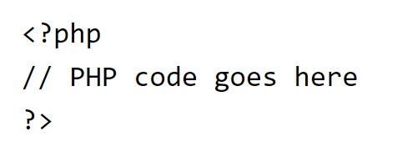
A PHP script can be placed anywhere in the document.
A PHP script starts with <?php and ends with ?>.
The default file extension for PHP files is ".php".
A PHP file normally contains HTML tags, and some PHP scripting code.

Slide 7
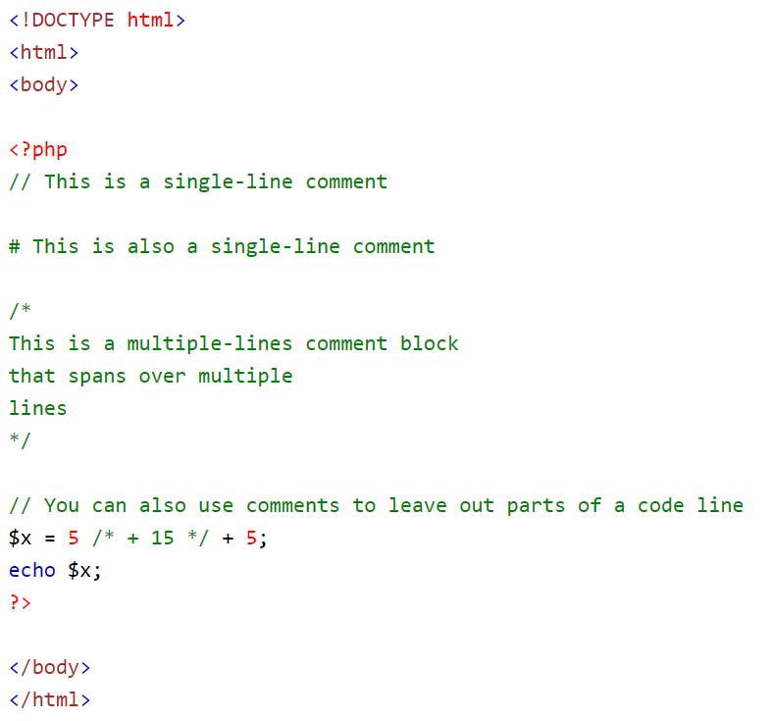

Slide 8
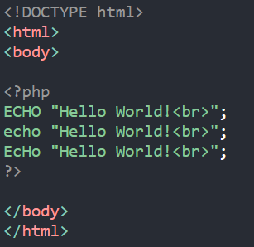
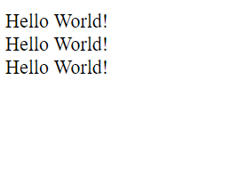

Slide 9
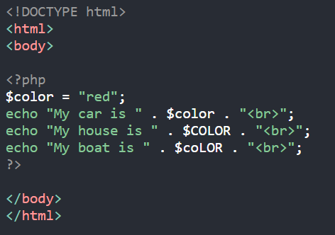
In the example below, only the first statement will display the value of the $color variable (this is because $color, $COLOR, and $coLOR are treated as three different variables):

Slide 10

Variables are "containers" for storing information.

Slide 11
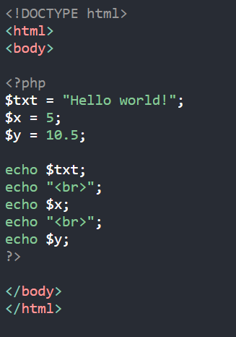
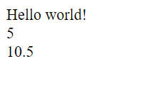
In PHP, a variable starts with the $ sign, followed by the name of the variable

Slide 12
A variable can have a short name (like x and y) or a more descriptive name (age, carname, total_volume).
Rules for PHP variables:
  A variable starts with the $ sign, followed by the name of the variable
  A variable name must start with a letter or the underscore character
  A variable name cannot start with a number
  A variable name can only contain alpha-numeric characters and underscores (A-z, 0-9, and _ )
  Variable names are case-sensitive ($age and $AGE are two different variables)

Slide 13
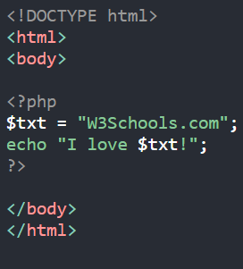
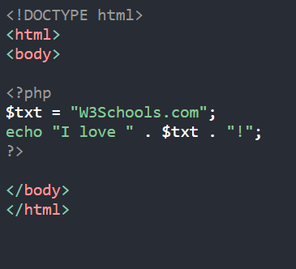
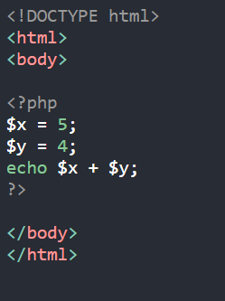
The PHP echo statement is often used to output data to the screen.

Slide 14
PHP is a Loosely Typed Language
In the example above, notice that we did not have to tell PHP which data type the variable is.
PHP automatically associates a data type to the variable, depending on its value. Since the data types are not set in a strict sense, you can do things like adding a string to an integer without causing an error.
In PHP 7, type declarations were added. This gives an option to specify the data type expected when declaring a function, and by enabling the strict requirement, it will throw a "Fatal Error" on a type mismatch.
You will learn more about the strict, and non-strict requirements, and the data type declarations in the PHP7 Functions chapter.

Slide 15
In PHP, variables can be declared anywhere in the script.
The scope of a variable is the part of the script where the variable can be referenced/used.
PHP has three different variable scopes:
      local
      global
      static

Slide 16
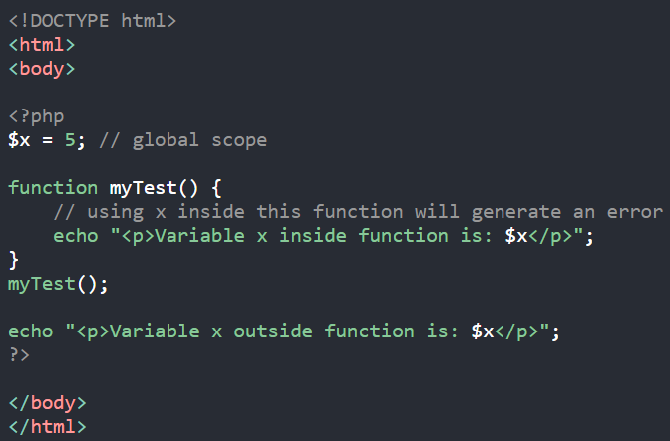
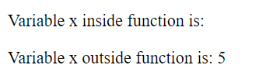
A variable declared outside a function has a GLOBAL SCOPE and can only be accessed outside a function

Slide 17
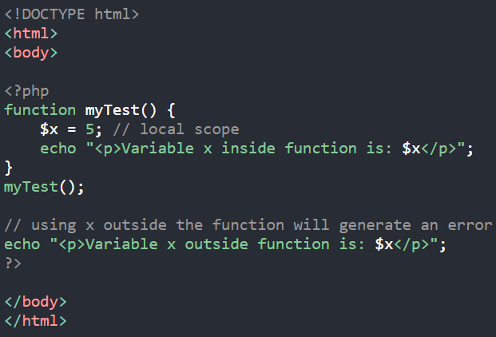
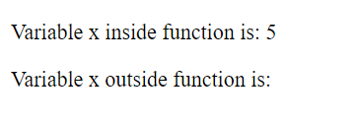
A variable declared inside a function has a LOCAL SCOPE and can only be accessed within that function

Slide 18
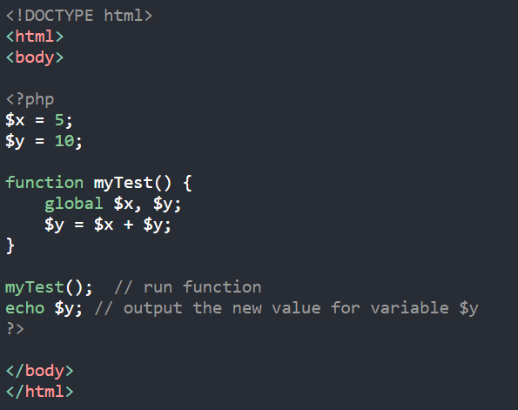

The global keyword is used to access a global variable from within a function.
To do this, use the global keyword before the variables (inside the function).

Slide 19
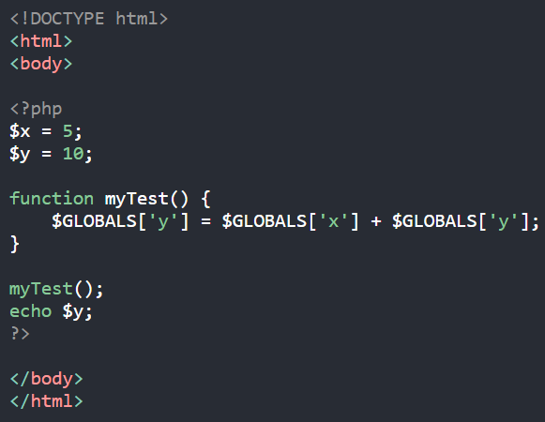
PHP also stores all global variables in an array called $GLOBALS[index]. The index holds the name of the variable. This array is also accessible from within functions and can be used to update global variables directly.

Slide 20
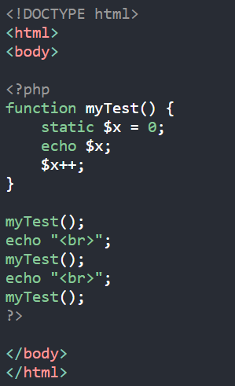
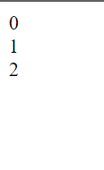
Normally, when a function is completed/executed, all of its variables are deleted. However, sometimes we want a local variable NOT to be deleted. We need it for a further job.
To do this, use the static keyword when you first declare the variable

Slide 21

In PHP there are two basic ways to get output: echo and print.
echo and print are more or less the same. They are both used to output data to the screen.
The differences are small: echo has no return value while print has a return value of 1 so it can be used in expressions. echo can take multiple parameters (although such usage is rare) while print can take one argument. echo is marginally faster than print.

Slide 22
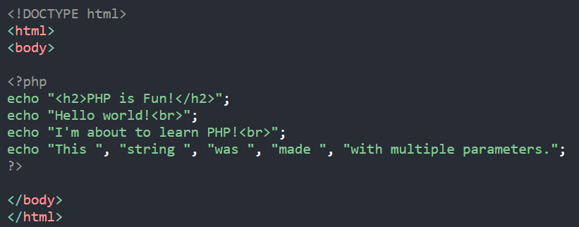
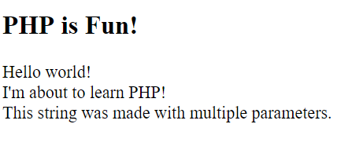
The echo statement can be used with or without parentheses: echo or echo().
Display Text

Slide 23
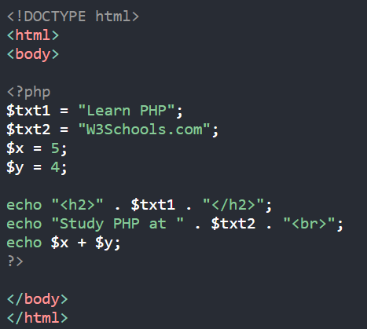

Display Variables

Slide 24
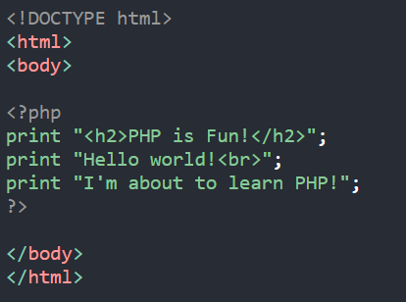
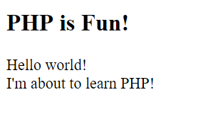
The print statement can be used with or without parentheses: print or print().
Display Text

Slide 25
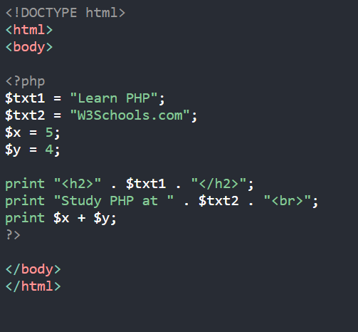

Display Variables

Slide 26

Variables can store data of different types, and different data types can do different things.
PHP supports the following data types:
        String
        Integer
        Float (floating point numbers - also called double)
        Boolean
        Array
        Object
        NULL
        Resource

Slide 27
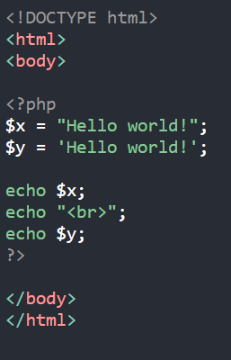
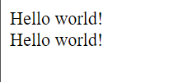
A string is a sequence of characters, like "Hello world!".
A string can be any text inside quotes. You can use single or double quotes.

Slide 28
An integer data type is a non-decimal number between -2,147,483,648 and 2,147,483,647.
Rules for integers:
  An integer must have at least one digit
  An integer must not have a decimal point
  An integer can be either positive or negative
  Integers can be specified in three formats: decimal (10-based), hexadecimal (16-based - prefixed with 0x) or octal (8-based - prefixed with 0)

Slide 29
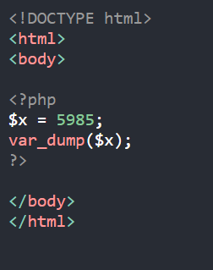
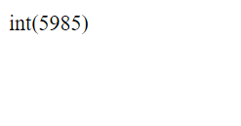

Slide 30
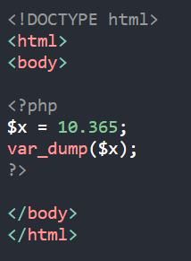

A float (floating point number) is a number with a decimal point or a number in exponential form.
In the following example $x is a float. The PHP var_dump() function returns the data type and value

Slide 31
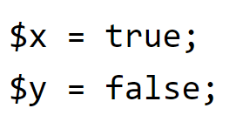
A Boolean represents two possible states: TRUE or FALSE.
Booleans are often used in conditional testing. You will learn more about conditional testing in a later chapter of this tutorial.

Slide 32
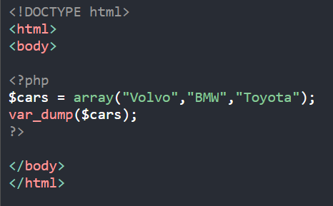
An array stores multiple values in one single variable.
In the following example $cars is an array. The PHP var_dump() function returns the data type and value

Slide 33
An object is a data type which stores data and information on how to process that data.
In PHP, an object must be explicitly declared.
First we must declare a class of object. For this, we use the class keyword. A class is a structure that can contain properties and methods

Slide 34
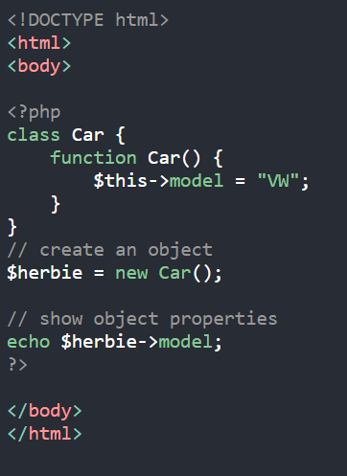


Slide 35
Null is a special data type which can have only one value: NULL.
A variable of data type NULL is a variable that has no value assigned to it.
Tip: If a variable is created without a value, it is automatically assigned a value of NULL.
Variables can also be emptied by setting the value to NULL

Slide 36
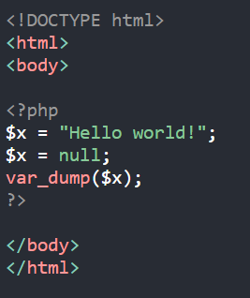
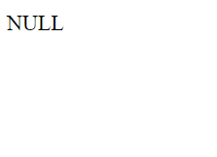

Slide 37
The special resource type is not an actual data type. It is the storing of a reference to functions and resources external to PHP.
A common example of using the resource data type is a database call.

Slide 38

A string is a sequence of characters, like "Hello world!".

Slide 39
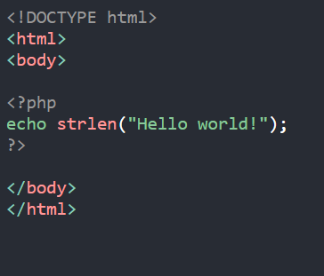
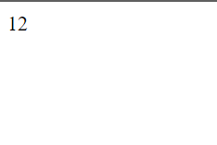
The PHP strlen() function returns the length of a string.
The example below returns the length of the string "Hello world!"

Slide 40

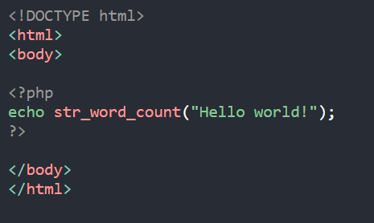
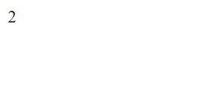
The PHP str_word_count() function counts the number of words in a string

Slide 41
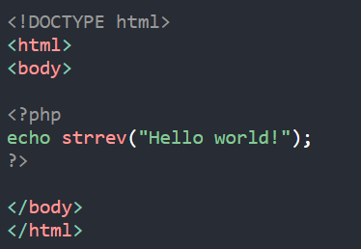
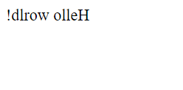
The PHP strrev() function reverses a string

Slide 42
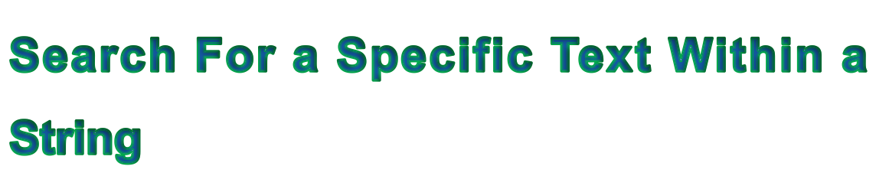
The PHP strpos() function searches for a specific text within a string.
If a match is found, the function returns the character position of the first match. If no match is found, it will return FALSE.
The example below searches for the text "world" in the string "Hello world!"

Slide 43
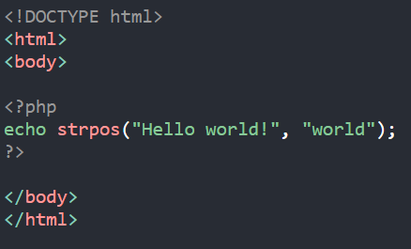
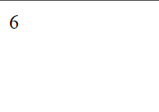

Slide 44
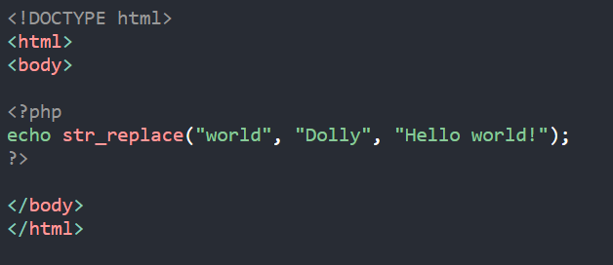
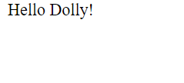
The PHP str_replace() function replaces some characters with some other characters in a string.
The example below replaces the text "world" with "Dolly"

