Slide 1

Database
by Norfatihah Ahmad Bistamam

Slide 2
CONTENTS
01. Introduction to database
02.Database Relationship

Slide 3

01
Introduction to database

Slide 4

What is Database?
Database is a collection of organized data, information and records

Slide 5
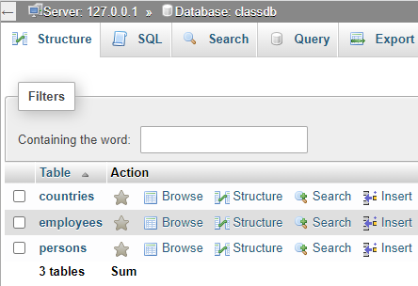
Relation Database Management System
Element in RDBMS
1. Database (Ex: classdb)

Slide 6
Relation Database Management System
Element in RDBMS
2. Table (Ex: counties, employee, persons)

Slide 7
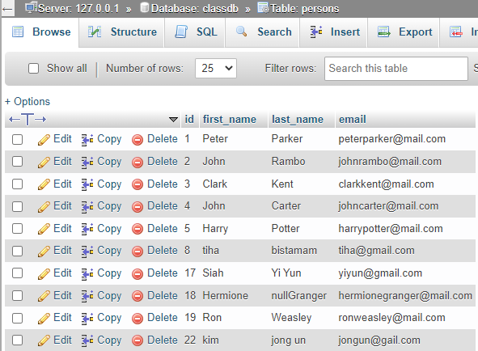
Relation Database Management System
Element in RDBMS
3. Column (Ex: id, first_name, last_name, email)

Slide 8
Relation Database Management System
Element in RDBMS
3. Row (Ex: 1, Peter, Parker, peterparker@mail.com)

Slide 9
02
Type of Relationships

Slide 10
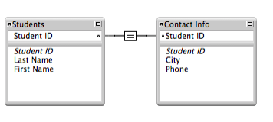
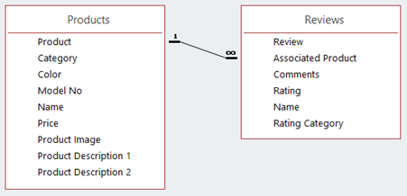
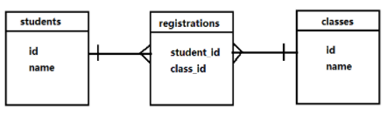
Type of database relationships
One-to-one
One-to-many
many-to-many
A one-to-one relationship is a link between the information in two tables, where each record in each table only appears once.
one-to-many relationship occurs when a parent record in one table can potentially reference several child records in another table.
A many-to-many relationship means that for each record in one table there can be many records in another table and for each record in the second table there can be many in the first.

Slide 11
THANK YOU

