Slide 1

Big Data Quality and Governance
大数据质量和治理
快阳科技（苏州）有限公司
2020 年3月

Slide 2

Data Quality and Data Governance Overview
What is Data Quality / 数据质量
Data quality is the process of conditioning data to meet the specific needs of business users and the reliability and effectiveness of data, particularly in a data warehouse. Accuracy, completeness, consistency, timeliness, uniqueness, validity and currency are the chief measures of data quality.

Slide 3
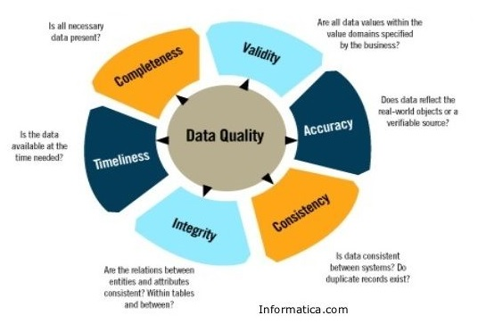
Data Quality and Data Governance Overview
Dimensions of Data Quality

Slide 4
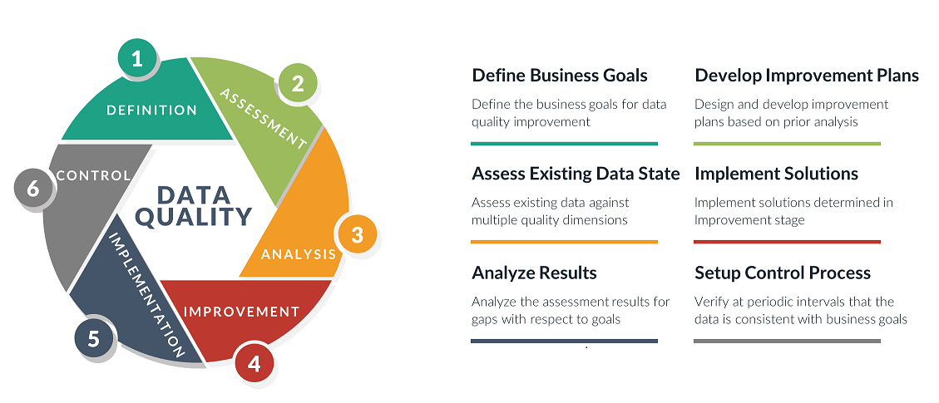
Data Quality and Data Governance Overview
Steps of Data Quality

Slide 5
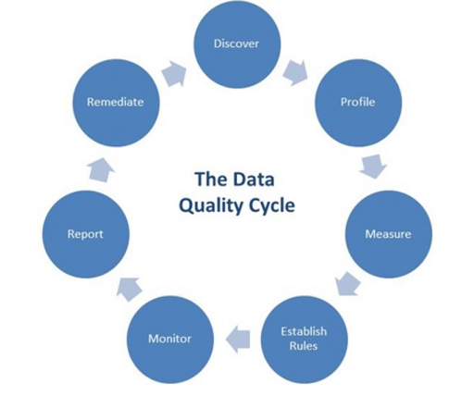
Data Quality and Data Governance Overview
Lifecycle of Data Quality

Slide 6
Data Quality and Data Governance Market
https://github.com/fastrivertech/kuaihe/wiki/Big-Data-Quality-and-Governance
Top Data Quality Vendors (Gartner)
Top Data Governance Vendors (Gartner)
Top Master Data Management Vendors (Gartner)
Open Source Data Quality Vendors
Patient / Entity Matching
中国数据治理市场
中国数据治理企业

Slide 7
Data Quality and Data Governance Market
Meetings and Conferences
MDM & Data Governance Summit By The MDM Institute
数据质量管理国际峰会 (2019第三届)
Machine Learning for Data Quality
MDM and Big Data
Address Data Quality
Address Doctor
Melissa Data
Data Quality: Moving Forward
5 Data Integration Challenges
Data Quality AS a Service
High Data Volume / Big Data / AI/MI
Different Streaming Sources

Slide 8
苏州快阳科技 -大数据治理平台背景
https://github.com/fastrivertech/kuaihe/wiki/Big-Data-Quality-and-Governance-Dev-Plan
SUN MICROSYSTEMS MDM / MURAL OPEN SOURCE
iOpenMPDM
Fast River
Data Quality
ORACLE Healthcare MPI
NextGate MatchMetrix
MegaData
SUN MICROSYSTEMS 业界最早并领先提出主数据管理和主数据质量概念和架构，并实现开源产品MURAL MDM
曾经占据业界技术和市场领先（参见GARTNER报告）
我们是SUN MICROSYSTEMS原始核心团队，我们也是ORACLE Healthcare MPI的架构师
我们二次开发iOpenMPDM，在美国和欧洲有多个客户包括Surcripts

Slide 9
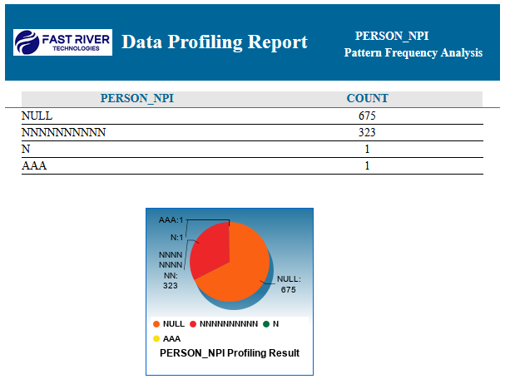
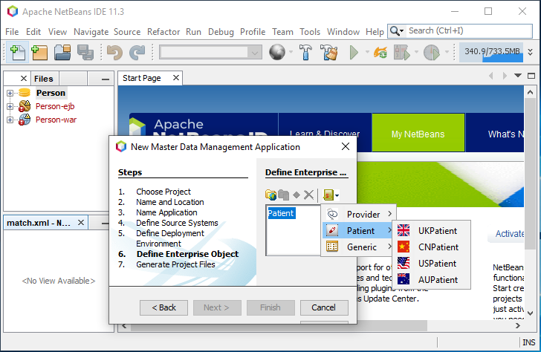
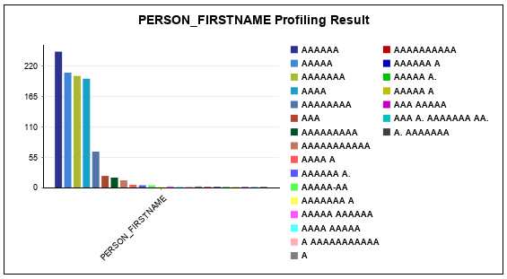
大数据治理平台 产品 1.0
大数据治理平台 - 设计和客户化平台
大数据质量分析结果实列一
数据质量分析结果实列二

Slide 10
Data Governance - Data Quality
Data Profiler - Data Profiling / Analyzing
Data Cleanser – Data Cleansing

Slide 11
Data Quality Lifecycle
Database
Define Schema
Generate Tools
Extract Data
Define Profiling Rules
Execute Profiler
Repeat
Redefine Rules
Analyze Cleansing Results
Execute Cleanser
Define Cleansing Rules
Load Data
Database

Slide 12
Data Quality Features
Data Profiling Features
Simple Frequency Analysis Rule
Constrained Frequency Analysis Rule
Pattern Frequency Analysis Rule
Data Cleansing Features
Standardization and Normalization
Data Validation Rules
Data Transformation Rules
Conditional Data Rules

Slide 13
Data Quality Features
Standardization and Normalization
Address
Name
Data Validation Rules
Data Type
IsNull Value
DataLength
DateRange
MatchFromFile
PatternMatch
DataRange
Reject in Conditional Statement
Return in Conditional Statement
ValidateDBField
Data Transformation Rules
Assign
PatternReplace
Replace
Truncate
Conditional Data Rules
Conditional Operators: If, Else, Then, Or, And, Not
Conditional Rules: DataLength, Equals, IsNull, Matches

Slide 14
苏州快阳科技 / 美国快河科技 - Data Quality 1.0 DEMO
Data Quality 平台 演示
生成数据分析工具 Data Profiler 工具
生成数据清洗工具 Data Cleanser 工具
重庆药交所药品数据质量项目实列
美国最大电子处方公司Surscripts 数据质量项目实列

Slide 15
快阳科技（苏州）有限公司
谢谢
联系：叶常青 电话:13661660473 邮箱: charles.ye@fastrivertech.com
周京平 电话:13817304612邮箱: jack.zhou@fastrivertech.com
www.fastrivertech.com
www.kuaihetech.com

