Slide 1

下一代智能大数据库 SPLICE MACHINE
- 赋能OLTP(联机事务处理) 、 OLAP(联机分析处理) 、 及AI/ML（人工智能）
快阳科技（苏州）有限公司
2020 年6月

Slide 2


智能大数据库 SPLICE MACHINE
Distributed Database 公司创建于2012年美国硅谷
美国甲骨文RAC数据库之父Roger Bamford是创始人之一、 Mr. Bamford 先生也是 著名MongoDB 数据库的杰出架构师（Distinguished Architect)
累计约上亿美元的VC投入 / VC-backed
唯一的基于大数据平台上的RDBMS传统数据库 / Only Hadoop RDBMS
目标取代美国甲骨文Oracle数据库 / Destroy Oracle RDBMS
SPLICE MACHINE是大数据应用的基础
大量的权威用户可靠验证如世界上最大的医疗集团Kaiser Permanente 、美国八大银行之一的Wells Fargo 银行等
快阳科技与SPLICE MACHINE 签订了深度战略研发合作和市场合作协议
快阳科技开发了第一个基于SPLICE MACHINE和FHIR的医疗大数据库

Slide 3
智能大数据库 SPLICE MACHINE
2012创建
2014 V1.0
2015 V1.5
2016 V2.0
2017 V2.5
2020 V3.0
智能大数据库 SPLICE MACHINE 发布日期

Slide 4
大数据技术和基础产品的空缺
传统的应用结构
目前的大数据应用结构
新一代智能大数据应用结构
各种应用程序
各种大数据应用程序
各种大数据应用程序
传统RDBMS数据库（Oracle, Microsoft)
美国甲骨文
医疗大数据库 HDR
缺少中间大数据库
智能大数据库
医疗大数据库
操作系统（Linux or Windows）
大数据操作系统/平台（Apache Hadoop or Cloudera or MapR）
大数据操作系统/平台（Apache Hadoop or Cloudera or MapR）

Slide 5
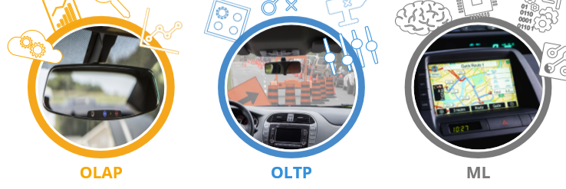
传统数据和大数据应用的三大场景
OLTP(联机事务处理)
what is happening right now？/ 解决当前发生什么？
RDBMS
OLAP(联机分析处理)
what has happened in the past that might impact you? / 解决过去发生什么？
RDBMS and Hadoop
AI/ML（人工智能）
what will happen in the future? / 解决将来发生什么？
RDBMS and Hadoop
Combined 综合场景

Slide 6
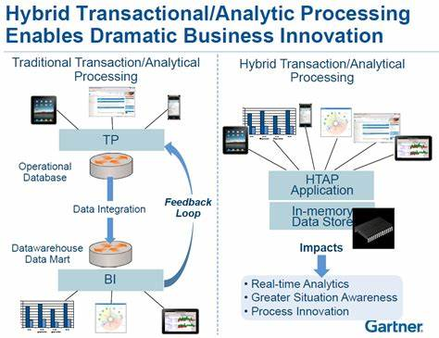
HTAP 架构

Slide 7
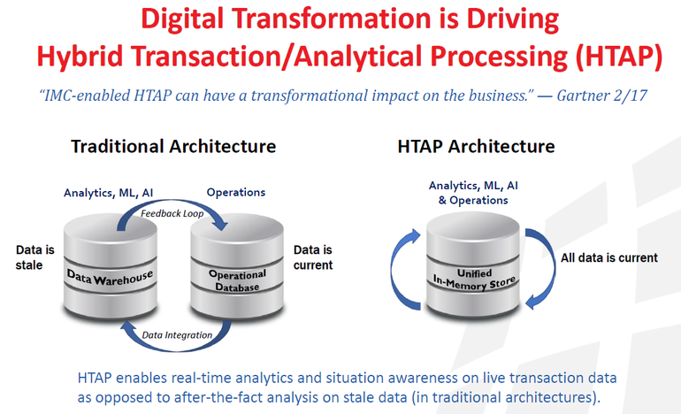
HTAP 架构

Slide 8
智能大数据库 SPLICE MACHINE
What Is Splice Machine?
A scale-out RDBMS and Distributed SQL on Hadoop
Enables simultaneous transactions (OLTP) and analytics (OLAP)
Powers Operational AI: the ability to run AI applications in real time
Standard ANSI SQL
Massively parallel architecture
atomic transaction
Who Uses Splice Machine?
Companies in financial services, healthcare, supply chain, etc.
One example: 7PB or 2B record updates per day, 2M queries per day with sub-second response time
How Does Splice Machine Work?
SQL Engine on Hadoop
Many Delivery Options: on-premise and cloud service

Slide 9
智能大数据库 SPLICE MACHINE目前的技术
Big Data Hadoop and HBase
Pros 利
Cost-Effective and Proven Scalability (from terabytes to petabytes),
Inexpensive Commodity Hardware,
Distributed Storage
Parallel Computing
Auto-sharding and Failover
Cons 弊
Cumbersome
Batch Analysis Only
Lack of Reliable Real-time Updates
Little or No SQL
Cannot Leverage Existing Investments in SQL-trained Resources
Cannot Leverage SQL-based Applications and Business Intelligence (BI) Tools
NoSQL Database
Cons 弊
Little or No SQL

Slide 10
智能大数据库 SPLICE MACHINE目前的技术
Traditional RDBMS Database - Oracle and IBM DB2
Pros 利
Supports Real-time Updates
Cons 弊
Requires Expensive Hardware to Scale up
Cost-Prohibitive
Open Source Databases - MySQL and PostgreSQL
Cons 弊
Unable to Scale Beyond a few Terabytes (Requires Manual sharding or Rewrite applications)
Maintenance Nightmare
Not Right Combination of Scalability, Consistency, Accessibility, and Recency to Cost-Effectively Handle Big Data

Slide 11
智能大数据库 SPLICE MACHINE
ANSI
SQL
Distributed Computing and Storage Hadoop
Hadoop RDBMS
OLTP/OLAP/AI
Real-Time Updates
ACID Transactions
Parallel Computing
Distributed Storage
Scale Out
Terabytes to Petabytes
Cost-Effective
Inexpensive Commodity Servers
Comparison to Other Hadoop® Technologies
All of other SQL-on-Hadoop technologies are designed for analytics only and cannot support high volumes of real-time updates

Slide 12
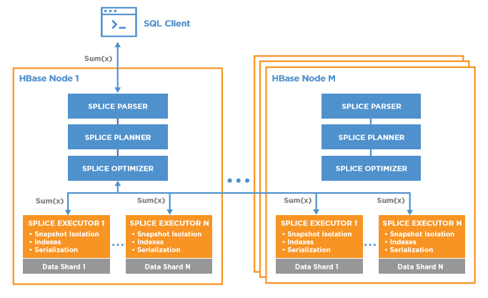
智能大数据库 SPLICE MACHINE
高性能分布式计算体系结构
Splice Machine is a high-performance, distributed computing architecture that delivers massive parallelization for predicates, joins, aggregations, and functions by pushing computation down to each distributed data shard. Splice Machine places its parser, planner, optimizer, and executor on each HBase node and uses HBase co-processors to distribute computation across shards.

Slide 13
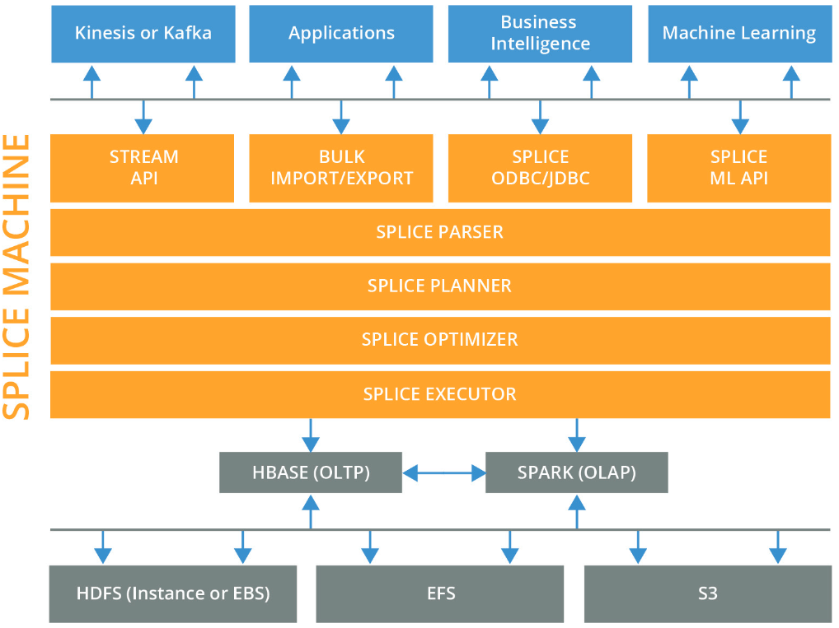
智能大数据库 SPLICE MACHINE 产品架构

Slide 14
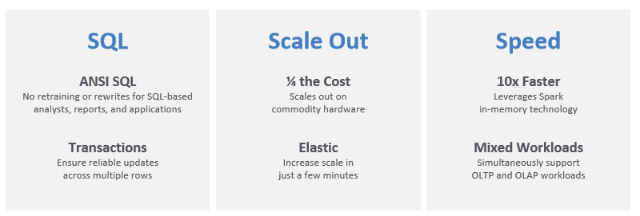
智能大数据库 SPLICE MACHINE

Slide 15
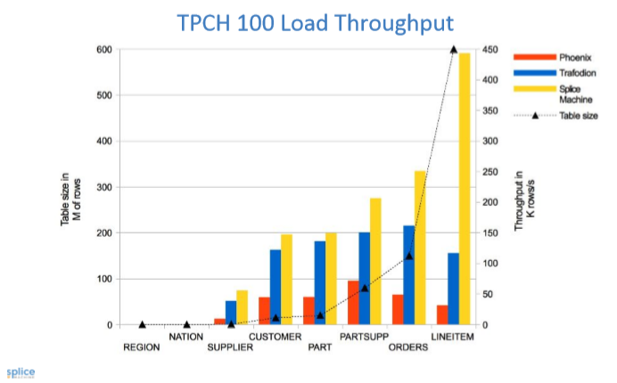
智能大数据库 SPLICE MACHINE
主要竟争产品的比较

Slide 16
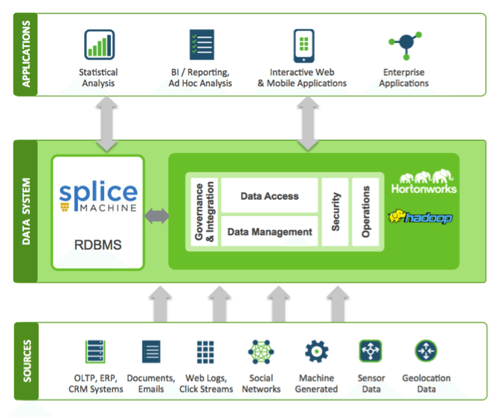
智能大数据库 SPLICE MACHINE 应用架构

Slide 17

智能大数据库 SPLICE MACHINE
主要已经部署的客户

Slide 18
快阳科技（苏州）有限公司
谢谢
联系：叶常青 电话:13661660473 邮箱: charles.ye@fastrivertech.com
周京平 电话:13817304612 邮箱: jack.zhou@fastrivertech.com
www.fastrivertech.com
www.kuaihetech.com

