Slide 1
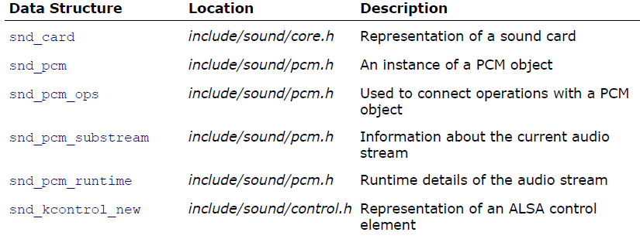
Data Structure

Slide 2
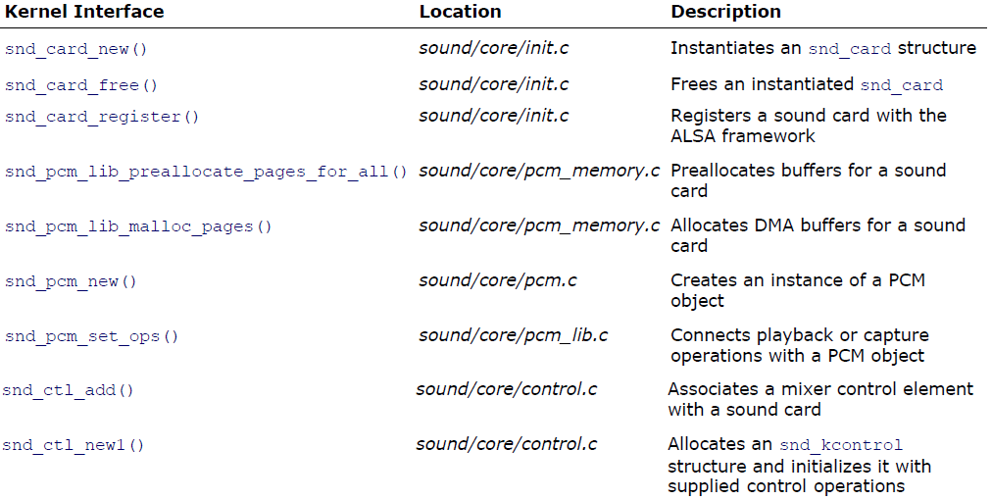
Kernel Programming Interfaces

Slide 3
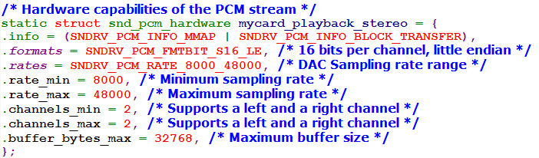
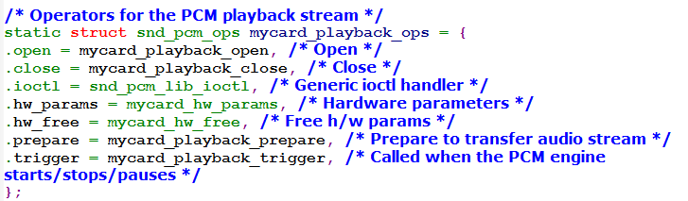
Sample ALSA Sound Driver

Slide 4
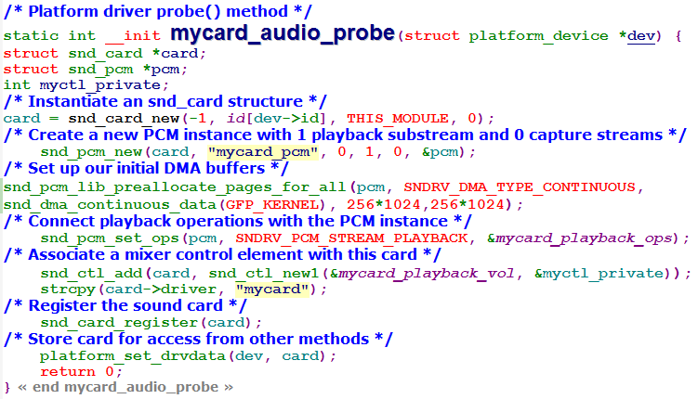
Sample ALSA Sound Driver

Slide 5
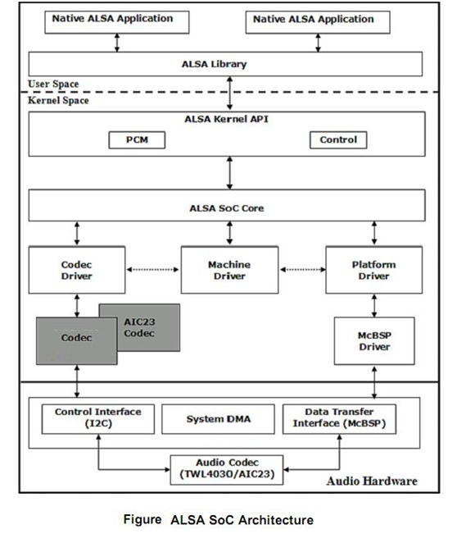
ALSA Soc Architecture

Slide 6
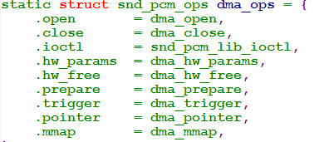

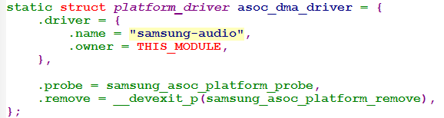
ASoC Platform Driver
An ASoC Platform class drivers includes the audio DMA engine driver, digital audio interface (DAI) drivers (e.g. I2S, AC97, PCM) and any audio DSP drivers for that platform.
The platform DMA driver optionally supports the following ALSA operations:-
The platform driver exports its DMA functionality
via struct snd_soc_platform_driver:-
sound/soc/samsung/Dma.c

Slide 7
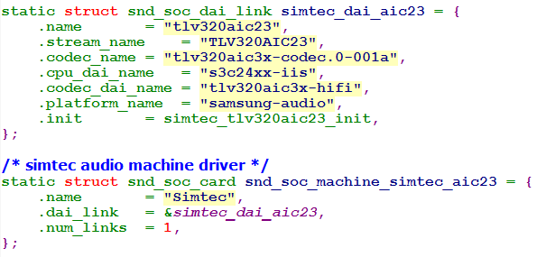
Machine Driver
ASoC Machine Driver
===================
The ASoC machine (or board) driver is the code that glues together all the component drivers (e.g. codecs, platforms and DAIs
The machine driver can contain codec and platform specific code. It registers the audio subsystem with the kernel as a platform device and is represented by the following
struct snd_soc_card:-
/* CPU <--> Codec DAI links */ struct snd_soc_dai_link *dai_link;

Slide 8
ASoC Codec Class Driver
The codec class driver is generic and hardware independent code that configures the codec, FM, MODEM, BT or external DSP to provide audio capture and playback.
It should contain no code that is specific to the target platform or machine
All platform and machine specific code should be added to the platform and machine drivers respectively.
Each codec class driver *must* provide the following features:
Codec DAI and PCM configuration
Codec control IO - using Reg Map API
Mixers and audio controls
Codec audio operations
DAPM description.
DAPM event handler.

Slide 9
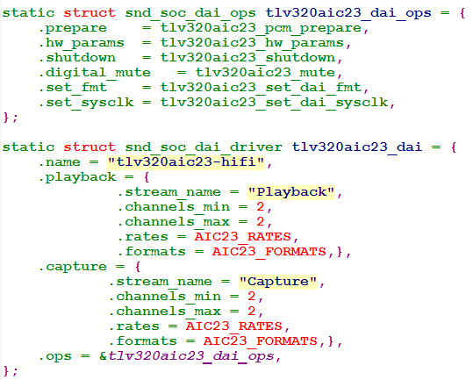
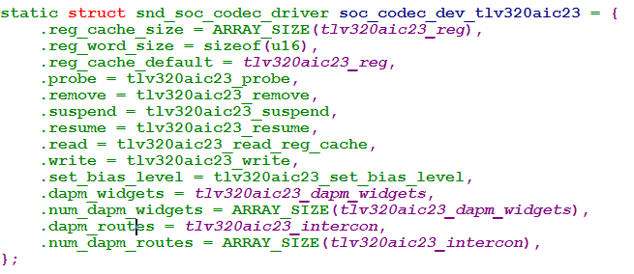
ASoC Codec Class Driver e.x codec driver TLV320AIC23

Slide 11
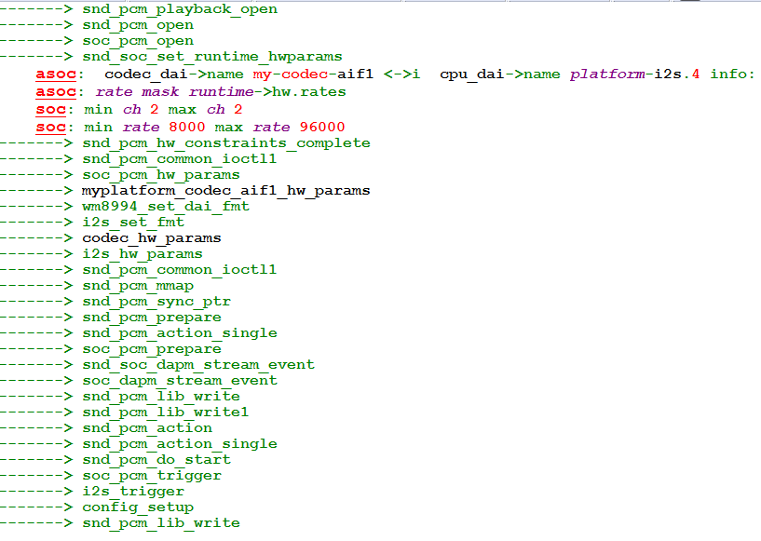

Slide 12
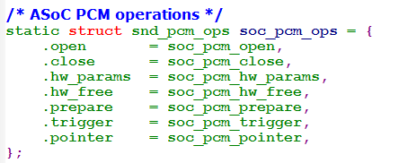

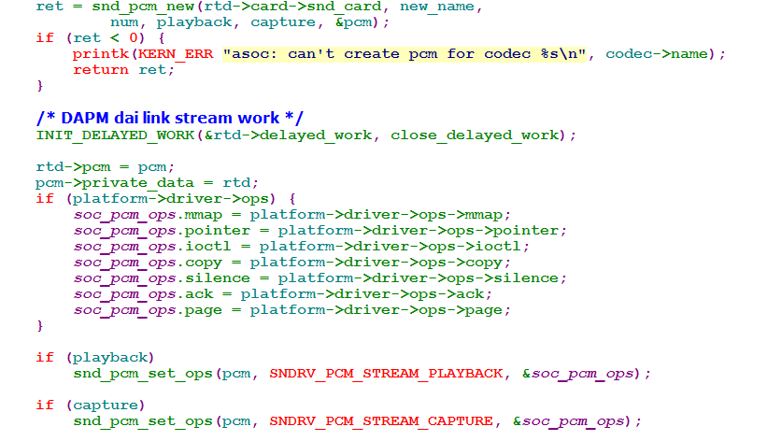
(sound\soc\ Soc-pcm.c)

