Slide 1
MTH251
25/1/2021

Slide 2

About Me
Zhong Lun
Linkedin: https://www.linkedin.com/in/zhonglun/
Email: zhonglun@gmail.com
HP: 9647 7009

Slide 3
Course Structure
6 weeks: Jan ~ Mar
6 seminars
6 labs
3 assignments
Open book exam

Slide 4
Learning Objectives
algorithm time & space complexity
basic data structure: array, stacks, queues, list, and tree
recursion algorithm

Slide 5
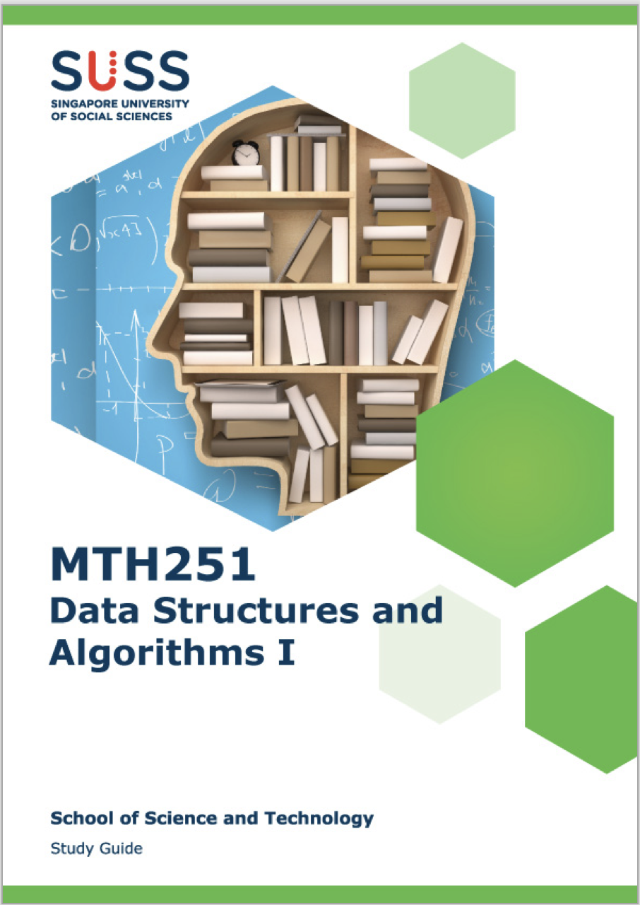

Resources

Slide 6
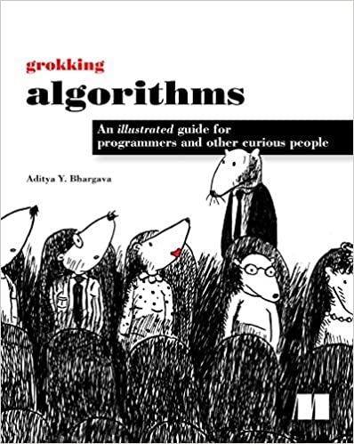
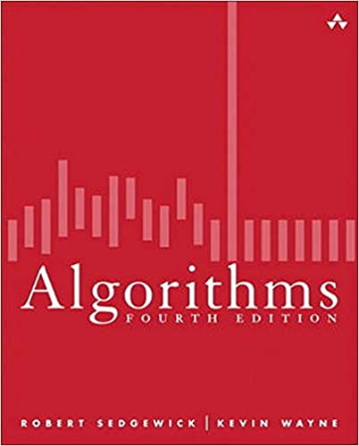
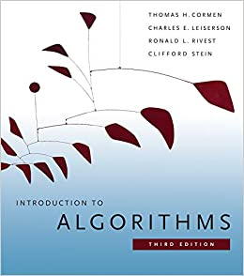

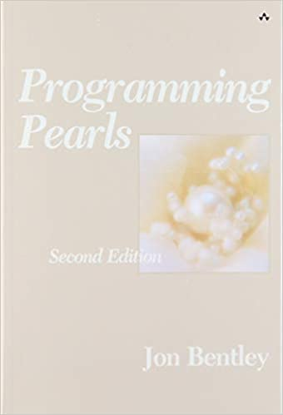
Resources

Slide 7

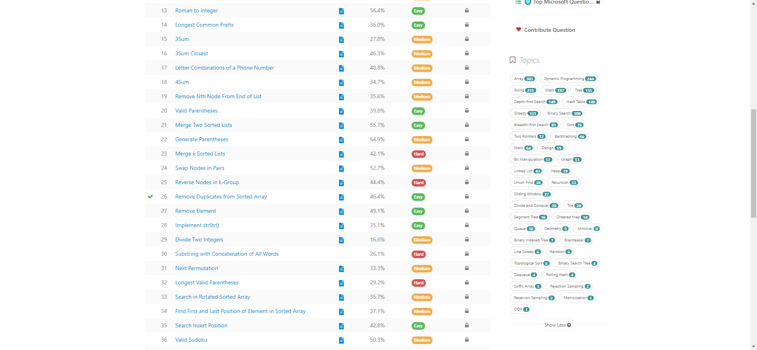
Resources

Slide 8
Topics
Python
Algorithm time & space complexity

Slide 9
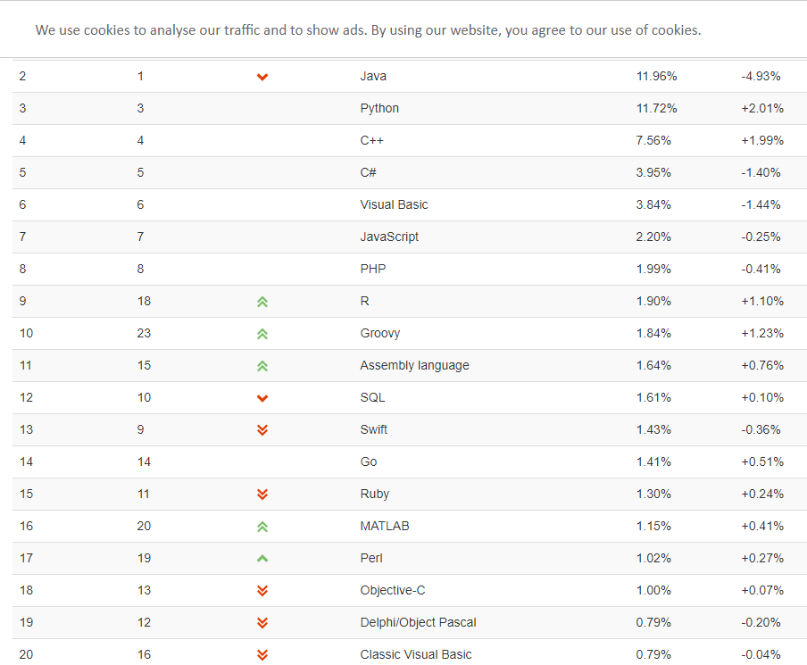
Python 101

Slide 10
Python 101
Life is short, use Python
Easy to learn
Human Readable
Productivity
The Zen of Python, by Tim Peters
Beautiful is better than ugly.
Explicit is better than implicit.
Simple is better than complex.
Readability counts.
Special cases aren't special enough to break the rules.
There should be one-- and preferably only one --obvious way to do it.
If the implementation is hard to explain, it's a bad idea.

Slide 11
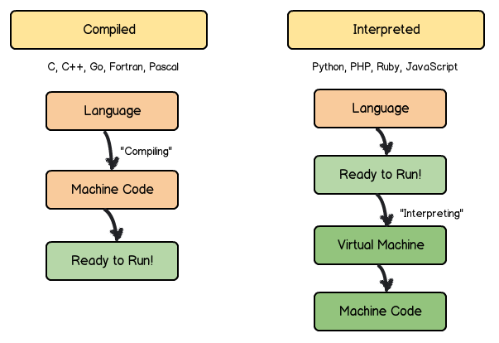
Python 101
Compiled vs. Interpreted

Slide 12
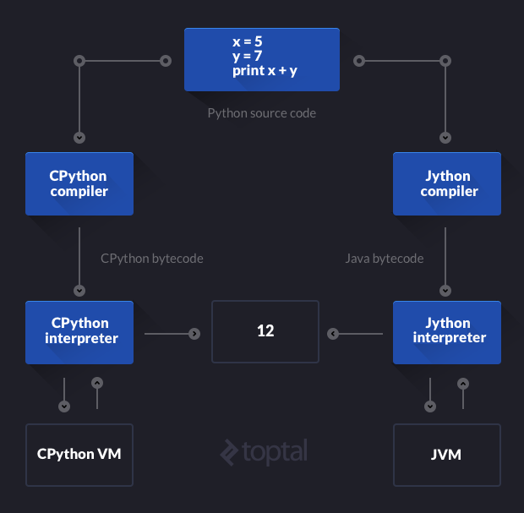
Python 101

Slide 13
Python data type
number: int, long, float, complex
string
bool
operator
arithmetic: +, -, *, /, %, //, **
logical: and, or, not
compare: >, <, ==, !=, >=, <=
math functions: abs(), ceil(), exp(), fabs(), floor(), log(), log10(), max(), min(), modf(), pow(), round(), sqrt()
variable
list, tuple, set, dictionary
if/else
while, for loop
function

Slide 14
Python OO
Encapsulation
Inheritance
Polymorphism
Advantages:
Productivity
Maintenance
Quality
Disadvantages ???

Slide 15
Introduction
What
A data structure is a way of organizing data so that it can be used effectively
Algorithms provides computer step by step instructions to solve a problem
Program = Data Structure + Algorithm
Finiteness
Definiteness
Effectiveness
Input
Output

Slide 16
Introduction
Data Structure
Linear
Array, String, Linked List
Stack, Queue, Deque, Set, Map/Hash, etc.
Non-Linear
Tree, Graph
Binary Search Tree, Red-Black Tree, AVL, Heap, Disjoin Set, Trie, etc.
Others
Bitwise, BloomFilter, LRU Cache

Slide 17
Algorithm
if-else, switch -> branch
for, while loop -> iteration
recursion -> divide & conquer, backtrace
search: binary search, depth first, breath first, A*, etc.
dynamic programming
greedy
Math, Geometry
…..

Slide 18
Introduction
Why
Deeper understand computer system
Improve coding skill
Coding Interview
Building framework and library
How
Implement from scratch
Problem solving
Learning by doing

Slide 19
Linear Search
Input: array, target element
Output: position (-1 if not existing)

Slide 20
Algorithm Complexity Analysis
Performance: cpu, memory, io, communication, etc.
worst/avg/best case
n = data.length
T = n? 2n? 3n?
lines? ms?
T = c1*n + c2 -> O(n)
Ignore the c1, c2
only consider the most complicated computation block (largest effect)

Slide 21
Algorithm Complexity Analysis
Big-O describes the trend of algorithm performance when the data size increases:
T1 = 10000n T2 = 2n^2
O(n) < O(n^2)
when n >= n0, T1 < T2
10000n < 2n^2
n > 5000, n0 = 5000

Slide 22
Big-O
O(1): constant complexity
O(logN): logarithmic complexity
O(n): linear complexity
O(n^2): N square complexity
O(2^n): exponential complexity
O(n!): factorial
Master theorem (analysis of algorithms): https://en.wikipedia.org/wiki/Master_theorem_(analysis_of_algorithms)

Slide 23
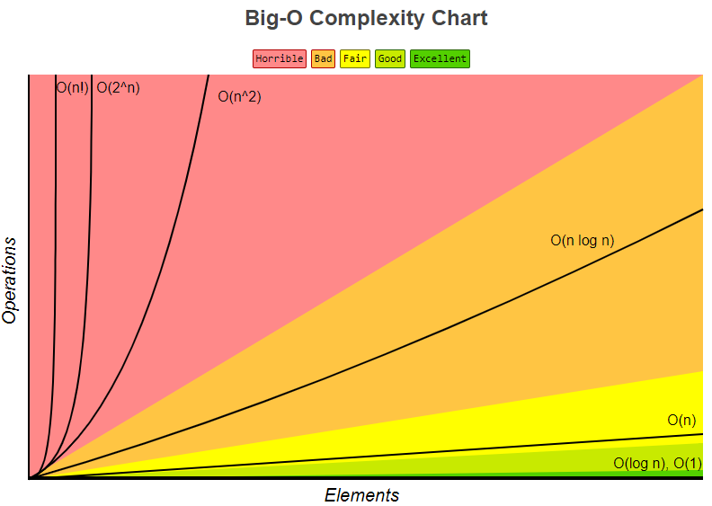
Big-O
O(1) < O(logN) < O(n) < O(NlogN) < O(n^2) < O(2^n) < O(n!)
Big-O cheatsheet:
https://www.bigocheatsheet.com/

Slide 24


Next: Jan 30, Sat
<TBD>
laptop
Software
Anacoda: https://www.anaconda.com/
VS Code & extensions: https://code.visualstudio.com/

