Slide 1
MTH251
01/02/2021

Slide 2
Topics
Arrays
Stacks & Queues

Slide 3
Array
To store a list of similar things:
A list of names: [“Alex”, “Bob”, “Charles”, “David”]
A list of numbers: [1, 2, 3, 4]
Each item in the array referred as “element”

Slide 4
Array
Element Type: same type (“structured data”)
Size: fixed
Java:
// declare & init String[] cars = {“BMW”, “Toyota”, “Tesla”}
// declare
int[] scores = new int[10]
// init
scores[0] = 90
scores[1] = 80
👉 Dynamic Array (List or ArrayList)
Index

Slide 5
Array: 2-D
students = [
[“Alex”, “M”, “S1111111A”],
[“Bob”, “M”, “S2222222B”],
[“Charles”, “M”, “S3333333C”],
]
students[2] -> [“Charles”, “M”, “S3333333C”]
Students[1][2] -> “S3333333C”
Index | 0 | 1 | 2
0 | Alex | M | S1111111A
1 | Bob | M | S2222222B
2 | Charles | M | S3333333C

Slide 6
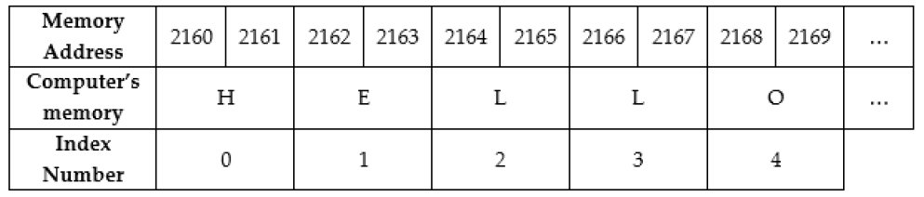
Array
str = “HELLO” = [‘H’, ‘E’, ‘L’, ‘L’, ‘O’]
data_type: char
data_type_size: 2 byte (1 byte = 8 bits, 0000 0000 ~ 1111 1111)
total_size = array_size * data_type_size
arr[i].address = base_address + i * data_type_size <- O(1)
Notes:
Array is very simple and fundamental data structure because it represents the structure how we allocate and use memory.
Memory is like a big building and it contains many rooms, the room can store data, each room has a unique room number which is the address, the room size is same and in computer the size unit is byte and one byte equals to 8 bit, 0~255. one byte can store 8 0s to 8 1s, for unsigned integer, it means from 0 to 255.
By definition array should contain a numbers of element with same data type. String can be considered as an array of chars. We can use the index to identify the element.
Why the starting index is 0?

Slide 7
Dynamic Array
Mem Size = 2 (allocate)
Φ | Φ
2 | Φ
2 | 3
Mem Size = 4 (resize & copy)
2 | 3 | 5 | Φ
2 | 3 | 7 | 5
3 | 5 | 7 | Φ
3 | 7 | Φ | Φ
Mem Size = 2 (resize & copy)
7 | Φ
Notes:
You may wonder how to implement a dynamic array, in fact it can be implemented by a normal array.
When we append, insert & delete, we touch not just a single element.
Memory is still a limited resource, the actual implementation of dynamic array has to take it into consideration. And memory management is a very complicated problem.

Slide 8
Complexity Analysis
Time Complexity: by giving the size of the data set as integer N, consider the number of operations that need to be conducted by computer before the algorithm can finish
Big(O) is to indicate the complexity level not the exact number of operations
Space Complexity
Worst-case Scenario
Accessing, Searching, Inserting, Deleting
Notes:
Algorithm is a step by step pragmatic instruction to computer to solve problem
To design and implement a algorithm usually we sacrifice space to achieve fast performance, in another word time is more important than space. But in reality we still need to take care of memory usage or storage otherwise computer may hang or hitting out of memory error.
Data structure is our building blocks for algorithm, so when using these data structure we need to consider the performance of those most common operations, namely Accessing, Searching, Inserting, Deleting.

Slide 9
Array: Operations
Operation | Array | Dynamic Array/ArrayList
Accessing | O(1) | O(1)
Searching | O(n) | O(n)
Inserting | - | O(n)
Deleting | - | O(n)
Notes:
Goto notebook

Slide 10
Programmatic
Variable
scope: global vs local
ref vs. value
mutable vs. immutable data
copy vs. deep copy

Slide 11
Programmatic
Array: List (Python)
Abstract Data Type (ADT) vs Data Structure (DS)
An abstract data type is an abstraction of a data structure which provides only the interface to which a data structure must adhere to.
The interface does not give any specific details about how something should be implemented.
👉 Programming language provides different data types to implement/represent different data structure.
Abstraction (ADT) | Implementation (DS)
List | Dynamic Array, Linked List
Queue | Array based Queue, Linked List based Queue, Stack based Queue
Vehicle | Bicycle, Motor, EV
Notes:
When designing and discussing algorithm to solve problems, we use data structure such as Array, Dynamic Array, Linked List, as the solution or algorithm is programming language independent.
When discussing programming issues or implementing the algorithm in a specific programming language like Python, we use data type like int, string, list which are supported by the language. Different programming language support different data types. Java has different List data type: ArrayList, AttributeList, LinkedList, Stack, and so on. We can build more advanced data structure by using the builtin date types.
So they are used in different context and don’t feel confused.

Slide 12
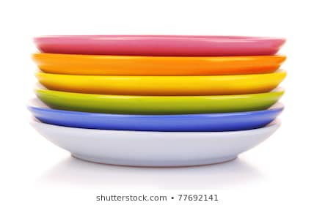
Stack
Sequential Access vs Random Access (such as Array)
LIFO (Last In First Out) sequential collection
Notes:
As we have known, any element in Array we can access directly by calling upon the index location, but unlike Array, for some linear data structure, the element can be accessed only in a particular order, Stack is one of them.
By definition, stack is a linear data structure that stores data in such a way that the last piece of data stored, is the first one retrieved also called last-in, first-out or first-in, last-out. We can consider a live example - a stack of plates, we can only place a new plate by stacking it on the top of others. And if we want to get a plate in the middle of the stack we have to take off all the plates on top of it. So every time the only accessible element is the top element or the last element we place. Last In First Out is the key to understand stack.

Slide 13
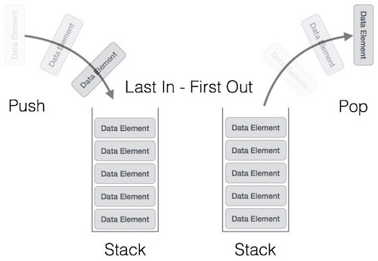
Stack: Operations
push() − pushing (storing) an element on the stack
pop() − removing (accessing) an element from the stack
top()/peek() − get the top data element of the stack, without removing it
size(), isEmpty(), isFull(), …
Notes:
Push & Pop are the 2 most important operations for stack. Push is to store an element to the top and stack size will increase 1. Be careful if the stack is full, pop will throw overflown exception. The opposite is Pop, pop is to remove the top element and the size will decrease 1. And if stack is empty, it will throw underflow exception.

Slide 14
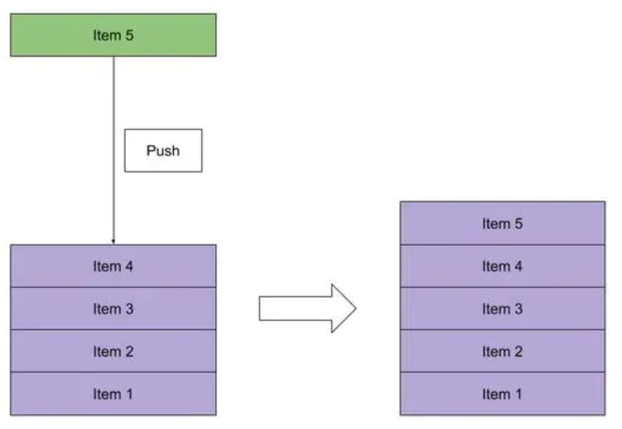
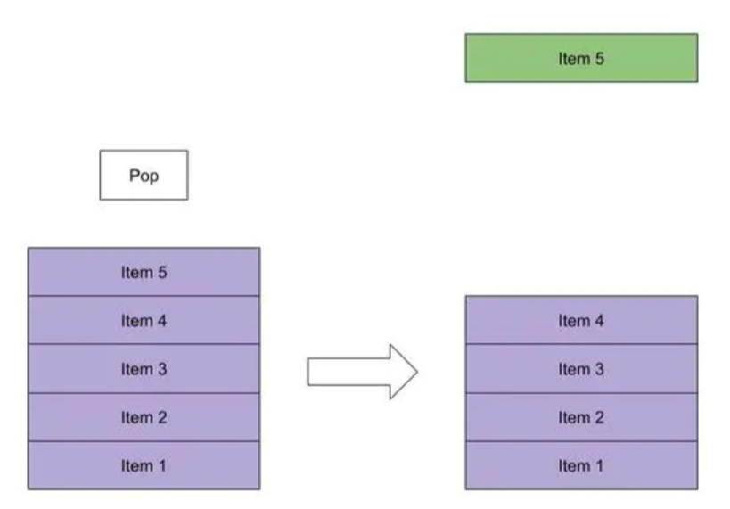
Stack: push & pop

Slide 15
Stack: Operations
Accessing | O(n)
Searching | O(n)
Inserting | O(1)(push)
Deleting | O(1)(pop)
Notes:
To access the bottom element of the stack, we have to remove all the elements above it, so the time complexity is O(n). This is the weakness when we apply stack to solve problem.
Search is similar to accessing.
As stack is LIFO we cannot insert and delete random element.
Goto notebook

Slide 16

Queue
FIFO (First In First Out) sequential collection

Slide 17
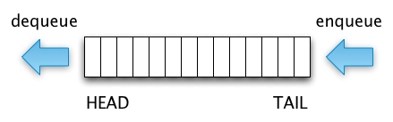
Queue: Operations
enqueue() − adding (storing) an element to the queue
dequeue() − removing (accessing) an element from the queue
fist()/peek() − get the first element of the queue, without removing it
size(), isEmpty(), isFull()

Slide 18
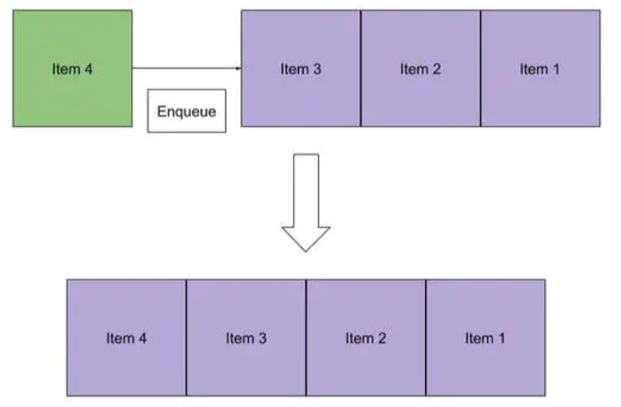
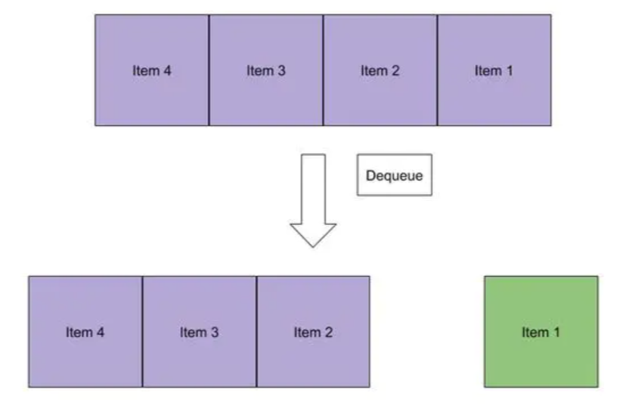
Queue: enqueue & dequeue
Notes:
Goto notebook

Slide 19
Queue: Operations
Accessing | O(n)
Searching | O(n)
Inserting | O(1)(enqueue)
Deleting | O(1)(dequeue)
Notes:
To access the bottom element of the stack, we have to remove all the elements above it, so the time complexity is O(n). This is the weakness when we apply stack to solve problem.
Search is similar to accessing.
As stack is LIFO we cannot insert and delete random element.
Goto notebook

Slide 20
Next
Linked List and Positional List
Recursion

