Slide 1
MTH251
08/02/2021

Slide 2
Topics
Linked List
Recursion

Slide 3
Linked List
Linked List: “dynamic” data structure
Implemented by Array Dynamic sizing via resize()
Dynamic Array
Stack
Queue
Notes:
In previous class, we introduce 4 linear data structure and 3 of them are dynamic – dynamic array, stack and queue. As we know, they can be actually implemented by array and rely on resize() function to increase or decrease the memory size when we add/remove element.
Today we will introduce a new data structure - Linked List, which is truly dynamic data structure. Similar to Array, it is basic but very important data structure and it is widely used.

Slide 4
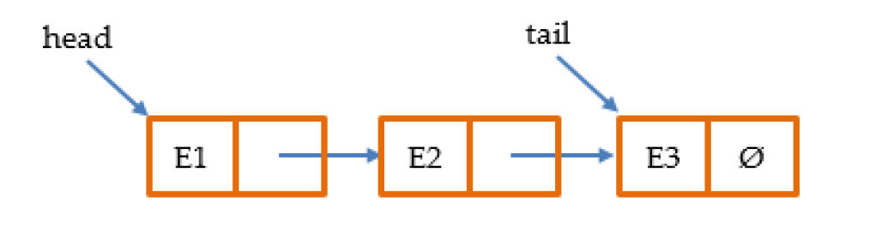

Linked List
Data stored in a “Node” class:
Pointer
Notes:
In Linked List, each a single node in the linked list has two parts, one is to store the actual data and the other is a pointer or ref which points to the next node.
https://visualgo.net/en/list
Goto notebook (linked list)

Slide 5
Linked List Operation
Operations (head, tail, anywhere) | Linked List | Array/Dynamic Array
Accessing | O(n) | O(1)
Searching | O(n) | O(n)
Inserting | O(1) | O(n)
Deleting | O(1) | O(n)
Notes:
For inserting, just need to create the new node and update the pre node
For deleting, just need to update the pre node and next node
Comparing Array, the accessing is slower but the update is much faster.

Slide 6
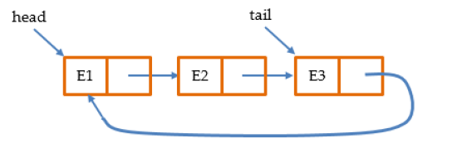
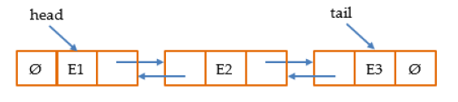
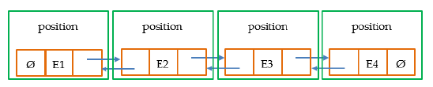
Linked List
Single Linked List
Circular Linked List
Double Linked List
Positional Linked List
Notes:
Besides Single Linked List, we have some other forms of linked list.
For Circular Linked List, the last element points back to the first element, instead of null
For Double Linked List, we have two pointers, one points to the previous node, the other points to the next.
To speed up the accessing, we can create the position class, each node is associated with a position object. We don’t use indexing as position as indexing can be changed as we remove/add the nodes. The actual position logic is up to the implementation.

Slide 7
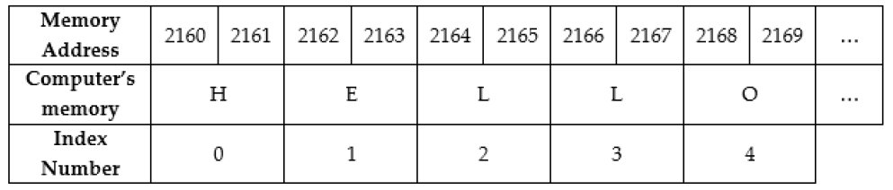
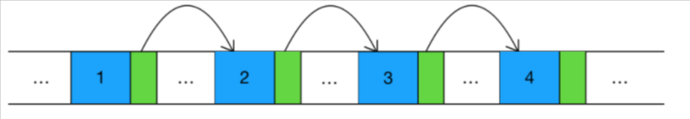
Linked List vs Array
✔dynamic, no need to deal with fixed memory size
✖accessing speed
Array:
Linked List:
Notes:
Both array and linked list are very foundation data structure, because they represent how we store data into memory. For array we require consecutive memory units, imaging after certain time, the memory becomes fragment. If we want to store a big chunk of data, for example the data needs 100 memory units, we may not able to find 100 unites together, but linked list can solve that problem as the node is stored randomly in the memory.
Linked list is more flexible than Array but Array is still very important and useful data structure.

Slide 8
Linked List vs Array
Regs
L1 Cache
L2 Cache
L3 Cache
Memory
SSD
HDD
Capacity: big => small
Inside CPU
CPU CACHE SRAM
Speed: fast => slow
Memory DRAM
Price: high => low
Hard Disk
Notes:
Let us look at this picture, data in our computer can be stored in different place, especially on runtime, data is accessible not just in memory but also in cpu cache. Giving one example, if we have one integer array which contains 4 integer 1,2,3,4, if 1 is being processed by cpu, it will be loaded into cpu cache. As 2, 3, 4 are close to 1, and very likely to be processed next, So modern cpu is so smart that it will preload 2,3,4 into cpu cache together with 1. This optimization operation is available for array data structure but not linked list.

Slide 9
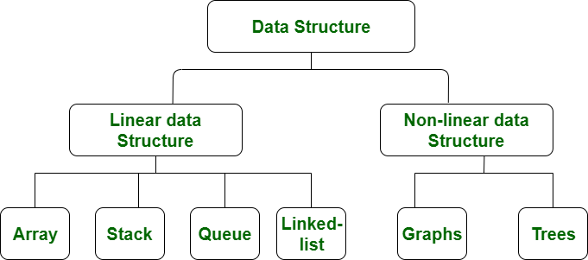
Linear Data Structure
Elements arranged in linear order
Elements can be traversed in a single run
Notes:
Ok, so far we have finished all linear data structure – array, stack, queue and linked list. Next week we introduce non-linear data structure.

Slide 10
Recursion
Example: Factorial
0! = 1
1! = 1
2! = 2 * 1
3! = 3 * 2 * 1
...
n! = n * (n-1) * (n-2) ... 1 or n! = n * (n-1)!
Example: Fibonacci sequence 0, 1, 1, 2, 3, 5, 8, …
when n = 1, fib(1) = 0
when n = 2, fib(2) = 1
when n > 2, fib(n) = fib(n-1) + fib(n-2)
Notes:
Tonight’s 2nd topic is Recursion. Recursion by definition is a function that calls itself. For understanding complicated concept, its always good to start with example.
Goto notebook (factorial, fibonacci sequence recursive)

Slide 11
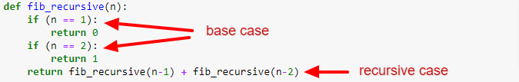
Recursion
the base case
the recursive case
Notes:
Recursion pattern – recursion includes 2 cases the base case and recursive case
Base case: the exist condition
Recursive case: reduce the original problem to a smaller version
Every single recursion function must have at least 1 base case and 1 recursive case.

Slide 12
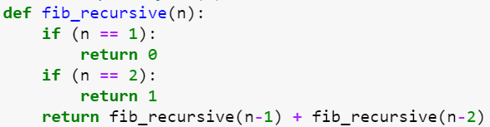


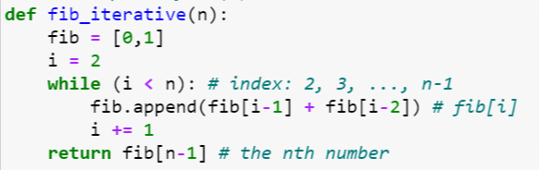
Recursive vs. Iterative
Anything with a recursion can be done iteratively (loop)
 | Intuitive/DRY, code readability
 | Optimization, call stack
Notes:
It is possible to convert a recursion implementation into iterative/loop implementation.
Goto notebook (factorial, fibonacci sequence iterative)
Goto notebook (call stack)

Slide 13
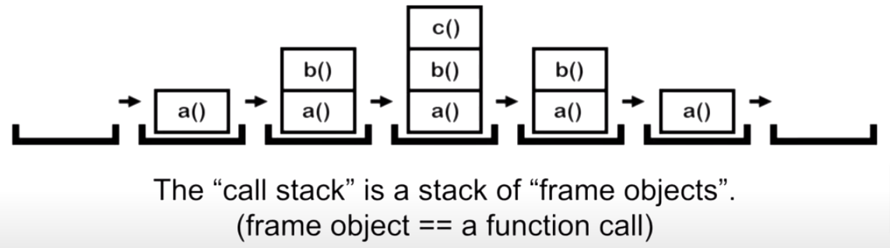
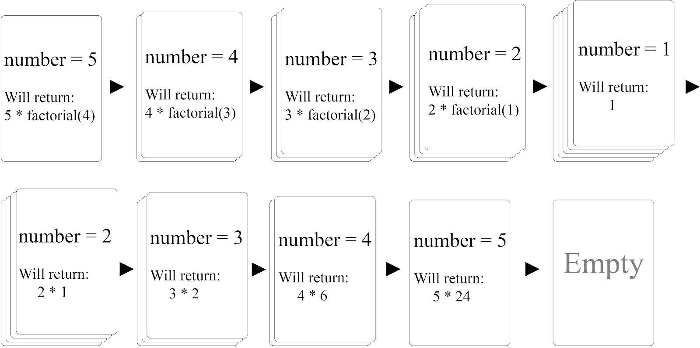
Recursive Call
Call Stack:
fac_recursive(5)
Notes:
Call stack:
visualize a, b, c
Visualize factorial call stack

Slide 14
Recursive Call
Max call stack size (stack overflow error)
Tail Call Optimization
Memorization

Slide 15
Recursion
Fundamental technique to solve problem:
Identifying the base case
Identifying the recursion formula/equation to transform the problem to smaller version
Problem requires back-tracking
Problem has tree structure
Notes:
Recursion is applied widely in many algorithms, so it is very important to master this technique.
Hopefully after the class, recursion is no more magic to you and you can understand how to resolve problem with recursion.

Slide 16
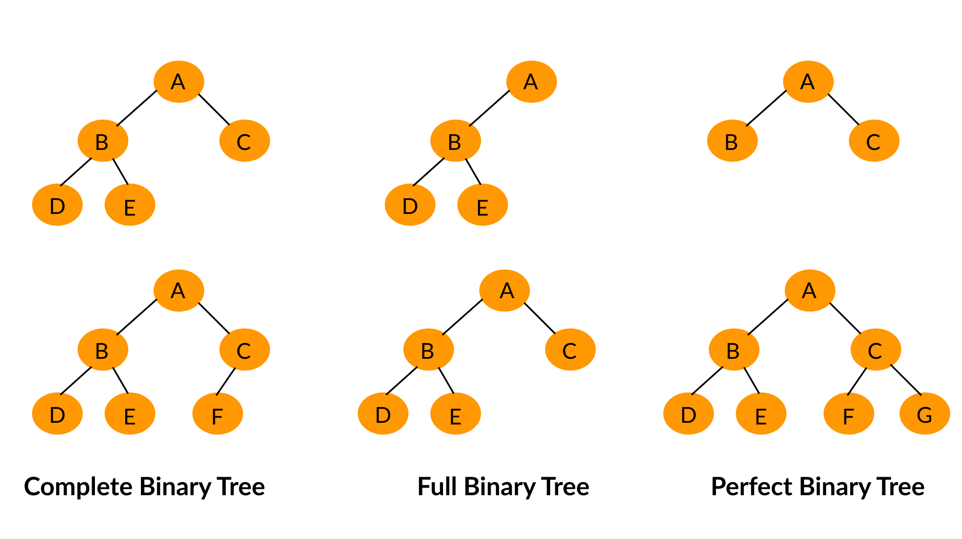
Next
Tree

