Slide 1
MTH251
15/02/2021

Slide 2
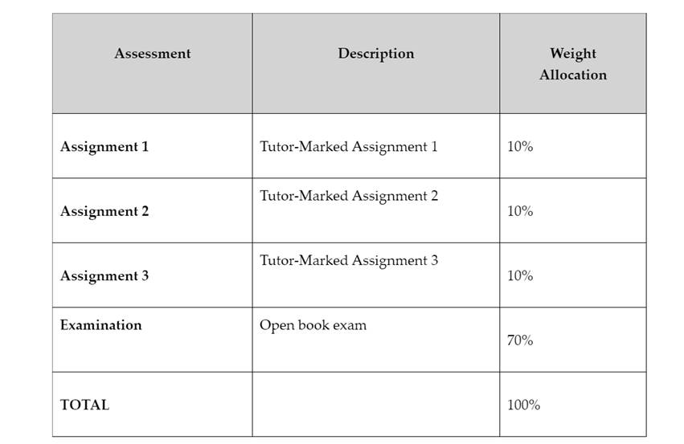

Slide 3
Topics
Tree

Slide 4
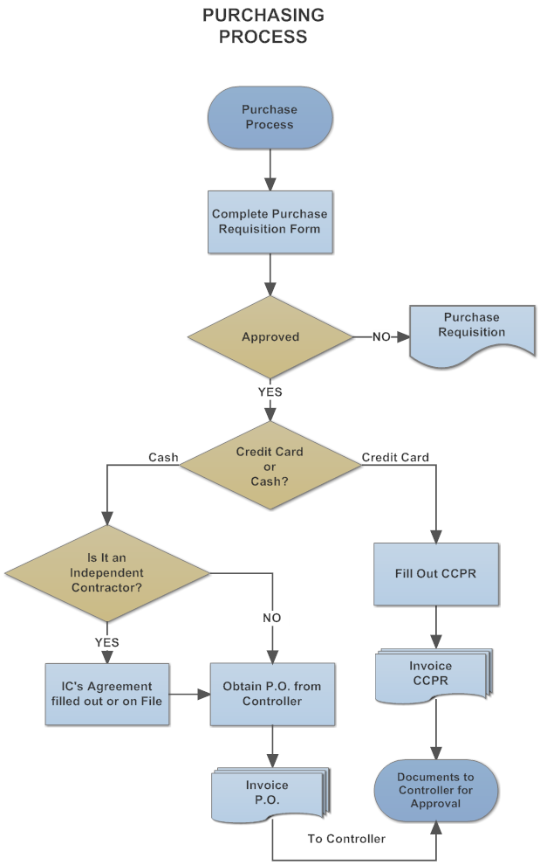
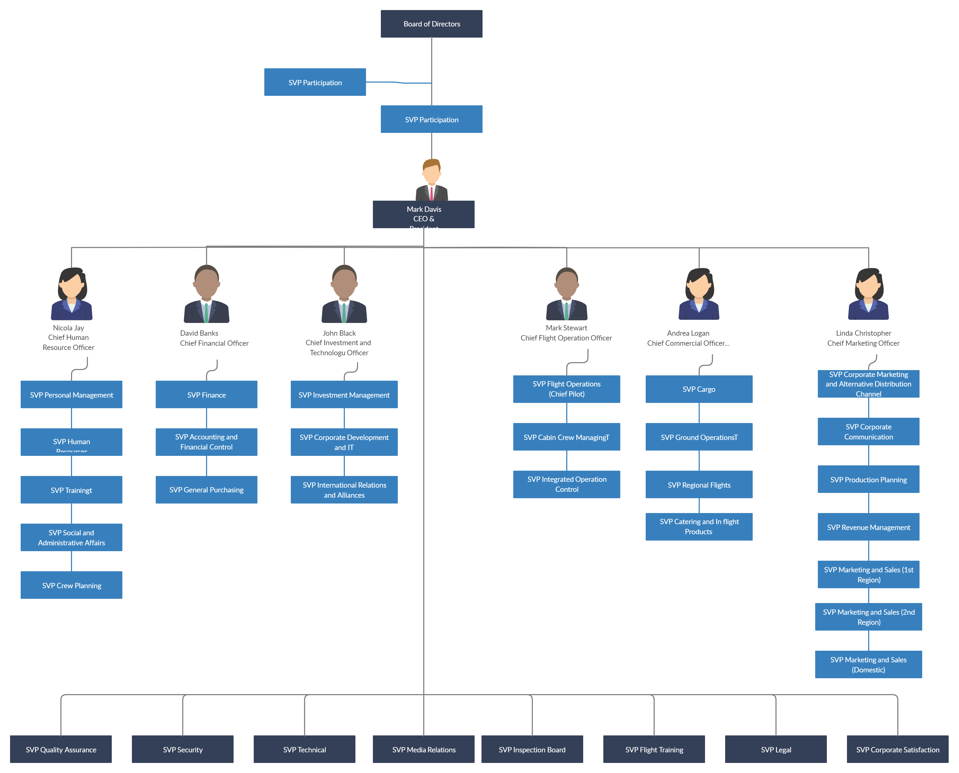
Real World Example

Slide 5
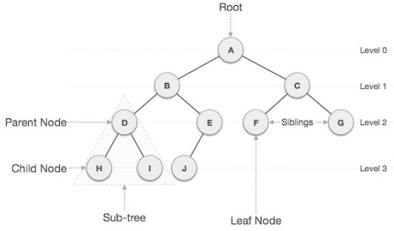
Tree Terminology
Node, Root, Leaf, Internal Node
Parent, Children, Sibling
Edge, Degree
SubTree
Path
Level
Only one root
“N” nodes with max “N-1” edges
Notes:
Tree is collection of data in hierarchical structure. Each element in the tree is called node but unlike Linked list, tree node can have multiple links to the others, the link is called edge.
We have different nodes in a tree, first node is root, no parent, only one root in a tree.
The degree of a node is the total numbers of links or total numbers of child nodes.
SubTree: child node forms a tree recursively.
Path: sequence of nodes and edges from one node to the other, A -> B -> D -> E

Slide 6
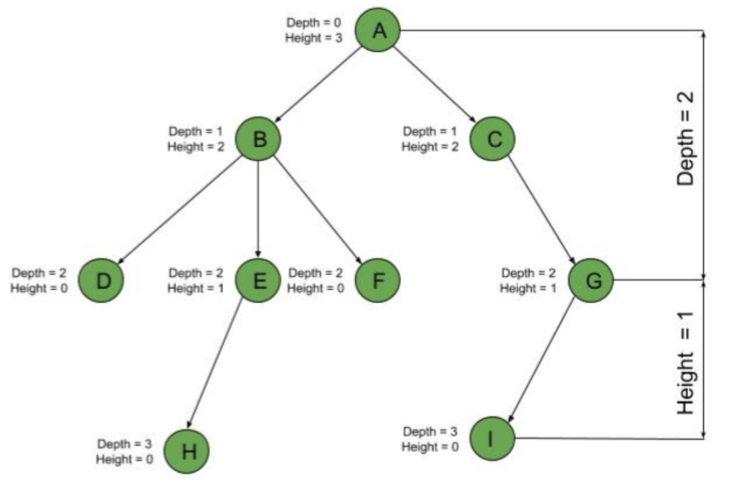
Tree Terminology
Depth, Height
Notes:
Level: edges in path from root to the node
Depth: edges in path from the node to the root
Height: edges in longest path from the node to the leaf

Slide 7
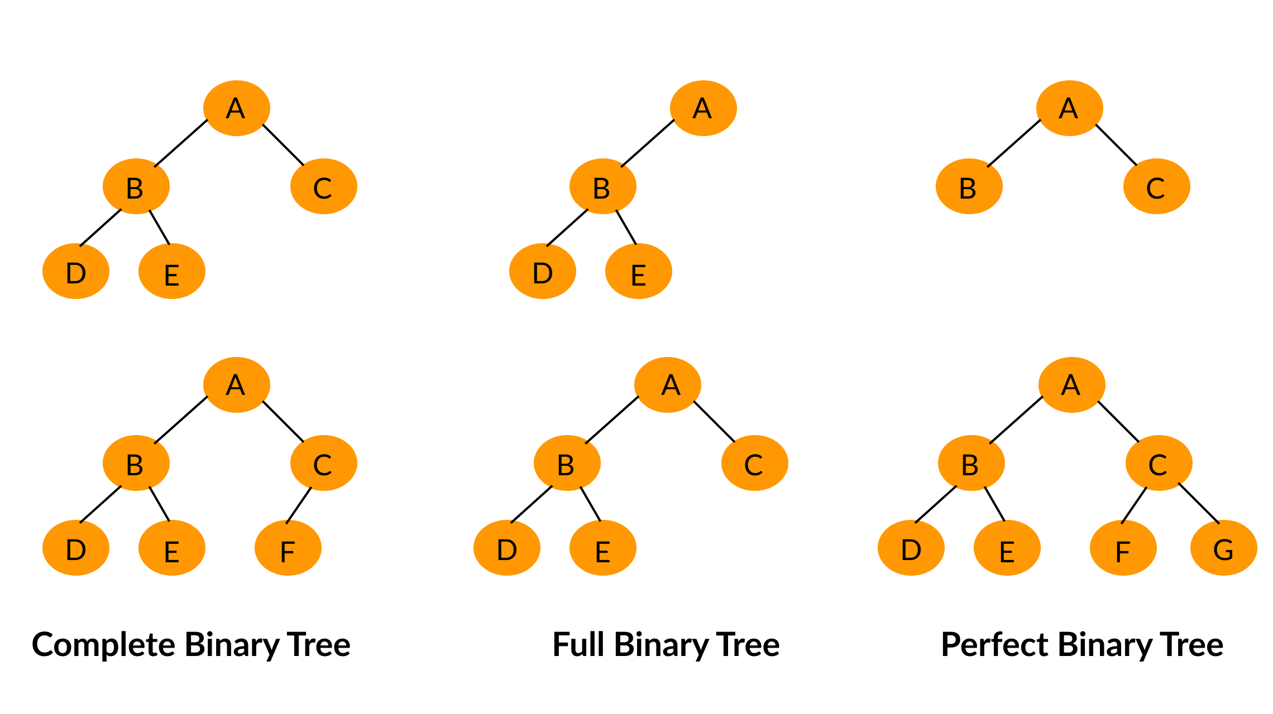
Binary Tree
Only one Root
Max 2 child nodes
One and Only One path from Root for each node
Max nodes on Leve: 2^L Max nodes total: 2^(H+1) -1
Notes:
Perfect Binary Tree: every node has two child nodes except leaf and all leaves on same level, 2^H -1
Full Binary Tree: every node has two child nodes except leaf
Complete Tree: every level is completely filled except the last (leaf) and all nodes are as far left as possible

Slide 8

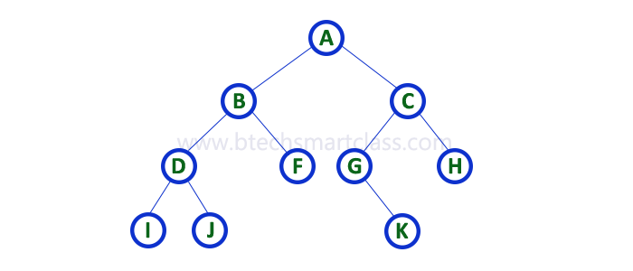

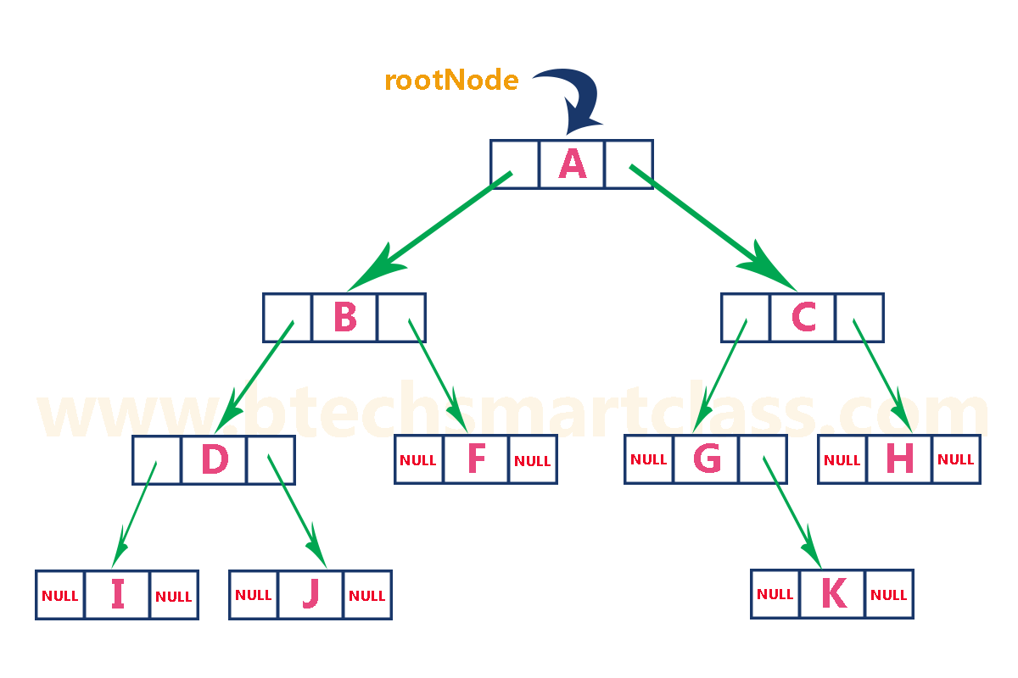
Binary Tree
Array
Left/Right Linked List

Slide 9
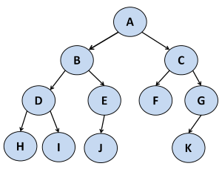
Tree Traverse DFS: pre-order
Root
Left
Right
Visit the root
Traverse the left subtree
Traverse the right subtree
A B D H I E J C F G K

Slide 10
Tree Traverse DFS: in-order
Left
Root
Right
Traverse the left subtree
Visit the root
Traverse the right subtree
H D I B J E A F C K G

Slide 11
Tree Traverse DFS: post-order
Left
Right
Root
Traverse the left subtree
Traverse the right subtree
Visit the root
H I D J E B F K G C A

Slide 12
Tree Traverse BFS (level order)
Visit root
Visit left node
Visit Right node
Go to next level
A B C D E F G H I J K

Slide 13
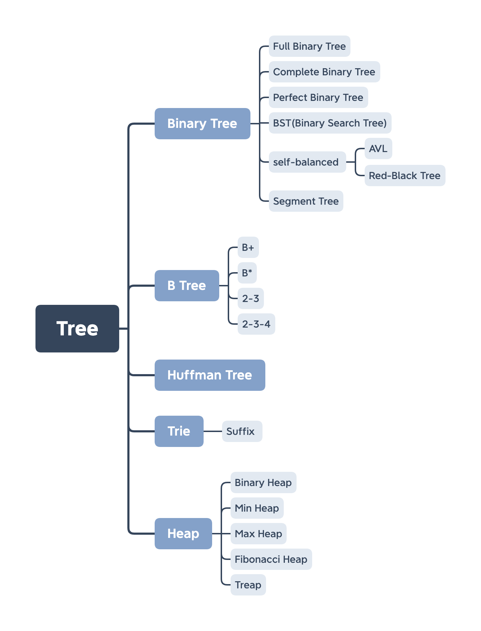
Different Trees
Notes:
Binary Search Tree:

Slide 14
Next
Review

