Slide 1
MTH251
22/02/2021

Slide 2
Python
Data Type
numbers: integer, float, complex
string: “” ‘’ \
byte
boolean
operators, casting
list: [], indexing, slicing, len, append, insert, pop, push
tuple: (), immutable list
set: {}, not repeatable
dict: {}, key-value pairs
None
dynamic data type
Variable: local vs. global

Slide 3
Python
syntax & code block
import
comments: #, “”””””
indention
flow control
for
while
break/continue
if elif else
function
def f()
arguments

Slide 4
Python
Object-Orient Program
class ClassA & instance
__init__ & self
encapsulation: attributes & methods
inheritance: class ChildClass(Parent)
Child can override Parent
polymorphism: same interface, different implementation
Everything is OO

Slide 5
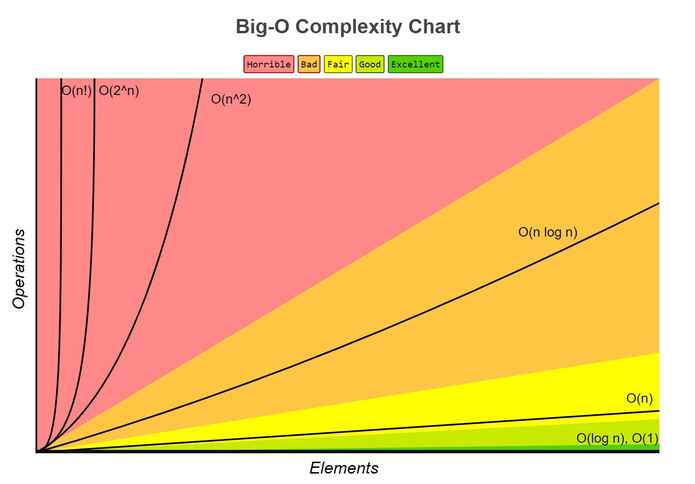
Big O
Big O
O(f) = f
O(f) + O(g) = O(f+g)
O(f) + O(g) = O(max(f,g))
O(Cf) = O(f) if C is positive constant
If g(n) = f(n), O(f) + O(g) = O(f)
O(f)O(g) = O(fg)
O(1) < O(logN) < O(n) < O(NlogN) < O(n^2) < O(2^n) < O(n!)
Complexity Analysis
best case time complexity
worst case time complexity
average case time complexity
amortized time complexity
bigocheatsheet.com

Slide 6
Array
Concept | consecutive memory space: arr[i].address = base_address + i * data_type_size <= O(1) same data type => same size for each element fixed length
Operations | Accessing O(1), Searching O(n)
Notes | not memory friendly cpu cachable index from 0 fundamental data structure to implement others such as stack, queue, heap data type (programming language) vs. data structure
Hands-on | dynamic array, stack/queue, binary search, etc.

Slide 7
Stack
Concept | LIFO/FILO
Operations | Accessing O(n), Searching O(n), Inserting/push O(1), Deleting/pop O(1)
Notes | Stack implementation by dynamic array or linked list
Hands-on | function call stack, expression matching, etc.

Slide 8
Queue
Concept | FIFO/LILO
Operations | Accessing O(n), Searching O(n), Inserting/enqueue O(1), Deleting/dequeue O(1)
Notes | Queue implementation by dynamic array or linked list
Hands-on | priority queue, circular queue, job queue, resource pool, etc.

Slide 9
Linked List
Concept | nonconsecutive memory space node: data + pointer Single Linked List, Doubly Linked List, Circular Linked List, Positional Linked List
Operations | Accessing O(n), Searching O(n), Inserting O(1), Deleting O(1)
Notes | accessing slower than array with/without head/tail node (which don’t store any data) fundamental data structure to implement others such as skip list, hash table, etc.
Hands-on | stack, queue, traverse/reverse/update/merge, etc.

Slide 10
Binary Tree
Concept | one root max 2 child nodes height & depth 4 traversal (DFS/BFS): in-order(left-root-right), pre-order(root-left-right), post-order(left-right-root), level-order proper, perfect, full, complete binary tree
Operations | DFS: time O(n), space O(h) (height of the tree) BFS: time O(n), space O(n)
Notes | stored in array or linked nodes
Hands-on | 4 traversal

Slide 11
Recursion
concept
recursive function
base case & recursive case
Notes
identify base case/exit conditions
identify formula/equation to reduce the problem to a smaller version
call stack overflow
tail call optimization
replaced by iteration
used in many algorithms: tree traversal, quick sort, merge sort, etc.

