Slide 1
MTH251
01/03/2021

Slide 2
Topics
Patterns & Techniques

Slide 3
Sliding Window
In many problems dealing with an array (or a LinkedList), we are asked to find or calculate something among all the contiguous subarrays (or sublists) of a given size.

Slide 4
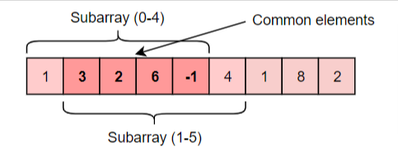
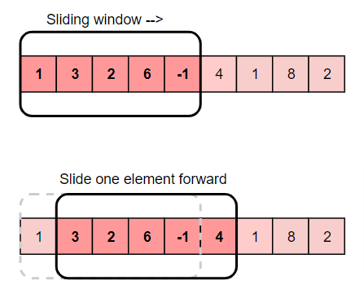
Sliding Window
Q1. Given an array, find the average of all contiguous subarrays of size ‘K’ in it.
Input Array: [1, 3, 2, 6, -1, 4, 1, 8, 2], K=5
Output: [2.2, 2.8, 2.4, 3.6, 2.8]
Notes:
Brute force:
1. For the first 5 numbers (subarray from index 0-4), the average is: (1+3+2+6-1)/5 => 2.2(1+3+2+6−1)/5=>2.2
2. The average of next 5 numbers (subarray from index 1-5) is: (3+2+6-1+4)/5 => 2.8(3+2+6−1+4)/5=>2.83
3. For the next 5 numbers (subarray from index 2-6), the average is: (2+6-1+4+1)/5 => 2.4(2+6−1+4+1)/5=>2.4

Slide 5
Sliding Window
Q2. Given a string, find the length of the longest substring in it with no more than K distinct characters.
Example1 Input: String="araaci", K=2 Output: 4
Explanation: The longest substring with no more than '2' distinct characters is "araa".
Example2 Input: String="araaci", K=1 Output: 2
Explanation: The longest substring with no more than '1' distinct characters is "aa".
Exmaple3 Input: String="cbbebi", K=3 Output: 5
Explanation: The longest substrings with no more than '3' distinct characters are "cbbeb" & "bbebi"

Slide 6
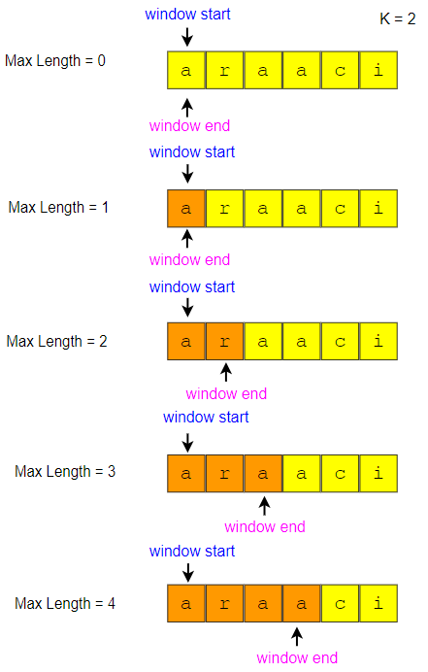
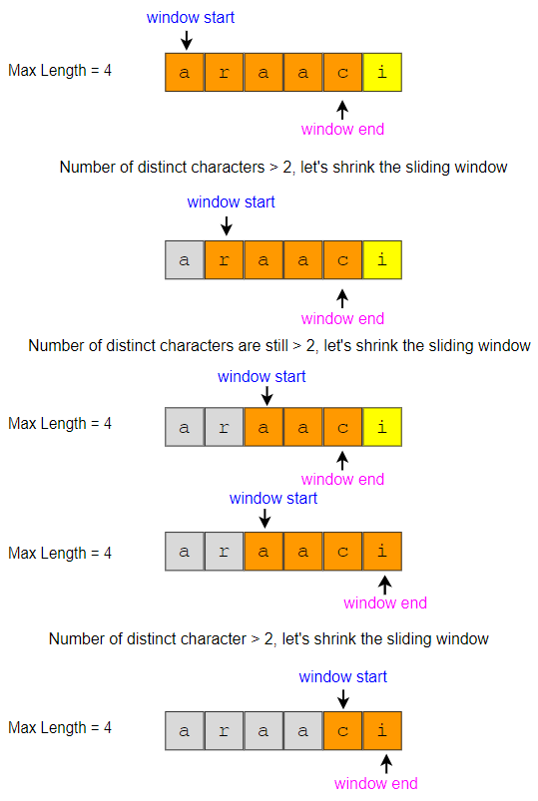
Sliding Window
Q2.

Slide 7
Sliding Window
Q3. Given a string, find the length of the longest substring which has no repeating characters.
Example1 Input: String="aabccbb“ Output: 3
Explanation: The longest substring without any repeating characters is "abc".
Example2 Input: String="abbbb“ Output: 2
Explanation: The longest substring without any repeating characters is "ab".
Example3 Input: String="abccde“ Output: 3
Explanation: Longest substrings without any repeating characters are "abc" & "cde".

Slide 8
Two Pointers
In problems where we deal with sorted arrays (or LinkedLists) and need to find a set of elements that fulfill certain constraints, the Two Pointers approach becomes quite useful. The set of elements could be a pair, a triplet or even a subarray.

Slide 9
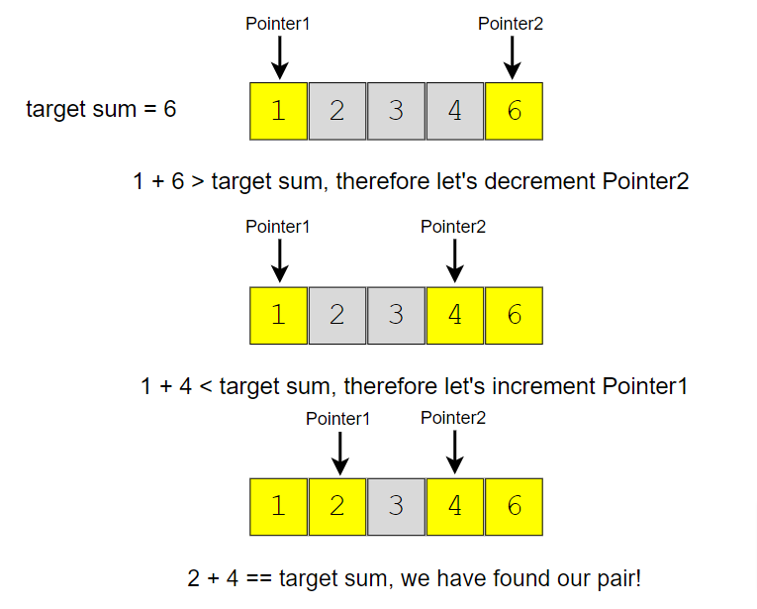
Two Pointers
Q1. Given an array of sorted numbers and a target sum, find a pair in the array whose sum is equal to the given target.
Input: {1,2,3,4,6}, target = 6
Output: [1,3]
Notes:
Brute force:
we can consider each element one by one (pointed out by the first pointer) and iterate through the remaining elements (pointed out by the second pointer) to find a pair with the given sum. The time complexity of this algorithm will be O(N^2) where ‘N’ is the number of elements in the input array.

Slide 10
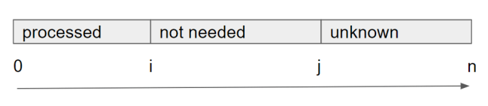
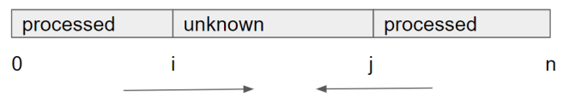
Tow Pointers
Same direction
Reverse direction

Slide 11
Tow Pointers
Reverse direction:
Range: [0, i) [i, j] (j, array.length-1]
Initialized two pointers i=0, j=array.length-1
While i <= j:
Decide what to do based on array[i] and array[j]
Move at least one of them forward in its direction

Slide 12
Tow Pointers
Q2. Write a function that reverses a string. The input string is given as an array of characters char[].
Do not allocate extra space for another array, you must do this by modifying the input array in-place with O(1) extra memory.
You may assume all the characters consist of printable ascii characters.
Example: Input: ["h","e","l","l","o"] Output: ["o","l","l","e","h"]

Slide 13
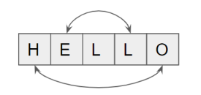
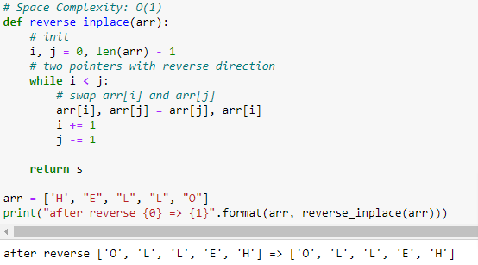
Tow Pointers
Q2.
Range: [0, i) [i, j] (j, array.length-1]
Initialized two pointers i=0, j=array.length-1
While i <= j:
Decide what to do based on array[i] and array[j]
Move at least one of them forward in its direction

Slide 14
Tow Pointers
Same direction:
Range: [0, i) [i, j) [j, array.length)
Initialized two pointers i,j usually both equal to 0
While j < array.length:
If array[j] is needed, keep assigning array[i] = array[j] and move i forward,
Move at least one of them forward in its direction

Slide 15
Tow Pointers
Q3. Given an array of sorted numbers, remove all duplicates from it. You should not use any extra space; after removing the duplicates in-place return the new length of the array.
Example: Input: [2, 3, 3, 3, 6, 9, 9] Output: 4

Slide 16
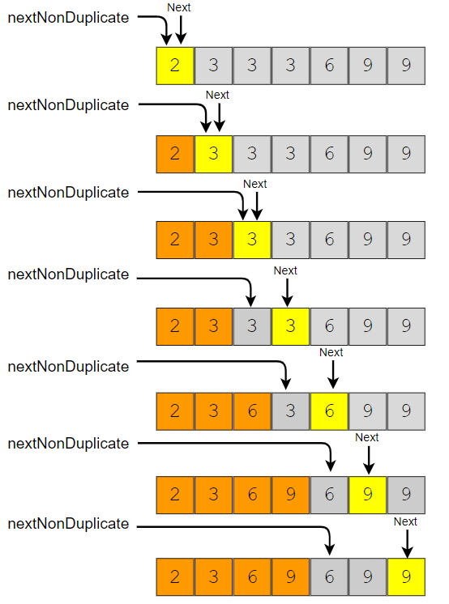
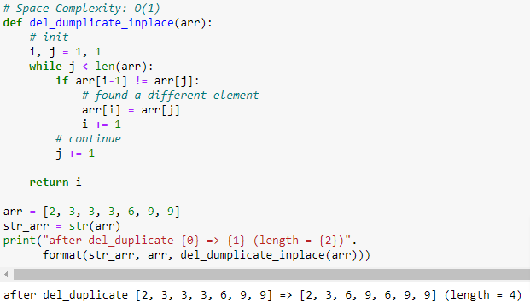
Tow Pointers
Q3.
Range: [0, i) [i, j) [j, array.length)
Initialized two pointers i,j usually both equal to 0
While j < array.length:
If array[j] is needed, keep assigning array[i] = array[j] and move i forward,
Move at least one of them forward in its direction

Slide 17
Two Pointers
Q4. Given an array nums, write a function to move all 0's to the end of it while maintaining the relative order of the non-zero elements.
Example 1 Input: [0,1,0,3,12] Output: [1,3,12,0,0]
You must do this in-place without making a copy of the array.
Minimize the total number of operations.

Slide 18
Fast & Slow Pointers
The Fast & Slow pointer approach, also known as the Hare & Tortoise algorithm, is a pointer algorithm that uses two pointers which move through the array (or sequence/LinkedList) at different speeds.

Slide 19
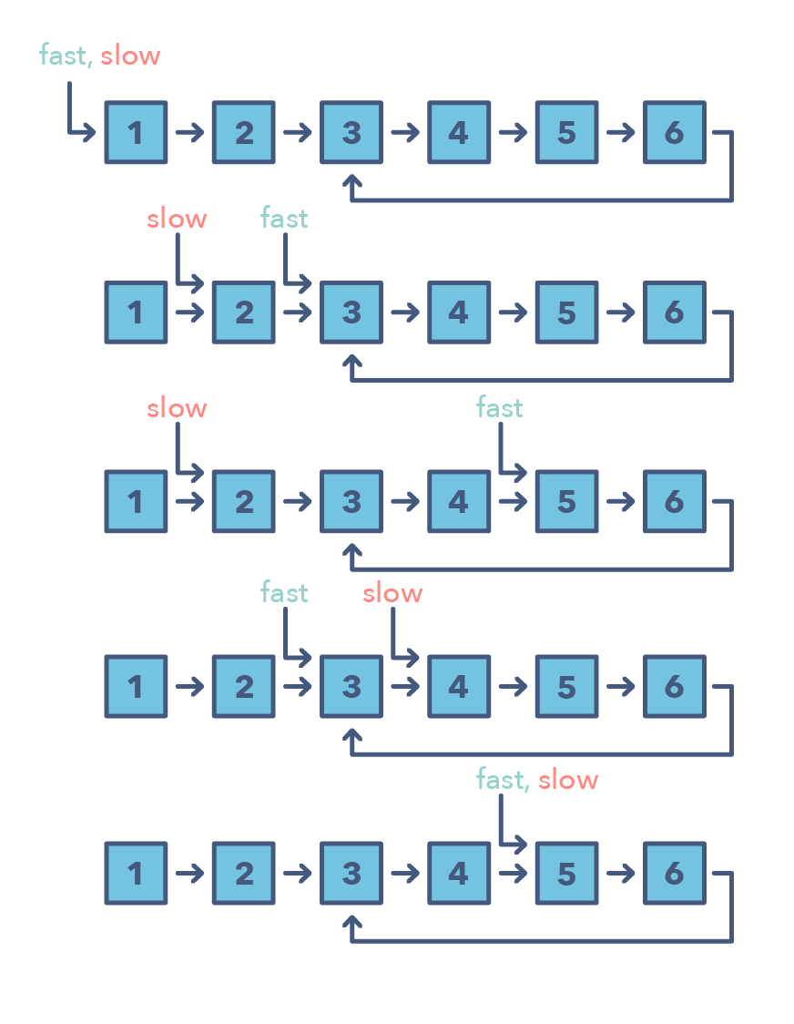
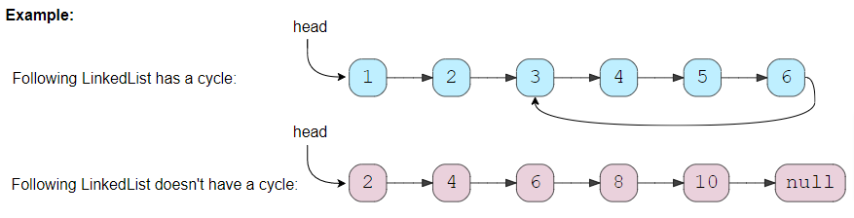
Fast & Slow Pointers
Q1. Given the head of a Singly LinkedList, write a function to determine if the LinkedList has a cycle in it or not.

Slide 20
Fast & Slow Pointers
Fast & Slow Pointers, distance btw them
Speed

Slide 21
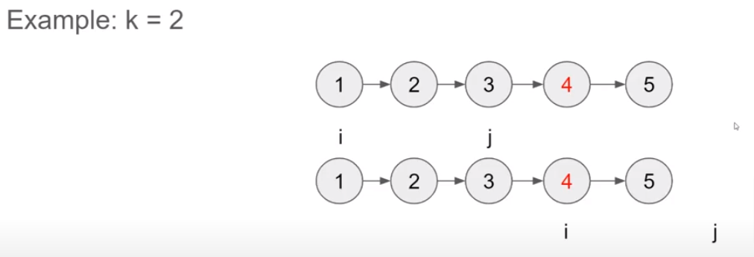
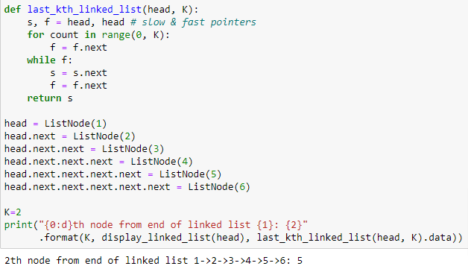
Fast & Slow Pointers
Q2. Find k'th node from the end of a linked list
Fast & Slow Pointers, distance btw them
Speed

Slide 22
Fast & Slow Pointers
Q3. Given the head of a Singly LinkedList, write a method to return the middle node of the LinkedList.
If the total number of nodes in the LinkedList is even, return the second middle node.
Example 1 Input: 1 -> 2 -> 3 -> 4 -> 5 -> null Output: 3
Example 2 Input: 1 -> 2 -> 3 -> 4 -> 5 -> 6 -> null Output: 4

Slide 23
Stack
LIFO (Last In First Out)
🚀 last state, last step, etc.
🚀 stack definition, e.g. call stack

Slide 24
Stack
Q1. Given a string s which represents an expression, evaluate this expression and return its value.
The integer division should truncate toward zero.
Example1 Input: s = “3 + 2 * 2“ Output: 7
Example2 Input: s = “3 + 5/2“ Output: 5
s consists of integers and operators ('+', '-', '*', '/') separated by some number of spaces

Slide 25
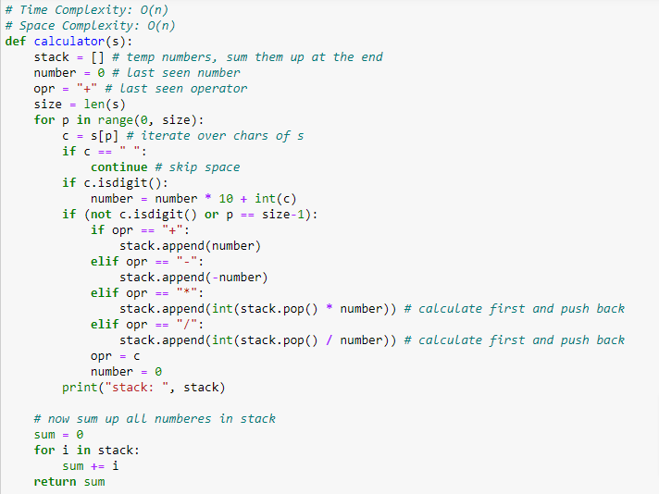
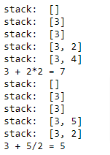
Stack
Stack: all temp results

Slide 26
Stack
Q2. Given a string s representing an expression, implement a basic calculator to evaluate it.
Example1 Input: s = "1 + 1“ Output: 2
Example2 Input: s = "(1+(4+5+2)-3)+(6+8)“ Output: 23
s consists of digits, '+', '-', '(', ')', and ' '.

Slide 27
Binary Search
As we know, whenever we are given a sorted Array or LinkedList or Matrix, and we are asked to find a certain element, the best algorithm we can use is the Binary Search.
e.g. find 3 in: [0, 1, 2, 3, 4, 5, 6, 7]

Slide 28
Binary Search
Shrink the search space every iteration (recursion)
Cannot exclude potential answers during each shrinking
# Time Complexity: O(logN)
def binary_search_contains(data_list, target):
l, r = 0, len(data_list)-1
while l <= r: # [l, r]
m = l + (r-l)//2
print("search space: [{0} - {1} - {2}]".format(l, m, r))
if (data_list[m] == target):
# found
return m
elif (data_list[m] < target):
# shrink right [m+1, r]
l = m + 1
else:
# shrink left [l, m-1]
r = m - 1
return -1
Although the basic idea of binary search is comparatively straightforward, the details can be surprisingly tricky
— Donald Knuth

Slide 29
Binary Search
Contains
First occurrence of a key
Last occurrence of a key
Least element greater than
Greatest element less than
Closest element

Slide 30
Binary Search
Further reading: Generalized Binary Search with predicates and main theorem
https://www.topcoder.com/community/competitive-programming/tutorials/binary-search

Slide 31
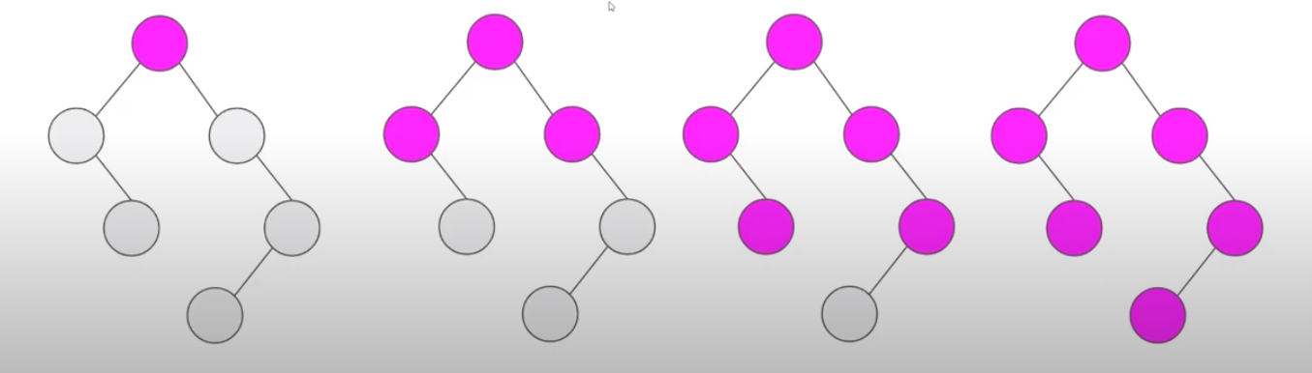
BFS
This pattern is based on the Breadth First Search (BFS) technique to traverse a tree.

Slide 32
BFS
General Steps: O(n)
Initialize Queue with all entry points
While Queue is not empty
For each node in the queue (current node)
Poll out the element (add to the result)
Expand it, offer children to the queue in order
Increase level

Slide 33
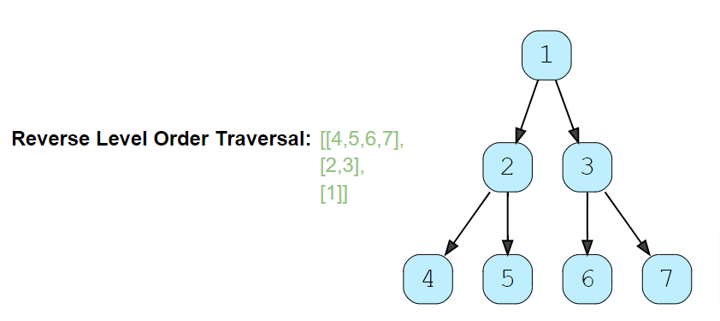
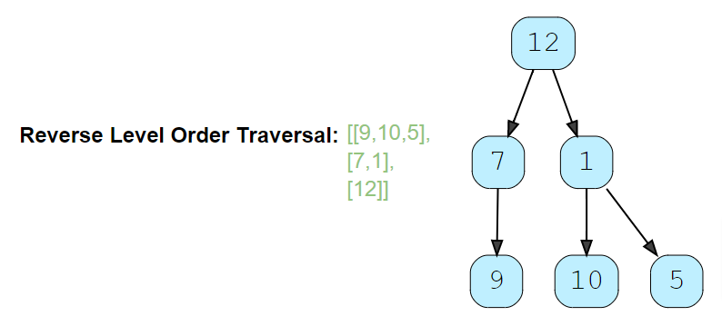
BFS
Q1. Given a binary tree, populate an array to represent its level-by-level traversal in reverse order, i.e., the lowest level comes first. You should populate the values of all nodes in each level from left to right in separate sub-arrays.

Slide 34
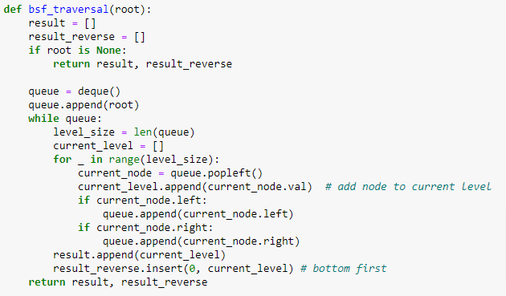
BFS
Initialize Queue with all entry points
While Queue is not empty
For each node in the queue (current node)
Poll out the element (add to the result)
Expand it, offer children to the queue in order
Increase level

Slide 35
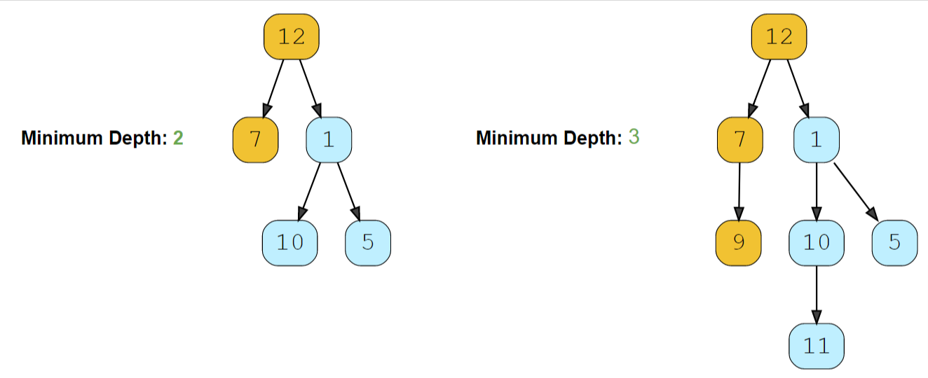
BFS
Q2. Find the minimum depth of a binary tree. The minimum depth is the number of nodes along the shortest path from the root node to the nearest leaf node.

Slide 36
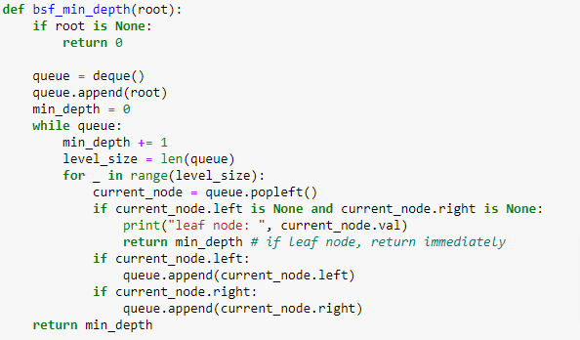
BFS
Initialize Queue with all entry points
While Queue is not empty
For each node in the queue (current node)
Poll out the element (add to the result)
Expand it, offer children to the queue in order
Increase level

Slide 37
BFS
Q3. There are a total of n courses you have to take labelled from 0 to n - 1. Some courses may have prerequisites, for example, if prerequisites[i] = [ai, bi] this means you must take the course bi before the course ai.
Given the total number of courses numCourses and a list of the prerequisite pairs, return the ordering of courses you should take to finish all courses. If there are many valid answers, return any of them. If it is impossible to finish all courses, return an empty array.
Example1. Input: numCourses = 2, prerequisites = [[1,0]] Output: [0,1]
Explanation: There are a total of 2 courses to take. To take course 1 you should have finished course 0. So the correct course order is [0,1].
Example2. Input: numCourses = 4, prerequisites = [[1,0],[2,0],[3,1],[3,2]] Output: [0,2,1,3]
Explanation: There are a total of 4 courses to take. To take course 3 you should have finished both courses 1 and 2. Both courses 1 and 2 should be taken after you finished course 0. So one correct course order is [0,1,2,3]. Another correct ordering is [0,2,1,3].

Slide 38
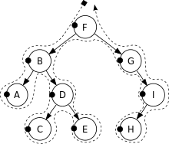
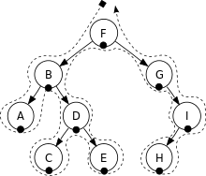

DFS
This pattern is based on the Depth First Search (DFS) technique to traverse a tree.
General Steps:
Base Case
DoSomething()
Recurse for subproblems

Slide 39
DFS
Top Down DFS
pass info as parameters from top to bottom
dfs() returns nothing
Bottom Up DFS (more popular and more difficult)
pass info from bottom (sub-problem) to top
ask for sub-problem result to generate new result in current level of recursion
dfs() returns result (for parent)

Slide 40
DFS: Top Down
General Steps:
base case
use the info from parent to generate new info
do something extra if necessary
pass down info to sub-problem (continue recursion)

Slide 41
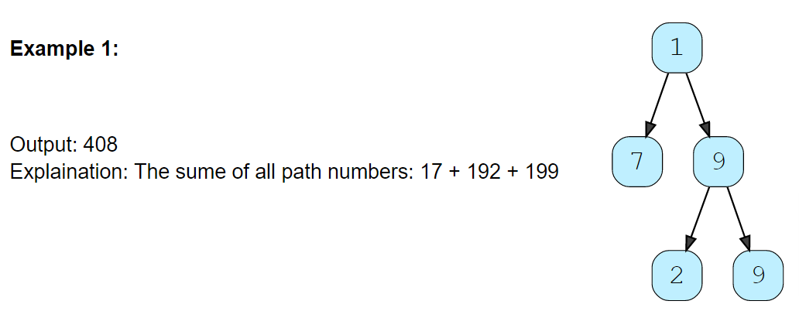
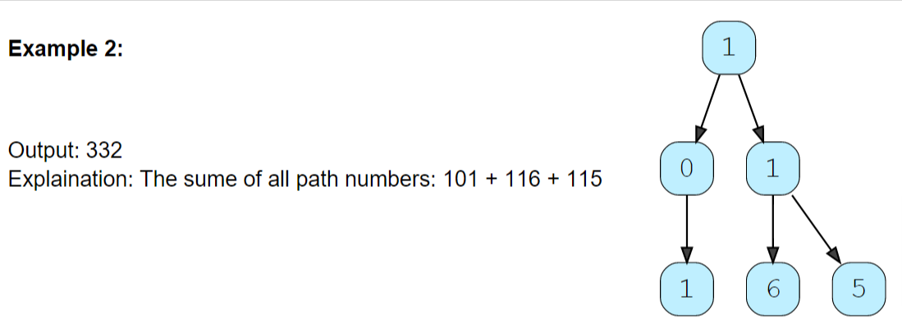
DFS: Top Down
Q1. Given a binary tree where each node can only have a digit (0-9) value, each root-to-leaf path will represent a number. Find the total sum of all the numbers represented by all paths.

Slide 42
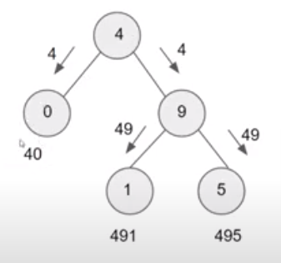
DFS: Top Down
base case (leaf) sum += num
use the info from parent to generate new info concat digits: num = num * 10 + node.val
do something extra if necessary
pass down info to sub-problem (continue recursion) dfs(child_node, num)

Slide 43
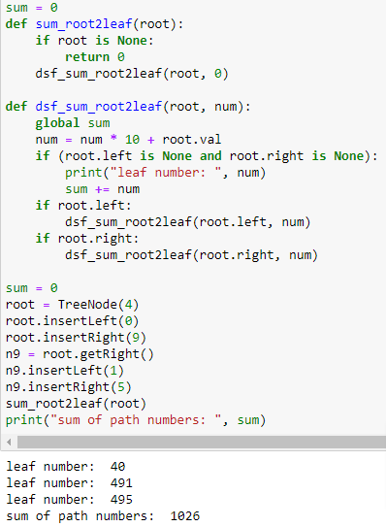
DFS: Top Down
base case (leaf) sum += num
use the info from parent to do something concat digits: num = num * 10 + node.val
do something extra if necessary
pass down result to sub-problem (continue recursion) dfs(child_node, num)

Slide 44
DFS: Bottom Up
General Steps:
base case
ask for sub-problem result
generate new result in current level of recursion (based on the reduced formula/transformation)
do something extra if necessary
return the new result

Slide 45
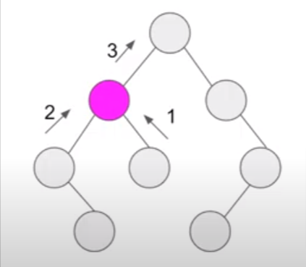
DFS: Bottom Up
Q2. Max depth of binary tree
base case
ask for sub-problem result max_depth
generate new result in current level of recursion (based on the reduced formula/transformation) max(left, right) + 1
do something extra if necessary
return the new result

Slide 46
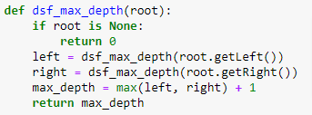
DFS: Bottom Up
base case
ask for sub-problem result max_depth
generate new result in current level of recursion (based on the reduced formula/transformation) max(left, right) + 1
do something extra if necessary
return the new result

Slide 47
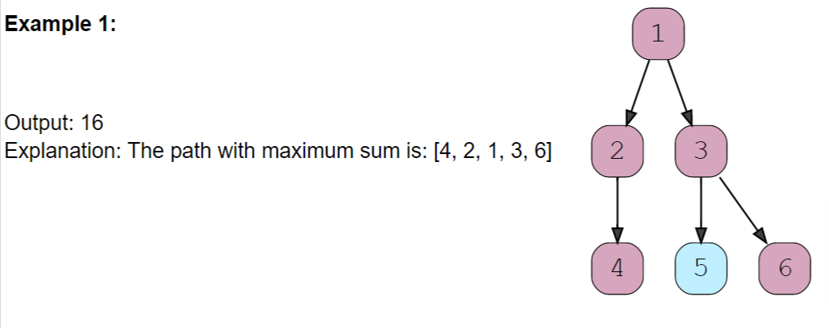
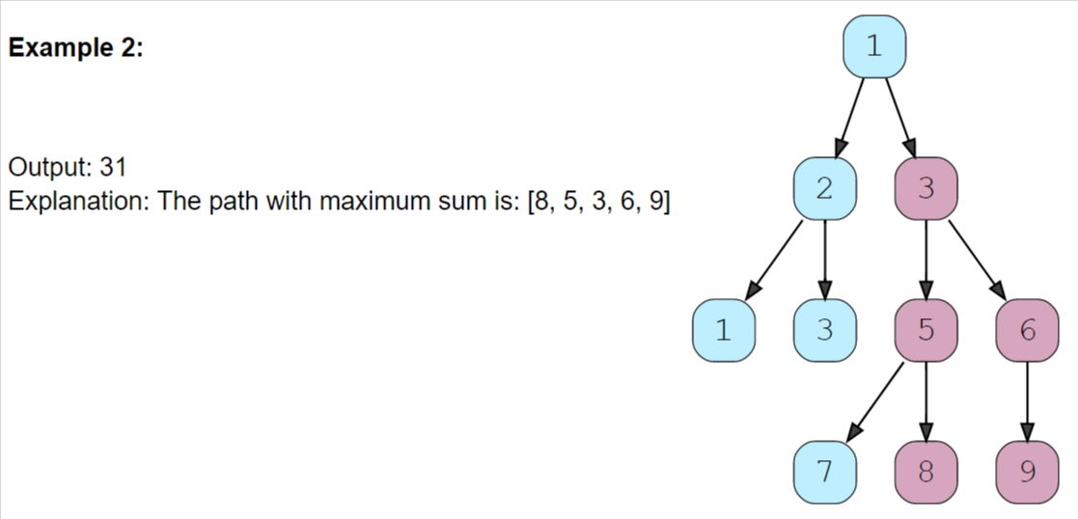
DFS: Bottom Up
Q3. Find the path with the maximum sum in a given binary tree. A path can be defined as a sequence of nodes between any two nodes and doesn’t necessarily pass through the root.

Slide 48
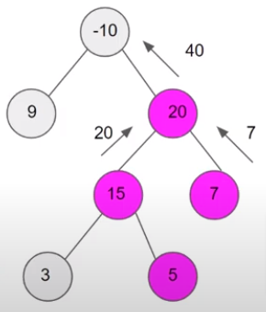
DFS: Bottom Up
base case
ask for sub-problem result max sum of root to leaf path
generate new result in current level of recursion (based on the reduced formula/transformation) max(left, right, 0) + node.val
do something extra if necessary sum = max(left, 0) + max(right, 0) + node.val
return the new result

Slide 49
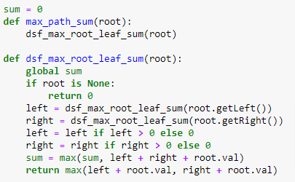
DFS: Bottom Up
base case
ask for sub-problem result max sum of root to leaf path
generate new result in current level of recursion (based on the reduced formula/transformation) max(left, right, 0) + node.val
do something extra if necessary sum = max(left, 0) + max(right, 0) + node.val
return the new result

Slide 50
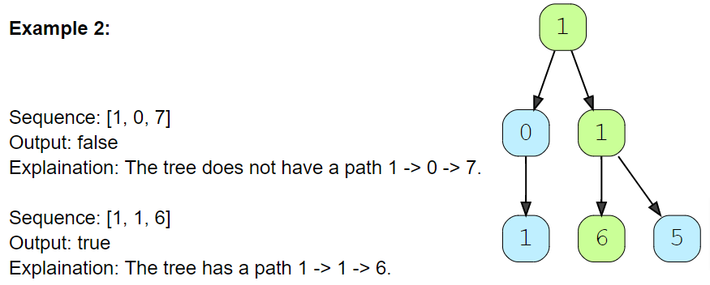
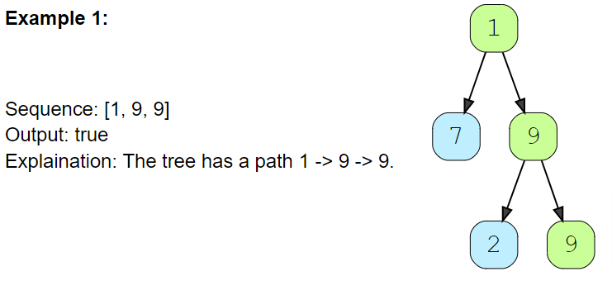
DFS
Q4: Given a binary tree and a number sequence, find if the sequence is present as a root-to-leaf path in the given tree.

Slide 51
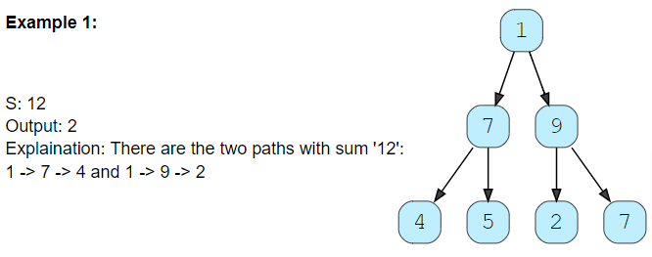
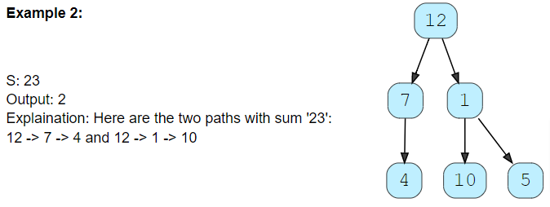
DFS
Q5: Given a binary tree and a number ‘S’, find all paths in the tree such that the sum of all the node values of each path equals ‘S’. Please note that the paths can start or end at any node but all paths must follow direction from parent to child (top to bottom).

Slide 52
Summary
Sliding Window
Two Pointers
Fast & Slow Pointers
Stack
Binary Search
BFS
DFS

Slide 53

Reference
https://hackernoon.com/14-patterns-to-ace-any-coding-interview-question-c5bb3357f6ed

