Slide 1

SPH IP Tracking
Implementation Review
ZHONG LUN (lunz@microsoft.com)
Feb 11, 2009

Slide 2
Agenda
architecture
crawler configuration
pipeline configuration
stages

Slide 3
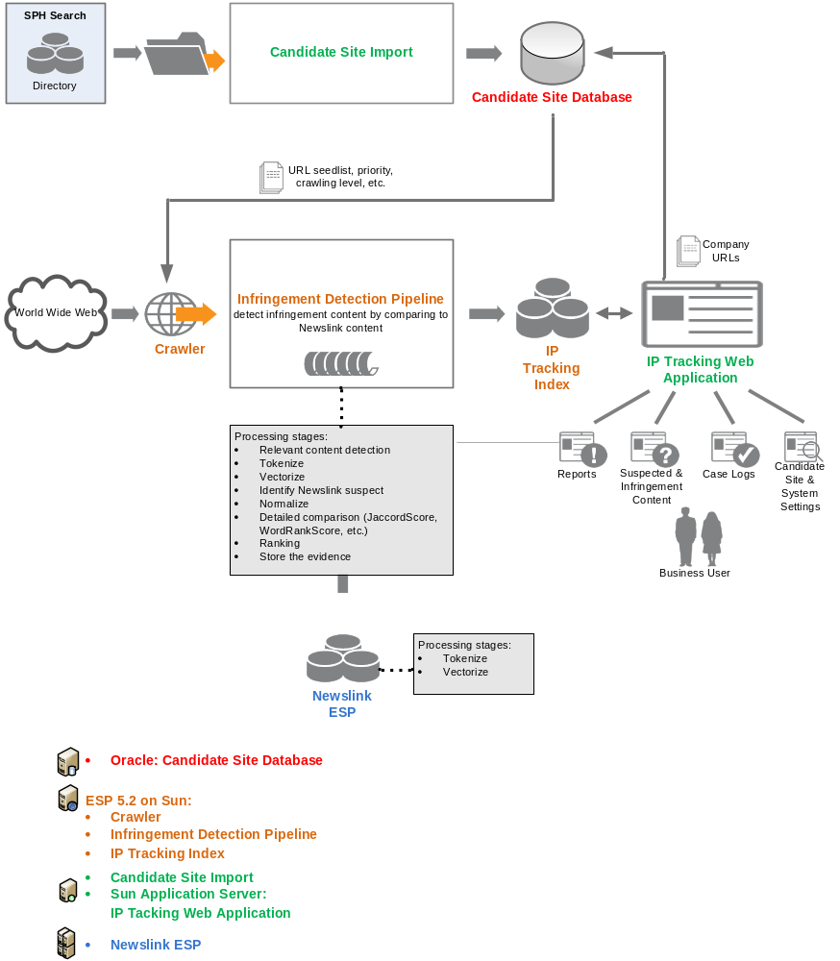
Architecture

Slide 4
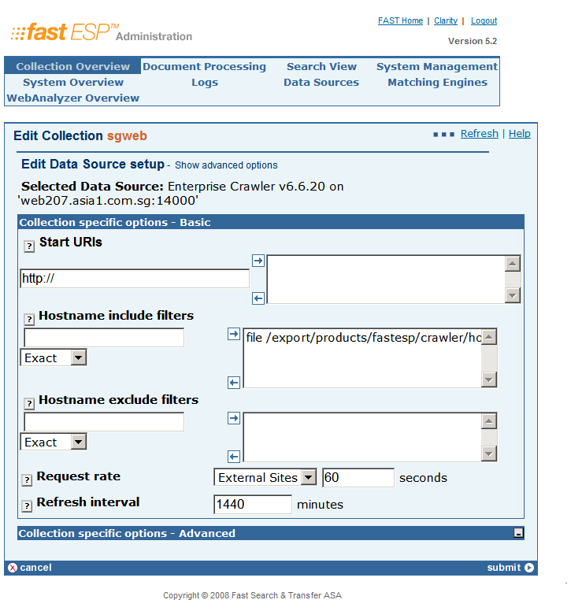
Crawler: Admin GUI
collections >>> edit >>> edit data source >>> configure crawler:

Slide 5
Crawler: XML Configuration (1)
<section name="crawlmode">
<attrib name="fwdlinks" type="boolean"> yes </attrib>
<attrib name="fwdredirects" type="boolean"> yes </attrib>
<attrib name="mode" type="string"> FULL </attrib>
<attrib name="reset_level" type="boolean"> no </attrib>
</section>
<attrib name="allowed_types" type="list-string">
<member> text/html </member>
<member> text/plain </member>
</attrib>
<attrib name="use_javascript" type="boolean"> yes </attrib>
<attrib name="robots" type="boolean"> yes </attrib>
<attrib name="robots_auth_ignore" type="boolean"> yes </attrib>
<attrib name="robots_timeout" type="integer"> 300 </attrib>
<attrib name="robots_tout_ignore" type="boolean"> no </attrib>
<attrib name="robots_ttl" type="integer"> 86400 </attrib>
<attrib name="obey_robots_delay" type="boolean"> no </attrib>

Slide 6
Crawler: XML Configuration (2)
<!-- SPH: priority -->
<section name="workqueue_priority ">
<attrib name="default" type="integer"> 2 </attrib>
<!-- Define a work queue with 3 priority levels -->
<attrib name="levels" type="integer"> 3 </attrib>
<attrib name="start_uri_pri" type="integer"> 2 </attrib>
<section name="1">
<attrib name="share" type="integer"> 10 </attrib>
<!-- These include rules defines the URIs that should enter the HIGHT priority level -->
<section name="include_domains">
<attrib name="suffix" type="list-string">
<member> 1.crawl-me-first.com </member>
<member> 2.crawl-me-first.com </member>
</attrib>
</section>
</section>
<section name="2">
<attrib name="share" type="integer"> 10 </attrib>
<!-- These include rules defines the URIs that should enter the LOW priority level -->
<section name="include_domains">
<attrib name="suffix" type="list-string">
<member> 1.crawl-me-last.com </member>
<member> 2.crawl-me-last.com </member>
</attrib>
</section>
</section>
</section>

Slide 7
Crawler: XML Configuration (3)
<!-- SPH: hostname include filter -->
<section name="include_domains">
<attrib name="file" type="list-string">
<member> /export/products/fastesp/crawler/hostname_include.txt </member>
</attrib>
</section>
<!-- SPH: uri include filter -->
<section name="include_uris">
<attrib name="file" type="list-string">
<member> /export/products/fastesp/crawler/uri_include.txt </member>
</attrib>
</section>
<!-- SPH: seed list -->
<attrib name="start_uri_files" type="list-string">
<member> /export/products/fastesp/crawler/seedlist.txt </member>
</attrib>

Slide 8
Crawler: external files
Seed List:
http://www.company1.com
http://www.company2.com
http://www.singnet.com.sg/company1
Hostname Include: [suffix|prefix|exact|regexp]:[value]
suffix:.company1.com
suffix:.company2.com
URI Include: [suffix|prefix|exact|regexp]:[value]
prefix:http://www.singnet.com.sg/company1
prefix:http://www.singnet.com.sg/company2

Slide 9
crawleradmin
Show help information:
$ crawleradmin –h
Show status:
$ crawleradmin –status
Show statistics:
$ crawleradmin –q <CollectionName>
Suspend & Resume:
$ crawleradmin –suspendcollection <CollectionName>
$ crawleradmin –resumecollection <CollectionName>
Re-crawl:
$ crawleradmin –refetch <CollectionName>
Refeed downloaded web pages & Reindex:
$ nctrl stop crawler
$ postprocess –I master –R <CollectionName>

Slide 10
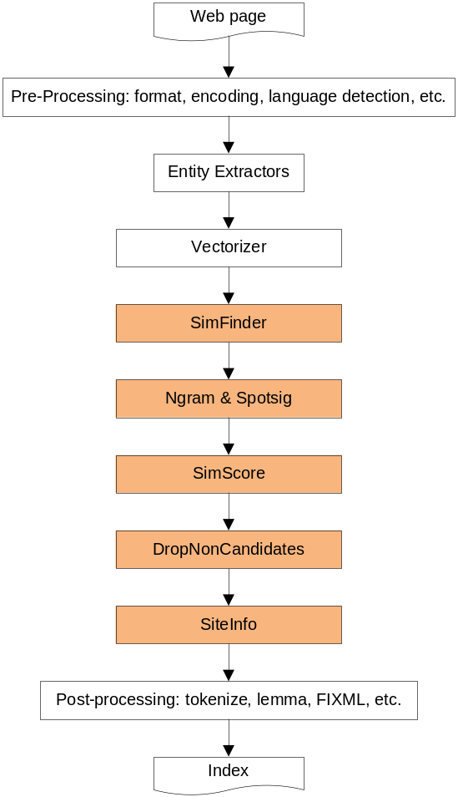
Pipeline

Slide 11
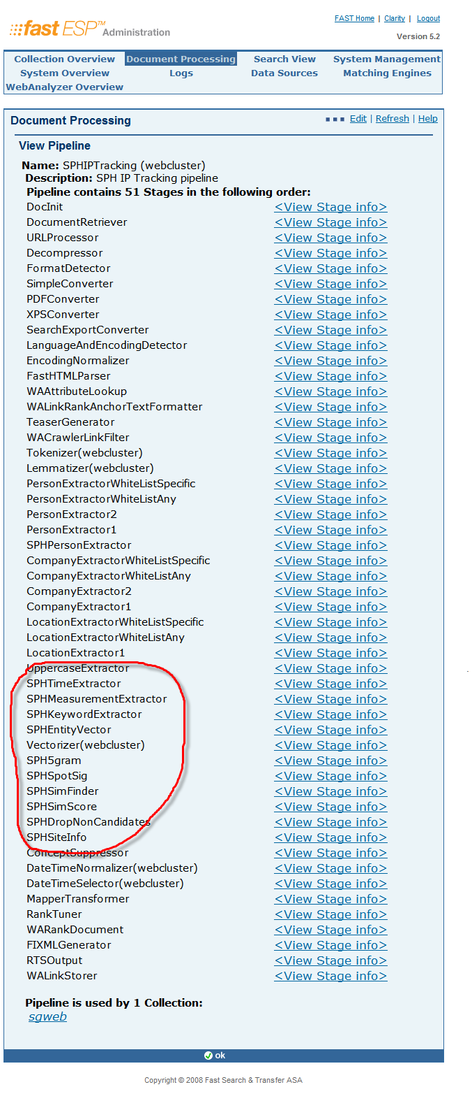
Pipeline: SPHIPTracking
Notes:
Domain-specific Corpora: gen analysis in biology

Slide 12
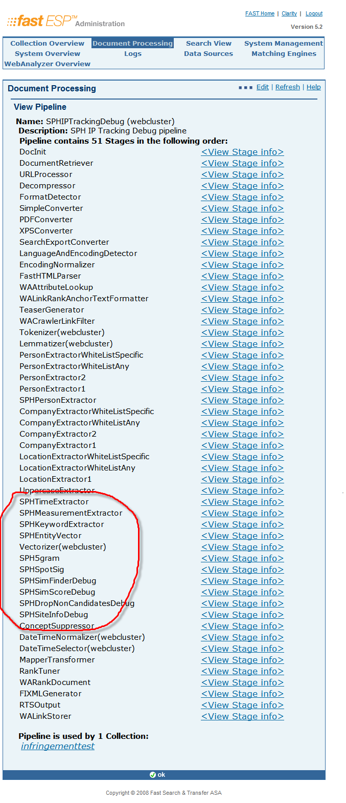
Pipeline: SPHIPTrackingDebug

Slide 13
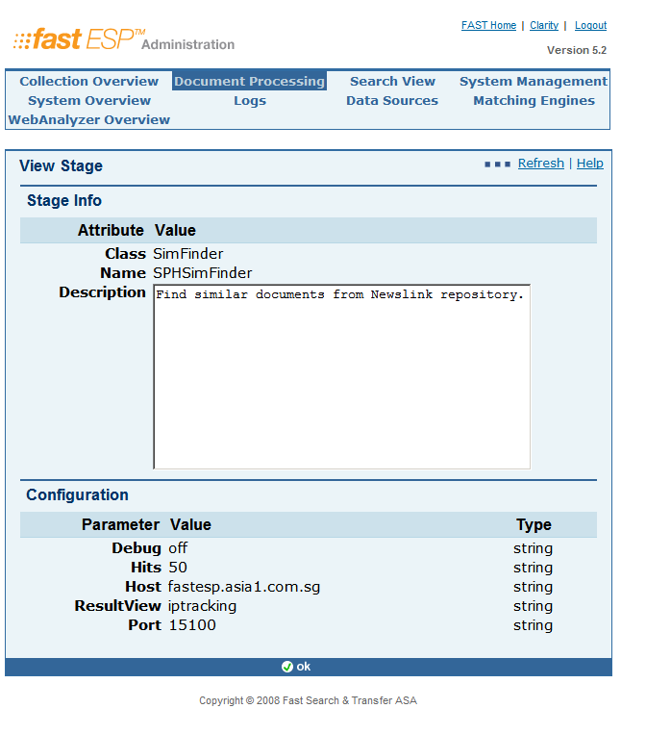
Stage: SPHSimFinder

Slide 14
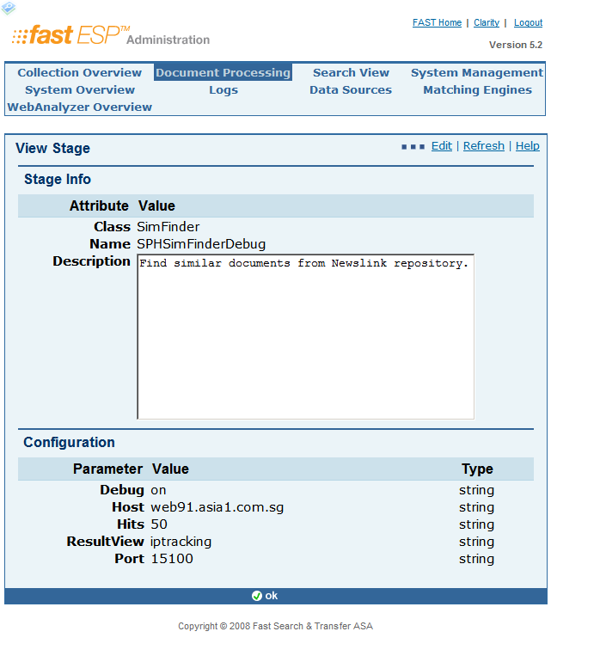
Stage: SPHSimFinderDebug

Slide 15
Stage: SimFinder Source
HTTP Get/Post
# final url
# HTTP Get
similarUrl = baseUrl + '?' + similarParams
similarQuery = urllib2.Request(similarUrl)
# HTTP Post
# similarUrl = baseUrl
# similarQuery = urllib2.Request(similarUrl, similarParams)
Query without date range:
urlParams['query'] = 'and(string("'+ titleString + ' ' + keywordString + ' ' + personnameString + ' ' + companyString + ' ' + locationString + ' ' + newspaperString + ' ' + uppercaseString + ' ' + measurementString + '",mode="simpleany"), filter(meta.collection:article), filter(language:en))'

Slide 16
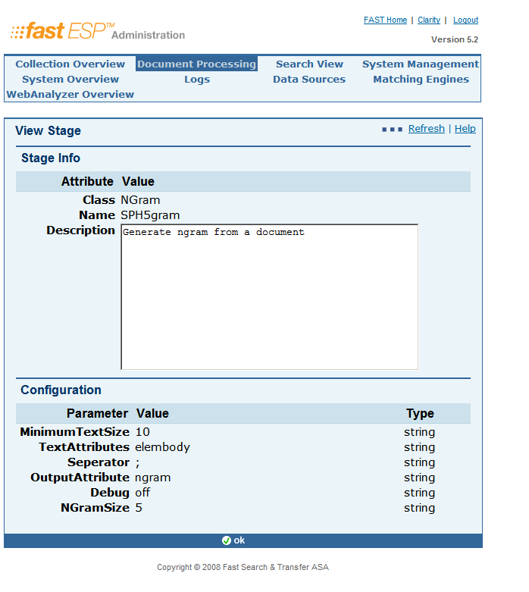
Stage: SPH5Gram
5gram:
singapore property real estate property;property real estate property in;real estate property in singapore; ……

Slide 17
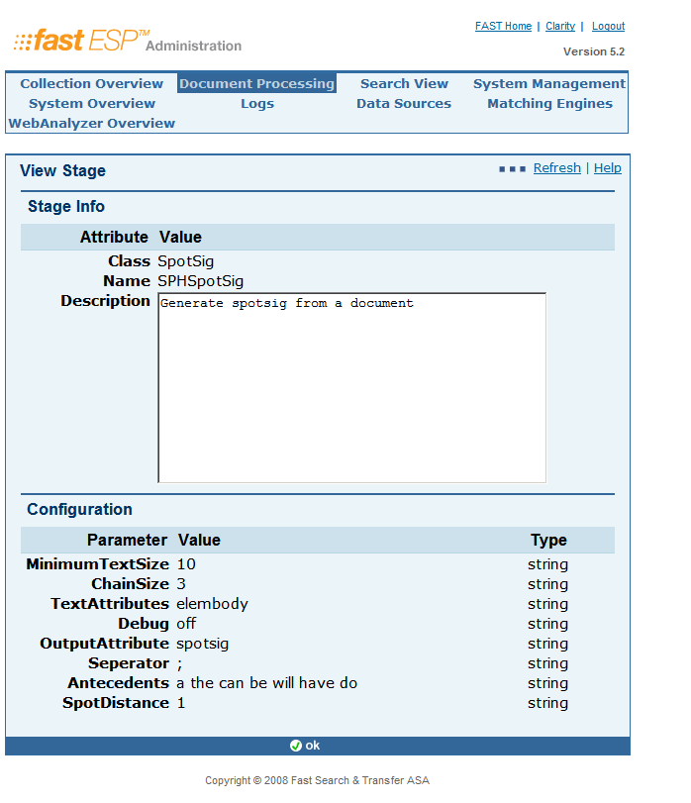
Stage: SPHSpotsig
Spotsig:
the straits times;the housing board;the long awaited;the initiative designed;the 2007 national; ……

Slide 18
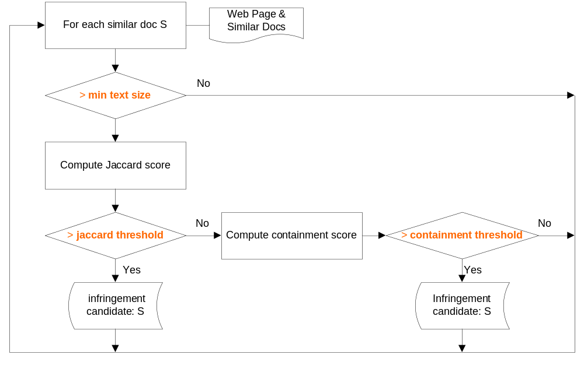
Stage: SimScore

Slide 19
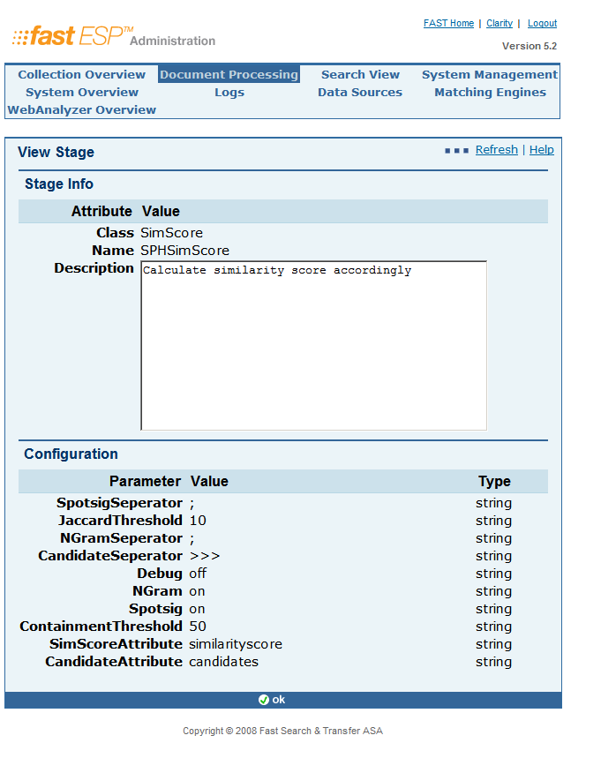
Stage: SPHSimScore

Slide 20
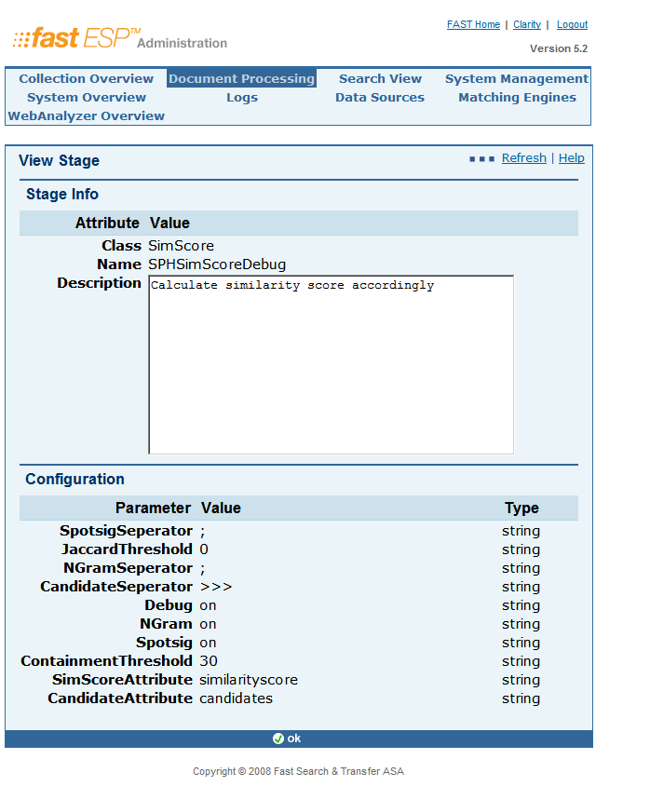
Stage: SPHSimScoreDebug
Notes:
Naraynan is VP at Google now.
5 is chosen by Google (5-gram of all webs is public available from Google) so I guess Google is using 5-gram to detect duplicated web pages.
We can compress the shingles by hashing.

Slide 21
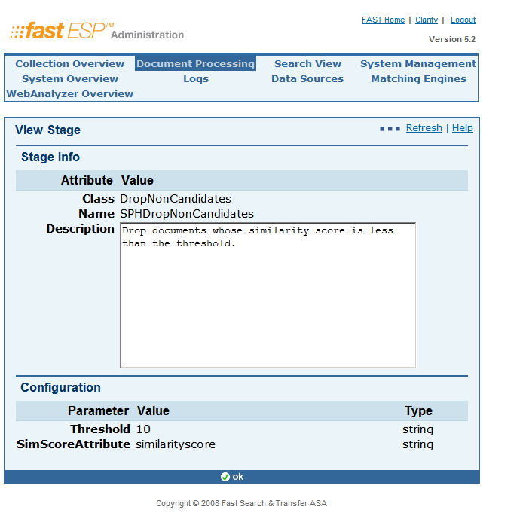
Stage: SPHDropNonCandidates

Slide 22
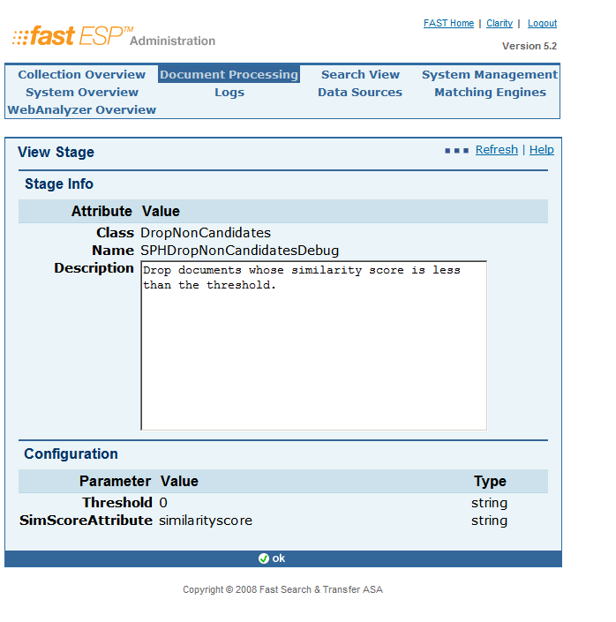
Stage: SPHDropNonCandidatesDebug

Slide 23
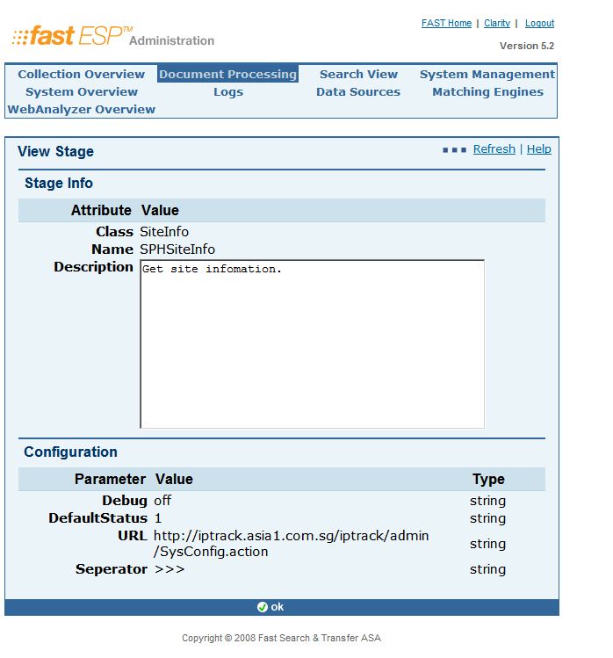
Stage: SPHSiteInfo

Slide 24
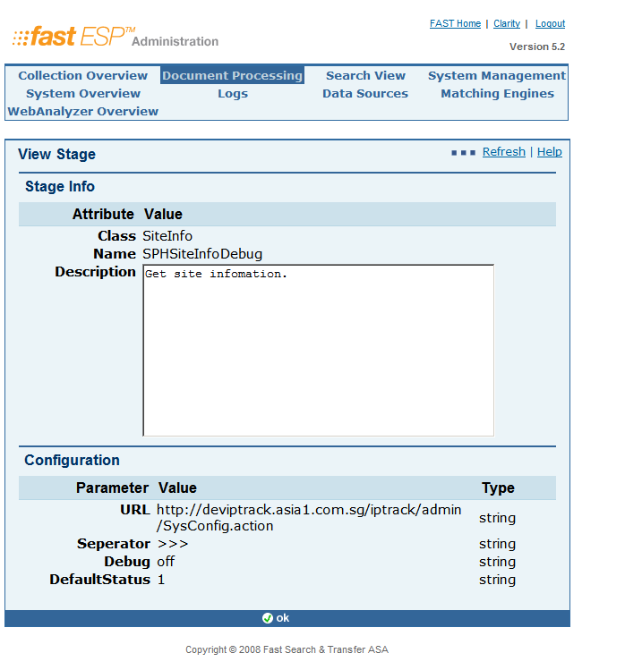
Stage: SPHSiteInfoDebug

Slide 25

Q&A.

Slide 26

ZHONG LUN
lunz@microsoft.com

