Slide 1
SPH IP Tracking
A Copy Content Detection Solution for Web
ZHONG LUN (lunz@microsoft.com)
Nov 30, 2008

Slide 2

Similarity: what is Similarity?
It is hard: while you may say A is similar to C, but
  A, B, C has the same size
  B and D has the same colour
A quantitative way to defining that two objects are similar is to use a similarity function. The similarity function measures degree of similarity between two objects and will return a value in [0, 1].

Slide 3
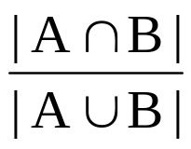
Similarity: Jaccard
The Jaccard coefficient measures similarity between sample sets, and is defined as the size of the intersection divided by the size of the union of the sample sets:
Jaccard(A, B) =
Example:
Apple = (1,1,1,1)
Banana = (0,0,1,0)
Jaccard(Apple, Banana) = ¼ = 0.25 Similarity is 25%
Fruit | Sphere Shape | Sweet | Sour | Crunch
Apple | Yes | Yes | Yes | Yes
Banana | No | No | Yes | No

Slide 4
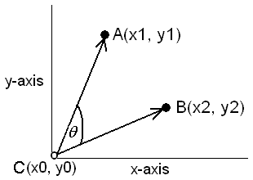
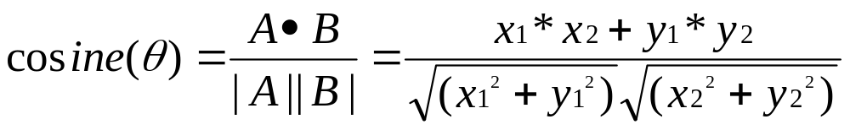
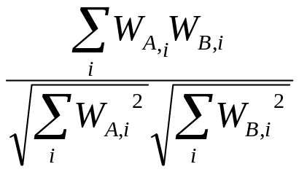




Similarity: Cosine
Cosine(A, B) =
w(term weight) reflects how import the term in the documents, which could be defined as:
Notes:
We can calculate the ranking score based on Cosine(query, doc).
If weights are defined as mere term counts (w = TF) then point coordinates are given by term frequencies; however, we don't have to define term weights in this manner. As a matter of fact, and as previously mentioned, most commercial search engines do not define term weights in this way.
ESP has more complicated definition.

Slide 5
Similarity: Cosine (cont.)
Example:
T1 T2 T3 T4 T5 T6 T7 T8 T9 T10
A = 3 2 0 5 0 0 0 2 0 0
B = 1 0 0 0 0 0 0 1 0 2
A • B = 3*1 + 2*0 + 0*0 + 5*0 + 0*0 + 0*0 + 0*0 + 2*1 + 0*0 + 0*2 = 5
|A| = (3*3+2*2+0*0+5*5+0*0+0*0+0*0+2*2+0*0+0*0)^{0.5} = (42) ^{0.5} = 6.481
|B| = (1*1+0*0+0*0+0*0+0*0+0*0+0*0+1*1+0*0+2*2) ^{0.5} = (6) ^{0.5} = 2.245
Cosine(A,B) = 0.3150
Similarity 31.50%

Slide 6
Similarity: schemes and algorithms
Shingling: (Andrei Broder) convert document into sets
Minhashing: (Edith Cohen, Broder) construct small signatures for sets so Jaccard similarity of sets can be determined from the signatures.
Locality-Sensitive Hashing: (Rajeev Motwani, Piotr Indyk) focus on (likely) similar pairs without looking at all pairs.
Fingerprint
……

Slide 7
Similarity: big picture
Min-
hashing
Locality-
sensitive
Hashing
Candidate pairs:
those pairs of signatures that we need to test for similarity.
Shingling
Doc
The set of strings
of length k that appear in the document
Signatures:
short integer vectors that
represent the
sets and
reflect their
similarity

Slide 8
Similarity: big picture (cont.)
Extract
minutiae
and
discretize
Locality-
sensitive
Hashing
Candidate pairs:
those pairs of fingerprints that we need to test for similarity.
Fingerprint
Optional
minhashing
here

Slide 9
Similarity: market survey
Reference:
G.S.Manku, A.Jain, A.D.Sarma. Detecting Near-Duplicates for Web Crawling. WWW 2007
“Jaccard & Cosine simple yet as effective as other complicated algorithms”
Notes:
To my understanding, most of the algorithms is trying to tackle the scalability and implementation cost issue – not the quality of similarity.

Slide 10
Similarity: nature of corpus
Documents on Web: HTML page, image, multimedia (music, video, flash, etc.), ……
Files in File System
Emails
Domain-specific Corpora
……
Notes:
Domain-specific Corpora: gen analysis in biology

Slide 11
Similarity: the goal
Clustering for “related documents”: “semantic” rather than “syntactic”
Plagiarism: to identify pairs of documents that seem to have borrowed from each other significantly.
Information extraction, collaborative filtering
www.imdb.com: new movie category
www.amazon.com: recommend products
Spam detection
Near-duplicates in domain-specific corpora

Slide 12
Similarity: watermarking vs. content-based
“Active”: Watermarking
“Passive”: Content-based

Slide 13
Similarity: syntactic vs. semantic
Syntactic
Semantic

Slide 14
Similarity: challenges
Resiliency: precisely detect the similarity between modified and original
  Similarity level: section, chapter, paragraph, …
  Modification: insert/delete something
  Format: i.e. text => PDF or PDF => text
  “web noise”: header, footer, navigation, ads, javascript, …
Accuracy
  false positive error: fail to detect the similar pair
  false negative error: fail to detect the non-similar pair
Scalability
Implementation Cost
Notes:
False Positive error: miss some suspected documents
False Negative error: report too many suspected documents

Slide 15
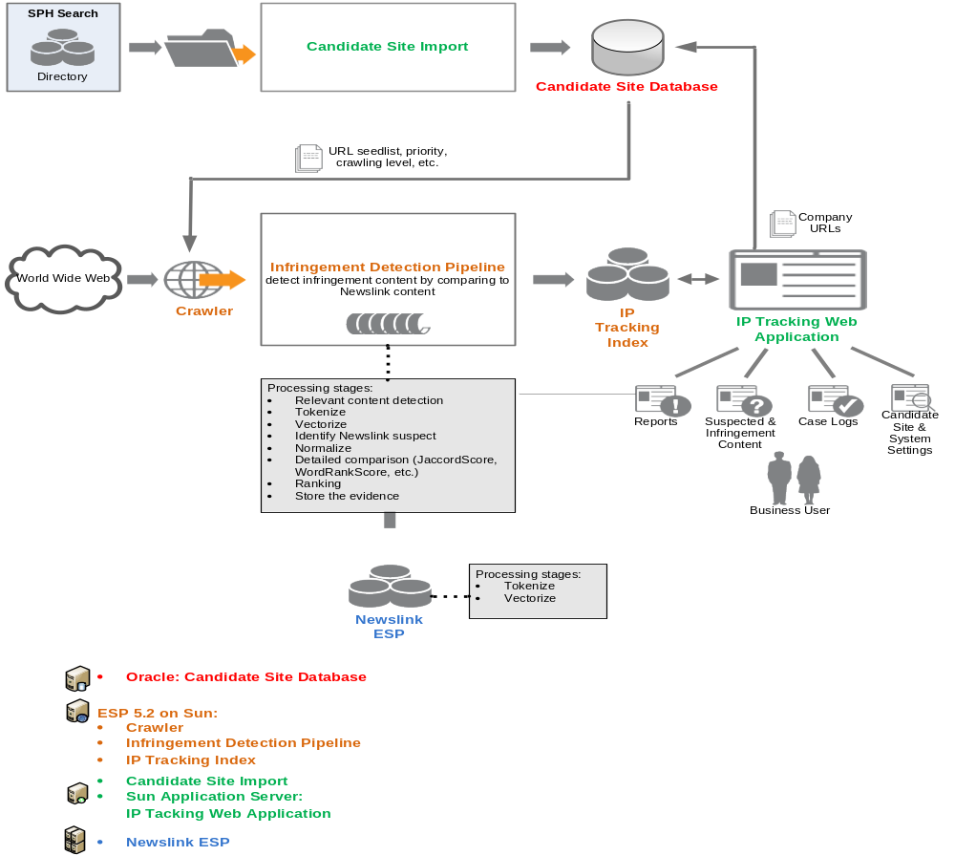

Solution: architecture

Slide 16
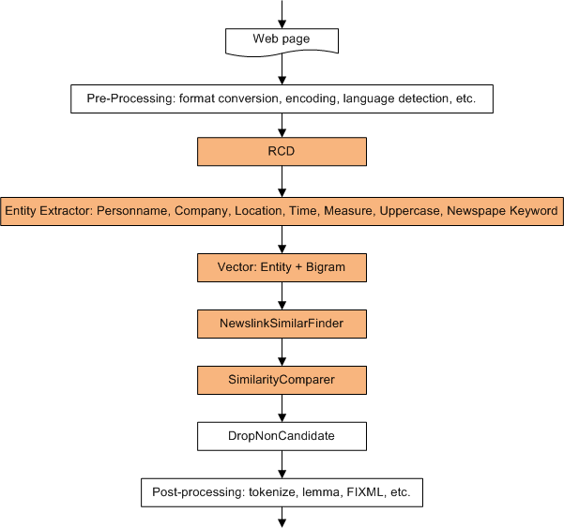
Solution: document processing

Slide 17
Solution: Relevant Content Detection
Problem: web pages from various segments generally contain advertisement, navigational menus, logos, headers, footers and other elements that can improve user navigation, but has no relation to the page's actual content (these content is called Template).
Obtain text from raw html is not as easy as it sounds !

Slide 18
Solution: Relevant Content Detection (cont.)
Solution:
Deepayan Chakrabarti, Ravi Kumar, and Kunal Punera. Page-level template detection via isotonic smoothing. In WWW '07: Proceedings of the 16th international conference on World Wide Web, pages 61--70, New York, NY, USA, 2007. ACM Press.
Deng Cai, Shipeng Yu, Ji-Rong Wen, and Wei-Ying Ma. Vips: a vision-based page segmentation algorithm. Technical Report MSR-TR-2003-79, 2003.
Sandip Debnath, Prasenjit Mitra, and C. Lee Giles. Automatic extraction of informative blocks from webpages. In SAC '05: Proceedings of the 2005 ACM symposium on Applied computing, pages 17221726, New York, NY, USA, 2005. ACM Press.
David Gibson, Kunal Punera, and Andrew Tomkins. The volume and evolution of web page templates. In WWW '05: Special interest tracks and posters of the 14th international conference on World Wide Web, pages 830839, New York, NY, USA, 2005. ACM Press.
Shian-Hua Lin and Jan-Ming Ho. Discovering informative content blocks from web documents. In KDD '02: Proceedings of the eighth ACM SIGKDD international conference on Knowledge discovery and data mining, pages 588593, New York, NY, USA, 2002. ACM Press.
Karane Vieira, Altigran S. da Silva, Nick Pinto, Edleno S.de Moura, ao M. B. Cavalcanti Jo and Juliana Freire. A fast and robust method for web page template detection and removal. In CIKM '06: Proceedings of the 15th ACM international conference on Information and knowledge management, pages 258267, New York, NY, USA, 2006. ACM Press.
Lan Yi, Bing Liu, and Xiaoli Li. Eliminating noisy information in web pages for data mining. In KDD '03: Proceedings of the ninth ACM SIGKDD international conference on Knowledge discovery and data mining, pages 296305, New York, NY, USA, 2003. ACM Press.
Notes:
In short the solution is to use DOM & STAM in order to detect the template pattern.
Not our focus, refer the papers in solution.

Slide 19
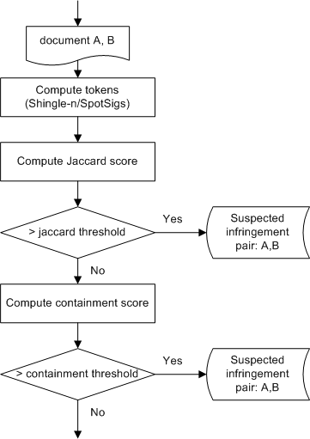
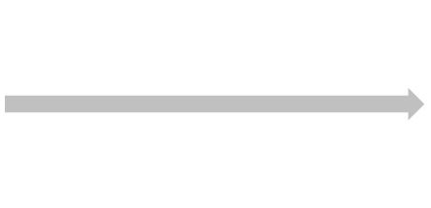
Solution: SimilarityComparer
5-gram
SpotSigs

Slide 20
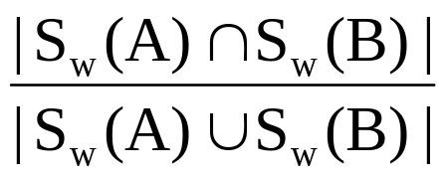
Solution: Shingling
Shingle: a contiguous subsequence contained in document D.
w-shingling Sw(D): set of all unique shingles of size w contained in D.
D=(a, car, has, four, wheels, a, car, has, four, wheels)
5-gram/shingle-5 (w=5) : S5(D)={(a car has four wheels), (car has four wheels a), (has four wheels a car), (four wheels a car has), (wheels a car has)}
Sim(A, B) =
Notes:
We are using Jaccard coefficient and do not consider term weight or TF.

Slide 21
Solution: 5-gram
Assumption: Documents that have lots of shingles in common have similar text, even if the text appears in different order.
Careful: We must pick w large enough, or most documents will have most shingles; w = 5 is OK for short documents; w = 10 is better for long documents.
5-gram yields best result comparing to 3-gram, 4-gram and other schemes:
Naraynan Shivakumar. DETECTING DIGITAL COPYRIGHT VIOLATIONS ON THE INTERNET. August, 1999 http://infolab.stanford.edu/~shiva/thesis.html
Notes:
Naraynan is VP at Google now.
5 is chosen by Google (5-gram of all webs is public available from Google) so I guess Google is using 5-gram to detect duplicated web pages.
We can compress the shingles by hashing.

Slide 22
Solution: SpotSigs
antecedents: anchor words that are typically chosen to be frequently within the corpus, i.e. the, a, is, do, have, etc.
A spot signature of a location in a document simply consists of a chain of words that follow an antecedent word ai at a fixed spot distance di, i.e. ai(di, ci) to denote a spot signature that is computed by finding a contiguous spot chain of ci words followed by ai, each of which is not itself stop word.
SpotSigs(D) = {ai(di, ci)} is called a spot set or spot signatures for the document. Spot set can contain multiple type spot signature, i.e. SpotSigs(D)={is(3,1), that(5,2), is(2,1)}
Sim(A, B) = Jaccard(SpotSigs(A), SpotSigs(B))

Slide 23
Solution: SpotSigs (cont.)
Consider the text snippet:
“At a rally to kick off a weeklong campaign for the South Carolina primary, Obama tried to set the record straight from an attack circulating widely on the Internet that is designed to play into prejudices against Muslims and fears of terrorism.”
for antecedents {a, the, an, is}, uniform spot distance d=1, chain length c=2
→ SpotSigs = {
a:rally:kick, a:weeklong:campain,
the:south:carolina, the:record:straight, the:internet:designed,
an:attack:circulating,
is:designed:play}
Notes:
Similar to shingling but “smarter”

Slide 24
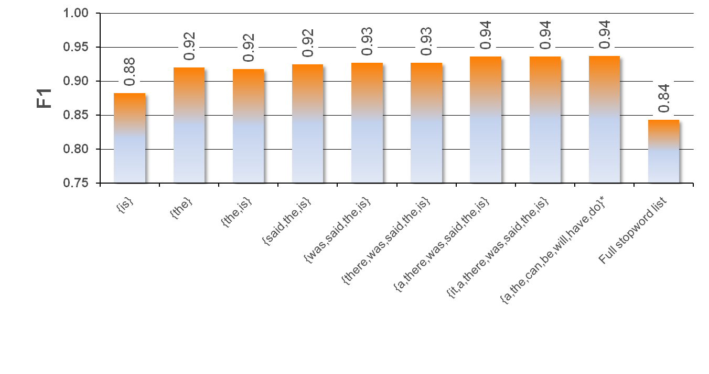

Solution: SpotSigs (cont.)
“best choice”
antecedents (ai): {a, the, can, be, will, have, do}
chain length (ci): 3
spot distance (di): 2

Slide 25
Solution: SpotSigs (cont.)
Advantages:
  self-exclude web noise
  Hardly occur in navigational web page components or ads
  efficient yet very simple
  Spot Signatures occur uniformly and frequently throughout any piece of natural-language text
Reference:
M.Theobald, J.Siddharth, A.Paepcke. SpotSigs: Robust and Efficient Near Duplicate Detection in Large Web Collections. SIGIR 2008 http://ilpubs.stanford.edu:8090/860/

Slide 26
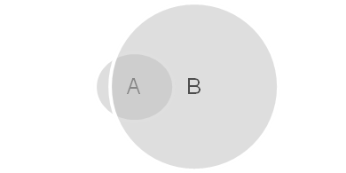
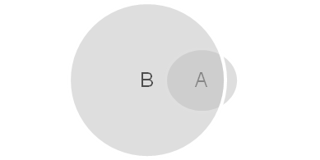
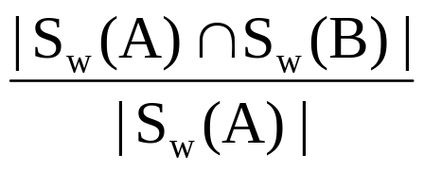

Solution: subset
Jaccard score very low in the case below:
Define the containment of A in B:
Con(A, B) =
When , Con(A, B) → 1
So we choose max(Con(A, B), Con(B,A)) as containment score
Notes:
If containment score is very high, we will consider it as similarity score.
But containment threshold we have to define, so far, there is no published report on this.

Slide 27
Solution: NewslinkSimilarFinder
Purpose: to narrow down the no. of documents for comparing and make sure they are highly similar.
This is achieved by:
  high quality vector
  minimum rank score
  maximum no. of return documents

Slide 28
Solution：NewslinkSimilarFinder (cont.)
Document Vector: a set of (string, weight) pairs.
Find Similar = Find Documents with Similar Vector
IP Tracking Vector: Bigram + Entity
Entity - given more weight:
  personname
  company
  location
  time
  numeric
  uppercase
  newspaper Keyword: Zaobao, Straits Times, My Paper, etc.
Notes:
This technique is used by a Korea POC – to detect duplicated news from different web sites.

Slide 29

Q&A.

Slide 30
ZHONG LUN
lunz@microsoft.com

