Slide 2
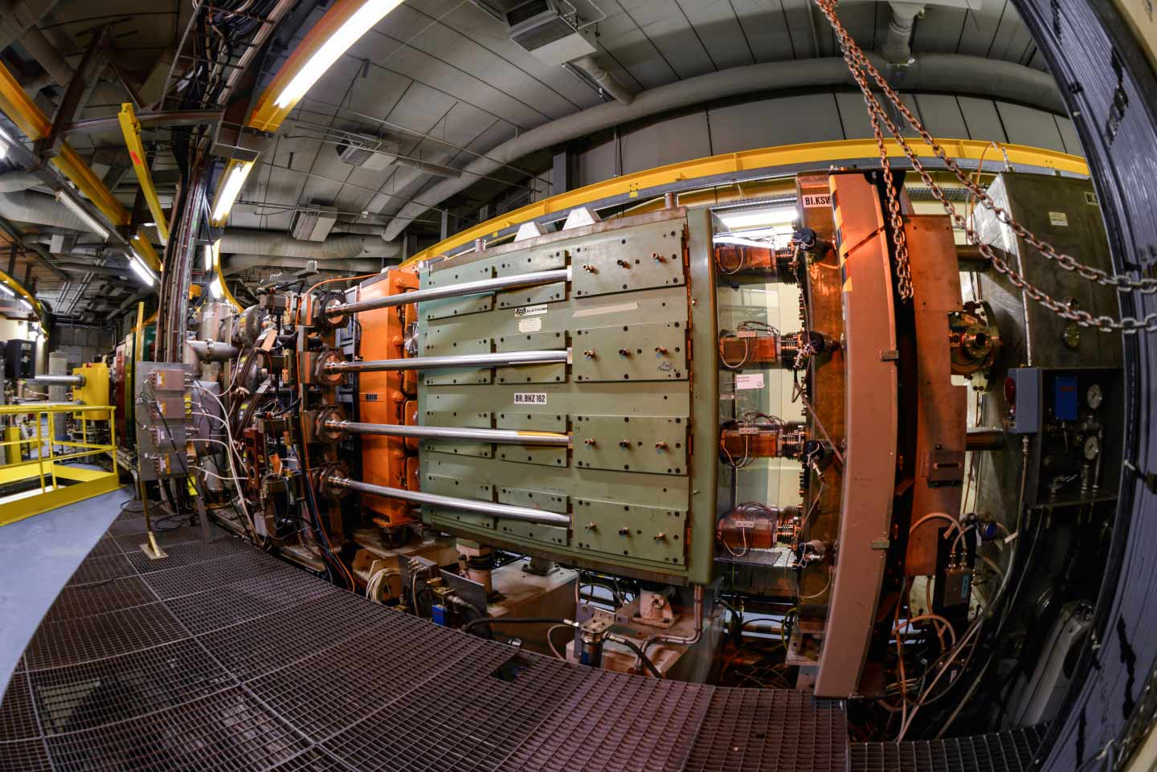
Introduction to the Proton Synchrotron Booster (PSB) Accelerator, beams & measurements
Foteini Asvesta & Tirsi Prebibaj
12-16/05/2025
Advanced Training School on Operation of Accelerators – ATSOA2025
EURO-LABS @ CERN

Slide 3
Outline
CERN injectors complex & facilities
PSB layout
Beam delivery – supercycles
Beam instrumentation
Beam dynamics
Data acquisition
Measurements for today
Space charge & resonances

Slide 4
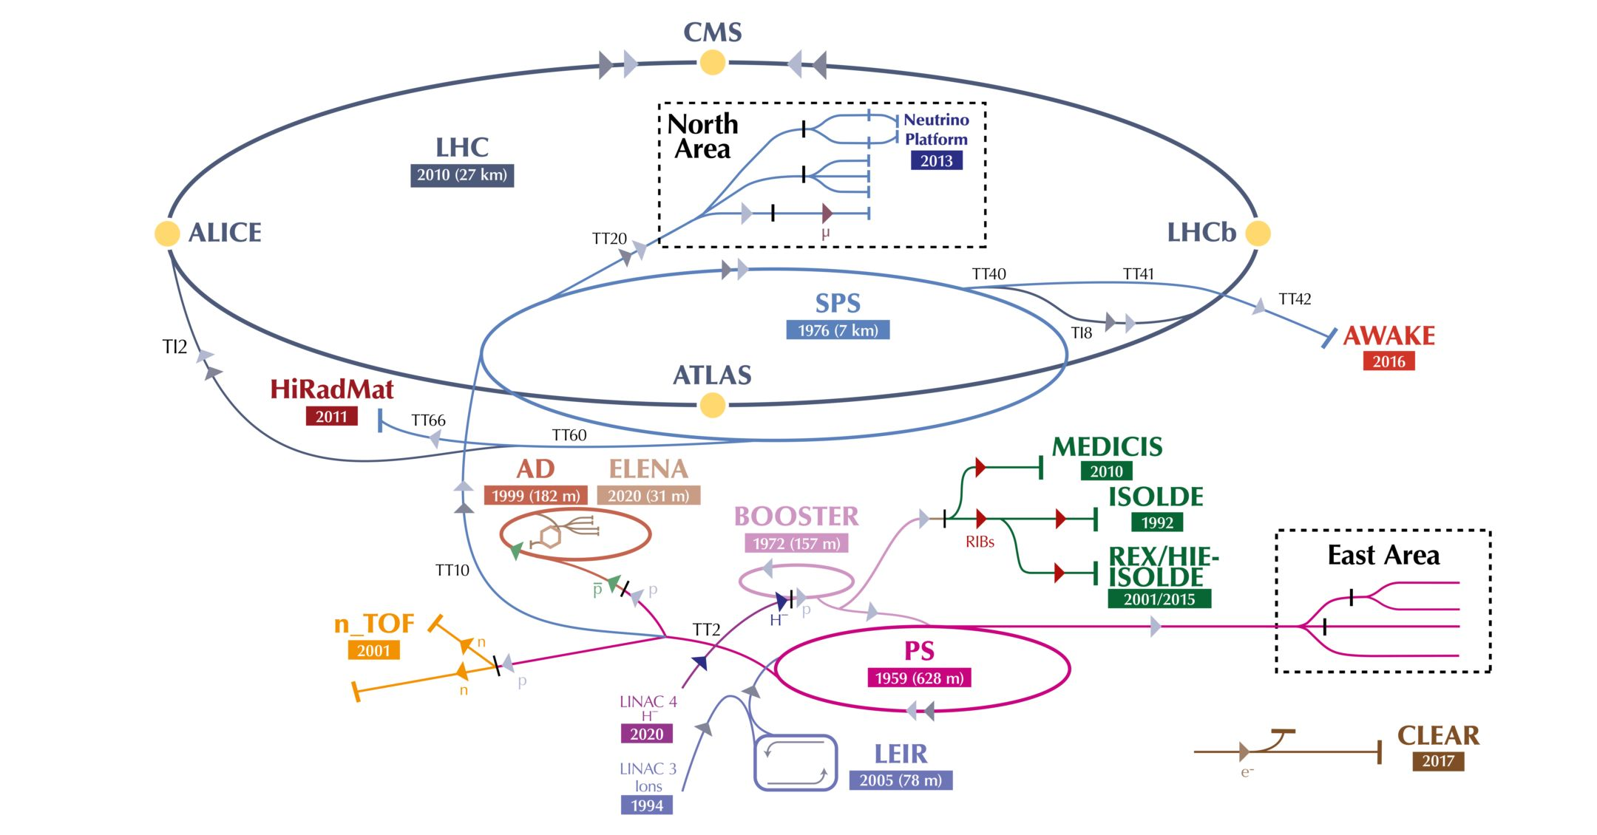
CERN accelerator complex & facilities

Slide 5
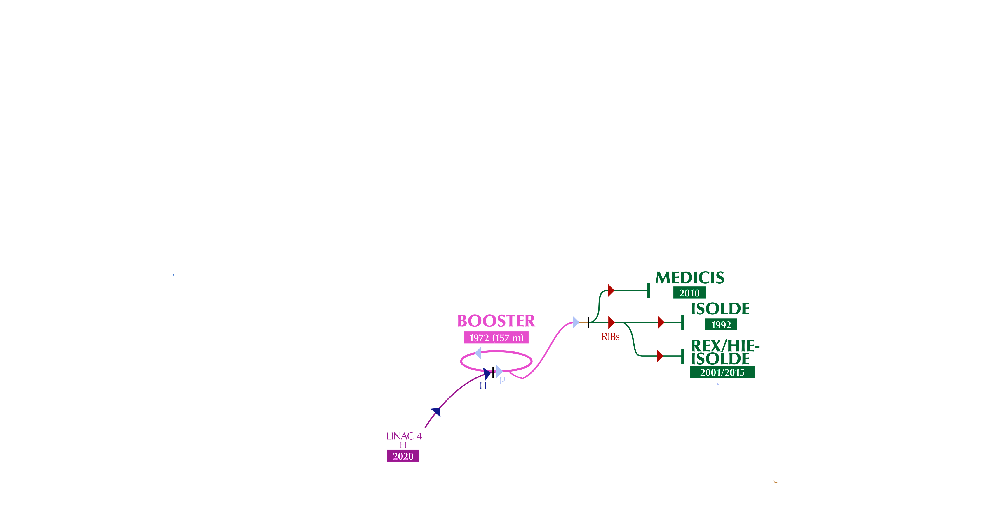
CERN accelerator complex & facilities

Slide 6
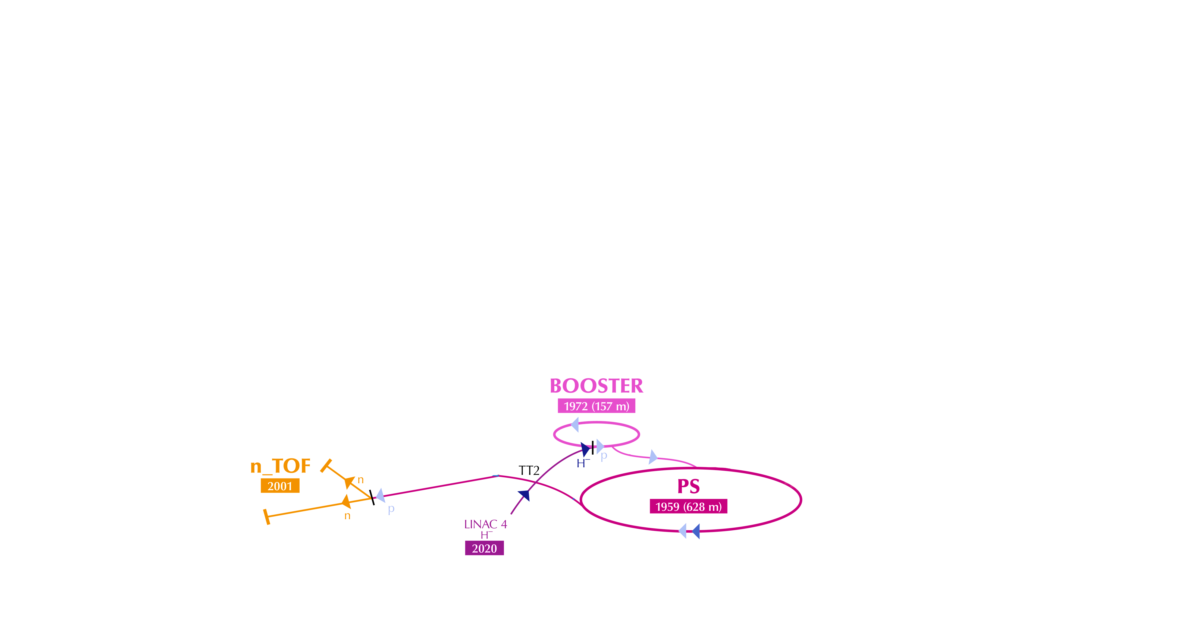
CERN accelerator complex & facilities

Slide 7
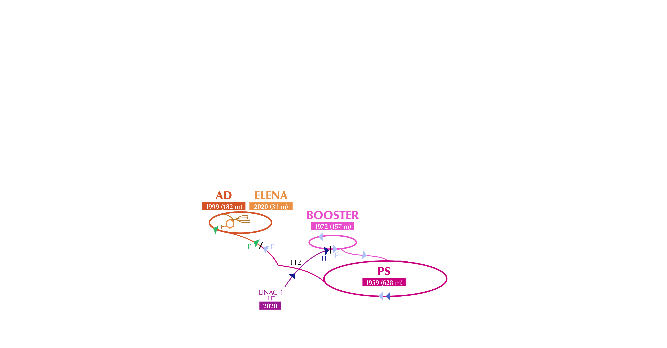
CERN accelerator complex & facilities

Slide 8
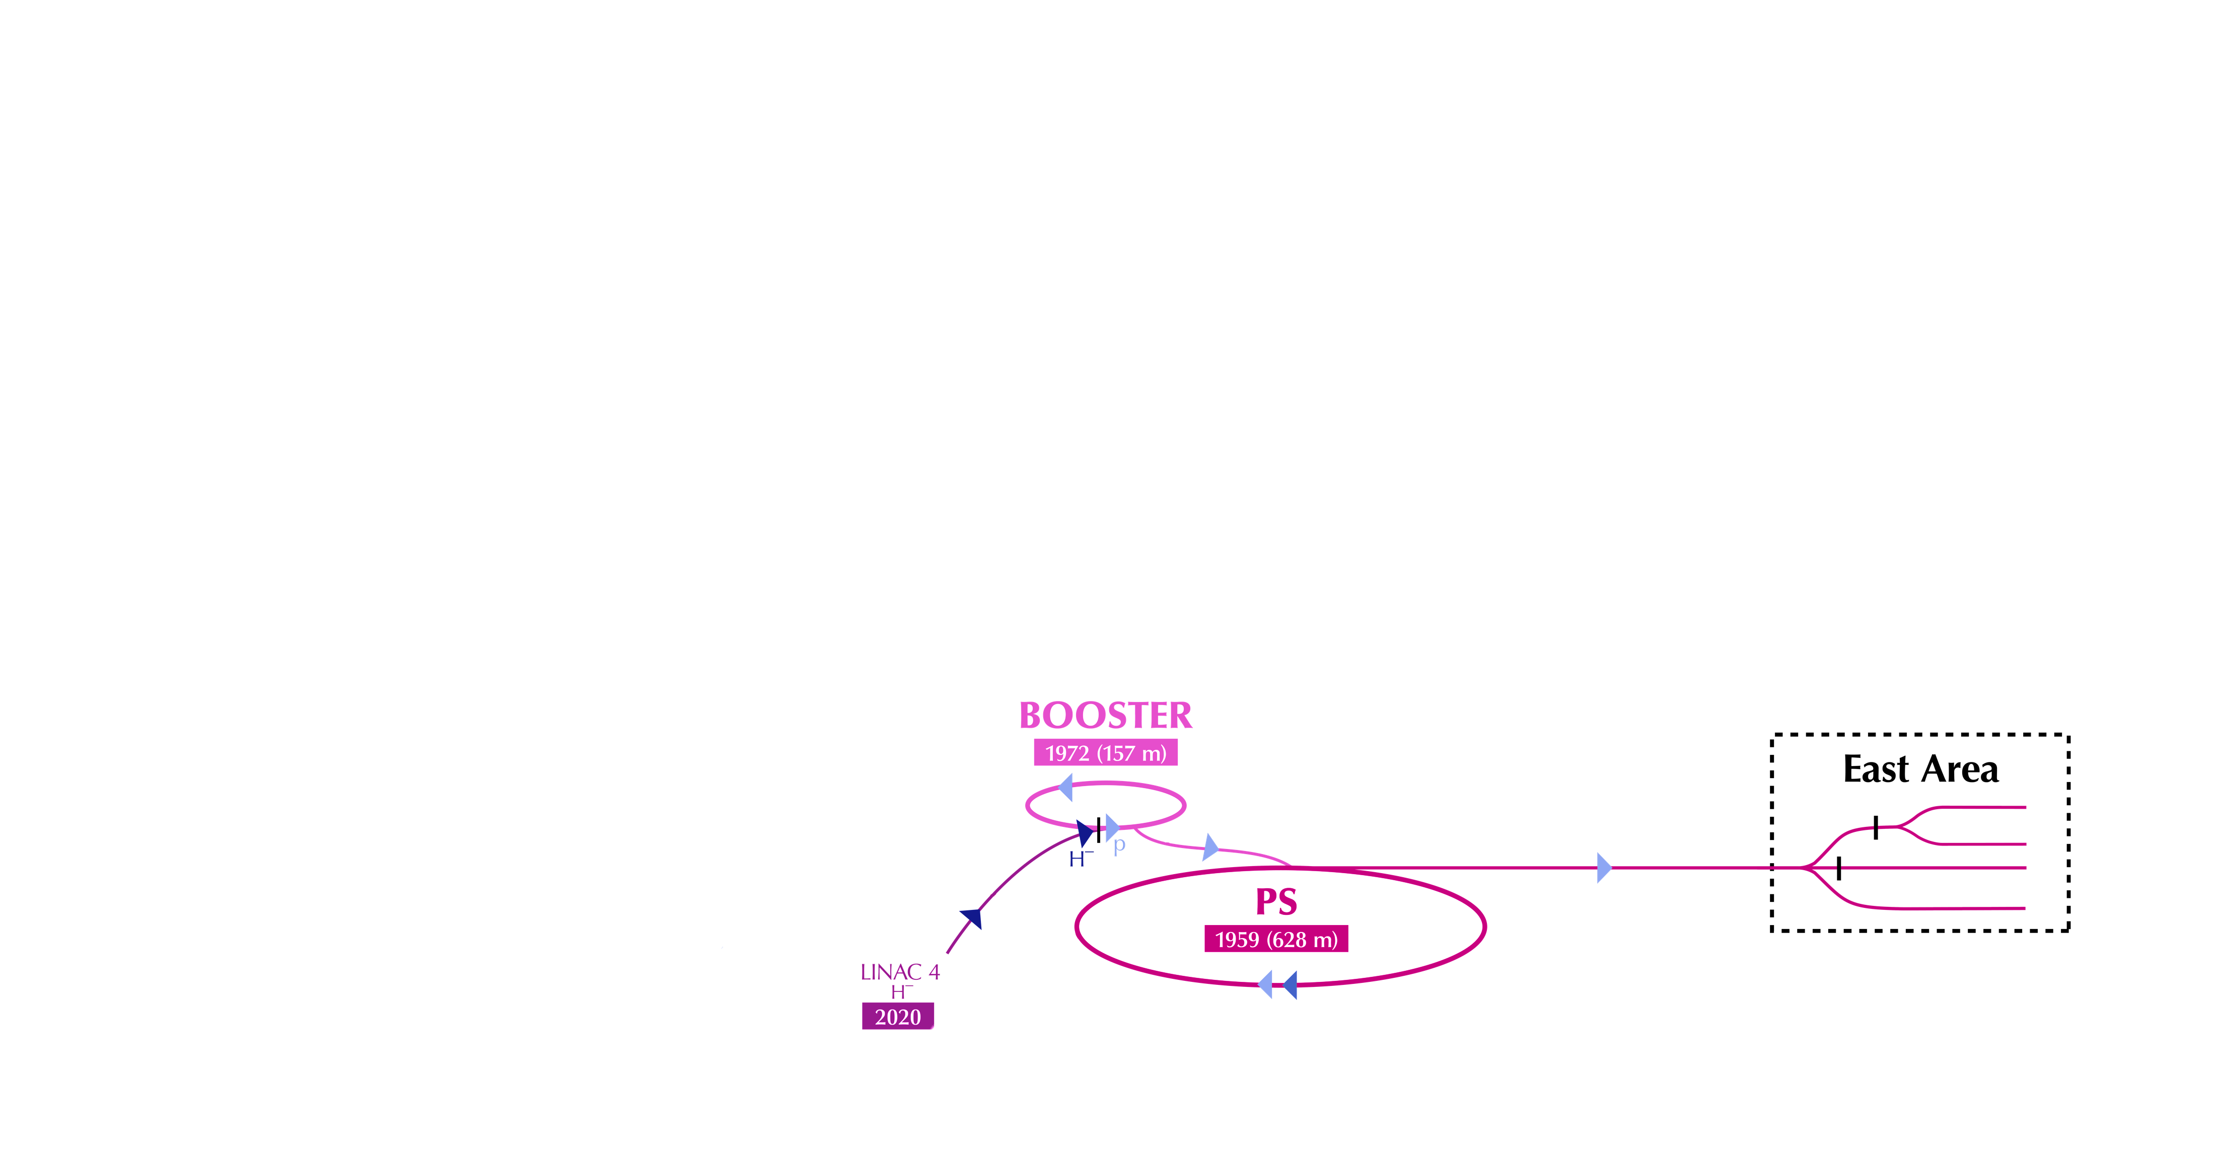
CERN accelerator complex & facilities

Slide 9
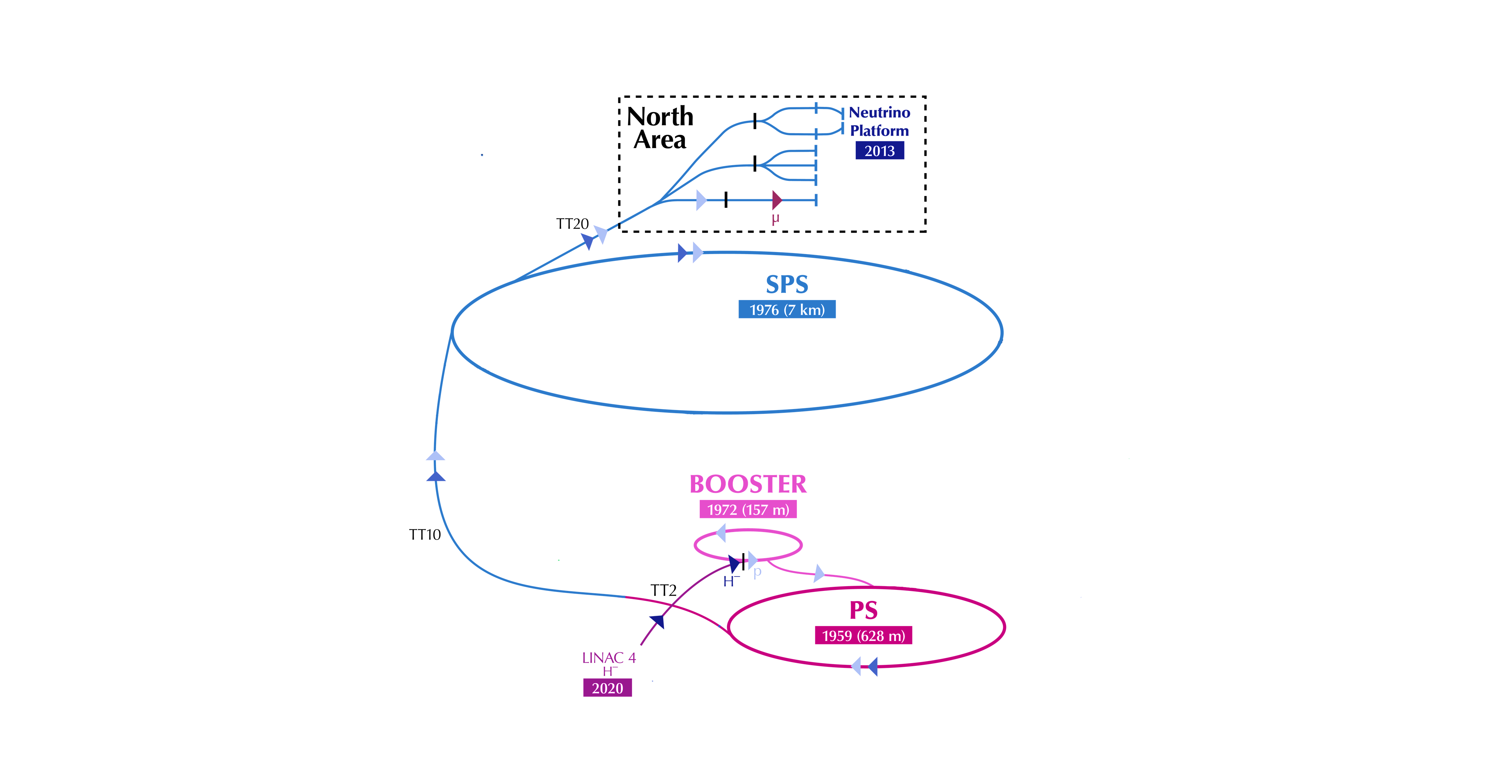
CERN accelerator complex & facilities

Slide 10
CERN accelerator complex & facilities

Slide 11
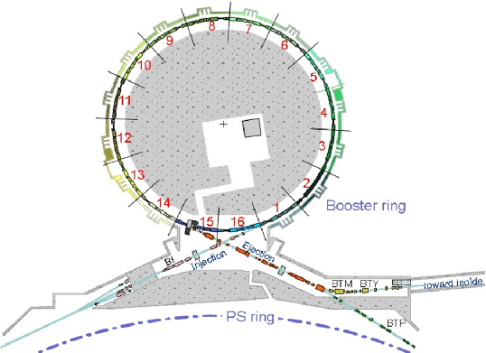
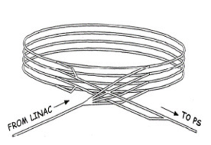

PSB layout
4 identical superimposed rings of $25$m radius.
Acceleration from 160 MeV to 2 GeV in ~0.5 sec.
Common injection and extraction line.

Slide 12
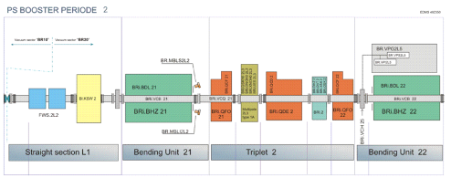

PSB layout
4 identical superimposed rings of $25$m radius.
Acceleration from 160 MeV to 2 GeV in ~0.5 sec.
Common injection and extraction line.
16 periods (sectors), each with two dipoles, three quadrupoles and a straight section for adittional elements.

Slide 13
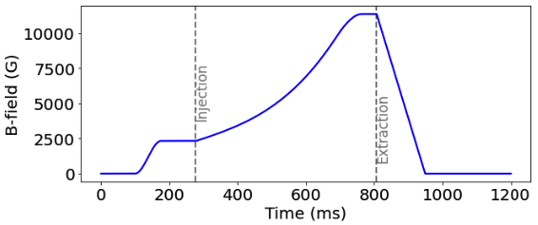

PSB layout
4 identical superimposed rings of $25$m radius.
Acceleration from 160 MeV to 2 GeV in ~0.5 sec.
Common injection and extraction line.
16 periods (sectors), each with two dipoles, three quadrupoles and a straight section for adittional elements.
Magnetic cycle of 1.2 sec. Beam injection at 275 ms and extraction at 805 ms.

Slide 14
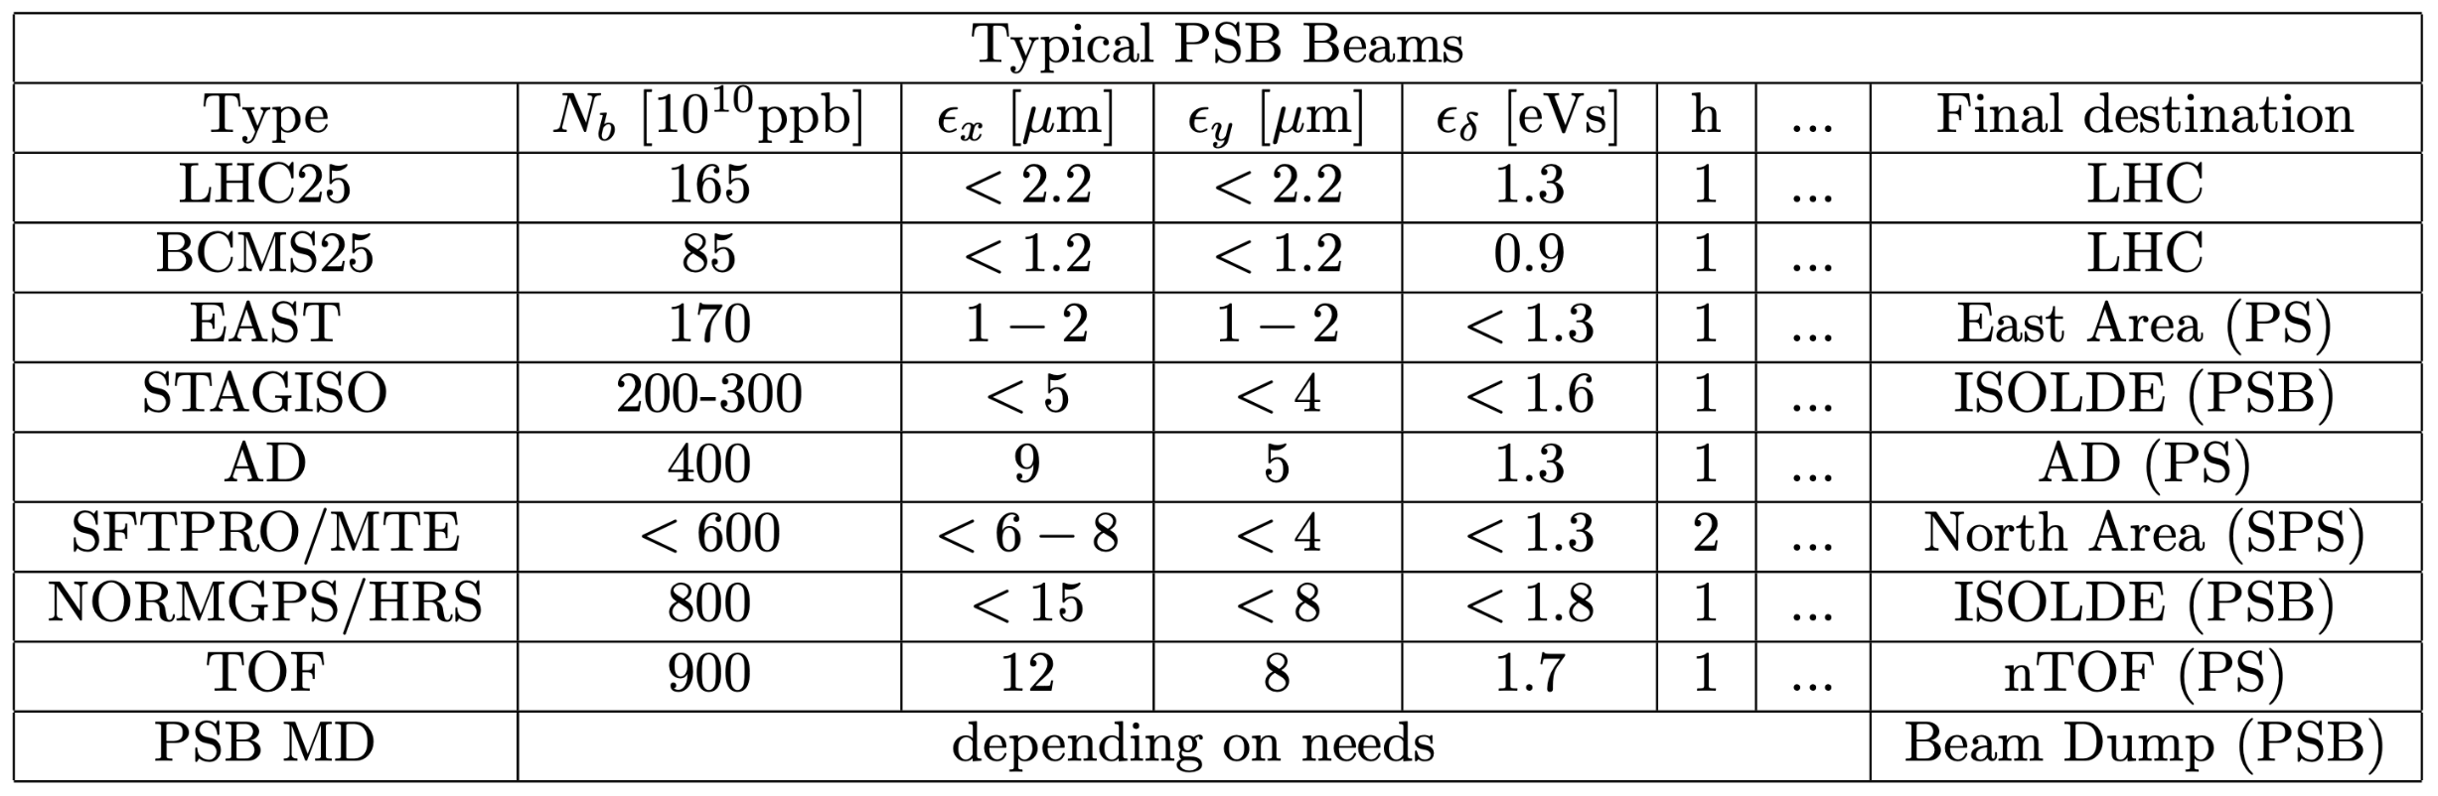
Beam delivery – supercycles

Slide 15
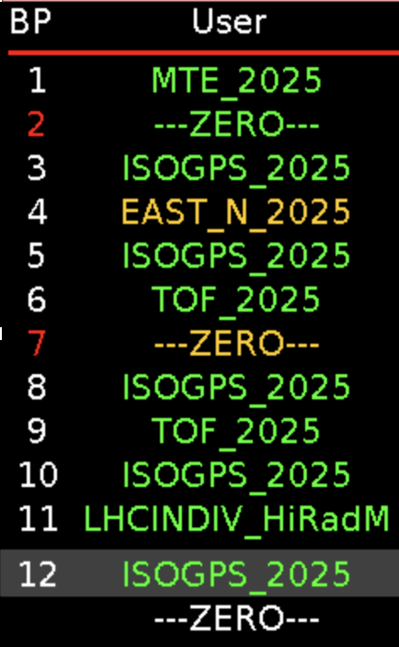
Beam delivery – supercycles
supercycle (sequence of cycles)
user (cycle name)
mapped
selector
added
In practice:
LHC25A_8b4e_2025
PSB.USER.LHC2A
MD15243_EUROLABS_2025
PSB.USER.MDX

Slide 16
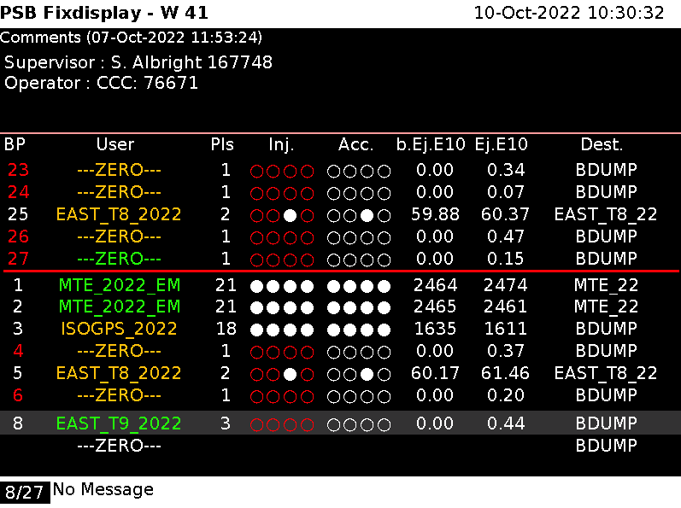
Beam delivery – supercycles
PSB is constantly cycled with different beams, each with its own characteristics and destination.
The cycles follow a predefined sequence (supercycle) which is repeated many times.

Slide 17
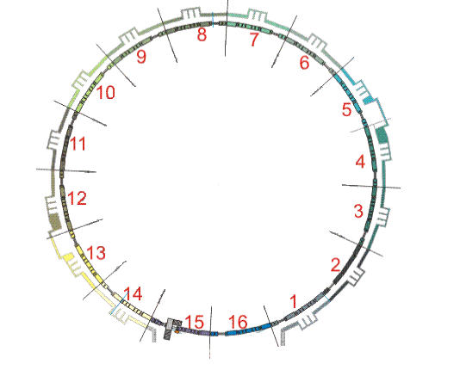
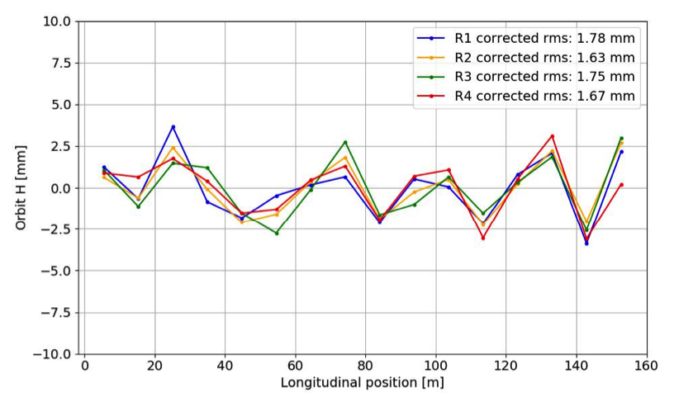
PSB beam instrumentation
For each of the 4 rings, 16 horizontal and 16 vertical Beam Position Monitors (BPM) measure the average transverse position of the beam.

Slide 18
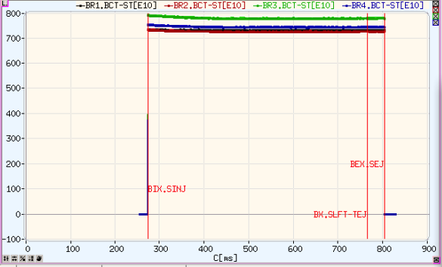
PSB beam instrumentation
A Beam Current Transformer (BCT) measures the beam intensity (or number of particles) with a 1 ms resolution (~500 points).

Slide 19
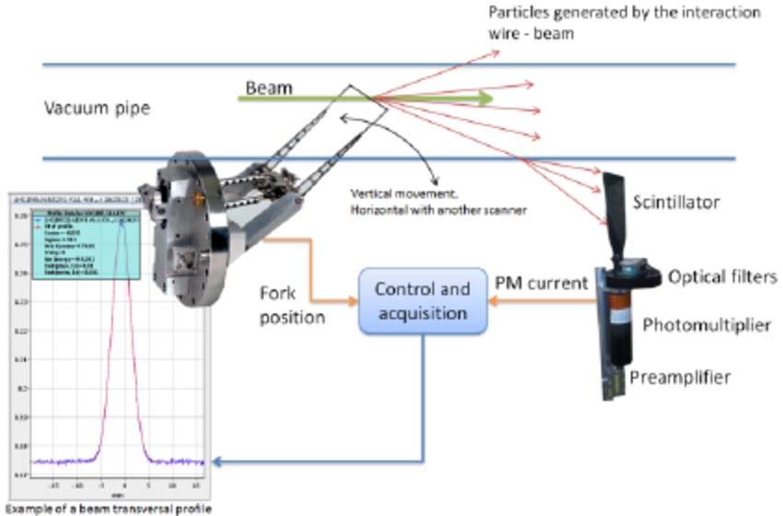
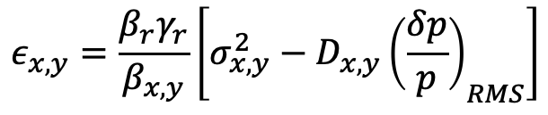
PSB beam instrumentation
The beam profile is measured with Wire Scanners. The emittance can be calculated from the beam size and the optical functions from the model.
$$ε_{x,y}=\frac{β_{r}γ_{r}}{β_{x,y}}\left[σ_{x,y}^{2}−D_{x,y}{\left(\frac{δp}{p}\right)}_{RMS}\right]$$

Slide 20
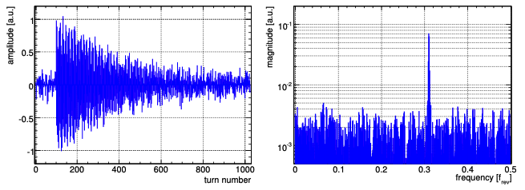
PSB beam instrumentation
The tune is measured with a Base-Band Tune (BBQ): a feedback system excites transverse beam oscillations using a frequency sweep (“chirp”), and a pickup records turn-by-turn beam position data. The fractional tune is determined with a Fast-Fourier-Transform (FFT).

Slide 21
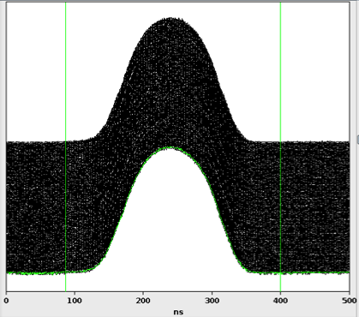
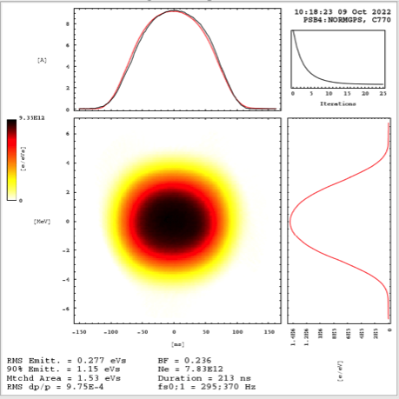
PSB beam instrumentation
Tomoscope: longitudinal phase space reconstruction. The longitudinal profile measurements over many turns correspond to different projections of the phase space at different angles (due to the synchrotron motion). By properly combining these profiles, the 2-D longitudinal phase space is reconstructed (like tomography).

Slide 22
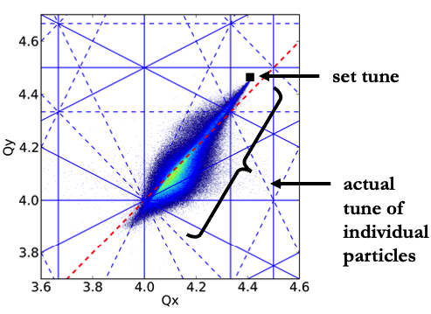
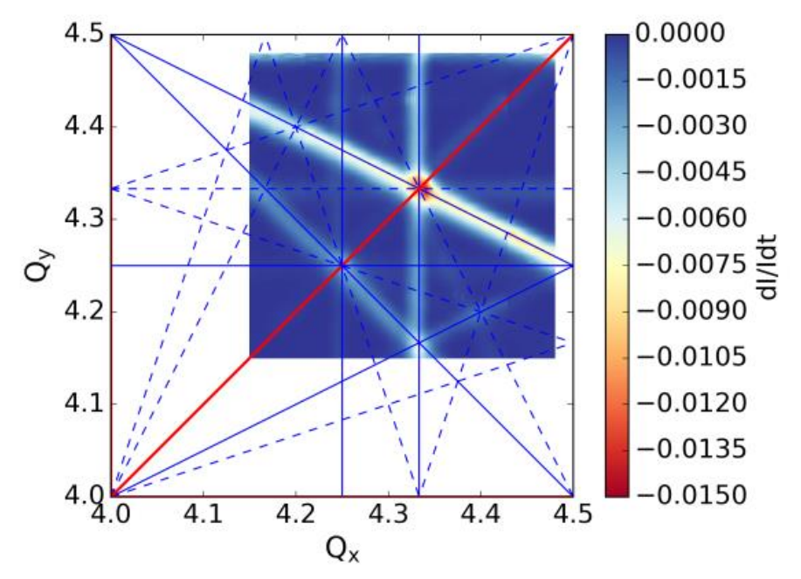
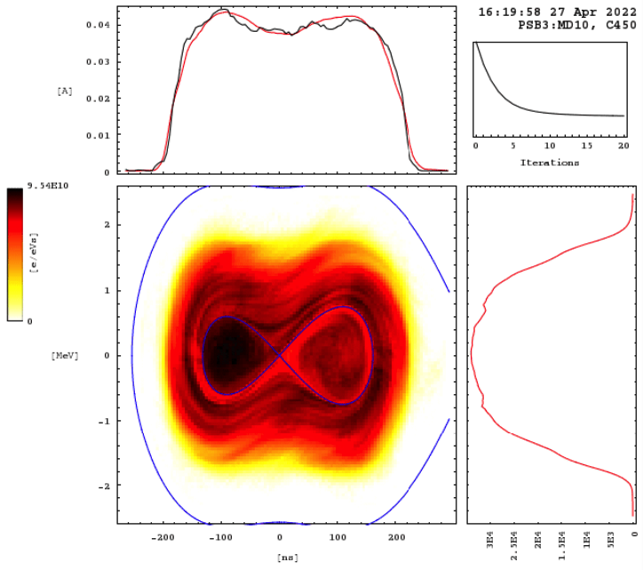
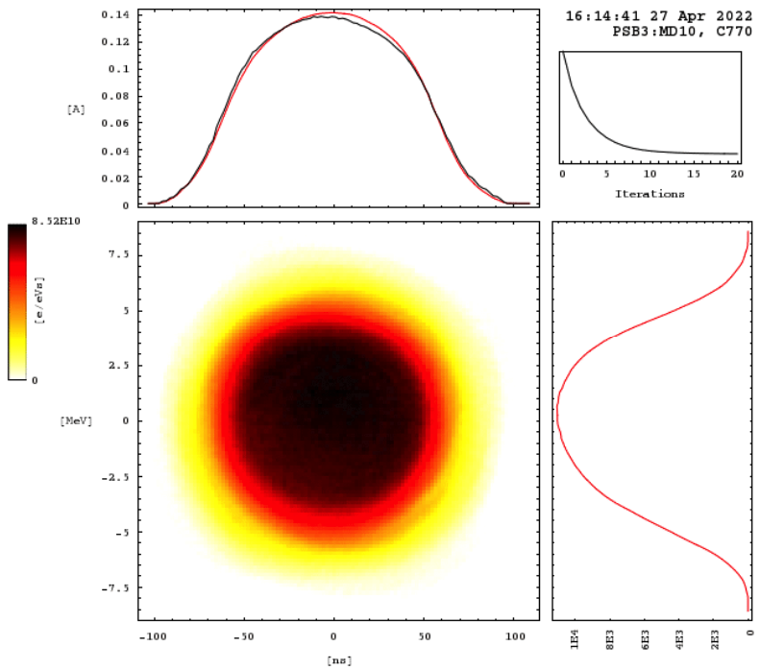
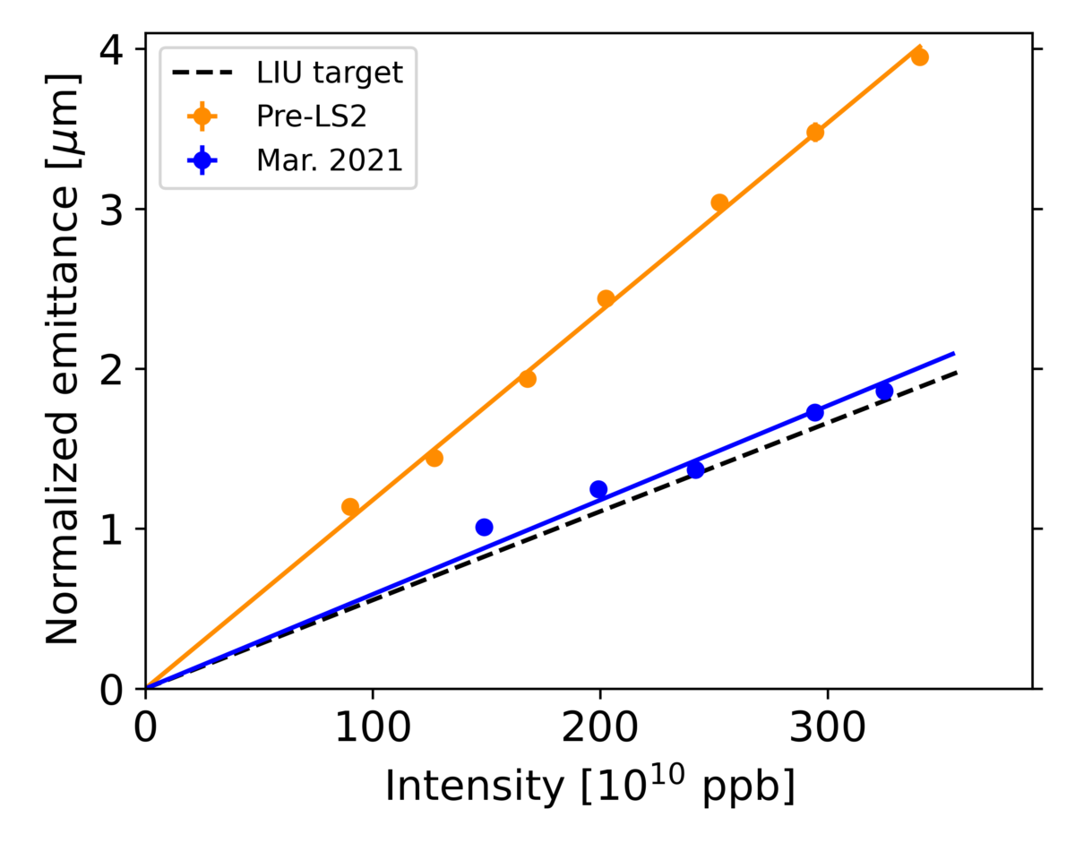
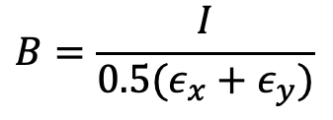
Relevant beam dynamics in the PSB
Beam goes from double harmonic to single harmonic to reduce the peak line density (therefore space charge)
Space Charge
Resonances
While beam is accelerated, tunes are dynamically changed.
Beam Brightness
$$B=\frac{I}{0.5(ε_{x}+ε_{y})}$$

Slide 23
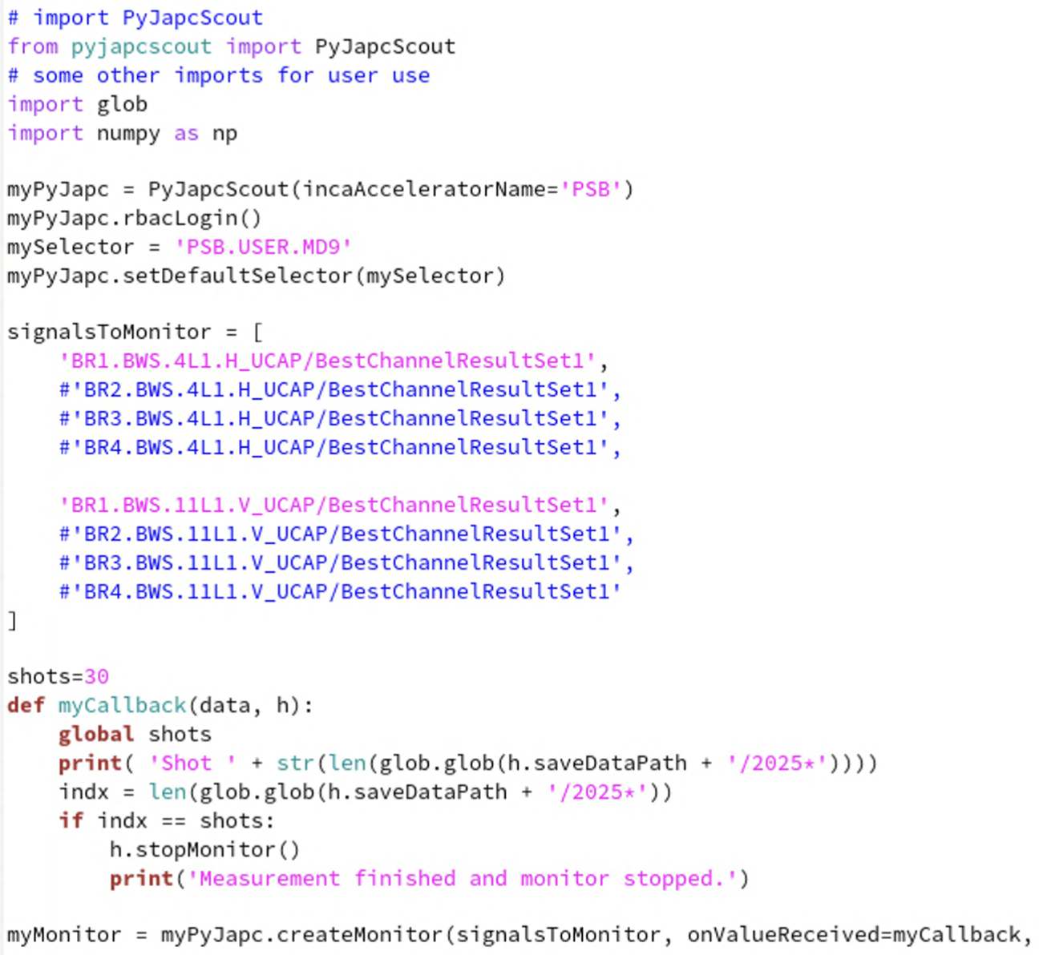
Data acquisition
Accelerator and beam data can be retrieved either from the accelerator logging system (NXCALS) or recorded locally using libraries for interacting with the accelerator control system (e.g. PyJAPC, PyJAPCScout, …)

Slide 24
Measurements of today

Slide 25
Getting familiar
Beam characterization
Get familiar with the PSB and basic instruments (BCT, Wire Scanner, Tomoscope).
Monitor basic beam parameters (beam intensity, emittance, bunch shape)
Injection effects
Understand multi-turn injection system and how to control it (Cruise Control).
Optimize injection process (minimize injection oscillations and foil scattering)
Tune setting and measurement
Get familiar with LSA interface.
Perform tune measurement (and correction if needed) all along the cycle for various working points.

Slide 26
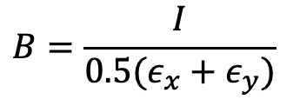
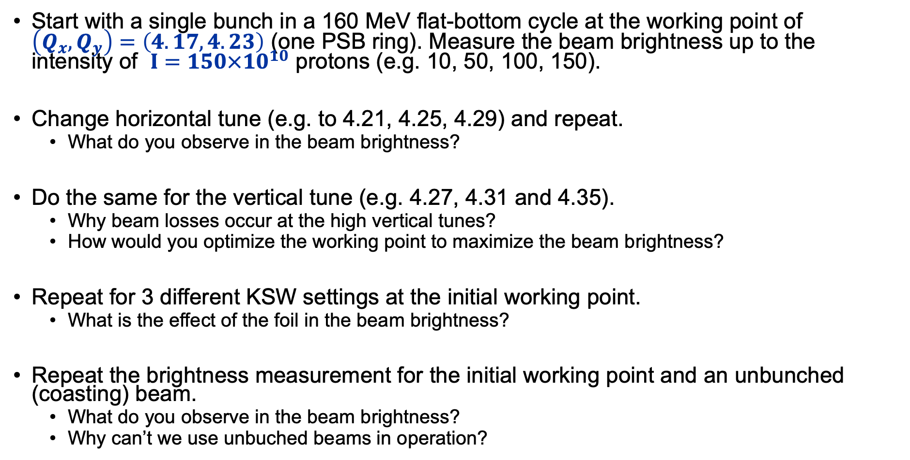

PSB brightness characterization
Start with a single bunch in a 160 MeV flat-bottom cycle at the working point of $\left(Q_{x},Q_{y}\right)=\left(4.17, 4.23\right)$ (one PSB ring). Measure the beam brightness up to the intensity of $I=150×{10}^{10}$ protons (e.g. 10, 50, 100, 150).
Change horizontal tune (e.g. to 4.21, 4.25, 4.29) and repeat.
What do you observe in the beam brightness?
Do the same for the vertical tune (e.g. 4.27, 4.31 and 4.35).
Why beam losses occur at the high vertical tunes?
How would you optimize the working point to maximize the beam brightness?
Repeat for 3 different KSW settings at the initial working point.
What is the effect of the foil in the beam brightness?
Repeat the brightness measurement for the initial working point and an unbunched (coasting) beam.
What do you observe in the beam brightness?
Why can’t we use unbuched beams in operation?
$$B=\frac{I}{0.5(ε_{x}+ε_{y})}$$
$$ε_{x,y}=\frac{β_{r}γ_{r}}{β_{x,y}}\left[σ_{x,y}^{2}−D_{x,y}{\left(\frac{δp}{p}\right)}_{RMS}\right]$$

Slide 27
Space charge & resonances

Slide 28
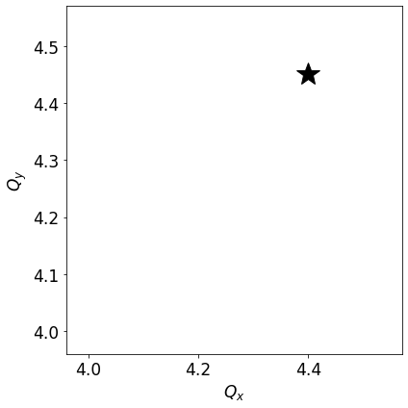
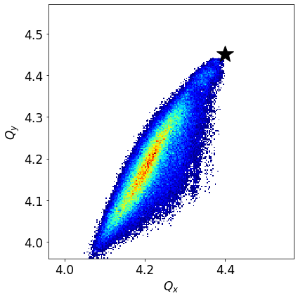
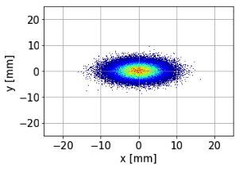
Beam dynamics in PSB
PSB performance is dominated by space charge and resonances.
Direct space charge induces a spread in the tune of the particles.
Defocusing depends on the particle’s amplitude: larger tune shift for the particles in the beam core.
Bare machine working point
Particles from the beam tails
Particles from the beam core

Slide 29
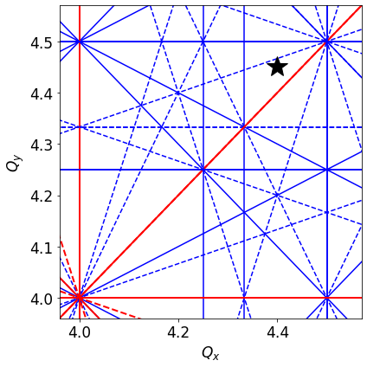
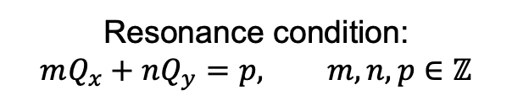
Beam dynamics in PSB
PSB performance is dominated by space charge and resonances.
Direct space charge induces a spread in the tune of the particles.
Defocusing depends on the particle’s amplitude: larger tune shift for the particles in the beam core.
Machine imperfections (field perturbations, misalignments, …) can excite resonances.
Resonances are identified and corrected experimentally using available multipole correctors.
Resonance condition:
$$mQ_{x}+nQ_{y}=p, m,n,p∈\text{ℤ}$$
Resonances are represented with lines in the tune diagram.
Motion near a resonance can become unstable and particles might get lost! Need to tune the machine in a “resonance free” region.

Slide 30
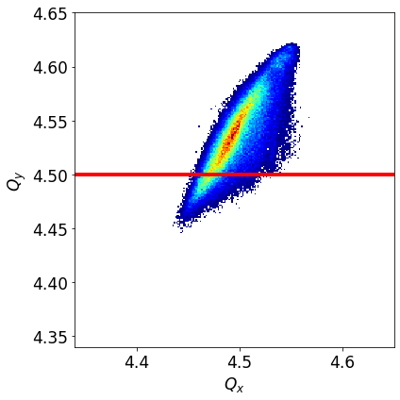
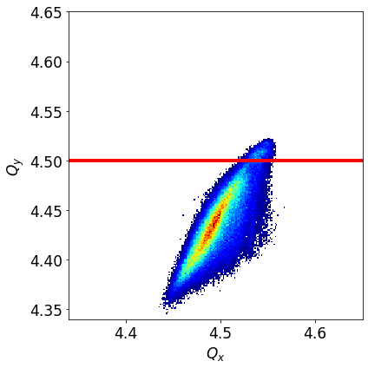
Beam dynamics in PSB
PSB performance is dominated by space charge and resonances.
Direct space charge induces a spread in the tune of the particles.
Defocusing depends on the particle’s amplitude: larger tune shift for the particles in the beam core.
Machine imperfections (field perturbations, misalignments, …) can excite resonances.
Resonances are identified and corrected experimentally using available multipole correctors.
Space charge detuning can drive particles to resonances.
Low amplitude particles (beam core) interact with the resonance: emittance blow-up
High amplitude particles (beam tails) interact with the resonance: losses

Slide 31
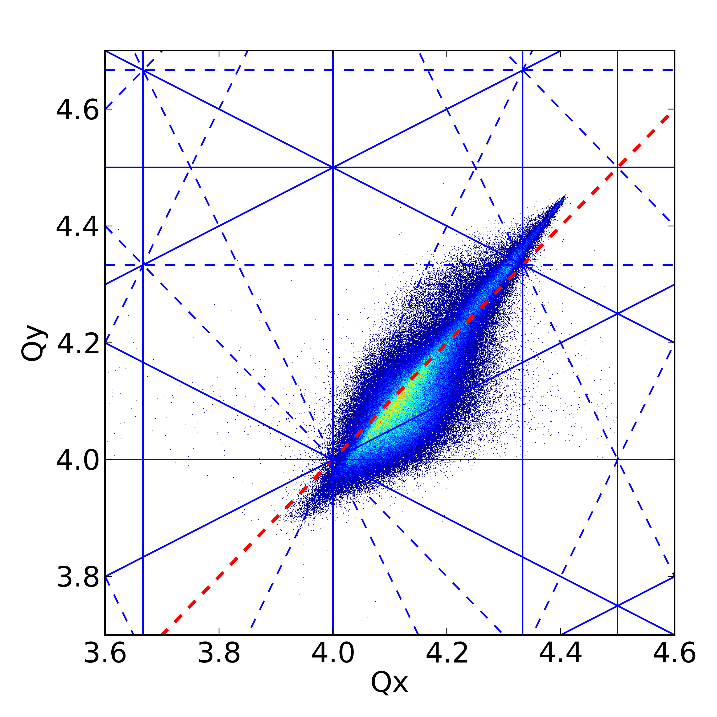
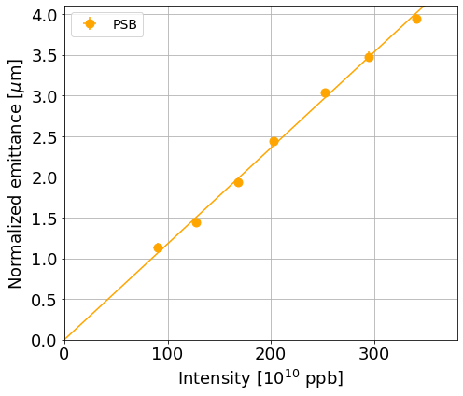


Beam dynamics in PSB
PSB performance is dominated by space charge and resonances.
Direct space charge induces a spread in the tune of the particles.
Defocusing depends on the particle’s amplitude: larger tune shift for the particles in the beam core.
Machine imperfections (field perturbations, misalignments, …) can excite resonances.
Resonances are identified and corrected experimentally using available multipole correctors.
Space charge detuning can drive particles to resonances.
The PSB beam brightness is limited by space charge.
For high beam intensities (high space charge), the detuning is so large that the emittance blows-up by the integer resonances.
$$4Q_{x}=16$$
The higher the intensity, the higher the emittance: constant brightness.
$$4Q_{y}=16$$

