Slide 1
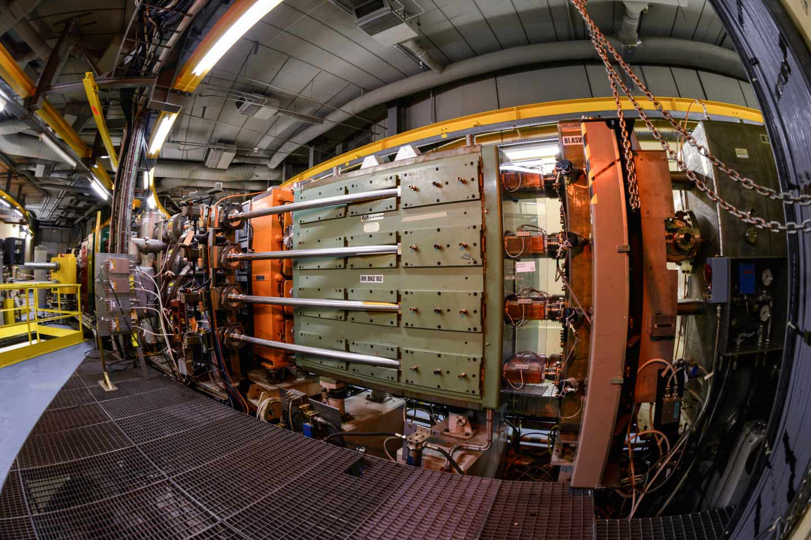
Introduction to the PSB: Accelerator, Control Systems, Measurements
F. Asvesta, T. Prebibaj
03-07/06/2024
Advanced Training School on Operation of Accelerators
EURO-LABS Training Sessions @ CERN Facilities

Slide 2
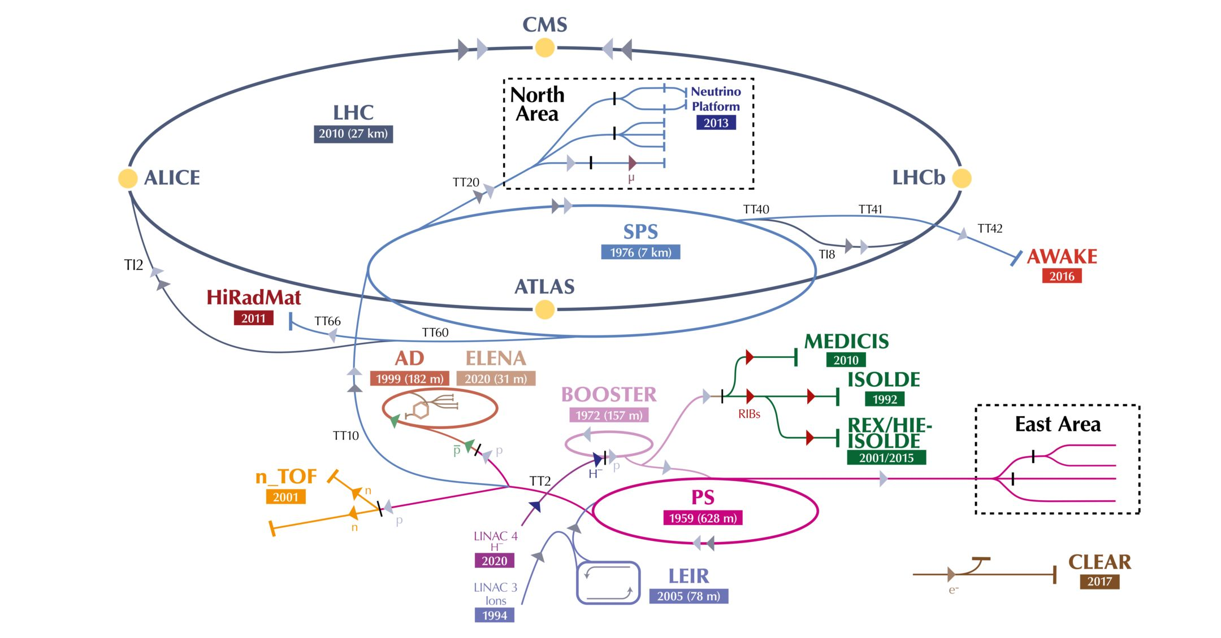
Injectors complex & facilities
ATSOA 2024
tirsi.prebibaj@cern.ch

Slide 3
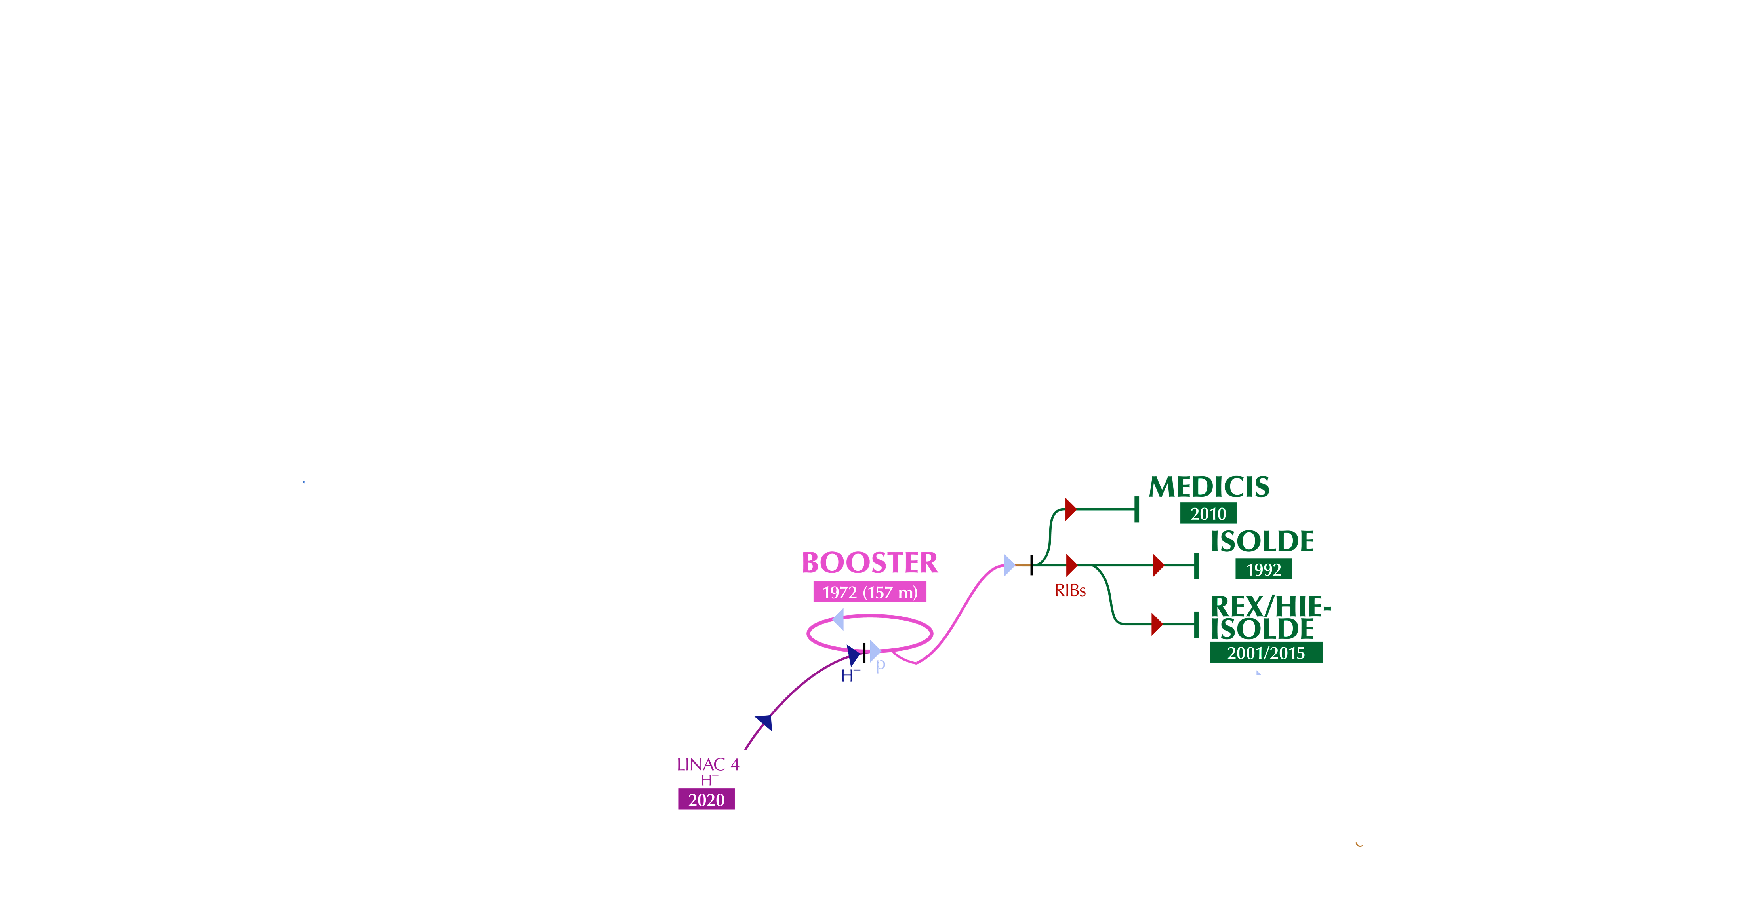
Injectors complex & facilities
ATSOA 2024
tirsi.prebibaj@cern.ch

Slide 4
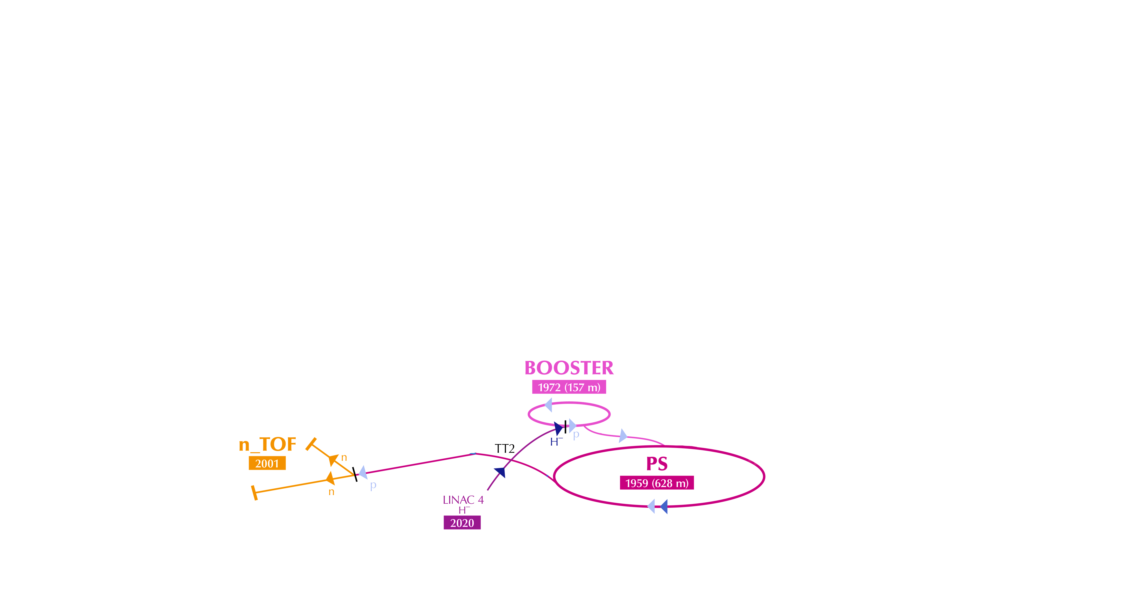
Injectors complex & facilities
ATSOA 2024
tirsi.prebibaj@cern.ch

Slide 5
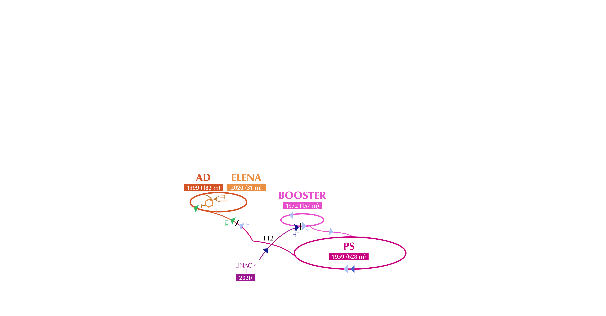
Injectors complex & facilities
ATSOA 2024
tirsi.prebibaj@cern.ch

Slide 6
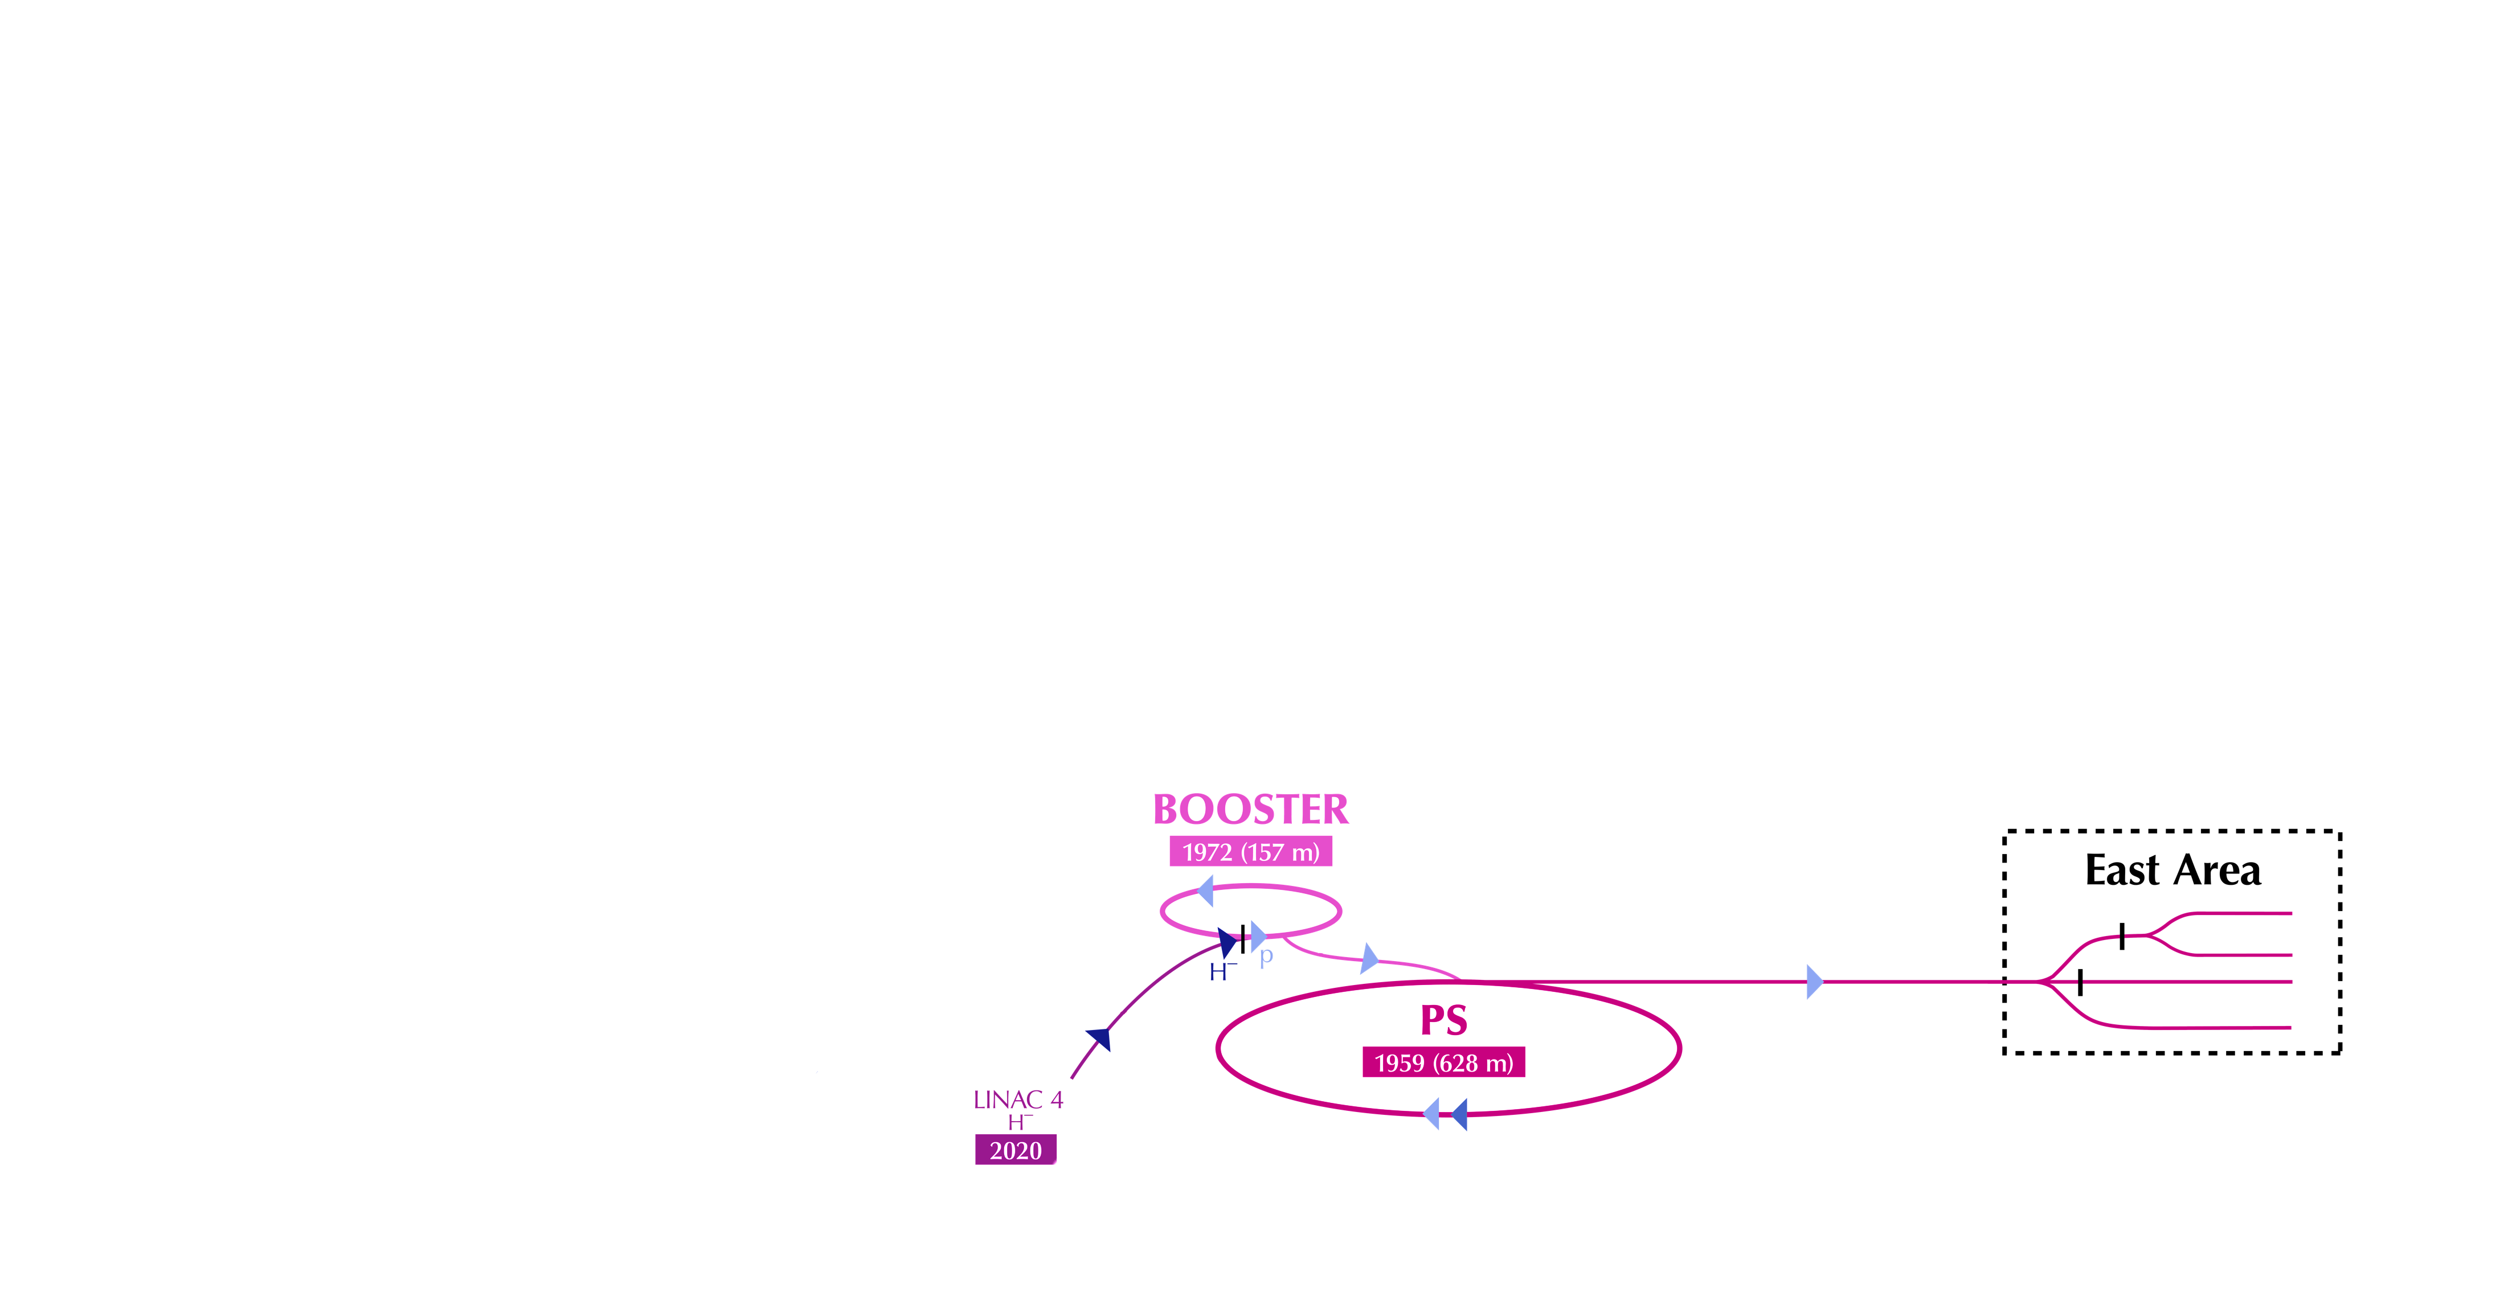
Injectors complex & facilities
ATSOA 2024
tirsi.prebibaj@cern.ch

Slide 7
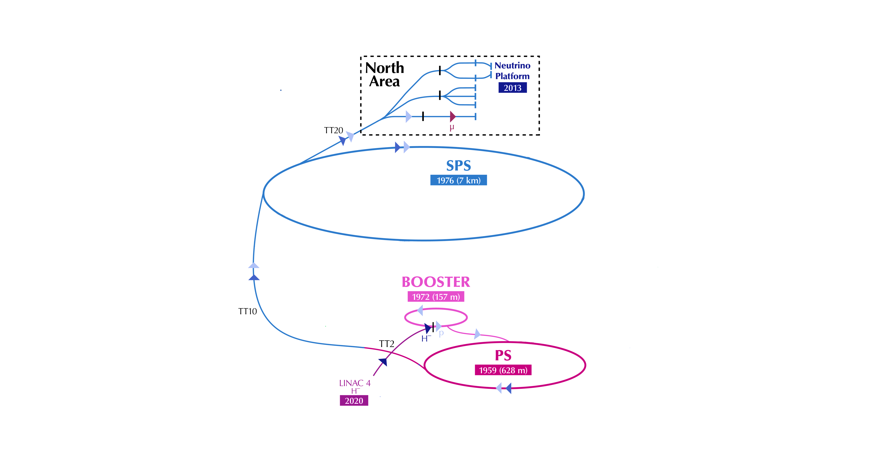
Injectors complex & facilities
ATSOA 2024
tirsi.prebibaj@cern.ch

Slide 8
Injectors complex & facilities
ATSOA 2024
tirsi.prebibaj@cern.ch

Slide 9
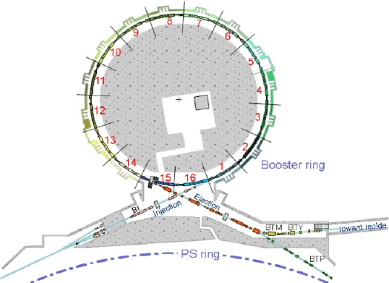
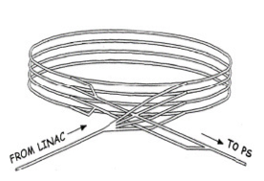
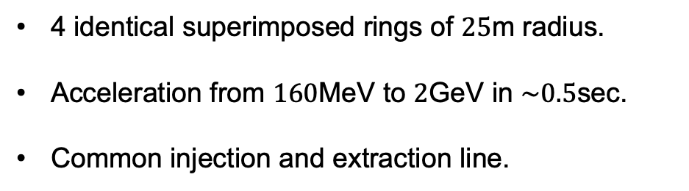
PSB layout
4 identical superimposed rings of $25$m radius.
Acceleration from $160$MeV to $2$GeV in $\sim 0.5$sec.
Common injection and extraction line.
ATSOA 2024
tirsi.prebibaj@cern.ch

Slide 10
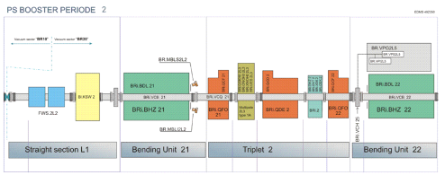
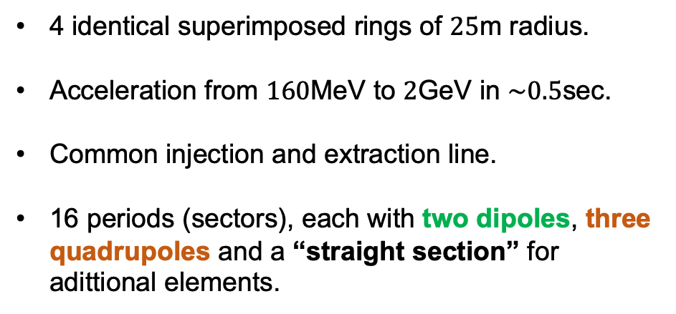
PSB layout
4 identical superimposed rings of $25$m radius.
Acceleration from $160$MeV to $2$GeV in $\sim 0.5$sec.
Common injection and extraction line.
16 periods (sectors), each with two dipoles, three quadrupoles and a “straight section” for adittional elements.
ATSOA 2024
tirsi.prebibaj@cern.ch

Slide 11
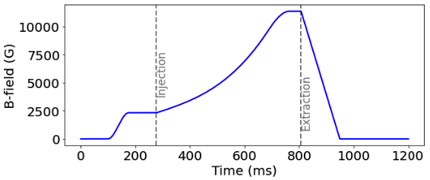
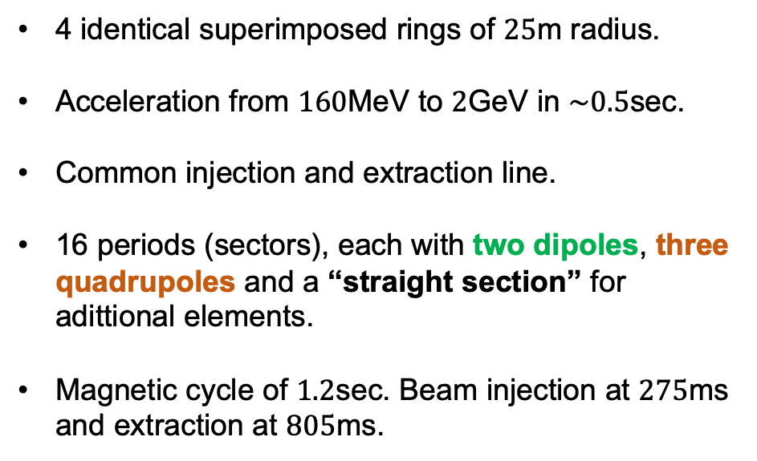
PSB layout
4 identical superimposed rings of $25$m radius.
Acceleration from $160$MeV to $2$GeV in $\sim 0.5$sec.
Common injection and extraction line.
16 periods (sectors), each with two dipoles, three quadrupoles and a “straight section” for adittional elements.
Magnetic cycle of $1.2$sec. Beam injection at $275$ms and extraction at $805$ms.
ATSOA 2024
tirsi.prebibaj@cern.ch

Slide 12
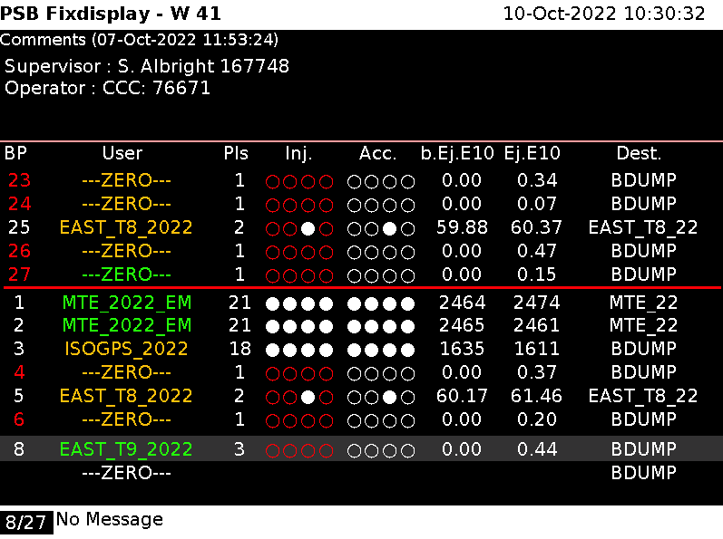
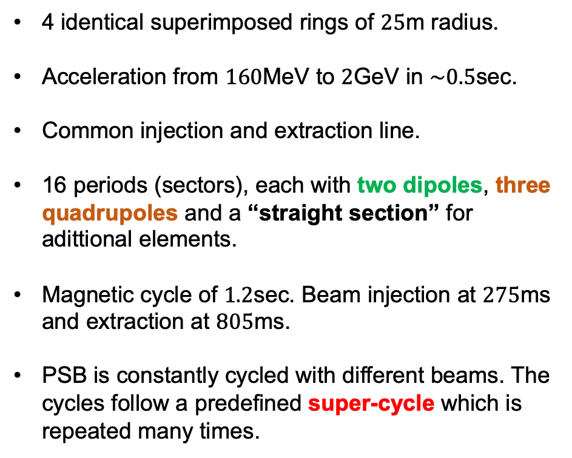
PSB layout
4 identical superimposed rings of $25$m radius.
Acceleration from $160$MeV to $2$GeV in $\sim 0.5$sec.
Common injection and extraction line.
16 periods (sectors), each with two dipoles, three quadrupoles and a “straight section” for adittional elements.
Magnetic cycle of $1.2$sec. Beam injection at $275$ms and extraction at $805$ms.
PSB is constantly cycled with different beams. The cycles follow a predefined super-cycle which is repeated many times.
ATSOA 2024
tirsi.prebibaj@cern.ch

Slide 13
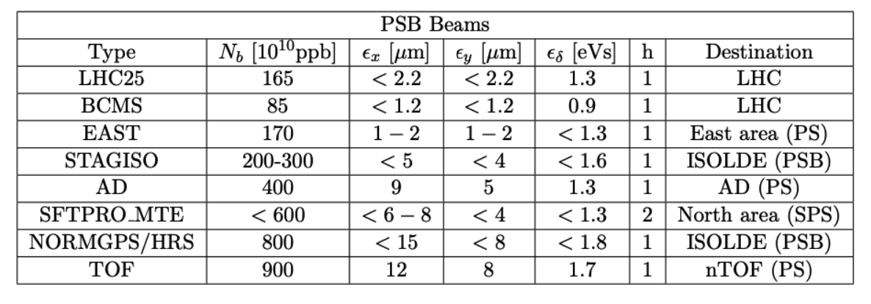
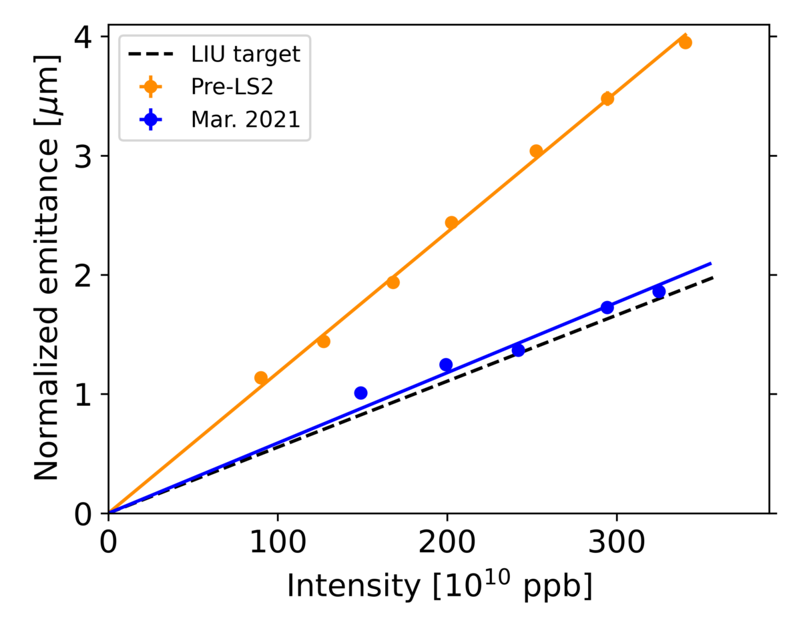
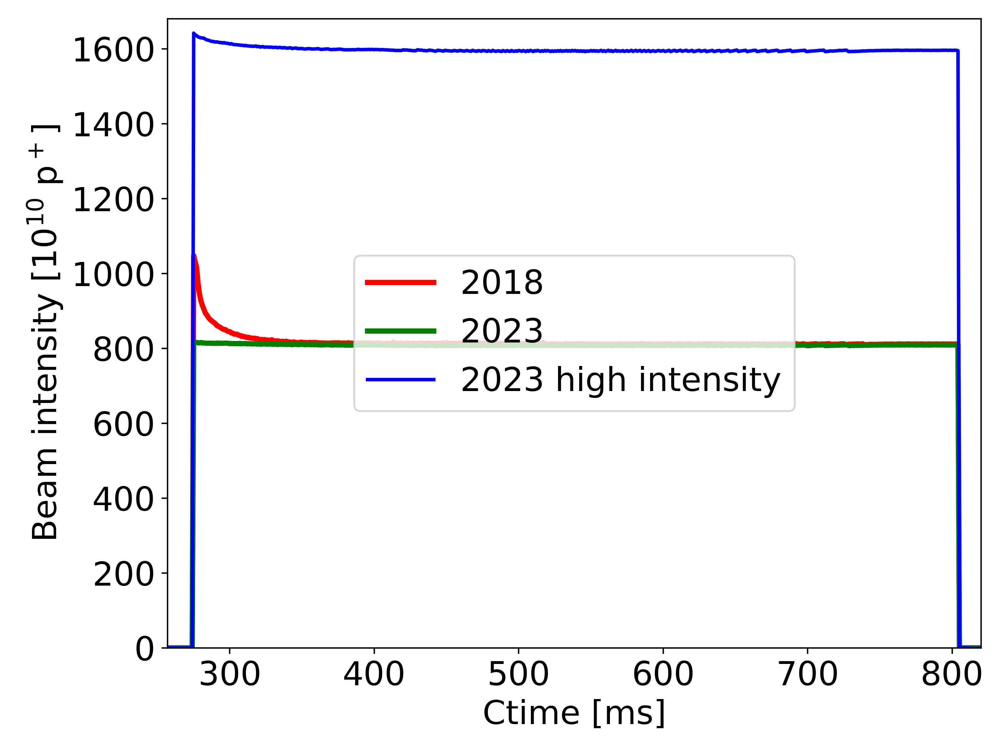
PSB beams
ATSOA 2024
tirsi.prebibaj@cern.ch

Slide 14
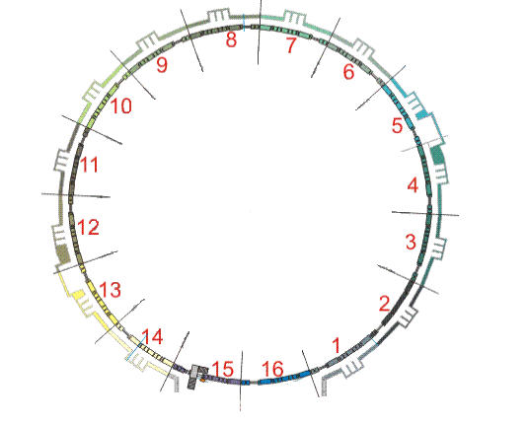
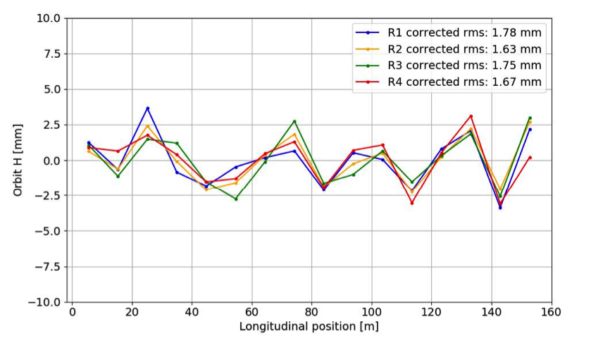
Devices
Beam Position Monitors (BPMs): turn-by-turn measurement of the beam center of mass. 16 horizontal and 16 vertical for each ring.
ATSOA 2024
tirsi.prebibaj@cern.ch

Slide 15
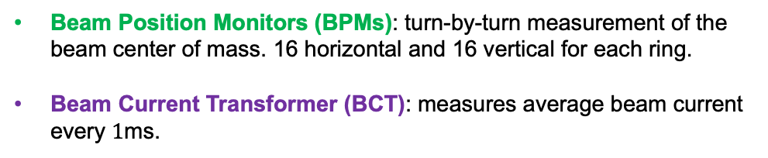
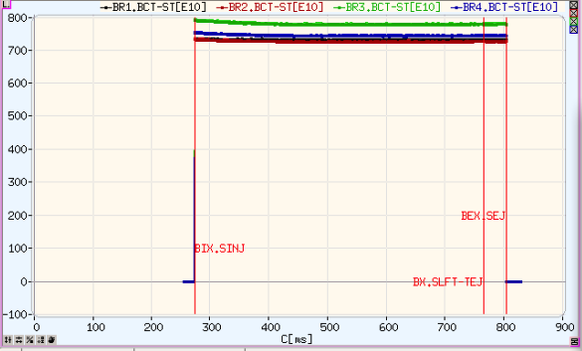
Devices
Beam Position Monitors (BPMs): turn-by-turn measurement of the beam center of mass. 16 horizontal and 16 vertical for each ring.
Beam Current Transformer (BCT): measures average beam current every $1$ms.
ATSOA 2024
tirsi.prebibaj@cern.ch

Slide 16
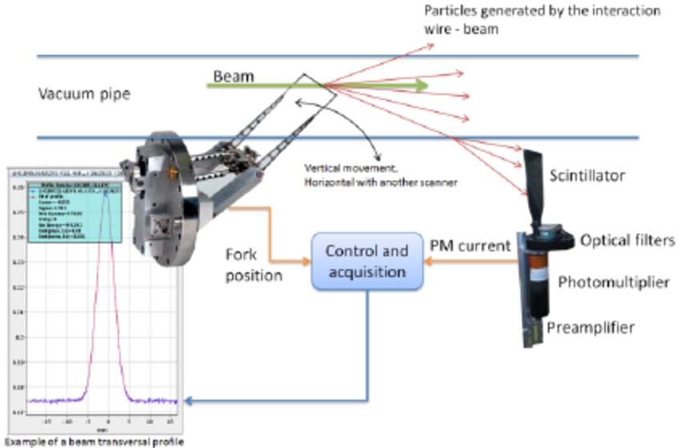
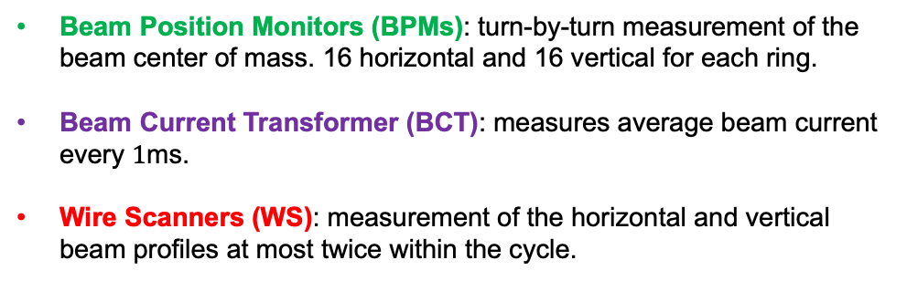
Devices
Beam Position Monitors (BPMs): turn-by-turn measurement of the beam center of mass. 16 horizontal and 16 vertical for each ring.
Beam Current Transformer (BCT): measures average beam current every $1$ms.
Wire Scanners (WS): measurement of the horizontal and vertical beam profiles at most twice within the cycle.
ATSOA 2024
tirsi.prebibaj@cern.ch

Slide 17
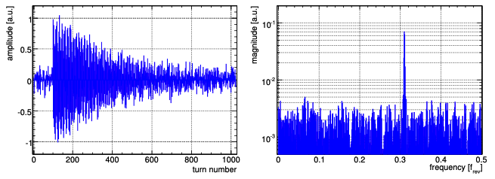
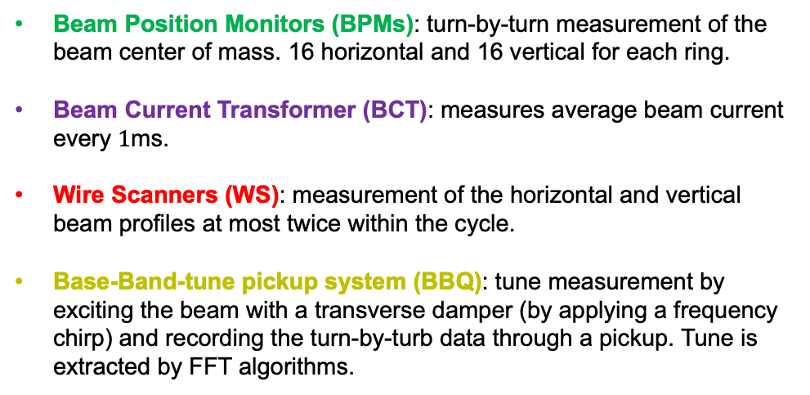
Devices
Beam Position Monitors (BPMs): turn-by-turn measurement of the beam center of mass. 16 horizontal and 16 vertical for each ring.
Beam Current Transformer (BCT): measures average beam current every $1$ms.
Wire Scanners (WS): measurement of the horizontal and vertical beam profiles at most twice within the cycle.
Base-Band-tune pickup system (BBQ): tune measurement by exciting the beam with a transverse damper (by applying a frequency chirp) and recording the turn-by-turb data through a pickup. Tune is extracted by FFT algorithms.
ATSOA 2024
tirsi.prebibaj@cern.ch

Slide 18
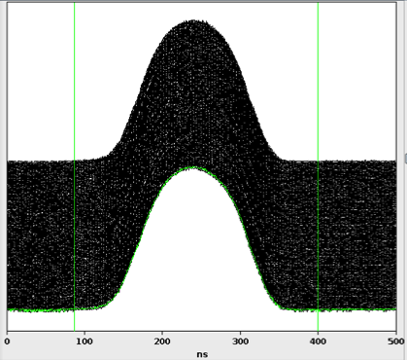
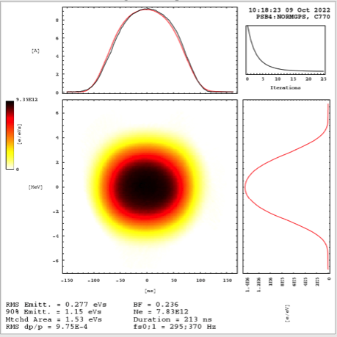
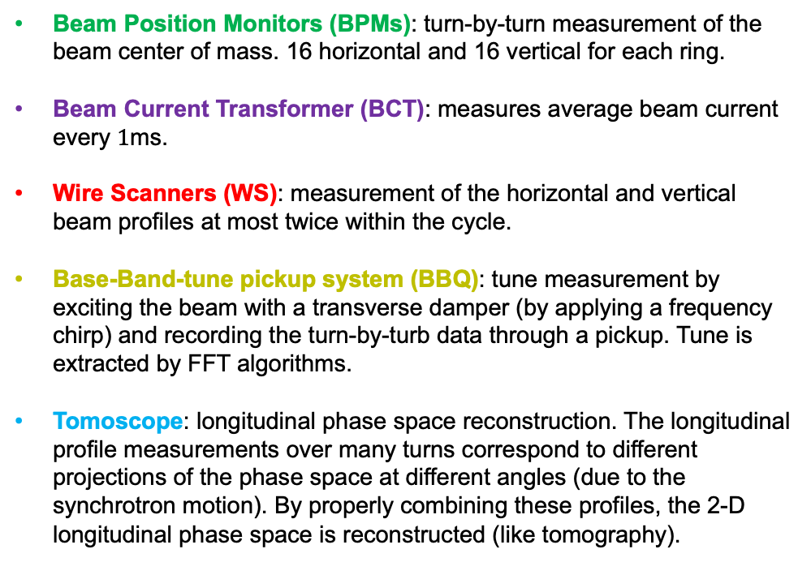
Devices
Beam Position Monitors (BPMs): turn-by-turn measurement of the beam center of mass. 16 horizontal and 16 vertical for each ring.
Beam Current Transformer (BCT): measures average beam current every $1$ms.
Wire Scanners (WS): measurement of the horizontal and vertical beam profiles at most twice within the cycle.
Base-Band-tune pickup system (BBQ): tune measurement by exciting the beam with a transverse damper (by applying a frequency chirp) and recording the turn-by-turb data through a pickup. Tune is extracted by FFT algorithms.
Tomoscope: longitudinal phase space reconstruction. The longitudinal profile measurements over many turns correspond to different projections of the phase space at different angles (due to the synchrotron motion). By properly combining these profiles, the 2-D longitudinal phase space is reconstructed (like tomography).
ATSOA 2024
tirsi.prebibaj@cern.ch

Slide 19
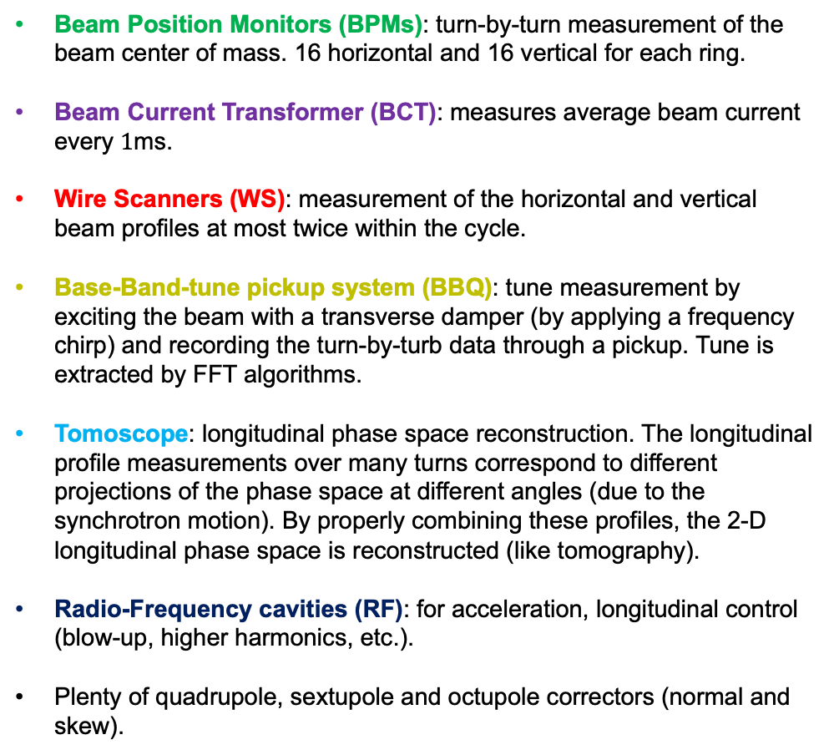
Devices
Beam Position Monitors (BPMs): turn-by-turn measurement of the beam center of mass. 16 horizontal and 16 vertical for each ring.
Beam Current Transformer (BCT): measures average beam current every $1$ms.
Wire Scanners (WS): measurement of the horizontal and vertical beam profiles at most twice within the cycle.
Base-Band-tune pickup system (BBQ): tune measurement by exciting the beam with a transverse damper (by applying a frequency chirp) and recording the turn-by-turb data through a pickup. Tune is extracted by FFT algorithms.
Tomoscope: longitudinal phase space reconstruction. The longitudinal profile measurements over many turns correspond to different projections of the phase space at different angles (due to the synchrotron motion). By properly combining these profiles, the 2-D longitudinal phase space is reconstructed (like tomography).
Radio-Frequency cavities (RF): for acceleration, longitudinal control (blow-up, higher harmonics, etc.).
Plenty of quadrupole, sextupole and octupole correctors (normal and skew).
ATSOA 2024
tirsi.prebibaj@cern.ch

Slide 20
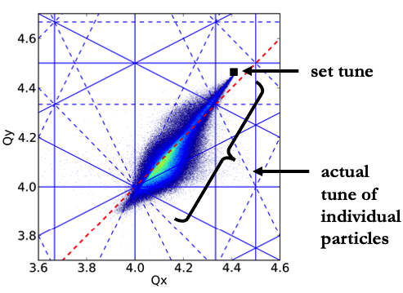
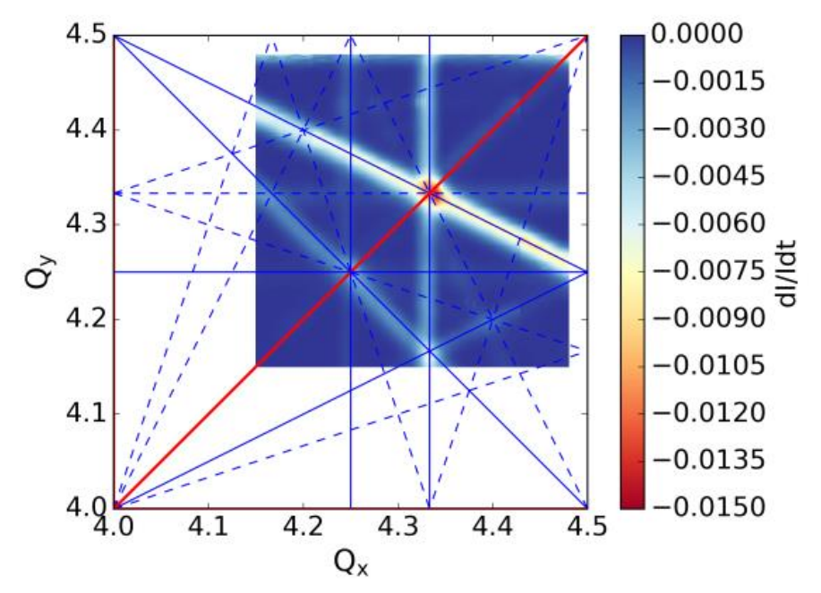
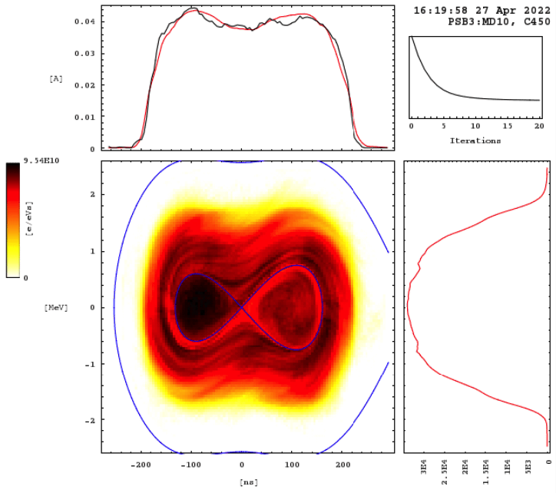
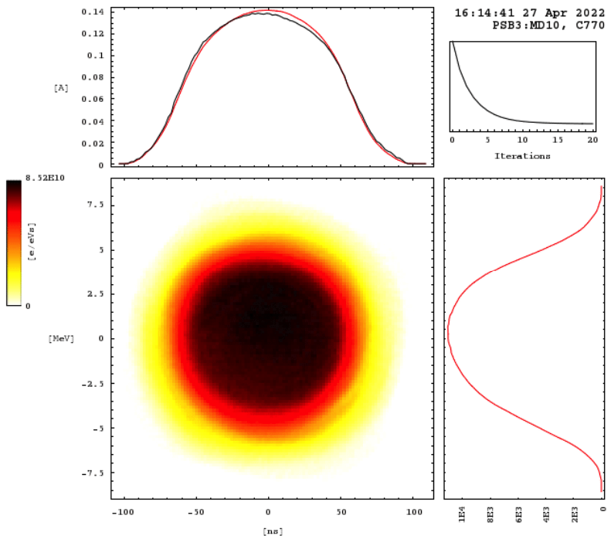
Beam Dynamics
Beam goes from double harmonic to single harmonic to reduce the peak line density (therefore space charge)
Space Charge
Resonances
While beam is accelerated, tunes are dynamically changed.
Brightness
ATSOA 2024
tirsi.prebibaj@cern.ch

Slide 21
Control Systems
CCC Consoles
(Linux-based with high-level Java/Python GUIs)
LSA/InCA: control system of the settings management
Cycle selector:
machine.USER.user_name
e.g..: PSB.USER.MD2
A cycle selector is mapped with a specific LSA user:
e.g.: MD2 → MDXXXX_EUROLABS_160MeV_2024
CERN Accelerators Logging Service (NXCALS), can be accessed from SWAN, Timber, etc.
Back-End Severs
JAPC framework
Access of JAPC parameters: “set” or “get” interactions , “subscribe” to get notified when their value changes.
See: PyJAPC, PyJAPCScout
Front-End Computers (FECs)
FESA classes
(Device-Property model)
device/property#field
e.g.: BR3.BWS.11V1/Scan#scanSelection
Controls Configuration Data Editor: ccde.cern.ch
Accelerator Equipment
CERN Gigabit Ethernet Technical Network (TN)
ATSOA 2024
tirsi.prebibaj@cern.ch

Slide 22
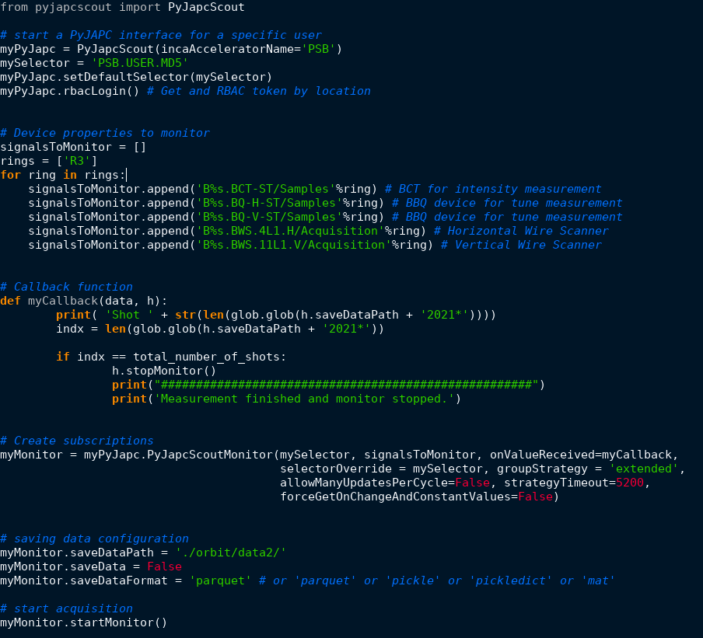
Control Systems
Data acquisition and monitoring scripts using python
ATSOA 2024

Slide 23
Measurements that we could try today
Beam parameter adjustments (intensity, emittance blow-up, energy spread).
Betatron tune measurement and correction.
Chromaticity measurement and correction.
Transverse profiles measurement and emittance/brightness reconstruction.
Closed orbit measurement and correction (?).
Resonance crossing and compensation.
Beta-beating measurement and correction.
Instabilites (?).
Other ideas?
In principle, we should avoid having high losses at high energy, mind the beam intensity.
With the non-accelerating flat bottom (160 MeV) cycle have more flexibility (unbunched beam, less dangerous for accelerator, etc.)
ATSOA 2024
tirsi.prebibaj@cern.ch

Slide 24
Measurements

Slide 25
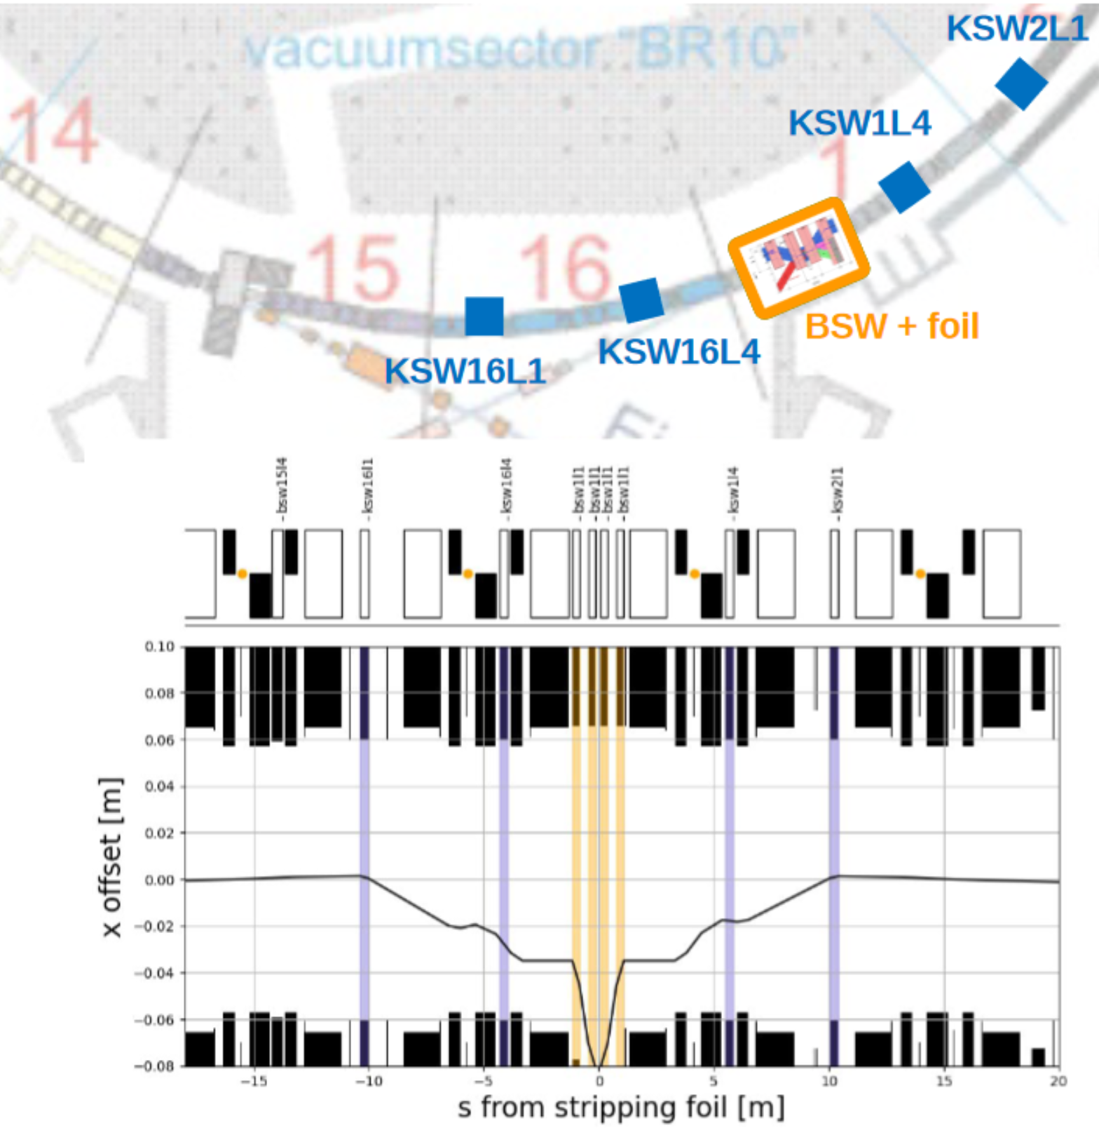
PSB $H^{−}$ Charge Exchange Injection System
Injection → beam orbit bump by:
4 phase space painting kicker magnets (KSW)
ATSOA 2024
tirsi.prebibaj@cern.ch

Slide 26
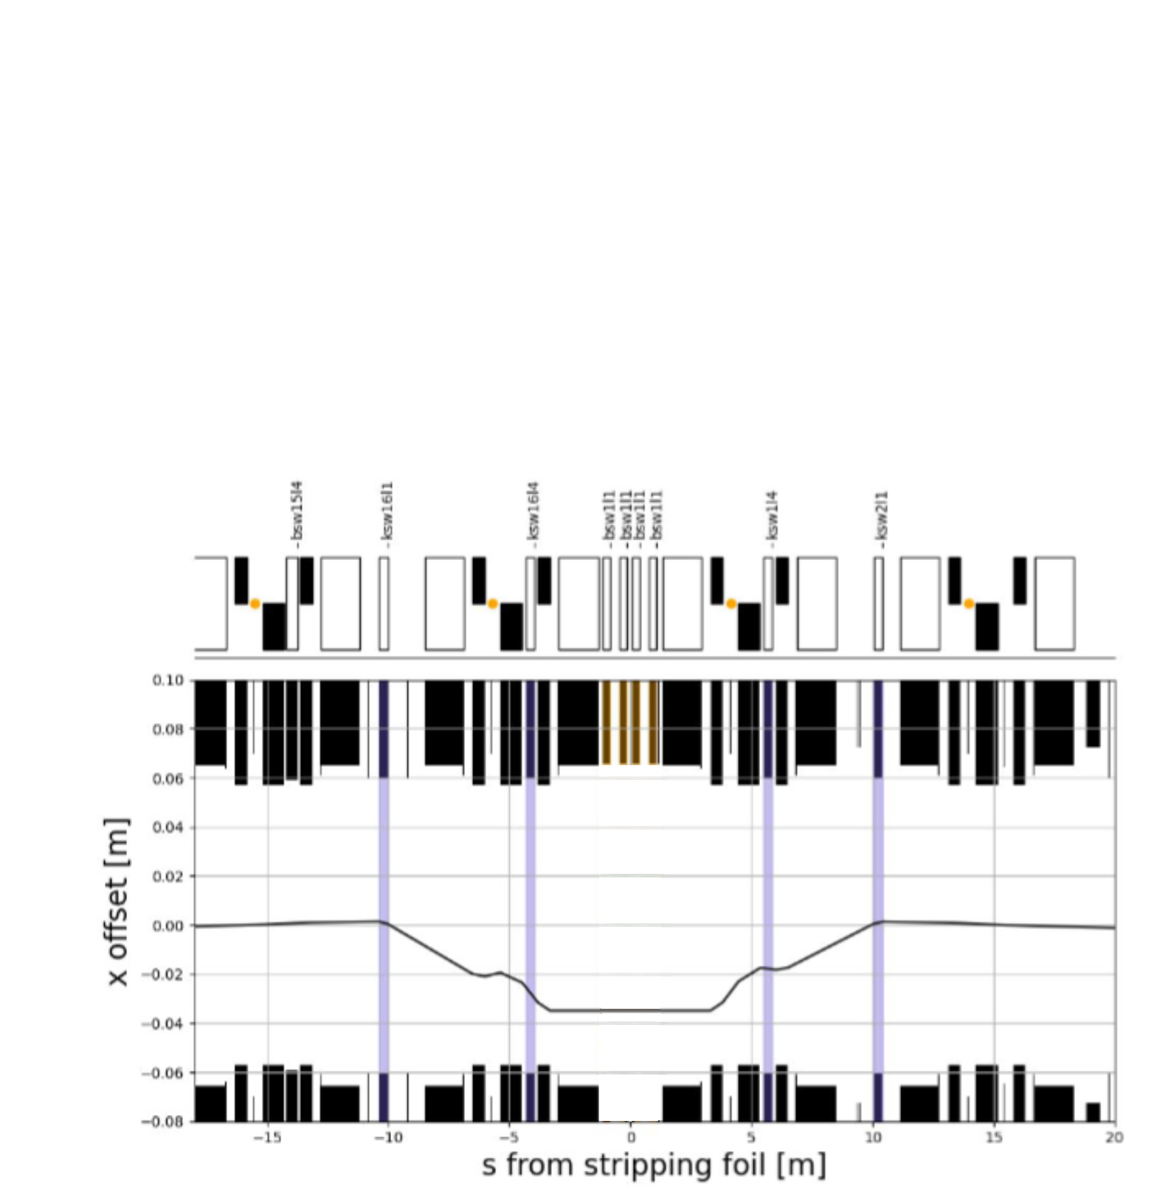
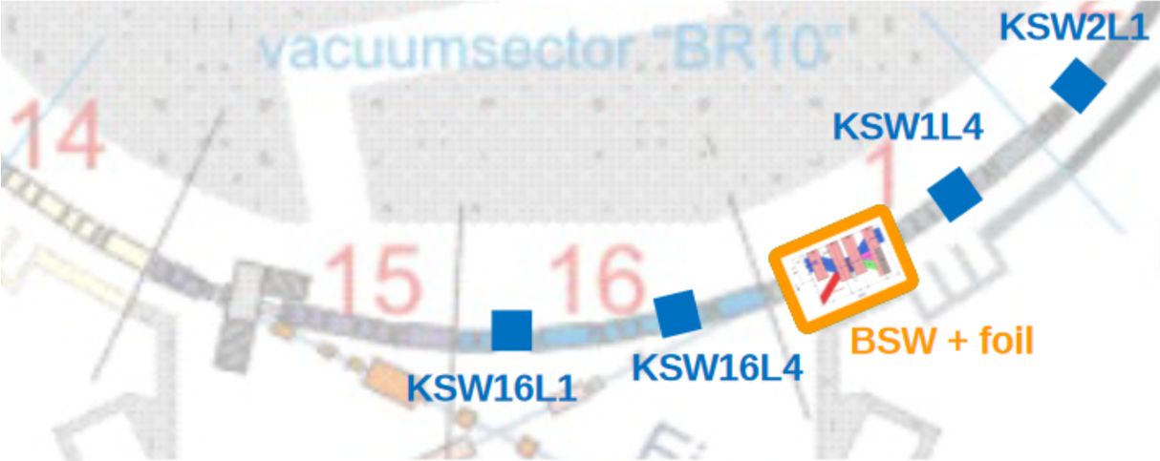
PSB $H^{−}$ Charge Exchange Injection System
Injection → beam orbit bump by:
4 phase space painting kicker magnets (KSW)
ATSOA 2024
tirsi.prebibaj@cern.ch

Slide 27
PSB $H^{−}$ Charge Exchange Injection System
Injection → beam orbit bump by:
4 phase space painting kicker magnets (KSW)
4 horizontal chicane magnets (BSW)
ATSOA 2024
tirsi.prebibaj@cern.ch

Slide 28
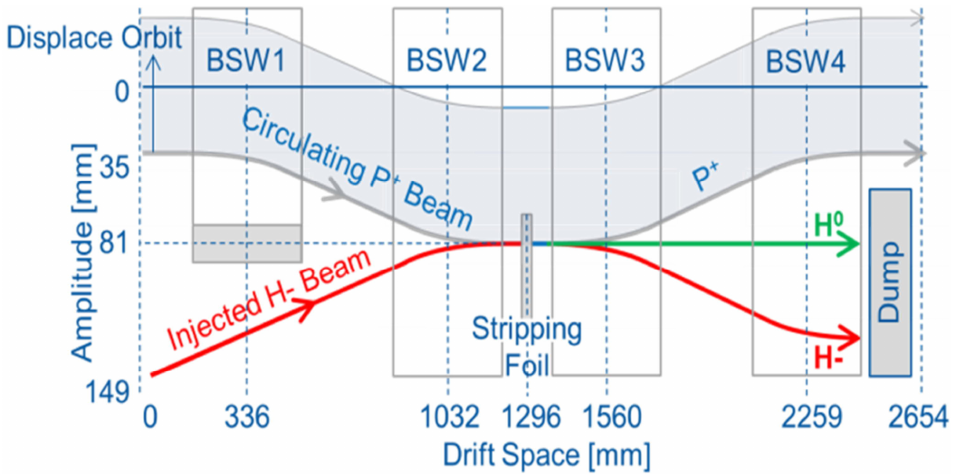
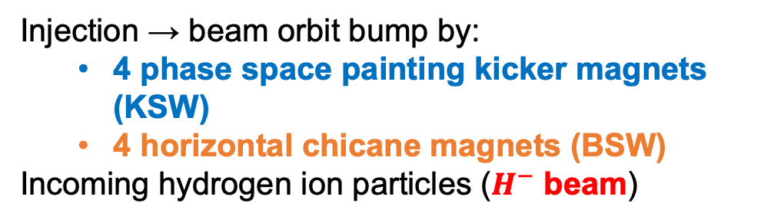
PSB $H^{−}$ Charge Exchange Injection System
Injection → beam orbit bump by:
4 phase space painting kicker magnets (KSW)
4 horizontal chicane magnets (BSW)
Incoming hydrogen ion particles ($H^{−}$ beam)
ATSOA 2024
tirsi.prebibaj@cern.ch

Slide 29
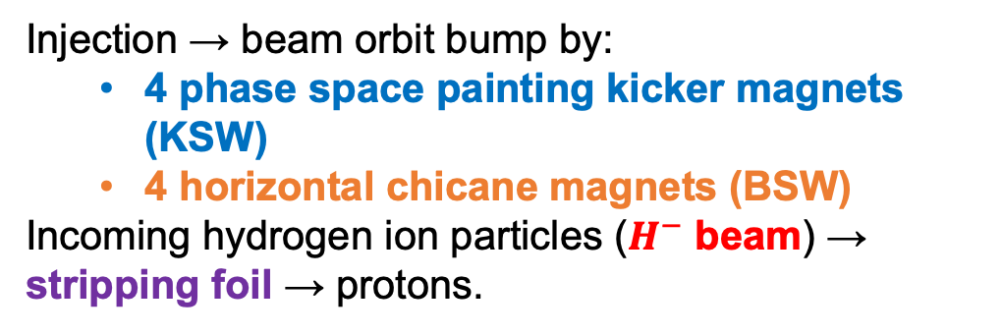
PSB $H^{−}$ Charge Exchange Injection System
Injection → beam orbit bump by:
4 phase space painting kicker magnets (KSW)
4 horizontal chicane magnets (BSW)
Incoming hydrogen ion particles ($H^{−}$ beam) → stripping foil → protons.
ATSOA 2024
tirsi.prebibaj@cern.ch

Slide 30
PSB $H^{−}$ Charge Exchange Injection System
Injection → beam orbit bump by:
4 phase space painting kicker magnets (KSW)
4 horizontal chicane magnets (BSW)
Incoming hydrogen ion particles ($H^{−}$ beam) → stripping foil → protons.
Injection process over ~100 turns (multi-turn inj.).
Closure of the bump over 5000 turns (~5ms).
ATSOA 2024
tirsi.prebibaj@cern.ch

Slide 31
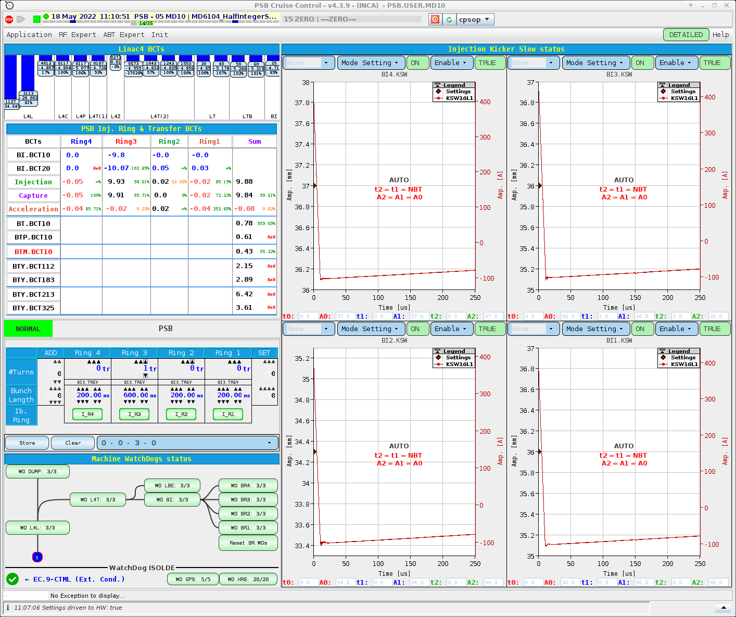
Beam parameter adjustments
Intensity
Changing the number and length of the pulses injected from Linac4
Momentum spread
Change the energy spread of the Linac4 pulse.
Emittance blow-up
Change the number of foil crossings
Injection misteering (injection oscillations)
ATSOA 2024

Slide 32
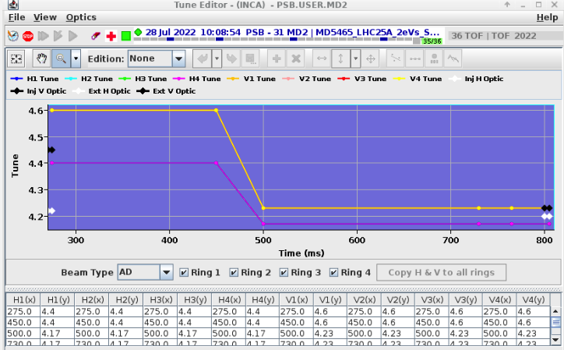
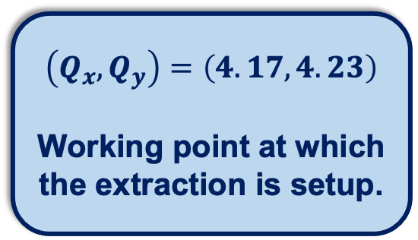
Tune setup
$$\left(Q_{x},Q_{y}\right)=\left(4.17,4.23\right)$$
Working point at which the extraction is setup.
Dynamic tune change during the PSB cycle
What is the optimal tune ramp?
ATSOA 2024
tirsi.prebibaj@cern.ch

Slide 33
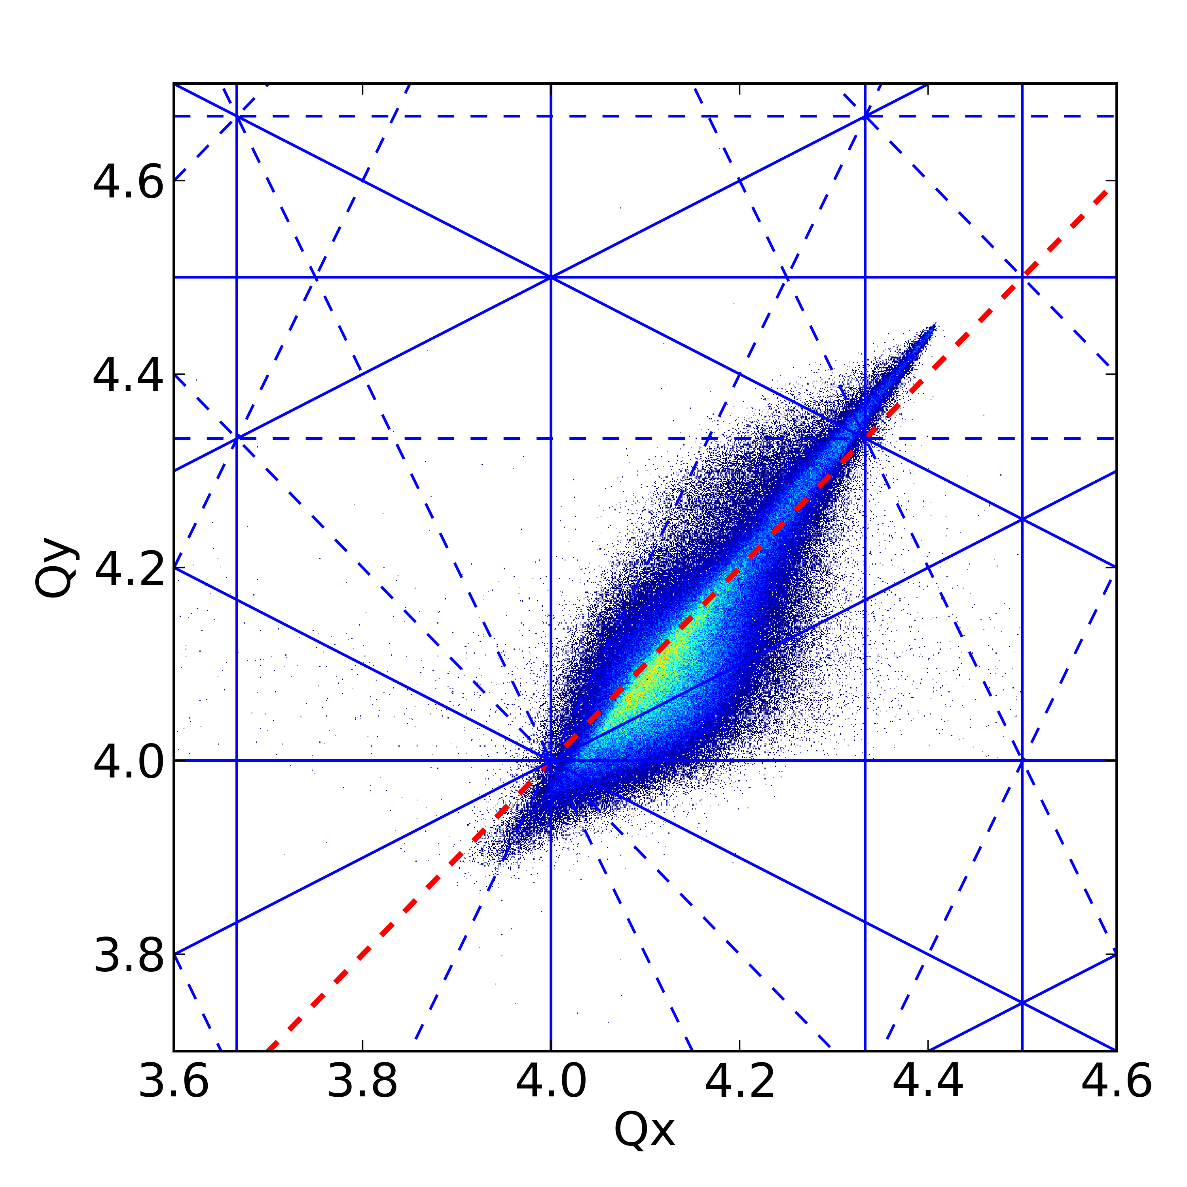
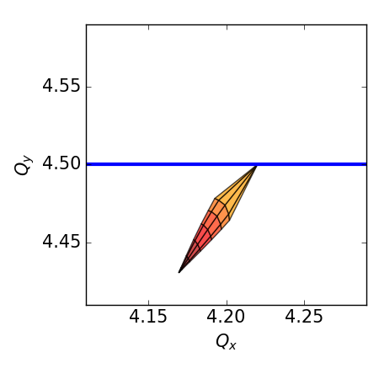
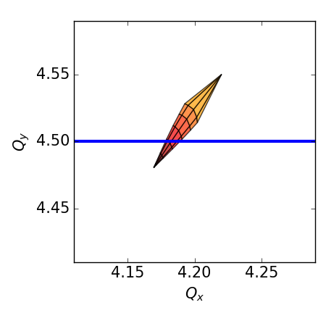



Tune setup: losses and emittance blow-up
High amplitude (tails) particles interact with the resonance:
losses
Low amplitude (core) particles interact with the resonance:
emittance blow-up
$$4Q_{x}=16$$
$$2Q_{y}=9$$
■ WP
$$4Q_{y}=16$$
PSB operates in the brightness limit:
space charge tune spread larger than 0.5
ATSOA 2024
tirsi.prebibaj@cern.ch

Slide 34
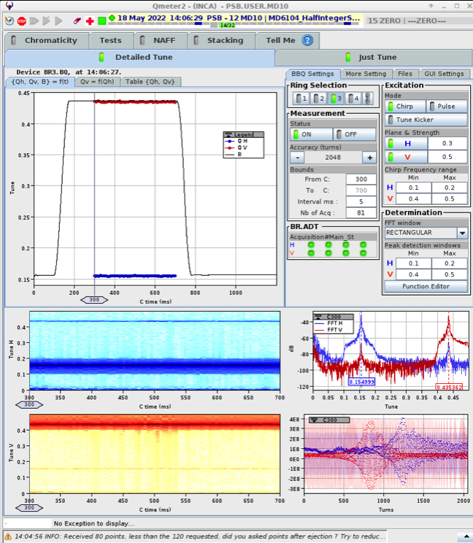
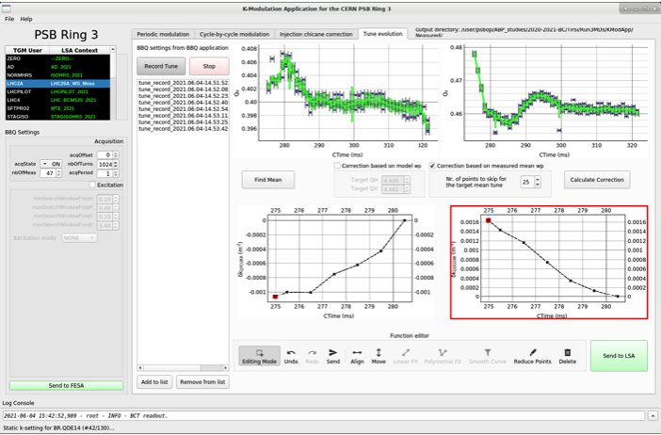
Tune measurement and correction
Tune correction based on the “make-rules”:
Q → k → I
ATSOA 2024
tirsi.prebibaj@cern.ch

Slide 35



Chromaticity measurement and correction
Chromaticity
$ξ=\frac{ δQ}{(δp/p)}$ or $Q^{′}=\frac{(δQ/Q)}{(δp/p)}$
Chromaticity is measured by measuring the tune shift for different radial steerings.
$\frac{δp}{p}=\frac{1}{η}\frac{δf_{rev}}{f_{rev}}$, where $η$ the phase slippage factor and $f_{RF}=hf_{rev}$
Chromaticity is very close to the model. MAD-X can be used to find the sextupole strength to compensate it.
ATSOA 2024
tirsi.prebibaj@cern.ch

Slide 36


Transverse and longitudinal profiles
ATSOA 2024

Slide 37


Emittance and Brightness
In the PSB we have non-zero dispesion: coupling between transverse and longitudinal motion →
growth of the horizontal phase space that the beam occupies
$${\left\langle x\right\rangle }_{measured}={\left\langle x\right\rangle }_{betatronic}∗{\left\langle x\right\rangle }_{dispersive} \\ {\left\langle x\right\rangle }_{measured}= \left\langle ε_{x}β_{x}\right\rangle ∗\left\langle D_{x} δp/p\right\rangle$$
If all three Gaussian
If at least one non-Gaussian
$$σ_{measured}=\sqrt{ε_{x}β_{x}+{\left(D_{x}\frac{δp}{p}\right)}^{2}}$$
Emittance → Normalized emittance
$$ε_{n}=ε_{x}β_{rel}γ_{rel}$$
Deconvolution not trivial; need iterative algorithms
Brightness → Intensity/emittance
ATSOA 2024
tirsi.prebibaj@cern.ch

Slide 38


Resonance crossing and compensation
Third and fourth order resonances are dynamically crossed at different times during the acceleration cycle.
Resonance compensation is applied using the available quadrupole, sextupole and octupole correctors, only when the resonance is crossed.
One corrector can perturb the compensation of other resonances. Attempts have been made for a global resonance compensation.
The compensation is done experimentally by finding a suitable magnet pair for the correction and changing the driving tern that they create.
ATSOA 2024
tirsi.prebibaj@cern.ch

Slide 39

Beta-beating
ATSOA 2024
tirsi.prebibaj@cern.ch

Slide 40



$β$-beating measurements at injection
Before correction
Measurement of the $β$-beating during the fall of the injection chicane using k-modulation (excellent agreement with expected perturbations).
Calculation of the dynamic correction which was applied to the machine.
After correction
ATSOA 2024
tirsi.prebibaj@cern.ch

Slide 41

$β$-beating measurements at injection
ATSOA 2024
tirsi.prebibaj@cern.ch

Slide 42


Instabilities
ATSOA 2024
tirsi.prebibaj@cern.ch

Slide 43
Closed Orbit Measurement and Correction
ATSOA 2024
tirsi.prebibaj@cern.ch

