Slide 2
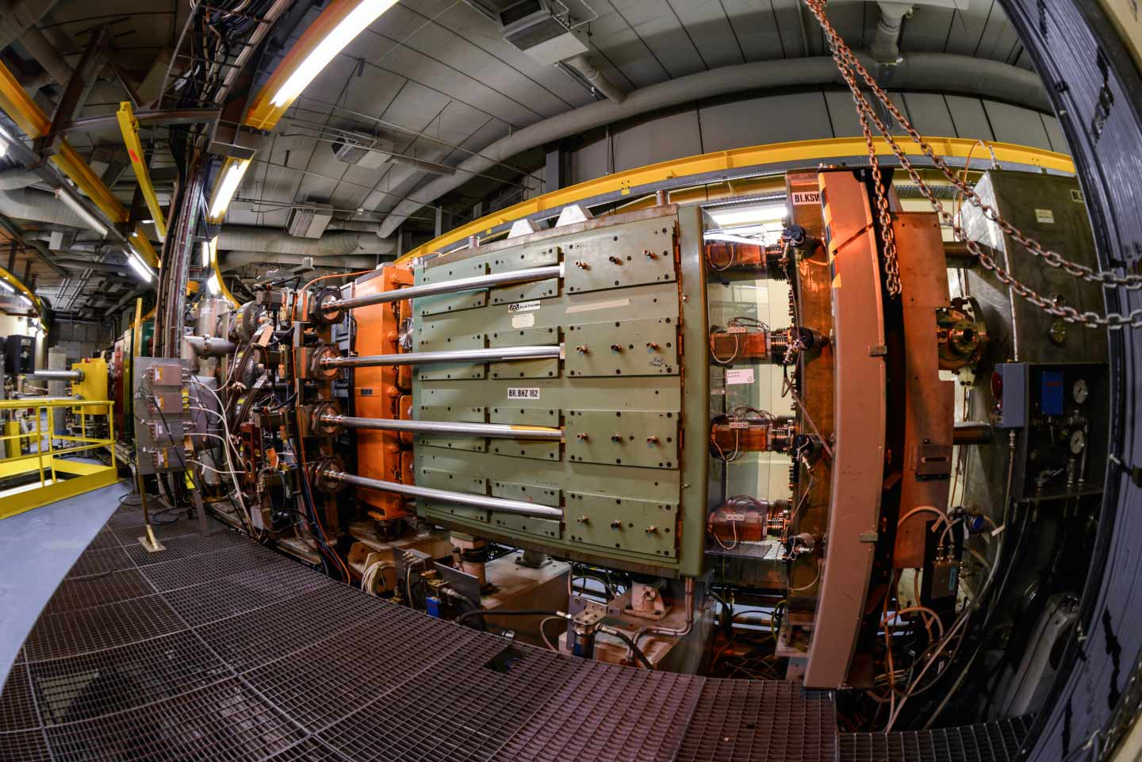
Introduction to the Proton Synchrotron Booster (PSB) Accelerator, Control Systems & Measurements
Tirsi Prebibaj & Foteini Asvesta
12-16/05/2025
Advanced Training School on Operation of Accelerators – ATSOA2025
EURO-LABS @ CERN

Slide 3
Outline
CERN injectors complex & facilities
Beam delivery – supercycles
PSB layout
Beam instrumentation
Beam dynamics
Control systems
Measurements for today

Slide 4
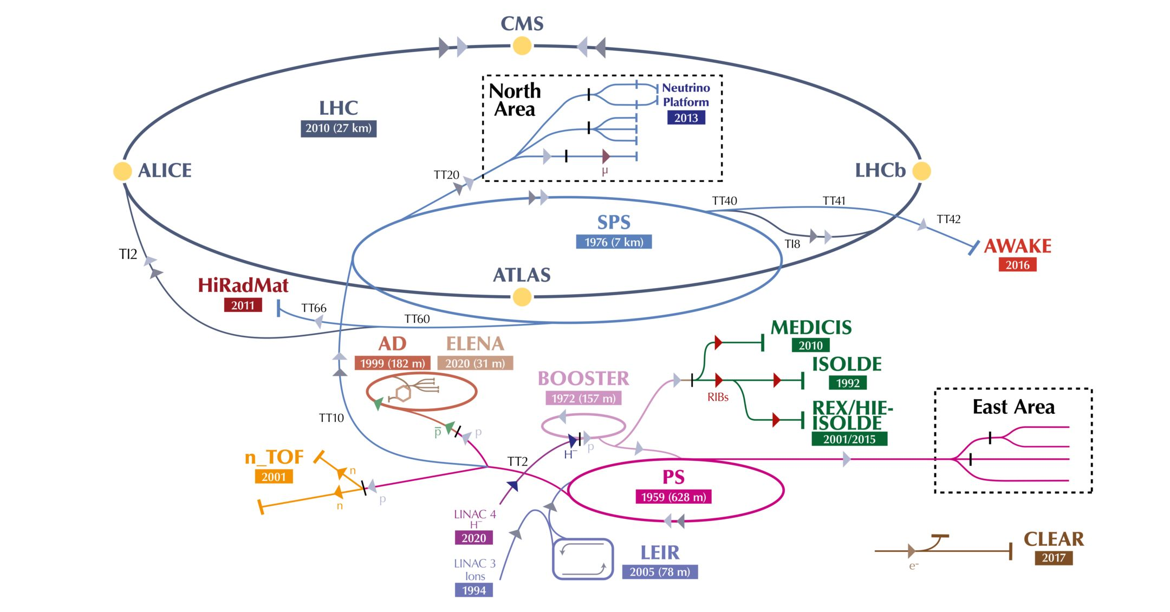
CERN injectors complex & facilities

Slide 5
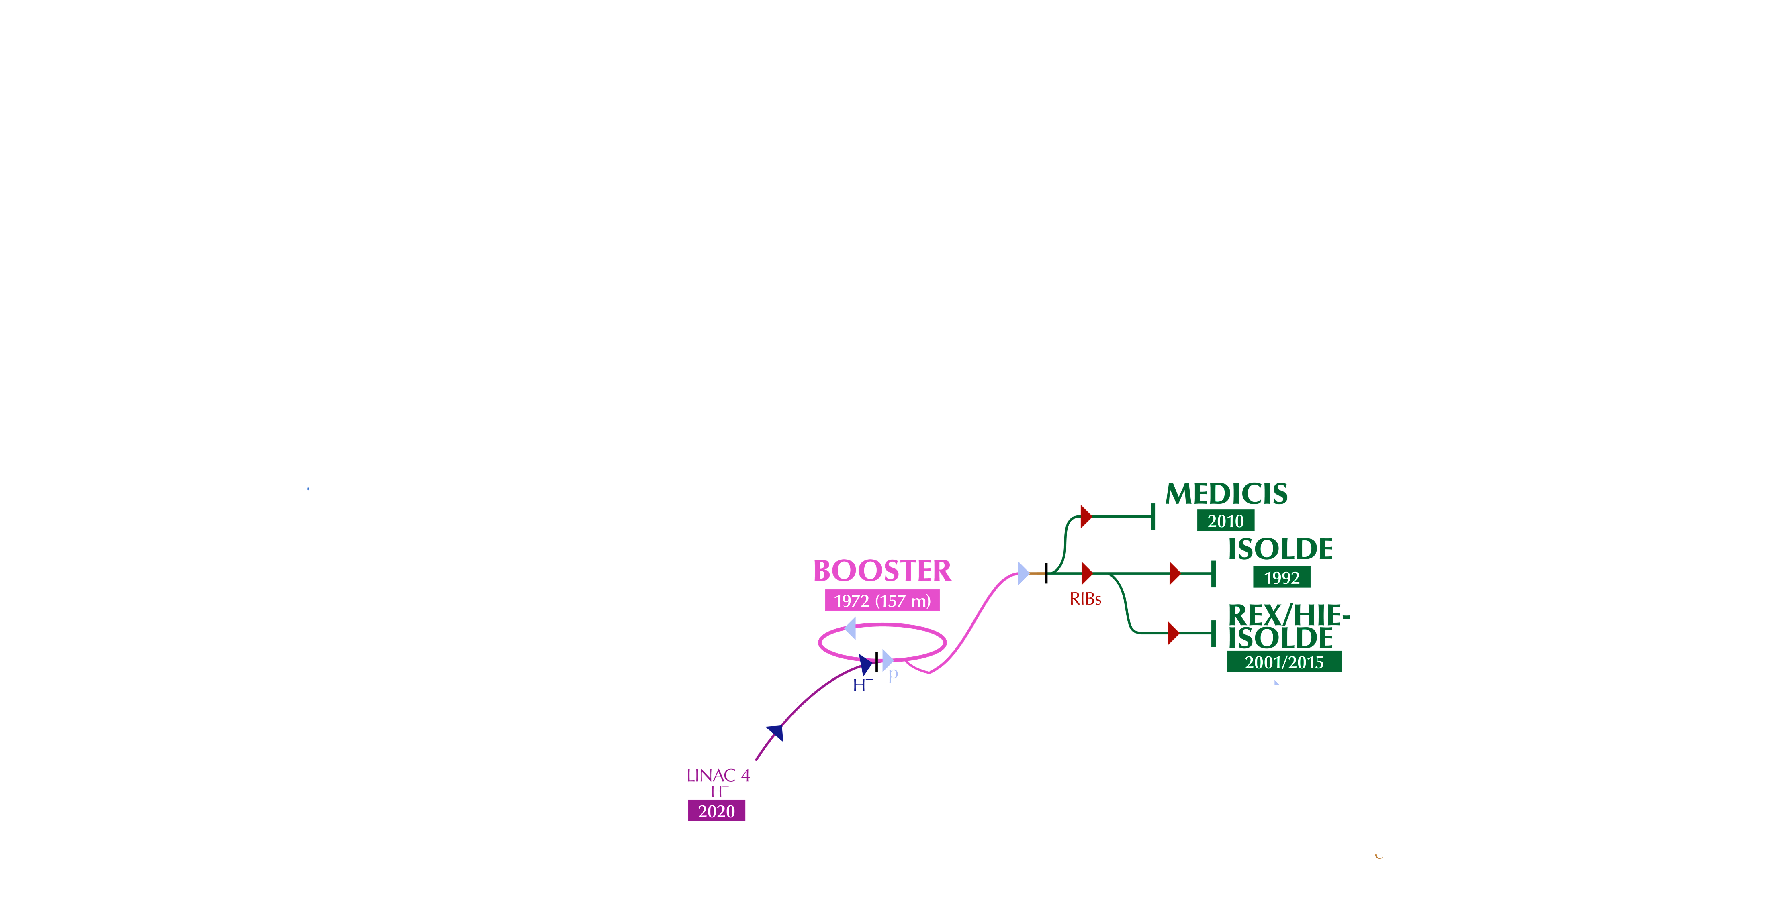
CERN injectors complex & facilities

Slide 6
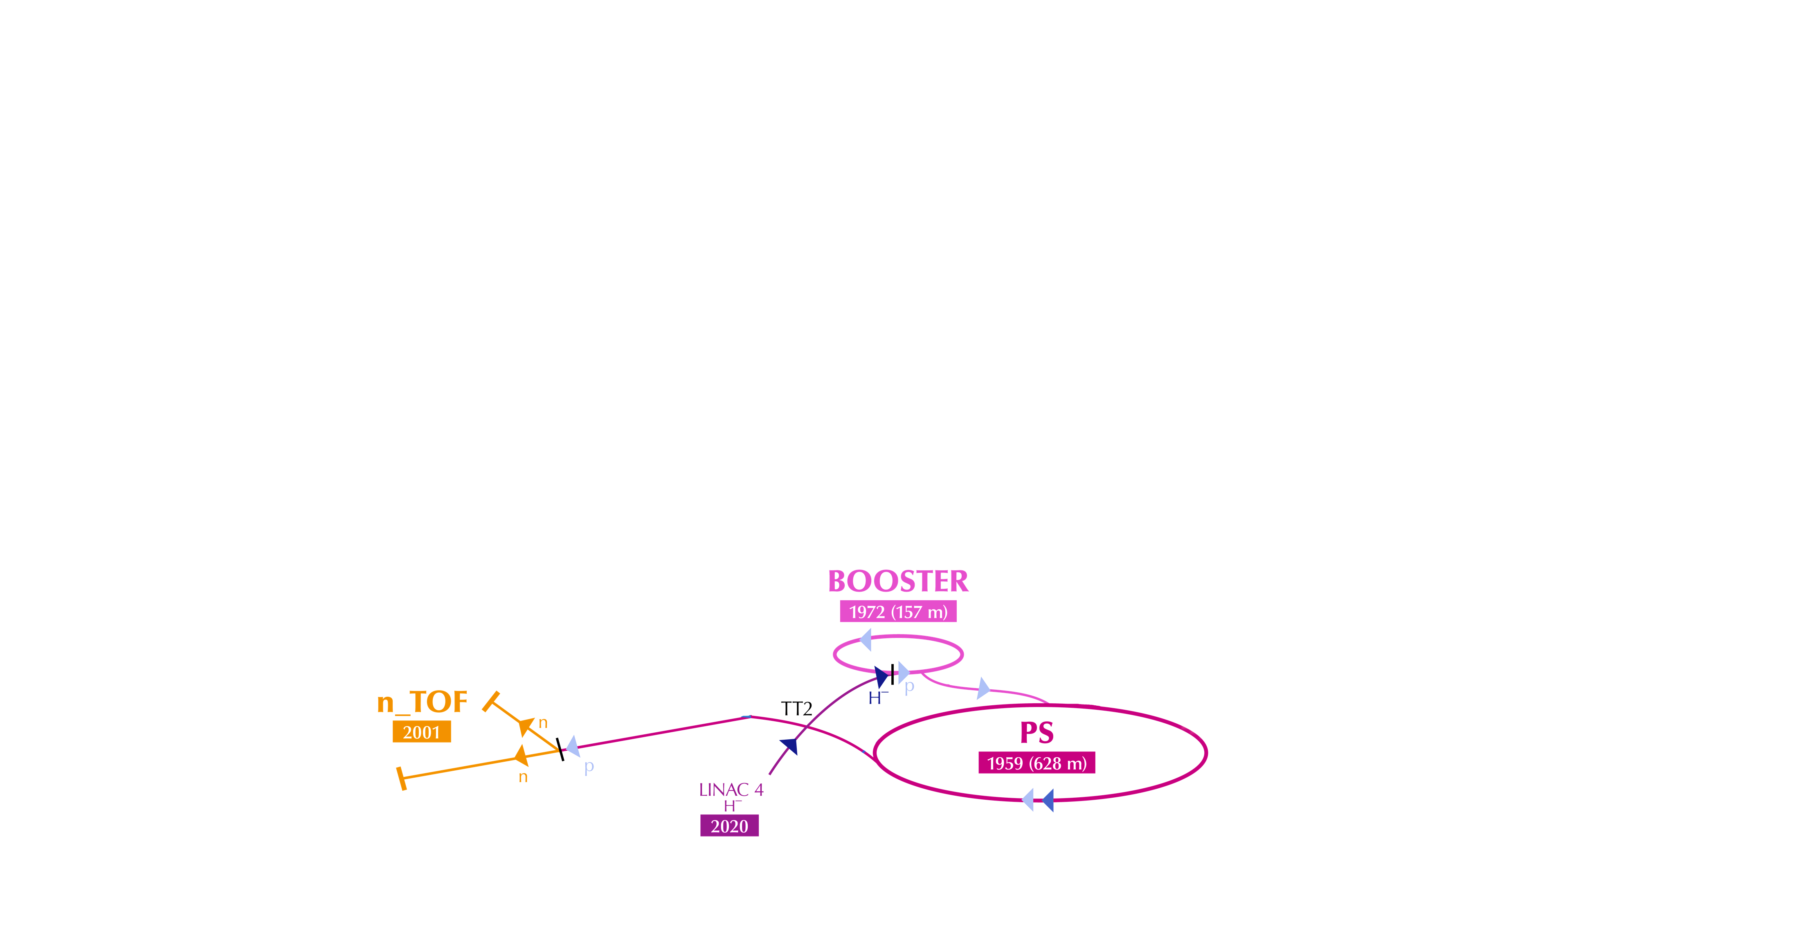
CERN injectors complex & facilities

Slide 7
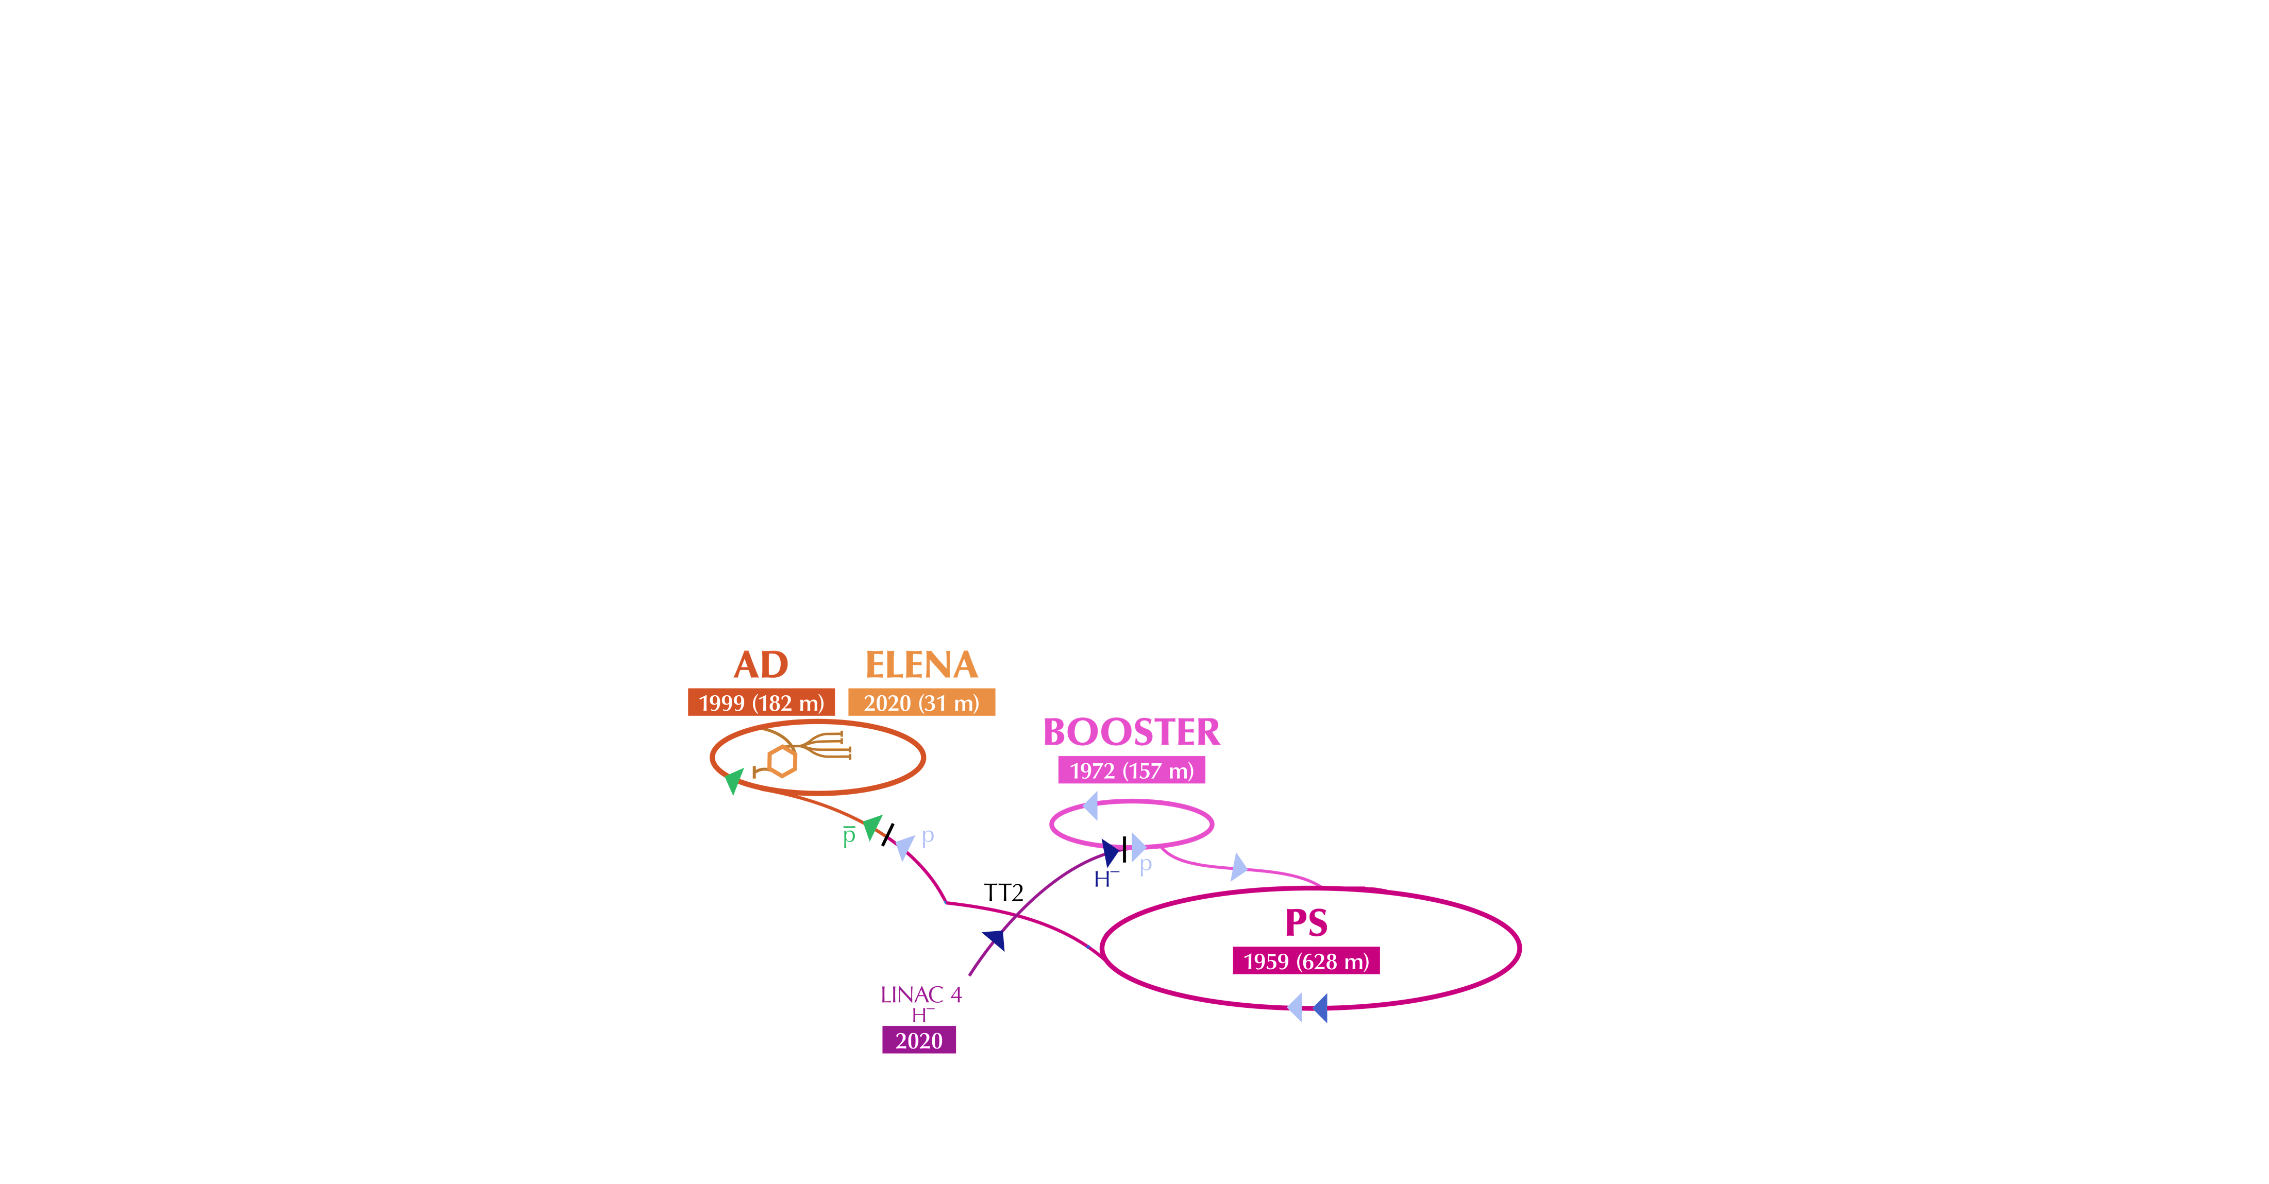
CERN injectors complex & facilities

Slide 8
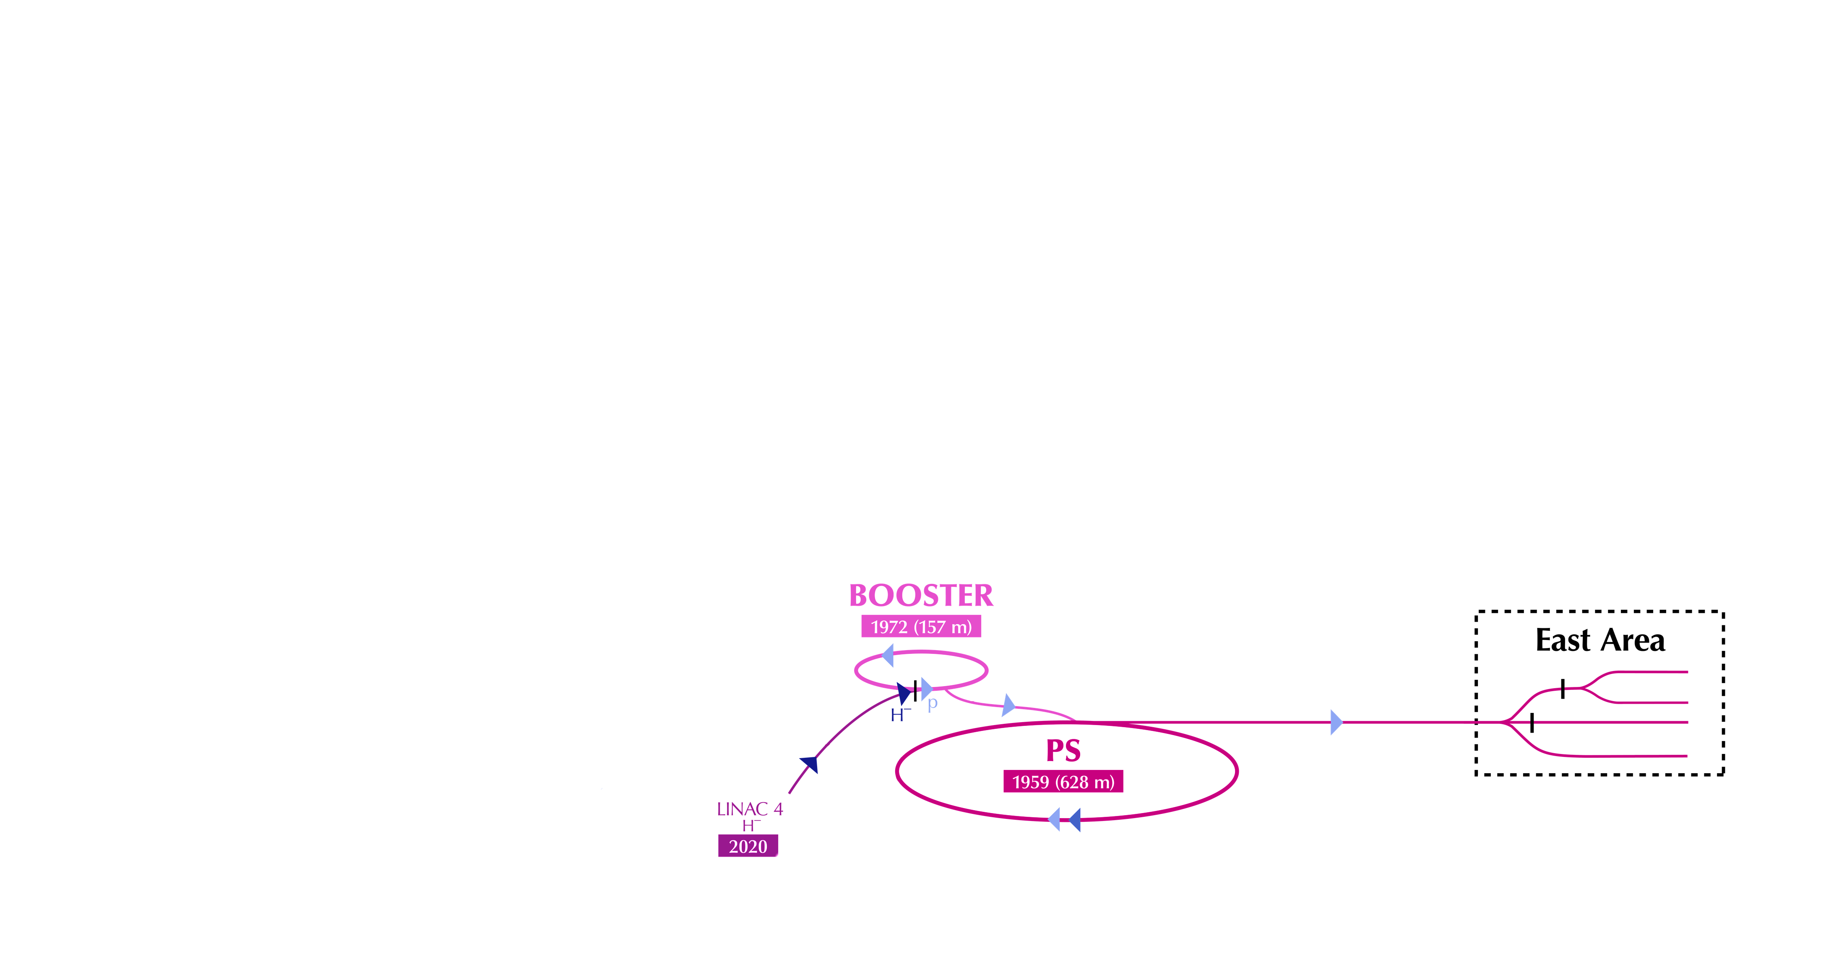
CERN injectors complex & facilities

Slide 9
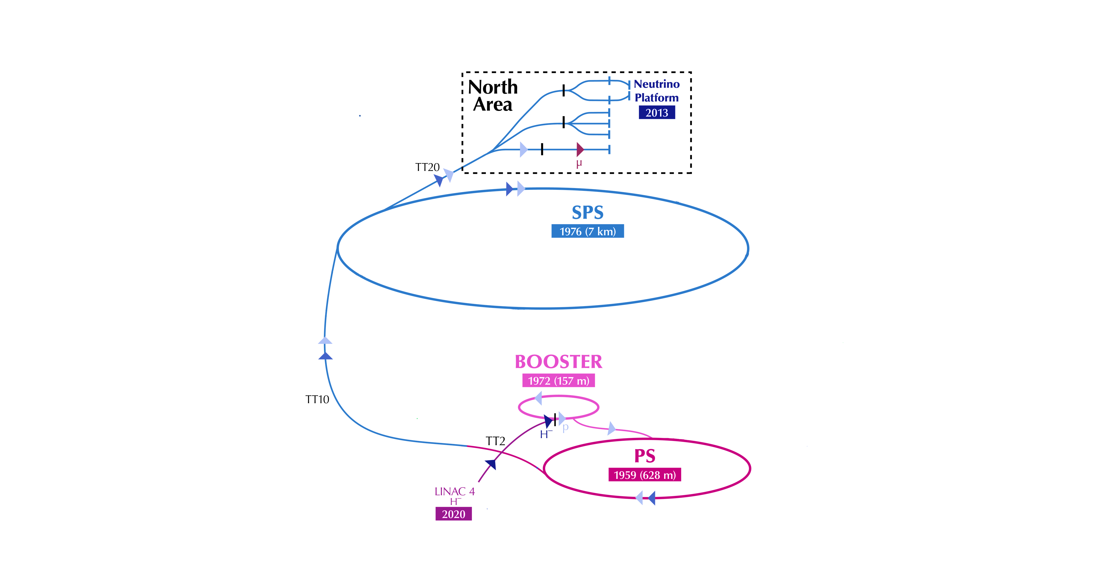
CERN injectors complex & facilities

Slide 10
CERN injectors complex & facilities

Slide 11
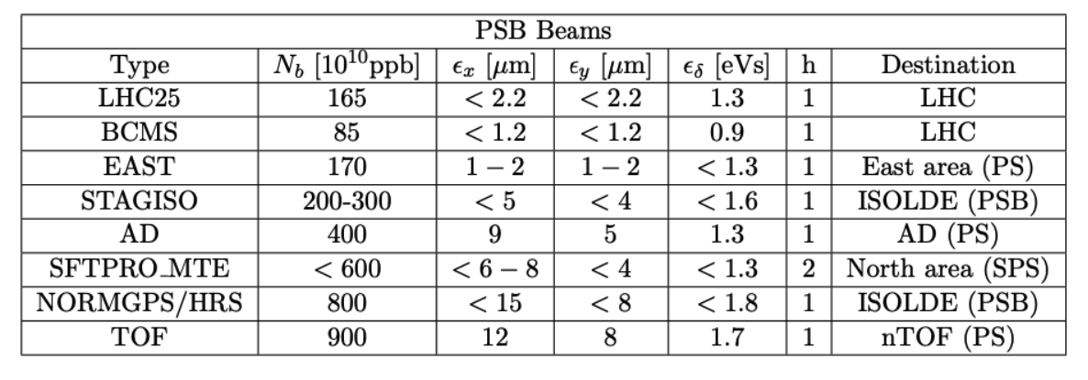
Beam delivery – supercycles

Slide 12
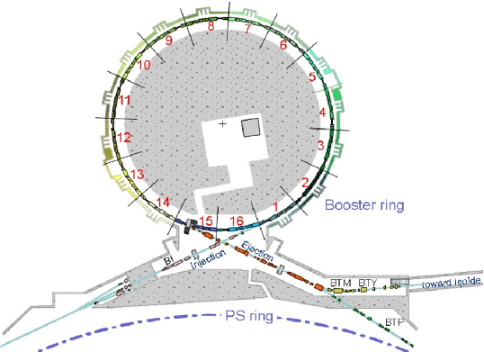
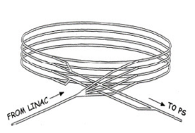

PSB layout
4 identical superimposed rings of $25$m radius.
Acceleration from 160 MeV to 2 GeV in ~0.5 sec.
Common injection and extraction line.

Slide 13
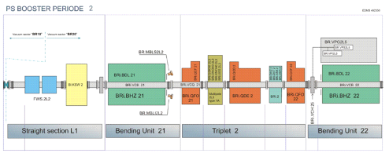

PSB layout
4 identical superimposed rings of $25$m radius.
Acceleration from 160 MeV to 2 GeV in ~0.5 sec.
Common injection and extraction line.
16 periods (sectors), each with two dipoles, three quadrupoles and a “straight section” for adittional elements.

Slide 14
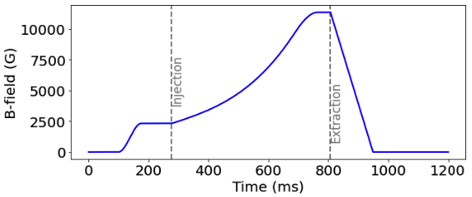

PSB layout
4 identical superimposed rings of $25$m radius.
Acceleration from 160 MeV to 2 GeV in ~0.5 sec.
Common injection and extraction line.
16 periods (sectors), each with two dipoles, three quadrupoles and a “straight section” for adittional elements.
Magnetic cycle of 1.2 sec. Beam injection at 275 ms and extraction at 805 ms.

Slide 15
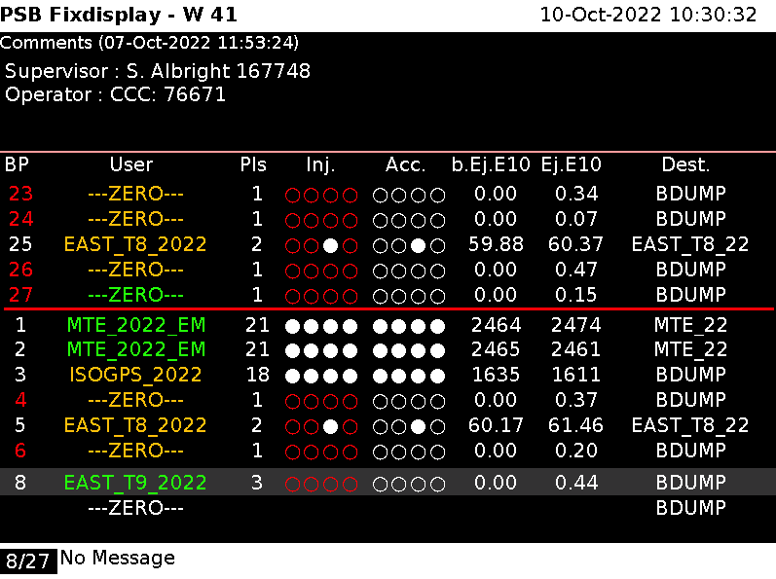
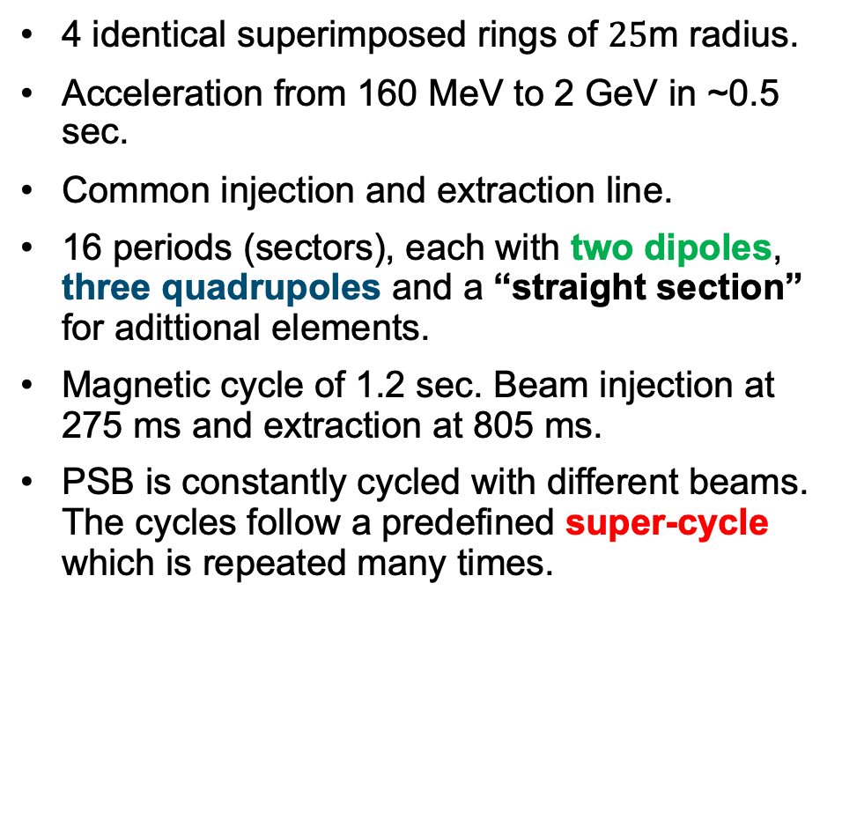
Beam delivery – supercycles
4 identical superimposed rings of $25$m radius.
Acceleration from 160 MeV to 2 GeV in ~0.5 sec.
Common injection and extraction line.
16 periods (sectors), each with two dipoles, three quadrupoles and a “straight section” for adittional elements.
Magnetic cycle of 1.2 sec. Beam injection at 275 ms and extraction at 805 ms.
PSB is constantly cycled with different beams. The cycles follow a predefined super-cycle which is repeated many times.

Slide 16
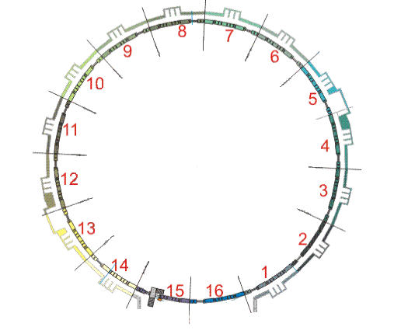
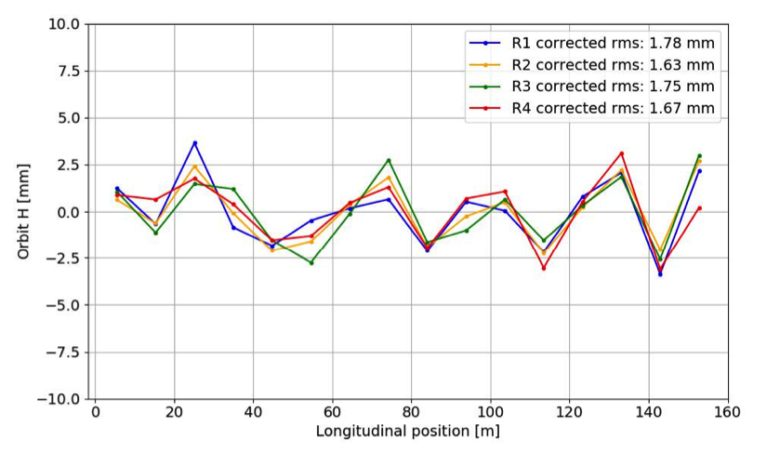
PSB beam instrumentation

Slide 17
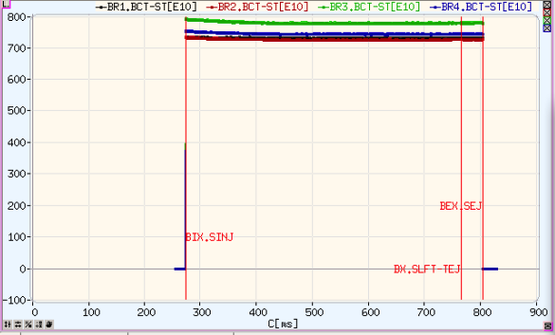
PSB beam instrumentation

Slide 18
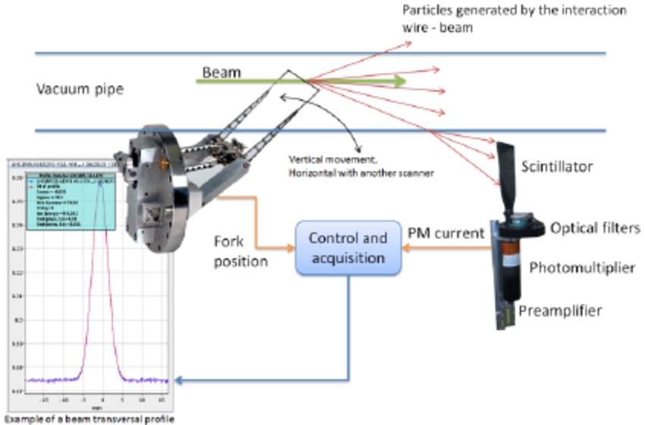
PSB beam instrumentation

Slide 19
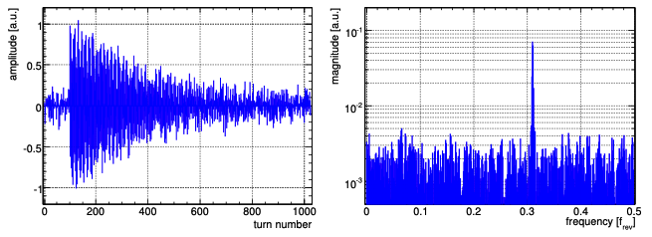
PSB beam instrumentation

Slide 20
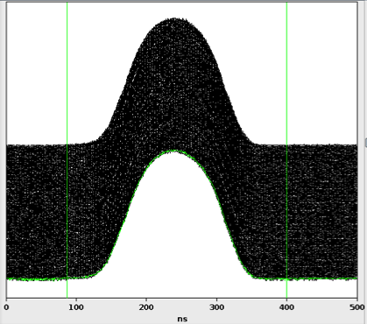
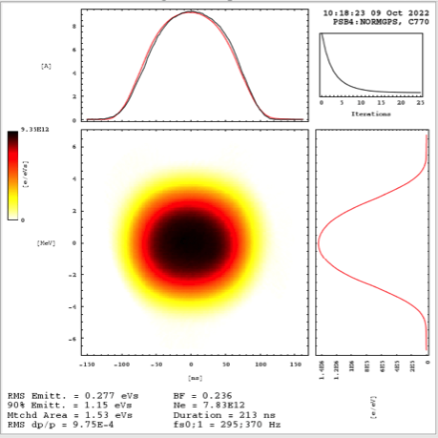
PSB beam instrumentation

Slide 21
PSB beam instrumentation

Slide 22
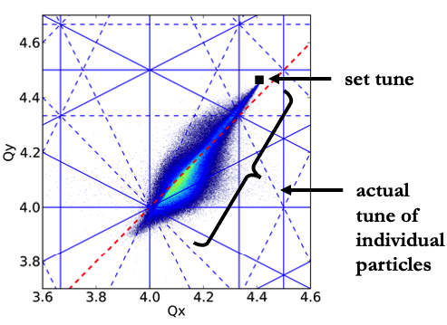
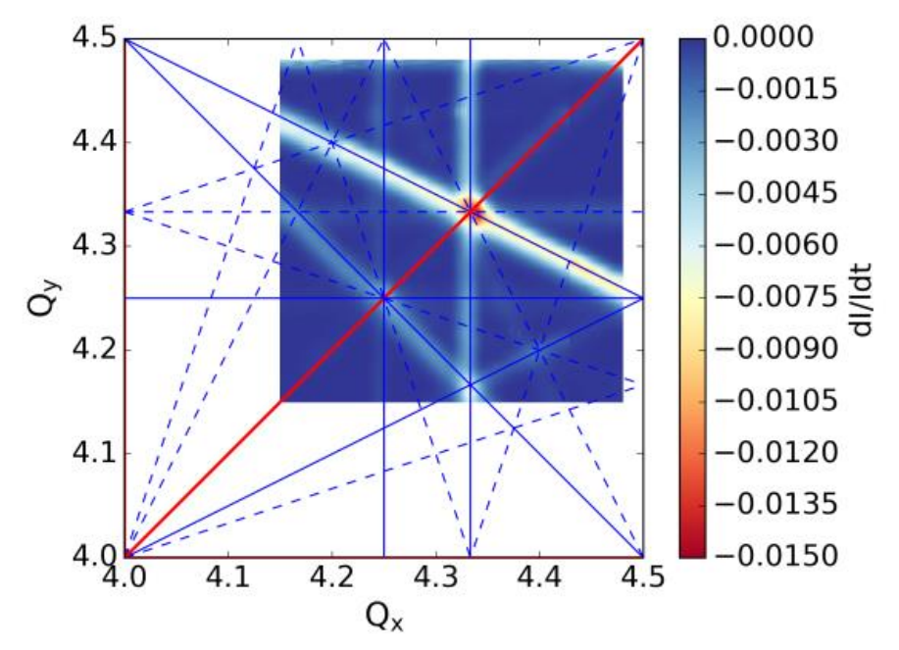
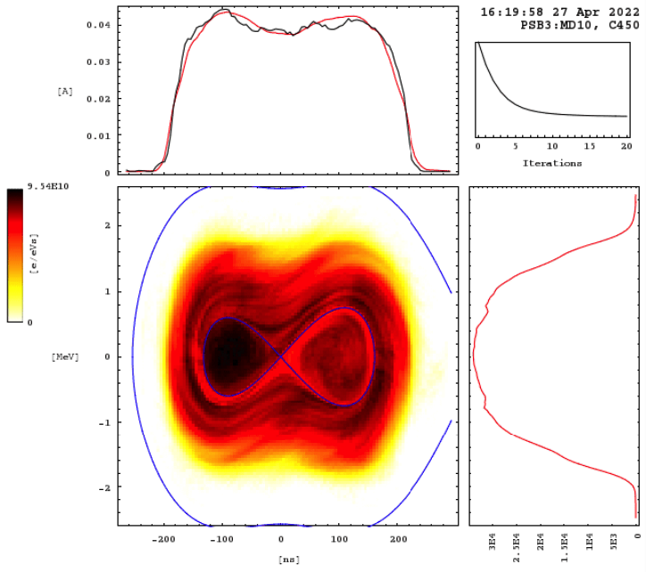
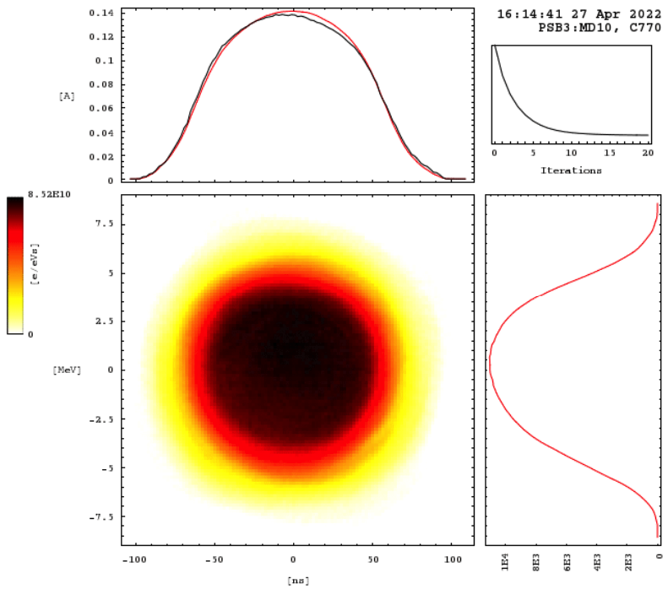
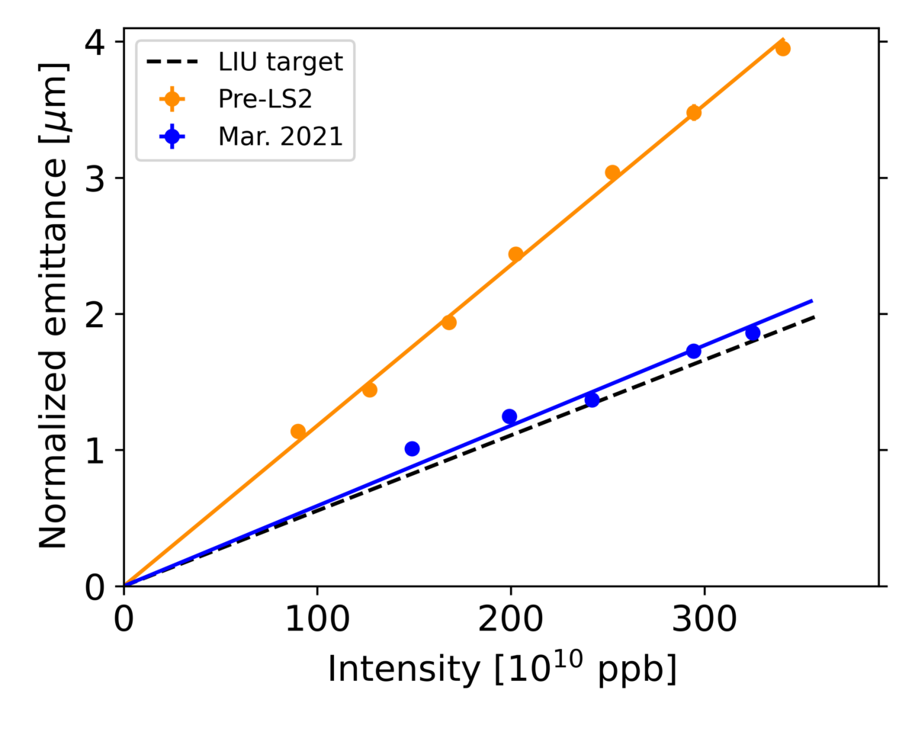
Beam dynamics
Beam goes from double harmonic to single harmonic to reduce the peak line density (therefore space charge)
Space Charge
Resonances
While beam is accelerated, tunes are dynamically changed.
Brightness

Slide 23
Control systems
CCC Consoles
(Linux-based with high-level Java/Python GUIs)
LSA/InCA: control system of the settings management
Cycle selector:
machine.USER.user_name
e.g..: PSB.USER.MD2
A cycle selector is mapped with a specific LSA user:
e.g.: MD2 → MDXXXX_EUROLABS_160MeV_2024
CERN Accelerators Logging Service (NXCALS), can be accessed from SWAN, Timber, etc.
Back-End Severs
JAPC framework
Access of JAPC parameters: “set” or “get” interactions , “subscribe” to get notified when their value changes.
See: PyJAPC, PyJAPCScout
Front-End Computers (FECs)
FESA classes
(Device-Property model)
device/property#field
e.g.: BR3.BWS.11V1/Scan#scanSelection
Controls Configuration Data Editor: ccde.cern.ch
Accelerator Equipment
CERN Gigabit Ethernet Technical Network (TN)

Slide 24
Measurements of today

Slide 25
Hands-on measurements in the PSB
Beam characterization
Get familiar with the PSB and basic instruments (BCT, wire scanner, tomoscope).
Monitor basic beam parameters (beam intensity, emittance, bunch shape)
Injection effects
Understand multi-turn injection system and how to control it (cruise control)
Optimize injection process (minimize injection oscillations and foil scattering)
Tune setting and measurement
Get familiar with LSA interface.
Perform tune measurement (and correction?) for various working points.
Brightness performance
Measure brightness for different working points (understand impact of space charge tune spread).
Resonance effects
Measure beam degradation from resonances.
Understand importance of machine imperfections and non-linear effects.

