Slide 2
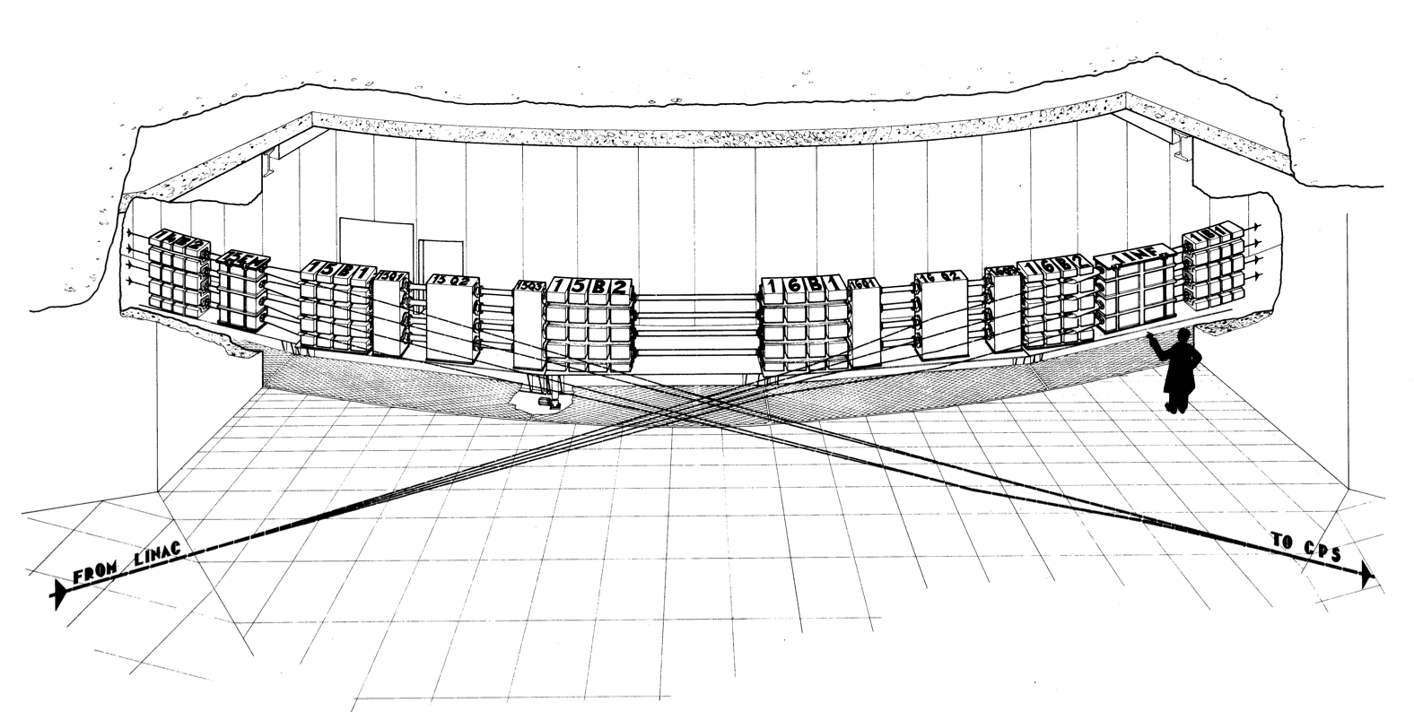
ATSOA 2025 @ PSB
Foteini Asvesta & Tirsi Prebibaj
12-16/05/2025
Advanced Training School on Operation of Accelerators – ATSOA2025
EURO-LABS @ CERN

Slide 3
CERN-MPS-INT-DL-B-67-19

Slide 4
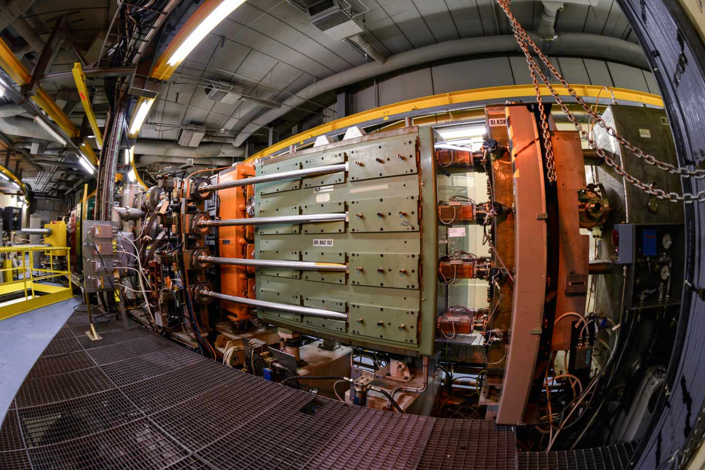

Slide 5
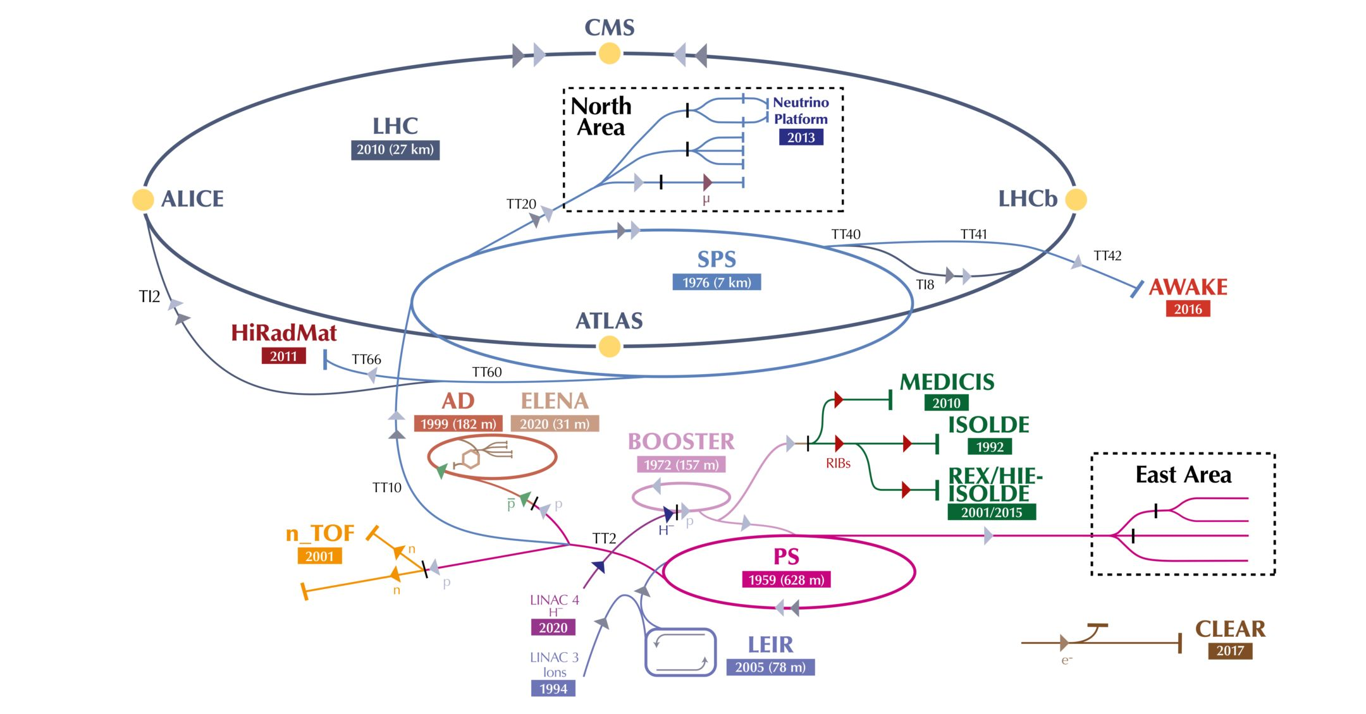

Slide 6
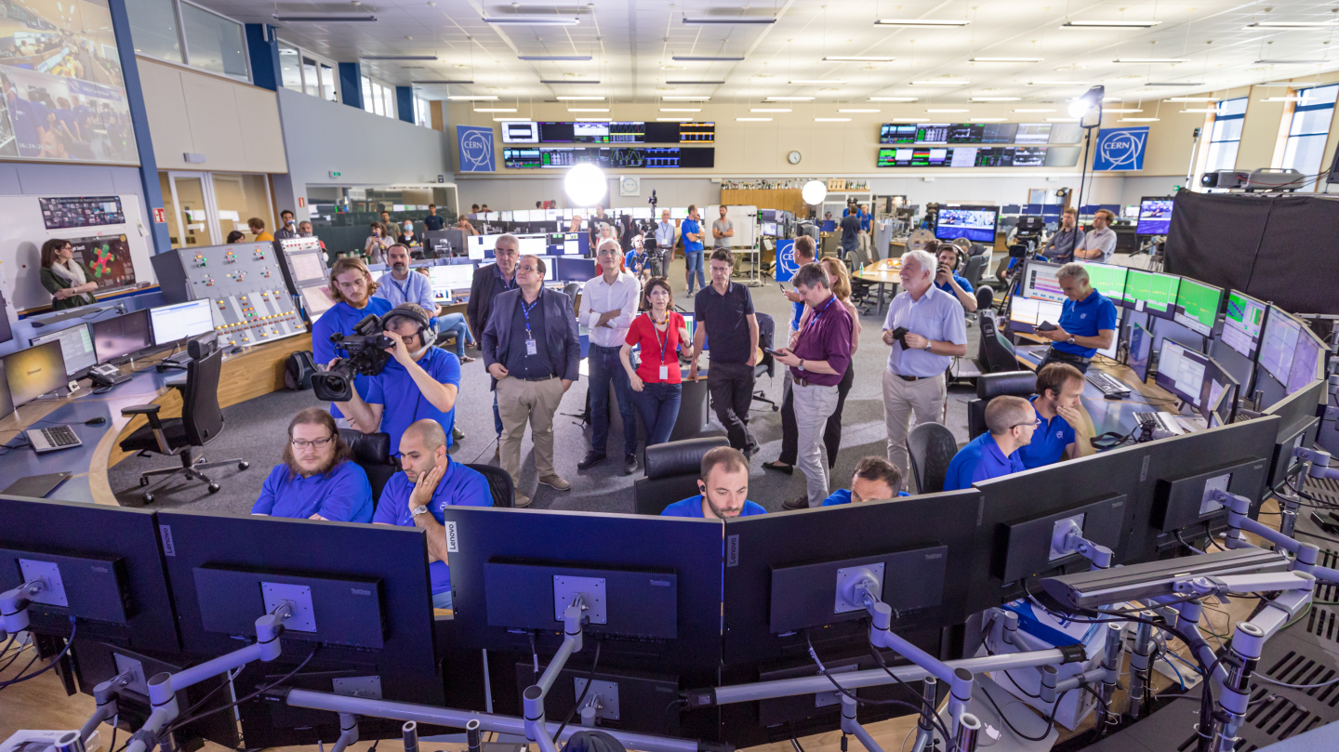

Slide 7
ATSOA 2025 @ PSB
The PSB training aims at:
Getting familiar with the PSB accelerator (layout, beams, operation, …)
Controlling and setting-up the beam (injection, extraction, controlling machine settings, monitoring beam parameters, …)
Characterize its brightness performance and understand the most important beam dynamics effects (space charge, resonances, working point, …)
For any question you can reach us by email (tirsi.prebiba@cern.ch and foteini.asvesta@cern.ch), or by phone to +41754111243.
All presentations and measurements will be done at the CERN Control Centre (CCC): building 874 (Prevessin site).

Slide 8
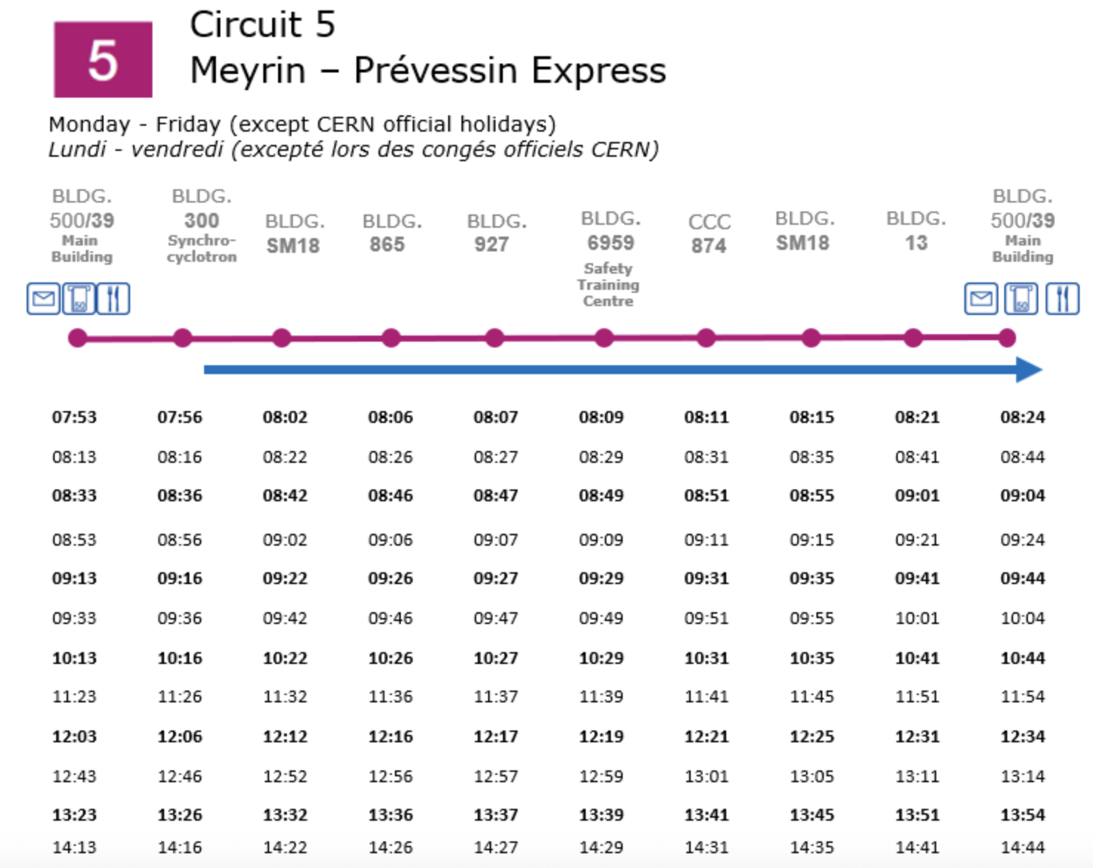
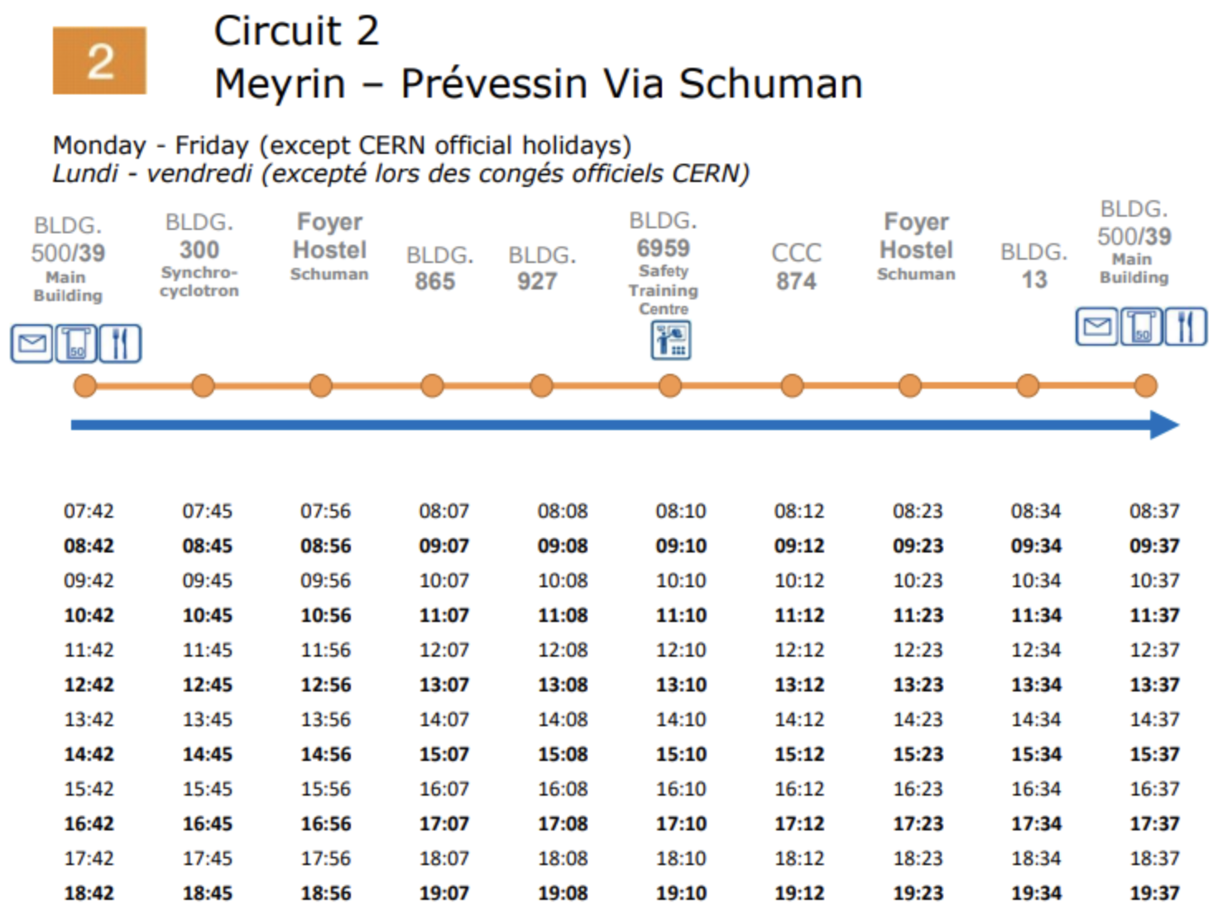
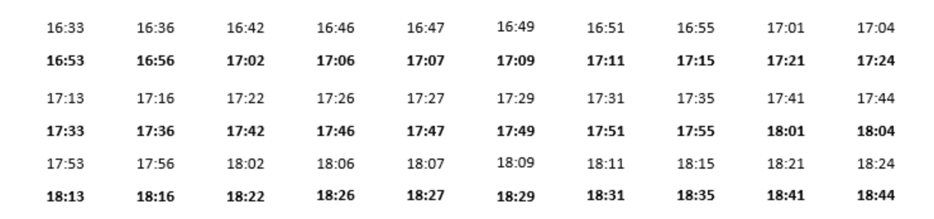
How to get to the CCC
CERN maps (also available for Android & iOS): https://maps.cern.ch
CERN shuttle service: https://sce-dep.web.cern.ch/cern-shuttle-service

Slide 9
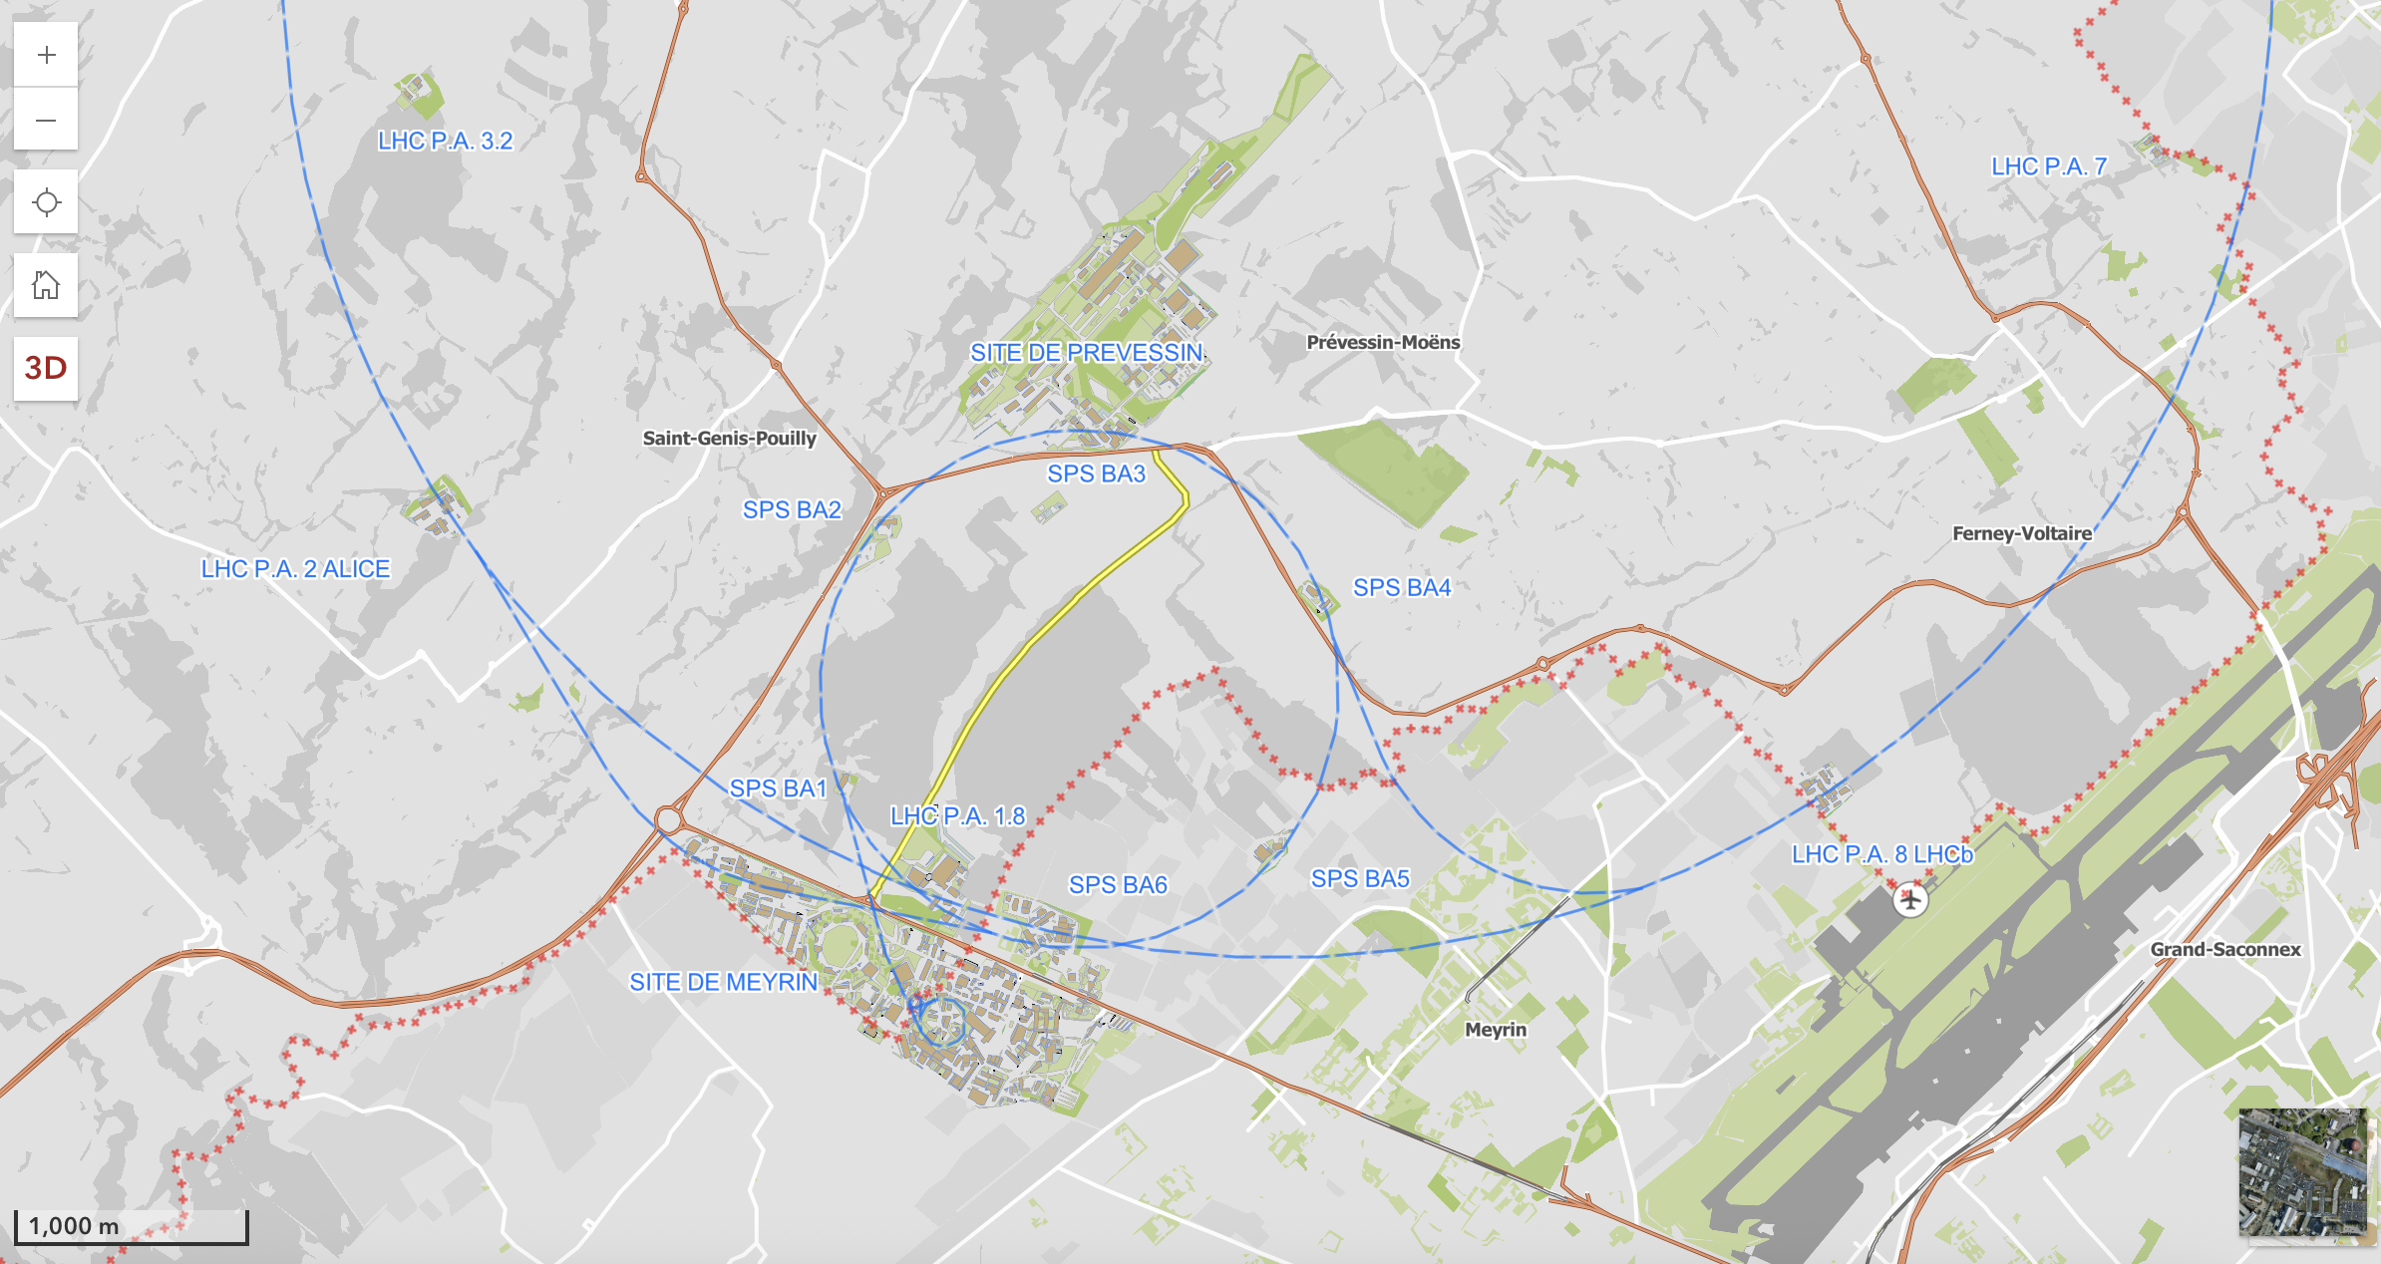

Slide 10
