Slide 1

Distributed Database Systems Project
Ivan Yazykov, Guilherme Diogo Department of Computer Science and Technology

Slide 2
Project Overview
Technologies Used:
Docker:
Containerization and orchestration of services.
MongoDB:
Sharded cluster for structured data.
Hadoop:
Distributed file system and analytics for unstructured data.
Redis:
In-memory caching for faster query response.
Node.js:
Backend runtime environment for web application development.

Slide 3
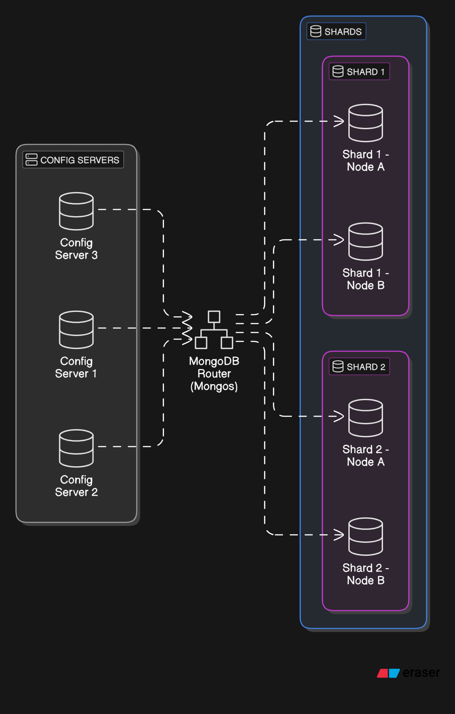
Data Center Design
Explanation:
MongoDB’s Sharded Cluster distributes data across multiple machines for horizontal scalability.
Replication ensures high availability and fault tolerance.
Router (mongos) routes client queries to the appropriate shard based on the shard key.

Slide 4
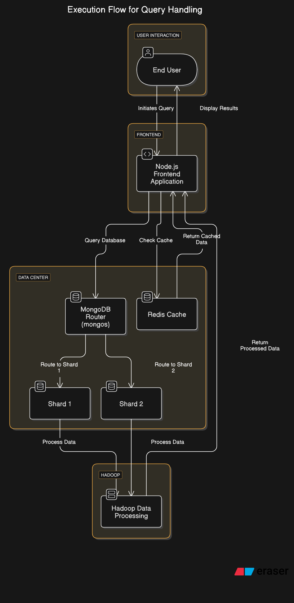
Initialization
Steps:
Start Docker Containers:
Launch MongoDB, Hadoop, Redis, and the frontend.
Initialize MongoDB Replica Sets:
Configure config servers and shards for MongoDB.
Check Connectivity:
Ensures that all services (MongoDB, Redis, Hadoop) are up and running.
Set up Router:
Adds the shards to the MongoDB cluster.
Bulk Load Data:
Pre-split data and load into MongoDB.

Slide 5
Query Execution
Execution Flow:
Frontend queries MongoDB through the Router (Mongos) service.
Cached queries are served from Redis to improve performance.
Script Overview:
index.js handles the fetching of data from MongoDB and Redis:
If data is in Redis, it’s returned immediately (cache hit).
If not, the query is forwarded to MongoDB (cache miss), and the result is cached in Redis.
Data Flow:
MongoDB: Handles structured data storage and querying.
Redis: Caches frequently accessed data to reduce MongoDB load.

Slide 6
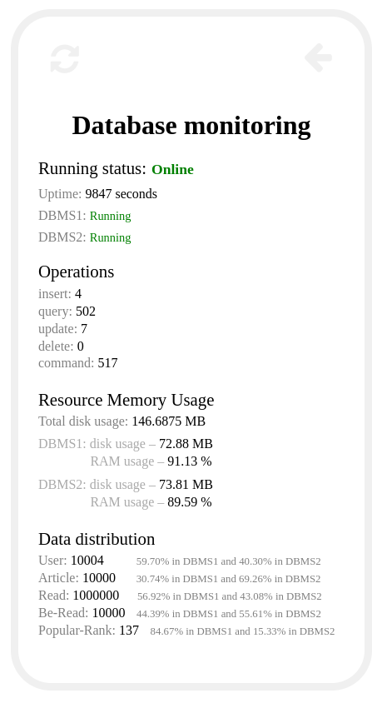
Monitoring
Content:
Database Monitoring Status:
Indicates if all database services are operational and how long they have been continuously running.
Operations Overview:
Query – number of data retrieval requests.
Insert – number of records added to the database.
Update/Delete – modifyed/removed data.
Command – operational commands executed.
Resource Memory Usage:
Total Disk Usage
Individual Disk Usage
Data Distribution:
Demonstrates the effectiveness of pre-splitting chunks during initialization to optimize shard distribution.

Slide 7
Thank you! We will now show a quick demo.
Ivan Yazykov, Guilherme Diogo Department of Computer Science and Technology

