Slide 1
gdb，Valgrind, Apache bench，Siege 使用介绍
2021.9.30
欧梦玲

Slide 2
docker commit id new-image 将容器打包成新的镜像
Docker rm –f id 删除容器
docker run --privileged -it -p 8888:9999 -v D:/2.MyFile/workspace/:/home/workspace --name Liso new-image /bin/bash 用刚才打包成新的镜像，创建新的容器

Slide 3
gdb

Slide 4
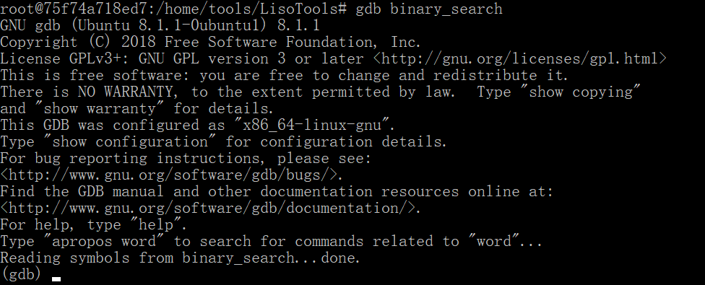
安装gdb
apt-get install gdb
编译.c文件
gcc –g file.c -o exec_file
-g选项的作用是：在可执行文件中加入源码信息
比如：可执行文件中第几条机器指令对应源代码的第几行，但并不是把整个
源文件都嵌入到可执行文件中，而是在调试时必须保证gdb能找到源文件。
gdb调试
gdb exec_file

Slide 5
命令 | 缩写 | 描述
run | r | 从头开始运行程序
start |  | 停在main函数第一行语句前面等待执行
quit | q | 退出调试
next | n | 执行下一行语句
step | s | 进入函数内部单步执行（finish：结束当前函数并返回到调用点）
continue | c | 从当前位置开始运行程序
list | l | 查看源码，接着上次的位置向下显示10行 （list n ：查看第n行源码；list 函数名：查看函数源码）
print | p | 打印
break n | b | 在第n行设置断点 （break 函数名：在函数开头设置断点）
info breakpoints num |  | 显示num号断点信息
delete breakpoints num |  | 删除num号断点
display var |  | 跟踪查看变量，每次停下都显示其值
undisplay num |  | 取消跟踪显示
set var |  | 设置变量的值
watch var |  | 设置观察点
info watchpoints |  | 查看当前设置的观察点信息

Slide 6
Valgrind

Slide 7
安装valgrind
https://www.valgrind.org/downloads/current.html
mkdir download
cd download
wget https://sourceware.org/pub/valgrind/valgrind-3.17.0.tar.bz2 从网络上自动下载
tar -xjvf valgrind-3.17.0.tar.bz2 解压
cd valgrind-3.17.0
./configure 是源代码安装的第一步，主要的作用是对即将安装的软件进行配置，
检查当前的环境是否满足要安装软件的依赖关系
make ./configure之后就有makefile出现，接着就是make编译
make install 安装
valgrind --version 查看版本，检查是否安装成功

Slide 8
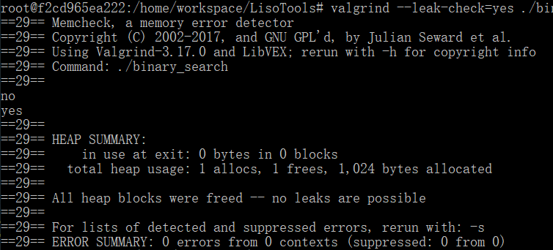
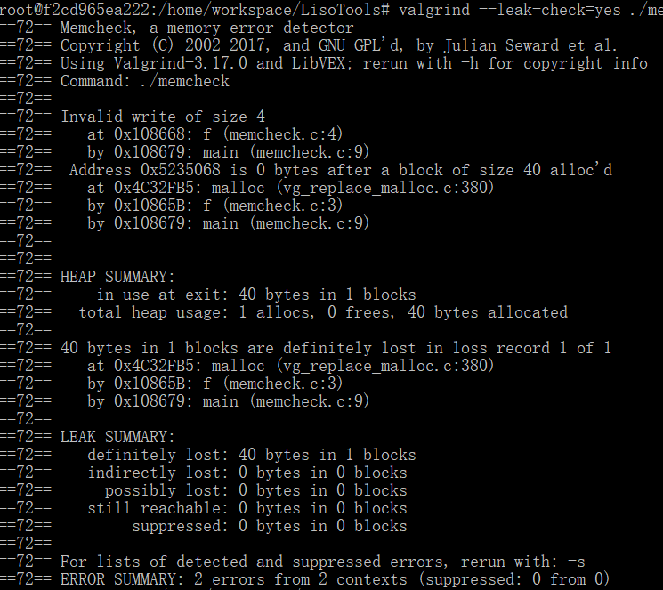
valgrind --leak-check=yes ./exec_file

Slide 9
Apache bench

Slide 10
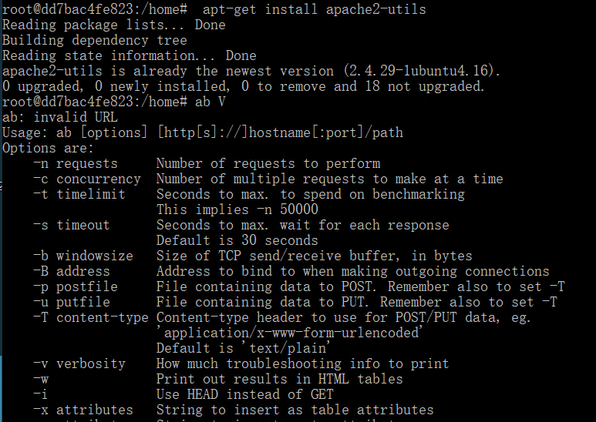
ab V

Slide 11
Options are:
-n requests Number of requests to perform 在测试会话中所执行的请求个数
-c concurrency Number of multiple requests to make at a time 并发数
-t timelimit Seconds to max. to spend on benchmarking
This implies -n 50000
-s timeout Seconds to max. wait for each response
Default is 30 seconds
-b windowsize Size of TCP send/receive buffer, in bytes
-B address Address to bind to when making outgoing connections
-p postfile File containing data to POST. Remember also to set –T
-u putfile File containing data to PUT. Remember also to set -T
-T content-type Content-type header to use for POST/PUT data, eg.
'application/x-www-form-urlencoded'
Default is 'text/plain'
-v verbosity How much troubleshooting info to print
-w Print out results in HTML tables
-i Use HEAD instead of GET
-x attributes String to insert as table attributes
-y attributes String to insert as tr attributes
-z attributes String to insert as td or th attributes

Slide 12
-C attribute Add cookie, eg. 'Apache=1234'. (repeatable)
-H attribute Add Arbitrary header line, eg. 'Accept-Encoding: gzip'
Inserted after all normal header lines. (repeatable)
-A attribute Add Basic WWW Authentication, the attributes are a colon separated username and password.
-P attribute Add Basic Proxy Authentication, the attributes are a colon separated username and password.
-X proxy:port Proxyserver and port number to use
-V Print version number and exit
-k Use HTTP KeepAlive feature
启用HTTP KeepAlive功能，即在一个HTTP会话中执行多个请求。默认不启用KeepAlive
-d Do not show percentiles served table.
-S Do not show confidence estimators and warnings.
-q Do not show progress when doing more than 150 requests
-l Accept variable document length (use this for dynamic pages)
-g filename Output collected data to gnuplot format file.
-e filename Output CSV file with percentages served
-r Don't exit on socket receive errors.
-m method Method name
-h Display usage information (this message)
-I Disable TLS Server Name Indication (SNI) extension
-Z ciphersuite Specify SSL/TLS cipher suite (See openssl ciphers)
-f protocol Specify SSL/TLS protocol
(SSL2, TLS1, TLS1.1, TLS1.2 or ALL)

Slide 13
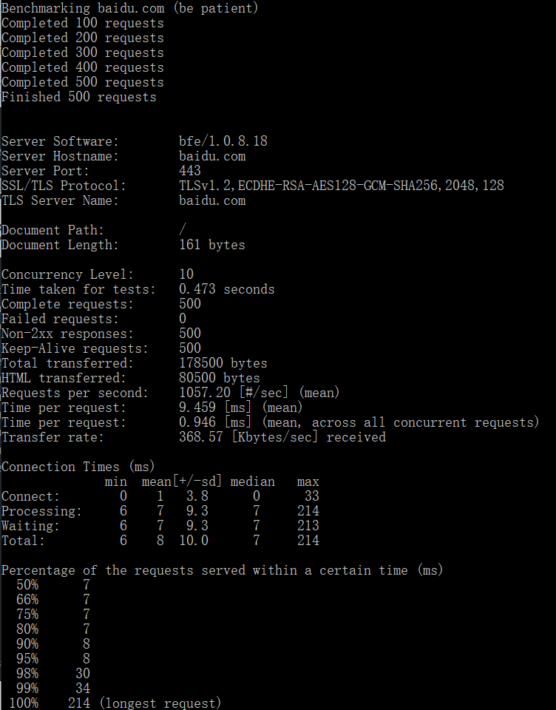
ab -n 500 -c 10 –k https://www.baidu.com/
ab -n 100 -c 10 -k http://127.0.0.1:9999/

Slide 14
Siege

Slide 15
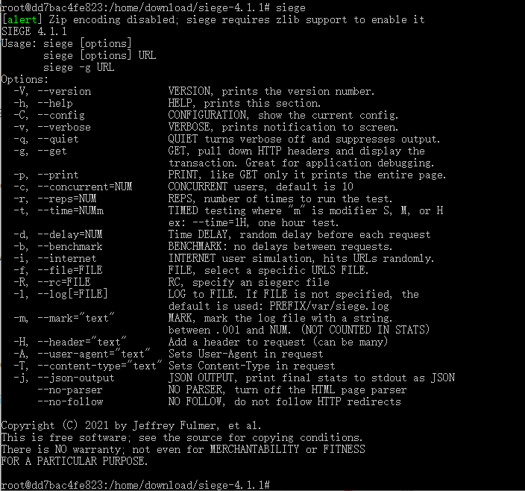

Slide 16
SIEGE 4.1.1
Usage: siege [options]
siege [options] URL
siege -g URL
Options:
-V, --version VERSION, prints the version number.
-h, --help HELP, prints this section.
-C, --config CONFIGURATION, show the current config.
-v, --verbose VERBOSE, prints notification to screen.
-q, --quiet QUIET turns verbose off and suppresses output.
-g, --get GET, pull down HTTP headers and display the
transaction. Great for application debugging.
-p, --print PRINT, like GET only it prints the entire page.
-c, --concurrent=NUM CONCURRENT users, default is 10
-r, --reps=NUM REPS, number of times to run the test.
-t, --time=NUMm TIMED testing where "m" is modifier S, M, or H
ex: --time=1H, one hour test.

Slide 17
-d, --delay=NUM Time DELAY, random delay before each request
-b, --benchmark BENCHMARK: no delays between requests.
-i, --internet INTERNET user simulation, hits URLs randomly.
-f, --file=FILE FILE, select a specific URLS FILE.
-R, --rc=FILE RC, specify an siegerc file
-l, --log[=FILE] LOG to FILE. If FILE is not specified, the
default is used: PREFIX/var/siege.log
-m, --mark="text" MARK, mark the log file with a string.
between .001 and NUM. (NOT COUNTED IN STATS)
-H, --header="text" Add a header to request (can be many)
-A, --user-agent="text" Sets User-Agent in request
-T, --content-type="text" Sets Content-Type in request
-j, --json-output JSON OUTPUT, print final stats to stdout as JSON
--no-parser NO PARSER, turn off the HTML page parser
--no-follow NO FOLLOW, do not follow HTTP redirects

Slide 18
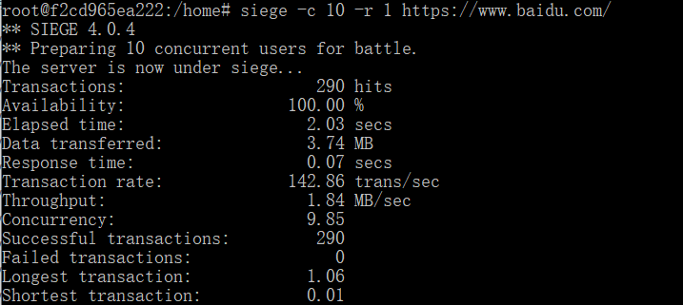
siege -c 10 -r 1 https://www.baidu.com/
Transactions: 访问次数 Availability: 成功次数百分比 Elapsed time: 测试用时
Data transferred: 测试传输数据量 Response time: 平均响应时间 Transaction rate: 平均每秒处理请求数 Throughput: 吞吐率 Concurrency: 最高并发 Successful transactions: 成功的请求数 Failed transactions: 失败的请求数
Longest transaction 最长响应时间
Shortest transaction 最短响应时间

