Slide 1

SOCIAL MEDIA PREDICTION
DAIMLER FLEET MANAGEMENT
BY SOCIAL JUSTICE CRAWLERS

Slide 2

PROBLEM STATEMENT
HACKATHON SOCIAL MEDIA PREDICTION / SOCIAL JUSTICE CRAWLERS
How can we use social media to identify potential leasing customers?

Slide 3
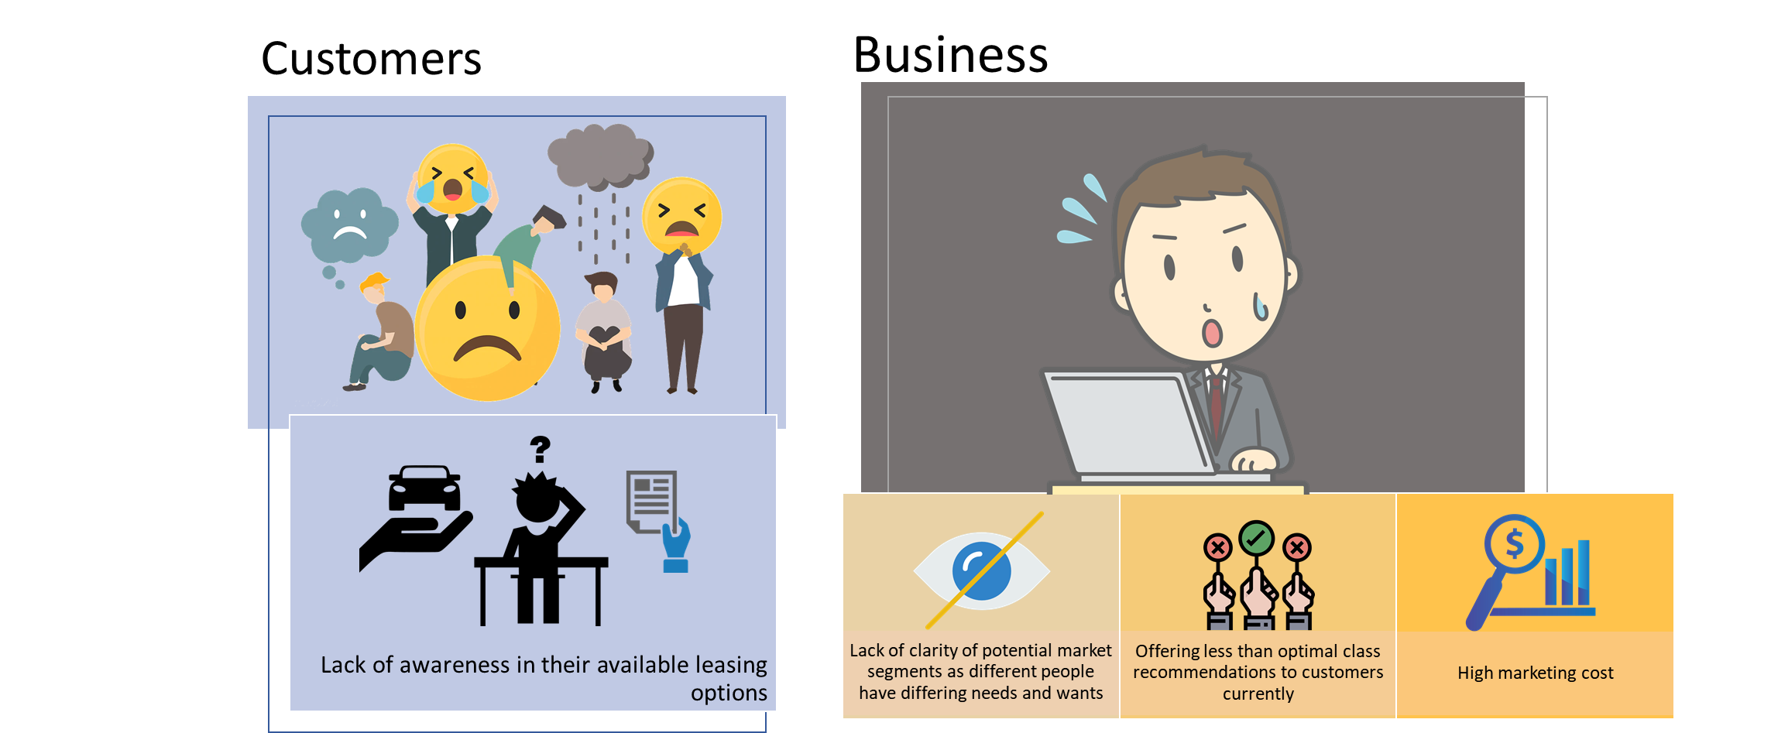
PAIN POINTS
HACKATHON SOCIAL MEDIA PREDICTION / SOCIAL JUSTICE CRAWLERS
Notes:
Customer
Customers are not aware of available leasing options suited to their profile
Business
Unsure of the different profiles of prospective customers (their traits and characteristics)
Different profiles have differing needs and wants - e.g. a married person with family likely goes for economical car with more space(Untapped social media resource that business can tapped on)
Offering less than optimal class recommendations to customers currently
Lose potential to fit customers with the right leasing options
High marketing cost as marketing is done at a global scale, can be done using targeted marketing

Slide 4

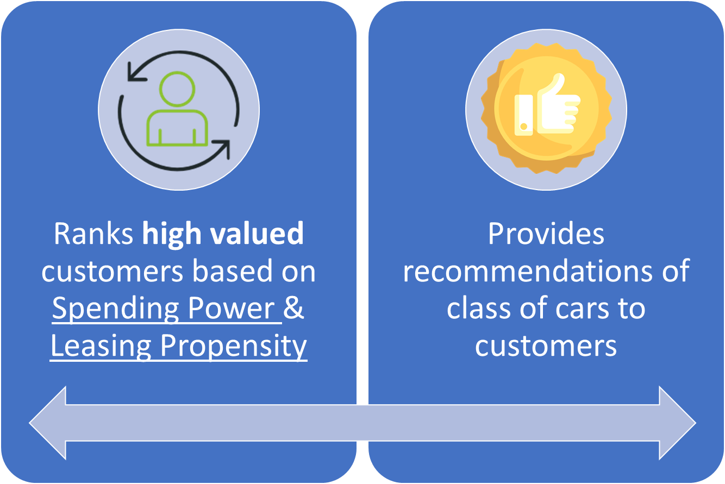
HACKATHON SOCIAL MEDIA PREDICTION / SOCIAL JUSTICE CRAWLERS
Solution Overview
Notes:
We wanted to rank each customer in the profile and to recommend a car class that they will suited for
Came up with 2 heuristics value (Spending Power & Leasing Propensity) to determine high valued customers
Spending Power = Student?, Highest Education, Years of Working Experience, Job title, Company size (MNC or SME)
Leasing Propensity = Job scope, family
Recommendation is based on spending power for now? Better to assign labels using clustering?

Slide 5
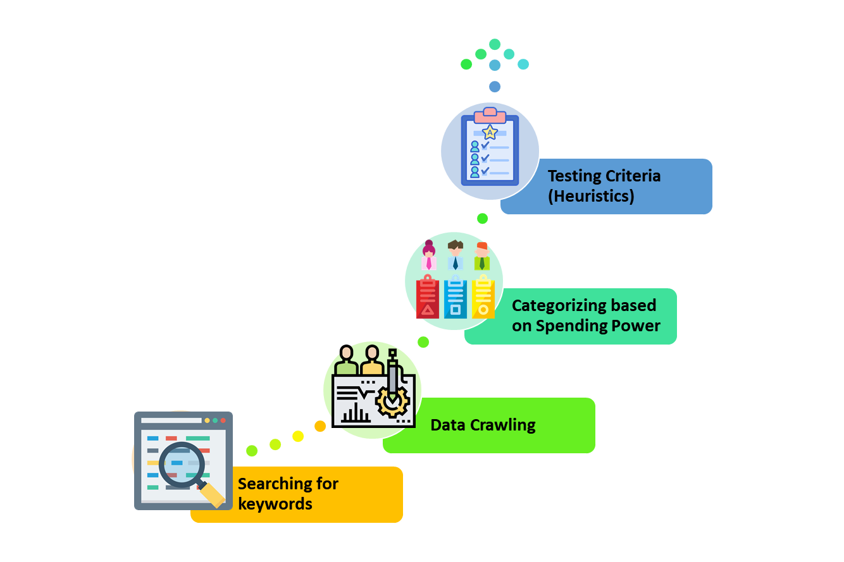
HACKATHON SOCIAL MEDIA PREDICTION / SOCIAL JUSTICE CRAWLERS
Methodology
Notes:
This is a 4-stage bottom-up approach that we using

Slide 6
MODEL RECOMMENDATION
HACKATHON SOCIAL MEDIA PREDICTION / SOCIAL JUSTICE CRAWLERS
Spending Power Level | Possible Classes
Entry | A, B
Middle | B,E
Middle - Upper | E
Upper | S, AMG GT
Note: Our recommendation model is based on spending power only
Notes:
We understand that many factors come into consideration when recommending a optimal class of car for a prospective customer. But due to time constraints, we focused on the factor that we thought was the most important which was price. Based on market research, we understand that the mercedes benz classes from A to S increase in size as well as price so, for our model, it will take this into consideration by using the normalized spending power score based on LinkedIn (0 to 1). Based on this score, we binned the customers into 4, namely entry, middle, middle-upper and upper levels and our model assigns them a possible car class in the corresponding bin.

Slide 7
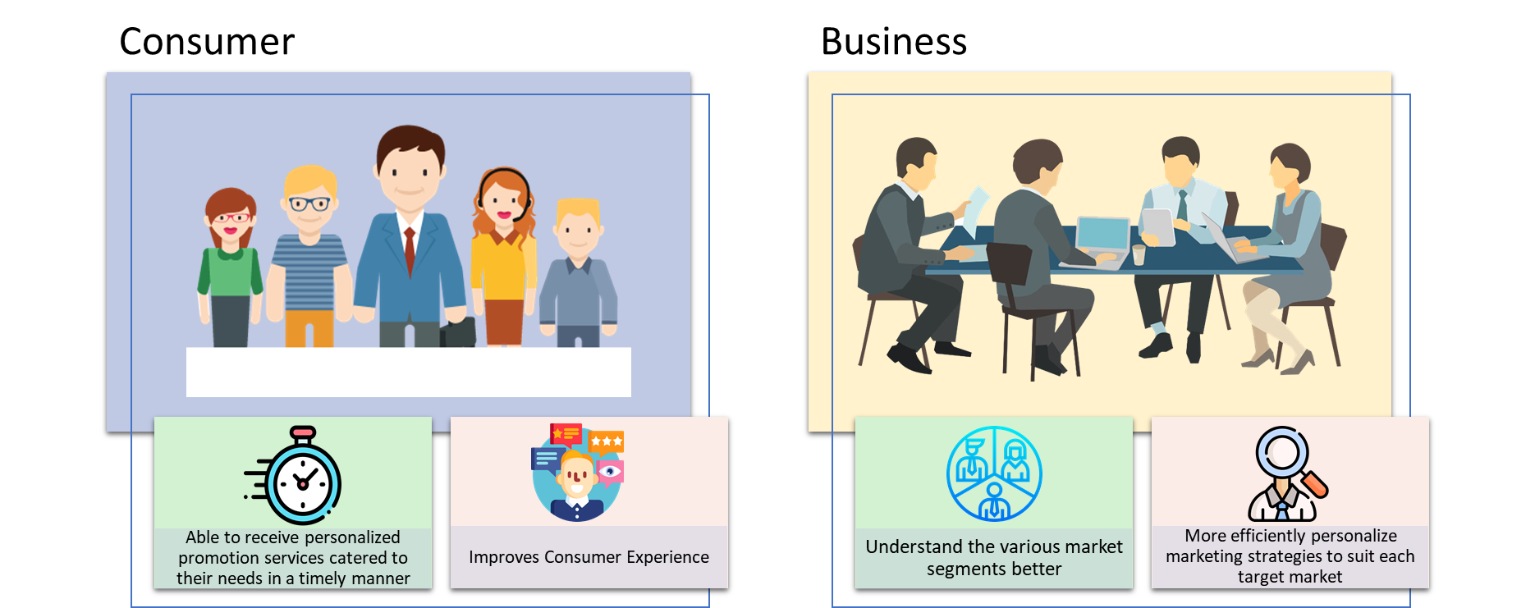
BENEFITS
HACKATHON SOCIAL MEDIA PREDICTION / SOCIAL JUSTICE CRAWLERS
Notes:
Customers
Characterised based on their professional roles
Able to target customers with right message, at the right time, at the right place
Able to receive personalised promotion services catered to their needs in a timely manner
Daimler
Profiling the customer and recommending class of car suggested by our model
Able to understand the various potential market segments better
Better able to personalize marketing strategies to suit each target market

Slide 8
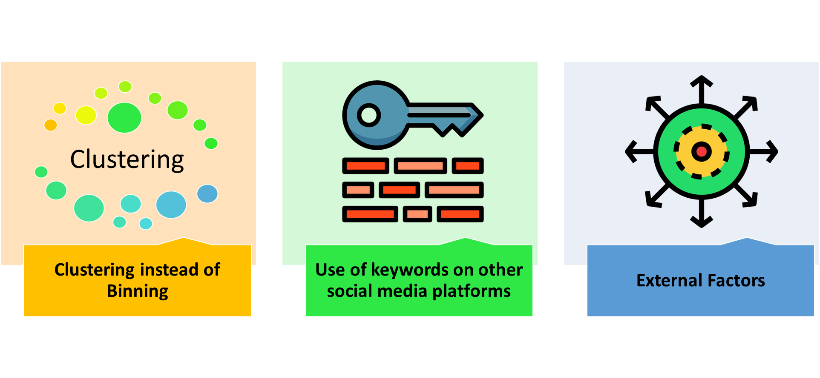
AREAS OF IMPROVEMENT
HACKATHON SOCIAL MEDIA PREDICTION / SOCIAL JUSTICE CRAWLERS
Notes:
Due to time constraint, the team used bins to assign labels. Clustering the data based on the LinkedIn features would be the recommended approach.
List of keywords generated from topic modelling can be used to crawl other social media platforms like Twitter & Instagram.
Other factors might also affect the recommendation of cars to customers. E.g. Credibility status of the buyer

Slide 9
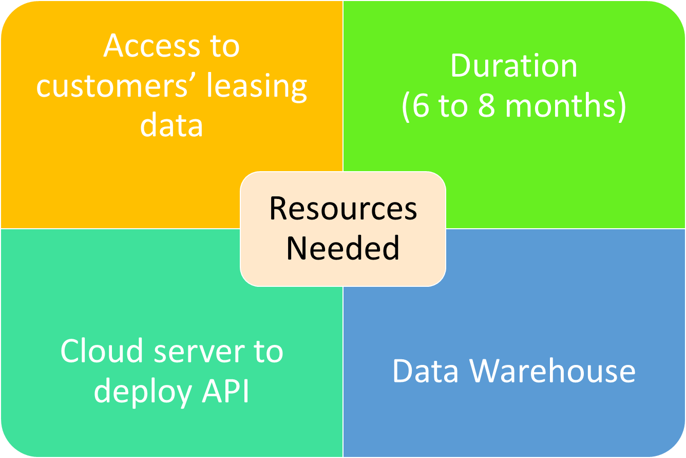
RESOURCES TO DEVELOP THE PROJECT
HACKATHON SOCIAL MEDIA PREDICTION / SOCIAL JUSTICE CRAWLERS

Slide 10
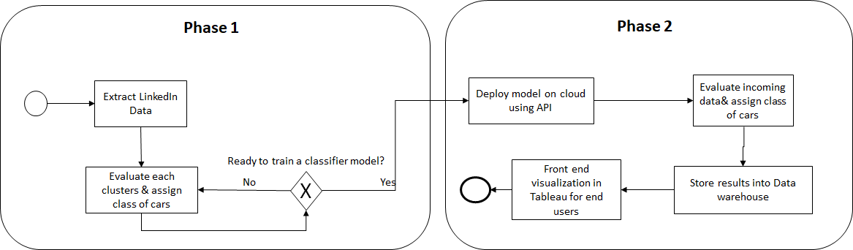
IMPLEMENTATION PROCESS
HACKATHON SOCIAL MEDIA PREDICTION / SOCIAL JUSTICE CRAWLERS

Slide 11


