Slide 1

Virtual memory
Presented by: Adrian Tang

Slide 2
what is virtual memory?
a memory management technique
Implementation is done by using both hardware & software
maps virtual to physical address in computer memory
Why do we need it?
compensate the lack of RAM to run a specific program
ease of programming by hiding fragmentations in physical memory

Slide 3
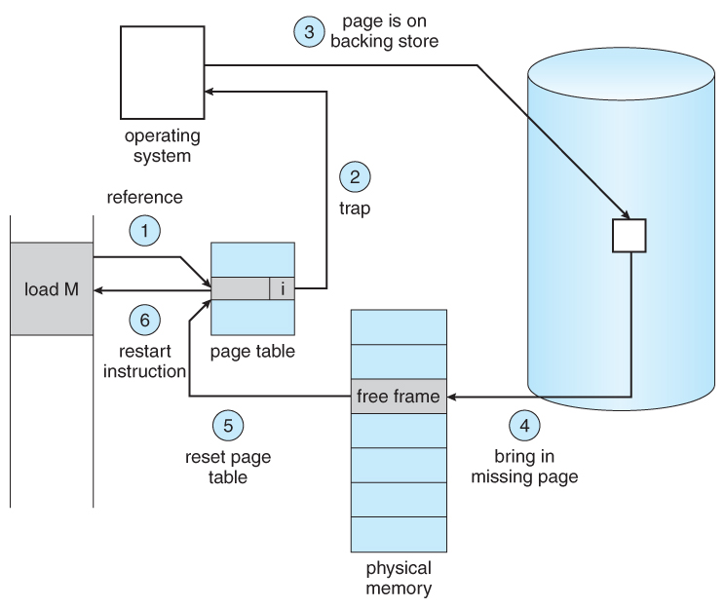
demand paging

Slide 4
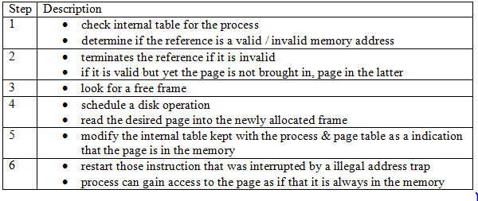
demand paging
How implementation is done:

Slide 5
page fault
an interrupt
occurs when a program requests data that is in the real memory
degrades performances of the OS itself
types of page fault
minor
major
invalid

Slide 6
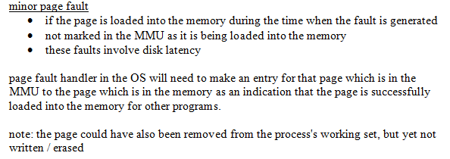

Slide 7
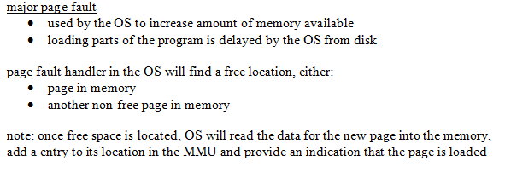

Slide 8
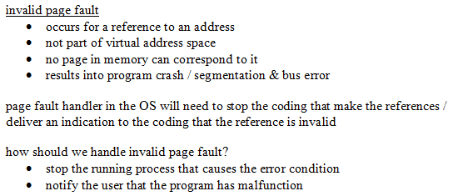

Slide 9
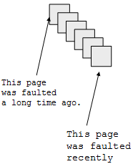
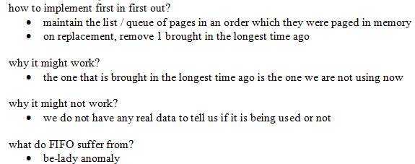
page replacement
first in first out

Slide 10
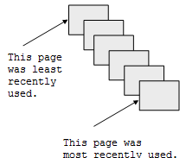
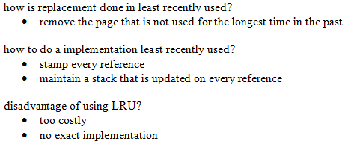
page replacement
first in first out

Slide 11
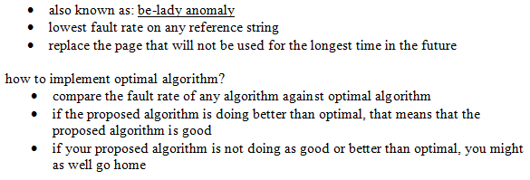
page replacement
optimal

Slide 12
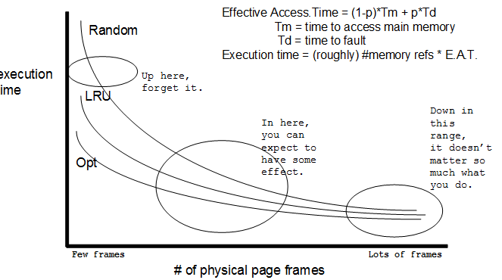
page replacement

Slide 13
references
http://www.webopedia.com/TERM/P/page_fault.html
http://www.cs.uic.edu/~jbell/CourseNotes/OperatingSystems/9_VirtualMemory.html
http://en.wikipedia.org/wiki/Page_fault
http://en.wikipedia.org/wiki/Page_replacement_algorithm
http://lovingod.host.sk/tanenbaum/BASIC-MEMORY-MANAGEMENT.html
http://cseweb.ucsd.edu/classes/fa04/cse120/lectures/replace.pdf
http://en.wikipedia.org/wiki/Page_replacement_algorithm
http://en.wikipedia.org/wiki/Page_replacement_algorithm#First-in.2C_first-out

