Slide 1
NDI and GStreamer
Video and Custom Track Data Streams

Slide 2
Architecture
Pipeline
… a pipeline consists of a chain of processing elements (processes, threads, coroutines, functions, etc.), arranged so that the output of each element is the input of the next; the name is by analogy to a physical pipeline…
Filter graph
A filter graph is used in multimedia processing…

Slide 3
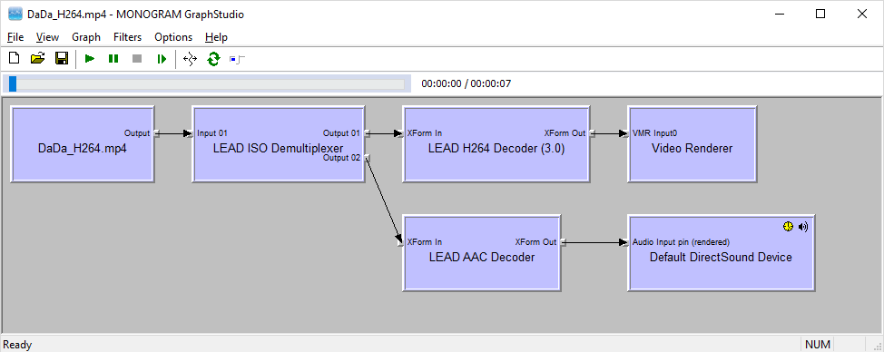
Direct Show
DirectShow divides a complex multimedia task into a sequence of fundamental processing steps known as filters.

Slide 4
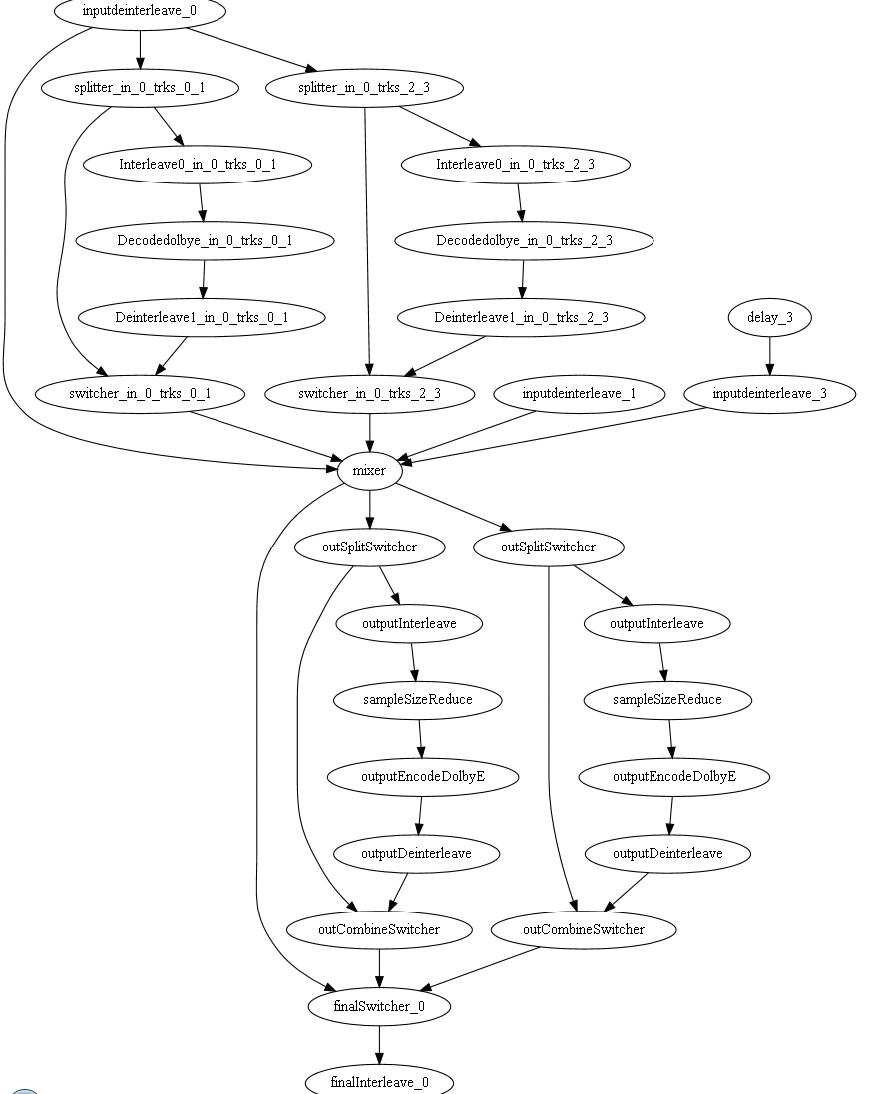
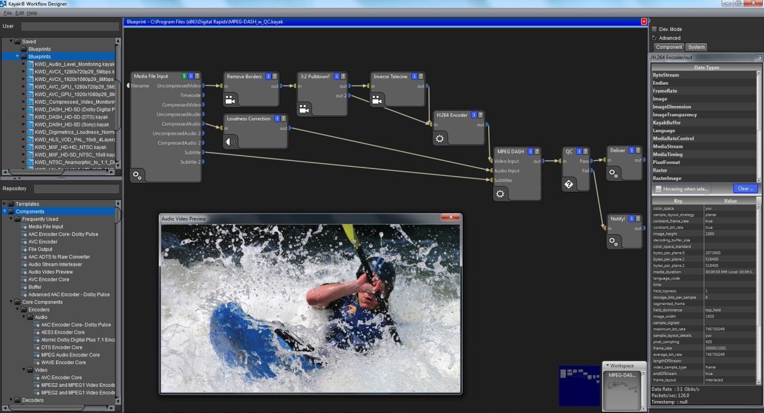
Broadcast Industry

Slide 5
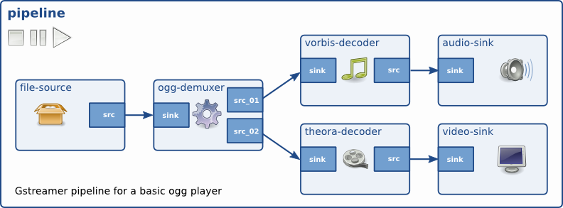
GStreamer
GStreamer is an extremely powerful and versatile framework for creating streaming media applications.
GStreamer can seamlessly incorporate new plugin modules. But because modularity and power often come at a cost of greater complexity, writing new applications is not always easy.

Slide 6
GStreamer Features
Open source multimedia framework
Cross platform
Based on GLib 2.0 object model for object-oriented design and inheritance
Written in C
Can be used for any type of streaming data such as scientific signal processing ( for example, Gravitational Waves )
do not need to do anything special to enable hardware acceleration (source)

Slide 7
Gtype/GObject
C programmers are likely to be puzzled at the complexity of the features exposed in the following chapters if they forget that the GType/GObject library was not only designed to offer OO-like features to C programmers but also transparent cross-language interoperability. (source)
GObject wikipedia entry

Slide 8
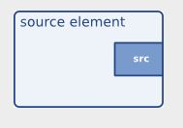
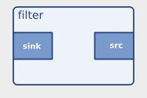
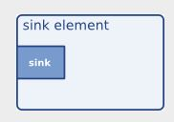
Pads
The ports through which GStreamer elements communicate with each other are called pads (GstPad). There exists sink pads, through which data enters an element, and source pads, through which data exits an element (quote source).

Slide 9
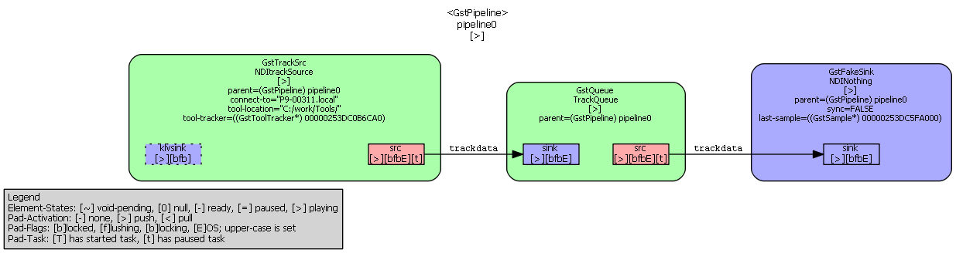
NDI Track Data
gst-launch-1.0 tracksrc connect-to=P9-00311.local rtsp-port=554 tool-location=C:/work/Tools/ tool-file=8700339.rom name=tracksource ! queue ! fakesink

Slide 10
CAPISample
Existing
library
sample
New
ndielems
tracksrc
trackoverlay
trackbin
vrdemo
capitogst

Slide 11
NDI Elements
gst-inspect-1.0 C:\gstreamer\1.0\x86_64\lib\gstreamer-1.0\ndielems.dll
ndi elems
gst-inspect-1.0 tracksrc
tracksrc element details
trackoverlay element details
trackbin element details

Slide 12
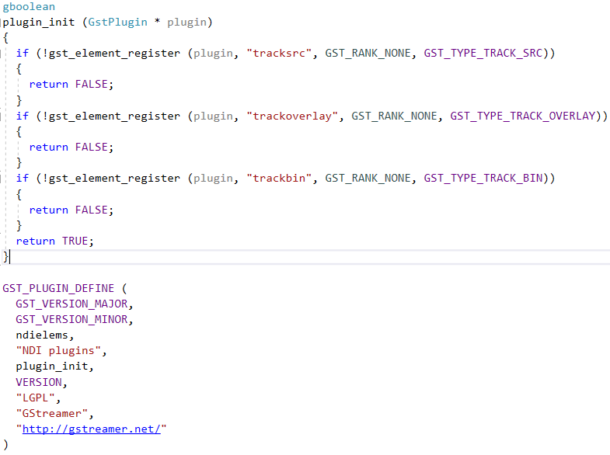
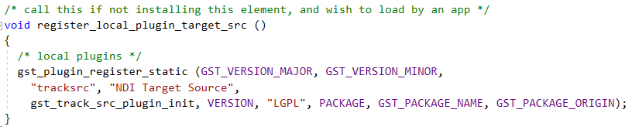
Register NDI Elements
ndielement.c
Place ndielems.dll into plugin directory
C:\gstreamer\1.0\x86_64\lib\gstreamer-1.0

Slide 13
Part of tracksrc.h shows template code

Slide 14
tracksrc declarations (top of tracksrc.c)
#define gst_track_src_parent_class parent_class
G_DEFINE_TYPE (GstTrackSrc, gst_track_src, GST_TYPE_PUSH_SRC);
static GstStaticPadTemplate sink_klv_factory = GST_STATIC_PAD_TEMPLATE ("klvsink",
GST_PAD_SINK,
GST_PAD_SOMETIMES,
GST_STATIC_CAPS ("meta/x-klv, parsed = (bool) true"));
static GstStaticPadTemplate gst_track_src_src_template =
GST_STATIC_PAD_TEMPLATE ("src",
GST_PAD_SRC,
GST_PAD_ALWAYS,
GST_STATIC_CAPS ("trackdata")
);
static gboolean gst_ndi_klv_sink_event (GstPad * pad, GstObject * parent, GstEvent * event);
static GstFlowReturn gst_ndi_src_chain (GstPad * pad, GstObject * parent, GstBuffer * buf);
static void gst_track_src_finalize (GObject * object);
static void gst_track_src_set_property (GObject * object, guint prop_id,
const GValue * value, GParamSpec * pspec);
static void gst_track_src_get_property (GObject * object, guint prop_id,
GValue * value, GParamSpec * pspec);
static gboolean gst_track_src_start (GstBaseSrc * basesrc);
static gboolean gst_track_src_stop (GstBaseSrc * basesrc);
static GstFlowReturn gst_track_src_create (GstPushSrc * basesrc,
GstBuffer ** buffer);

Slide 15
Part of tracksrc init (tracksrc.c), shows function pointers to satisfy inheritance
static void
gst_track_src_class_init (GstTrackSrcClass * klass)
{
GObjectClass *gobject_class;
GstElementClass *gstelement_class;
GstBaseSrcClass *gstbasesrc_class;
GstPushSrcClass *gstpushsrc_class;
gobject_class = (GObjectClass *) klass;
gstelement_class = (GstElementClass *) klass;
gstbasesrc_class = (GstBaseSrcClass *) klass;
gstpushsrc_class = (GstPushSrcClass *) klass;
...
gstbasesrc_class->start = GST_DEBUG_FUNCPTR (gst_track_src_start);
gstbasesrc_class->stop = GST_DEBUG_FUNCPTR (gst_track_src_stop);
gstpushsrc_class->create = GST_DEBUG_FUNCPTR (gst_track_src_create);
gstbasesrc_class->query = GST_DEBUG_FUNCPTR (gst_track_src_query);
GST_DEBUG_CATEGORY_INIT (track_src_debug, "tracksrc", 0,
"NDI Target Source");
}

Slide 16
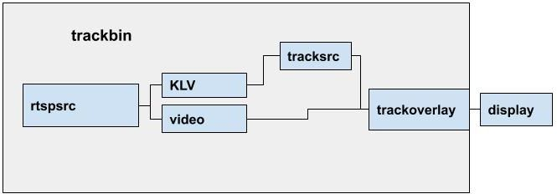
Simplified Pipeline

Slide 17
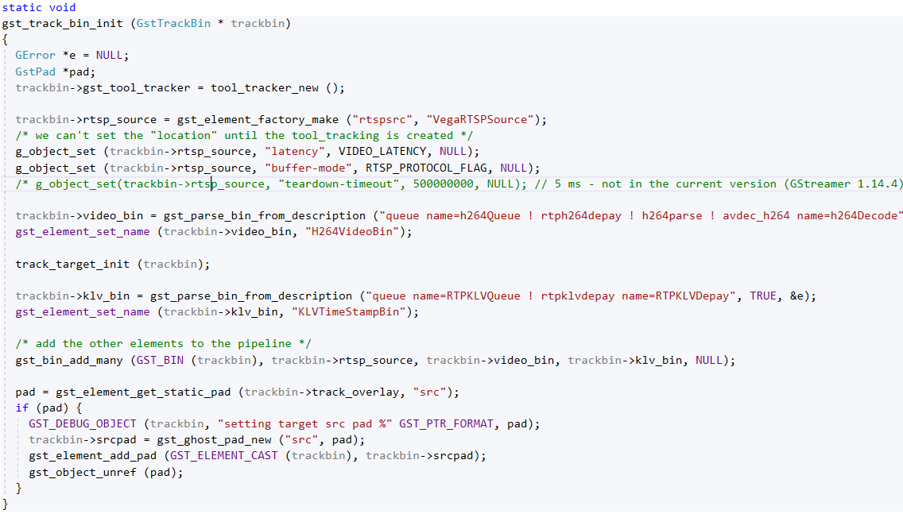
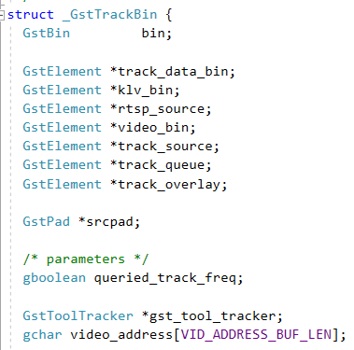
trackbin
Compare to DOT file
A bin in GStreamer can be treated the same way as an element.

Slide 18
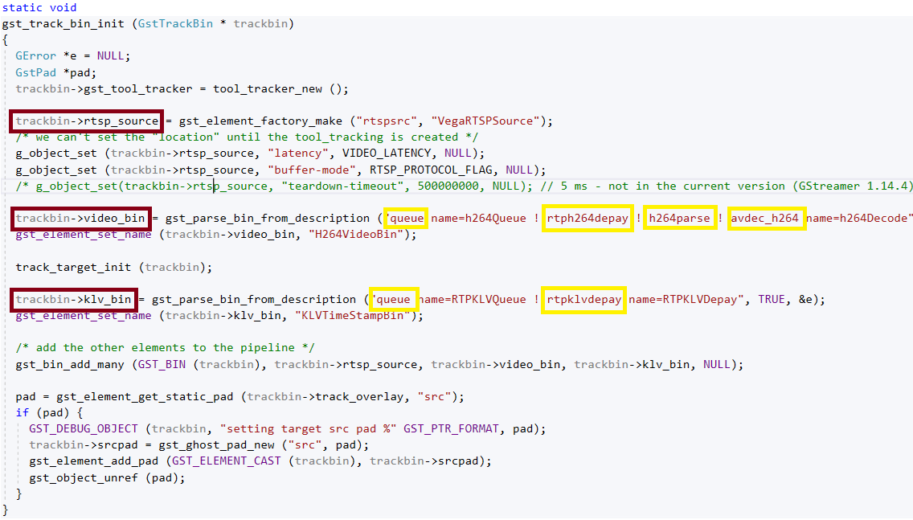
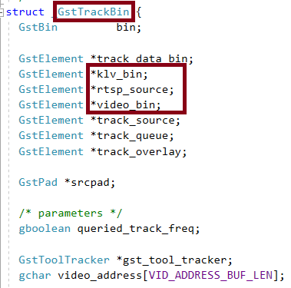
trackbin
Compare to DOT file
A bin in GStreamer can be treated the same way as an element.

Slide 19
Element Communication
Properties
gst-launch-1.0 -e trackbin connect-to=P9-00311.local rtsp-port=554
“tool-tracker” created in trackbin, set in tracksrc as property
GST object type, see tooltracker.h
Buffers
Track data
Events
Pass information from the tracksrc to the trackoverlay
Lens parameters
See lensparam.h
Sample Frequency
Messages and Queries (not utilized for NDI elements)

Slide 20
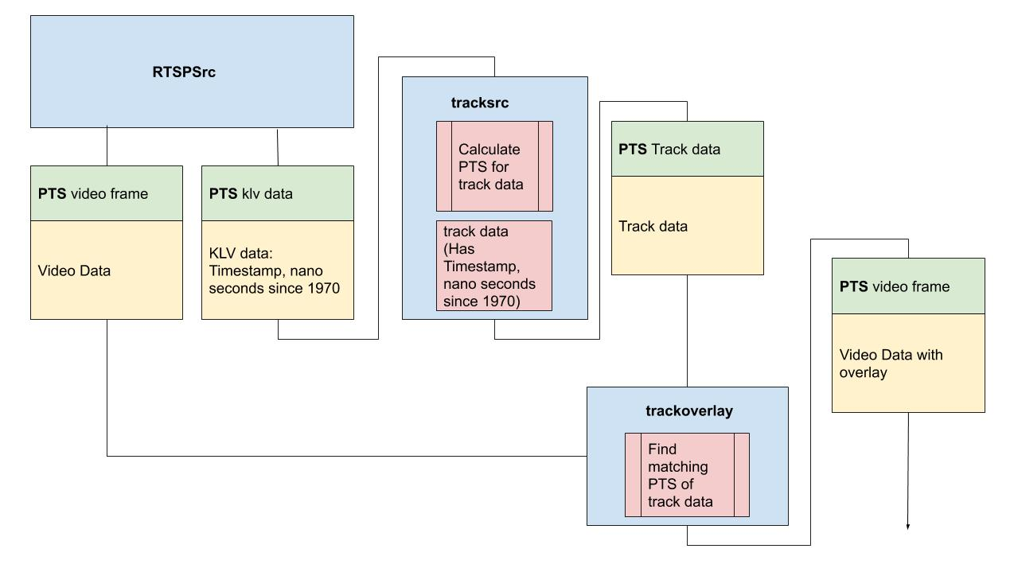
Matching Track Data to Video

Slide 21
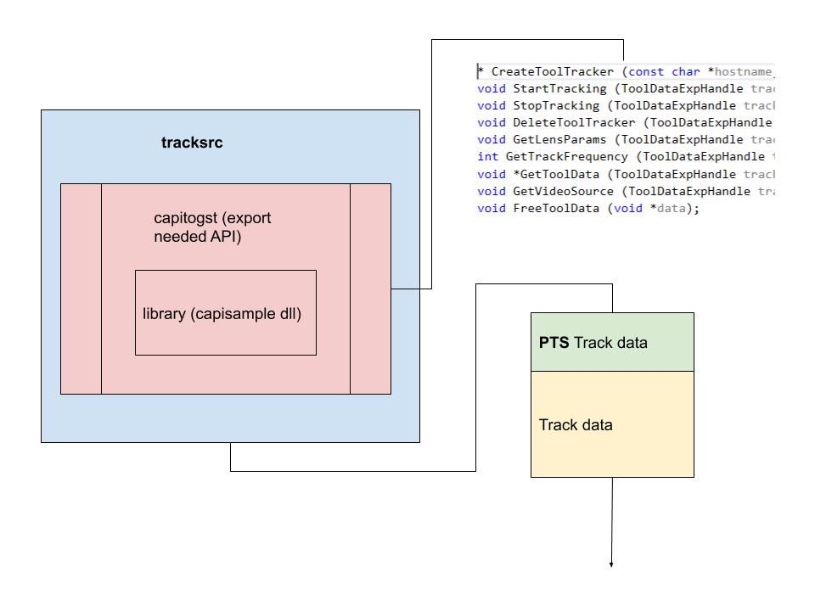
Track Data
Makes use of Google Flatbuffers
Improving Facebook’s performance on Android with FlatBuffers
flattooldata.txt

Slide 22
NDI Elements in use
Run application
vrdemo.exe "P9-00311.local" "C:/work/Tools/" "8700339.rom" "554"
gstlaunch
gst-launch-1.0 trackbin connect-to=P9-00311.local rtsp-port=554 tool-location=C:/work/Tools/ tool-file=8700339.rom name=VegaTrackBin ! autovideosink sync=false name=VideoDisplay
Dot file
Capture to file
gst-launch-1.0 -e trackbin connect-to=P9-00311.local rtsp-port=554 tool-location=C:/work/Tools/ tool-file=8700339.rom name=VegaTrackBin ! queue ! x264enc speed-preset=ultrafast ! queue ! h264parse ! mp4mux ! filesink sync=false location=c:/work/media/nativetest7.mp4
captured file
Playback
gst-launch-1.0 filesrc location=C:/work/media/nativetest10-cut.mp4 ! decodebin name=dec ! queue ! videoconvert ! autovideosink

