Slide 1


SMART INDIA HACKATHON 2026
TITLE PAGE
• Problem Statement ID – SIH26083
• Problem Statement Title- Extreme Heatwave Early Warning and Human Thermal Stress Index
• Theme- Disaster Management
• PS Category- Software
• Organization- Ministry of Earth Sciences (MoES) / NCMRWF
• Team ID- [YOUR REGISTERED TEAM ID]
• Team Name (Registered on portal)- ThermoShield
PROPOSED SYSTEM: ThermoShield
AI-Driven Human Heat Risk & Biometeorological Early Warning OS From Weather Forecasts → Physiological Thermal Stress → Hyper-Local Ward Action

Slide 2
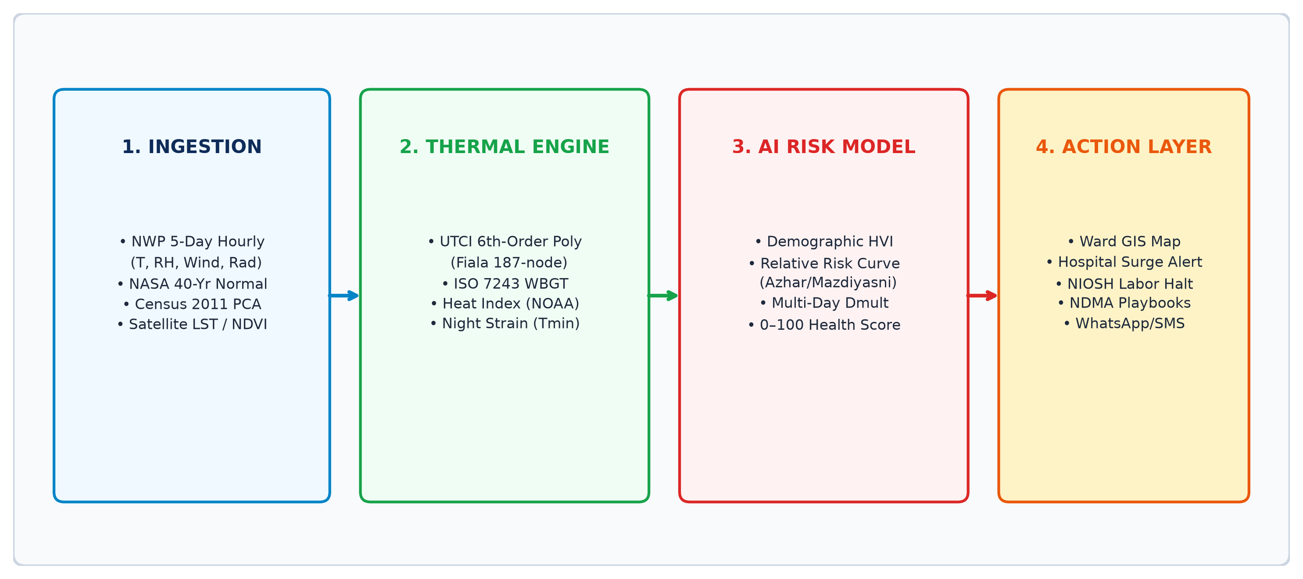
Team
Thermo-
Shield
IDEA TITLE: THERMOSHIELD — AI-DRIVEN HUMAN HEAT RISK OS
❖ Proposed Solution (Describe your Idea/Solution/Prototype)
• Detailed Explanation of the Solution
• How It Addresses the Problem
• Innovation and Uniqueness
❖ Dual-Branch Ingestion: Fuses 5-Day hourly NWP forecasts (T, RH, Wind, Rad) with Census 2011 PCA demographics.
❖ UTCI Physiological Engine: Universal Thermal Climate Index (6th-order polynomial based on Fiala 187-node model).
❖ ISO 7243 WBGT: Natural wet bulb (Stull) and globe temp (Liljegren) for occupational and outdoor labor stress.
❖ Multi-Day Persistence: Exponential duration multiplier (Dmult) and uncooled night penalty (Tmin > 28°C).
❖ Human Impact vs Weather: Overcomes dry-bulb limitations where 40°C with high humidity breaks thermoregulation.
❖ Hyper-Local Ward Granularity: Differentiates shaded affluent zones from informal settlements with tin roofs.
❖ Epidemiological Grounding: Calibrated against Indian empirical studies (Azhar 2014 & Mazdiyasni 2017).
❖ Relative Risk Indexing: Bounded 0–100 Human Heat-Health Risk Score replacing uncalibrated death claims.
❖ 72h–120h Pre-Emptive Window: 3–5 day anticipation enabling municipal water tankers and cooling shelters to be staged.
❖ Automated Multi-Sector Triggers: Converts risk into hospital surge beds, DISCOM load warnings, and NIOSH labor halts.
❖ Bilingual Public Advisories: Plain-language vernacular WhatsApp/Telegram warnings in Hindi and English.
❖ Production Open Stack: 25 REST APIs with sub-second latency and zero proprietary software licensing.
@SIH Idea submission- Template
2

Slide 3
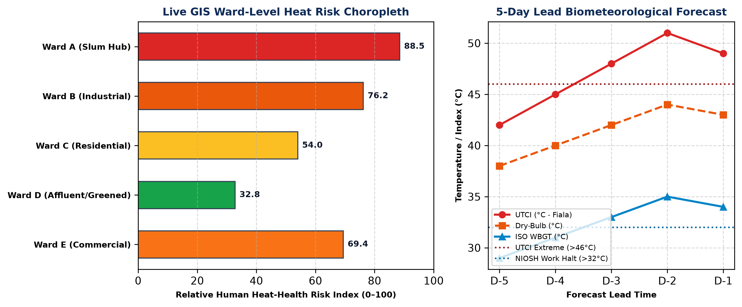
Team
Thermo-
Shield
TECHNICAL APPROACH
• Methodology & Implementation Process (Working Prototype Architecture & Live GIS Output)
4-STAGE COMPUTATIONAL PIPELINE
• 1. Ingestion: Open-Meteo 0.1° NWP 5-day hourly weather + NASA POWER 40-yr baseline + Census 2011 PCA demographics.
• 2. Thermal Engine: UTCI 6th-order polynomial (Fiala) + ISO 7243 WBGT psychrometrics + Multi-day persistence penalty (Dmult).
• 3. AI & HVI Synthesis: PCA Demographic Vulnerability Index (slums, elderly, gig labor, canopy deficit) → 0–100 Heat-Health Score.
• 4. Automated Action: Interactive Leaflet GIS map, 25 REST APIs, NDMA playbooks, hospital cooling beds, NIOSH labor halts.
• Technologies to be used (Programming Languages, Frameworks, GIS & Deployment):
❖ Backend & REST APIs: Python 3.11, FastAPI, Pydantic v2, Uvicorn, AsyncIO (25 REST production endpoints)
❖ Biometeorology & GIS Engine: NumPy, Pandas, GeoPandas, Shapely, Scipy (UTCI 6th-order polynomial & ISO 7243 psychrometrics)
❖ Web GIS & Visualization: Leaflet.js (Choropleth GIS), Chart.js (5-Day Trend Curves), HTML5/CSS3 Responsive UI
❖ Data Ingestion & Deployment: Open-Meteo NWP, NASA POWER MERRA-2, Census India PCA, Docker, Linux VPS (Oracle Linux)
@SIH Idea submission- Template
3

Slide 4
Team
Thermo-
Shield
FEASIBILITY AND VIABILITY
• Analysis of the Feasibility of the Idea
The ThermoShield platform is highly feasible due to open, keyless Tier-1 atmospheric data pipelines (Open-Meteo 0.1° NWP hourly forecasts and NASA POWER MERRA-2 40-year climatological normals) and validated biometeorological formulations (WMO UTCI polynomial & ISO 7243 WBGT). Integrating Census 2011 PCA demographics enables hyper-local ward-level vulnerability mapping without waiting for restricted government permissions.
• Potential Challenges & Risks • Strategies for Overcoming
• Target Users & Viability:
➢ Municipal Corporations & Smart Cities
For ward-level water tankers, cool roofs & cooling centers.
➢ Health Departments & Hospitals
For heatstroke emergency ward & IV fluid prepositioning.
➢ State Disaster Management (SDMA / NDMA)
For automated Heat Action Plan (HAP) trigger activation.
➢ Gig Platforms & Construction Sector
For mandatory NIOSH labor halt (11 AM–4 PM) compliance.
➢ DISCOMs & Power Utilities
For predictive grid load planning during peak cooling demand.
• Data Heterogeneity (0.1° Grid vs Wards) ➔ Spatial Harmonization & Polygon Attribution
• Confidential Hospital Mortality Records ➔ Epidemiological Calibration (Azhar 2014 & Mazdiyasni 2017)
• Model Overfitting / False Death Claims ➔ Bounded 0–100 Human Heat-Health Risk Score
• False Alarm Fatigue (Single Spikes) ➔ Compound Multi-Day Persistence Multiplier (Dmult)
• Uncooled Nighttime Strain (Tmin > 28°C) ➔ Explicit Nocturnal Recovery Penalty Algorithm
@SIH Idea submission- Template
4

Slide 5
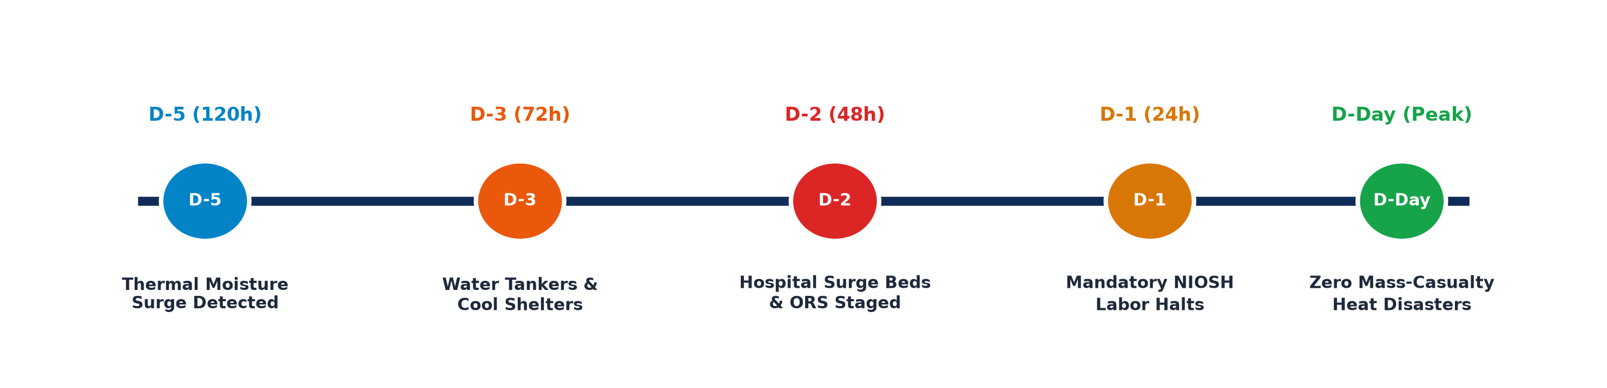
Team
Thermo-
Shield
IMPACT AND BENEFITS
• Potential Impact on the Target Audience (72h–120h Pre-Emptive Intervention Timeline)
• Social Benefits
▪ Protects Vulnerable Citizens: Dramatically reduces heatstroke morbidity among elderly, infants, and chronic disease patients.
▪ Protects Informal Laborers: Enforces humane work-rest cycles for delivery and construction workers.
▪ Bilingual Public Alerts: Delivers plain-language vernacular guidance via SMS/WhatsApp to eliminate technical barriers.
• Economic Benefits
▪ Prevents Productivity Loss: Mitigates lost labor hours through scheduled morning/evening shifts ($3.8B/yr India heat loss).
▪ Optimized Relief Routing: Avoids wasteful blanket relief by targeting water tankers to high-vulnerability wards.
▪ Reduces Emergency Care Costs: Pre-empts severe multi-organ failure and ICU hospitalization surges.
• Environmental & Urban Benefits
▪ Urban Heat Island (UHI) Mapping: Identifies micro-urban hot spots and green canopy deficits.
▪ Sustainable Urban Planning: Guides long-term municipal cool roof installations and tree planting programs.
▪ Effective Climate Resilience: Operationalizes national disaster mitigation at municipal ward scale.
@SIH Idea submission- Template
5

Slide 6
Team
Thermo-
Shield
RESEARCH AND REFERENCES
• Details / Links of the Reference and Research Work
• Universal Thermal Climate Index (UTCI) Consortium (WMO / COST Action 730): "Development of the Universal Thermal Climate Index (UTCI)", Bröde, Fiala, Błażejczyk et al., Int J Biometeorol (2012). Multi-node thermophysiological polynomial.
• Occupational Heat Stress Standards (ISO 7243:2017 & NIOSH): "Criteria for a Recommended Standard: Occupational Exposure to Heat and Hot Environments", CDC / NIOSH Publication No. 2016-106. Standard for WBGT thresholds & work-rest cycles.
• Epidemiological Heat-Health Grounding in Indian Cities (Ahmedabad 2010): "The 2010 Ahmedabad Heat Wave: Impact on Mortality and Strategy for Resilient Cities", Azhar et al., PLoS ONE (2014). Documented 1,344 excess deaths (43.1% surge) validating humidity-heat risk.
• 50-Year Multi-Decadal Heat Impact in India (PNAS Reference): "Increasing probability of mass-fatality heatwaves in India", Mazdiyasni et al., Proceedings of the National Academy of Sciences (PNAS, 2017). Proving +0.5°C threshold triggers 146% rise in mass mortality events.
• National Disaster & Health Policy Guidelines (NDMA & MoHFW NCDC): "National Action Plan for Heat-Related Illnesses (NAP-HRI)", National Programme on Climate Change and Human Health (NPCCHH, 2024) & NDMA National Heatwave Guidelines.
• NWP & Satellite Climatology Portals: National Centre for Medium Range Weather Forecasting (NCMRWF) NWP Portal, IMD Geospatial Bulletins & NASA POWER MERRA-2 (LaRC) 40-Year Climatological Baseline.
• Demographic Spatial Vulnerability: Census of India 2011 Primary Census Abstract (PCA) Ward Demographics & Open-Meteo High-Resolution Numerical Weather Prediction API.
RESEARCH GAP SOLVED: Existing systems provide either macro-weather forecasts OR static vulnerability maps. ThermoShield operationalizes the complete unified pipeline: Forecast → Physiological Thermal Stress → Demographic Vulnerability → Ward Risk → Automated Action.
@SIH Idea submission- Template
6

