Slide 1
BSidesDE’19 – Zeek and ye shall find.
Fatema Bannat Wala
University of Delaware
fatemabw@udel.edu

Slide 2
whoami
A very big fan of Zeek IDS
Have been working with Zeek for past three years
Passionate about Cyber-Security
Also a part-time Ph.D student under Dr.Cotton and a full time Security Engineer

Slide 3
What’s in today’s class
What is BRO Zeek NSM?
Some history or Zeek
Why use Zeek?
Labwork: Steps 1,2,3
Zeek Logs
Labwork: Step 4
Zeek’s Signature Framework
Labwork: Step 5
Zeek’s Scripting Framework
Labwork: Step 6

Slide 4
Wait What... Bro is now Zeek?
‘s/Bro/Zeek/g’
What’s new besides name?
New analyzers for NTP and MQTT, and extended analyzers for DNS (SPF/DNSSEC), RDP, SMB, and TLS.
Support for decapsulating VXLAN tunnels.
Support for logging in UTF8.
Several extensions of the scripting language
Detailed: https://github.com/zeek/zeek/blob/master/NEWS

Slide 5
Zeek - Changed Functionality at Glance
The following executable names have changed (the old names will continue to work, but emit a deprecation warning):
“bro” is now “zeek”
“bro-config” is now “zeek-config”
“broctl” is now “zeekctl”
“bro-cut” is now “zeek-cut”
BroControl has been completely renamed to ZeekControl
The default install prefix is now “/usr/local/zeek”
All scripts ending in “.bro” that ship with the Zeek source tree have been renamed to “.zeek”
Detailed: https://github.com/zeek/zeek/blob/master/NEWS

Slide 6


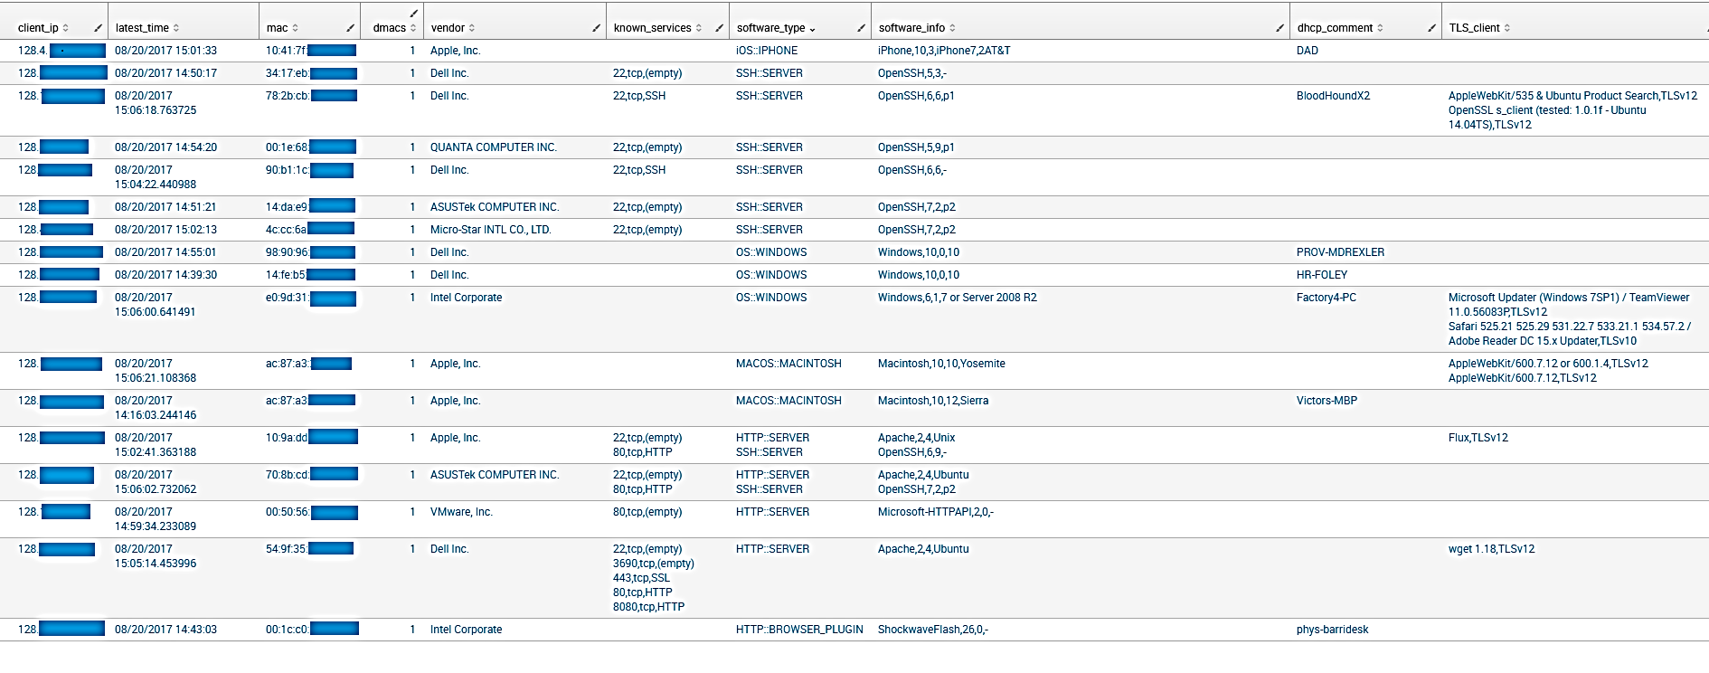
What is Zeek?
IDS NSM
Sniff traffic
Logs for various protocols seen in traffic
Notes:
Different than IDS system

Slide 7
History….
Came from Big Brother - reference to George Orwell's Big Brother from his novel Nineteen Eighty-Four
First line of code written by Dr. Vern Paxson in 1994
Since then managed and maintained by a vast community
More than 50 protocol analyzers supported as of today

Slide 8
Why use Zeek?
It is a powerful network analysis framework that is much different from the typical IDS you may know.
One of the coolest features is, it’s a great sniffer and generates [User-Friendly] logs of what it saw on the network. Take Advantage of that!
Open Source free software with great community support.

Slide 9
Labwork: Steps 1,2,3
Lets get our feet wet in Zeek Land!
Let’s install, configure and try to run Zeek on our network.

Slide 10
Zeek Logs
Leverage different log files: To know what’s running on your network, look for interesting log files - software.log, known_services.log, sites_open_ports.log, notice.log, weird.log
When run in tap (sniffing) mode: They are in ‘$ZEEK:HOME/logs/current’ folder
When run in offline mode, spits out the logs in whatever dir it is run in

Slide 11
Labwork: Step 4
Lets go over some log files that are generated in our environment.

Slide 12
Zeek’s Signature Framework
Zeek also provides an independent signature language for doing low-level, Snort-style pattern matching.
While signatures are not Zeek’s preferred detection tool, they sometimes come in handy and are closer to what many people are familiar with from using other NIDS
There was once a ‘snort2bro script, that converted Snort signatures automatically into Zeek’s signature syntax.
Ref: https://www.bro.org/sphinx/frameworks/signatures.html#id7

Slide 13
Labwork: Step 5
Lets write our first signature detection.

Slide 14
Zeek’s Scripting Framework
base/ dir:
Everything is loaded by default.
The scripts are only meant to enable analyzers, collect state, generate protocol logs, and provide reusable frameworks and function libraries.
policy/ dir:
Nothing here is loaded by default.
This is where many of the detections that Bro does out of the box take place.
site/ dir:
This is where local configuration goes.
Files are not overwritten during installation.
Itʼs loaded with @load statements in local.zeek.

Slide 15
Labwork: Step 6
Lets write our first script.

Slide 16
Zeek’s Scripting Framework
Lets detect some cool things in the traffic using Zeek!
ZeekLab-Part2
Detect Scanners!
Detect Zero Access rootkit!
Detect SSH bruteforcing!
Detect IOCs in your network!
Hands on – How can I test my script in Zeek?
Use try.bro!
Example – DHCP Finger printing

Slide 17
Appendix – Some Extras
Do I need to write my own scripts for Zeek to do cool things on my network?
Answer is NO!!!
Look online, a lot of people have contributed scripts and plugins for Zeek!

Slide 18
Summary: Ask Zeek anything you want
Enumerating various services/servers: Which services & How many servers:
What all servers providing DNS service on the network?
What all servers providing Web service on the Network?
What all systems have xyz service running or xx port open?
Malware IR: Get all possible information of an infected system
Hmm, one of the IDSs has detected Petya downloaded on a box.
Is the system actually vulnerable To Petya?
A new vulnerability just got released that exploits a particular software/version. What all systems on my Network are running that piece of software.

Slide 19
Advanced: TLS Fingerprinting [Special Thanks to Seth ]
Detecting the TLS Client in use by fingerprinting TLS traffic.
Use a table of data set to compare the sniffed TLS traffic to fingerprint the known TLS client.
Bro has all the events to capture all the information transpired in TLS handshake.
How it works? Explained in next Slide.

Slide 20
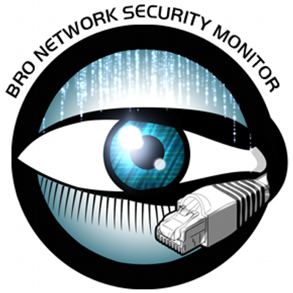
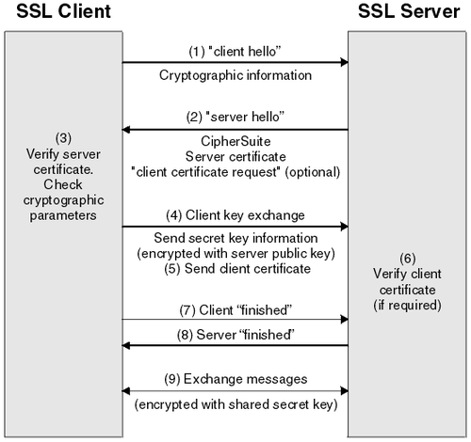
TLS FP Data Set
#fields c_ts conn_uid c_id.orig_h c_id.orig_p c_id.resp_h c_id.resp_p c_history TLSclient TLSversion
#types time string addr port addr port string string string
1503518399.695575 CzkJHy381vUQWhK2yj 128.4.61.52 39769 72.21.207.120 443 ShAD RingCentral App (unknown platform) #2 TLSv12
1503518399.969706 C9n2DFsCzzpeVxQC5 128.175.93.225 53336 157.56.77.141 443 ShAD Windows 10 Native Connection TLSv12
1503518399.964234 CqhIcA4gl316hUOFO7 128.175.10.83 54977 192.229.211.36 443 ShAD MS Edge TLSv12
1503518399.243547 C35BFhWjur9EAWtjf 128.175.26.139 62201 172.217.3.110 443 ShAD BlueCoat Proxy TLSv12

Slide 21
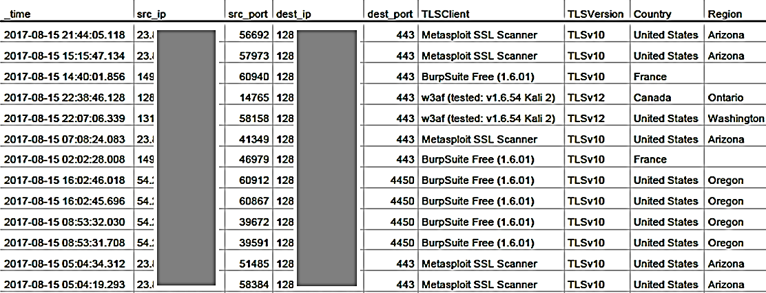
TLS Fingerprinting- Block the Offensive clients
Look for ‘Metasploit’ OR ‘BurpSuite’ OR ‘SkipFish’ OR ‘w3af’ OR ‘mitmproxy’ in the log file.

Slide 22
Where to find scripts?
Custom scripts used in this presentation can be found at :
https://github.com/fatemabw/bro-scripts
The TLS Fingerprint Dataset can be found at:
https://github.com/LeeBrotherston/tls-fingerprinting/blob/master/fingerprints/fingerprints.json

