Slide 1
Research Progress Update
Fateme Mohammad Mohammadi, Chemical Engineering

Slide 2
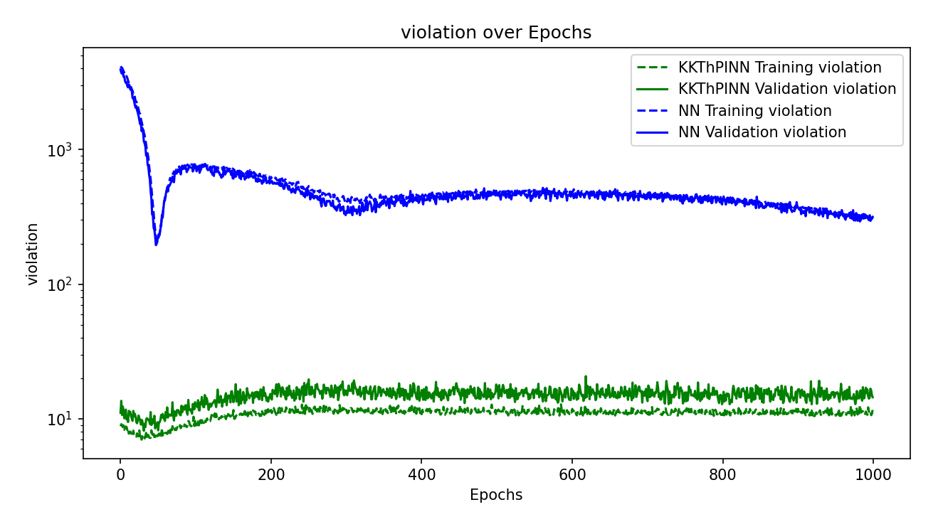
Violation – 200 sample points

Slide 3
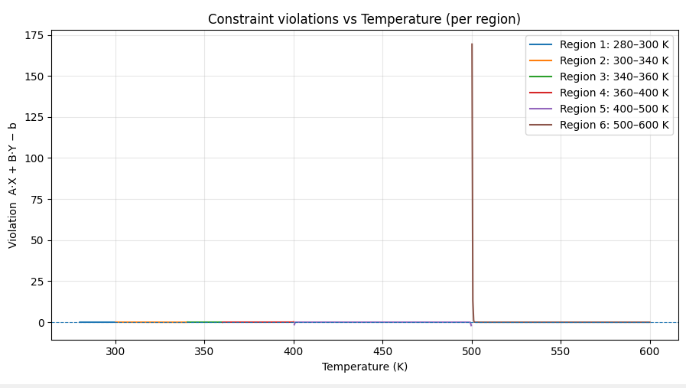
وقتیکه تعداد نقاط رو از 500 به 700 تغییر دادم.

Slide 4
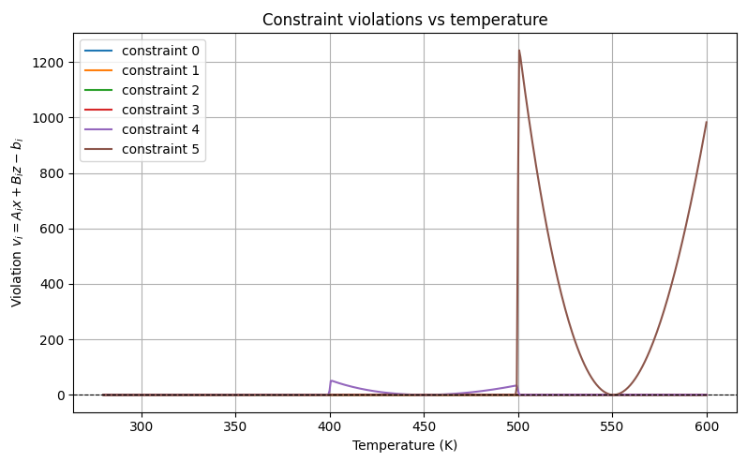

Slide 5
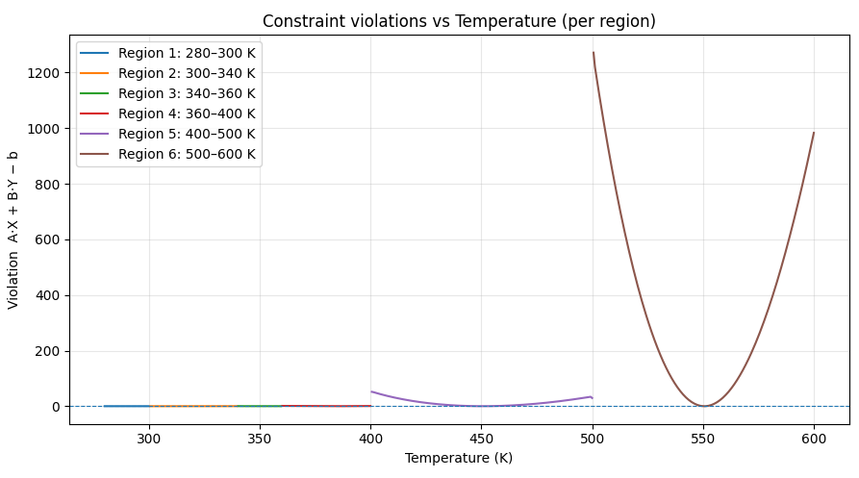

Slide 6
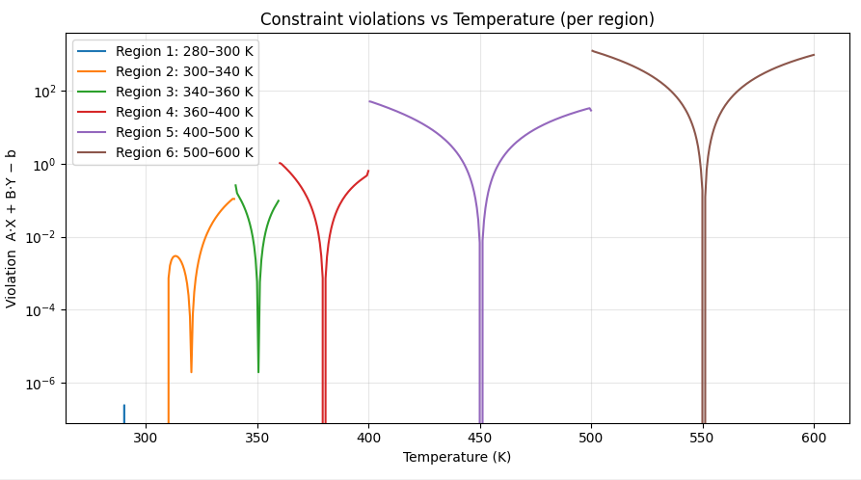

Slide 7
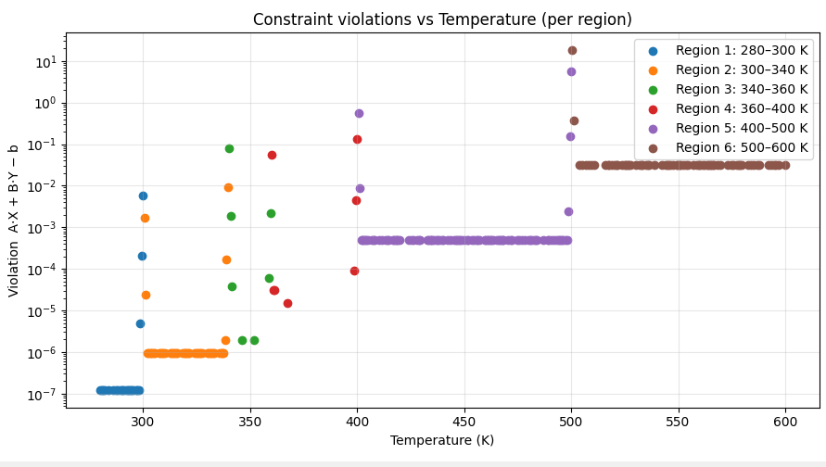
Scatter – abs – no subtraction from original linearized form

Slide 8
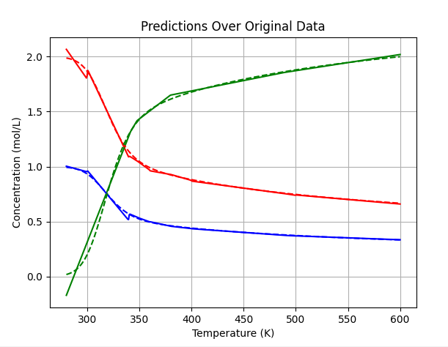

Slide 9
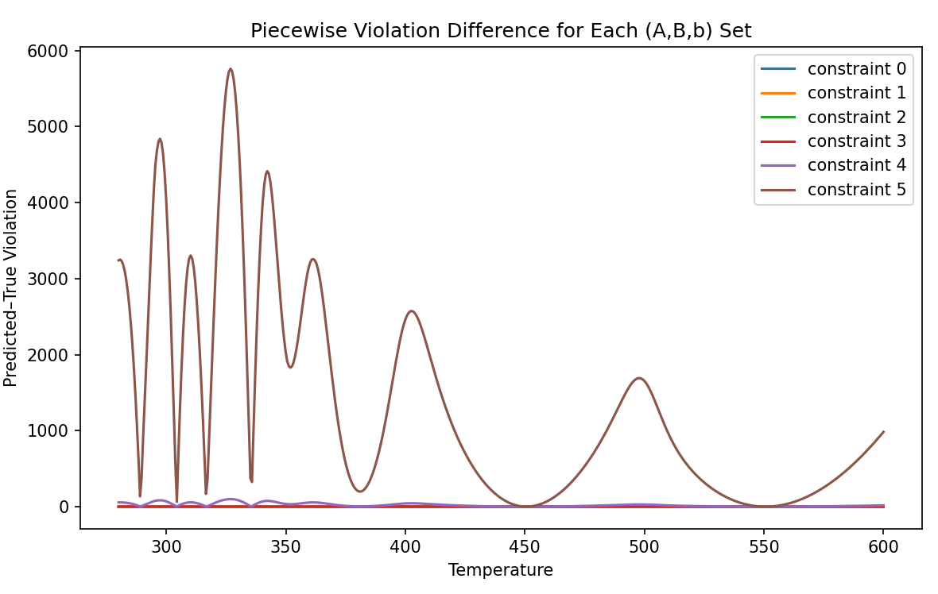

Slide 10
