Slide 1
Research Progress Update
Fateme Mohammad Mohammadi, Chemical Engineering

Slide 2
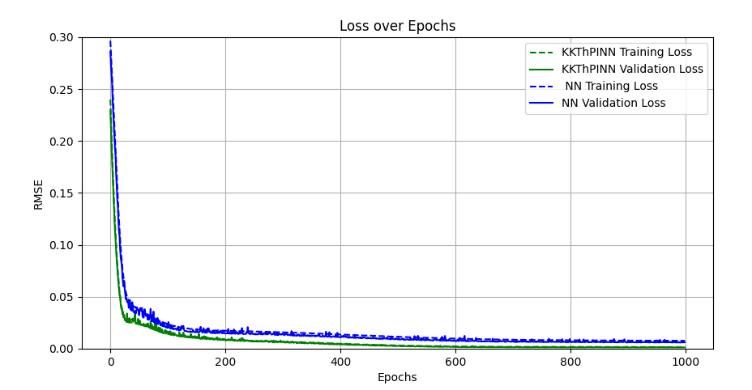
F and g defined explicitly and calculated based on Ca,Cb,Cc of NN

Slide 3
F and g defined explicitly and calculated based on Ca,Cb,Cc of NN
KKThPINN Training Loss (Epoch 1000): 0.0015935207548965935
KKThPINN Validation Loss (Epoch 1000): 0.0012231898124928475
NN Training Loss (Epoch 1000): 0.00776587056386453
NN Validation Loss (Epoch 1000): 0.006291127326489218

Slide 4
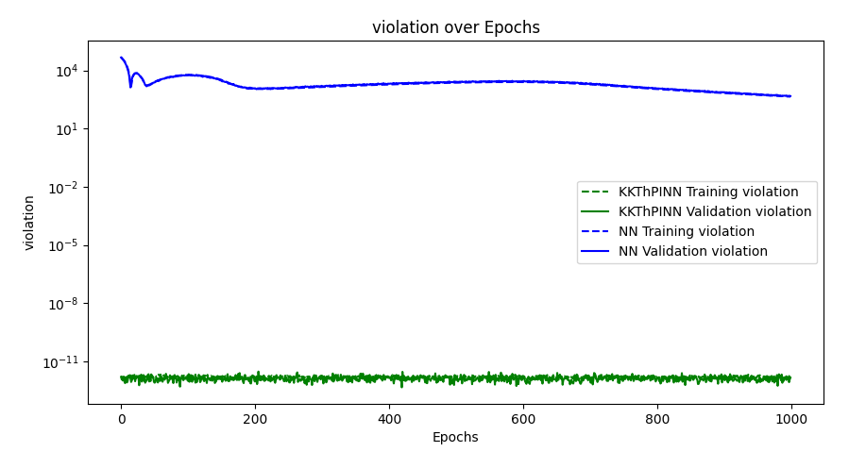
F and g defined explicitly and calculated based on Ca,Cb,Cc of NN

Slide 5
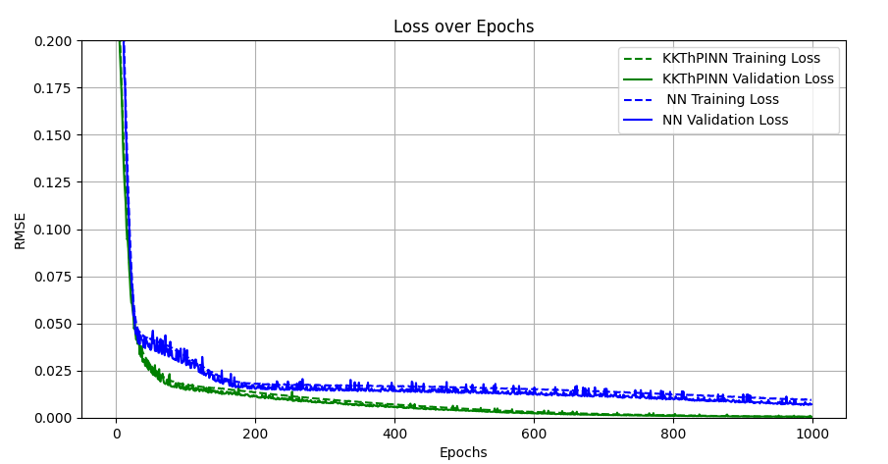
Use the 5 outputs of NN in the KKT model

Slide 6
Use the 5 outputs of NN in the KKT model – loss values
KKThPINN Training Loss (Epoch 1000): 0.000649441753959758
KKThPINN Validation Loss (Epoch 1000): 0.0005778171043754823
NN Training Loss (Epoch 1000): 0.009564732329233017
NN Validation Loss (Epoch 1000): 0.007198991886844008

Slide 7
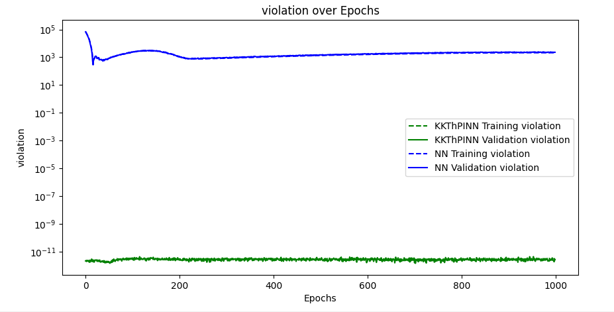
Use the 5 outputs of NN in the KKT model

Slide 8
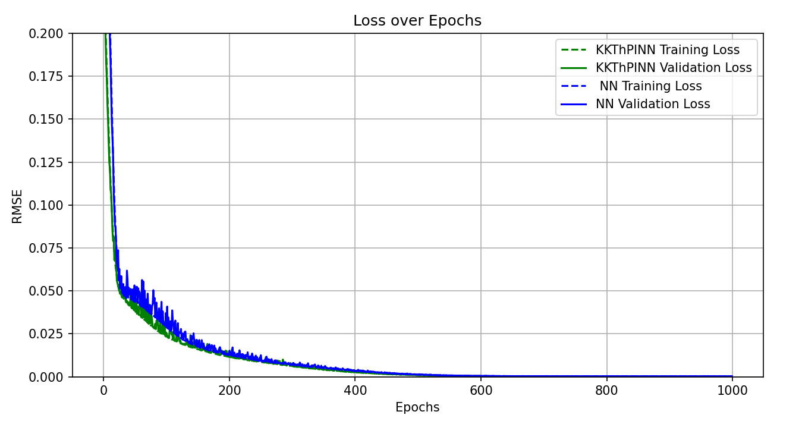
Use the 4 outputs of NN in the KKT model, Ca, Cb, Cc, f+g

Slide 9
Use the 4 outputs of NN in the KKT model
KKThPINN Training Loss (Epoch 1000): 0.00011754719475802074
KKThPINN Validation Loss (Epoch 1000): 0.0001061892212423211
NN Training Loss (Epoch 1000): 0.00022777821932331273
NN Validation Loss (Epoch 1000): 0.00024855702375408664

Slide 10
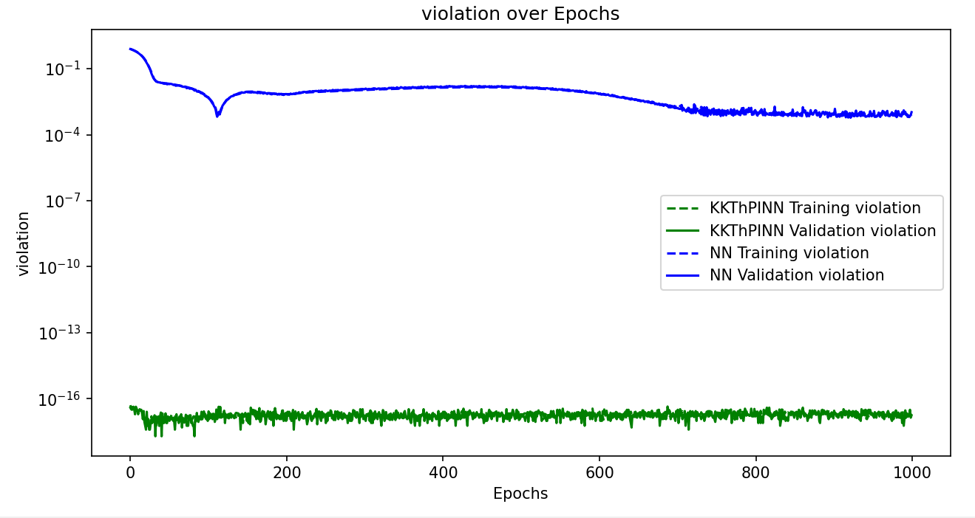
Use the 4 outputs of NN in the KKT model

Slide 11
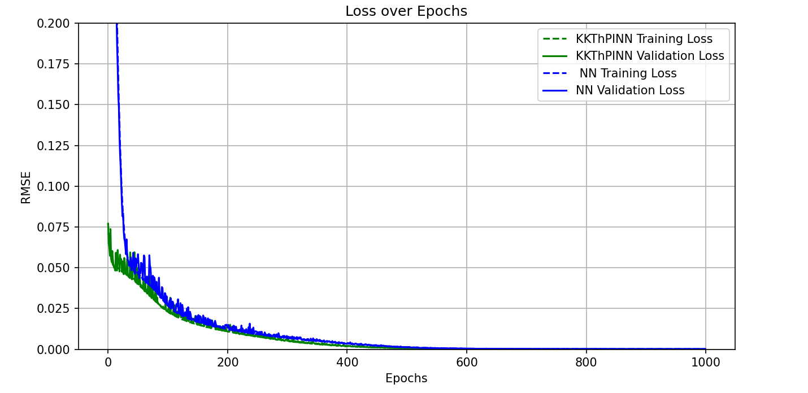
Use the 2 outputs of NN in the KKT model, Ca and f+g

Slide 12
Use the 2 outputs of NN in the KKT model
KKThPINN Training Loss (Epoch 1000): 5.5391030010630224e-05
KKThPINN Validation Loss (Epoch 1000): 5.5798046694264723e-05
NN Training Loss (Epoch 1000): 0.00014969633853121865
NN Validation Loss (Epoch 1000): 0.0001402782563571227

Slide 13
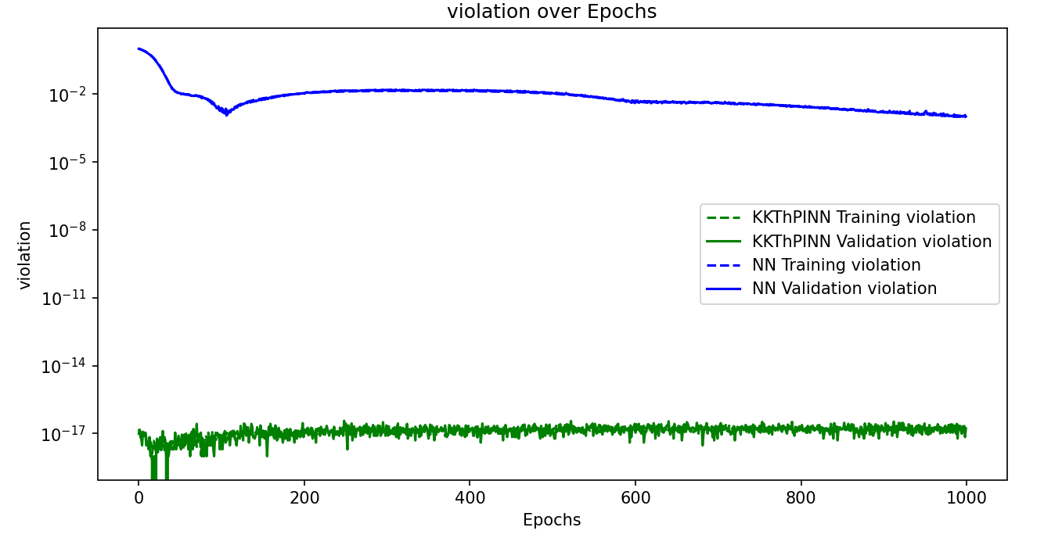
Use the 2 outputs of NN in the KKT model

Slide 14
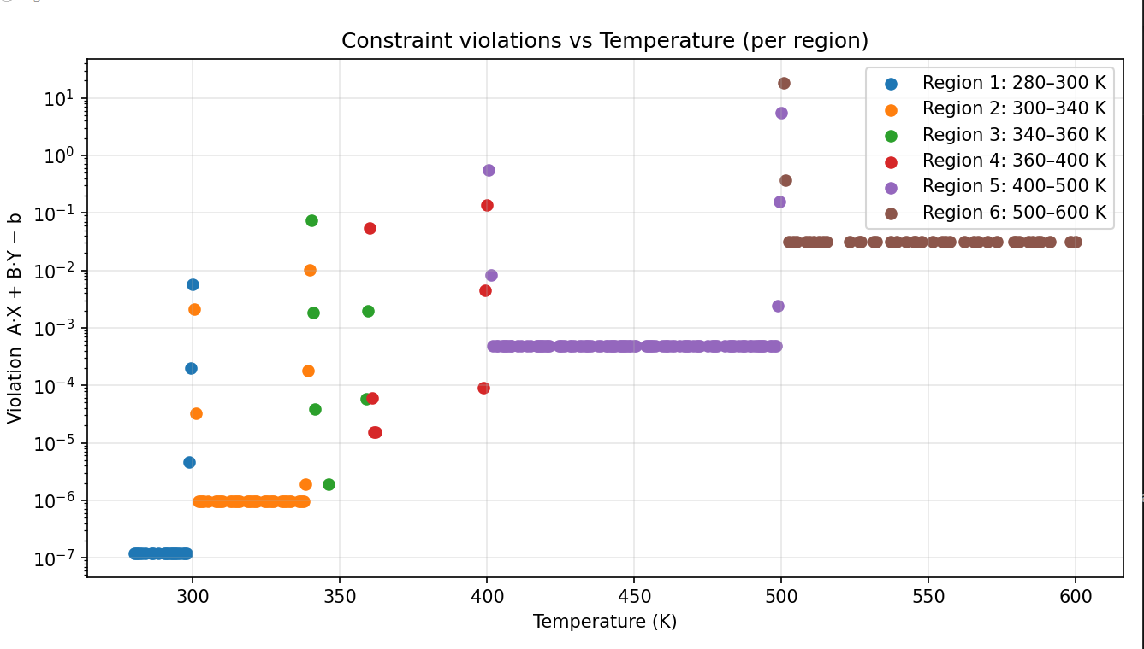
Float 32

Slide 15
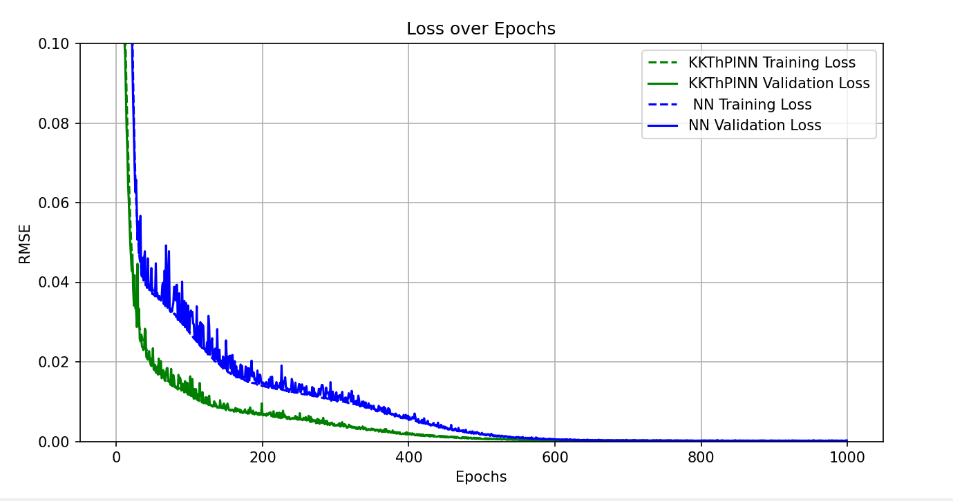
Float 32

Slide 16
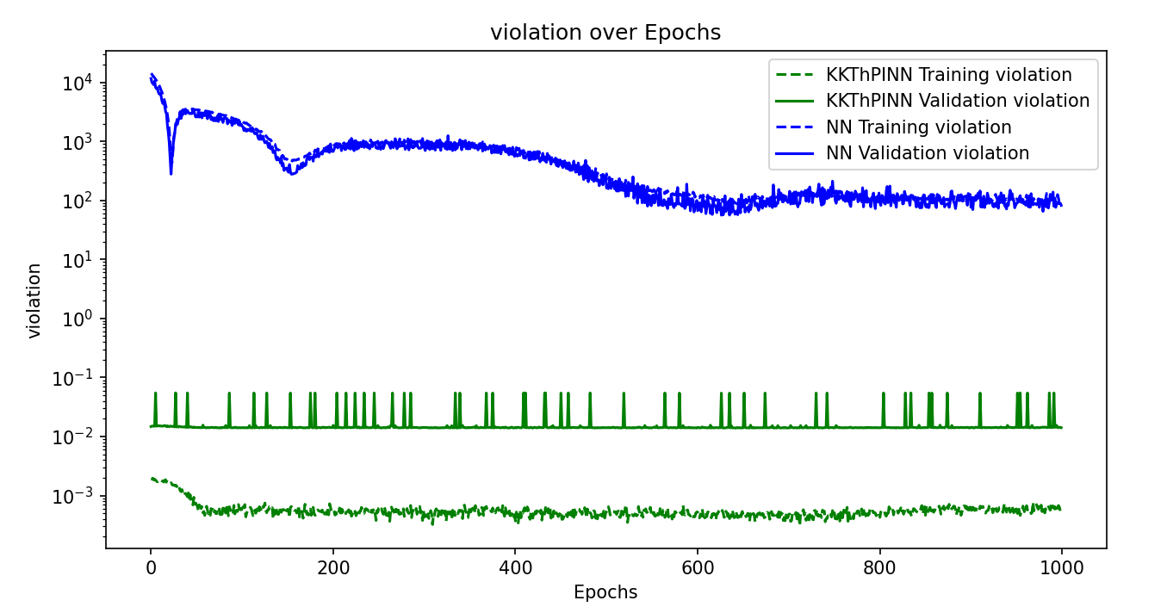
Float 32

Slide 17
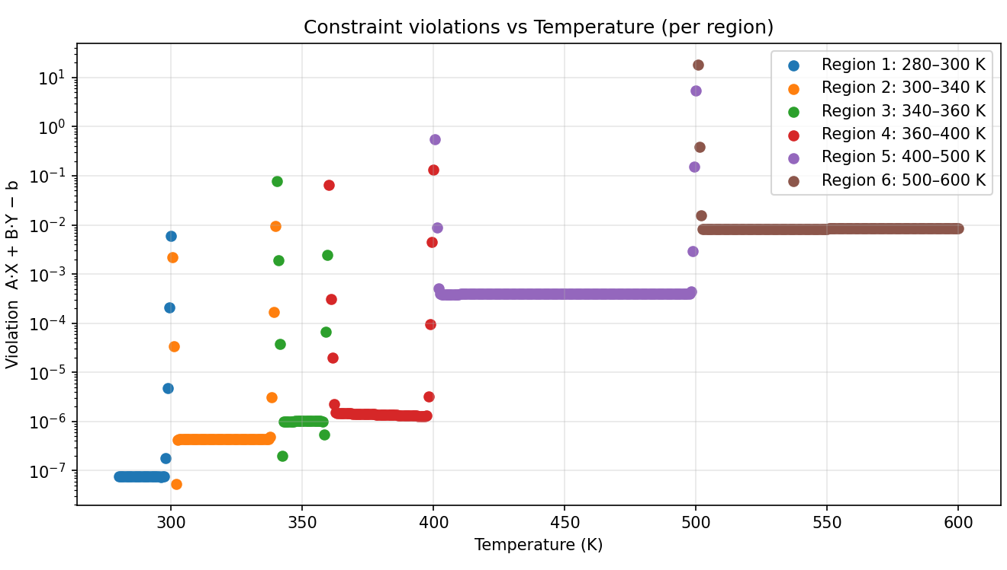
Float 64

Slide 18
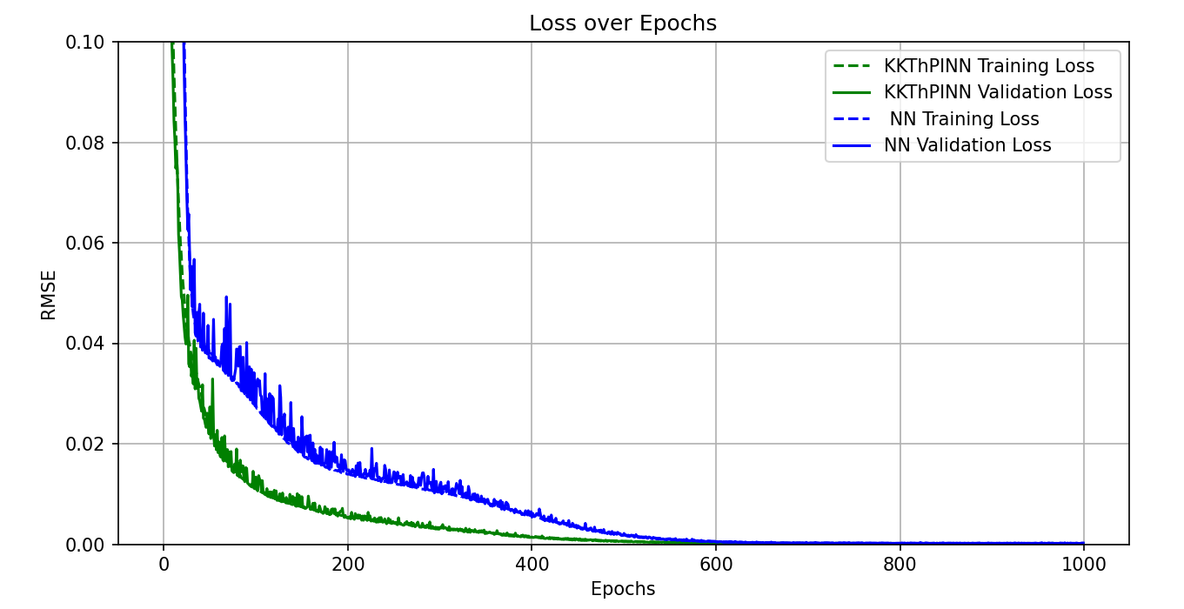
Float 64

Slide 19
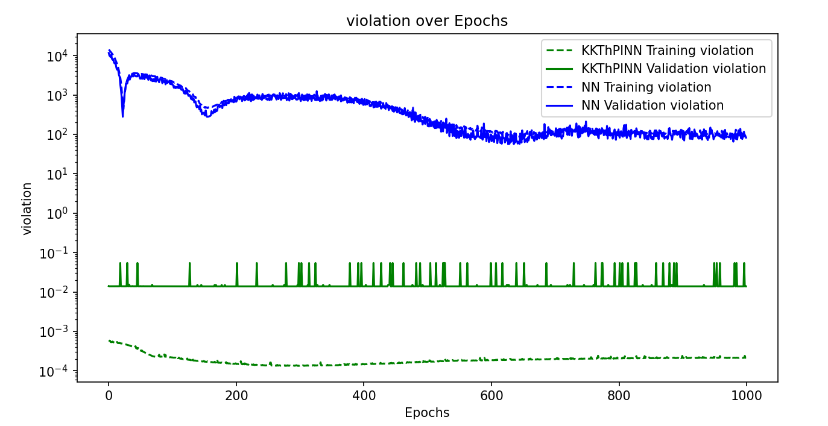
Float 64

Slide 20
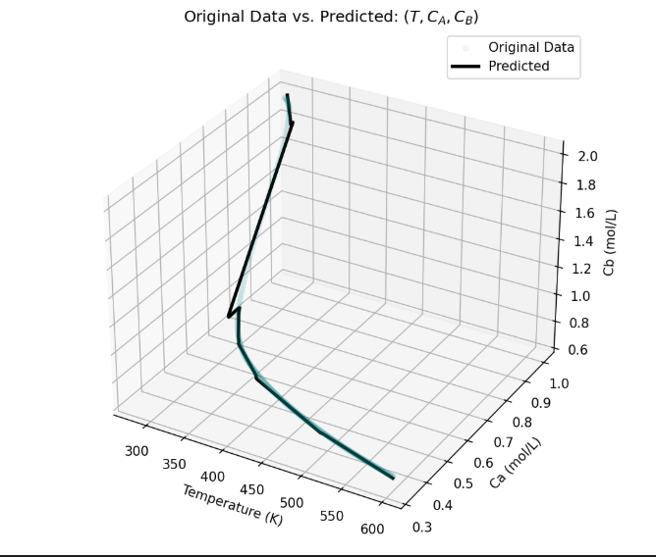

Slide 21
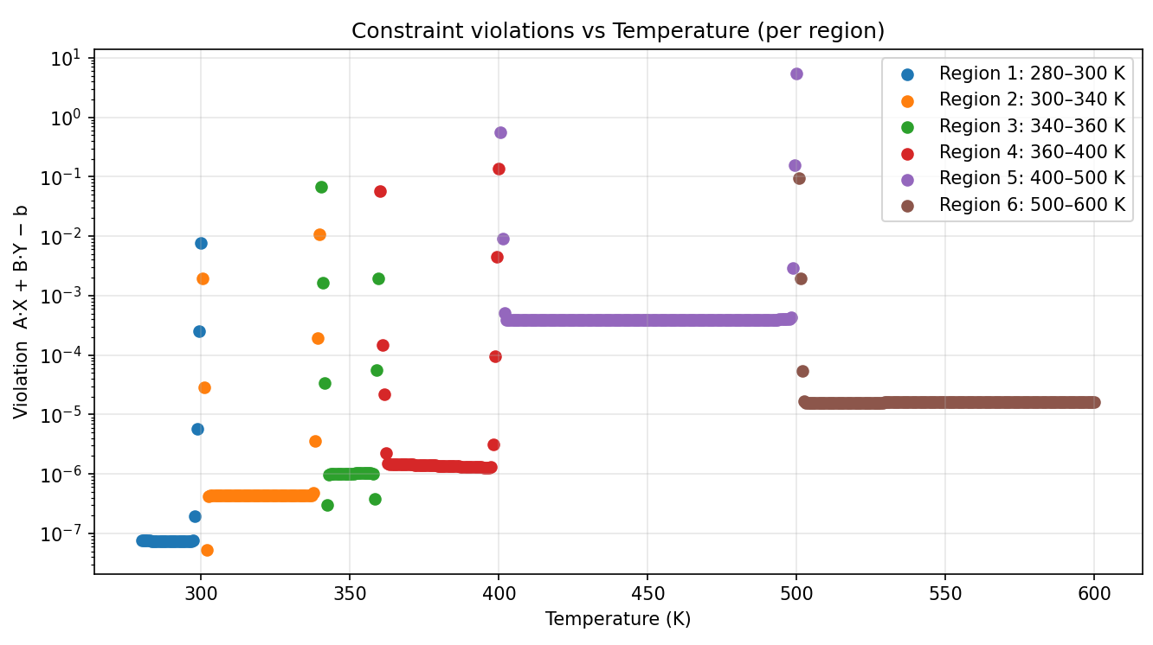
Smaller coefficients, divide by b.

Slide 22
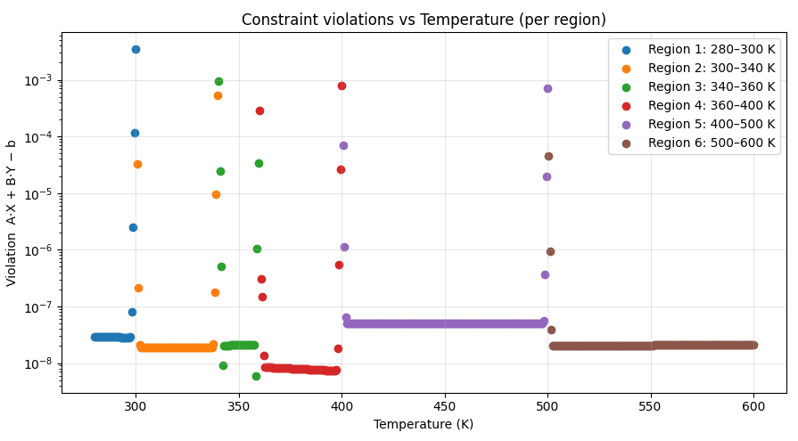
Divide by the norm of A and B- geometric normalization (?)

Slide 23
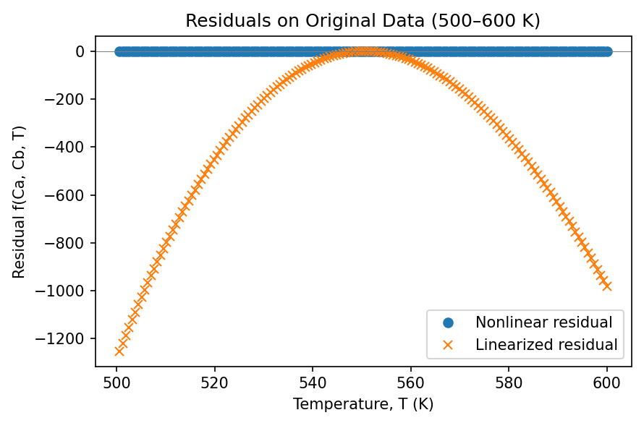

Slide 24
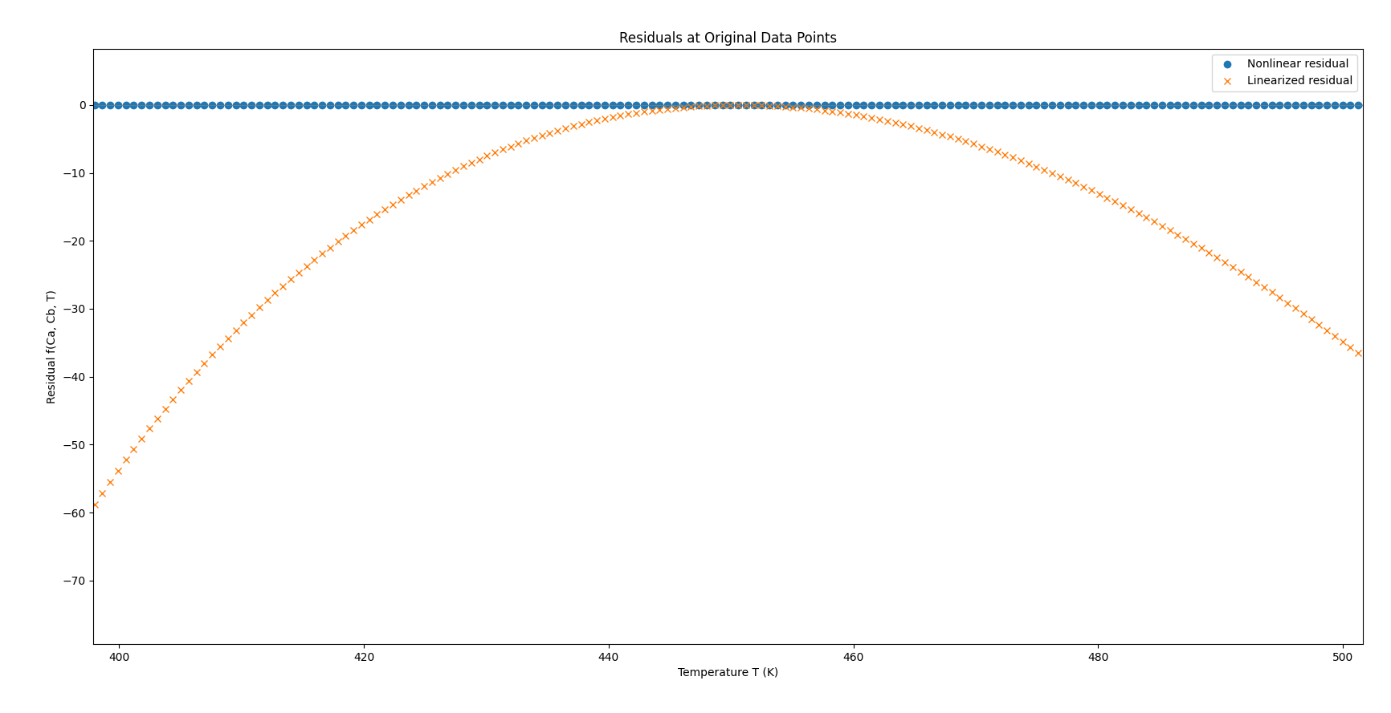

Slide 25
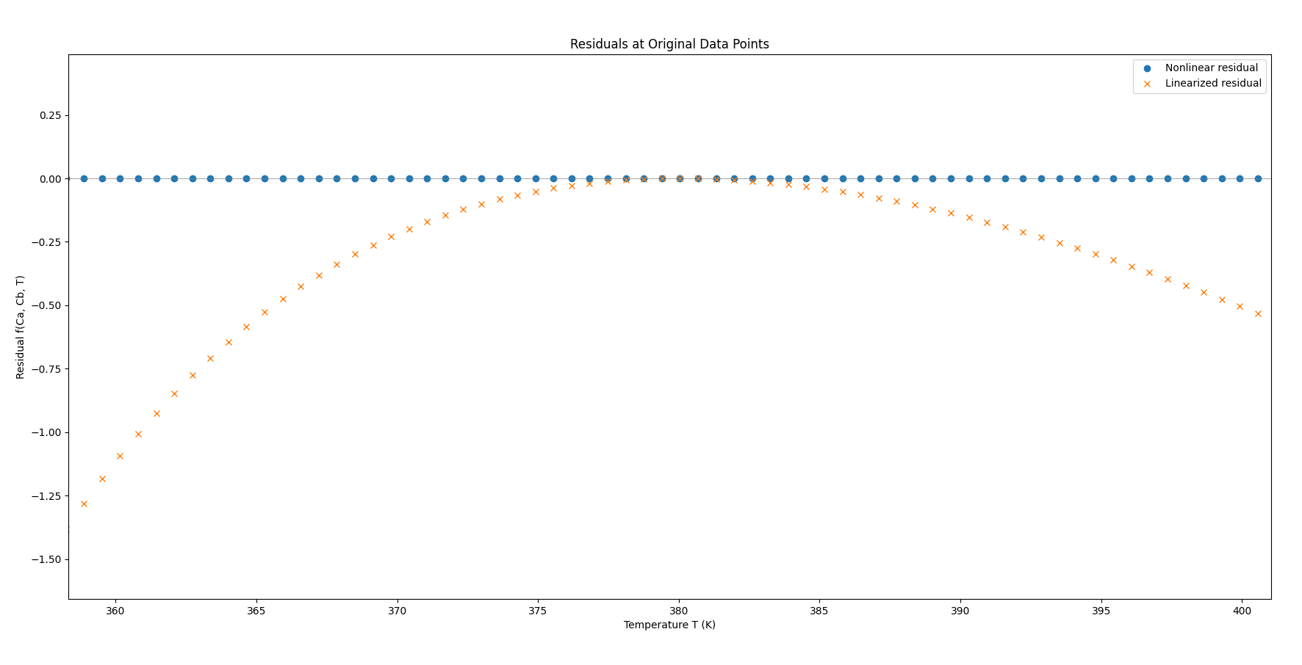

Slide 26
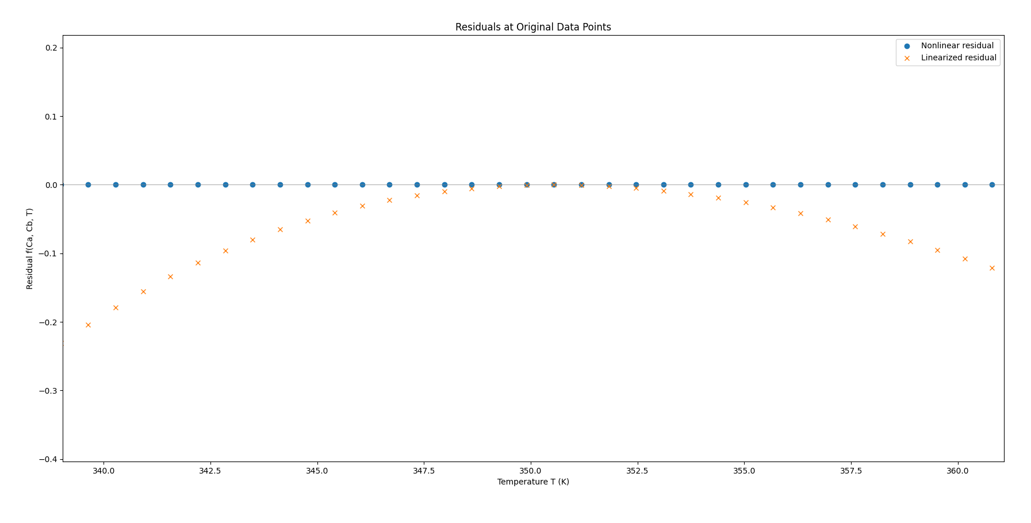

Slide 27
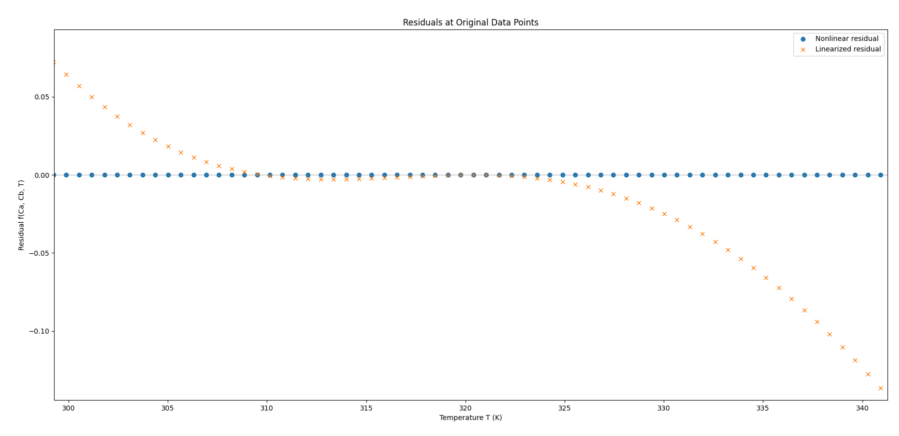

Slide 28
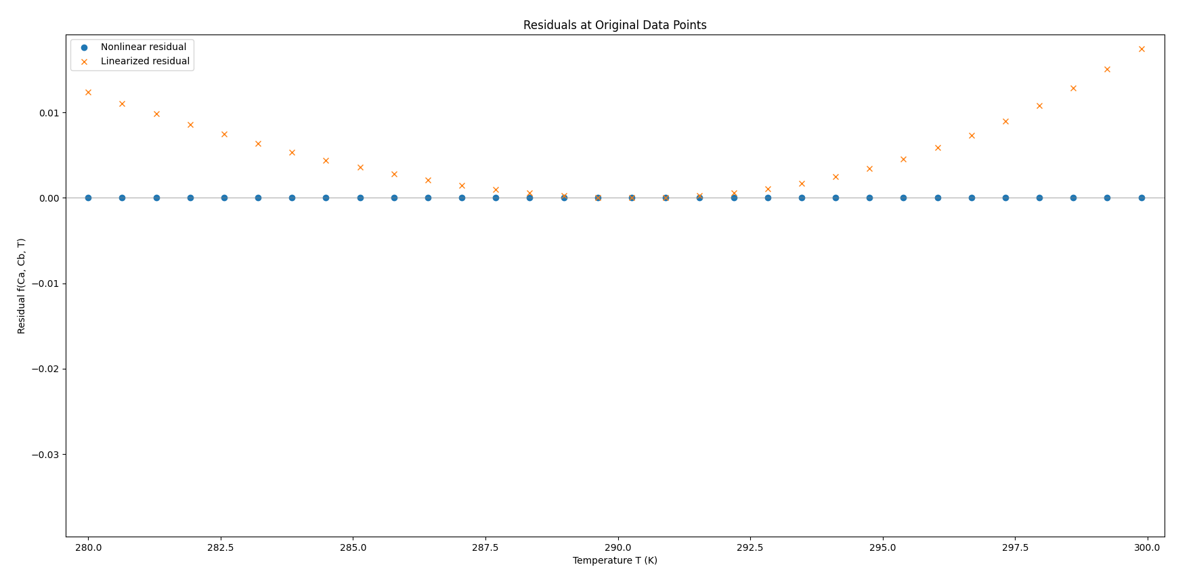

Slide 29
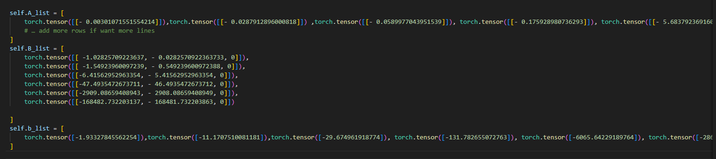

Slide 30
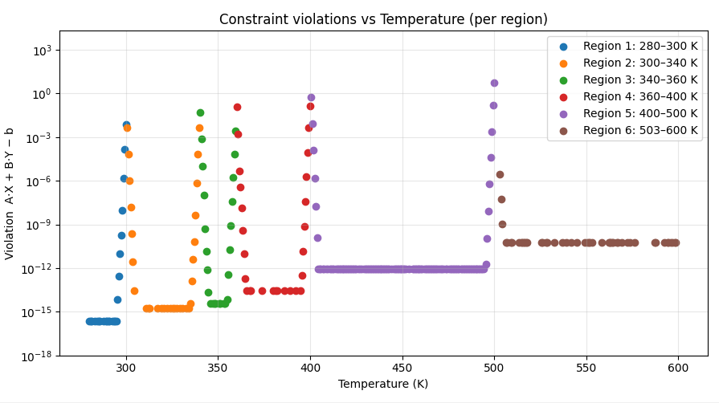

Slide 31
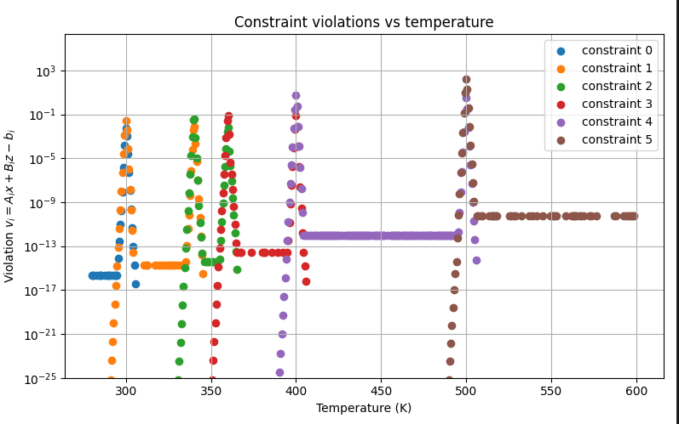

Slide 32
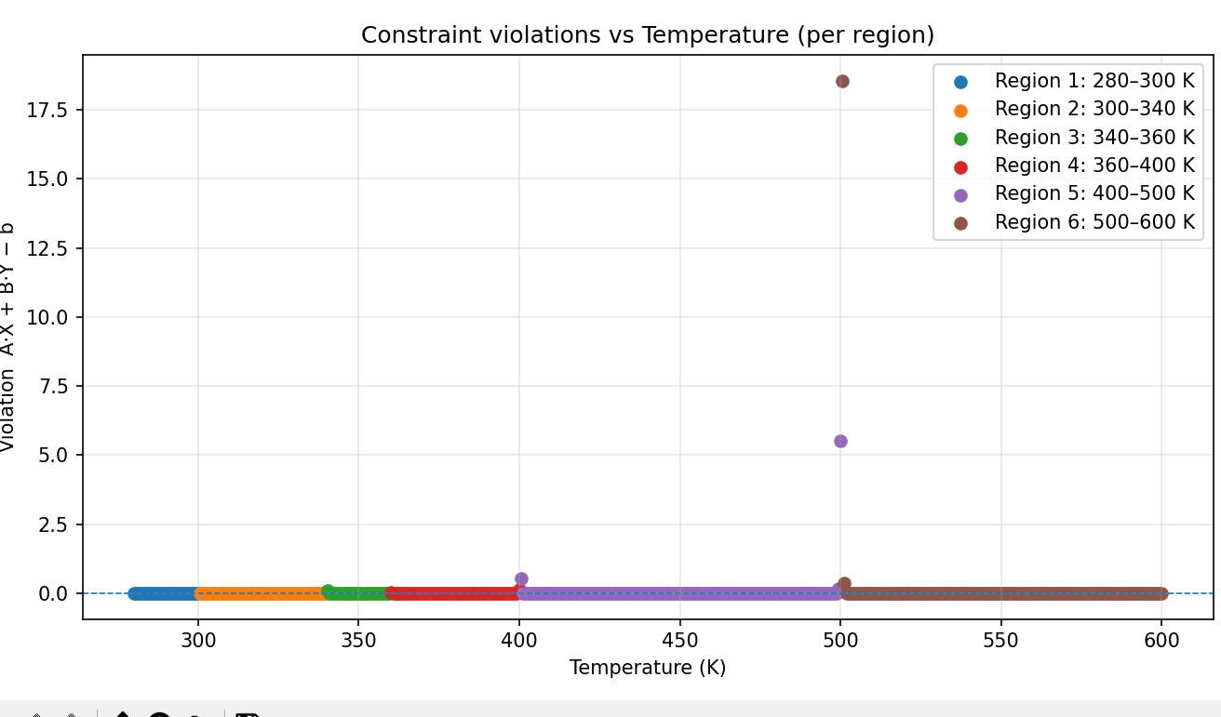
Steepness=500000

Slide 33
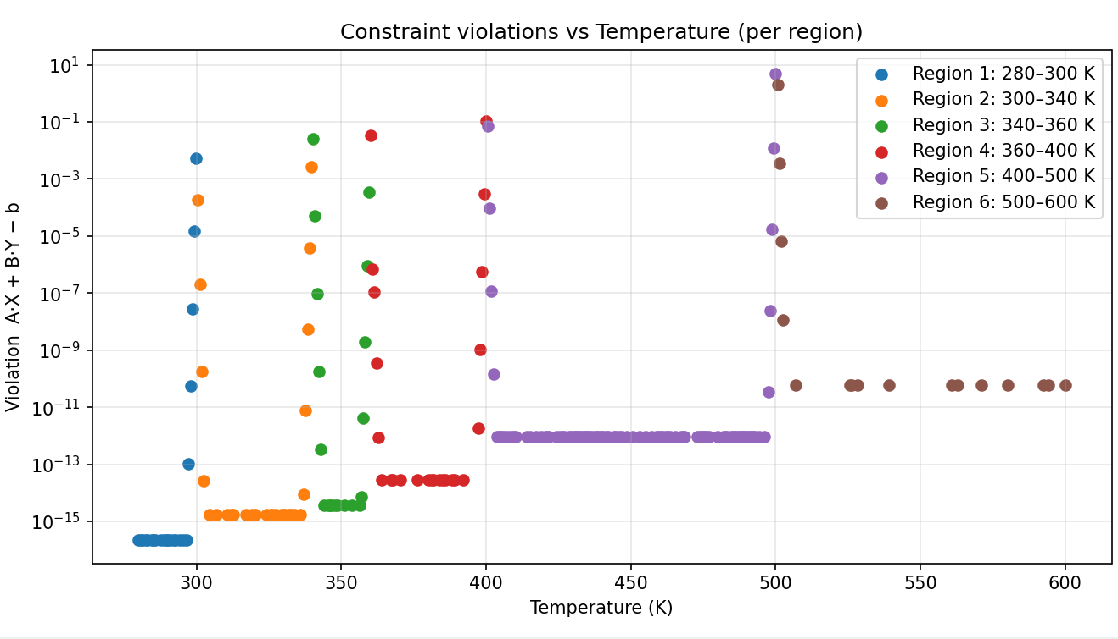
Steepness=800000

Slide 34
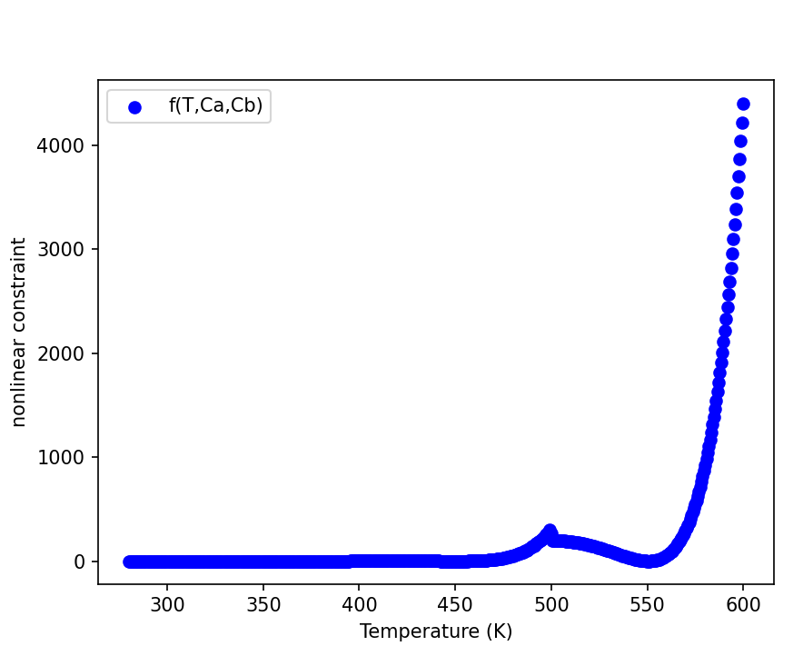

Slide 35
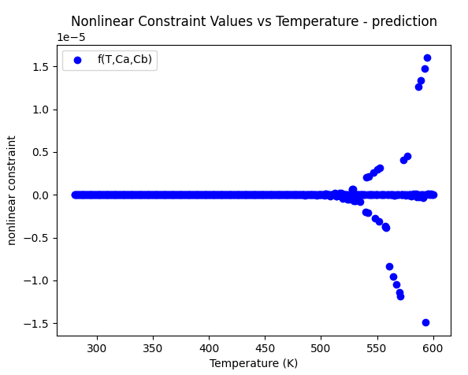

Slide 36
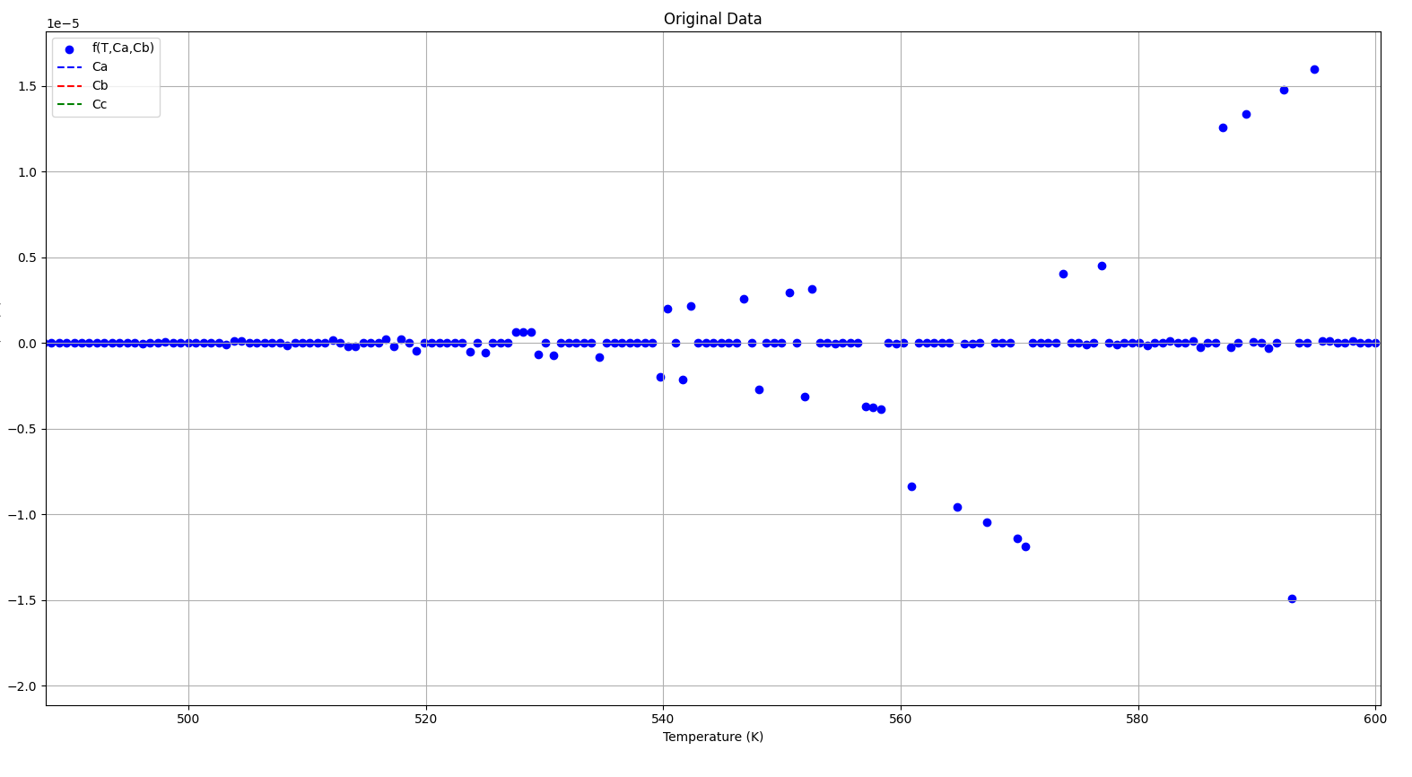

Slide 37
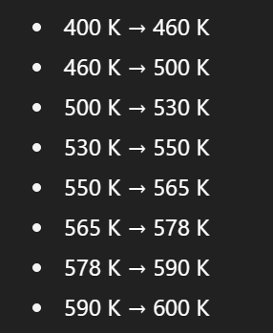

Slide 38
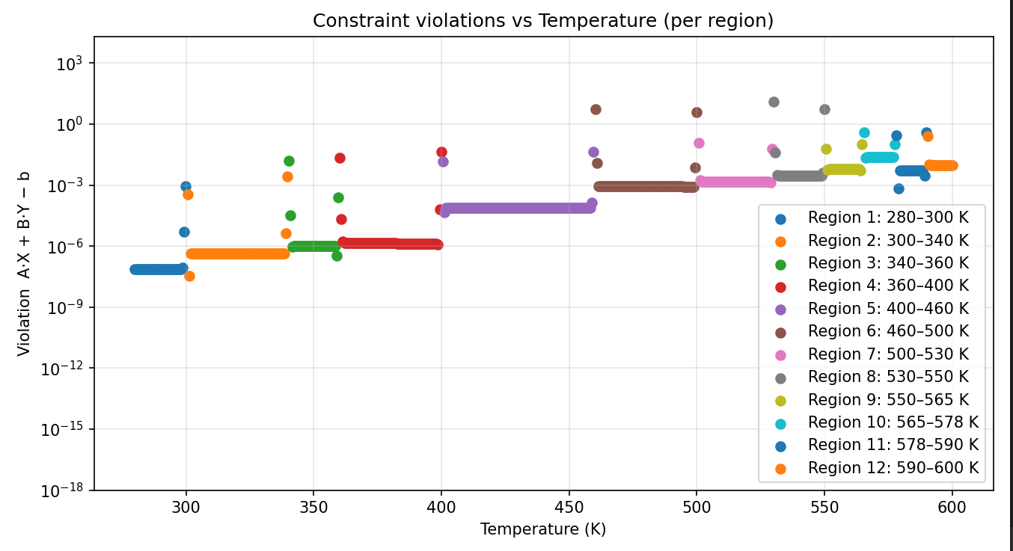

Slide 39
