Slide 1
1/20/2025

Slide 2
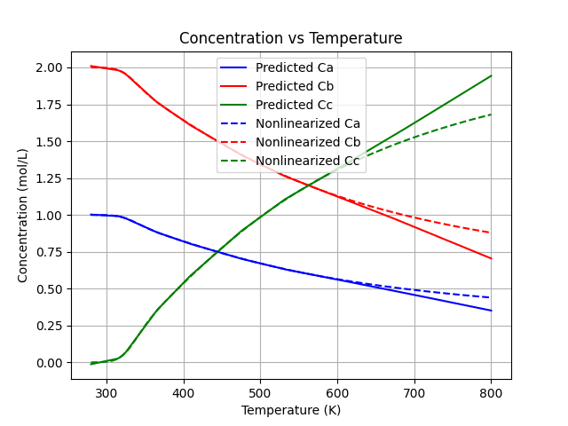
KKT-extrapolate

Slide 3
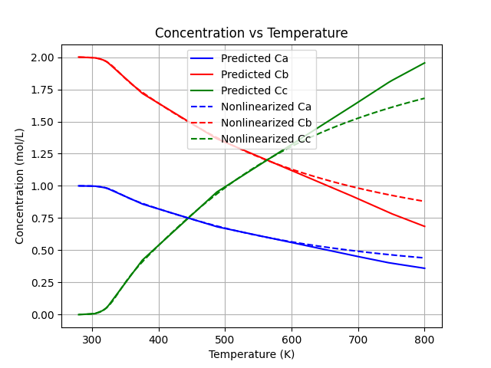
KKT-extrapolate

Slide 4
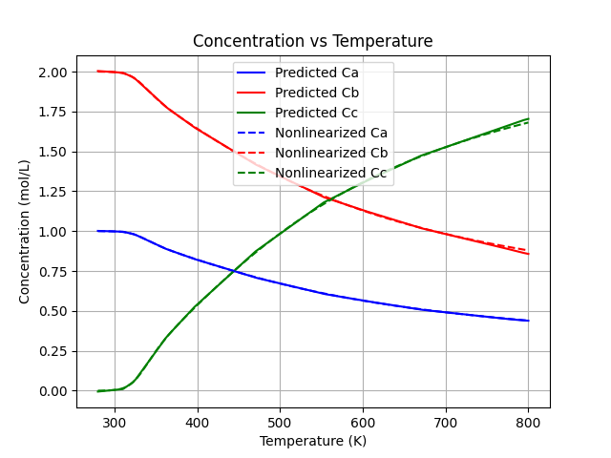
KKT-extrapolate

Slide 5

NN-extrapolate

Slide 6
Noise

Slide 7
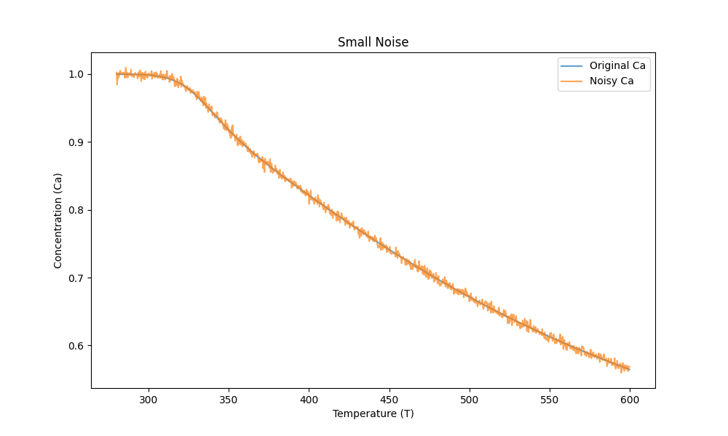
Small Noise

Slide 8
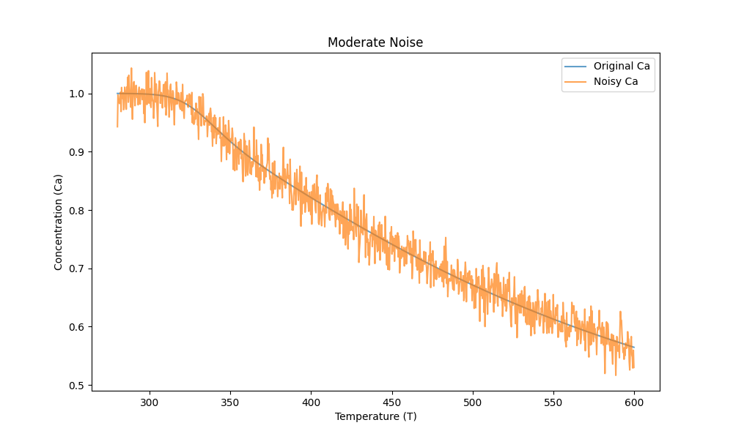
Small Noise

Slide 9
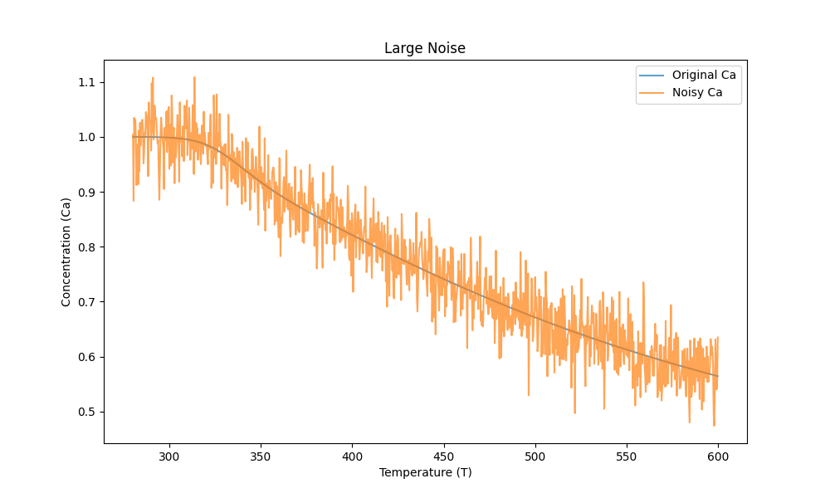
Small Noise

Slide 10
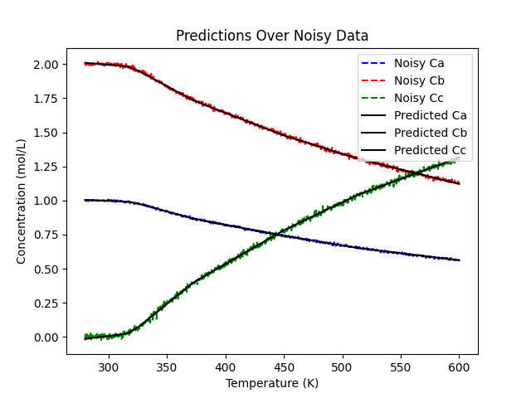
KKT-Small Noise

Slide 11
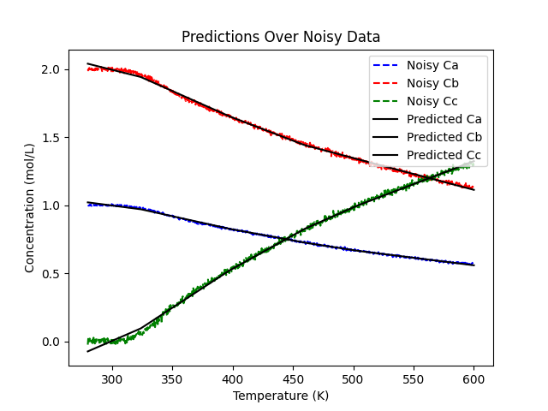
NN-Small Noise

Slide 12
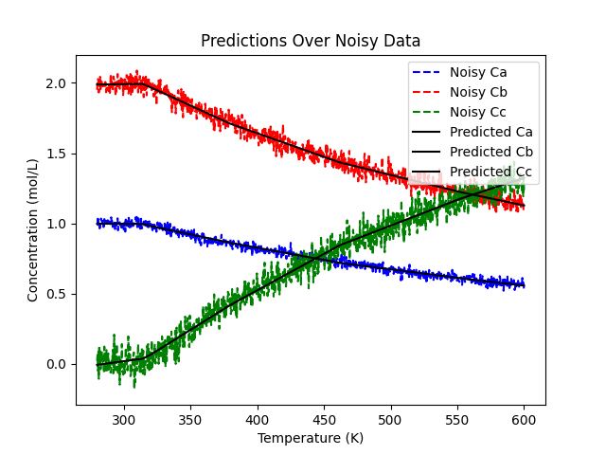
NN-Moderate Noise

Slide 13

KKT-Moderate Noise

Slide 14
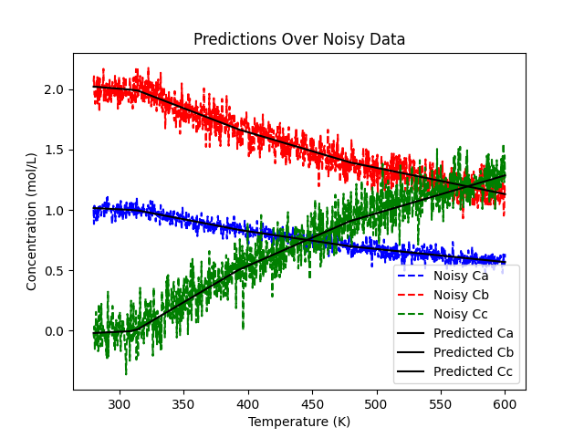
NN-Large Noise

Slide 15

KKT-Large Noise

Slide 16
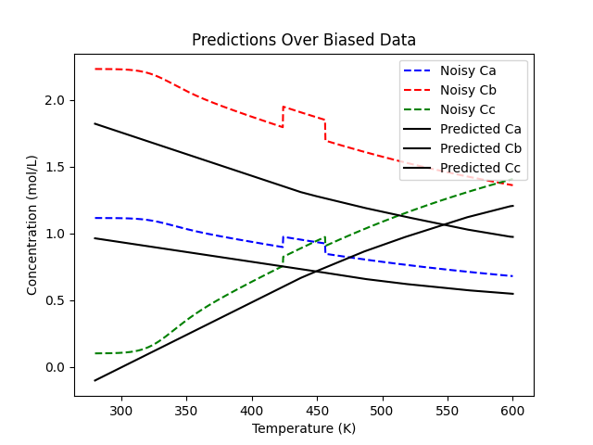
KKT-Bias

Slide 17
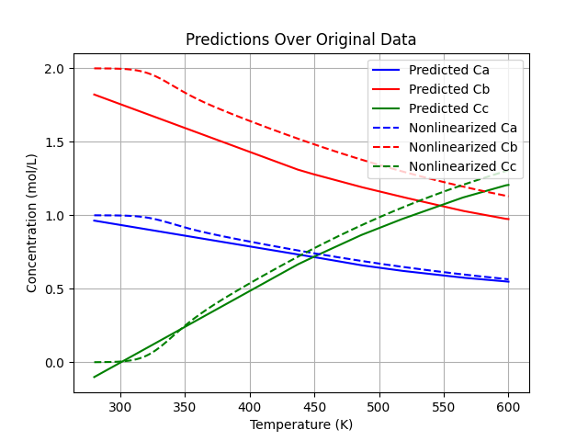
KKT-Bias

