Slide 1
1/27/2025

Slide 2
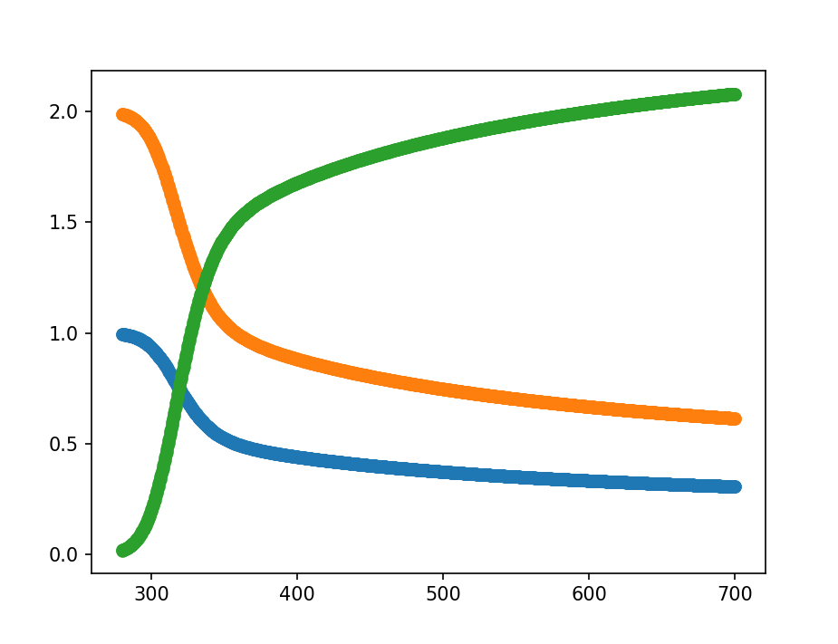
Make the data more nonlinear

Slide 3
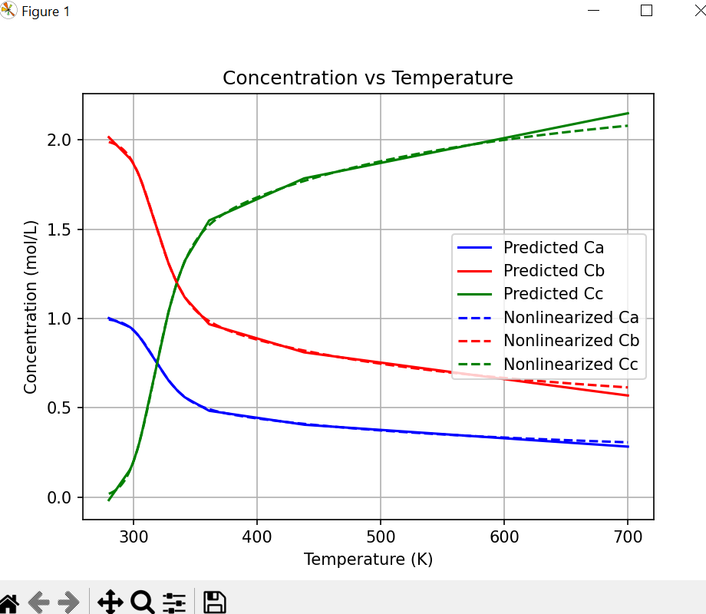
Extrapolate-KKT

Slide 4
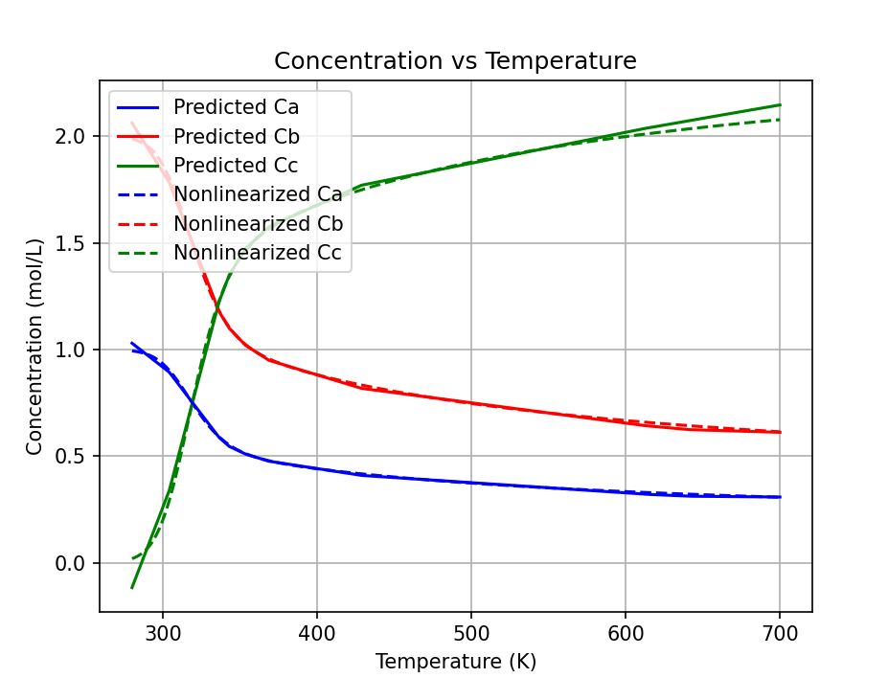
Extrapolate-NN

Slide 5
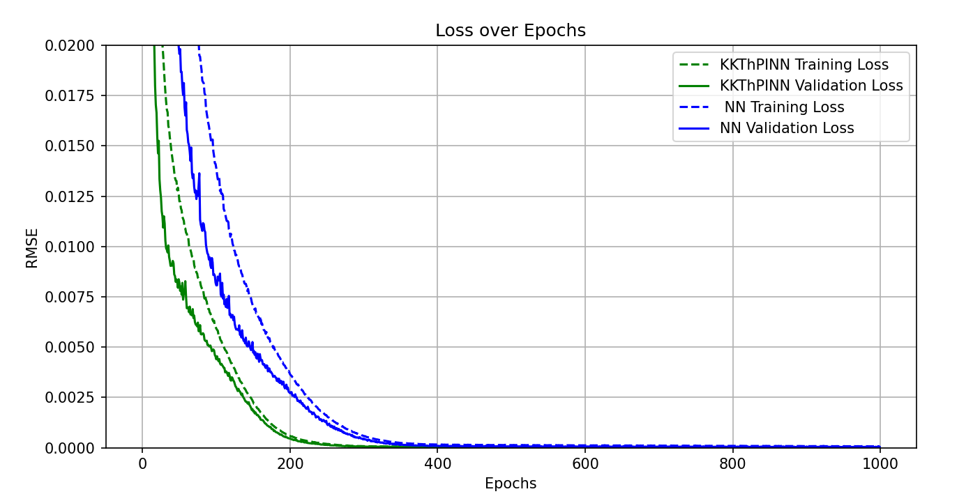
error

Slide 6
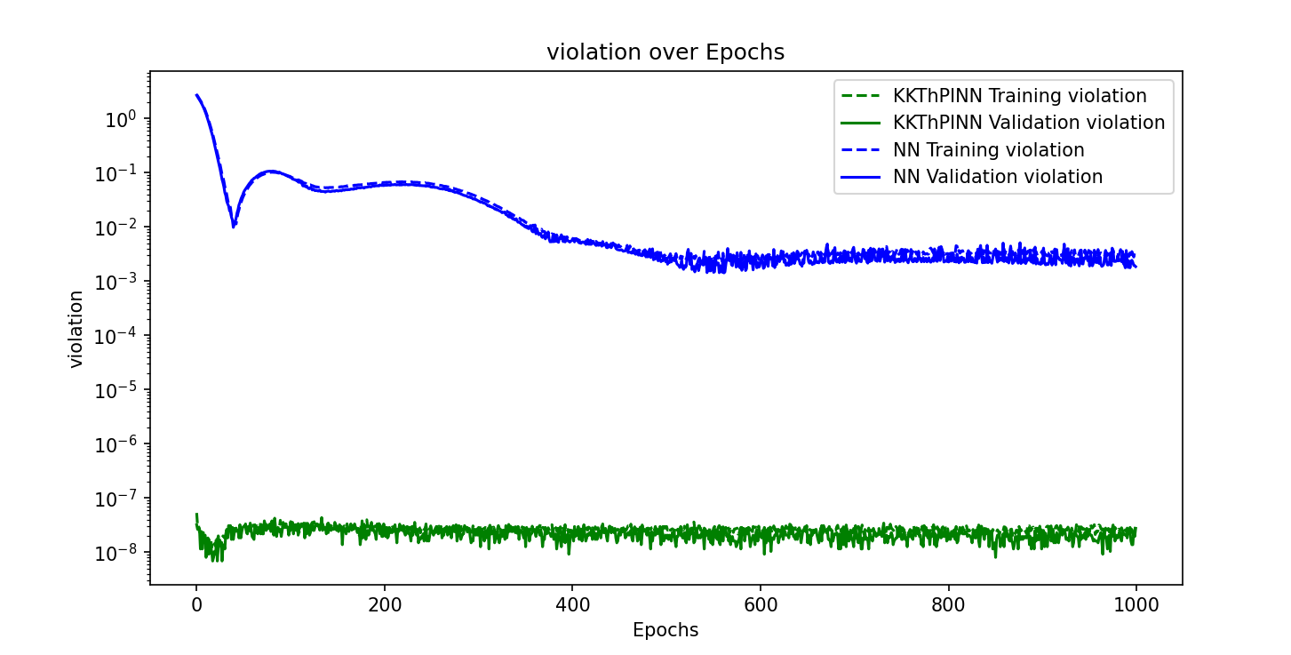
violation

