Slide 1
2/13/2025

Slide 2
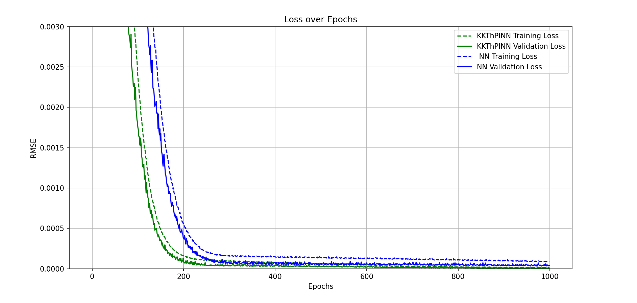
Clean data- linear constraint

Slide 3
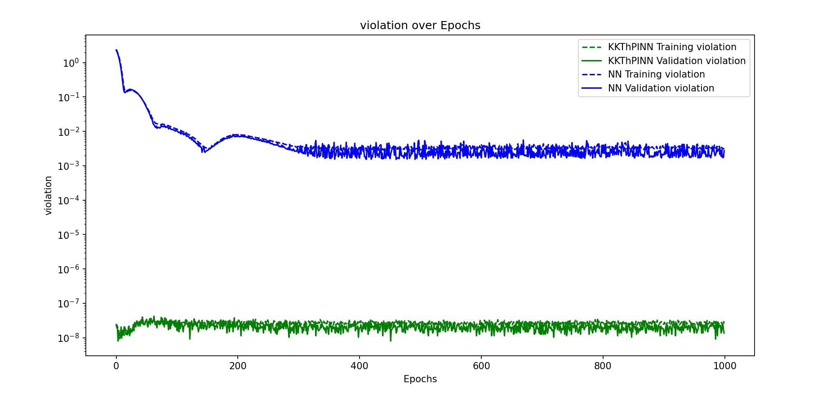
Clean data- linear constraint

Slide 4
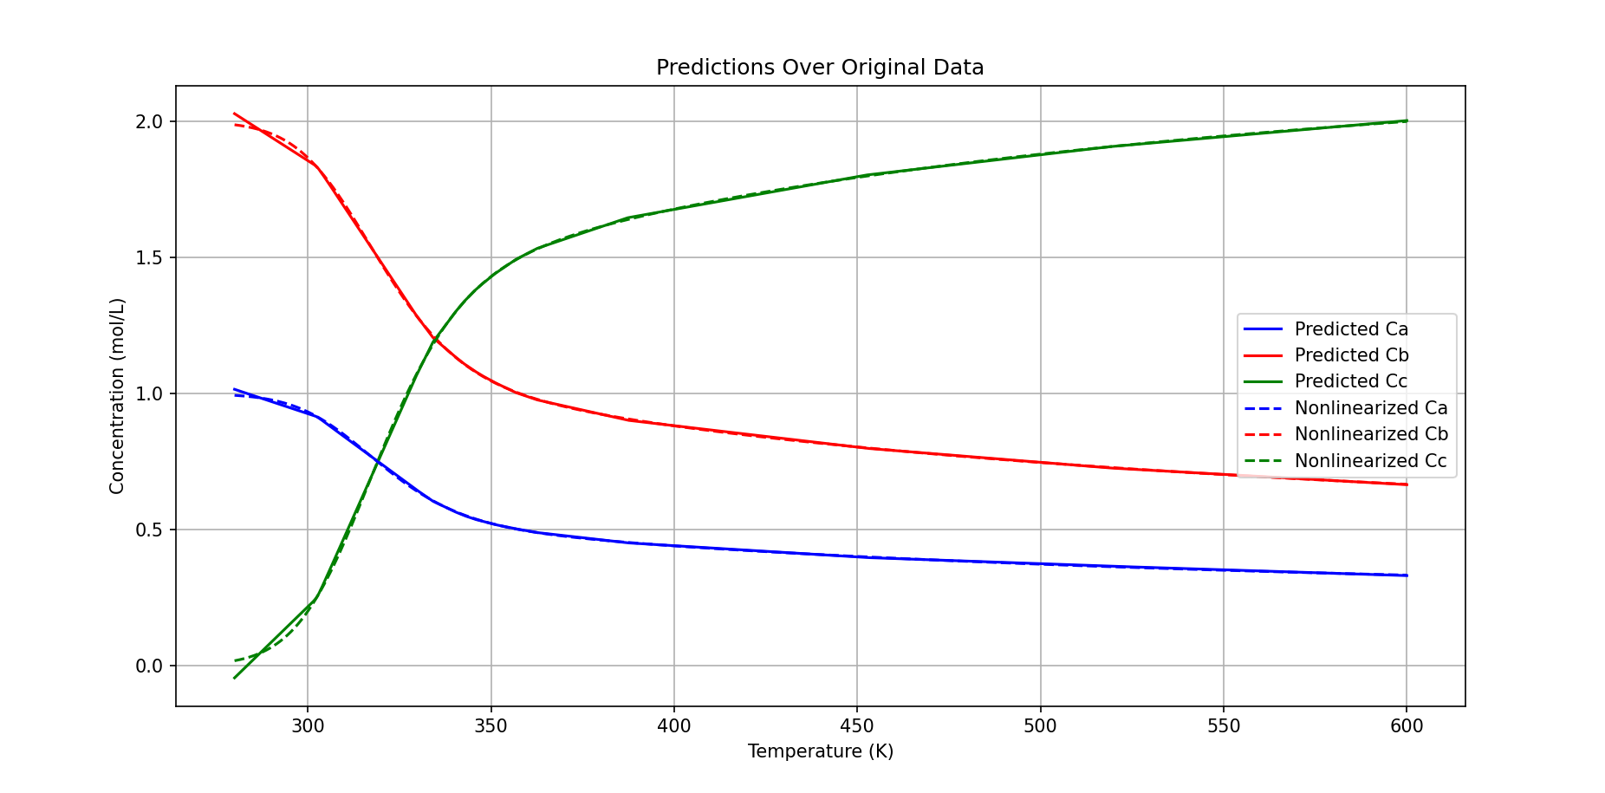
Clean data- linear constraint

Slide 5
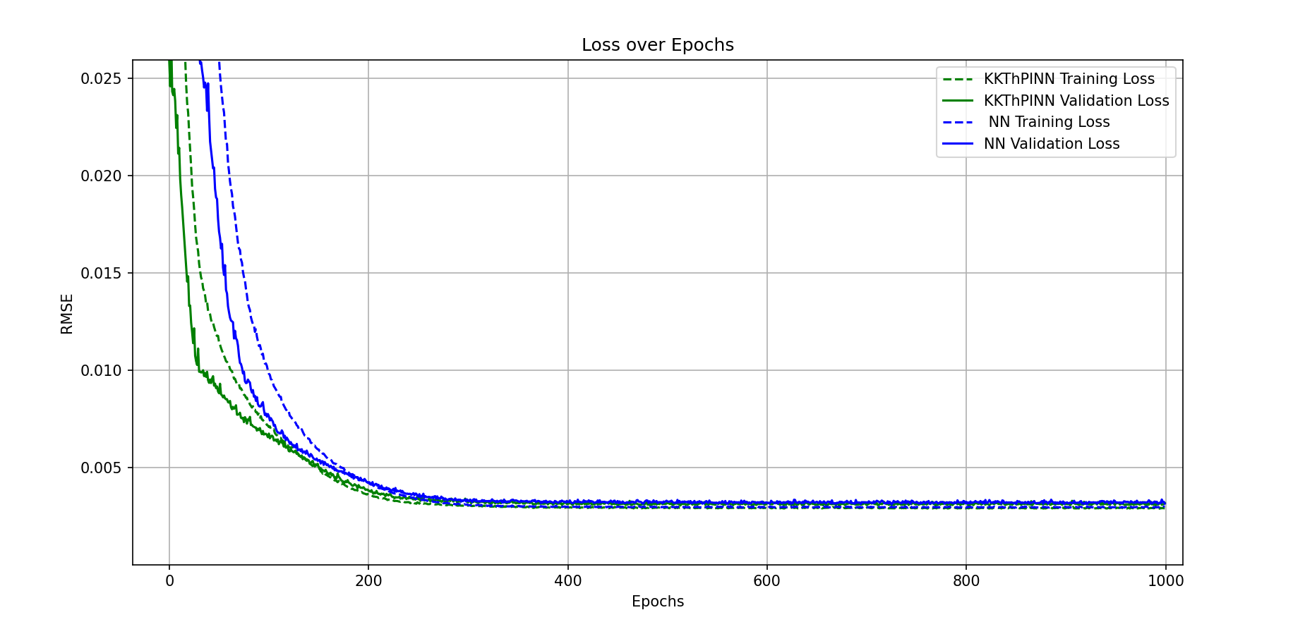
Large Noise- linear constraint- kkt better

Slide 6
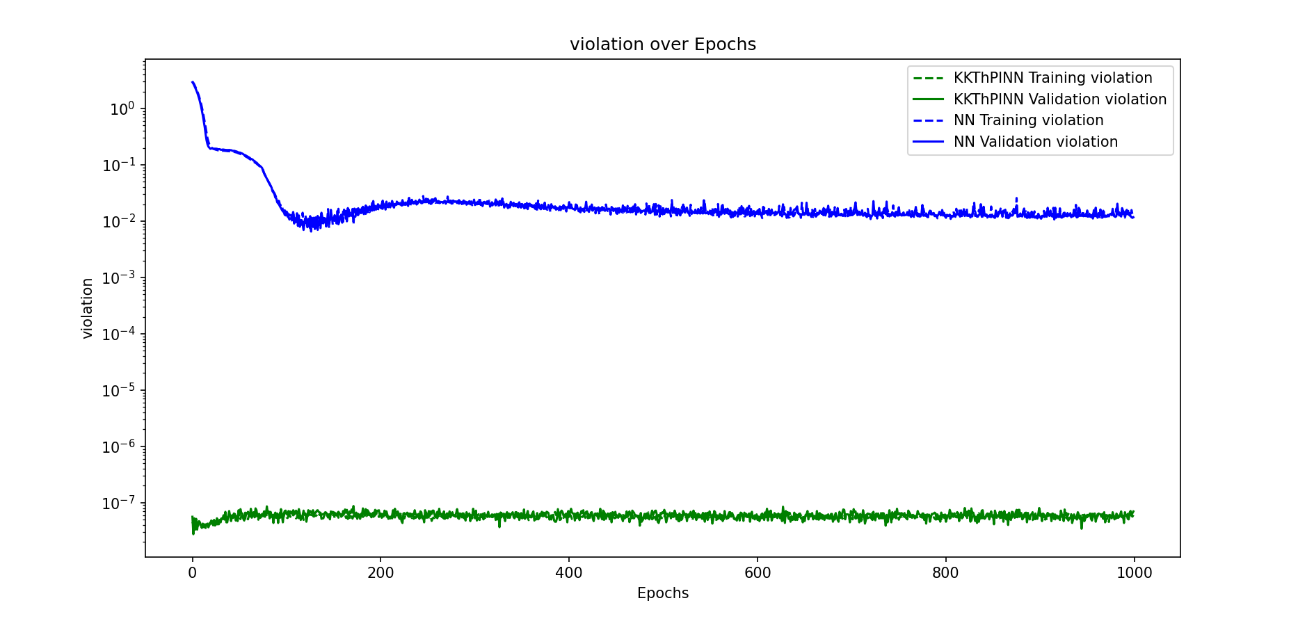
Large Noise- linear constraint- kkt better

Slide 7
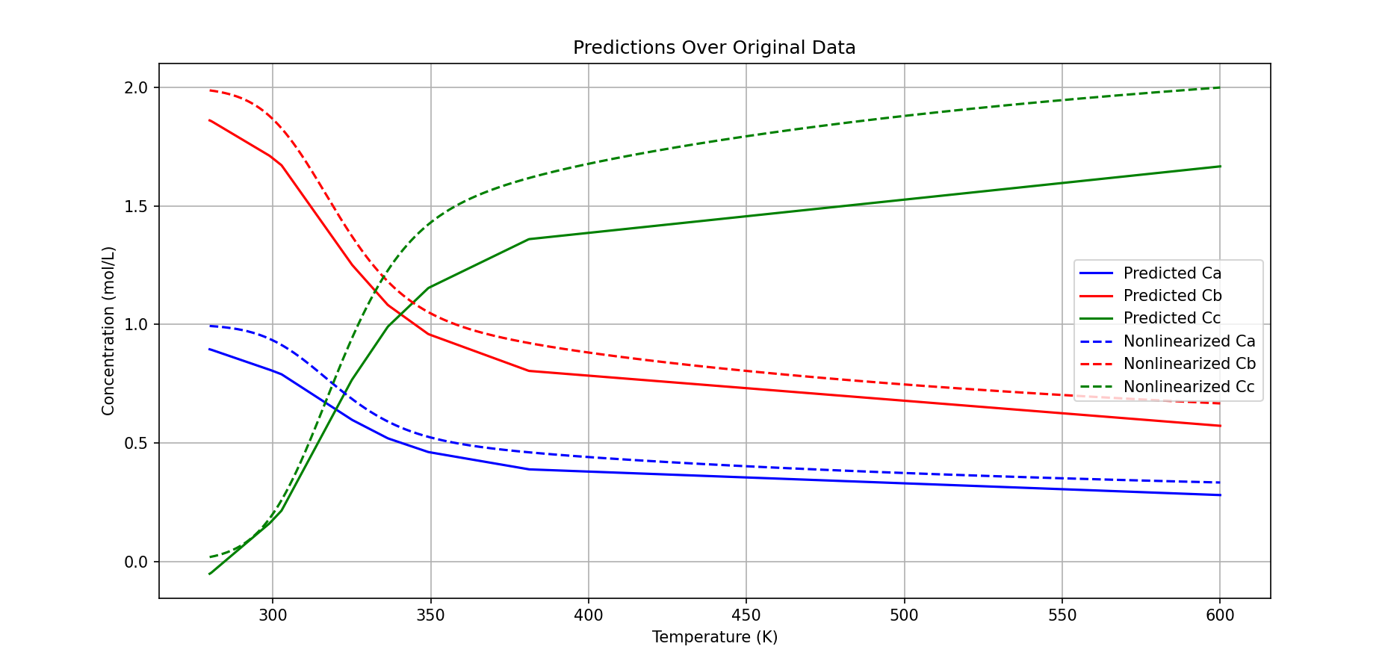
Large Noise- linear constraint-KKT

Slide 8
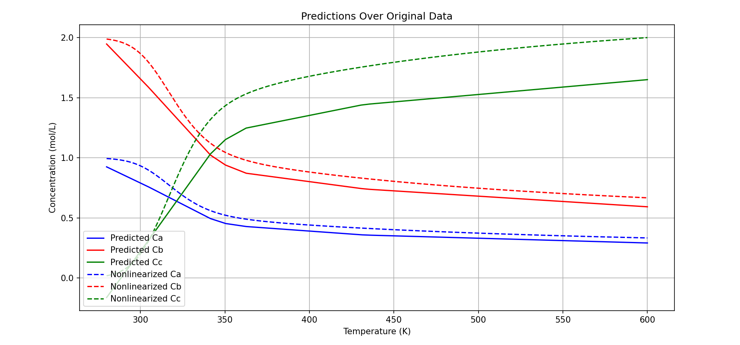
Large Noise- linear constraint-NN

Slide 9
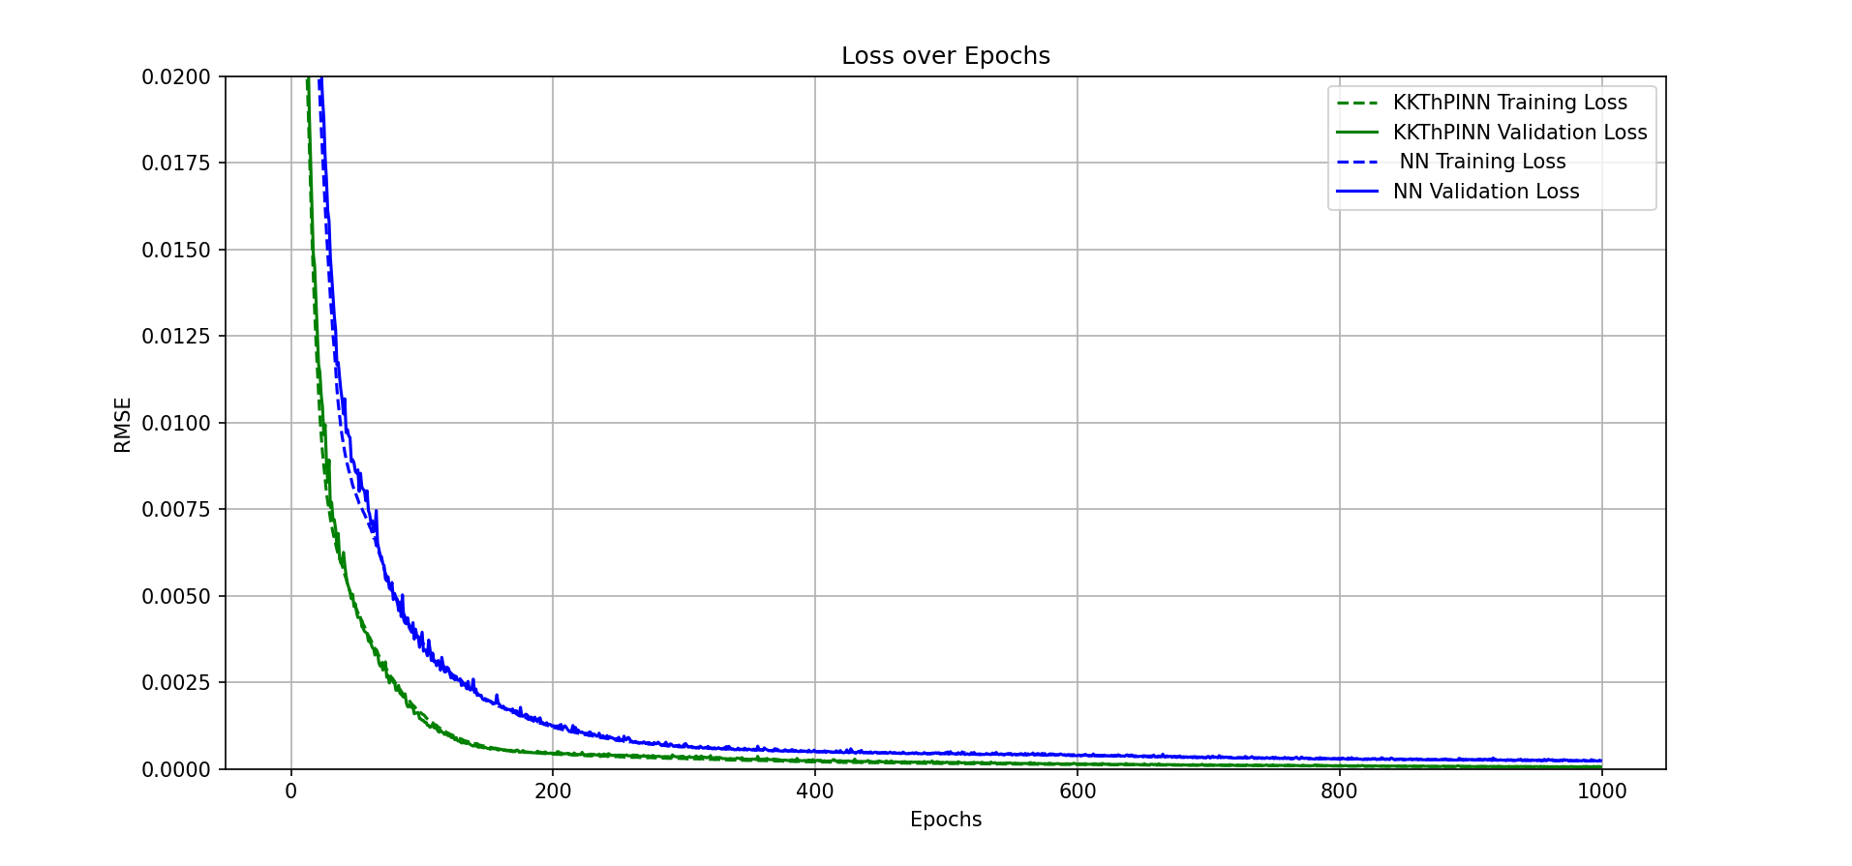
Their work-CSTR

Slide 10
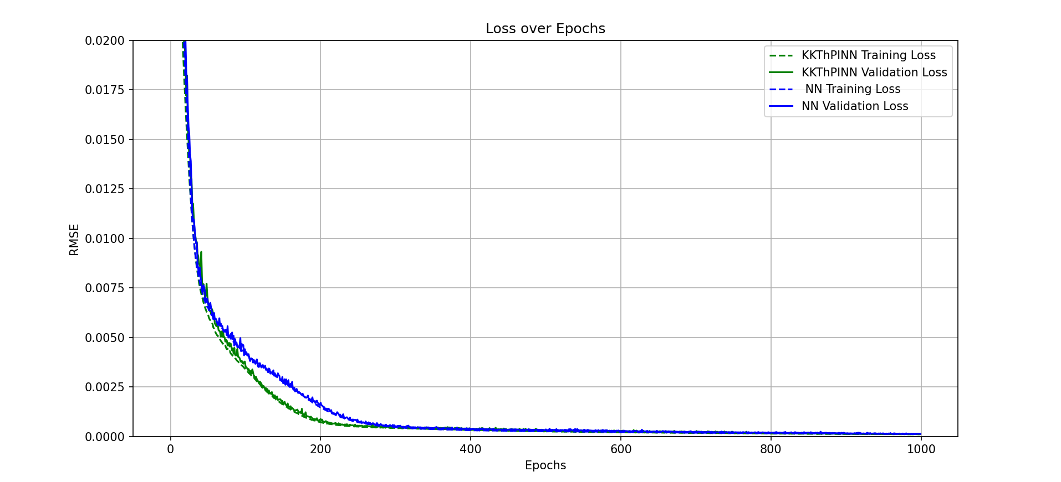
Another run

Slide 11
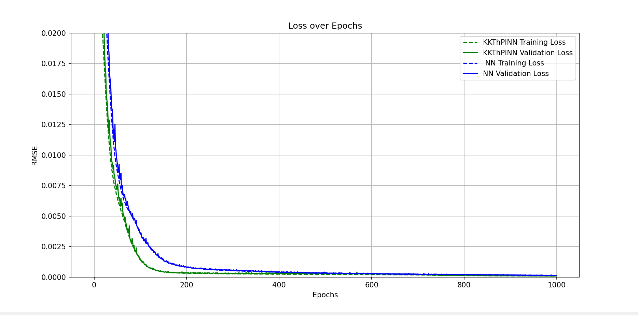
Another run

Slide 12
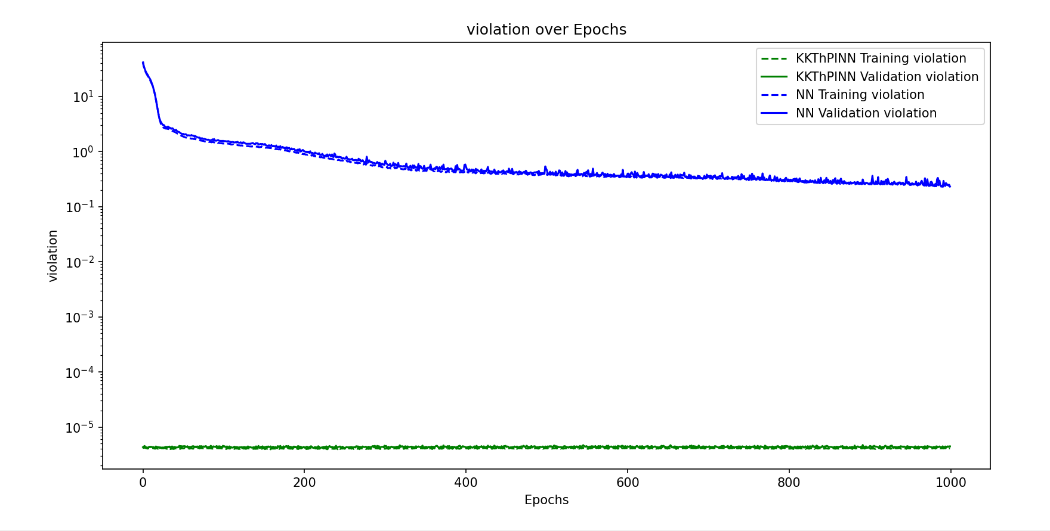
Their work-cstr

Slide 13
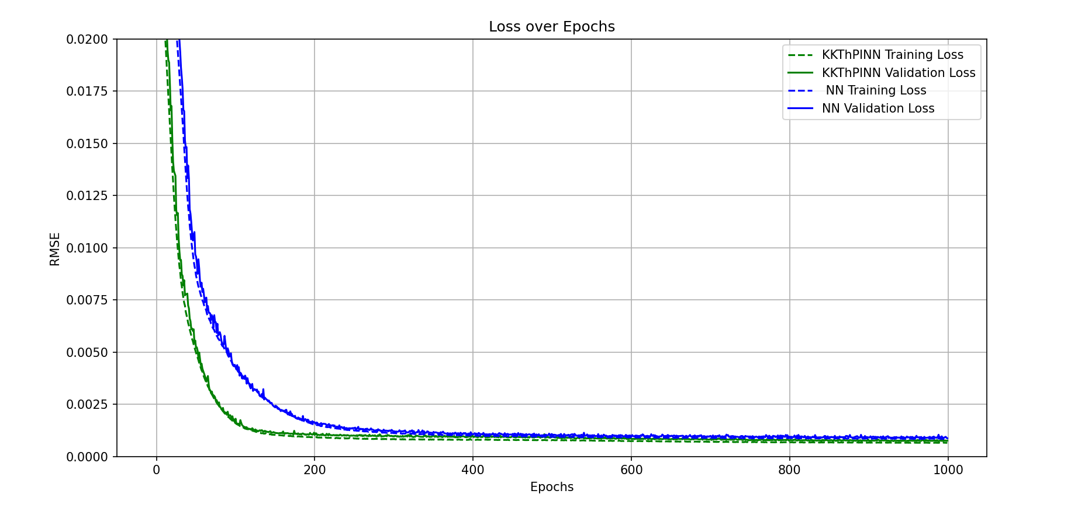
Noisy data

Slide 14
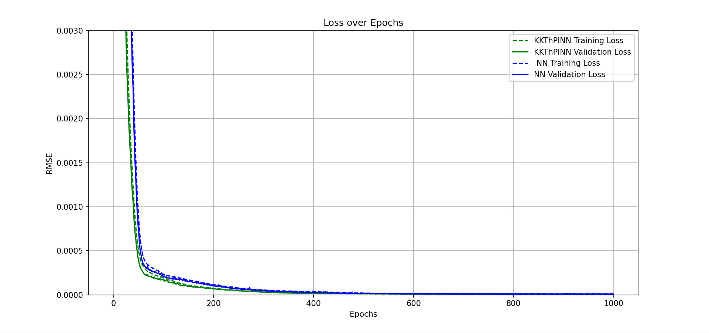
Their work-plant

Slide 15
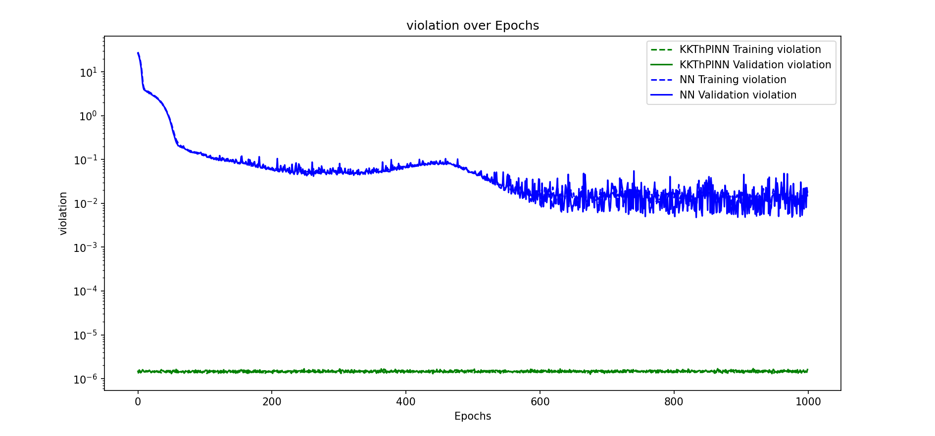
Their work-plant

Slide 16
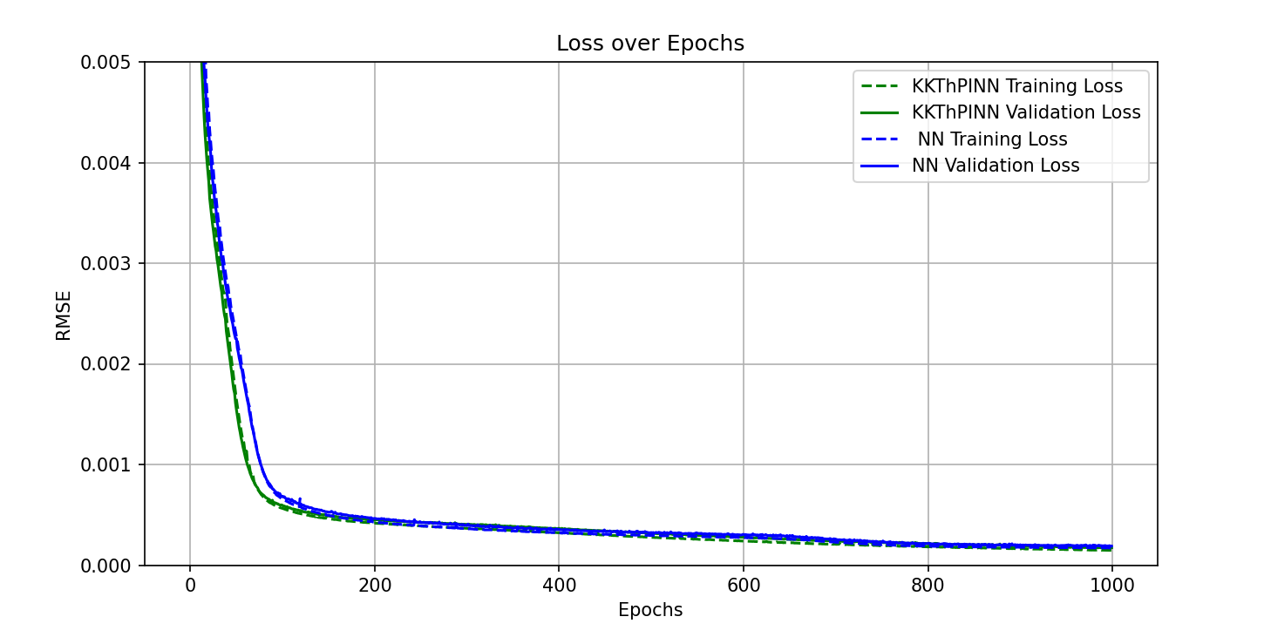
Their work-distillation

Slide 17
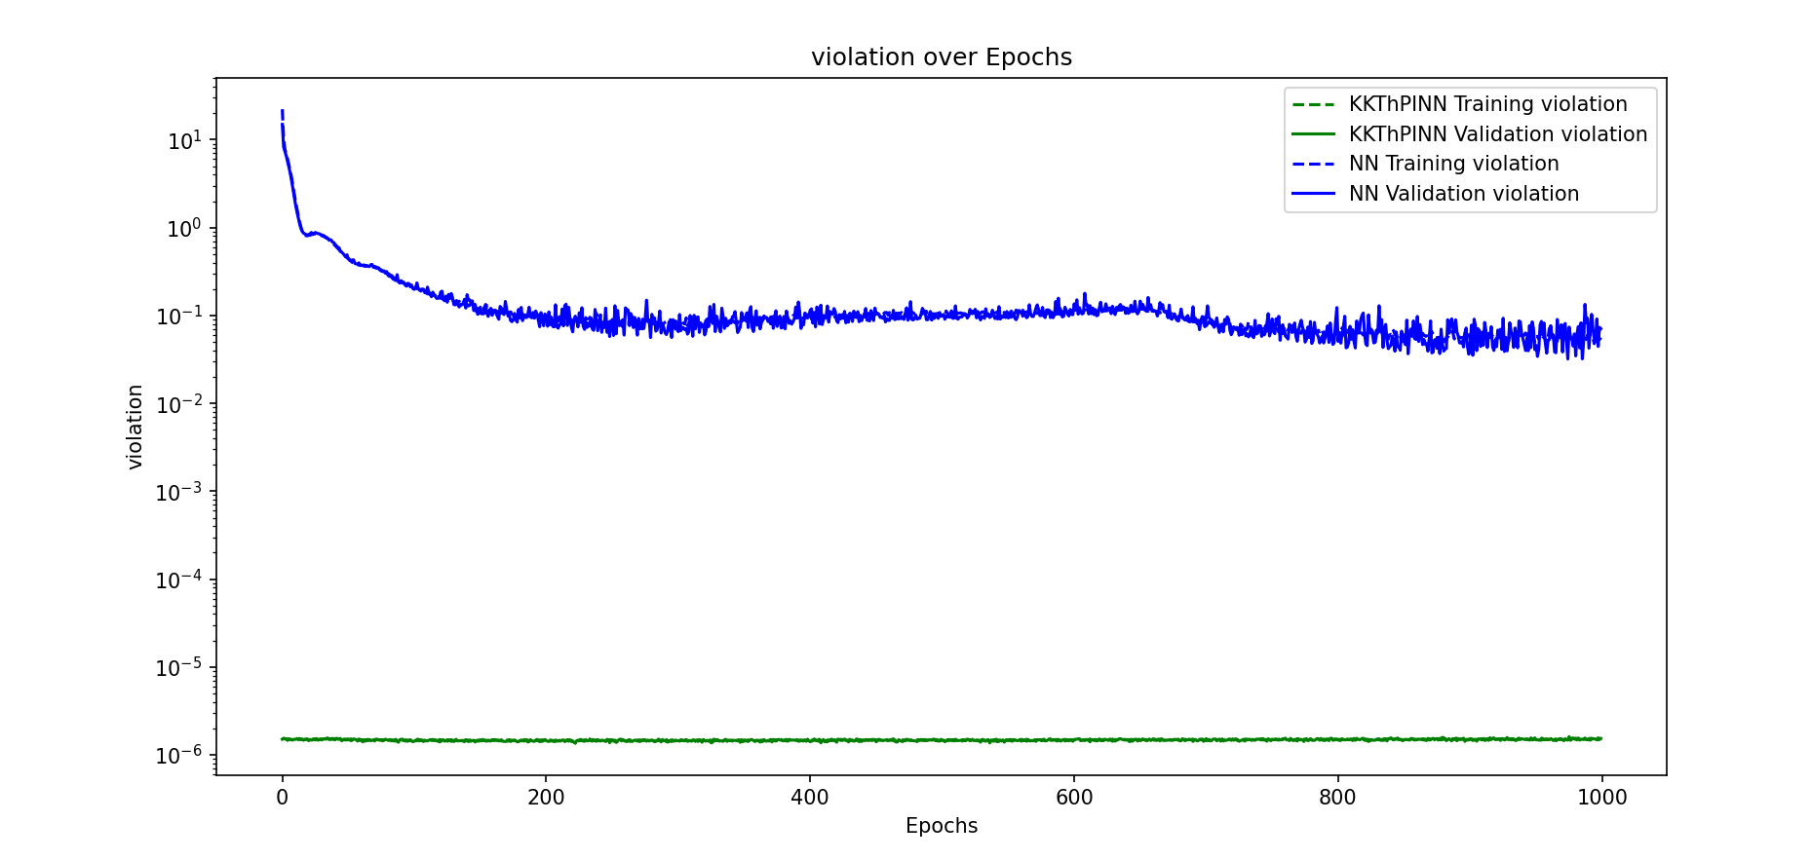

Slide 18
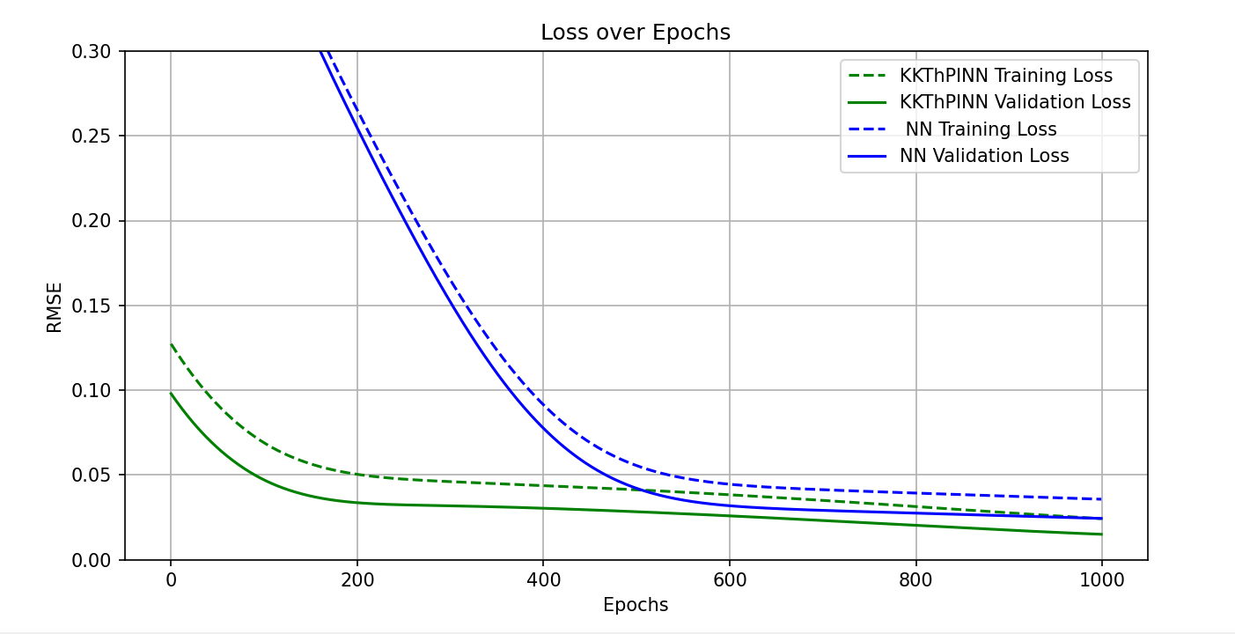
Batch size= dataset size

Slide 19
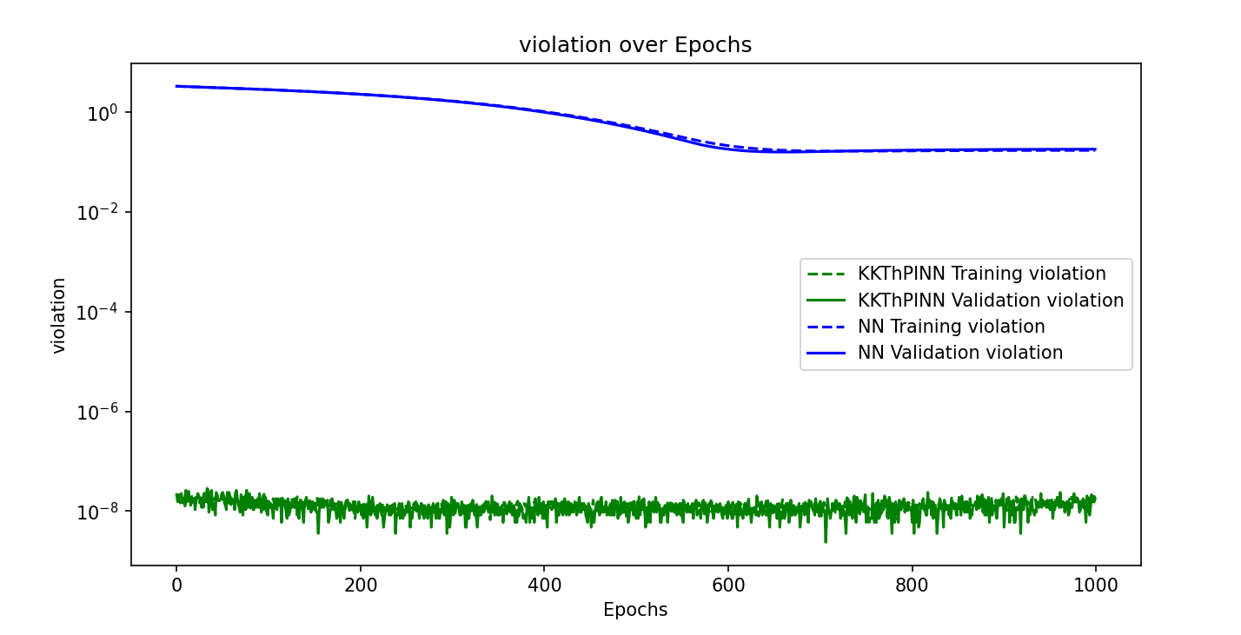
Batch size= dataset size

Slide 20
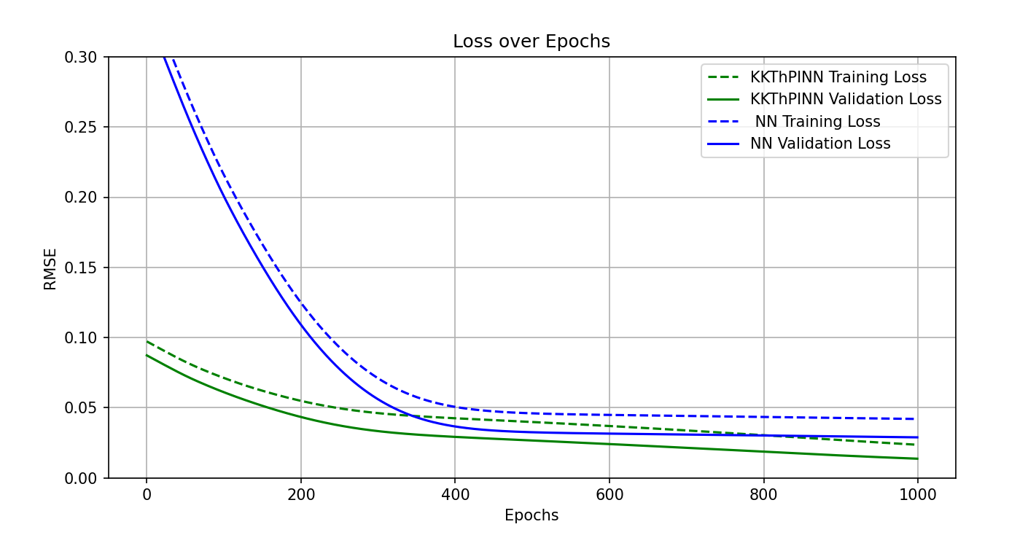
Another run

Slide 21
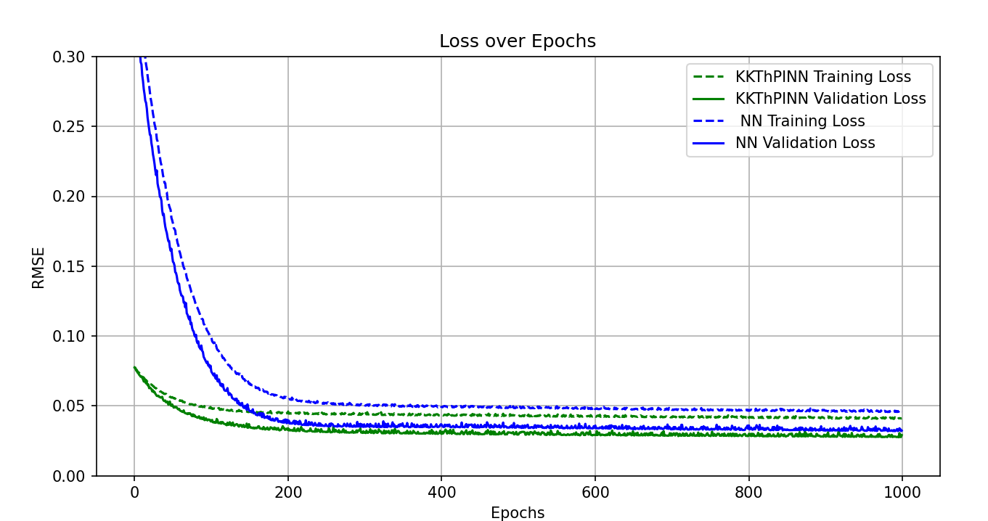
Optimizer= SGD

Slide 22
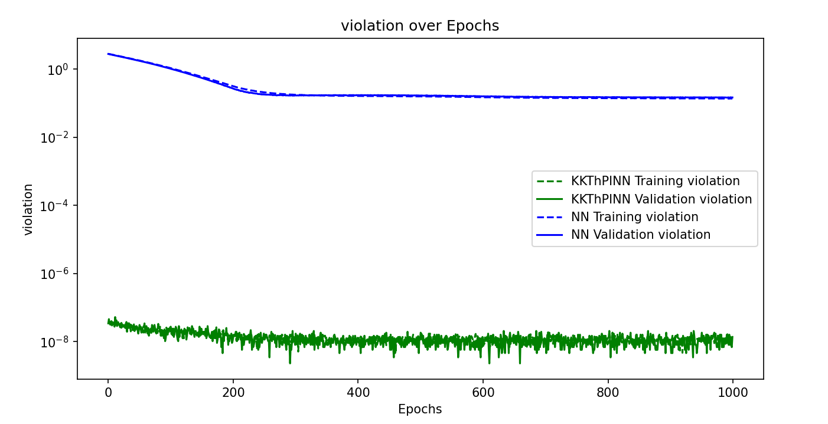
Optimizer= SGD

Slide 23
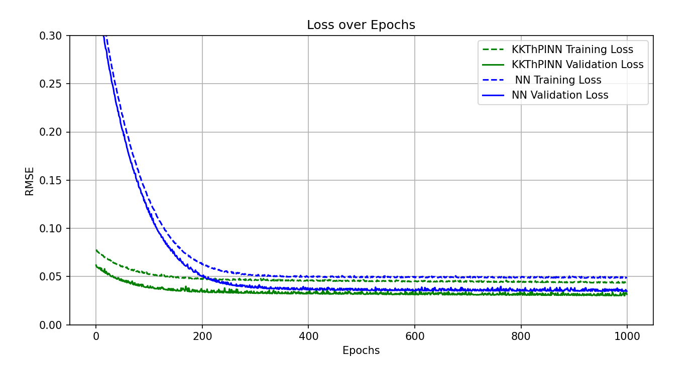
Another run

Slide 24
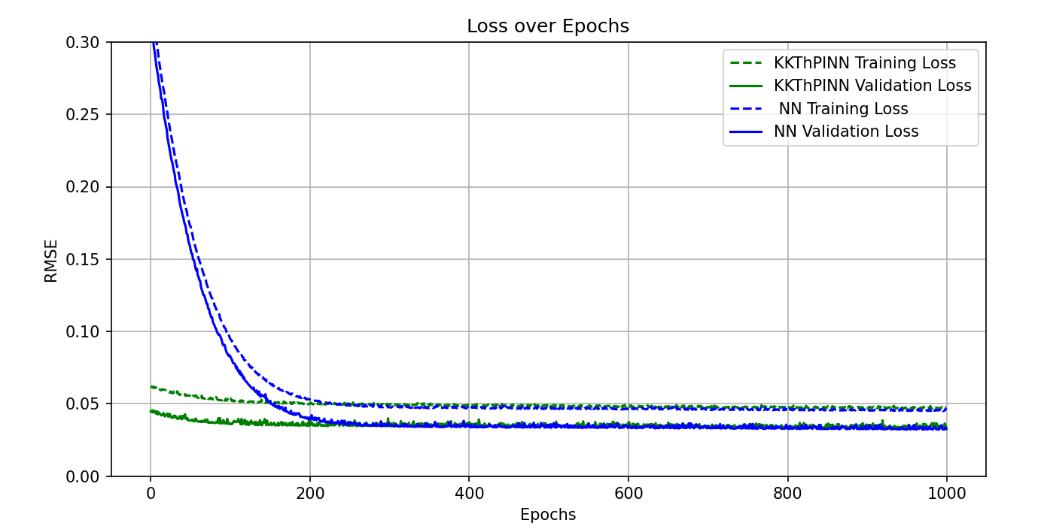
Another run

