Slide 1
2/3/2025

Slide 2
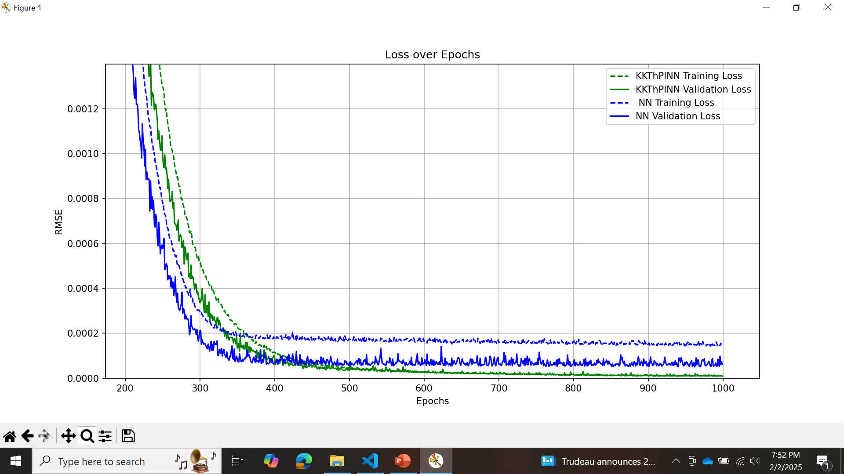
Error-simple case

Slide 3
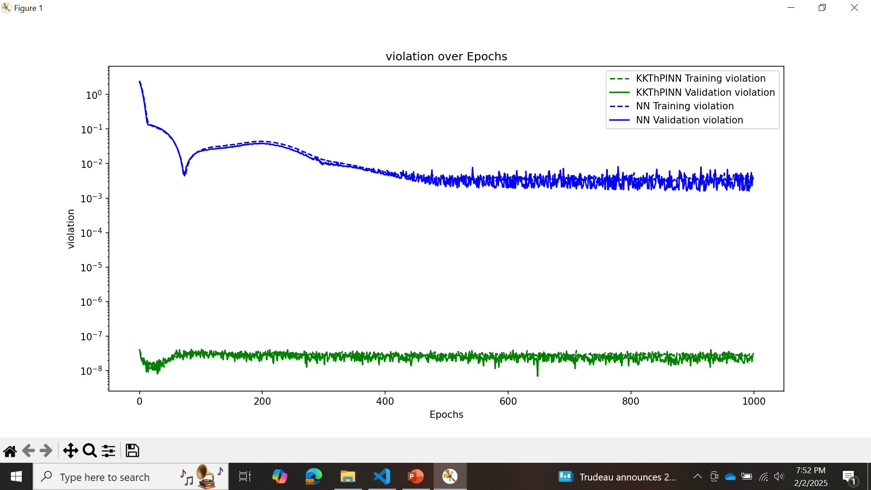
Violation-simple case

Slide 4
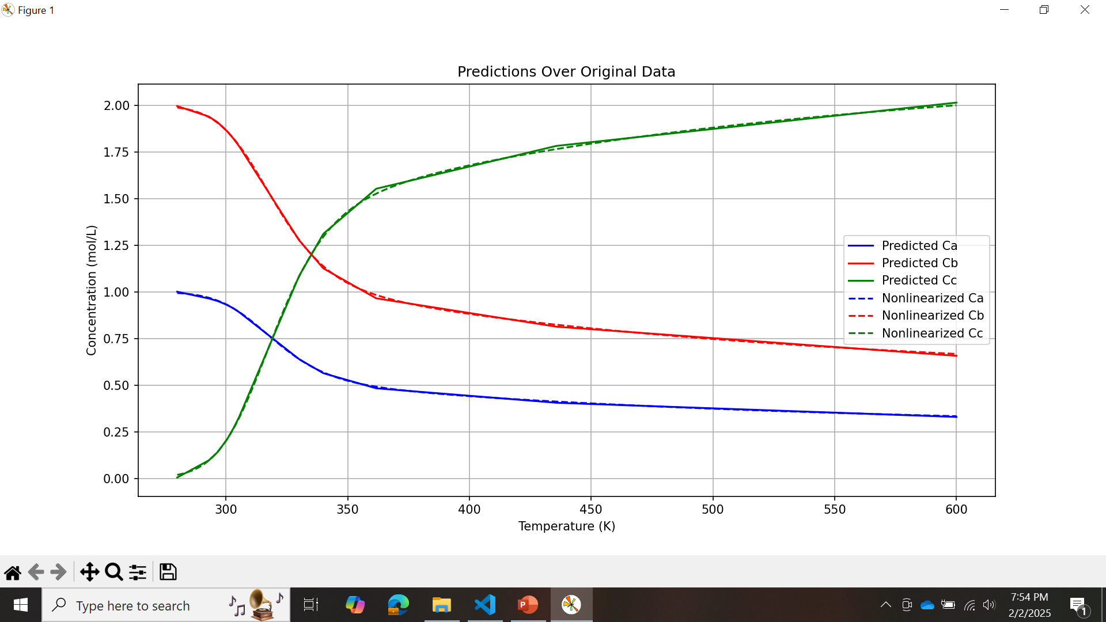
KKT- simple case

Slide 5
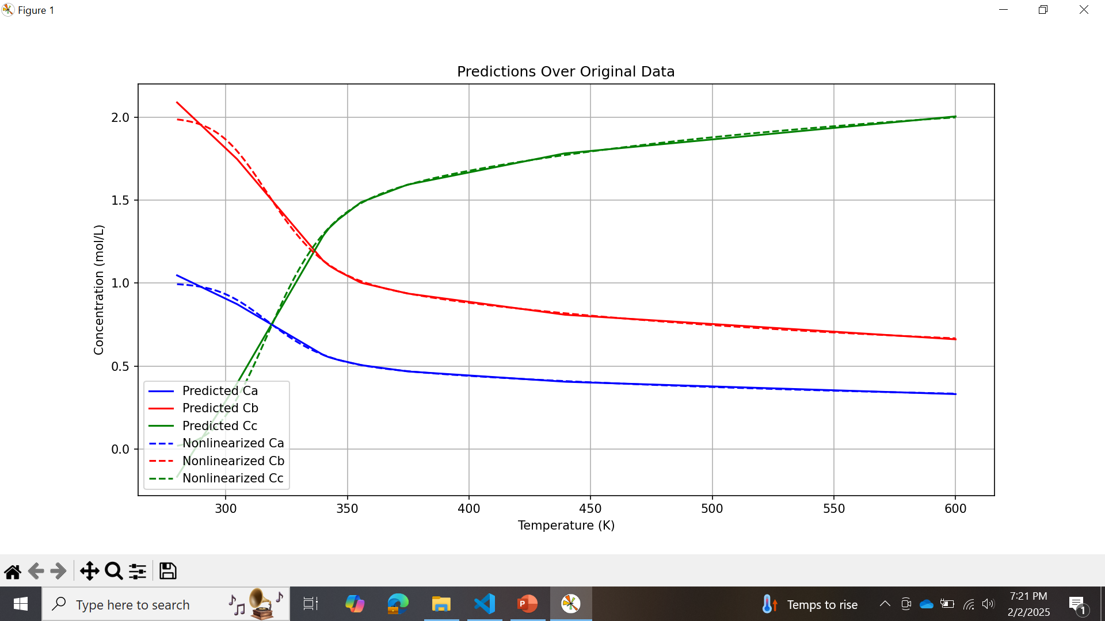
NN- simple case

Slide 6
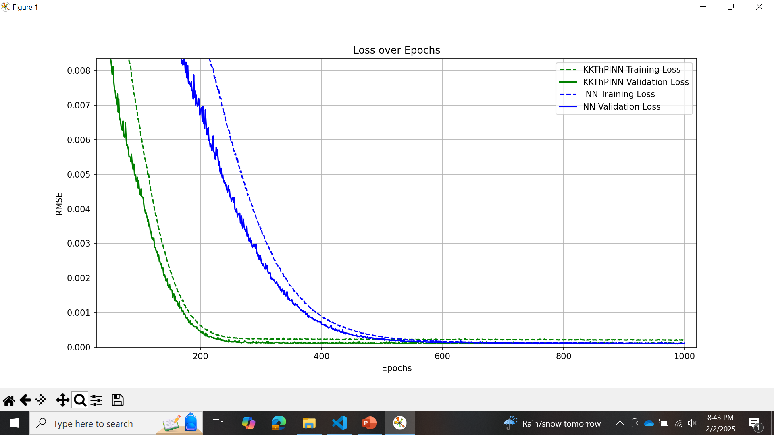
Small noisy data

Slide 7
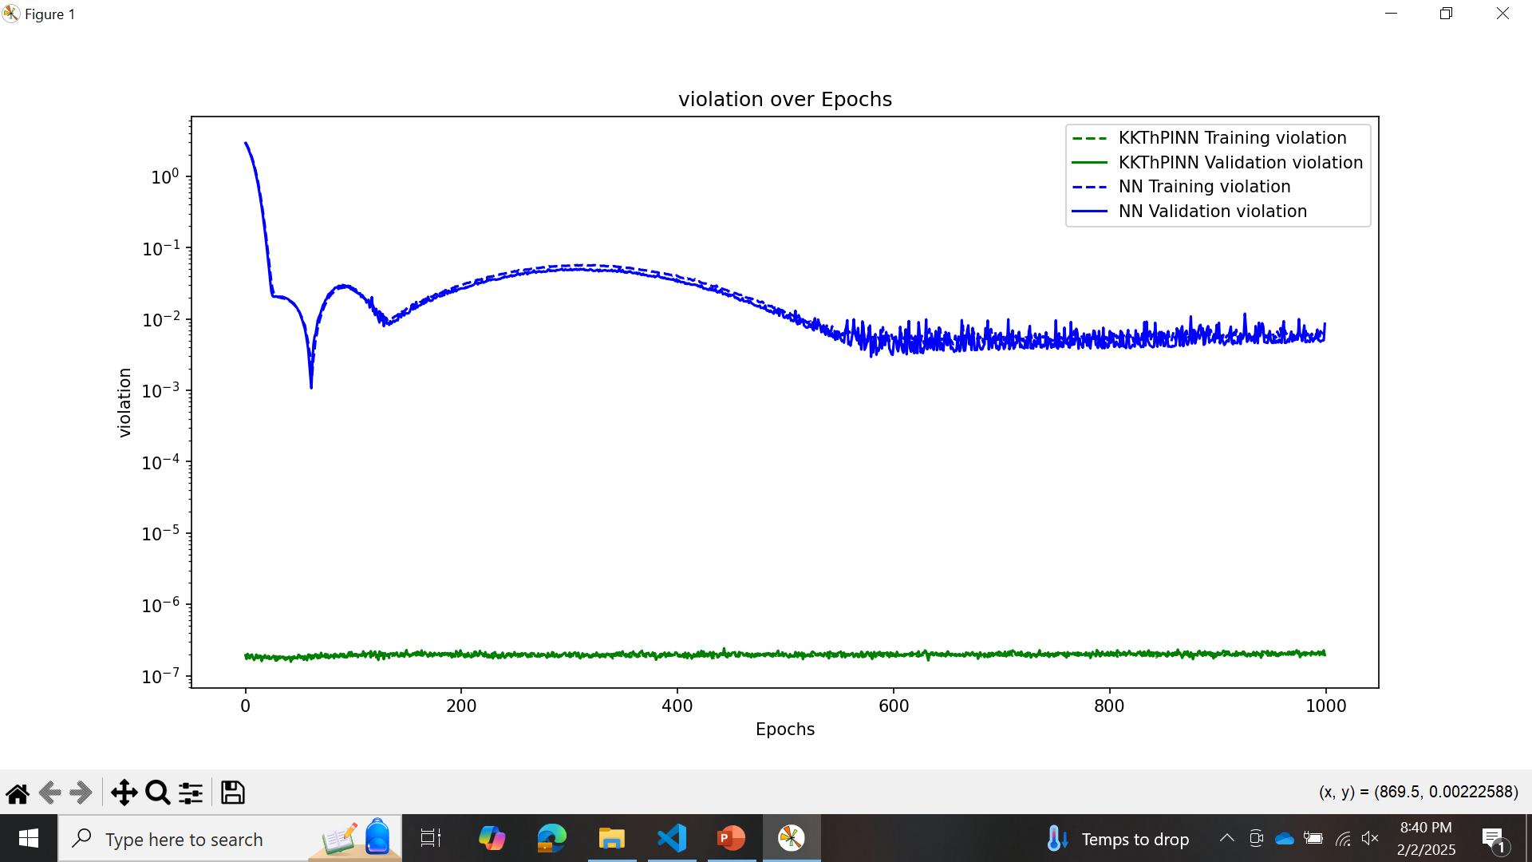
Small noisy data

Slide 8
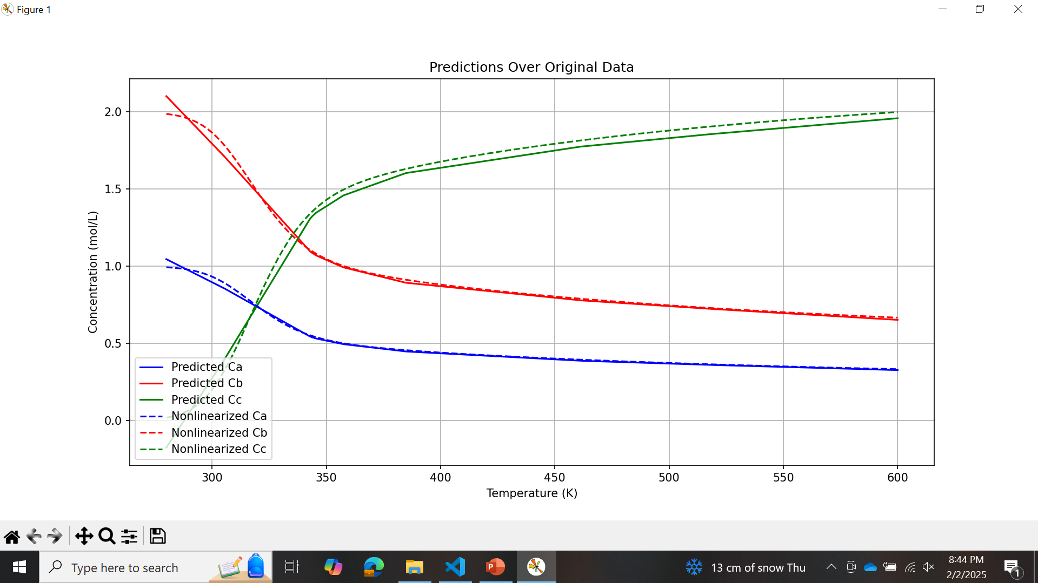
Small noisy data-kkt-linear constraint

Slide 9
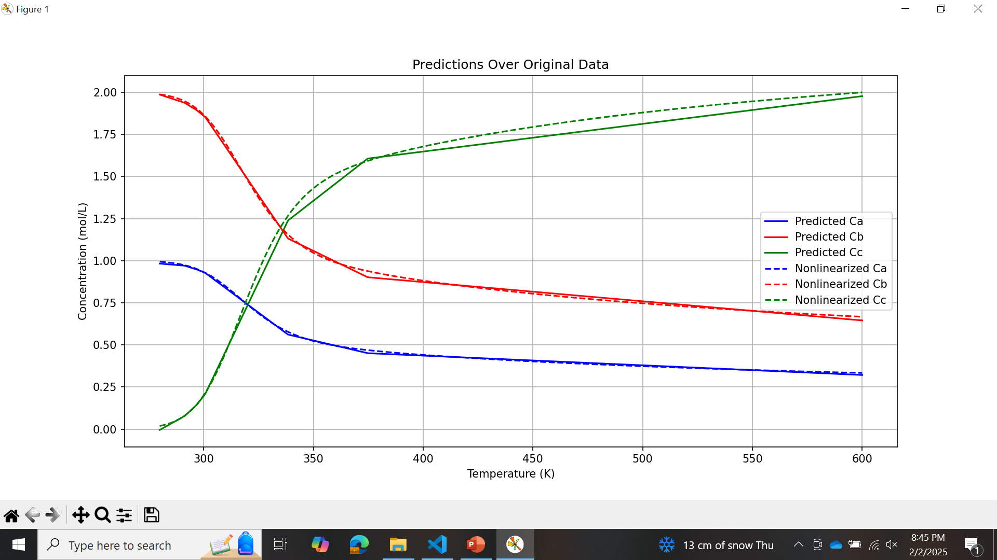
Small noisy data-NN

Slide 10
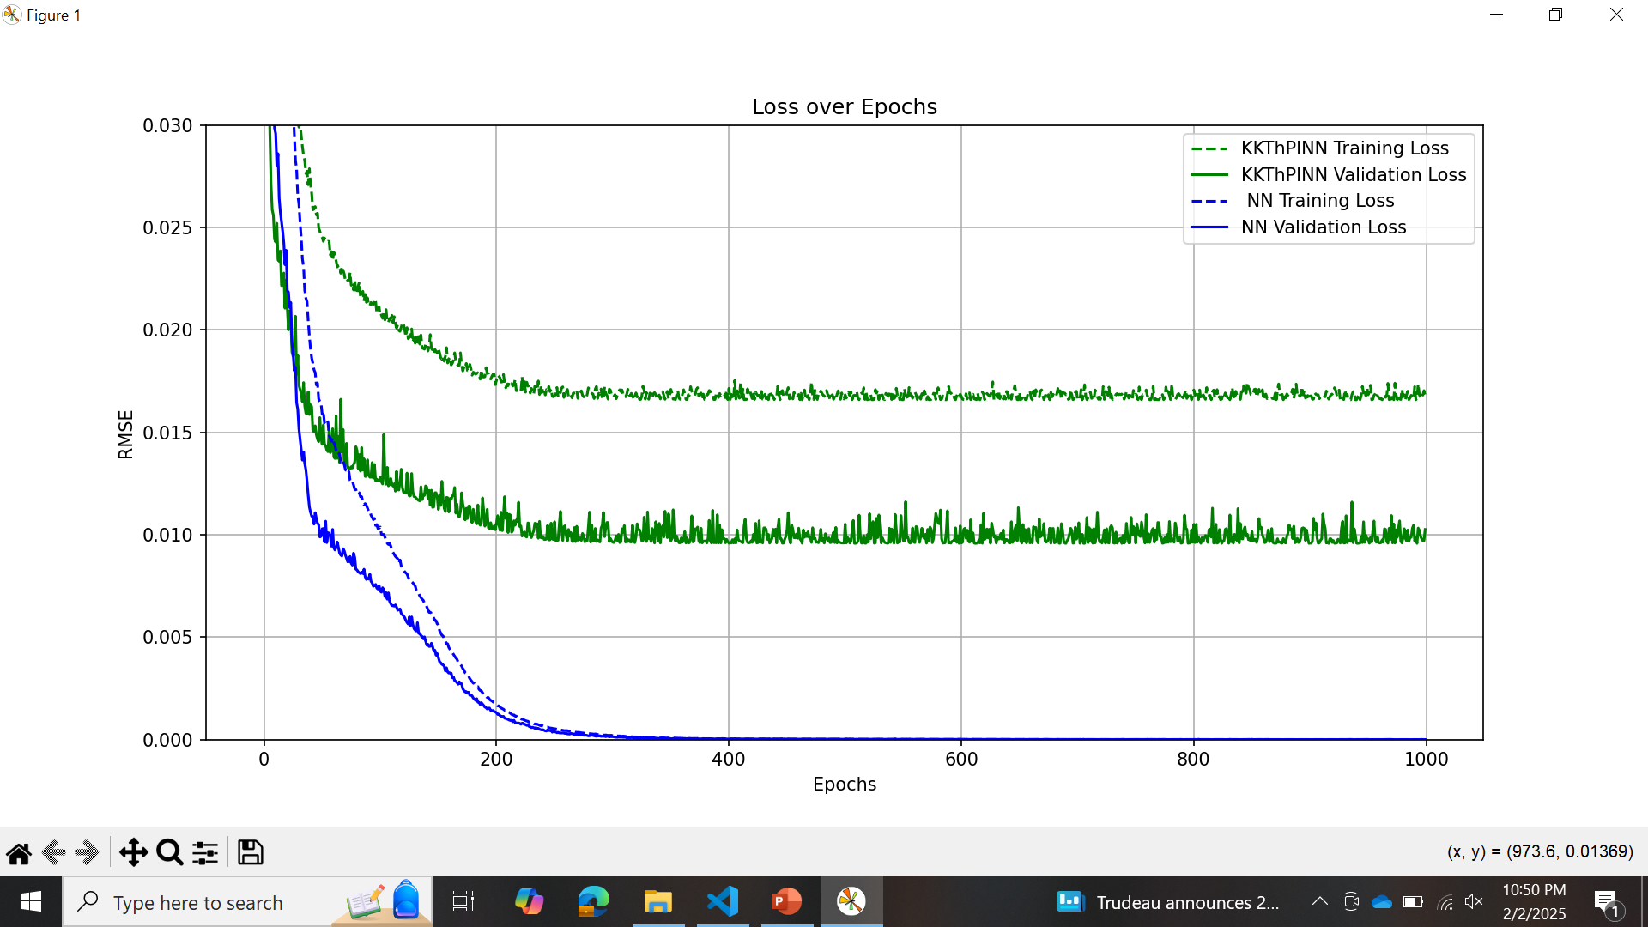
Simple case- kkt- nonlinear constraint

Slide 11
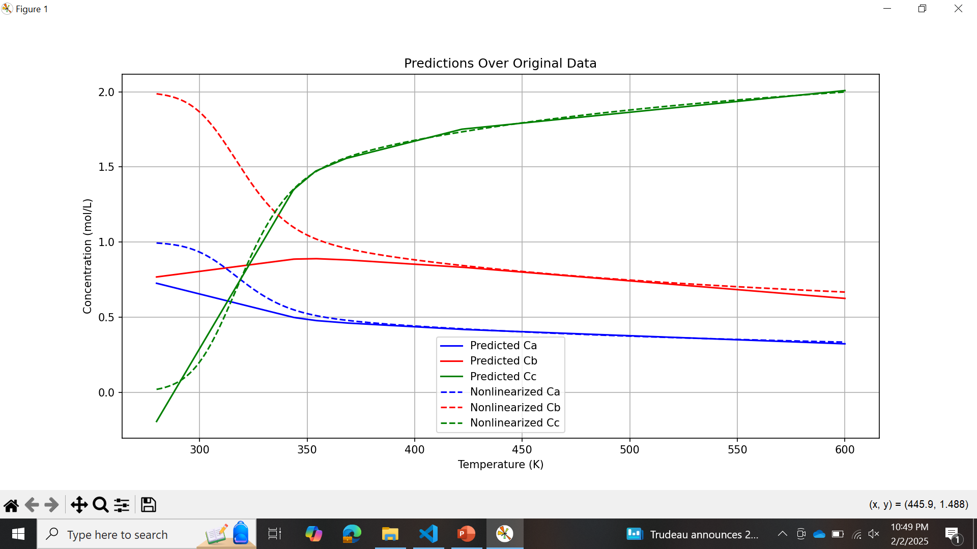
Simple case- kkt- nonlinear constraint

Slide 12
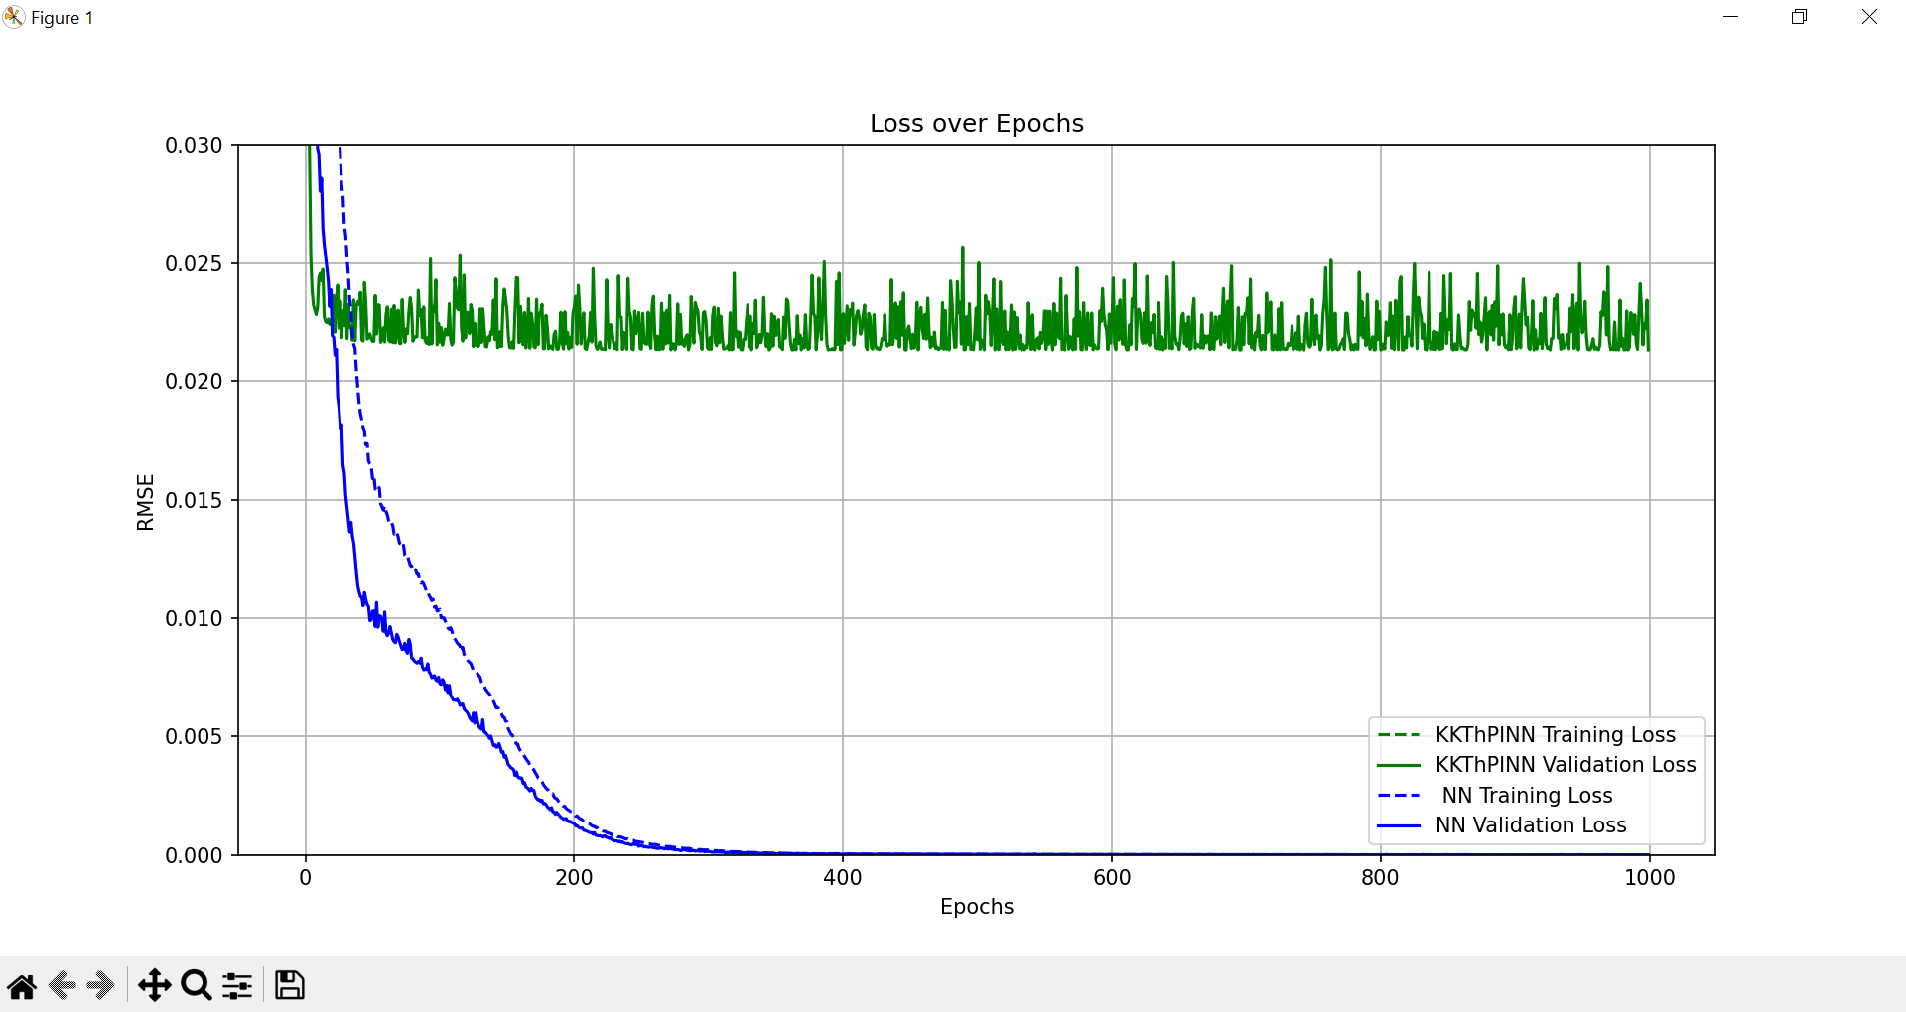
Simple case- both constraints

Slide 13
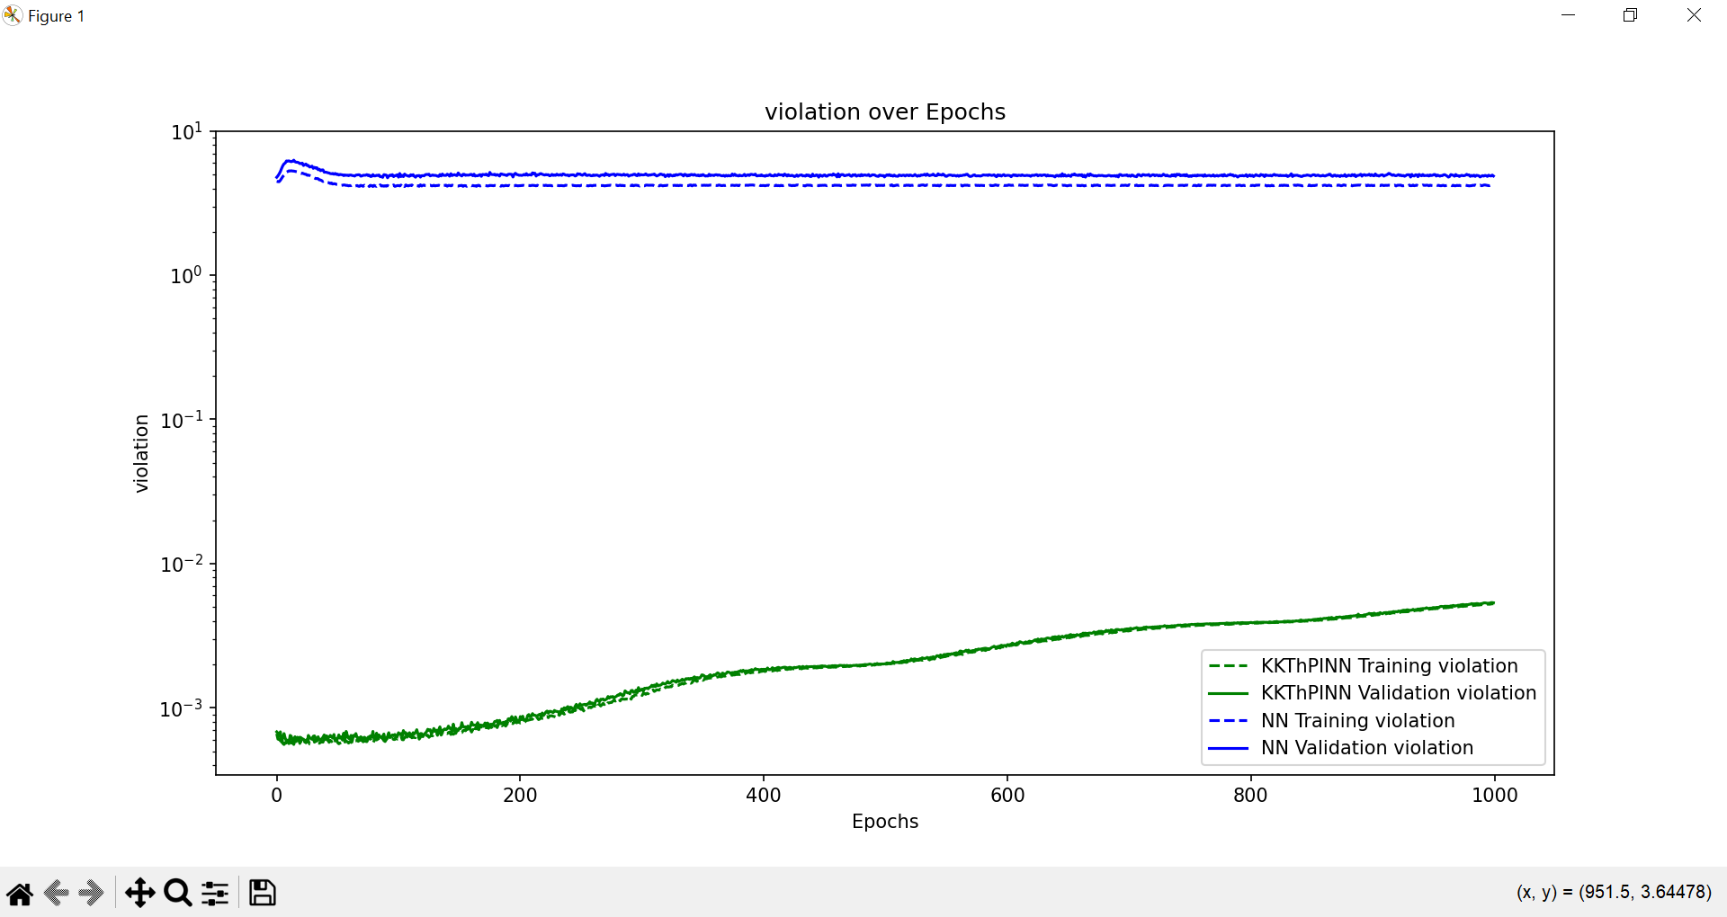
Simple case- both constraints

Slide 14
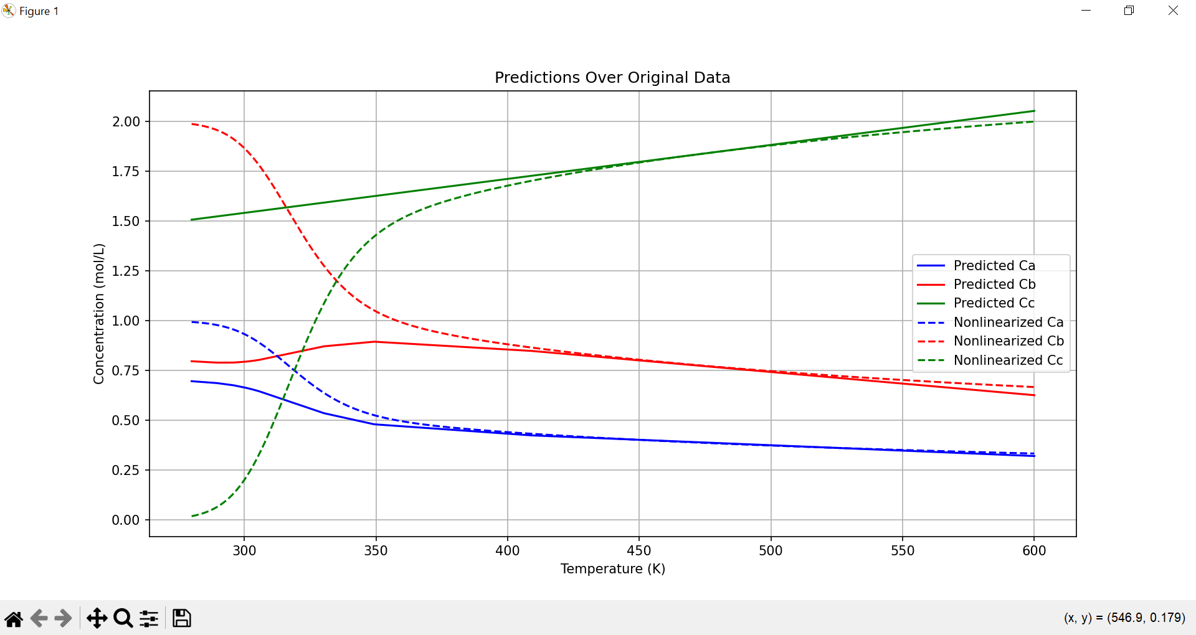
Simple case- both constraints

Slide 15
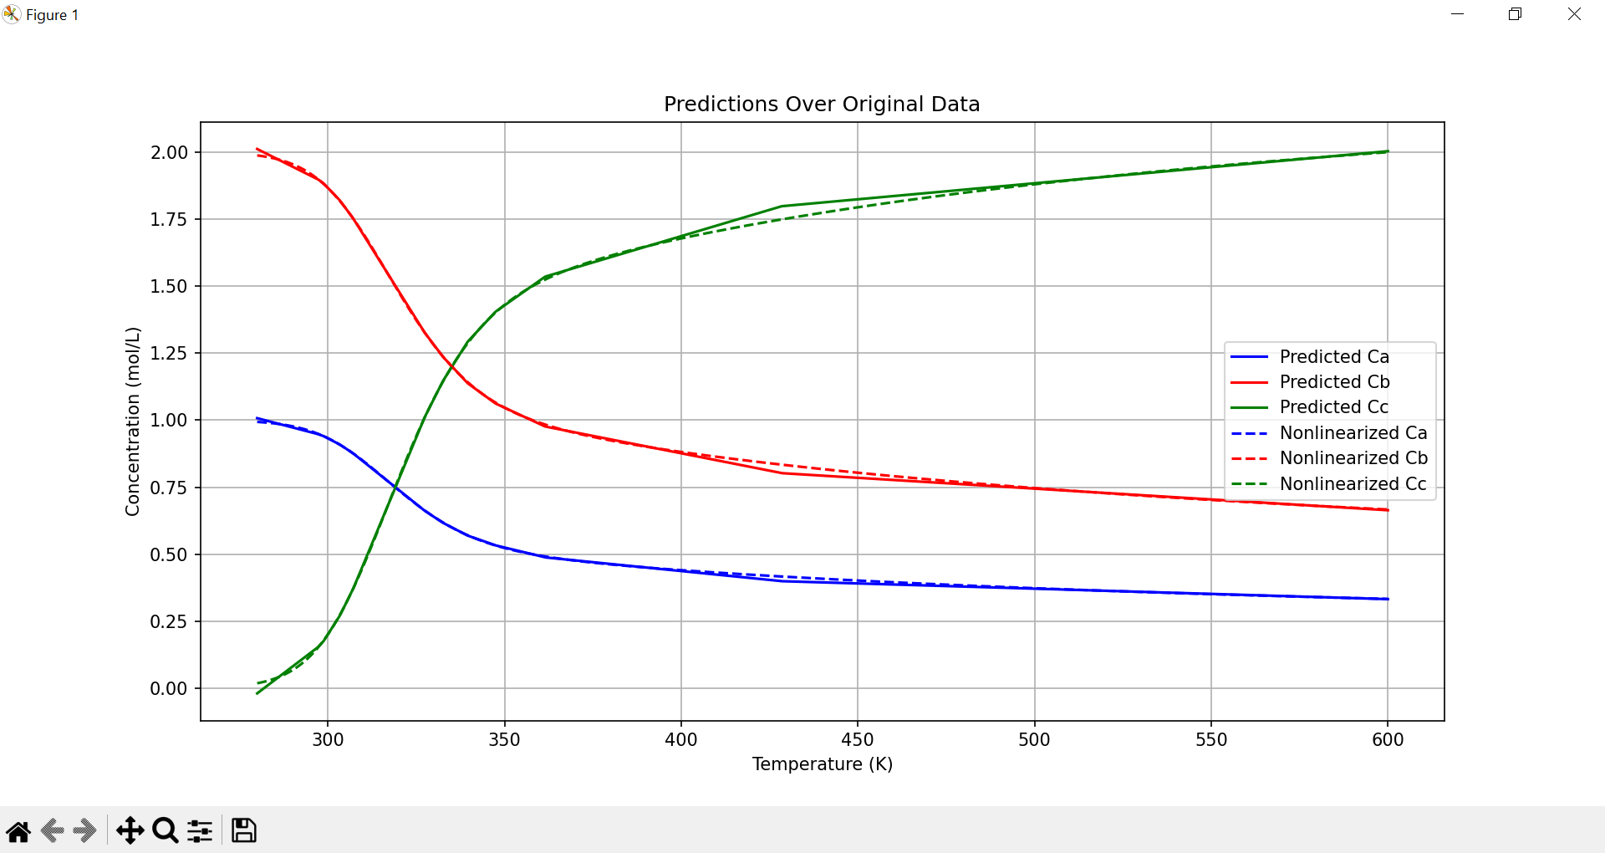
Scarcity- linear constraint- KKT

Slide 16
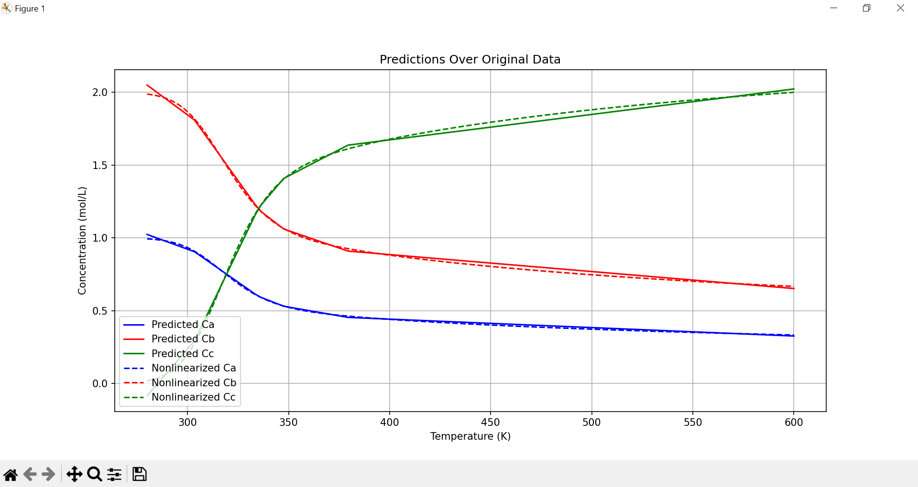
Scarcity- linear constraint- NN

Slide 17
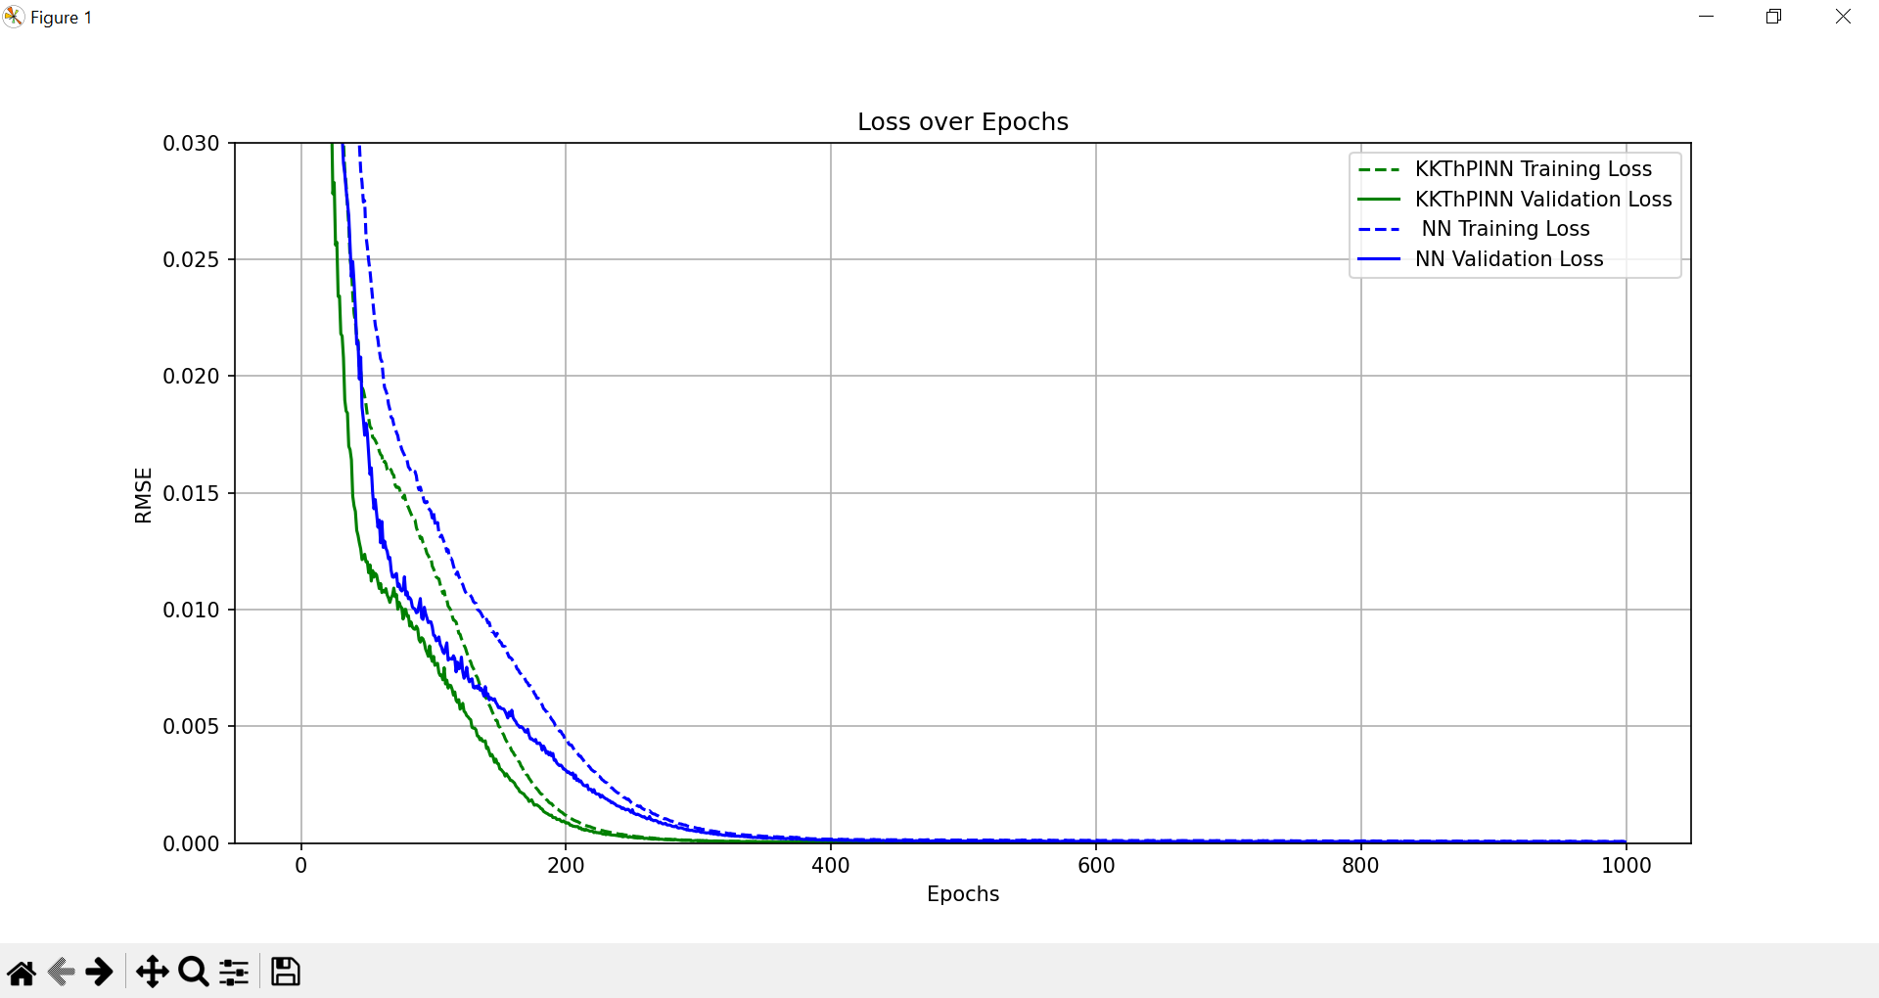
Scarcity- linear constraint

Slide 18
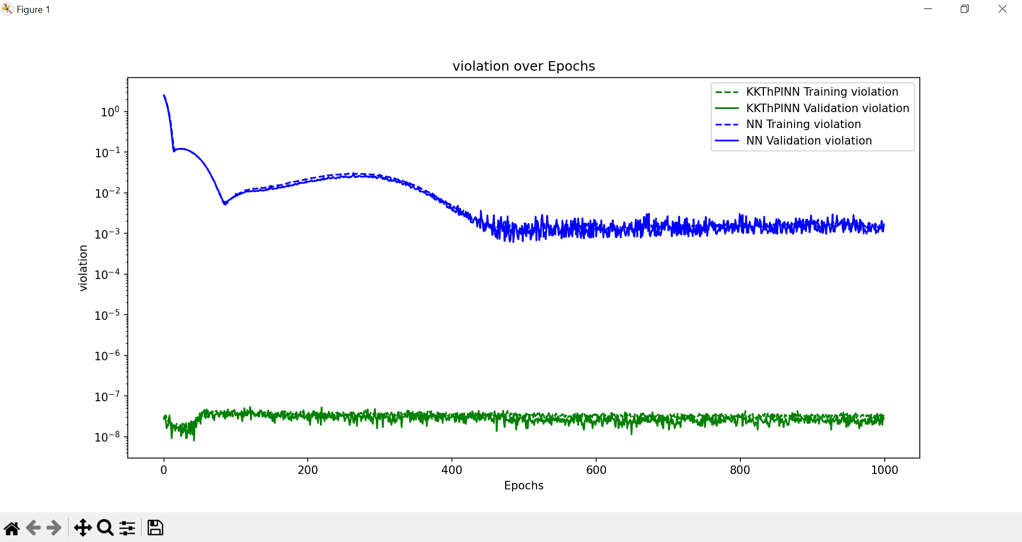
Scarcity- linear constraint

