Slide 1
3/10/2025

Slide 2
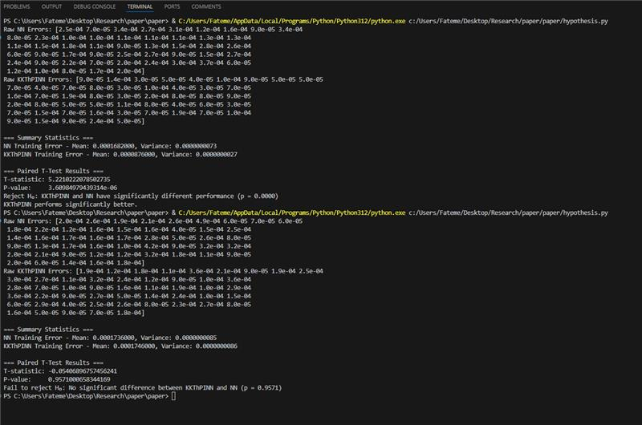

Slide 3

Training- CSTR

Slide 4
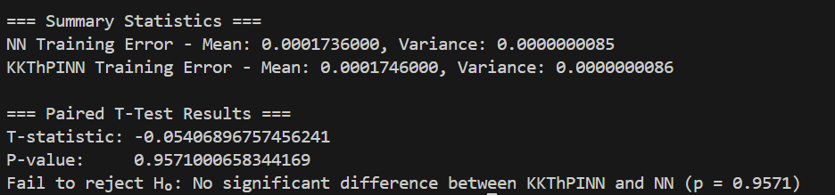
Experiment- CSTR

Slide 5

Our work-training

Slide 6

Our work-experiment

Slide 7
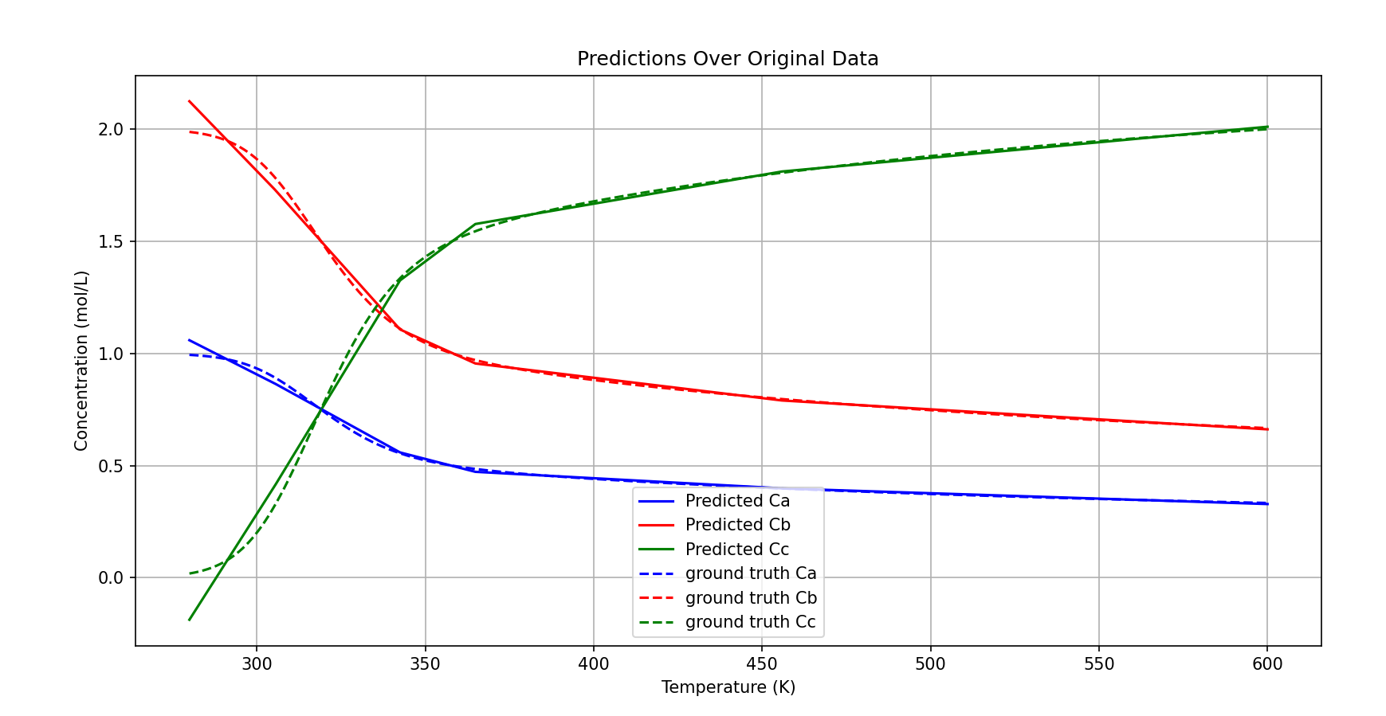
Our work- NN

Slide 8
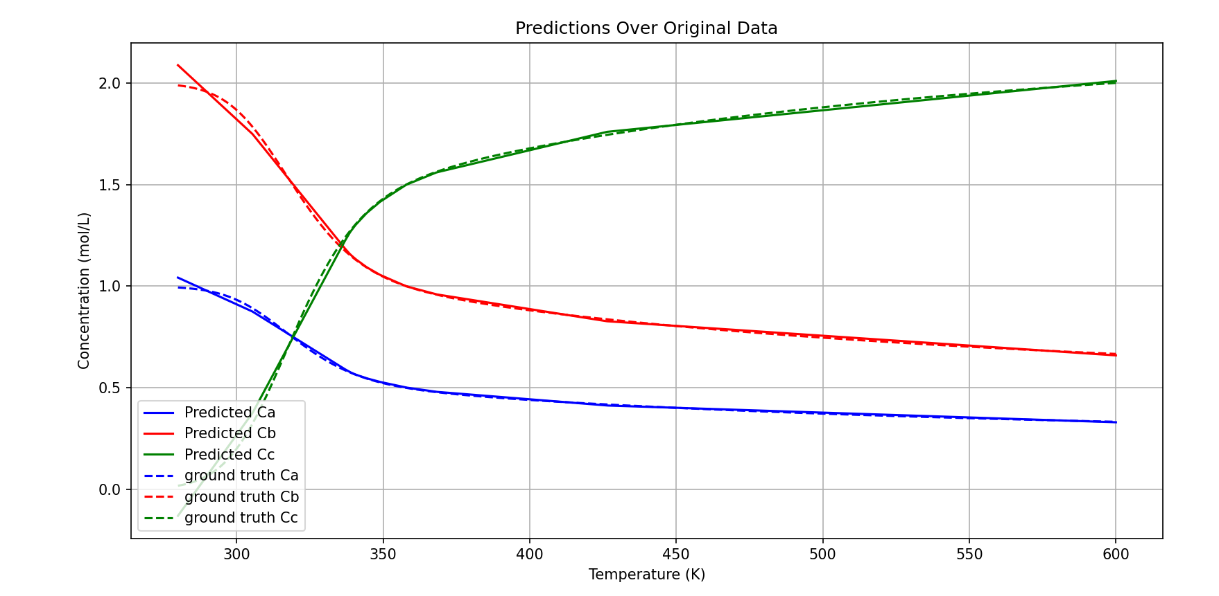
Our work- KKT

