Slide 1
Research Progress Update
Fateme Mohammad Mohammadi, Chemical Engineering

Slide 2
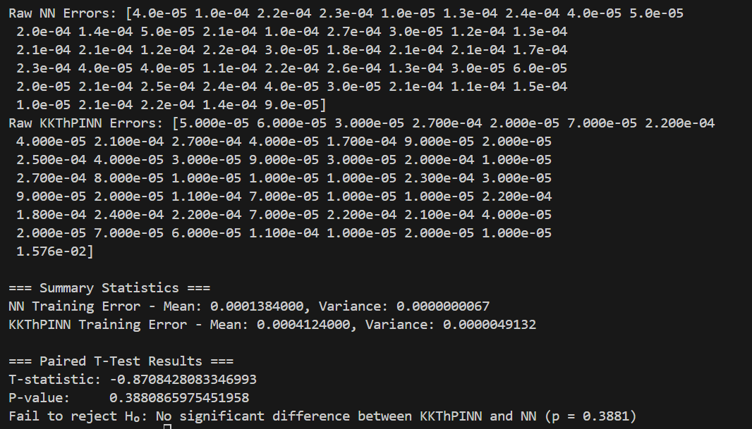
Our CSTR example –Training – 1000 sample points

Slide 3
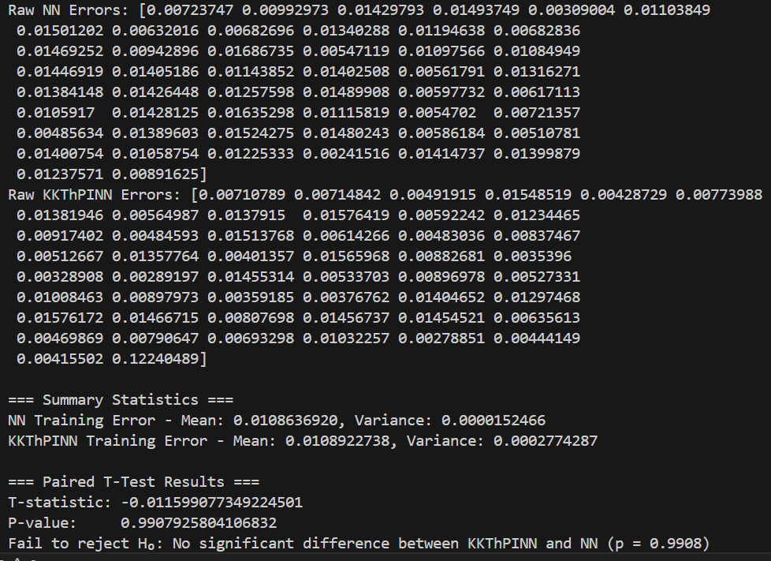
Our CSTR example – Experiment – 1000 sample points

Slide 4
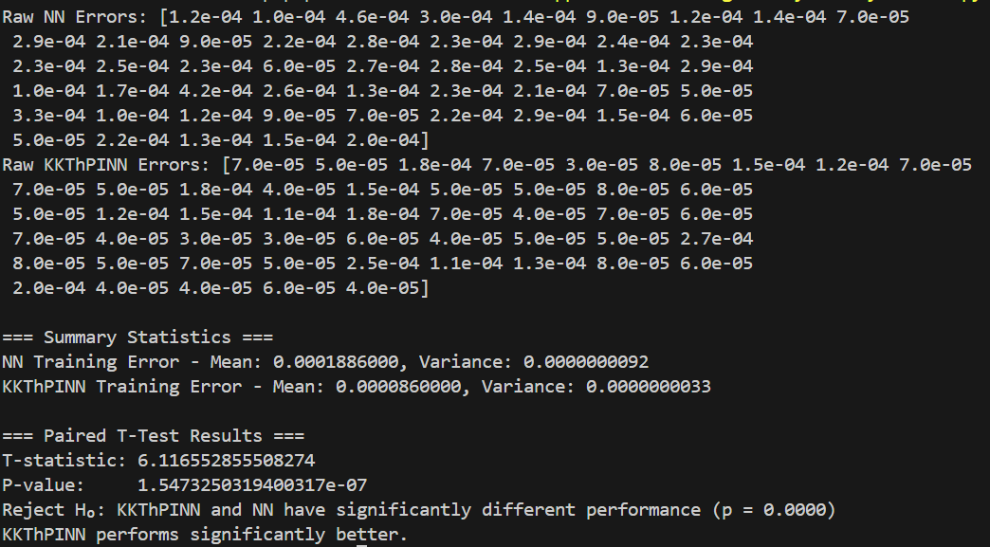
Paper – CSTR case study - Training

Slide 5
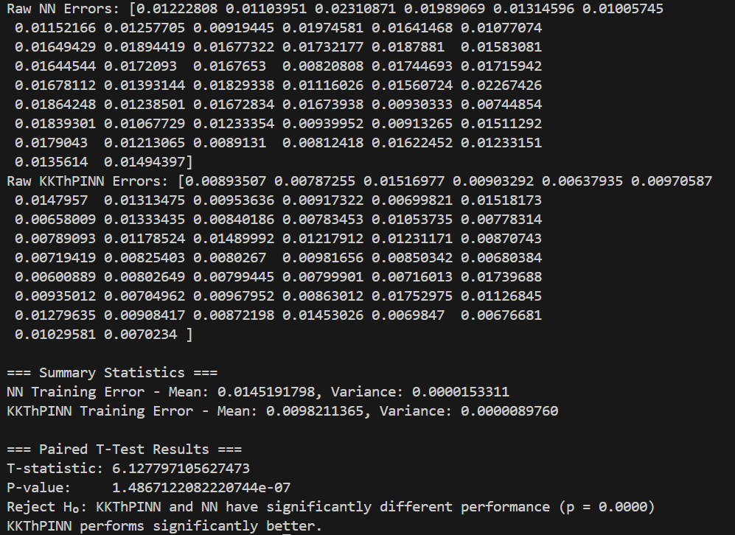
Paper – CSTR case study - Experiment

Slide 6
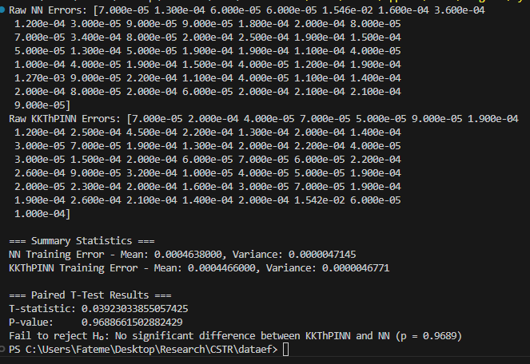
Our CSTR example –Training – 600 sample points

Slide 7
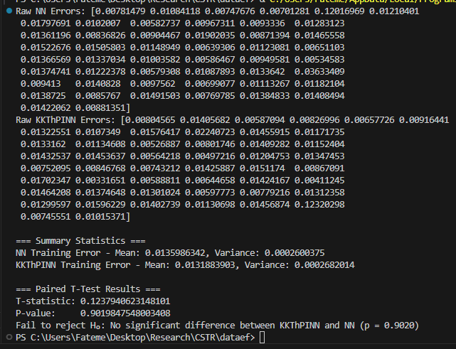
Our CSTR example –Experiment – 600 sample points

Slide 8
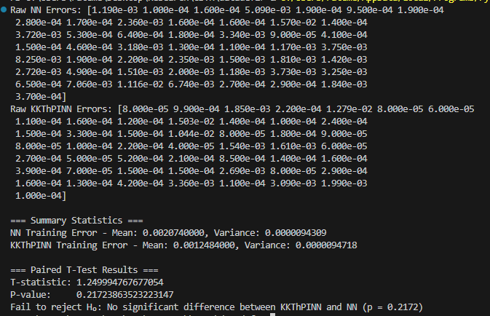
Our CSTR example –Training – 300 sample points

Slide 9
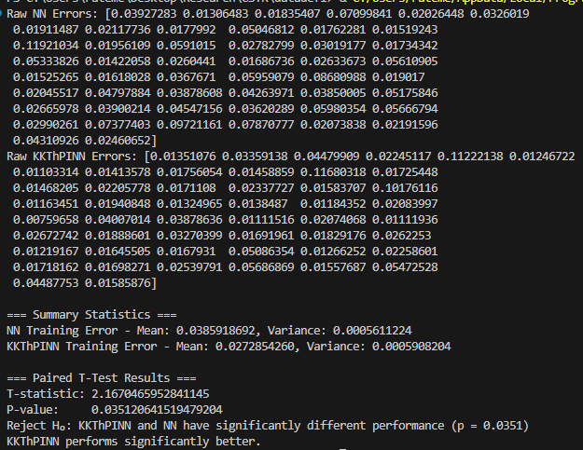
Our CSTR example –Experiment – 300 sample points

Slide 10
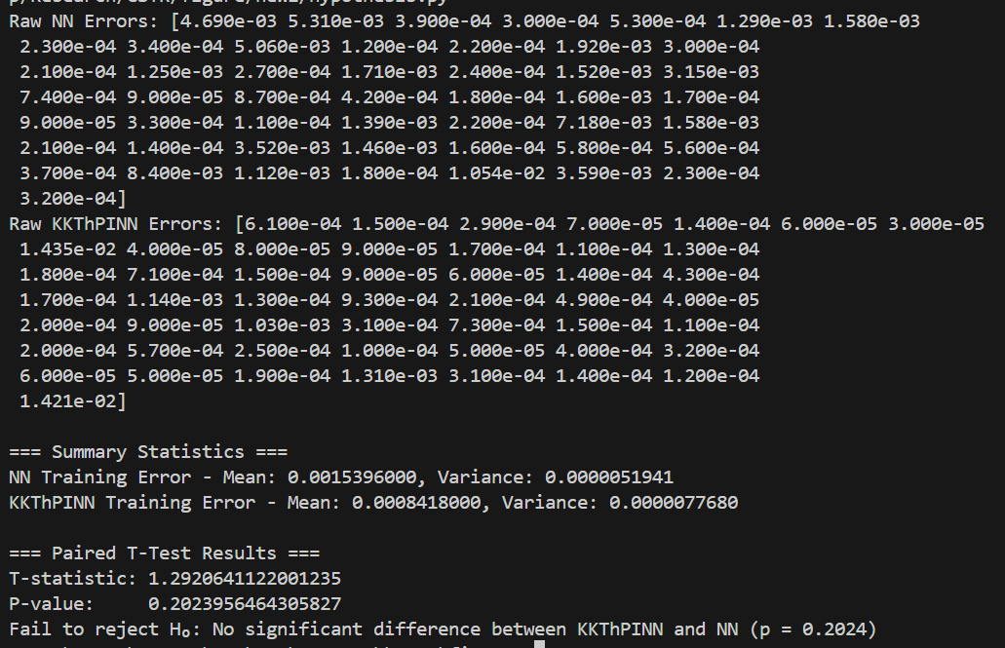
Our CSTR example –Training – 300 sample points - Run again

Slide 11
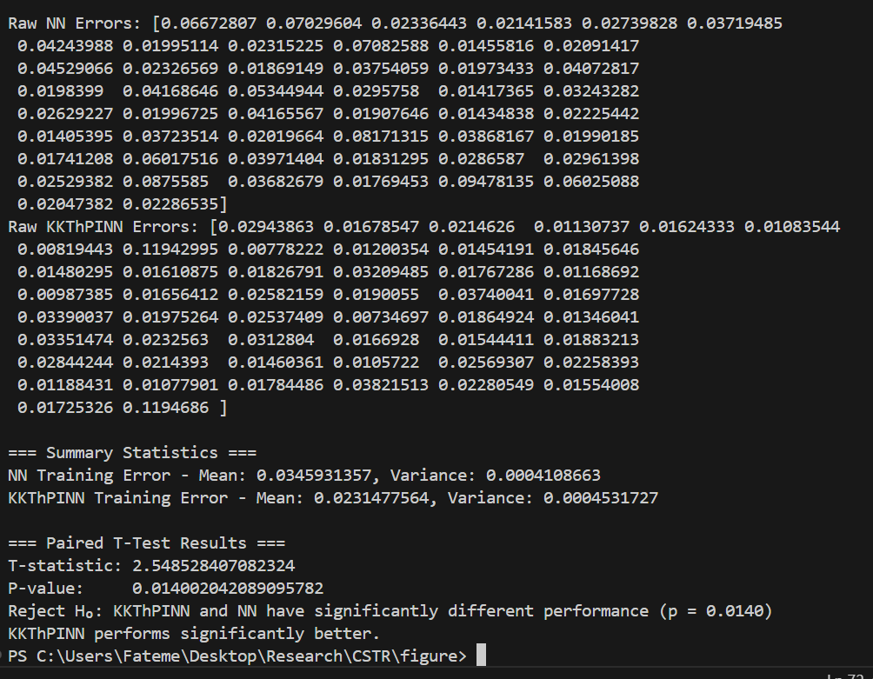
Our CSTR example –Experiment – 300 sample points – Run again

Slide 12
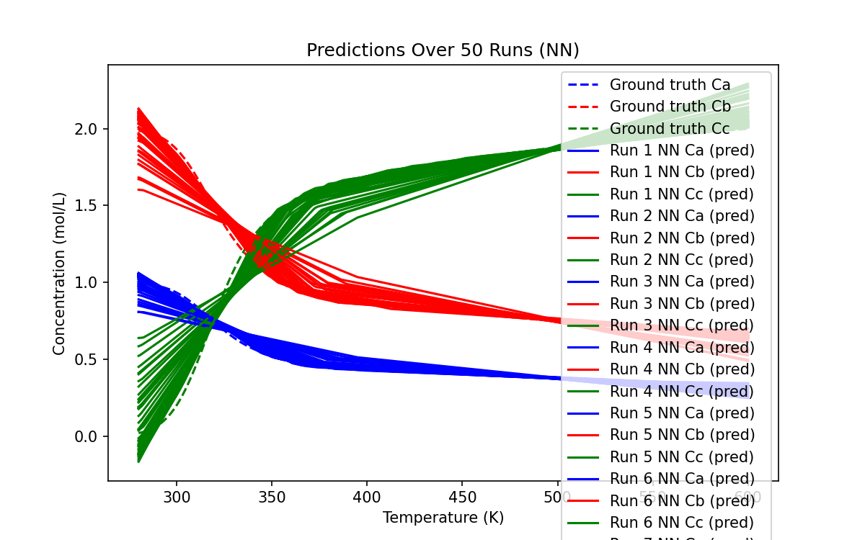
Visualization – Prediction - NN

Slide 13
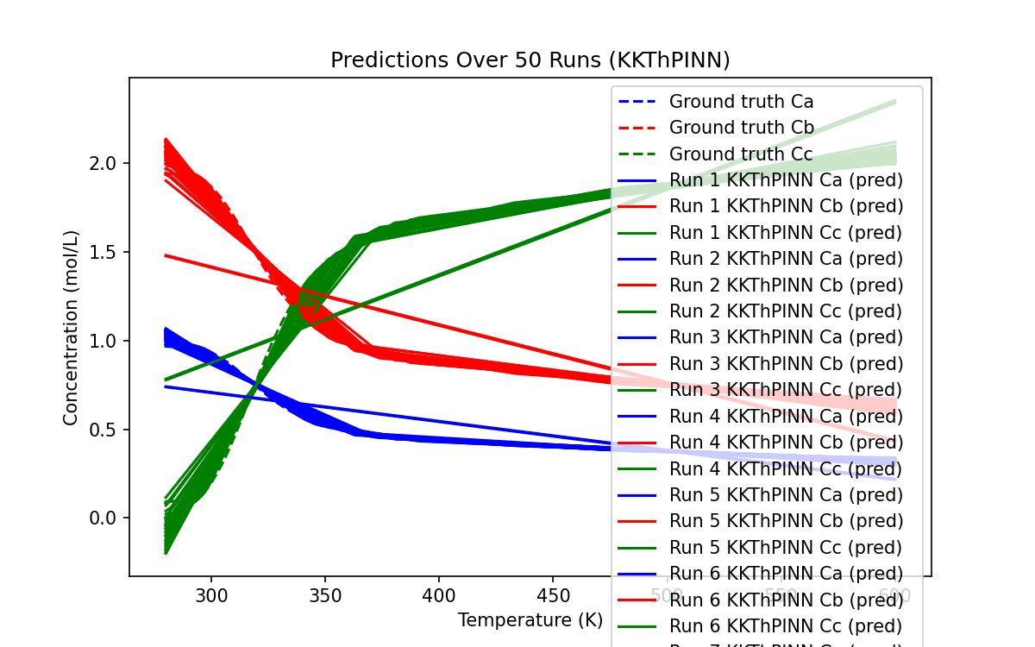
Visualization – Prediction - KKT

Slide 14
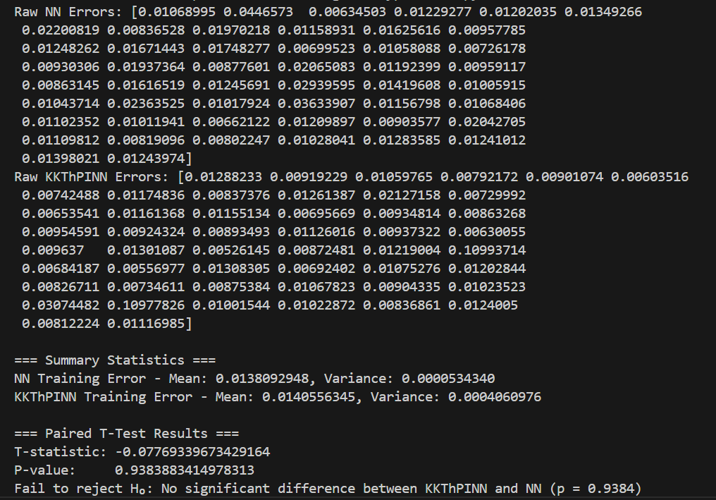
Our CSTR example –Experiment – 400 sample points

Slide 15
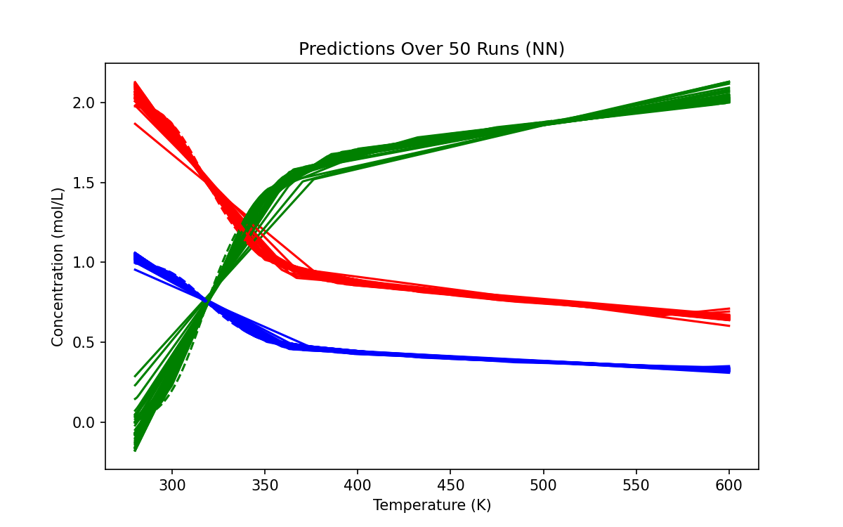
Visualization – Prediction - NN

Slide 16
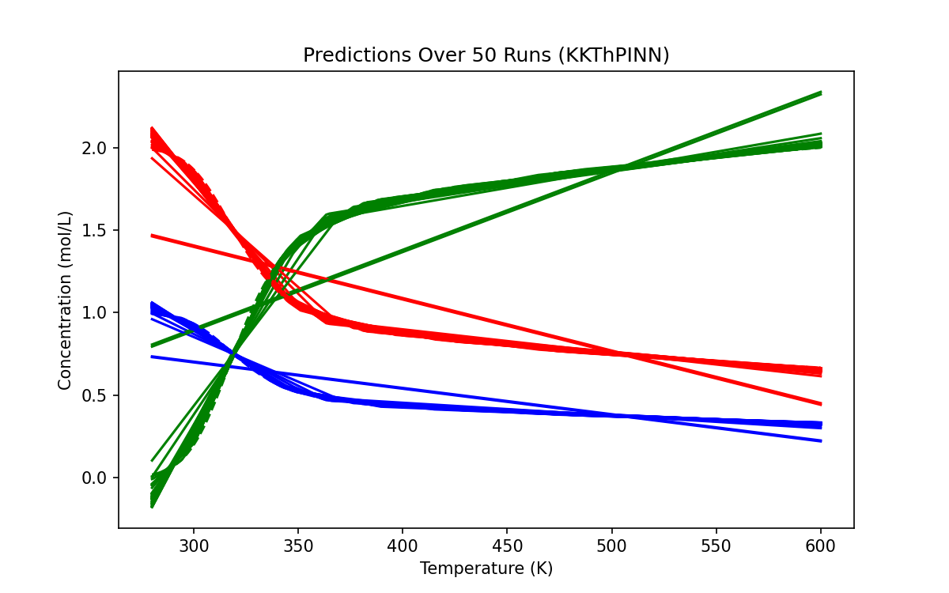
Visualization – Prediction - KKT

Slide 17
Thank You for Listening

