Slide 1
3/3/2025

Slide 2
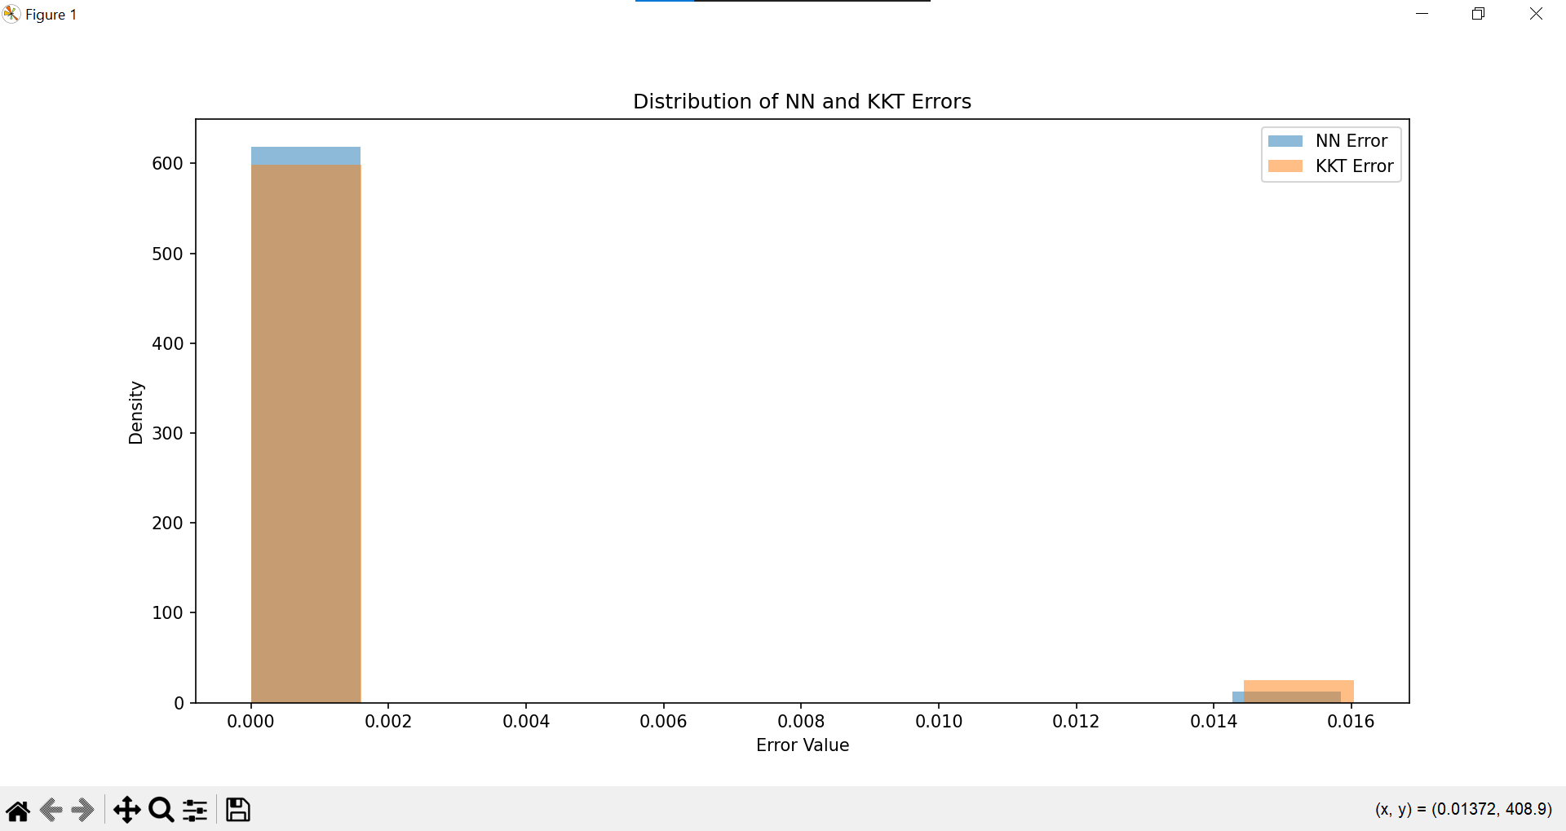
Histograms

Slide 3
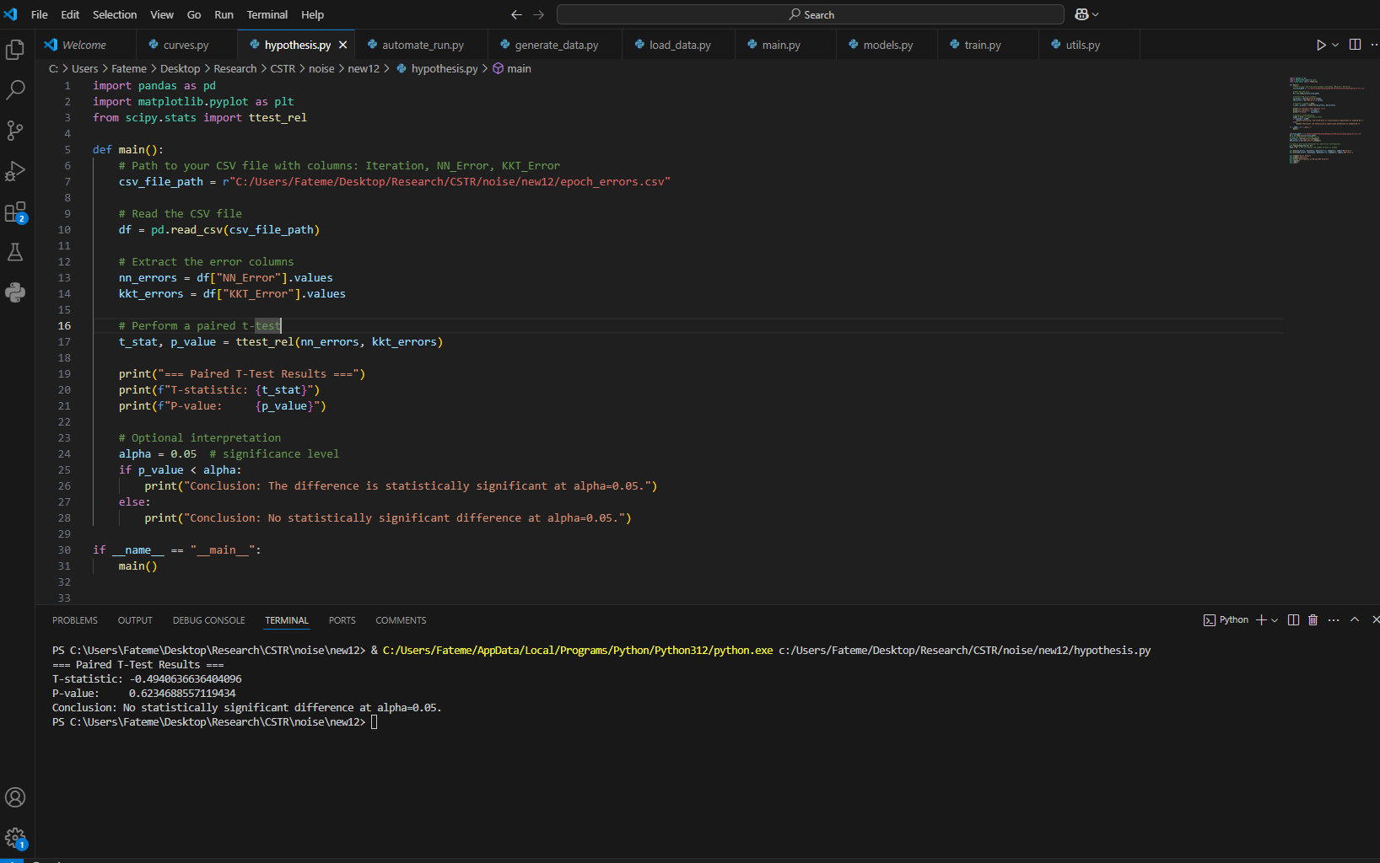
T-test

