Slide 1
Research Progress Update
Fateme Mohammad Mohammadi, Chemical Engineering

Slide 2
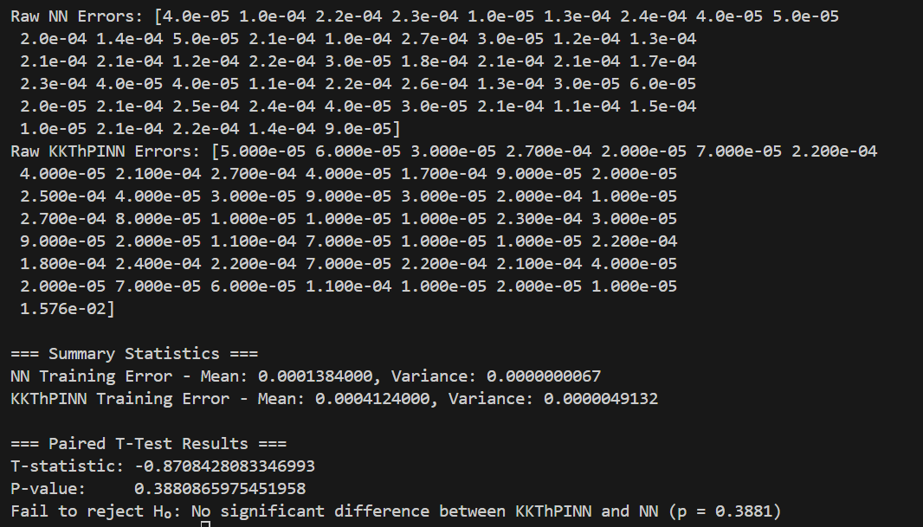
Our CSTR example –Training – 1000 sample points

Slide 3
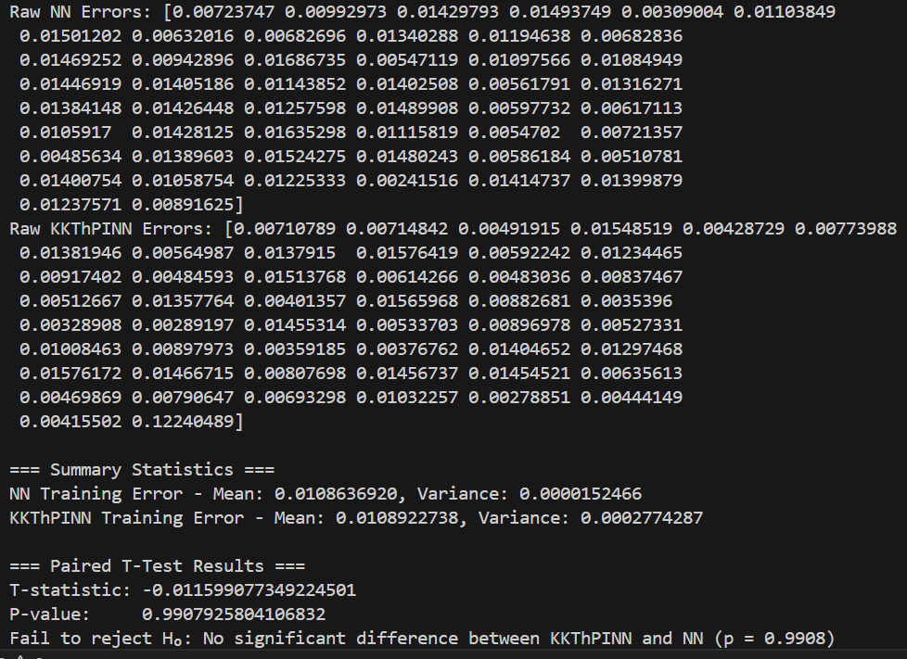
Our CSTR example – Experiment – 1000 sample points

Slide 4
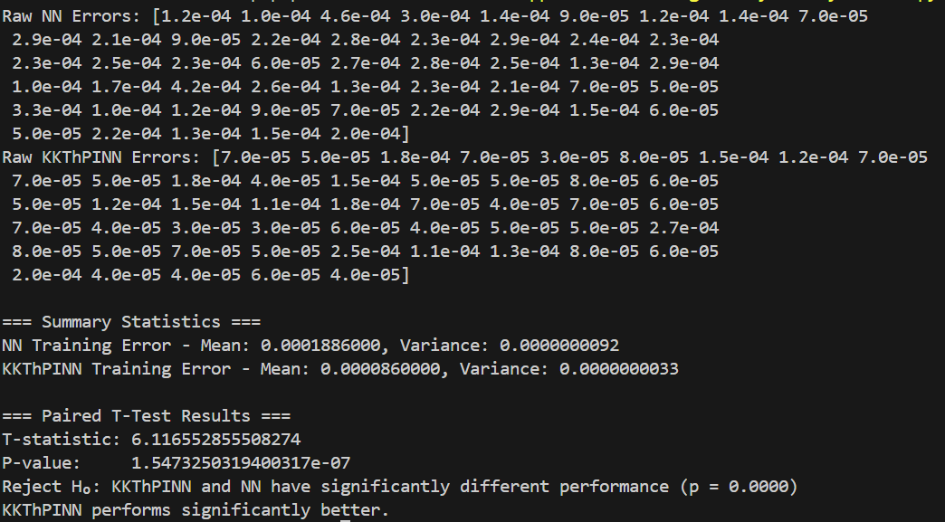
Paper – CSTR case study - Training

Slide 5
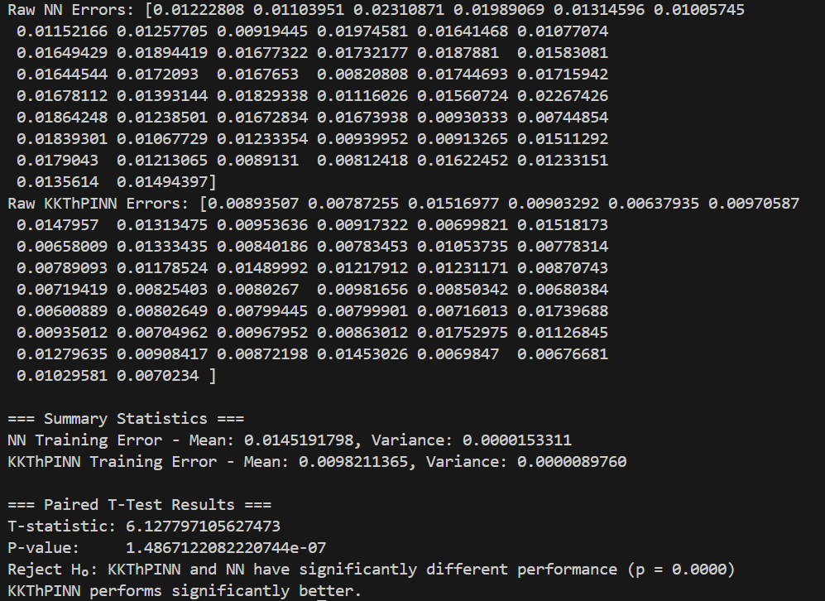
Paper – CSTR case study - Experiment

Slide 6
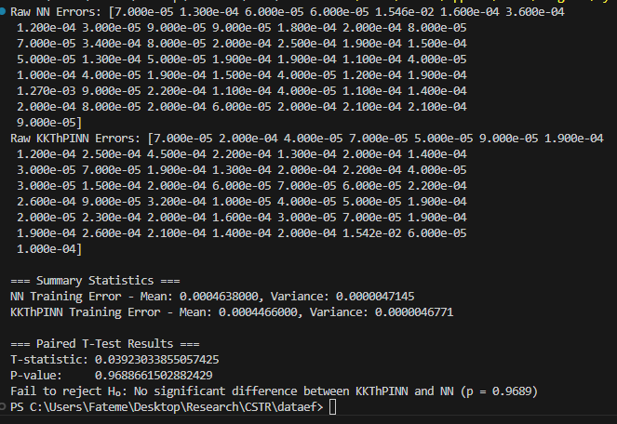
Our CSTR example –Training – 600 sample points

Slide 7
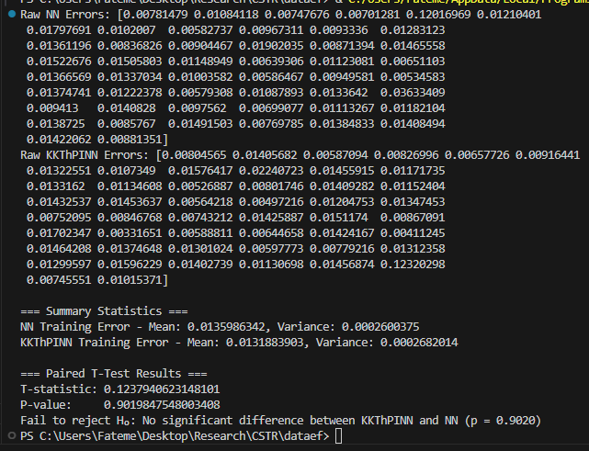
Our CSTR example –Experiment – 600 sample points

Slide 8
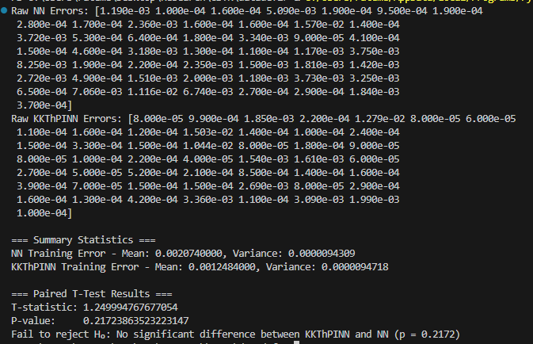
Our CSTR example –Training – 300 sample points

Slide 9
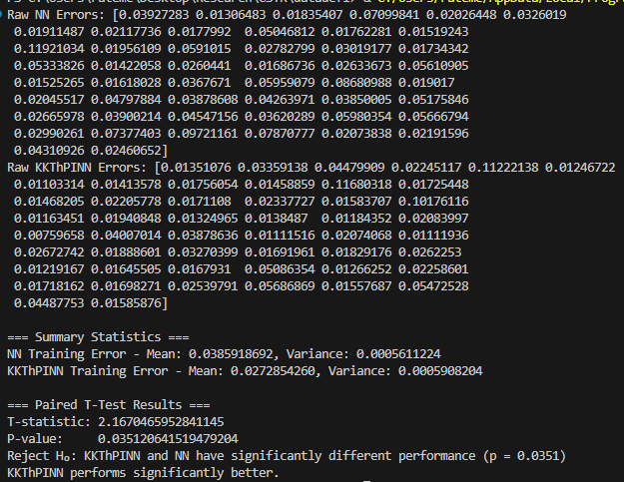
Our CSTR example –Experiment – 300 sample points

Slide 10
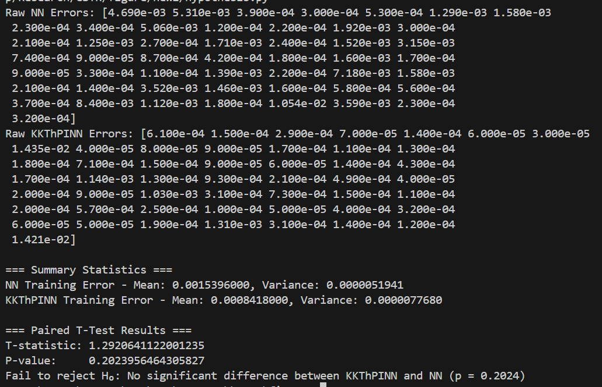
Our CSTR example –Training – 300 sample points - Run again

Slide 11
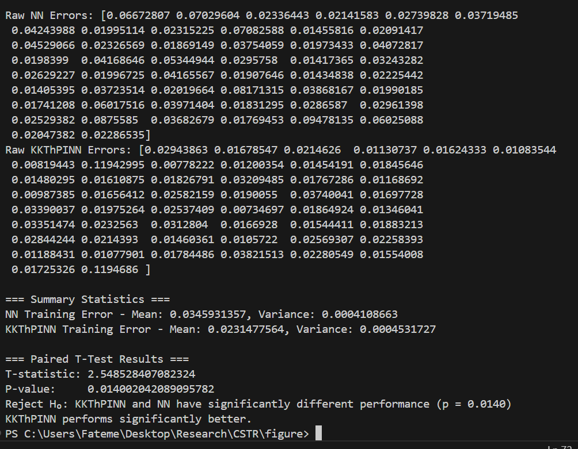
Our CSTR example –Experiment – 300 sample points – Run again

Slide 12
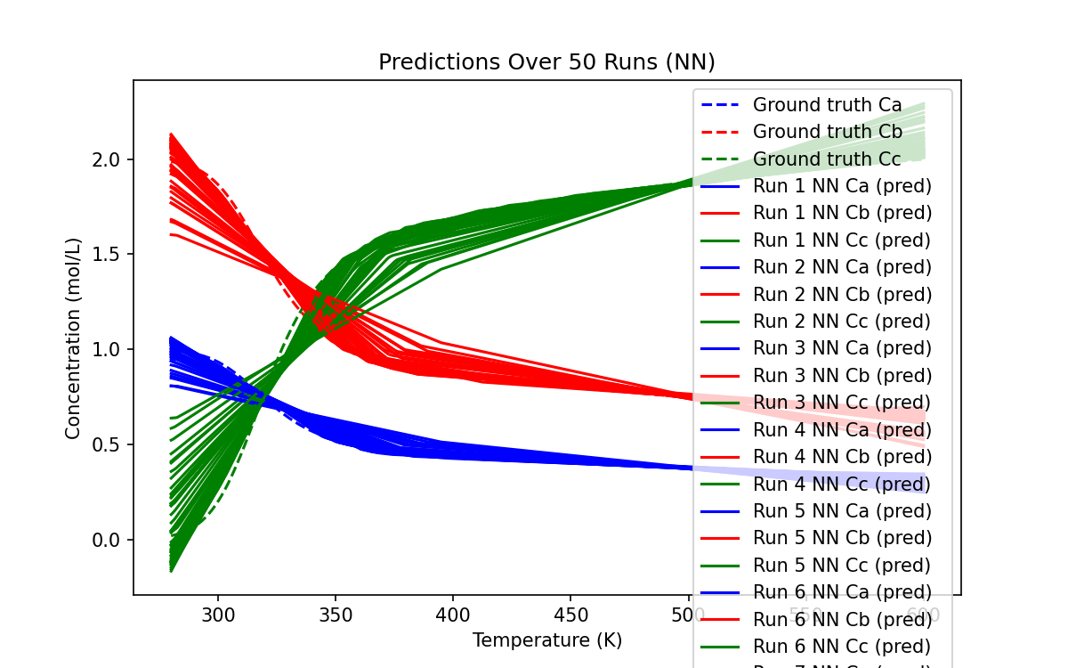
Visualization – Prediction - NN

Slide 13
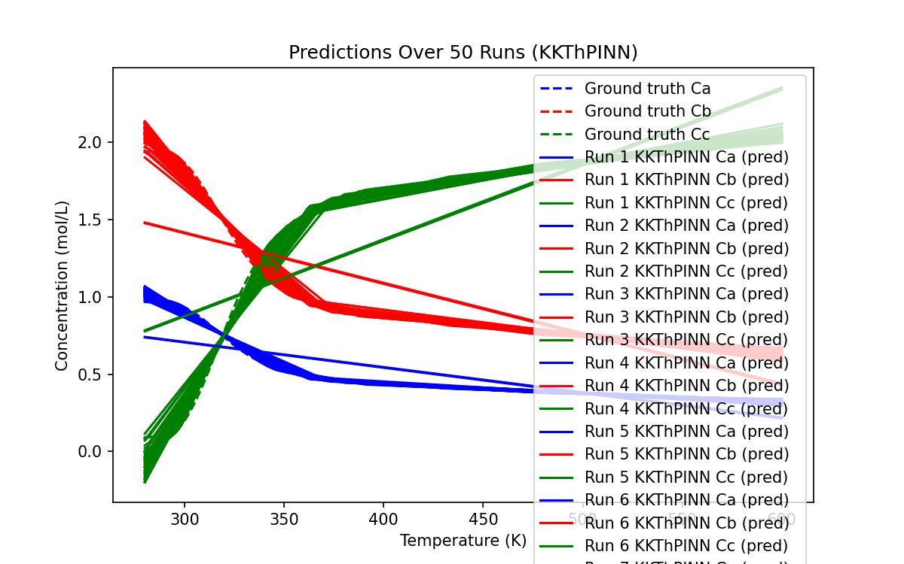
Visualization – Prediction - KKT

Slide 14
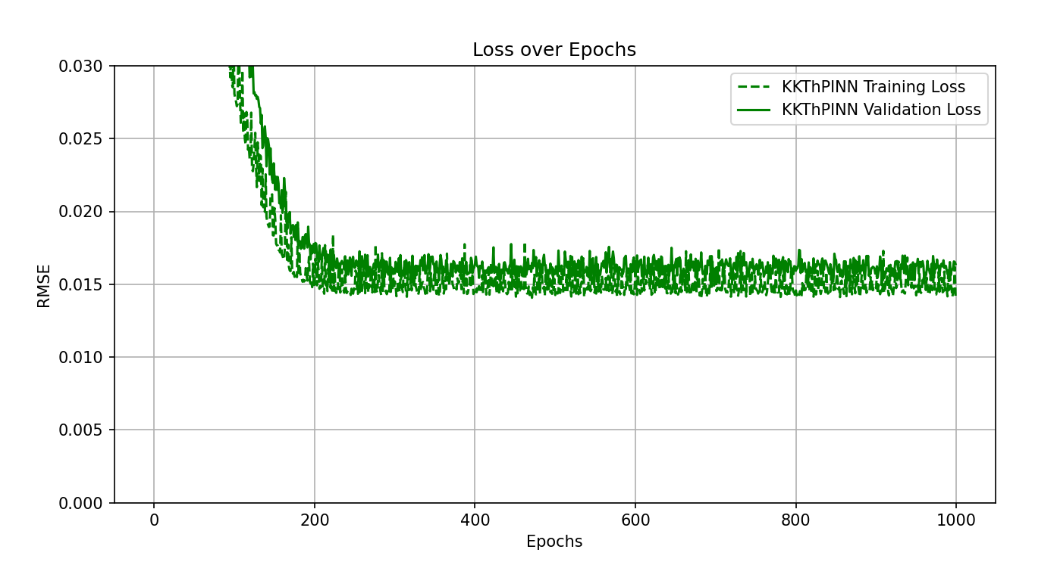
Last run -KKT

Slide 15
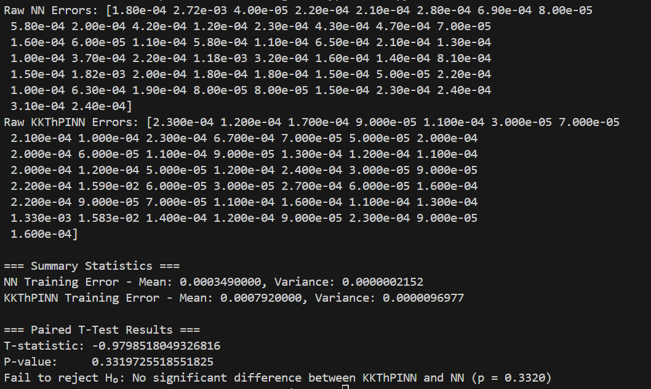
Our CSTR example –Training – 400 sample points

Slide 16
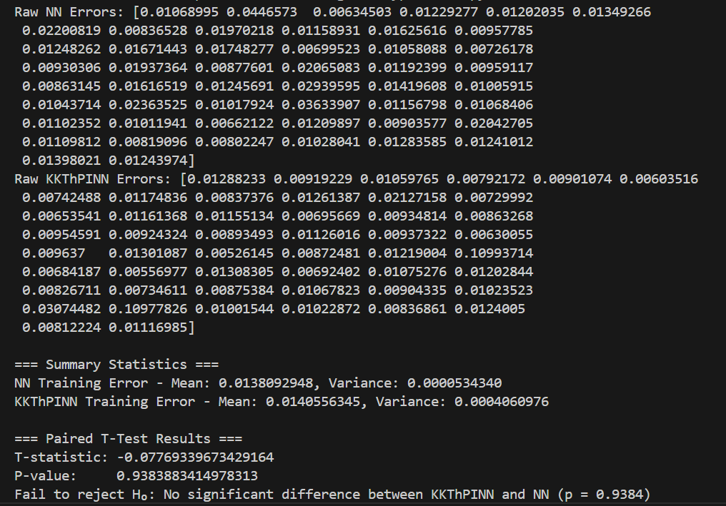
Our CSTR example –Experiment – 400 sample points

Slide 17
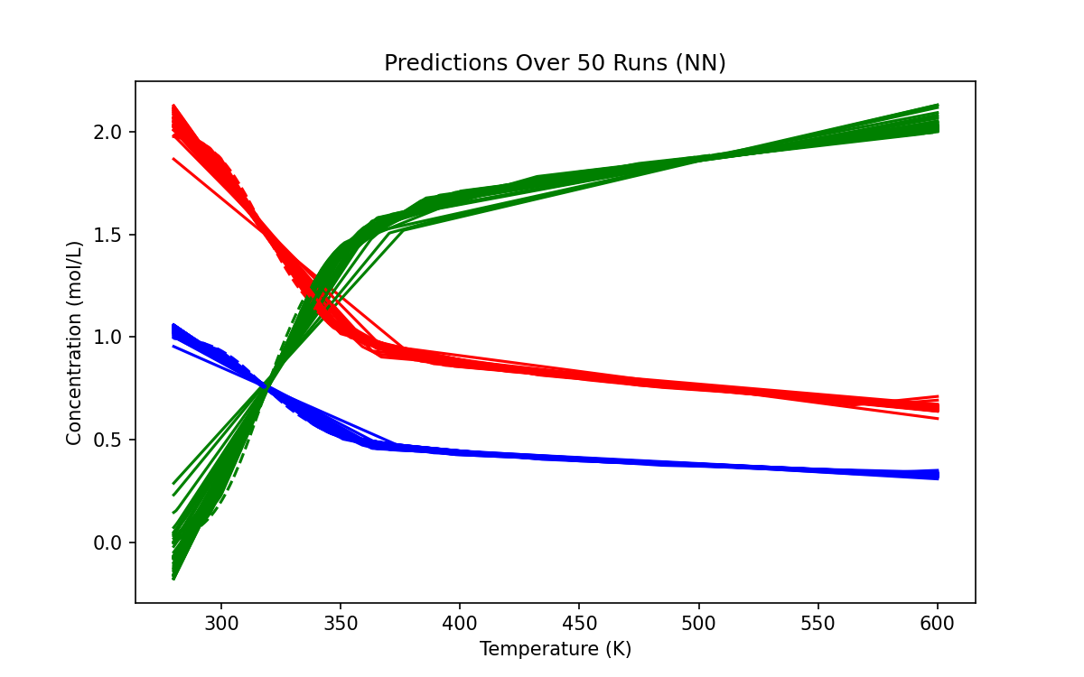
Visualization – Prediction - NN

Slide 18
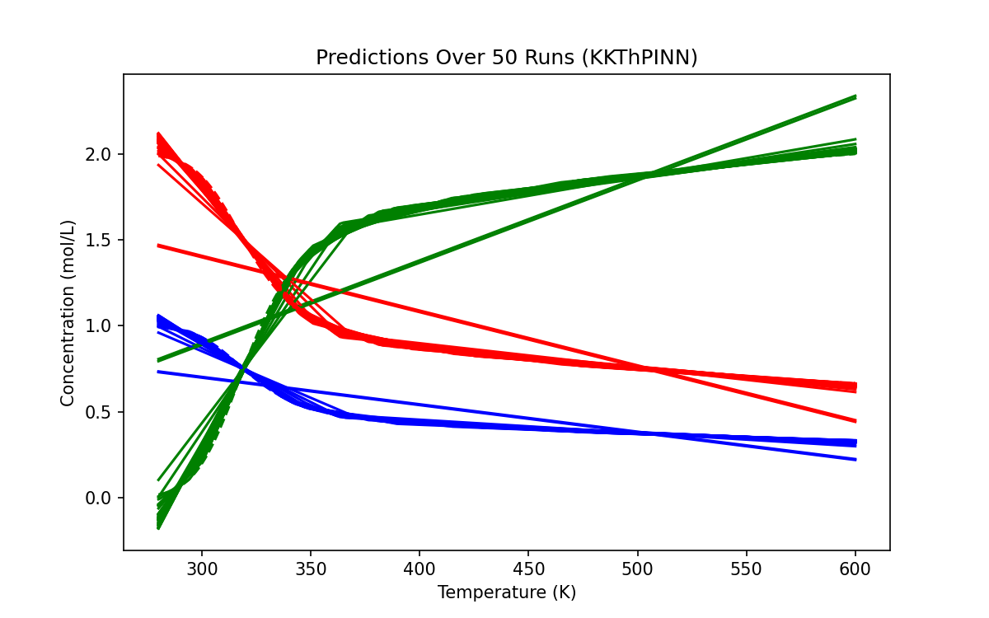
Visualization – Prediction - KKT

Slide 19
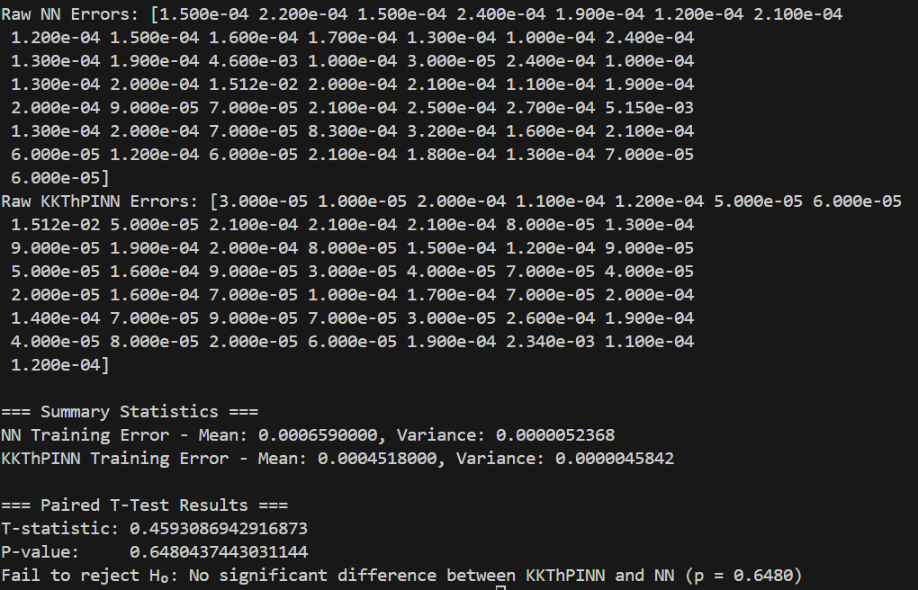
Our CSTR example –Training – 500 sample points

Slide 20
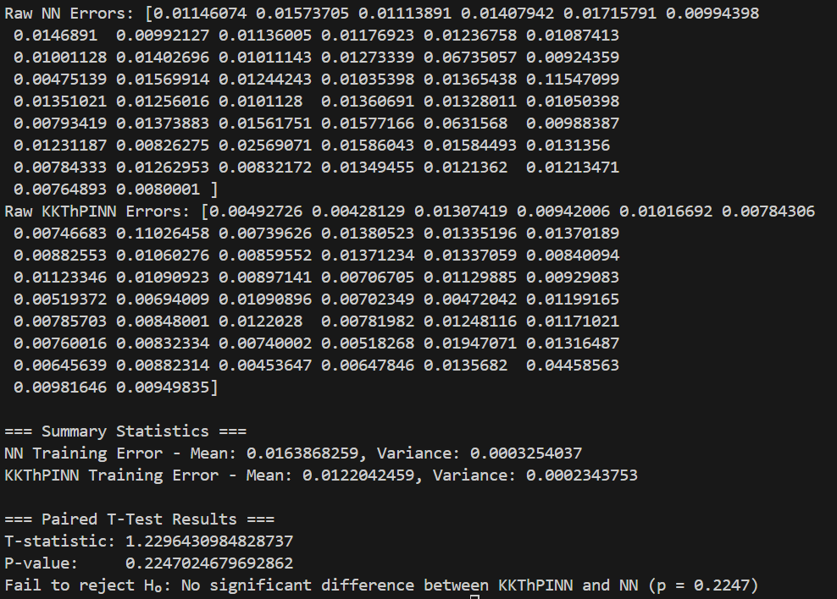
Our CSTR example –Experiment – 500 sample points

Slide 21
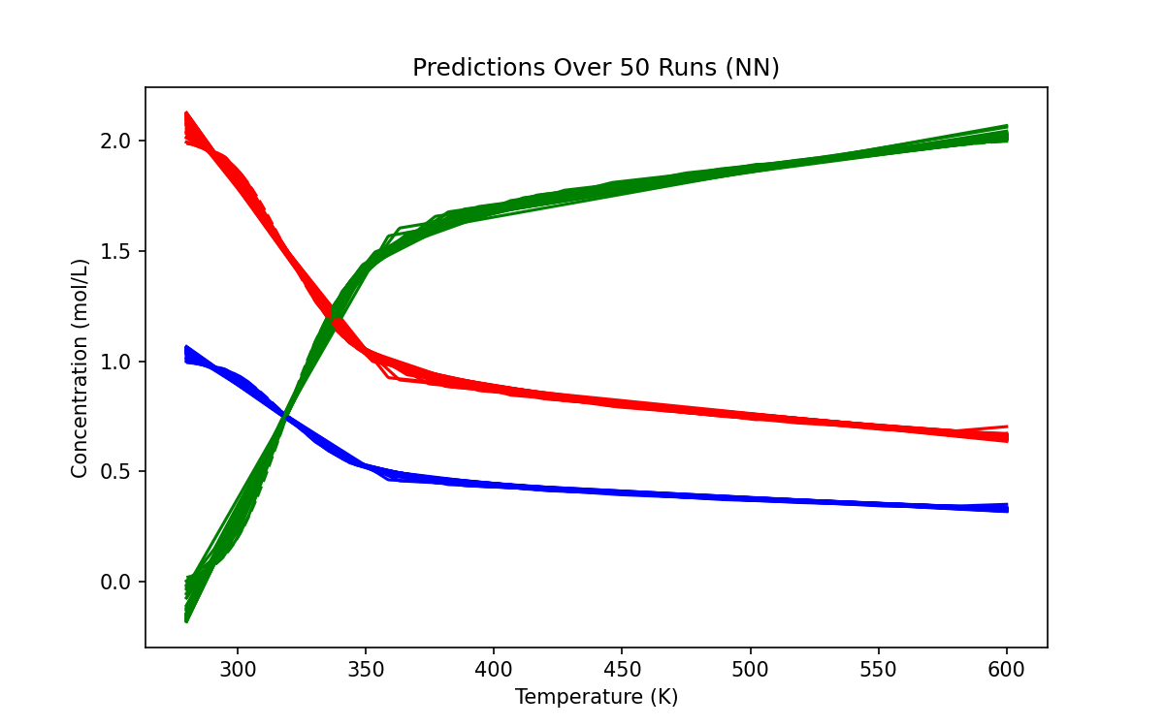
Visualization – Prediction - NN

Slide 22
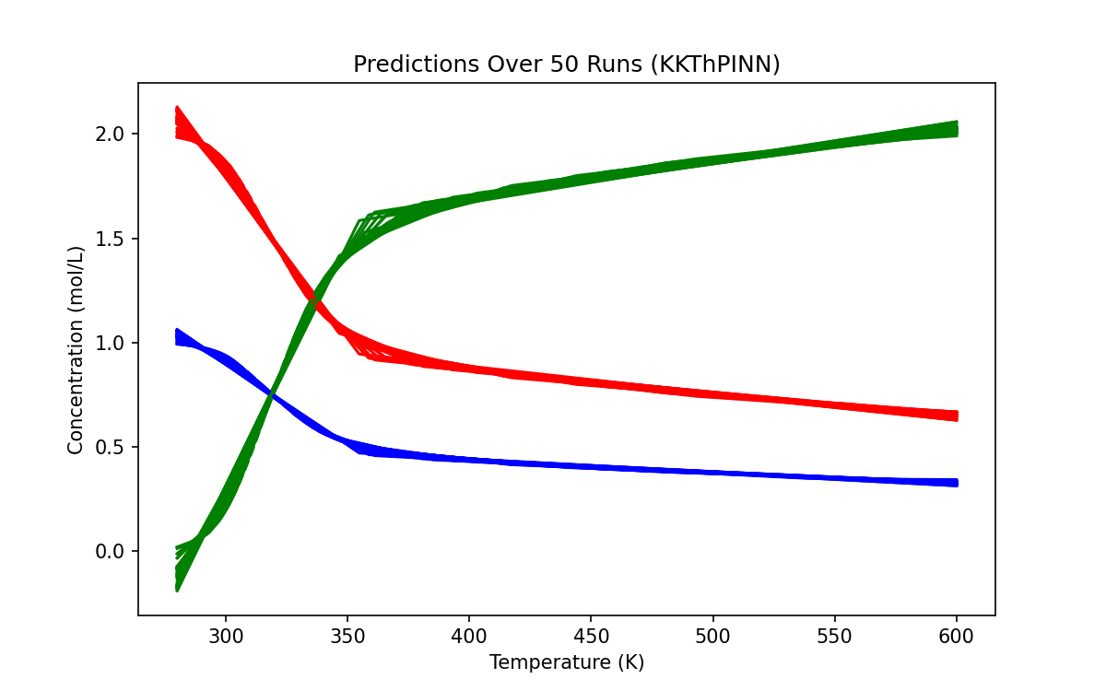

Slide 23
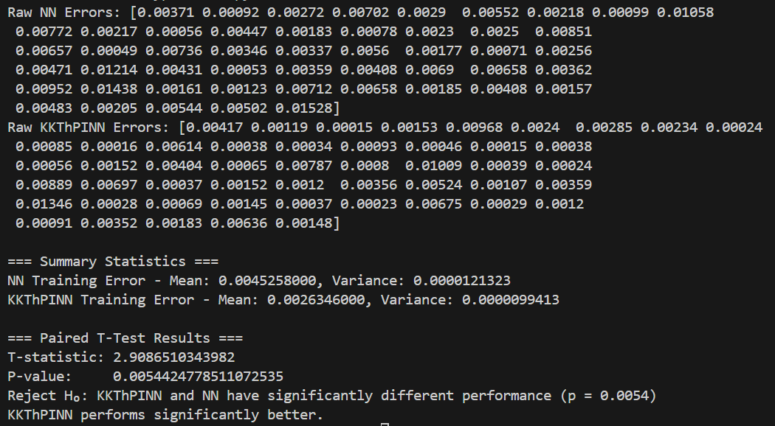
Our CSTR example –Training – 200 sample points

Slide 24
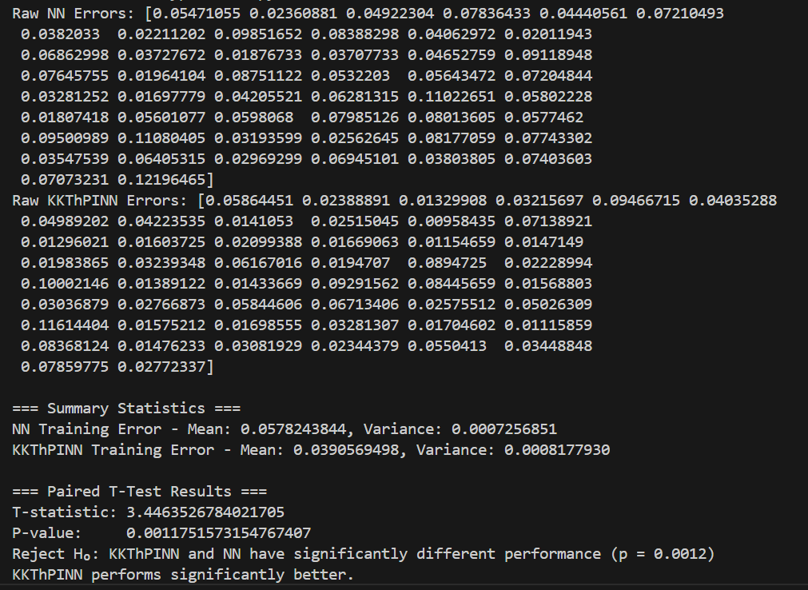
Our CSTR example –Experiment – 200 sample points

Slide 25
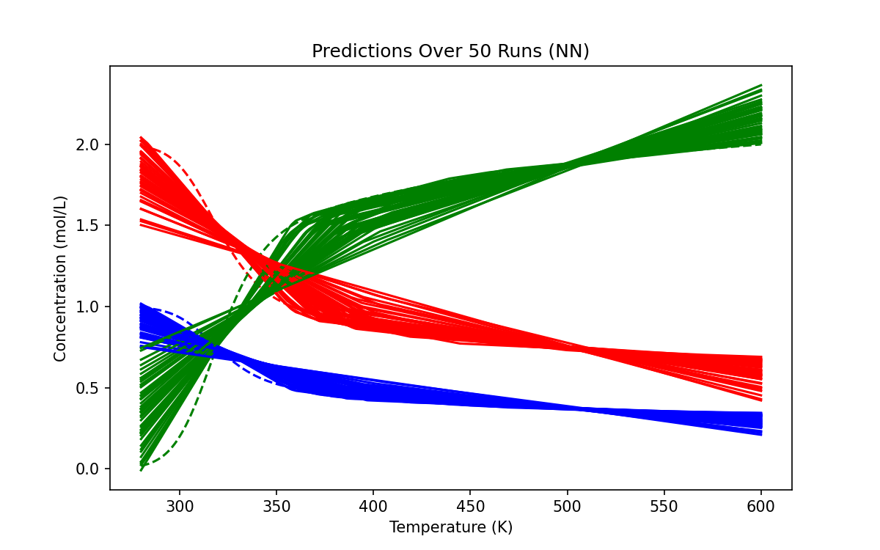
Visualization – Prediction - NN

Slide 26
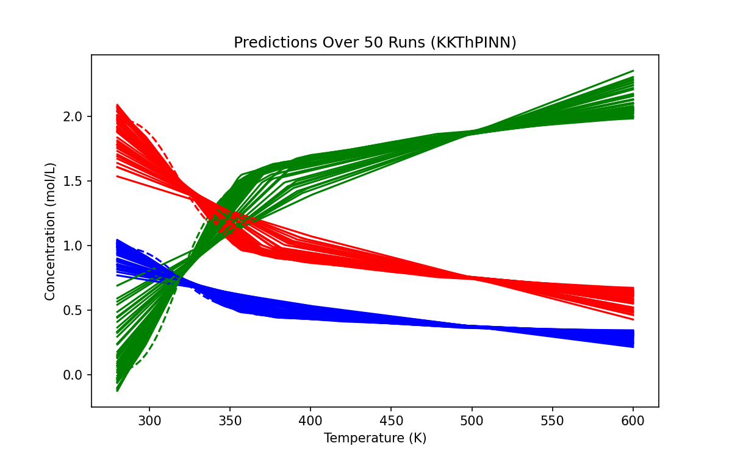
Visualization – Prediction - KKT

Slide 27
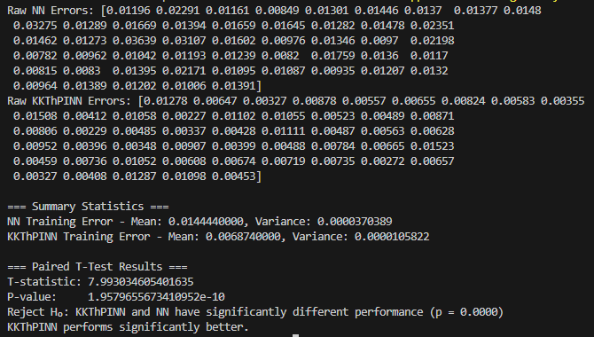
Our CSTR example –Training – 100 sample points

Slide 28
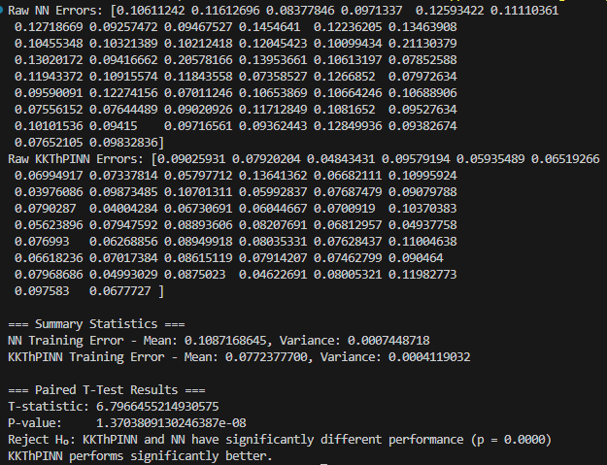
Our CSTR example –Experiment – 100 sample points

Slide 29
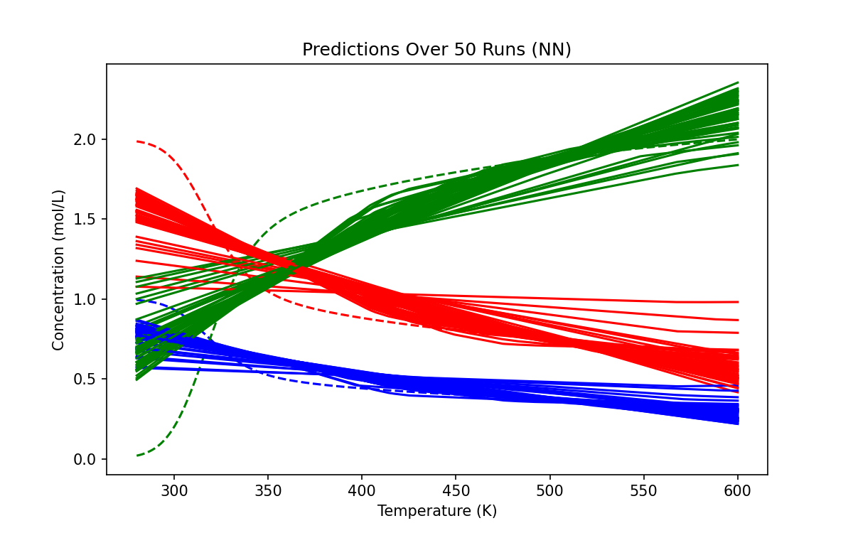
Visualization – Prediction - NN

Slide 30
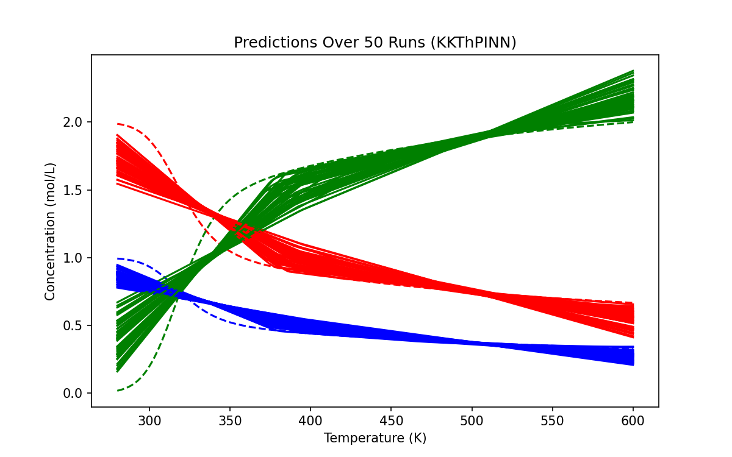
Visualization – Prediction - KKT

Slide 31
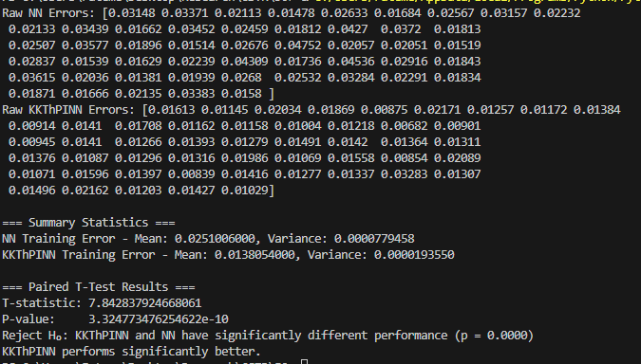
Our CSTR example –Training – 50 sample points

Slide 32
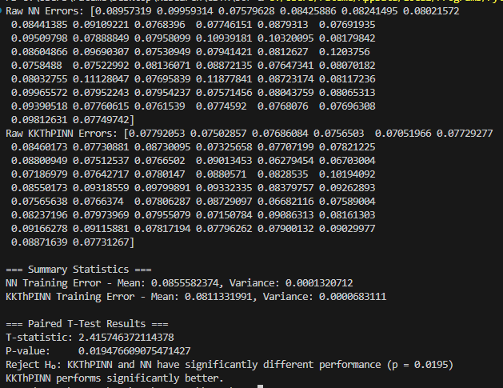
Our CSTR example –Experiment – 50 sample points

Slide 33
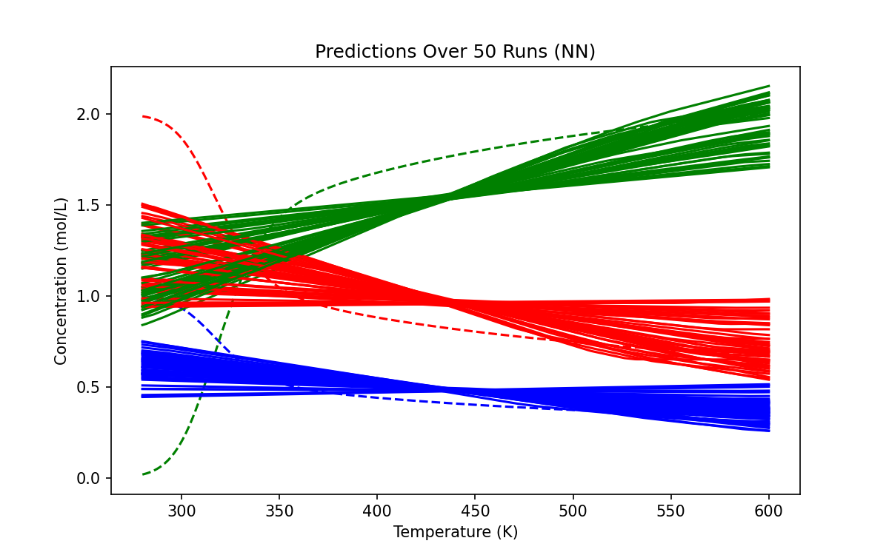
Visualization – Prediction - NN

Slide 34
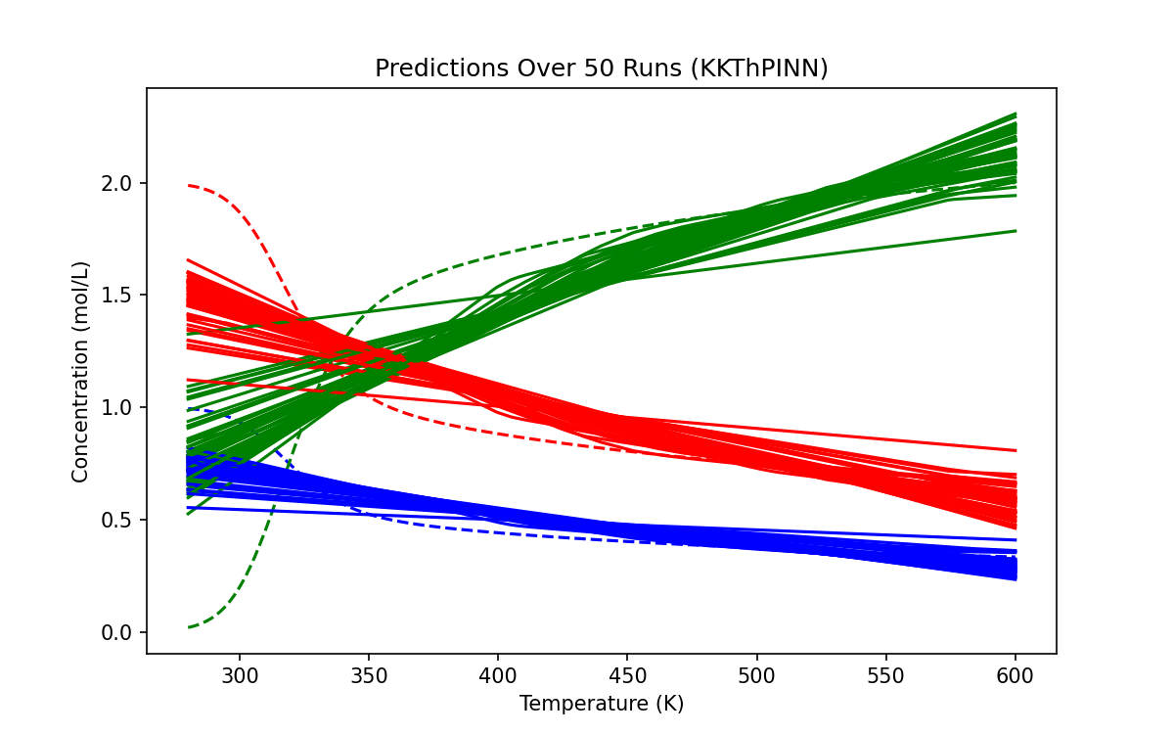
Visualization – Prediction - KKT

Slide 35
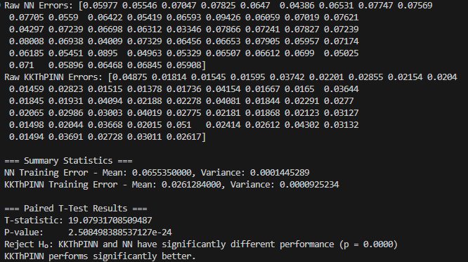
Our CSTR example –Training – 10 sample points

Slide 36
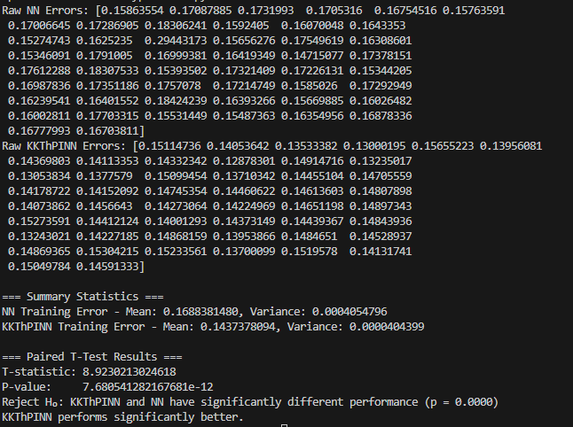
Our CSTR example –Experiment – 10 sample points

Slide 37
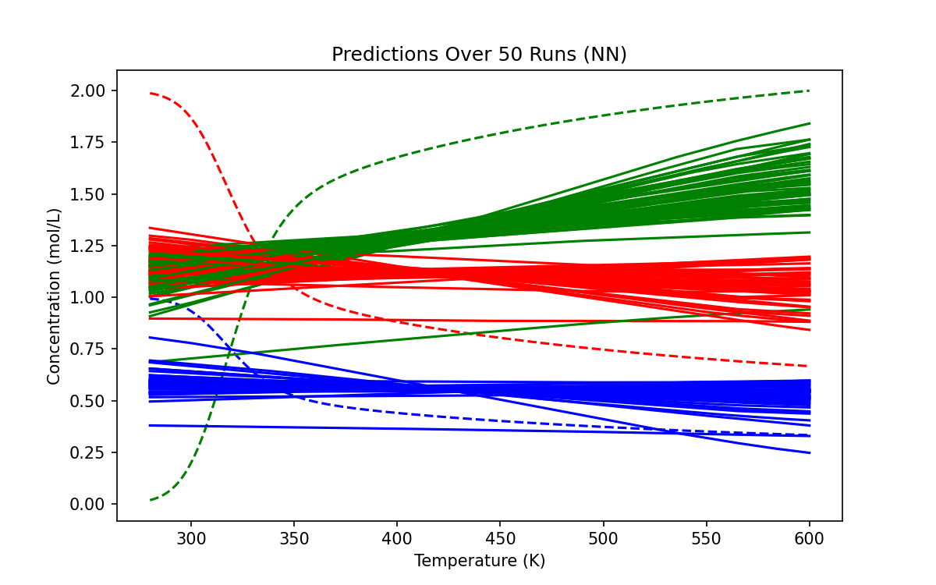
Visualization – Prediction - NN

Slide 38
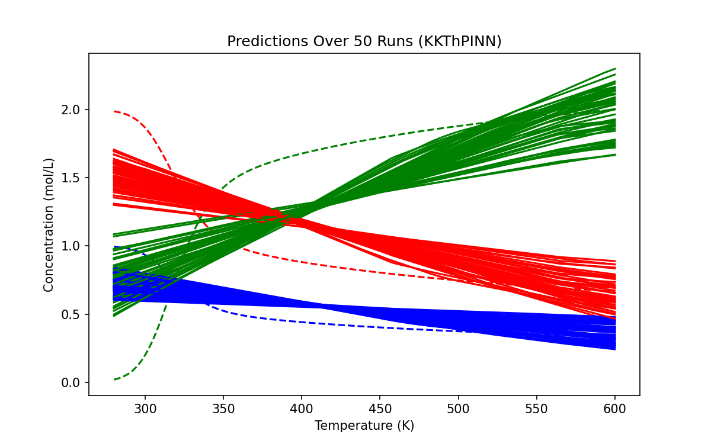
Visualization – Prediction - KKT

Slide 39
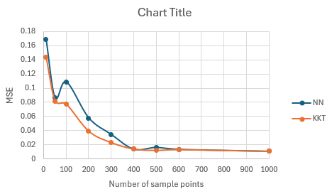
Conclusion - Experiment

Slide 40
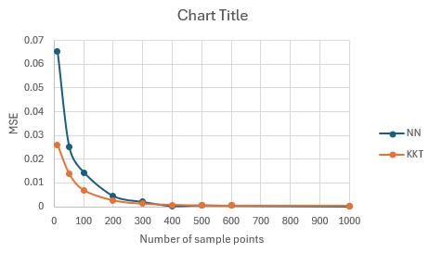
Conclusion - Training

Slide 41
Thank You for Listening

