Slide 1
Research Progress Update
Fateme Mohammad Mohammadi, Chemical Engineering

Slide 2
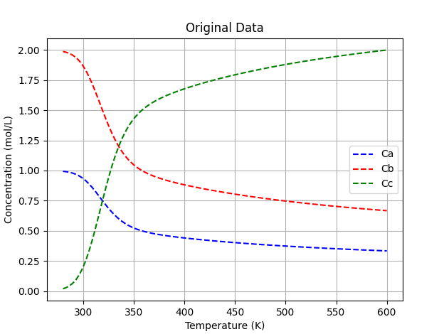
Original data

Slide 3
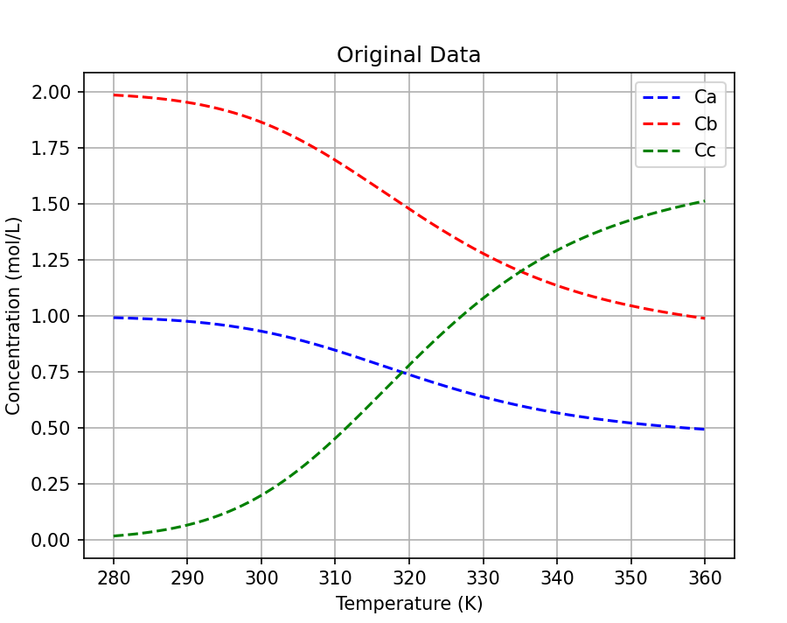
First half

Slide 4
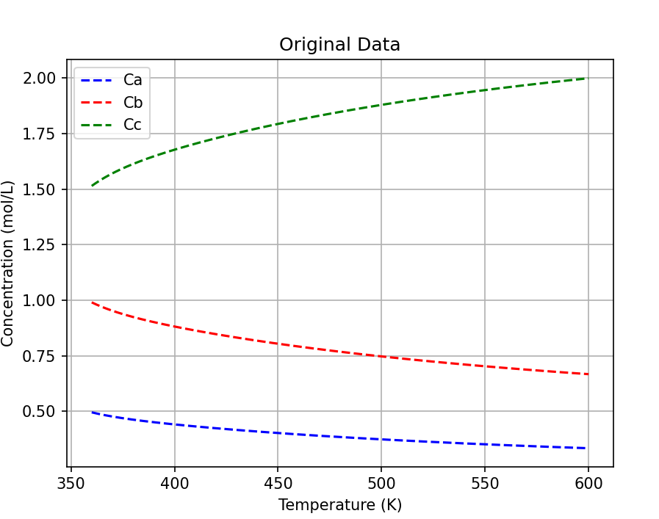
Second half

Slide 5
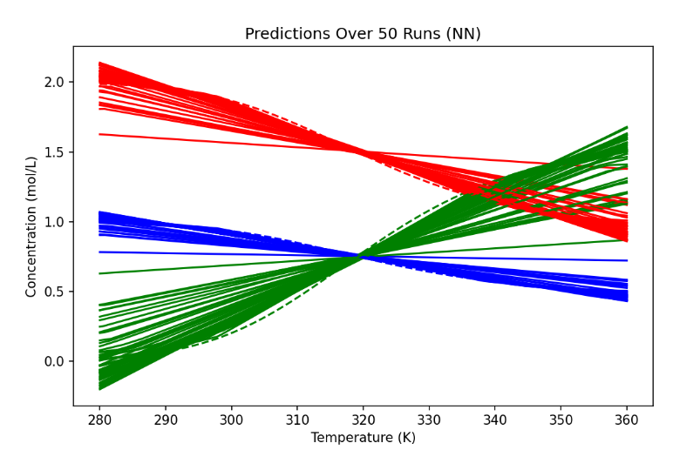
First half – 300 points – NN (used 600 points for prediction)

Slide 6
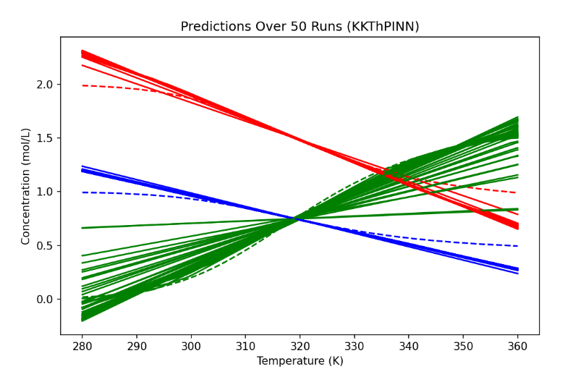
First half – 300 points – KKT (used 600 points for prediction)

Slide 7
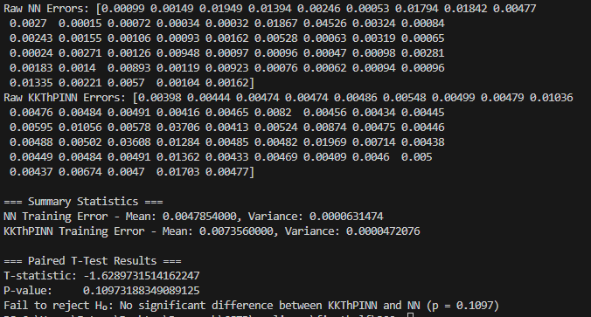
First half - Training – 300 points

Slide 8
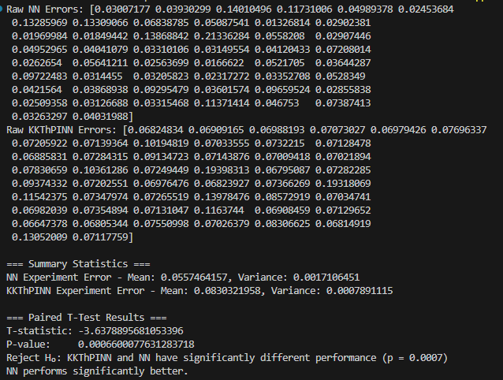
First half - Experiment – 300 points

Slide 9
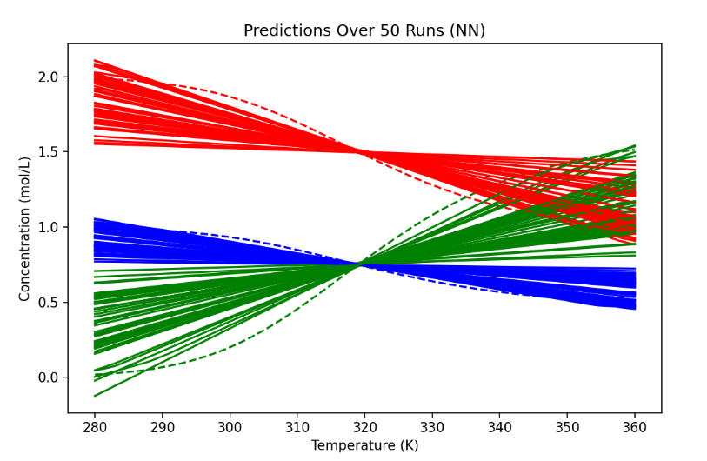
First half – 200 points - NN

Slide 10
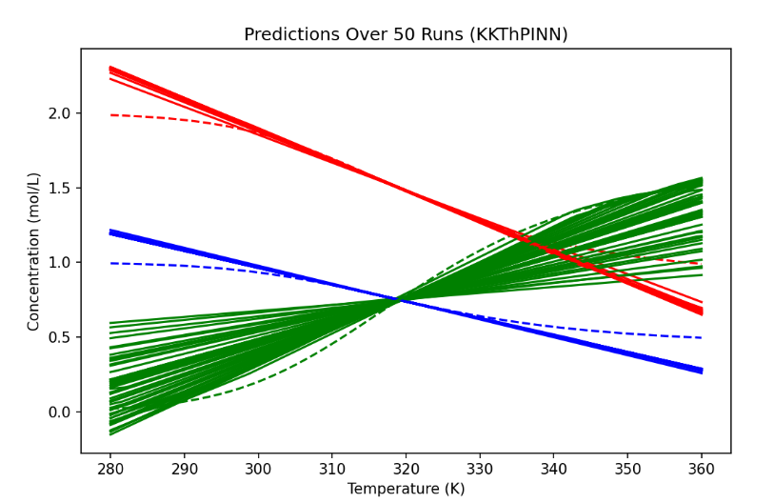
First half – 200 points - KTT

Slide 11
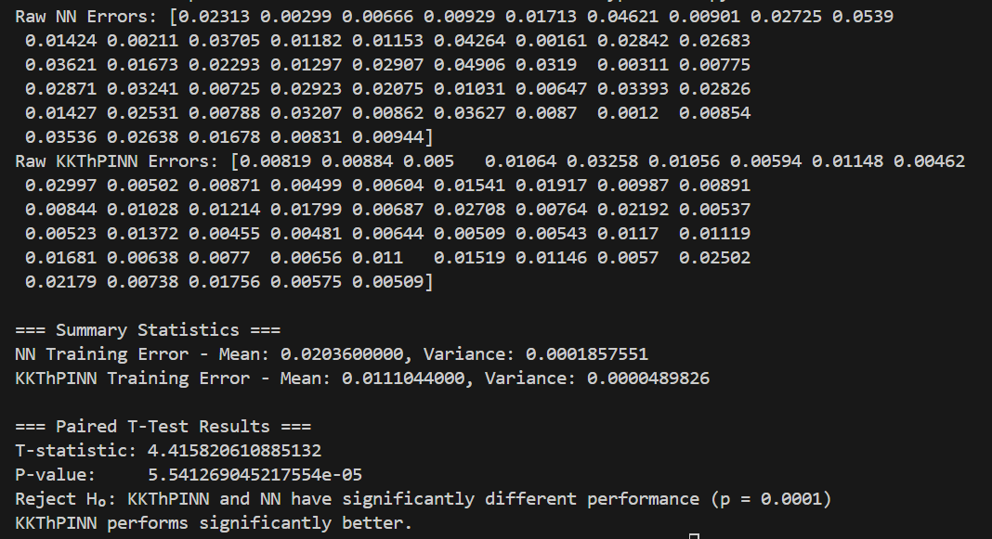
First half - Training – 200 points

Slide 12
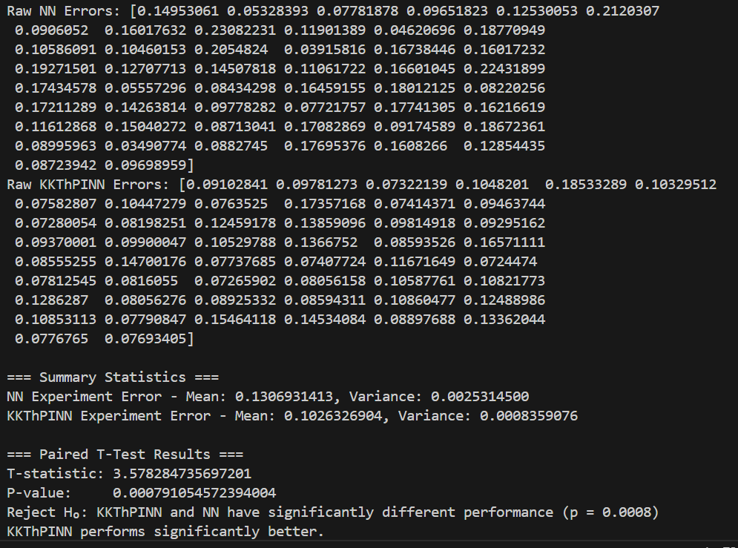
First half - Experiment – 200 points

Slide 13
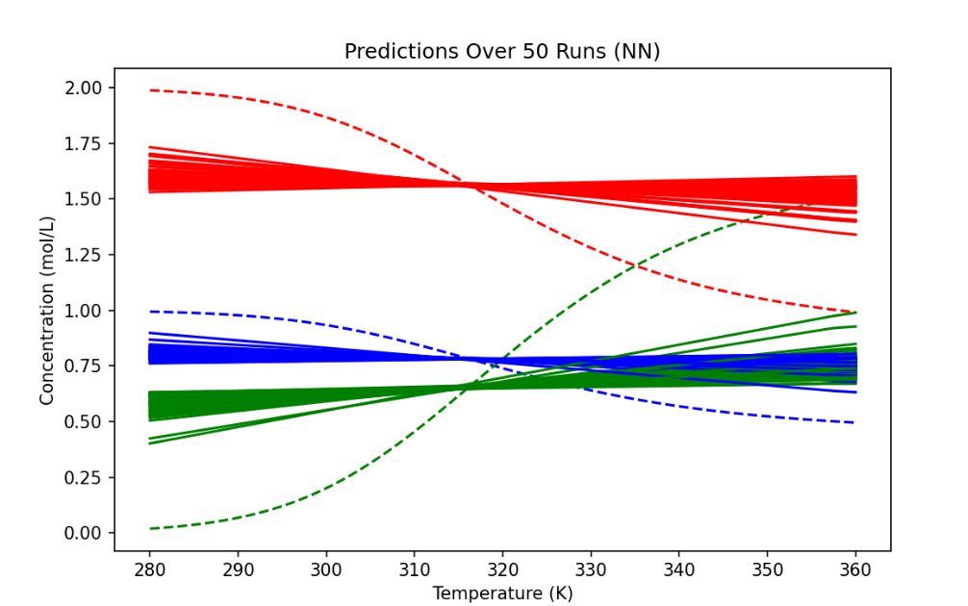
First half – 100 points - NN

Slide 14
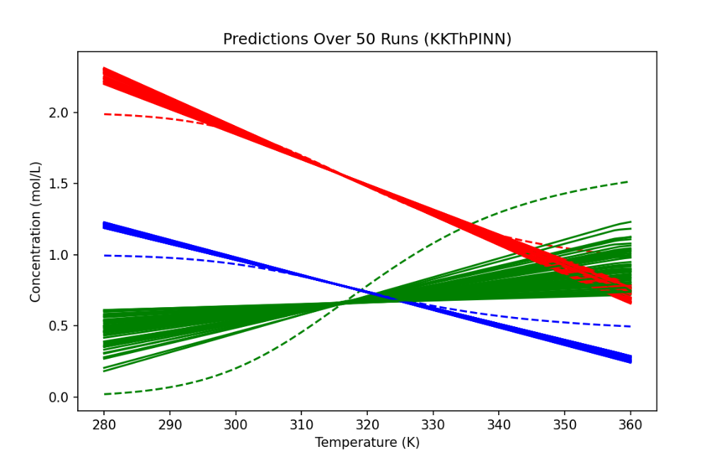
First half – 100 points - KKT

Slide 15
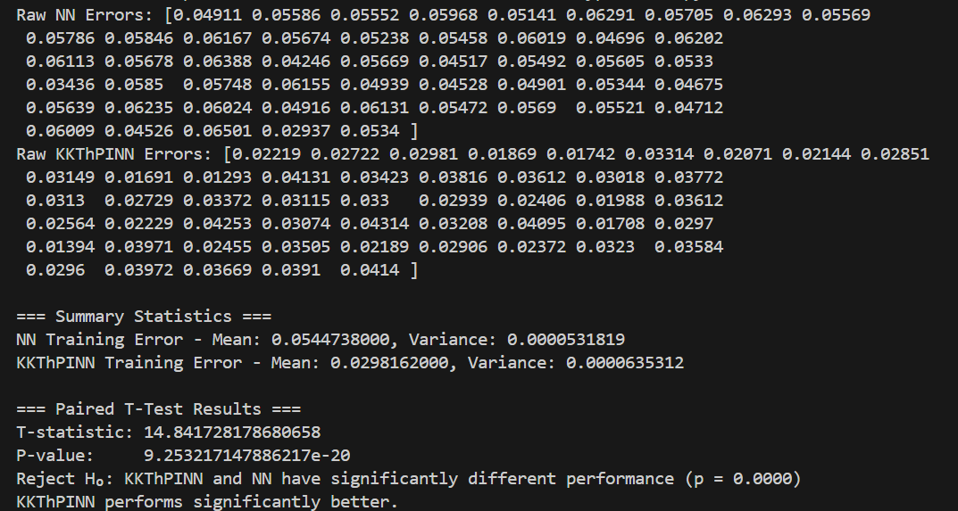
First half - Training – 100 points

Slide 16
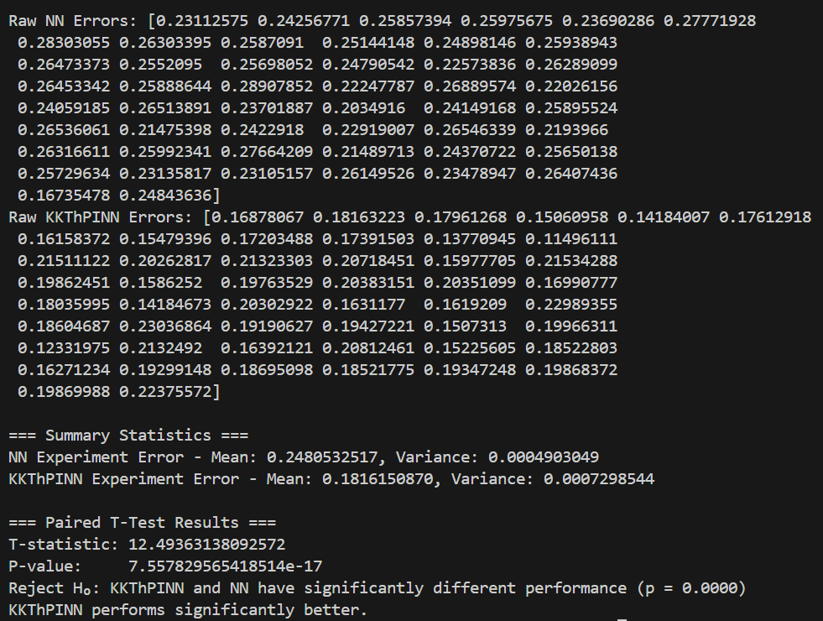
First half - Experiment – 100 points

Slide 17
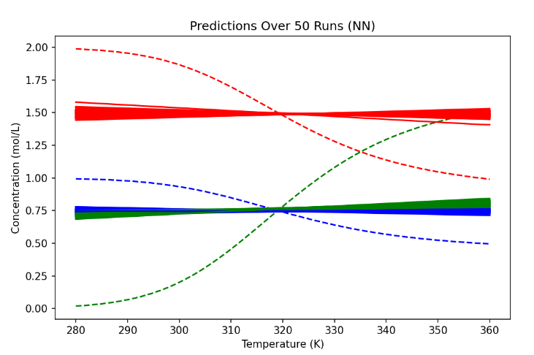
First half – 50 points - NN

Slide 18
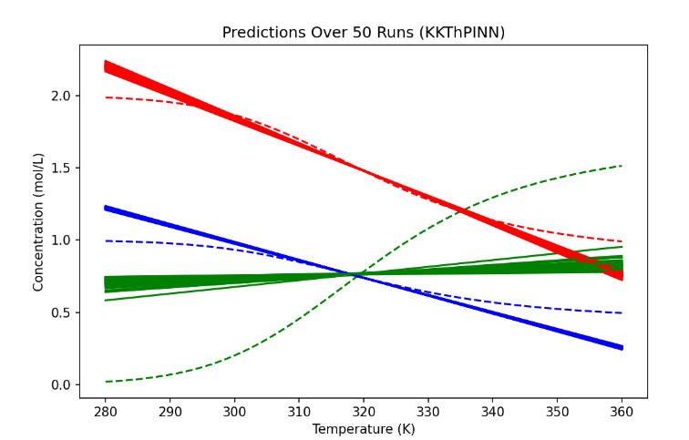
First half – 50 points - KKT

Slide 19
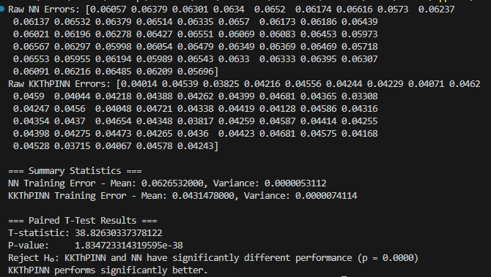
First half - Training – 50 points

Slide 20
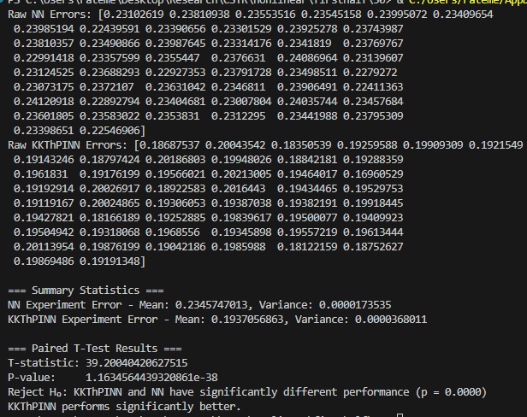
First half - Experiment – 50 points

Slide 21
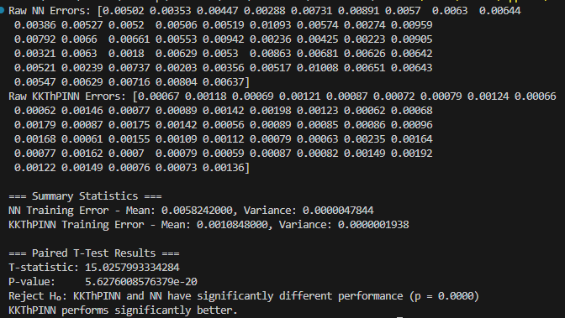
Second half - Training – 50 points

Slide 22
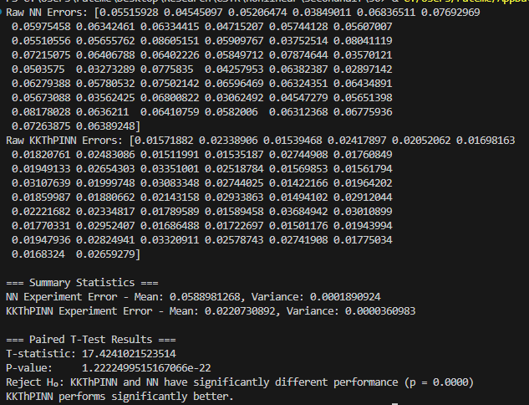
Second half – Experiment – 50 points

Slide 23
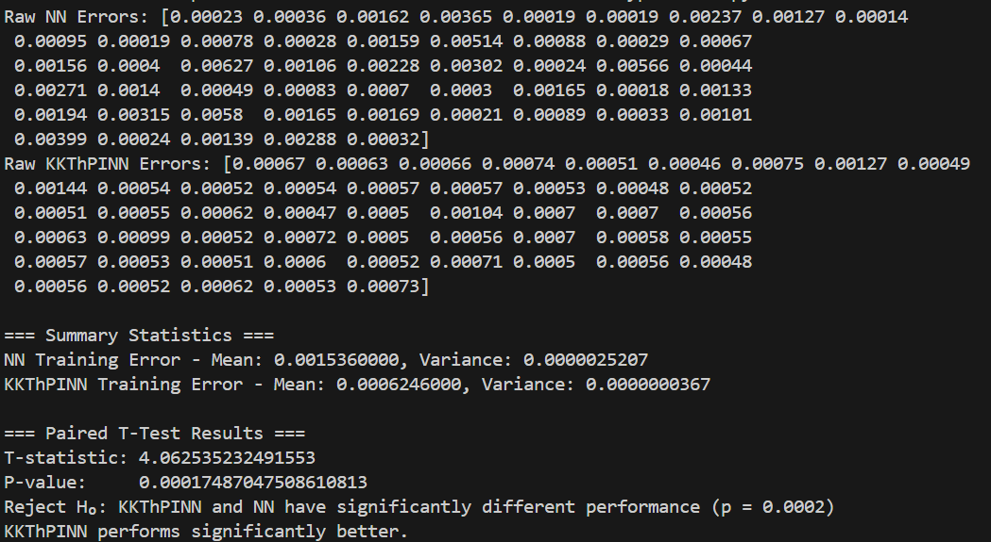
Second half - Training – 100 points

Slide 24
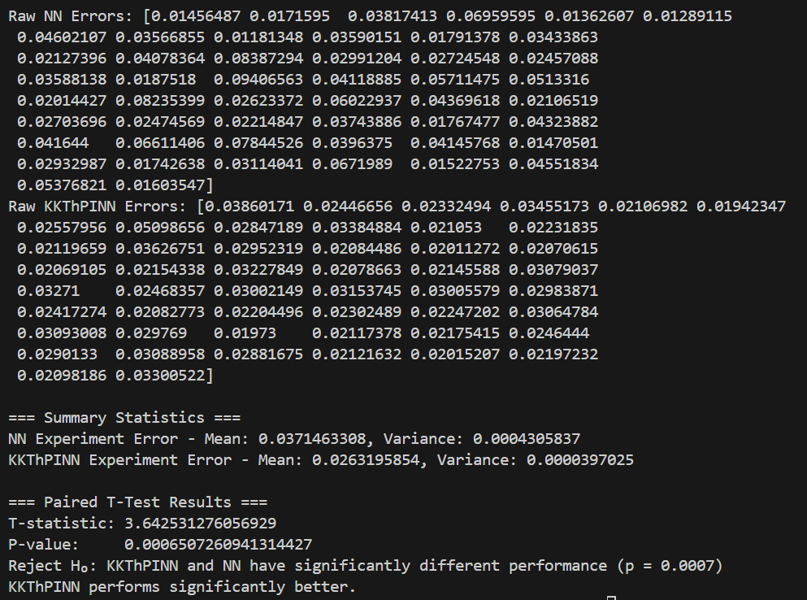
Second half - Experiment – 100 points

Slide 25
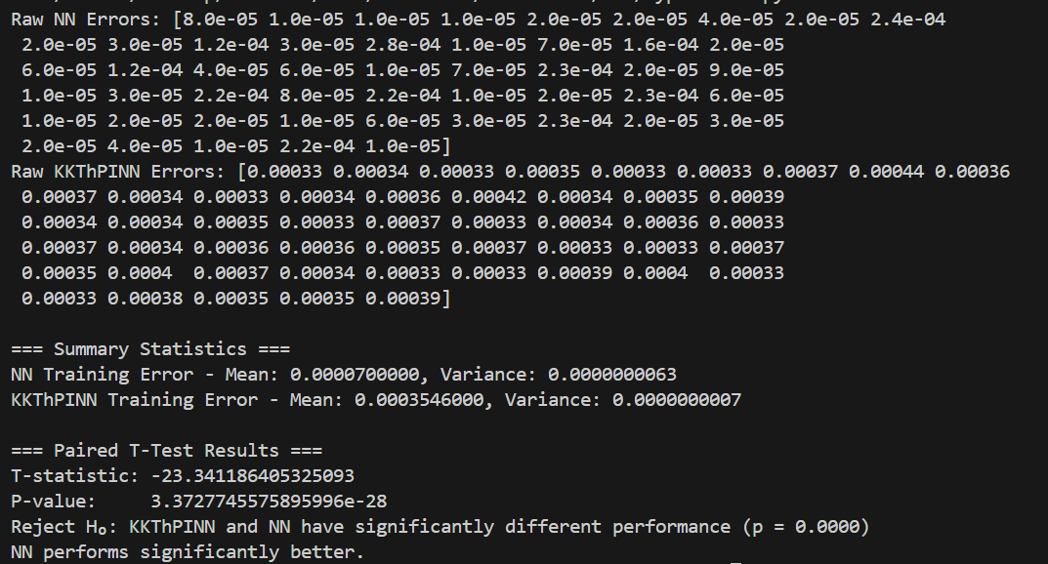
Second half - Training – 300 points

Slide 26
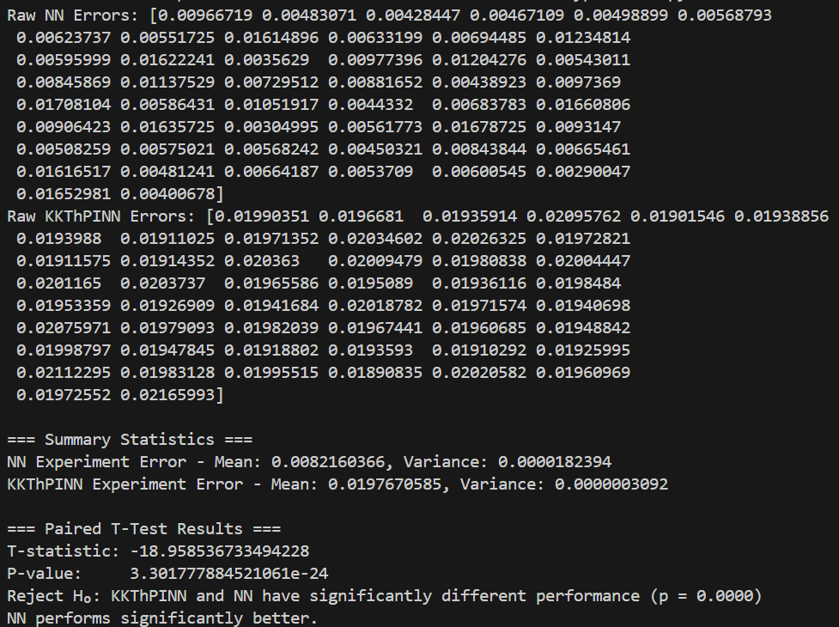
Second half - Experiment – 300 points

Slide 27
Thank You for Listening

