Slide 1
Research Progress Update
Fateme Mohammad Mohammadi, Chemical Engineering

Slide 2
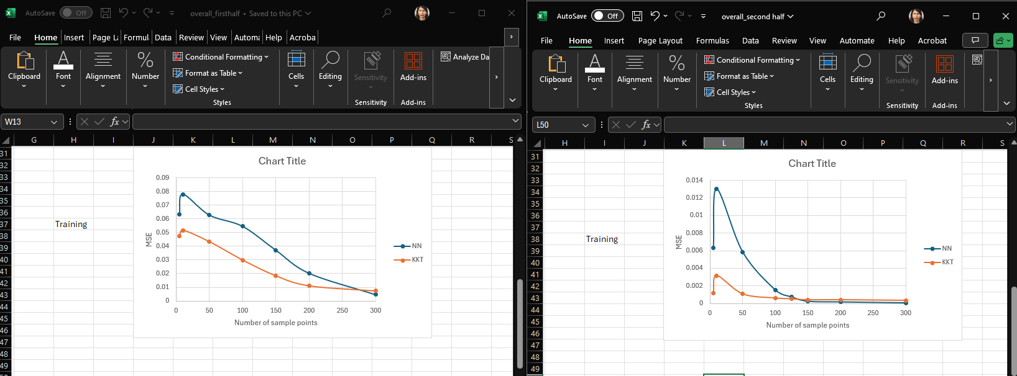
Training

Slide 3
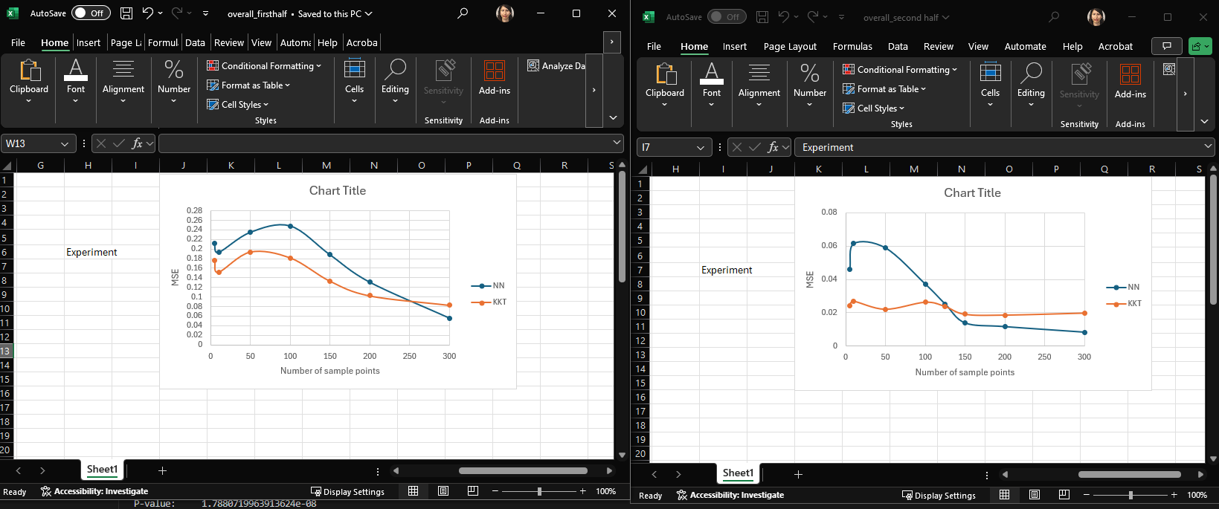
Experiment

Slide 4
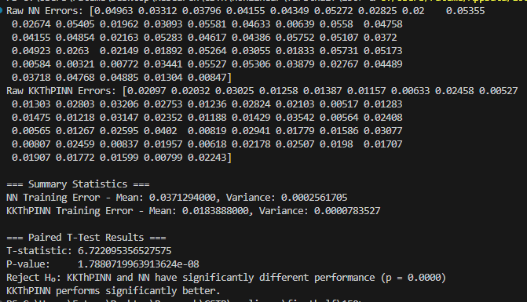
32 nodes – 150 sample points – first half - training

Slide 5
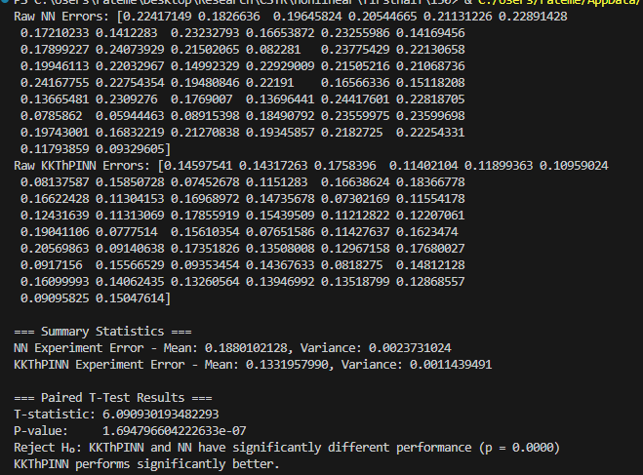
32 nodes – 150 sample points – first half - experiment

Slide 6
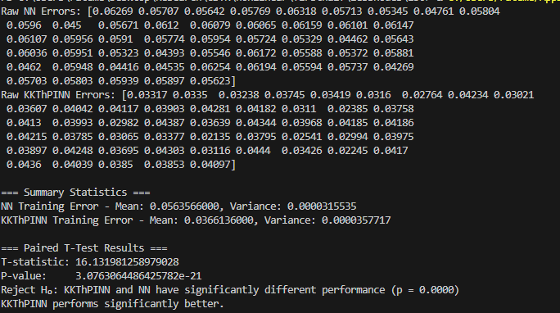
16 nodes – 150 sample points – first half - training

Slide 7
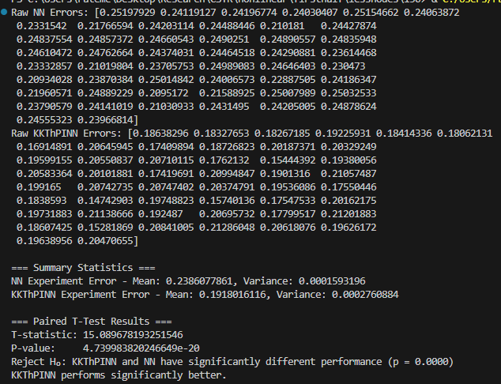
16 nodes – 150 sample points – first half - experiment

