Slide 1
Research Progress Update
Fateme Mohammad Mohammadi, Chemical Engineering

Slide 2
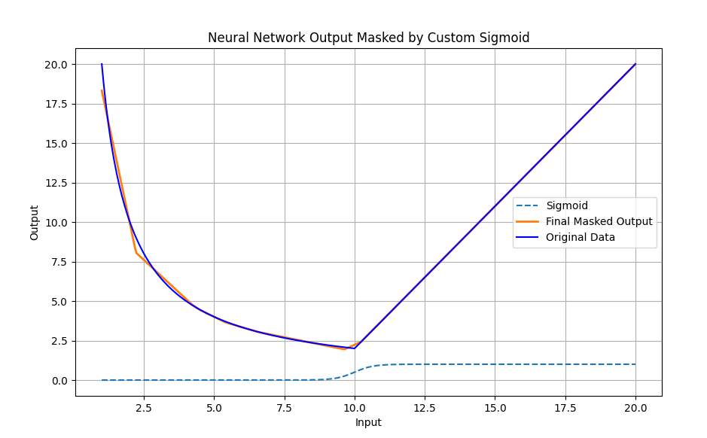

Slide 3
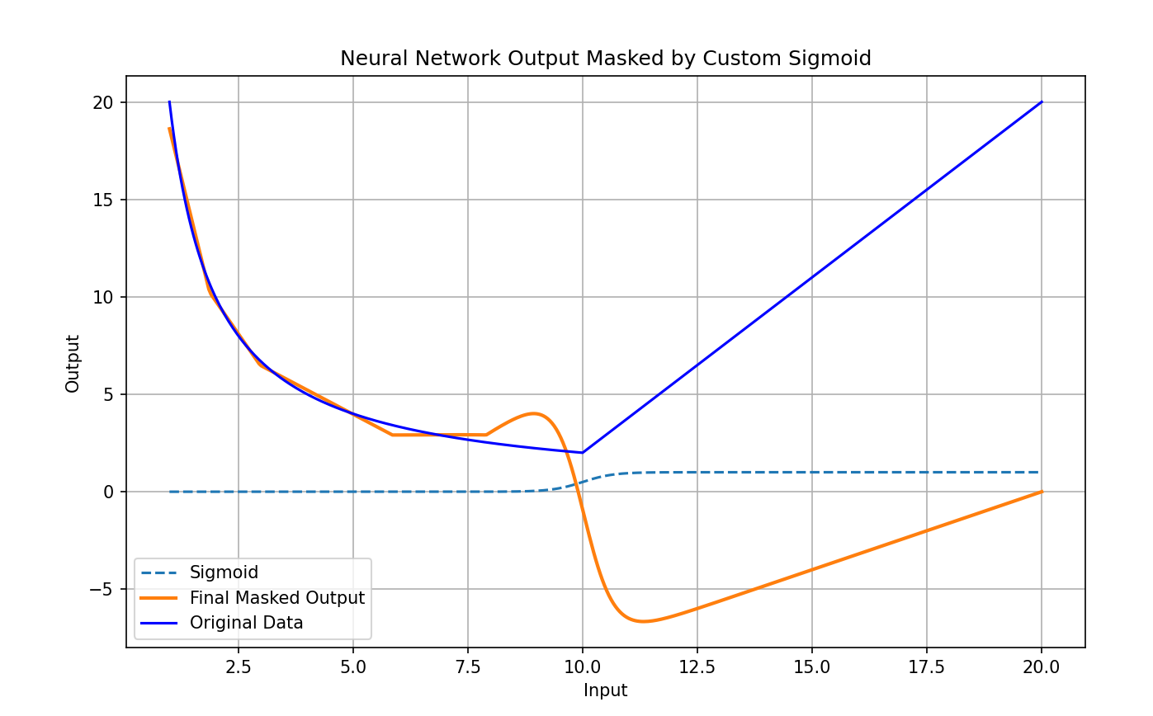

Slide 4
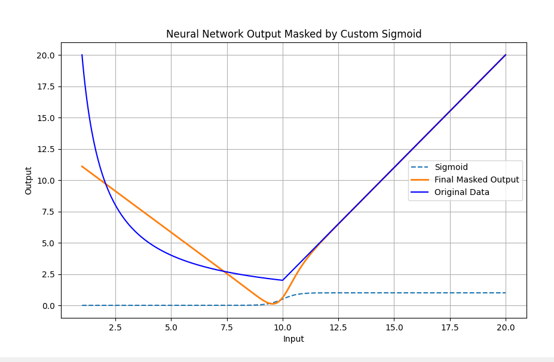

Slide 5
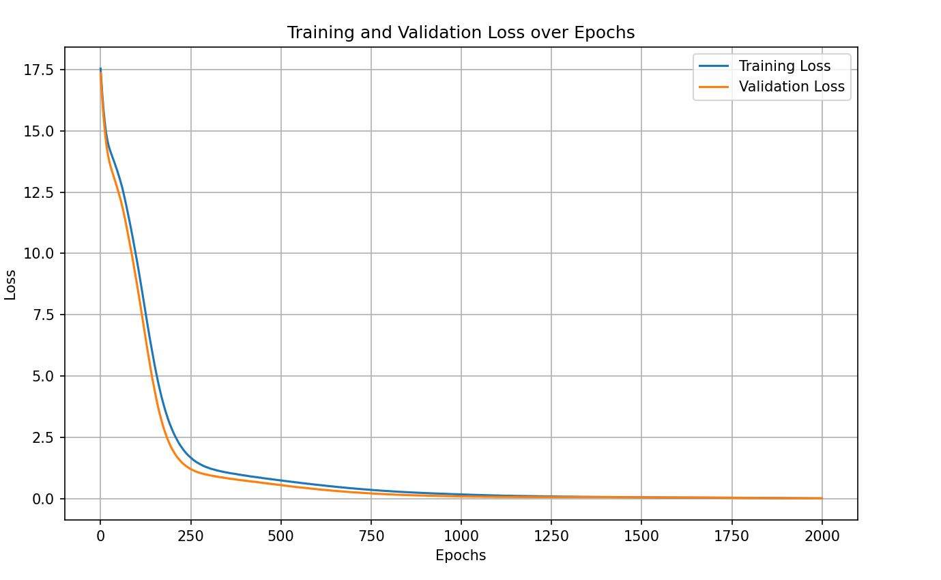

Slide 6
