Slide 1
Research Progress Update
Fateme Mohammad Mohammadi, Chemical Engineering

Slide 2
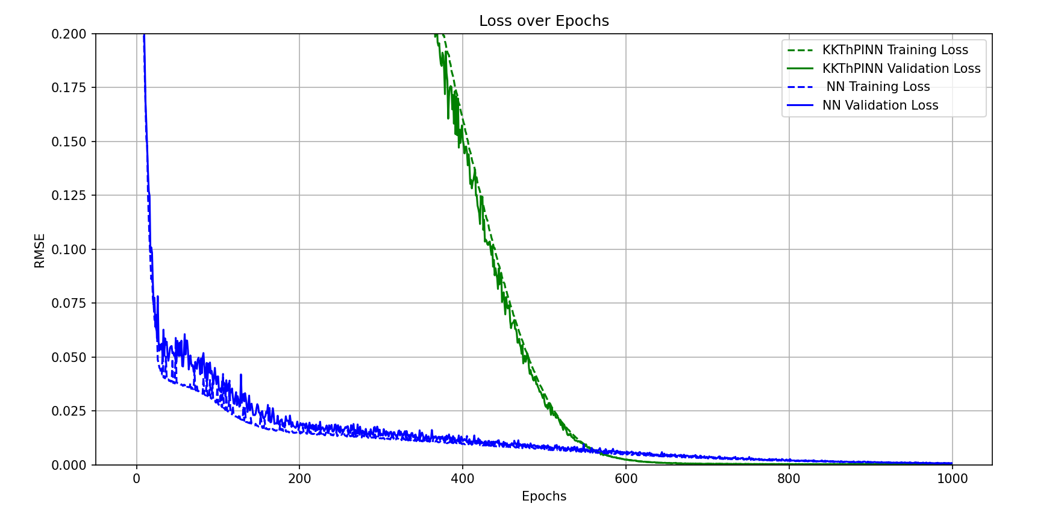
No use of sigmoid, use both linearized constraints for the whole range
Notes:
I defined the two linearized constraints, one was linearizing the first half, the other was linearizing the second half. Although I used them without specifying the ranges they are related to. Supposedly, they are two different constraints that are active for the whole range.
Interestingly, what I observed was a good model performance for KKT.

Slide 3
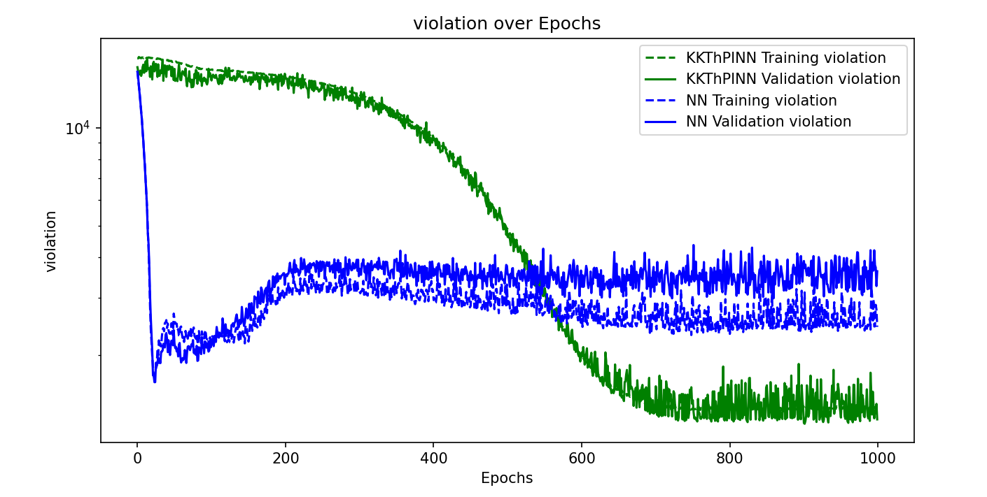
No use of sigmoid, use both linearized constraints for the whole range
Notes:
High violation of constraints: I think it’s because in each range we want to enforce two constraints, however the loss function tries to minimize the loss with respect to the original data, so the loss would be very small.
So, no guarantee of enforcing constraints anymore! It results in the optimal prediction, however it questions the guarantee of KKT method.

Slide 4
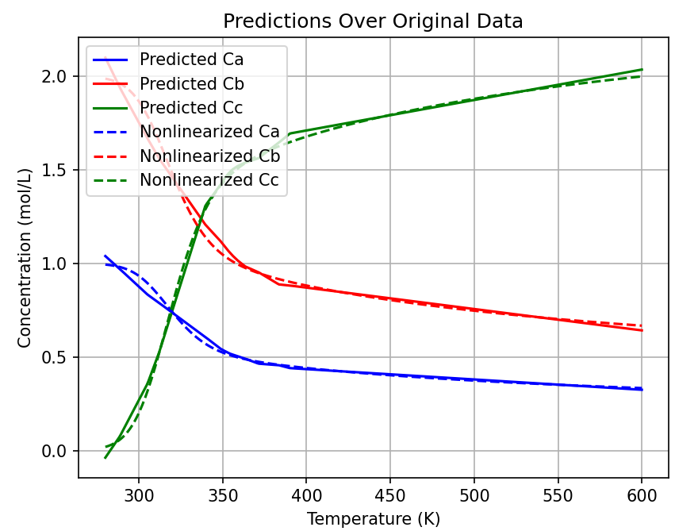
No use of sigmoid, use both linearized constraints for the whole range

Slide 5
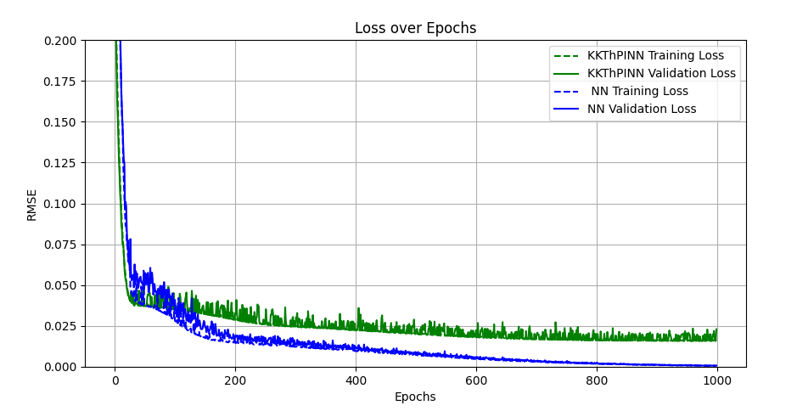
No use of sigmoid, use second half linearized constraint
Notes:
This time, instead of two, I just used one of the constraints, the second one. Again, assuming it could be active for the whole range!
We clearly observe that the MSE increases. However, the violation decreases significantly. My guess is that it’s because the first half is very small with respect to the second half (the x range for the first half is smaller than the second half). Although this constraint is violating the first half, its impact is not that much. (which necessarily it wouldn’t be the case for different case studies, so we have to generalize the linearization approach→ using sigmoid functions to turn on and off the constraints)

Slide 6
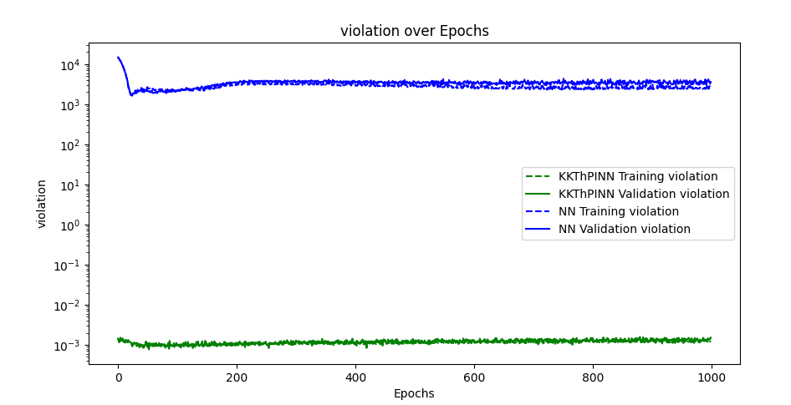
No use of sigmoid, use second half linearized constraint

Slide 7
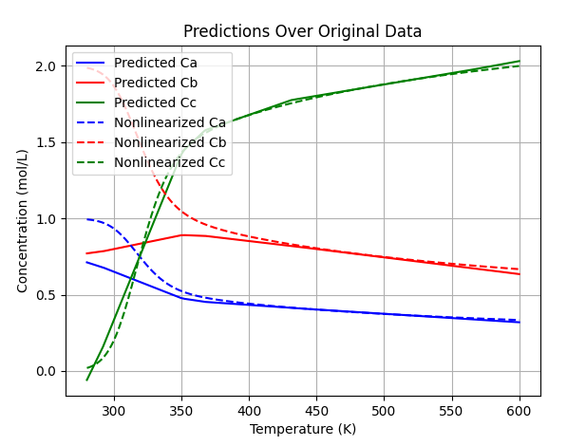
No use of sigmoid, use second half linearized constraint

Slide 8
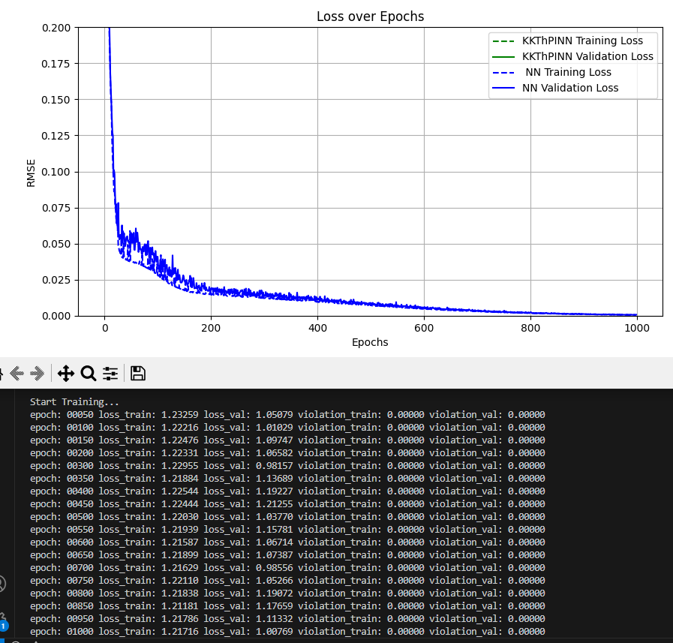
No use of sigmoid, use first half linearized constraint
Notes:
Doing the same, this time, I just used one of the constraints, the first one. Again, assuming it could be active for the whole range!
We observe that the KKT error is very high, out of the shown bounds. We can see the order of magnitude in the screenshot of each epoch.

Slide 9
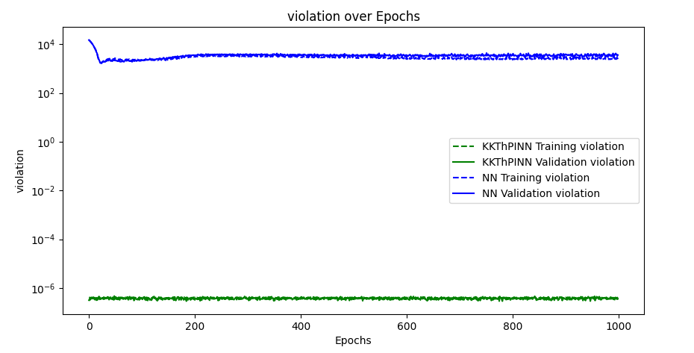
No use of sigmoid, use first half linearized constraint
Notes:
Here, I don’t have any justification in my mind for this low violation!

Slide 10
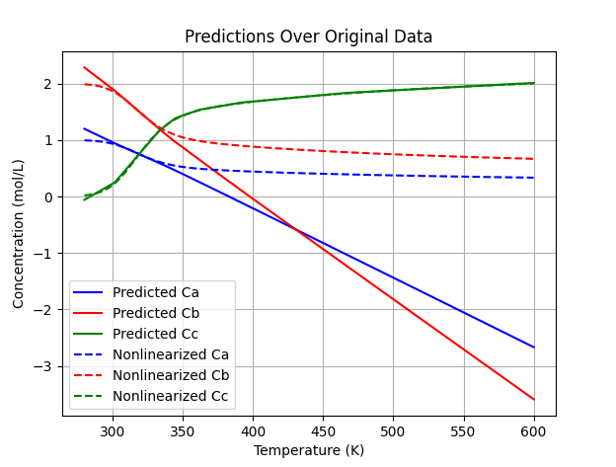
No use of sigmoid, use first half linearized constraint

Slide 11
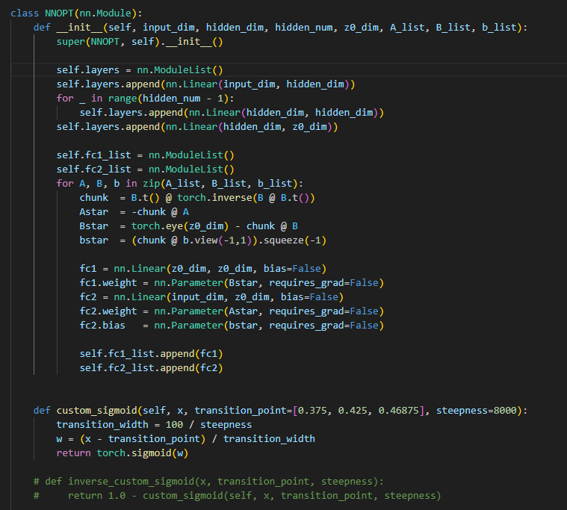
Architecture of the model

Slide 12
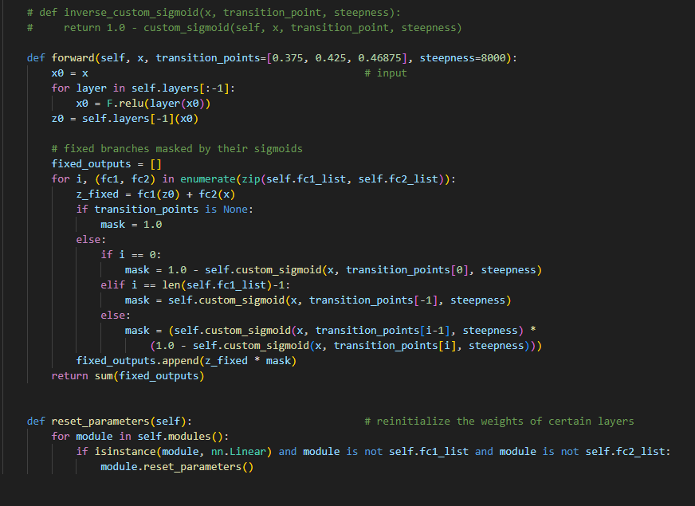
Architecture of the model

Slide 13
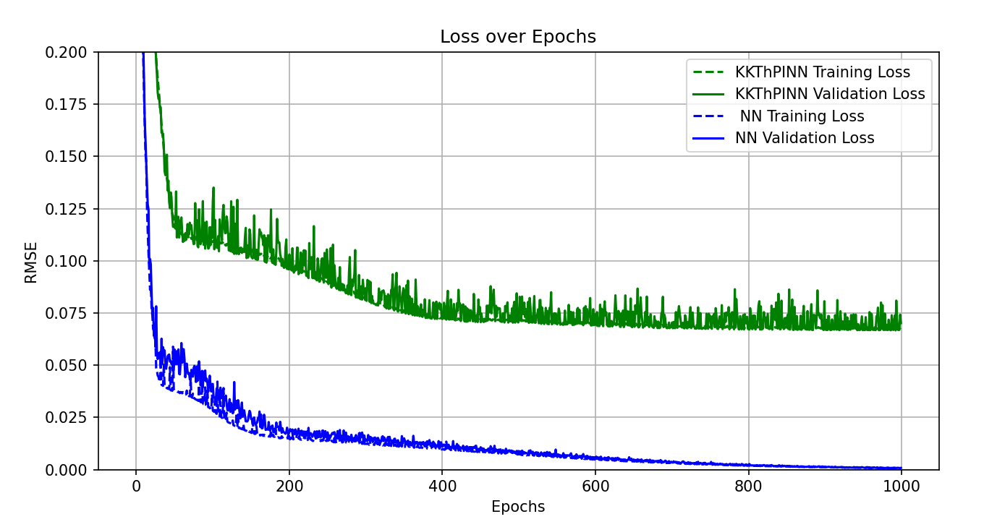
Use of sigmoid, use second half linearized constraint
Notes:
To start to generalize the linearization approach, I started with only one constraint.

Slide 14
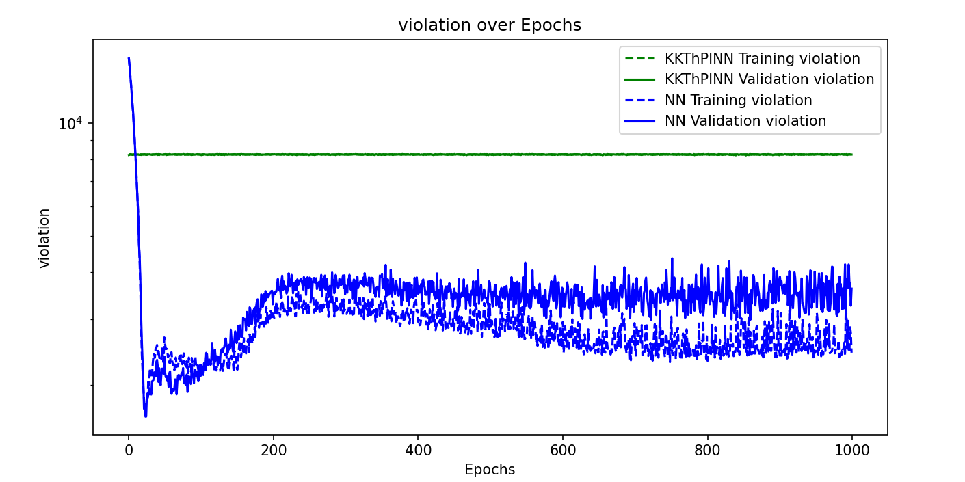
Use of sigmoid, use second half linearized constraint

Slide 15
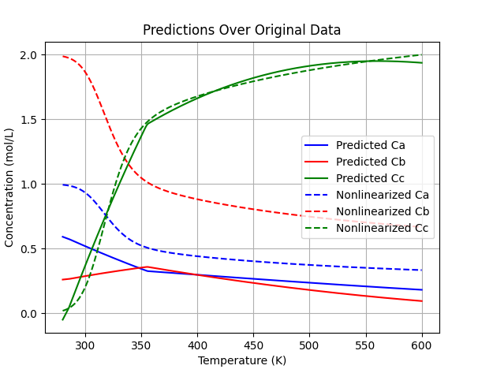
Use of sigmoid, use second half linearized constraint
Notes:
As only one sigmoid is applied (we only have one constraint), which is the inverse sigmoid for the first part, so the effect of second linearized constrain for second half is destroyed! Actually, if we defined the architecture of sigmoid functions in another way, it could work here for the second half. I will try this later. As of now, the architecture is responding to at least two constraint or above. (it’s good to found a bug here ☺)

Slide 16
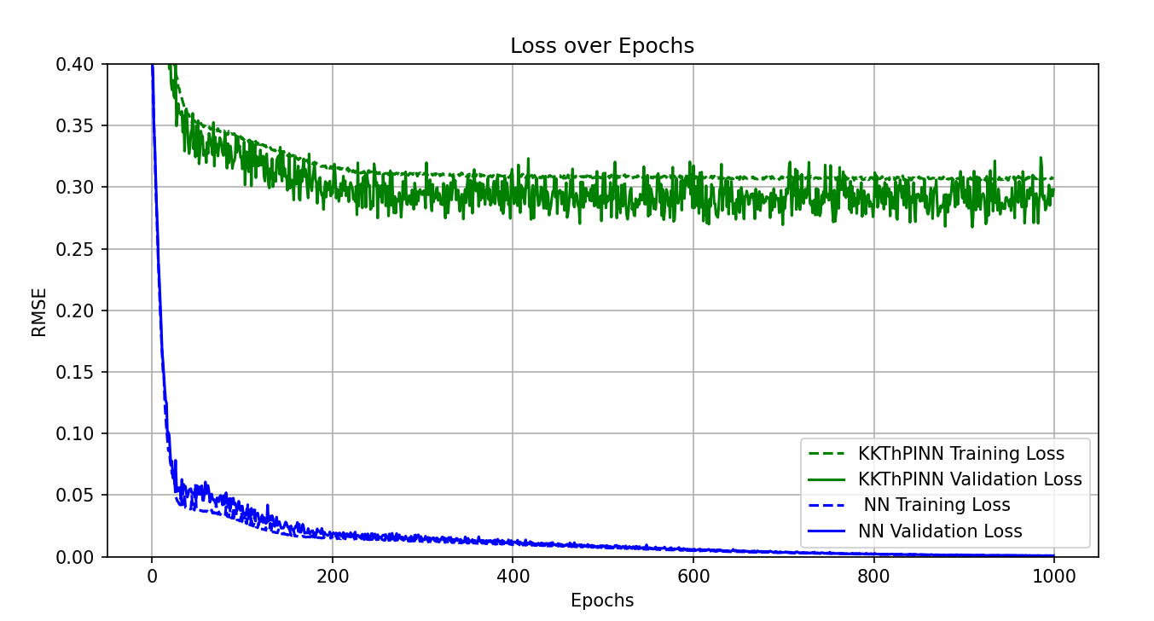
Use of sigmoid, use first half linearized constraint
Notes:
Same idea to use only one constraint. This time, the first half linearized constraint.

Slide 17
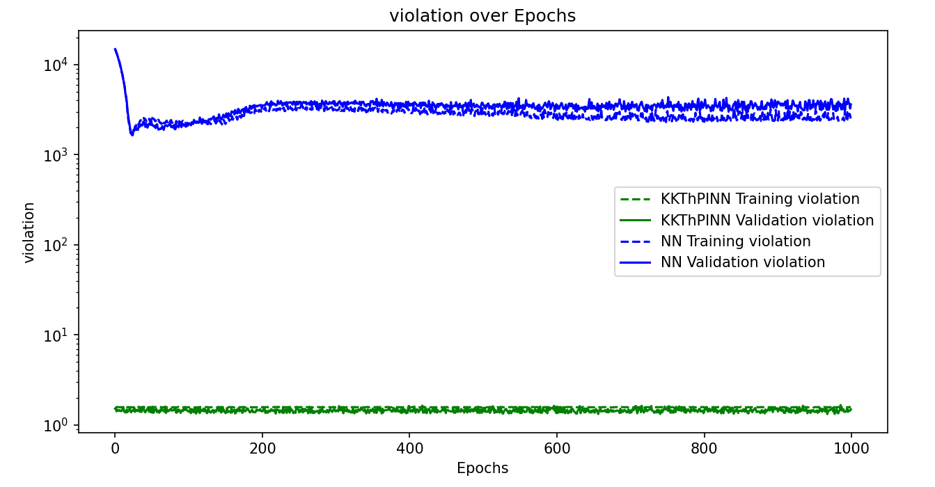
Use of sigmoid, use first half linearized constraint

Slide 18
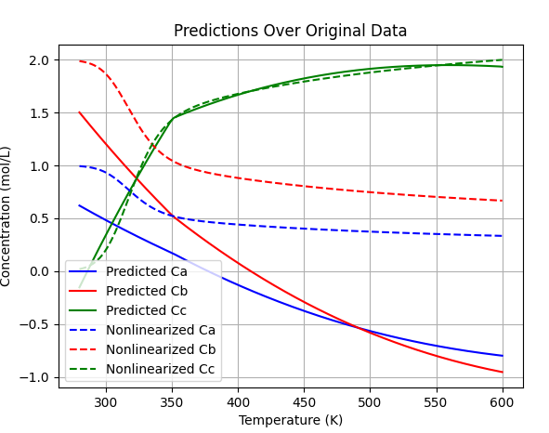
Use of sigmoid, use first half linearized constraint
Notes:
This result is strange! I didn’t expect that! I expected to see constraint enforcing for the first half, as we have the inverse sigmoid function for first half and the constraint is linearized for the first half.

Slide 19
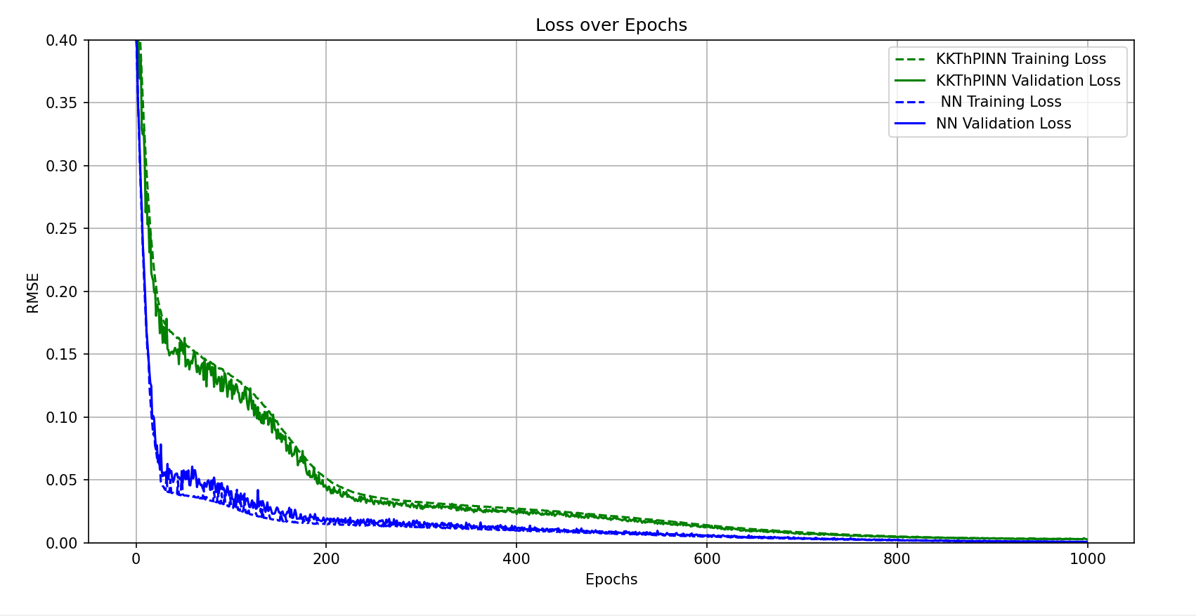
Use of sigmoid, use both linearized constraints, steepness=300
Notes:
Now, it’s time to use both linearized constraints, activating each for the related range.

Slide 20
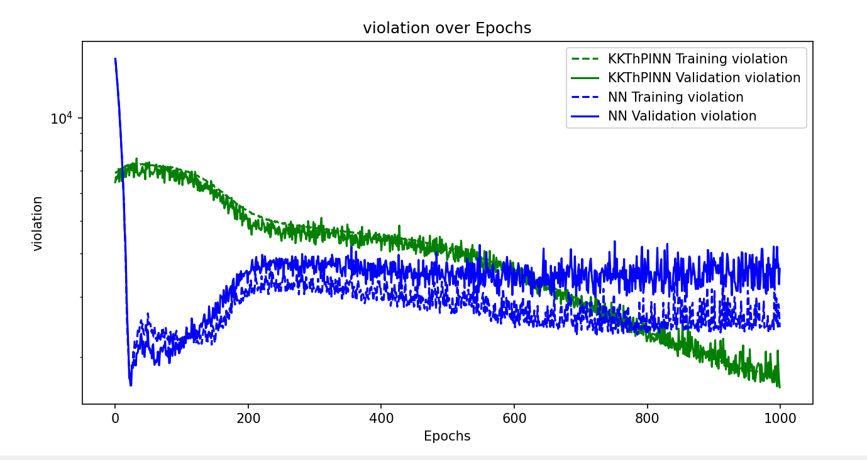
Use of sigmoid, use both linearized constraints, steepness=300

Slide 21
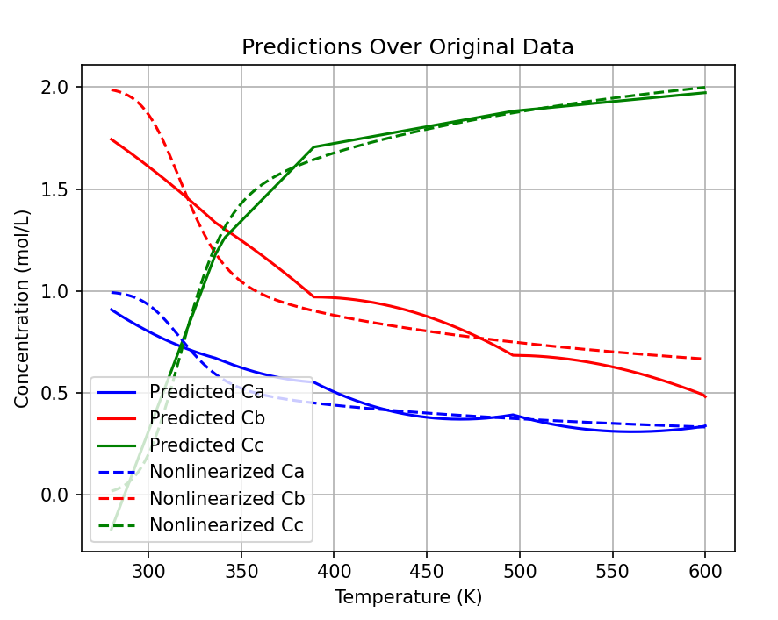
Use of sigmoid, use both linearized constraints, steepness=300
Notes:
As we see, the transition points are very sharp, and the model failed to predict the original data.

Slide 22
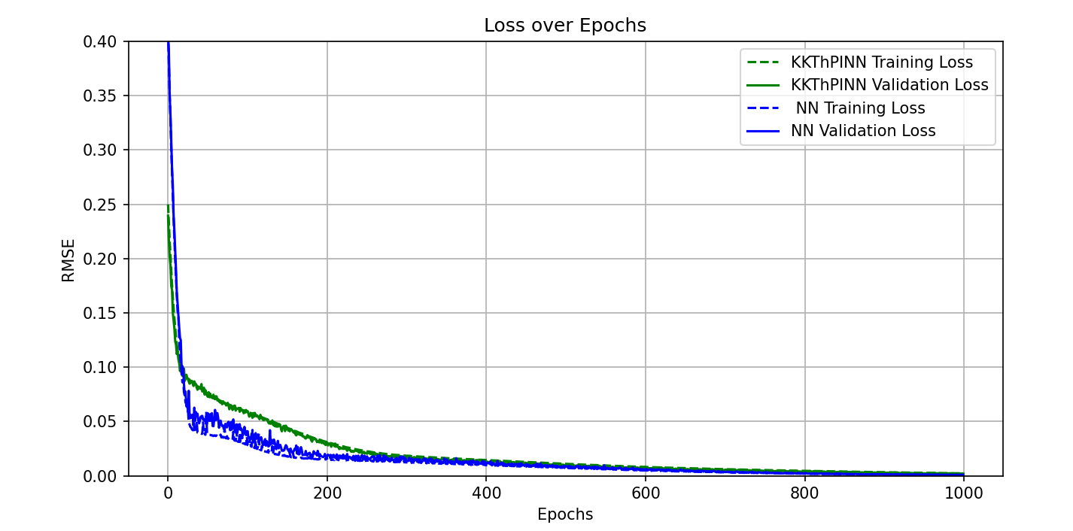
Use of sigmoid, use both linearized constraints, higher steepness
Notes:
By increasing the steepness of sigmoid functions, the error has decreased.

Slide 23
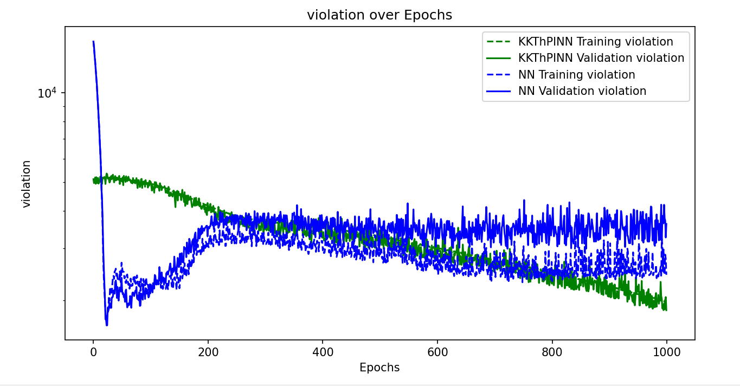
Use of sigmoid, use both linearized constraints, higher steepness

Slide 24
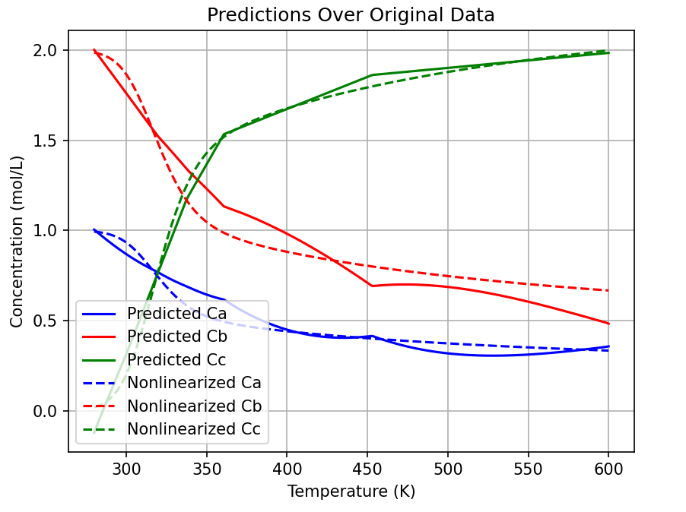
Use of sigmoid, use both linearized constraints, higher steepness

Slide 25
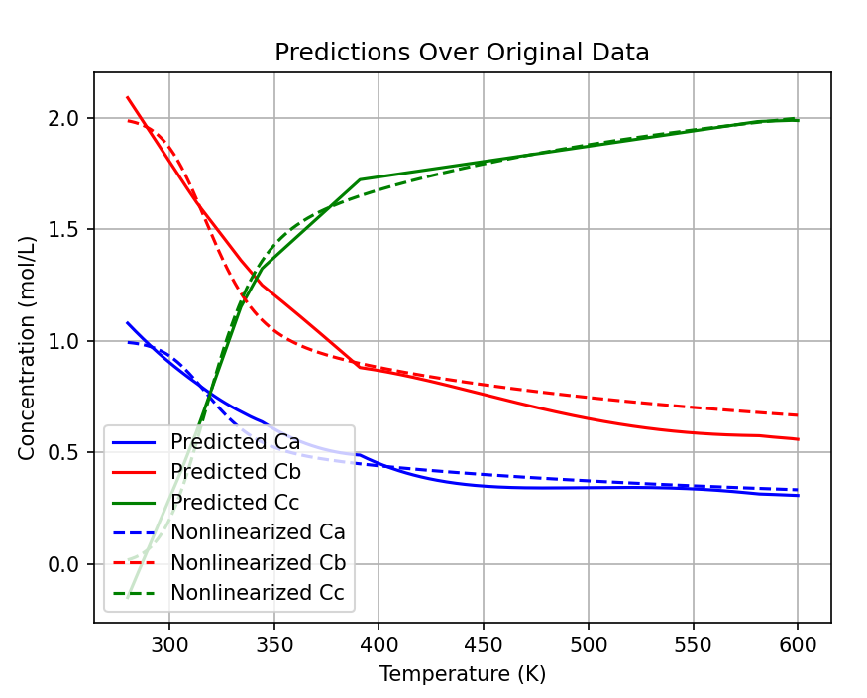
Steepness= 1000

Slide 26
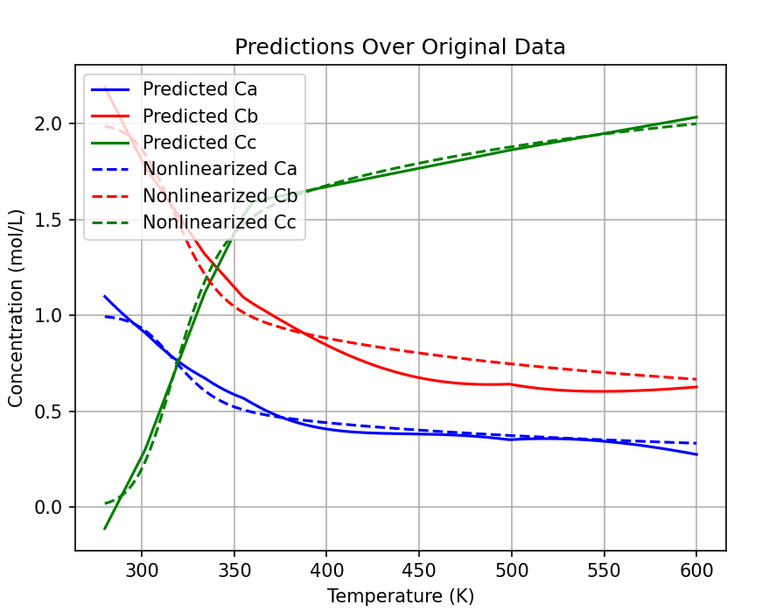
Steepness= 3000

Slide 27
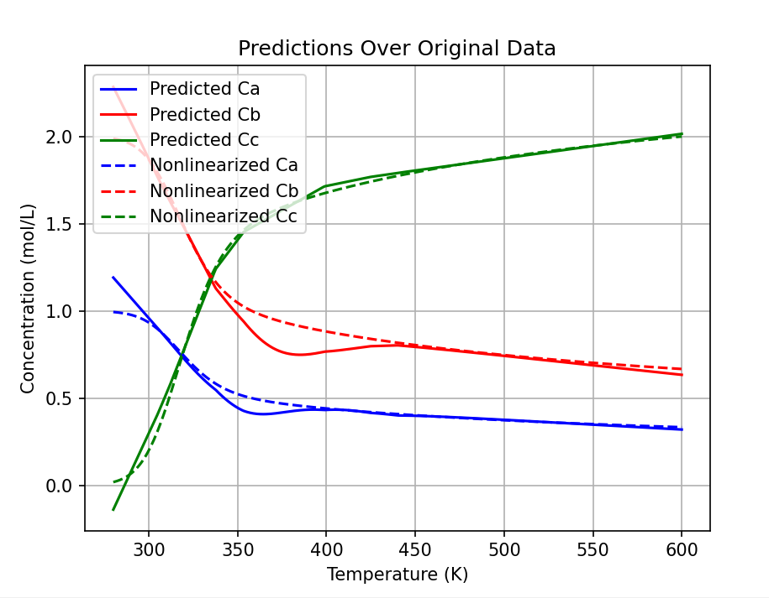
Steepness= 5000
Notes:
As we see, we have two major issues now. One for the beginning of the curve, the other in the transition area. To solve the first issue, I came up with the idea to add one more line that is fitted on the staring range, which is curve shape. It means that one line is not able to describe the whole range of 280 to 360. so, we broke it into two ranges, 280 to 300 and 300 to 360.

Slide 28
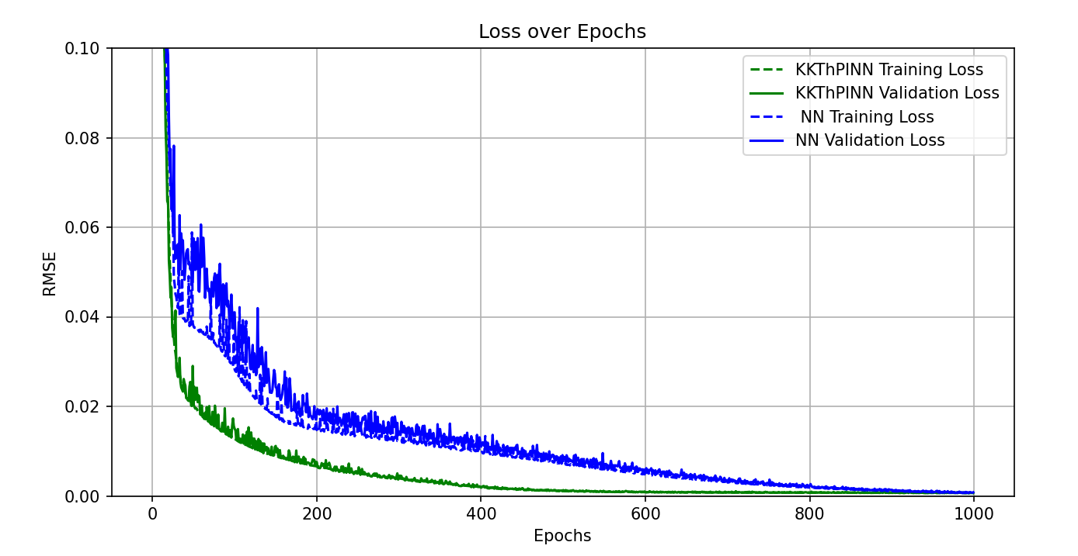
Steepness= 8000 – 3 lines

Slide 29
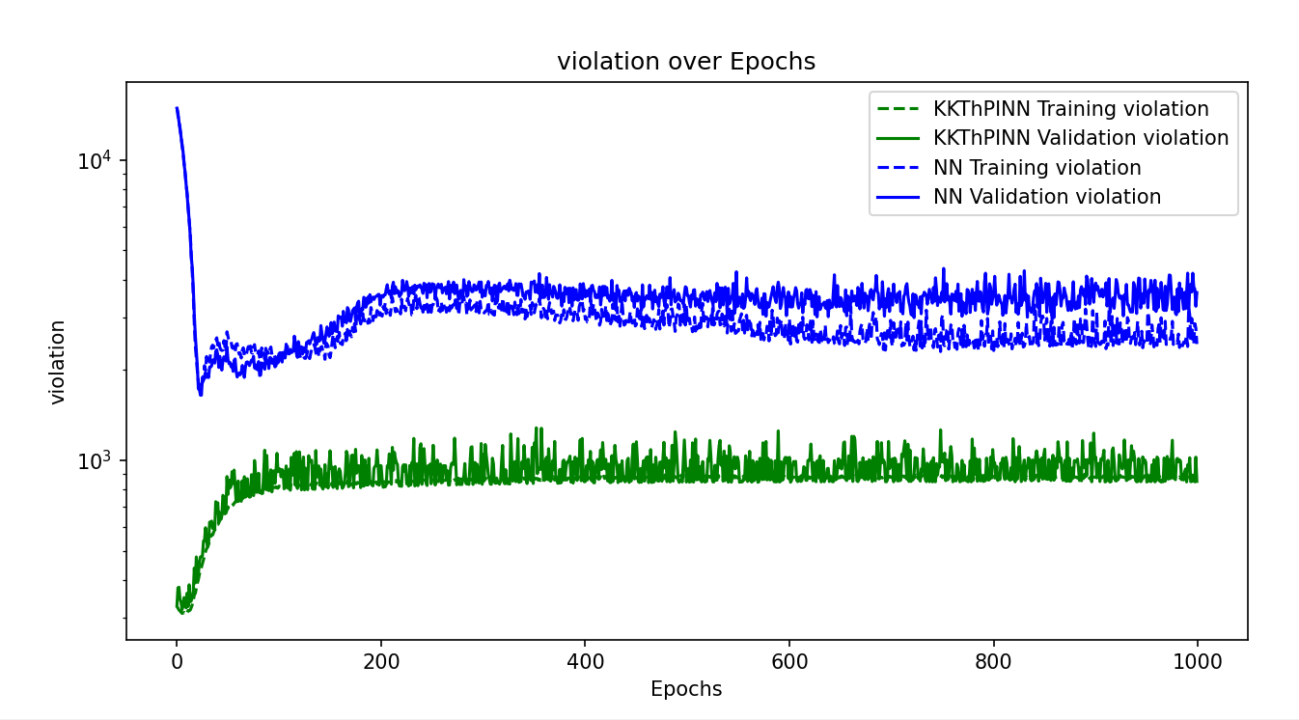
Steepness= 8000 – 3 lines

Slide 30
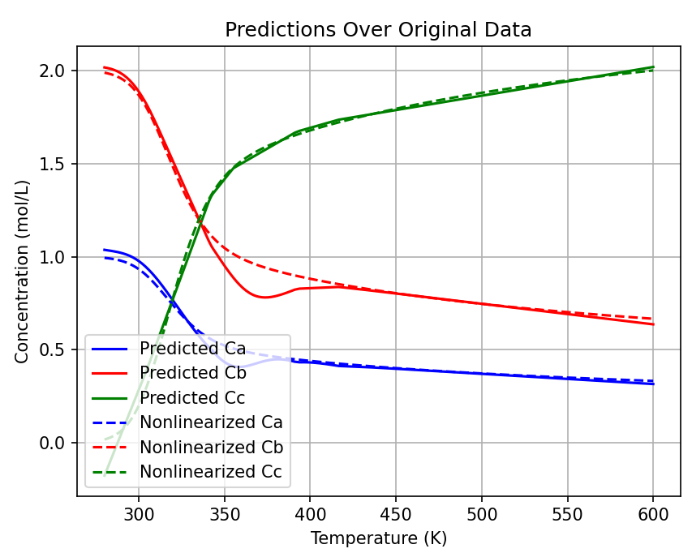
Steepness= 8000 – 3 lines
Notes:
To fix the transition area, I’m going to add one more line. So, we will have four lines describing this whole curve. (280 to 300, 300 to 340, 340 to 375, 375 to 600).

Slide 31
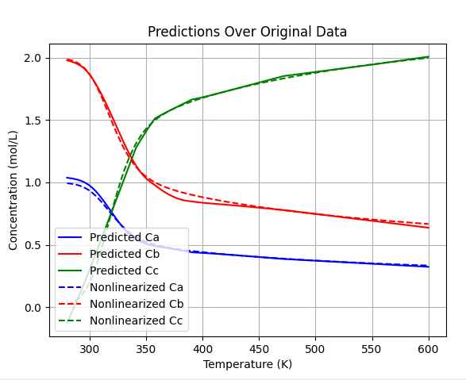
Steepness= 8000 – 4 lines
Notes:
Now, we see that the result is promising.
At this point we can return the steepness to lower levels, to check if it is still working or not. I will try this later.

Slide 32
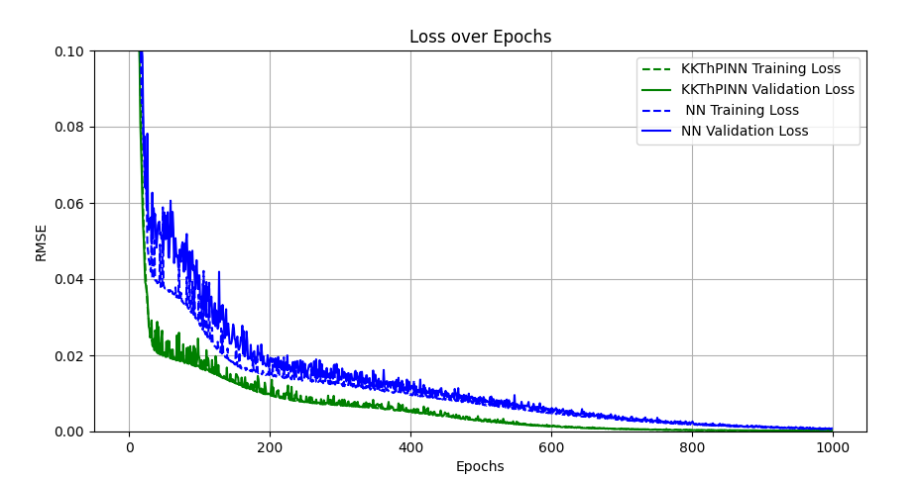
Steepness= 8000 – 4 lines

Slide 33
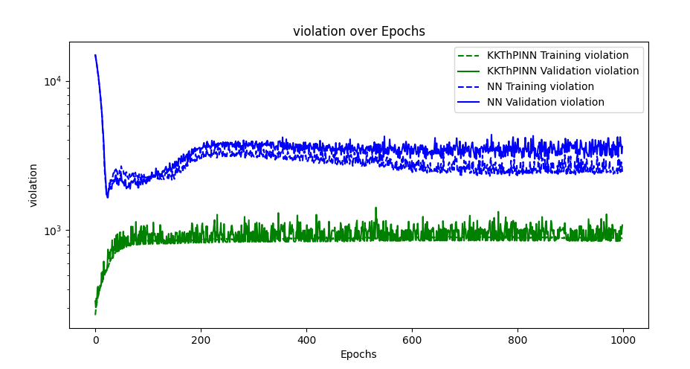
Steepness= 8000 – 4 lines

Slide 34
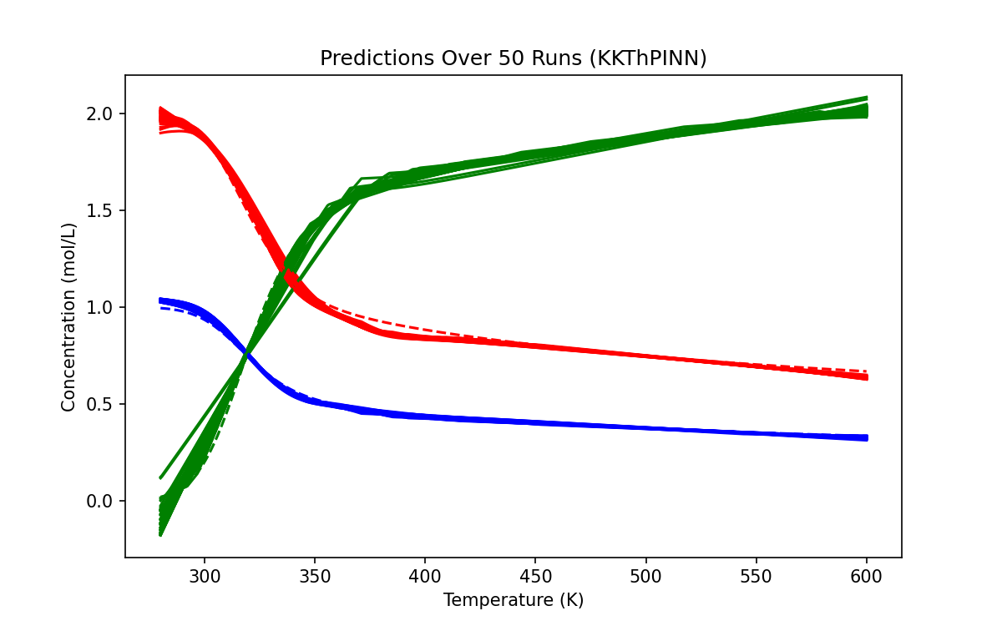
KKT – sample points = 500
Notes:
Now, it’s time to compare NN and KKT performance.
I ran this on my computer and it took two hours to give the results. However, I ran it again on the cpu of server, and it took half an hour. Later, I will try to run them on GPU, and test that as well. Thank you for providing the server ☺

Slide 35
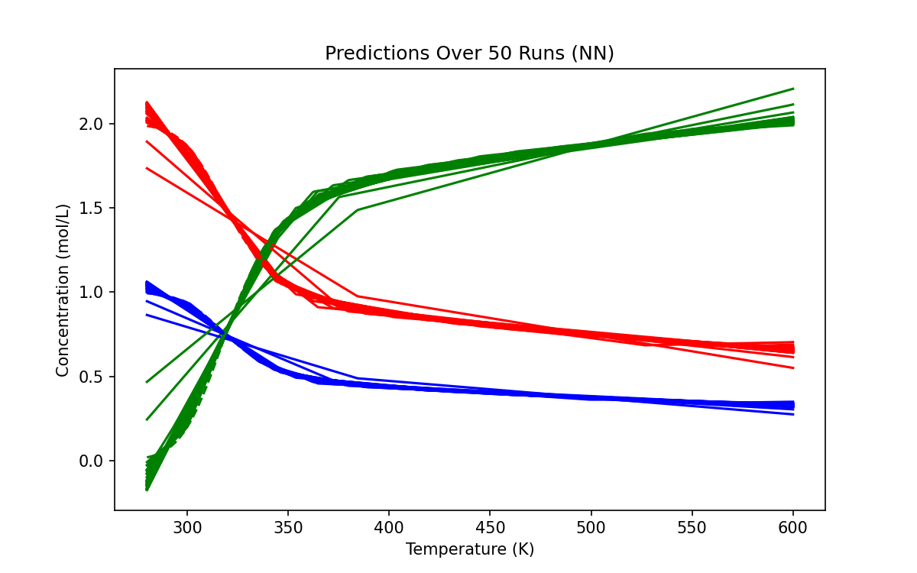
NN - sample points = 500

Slide 36
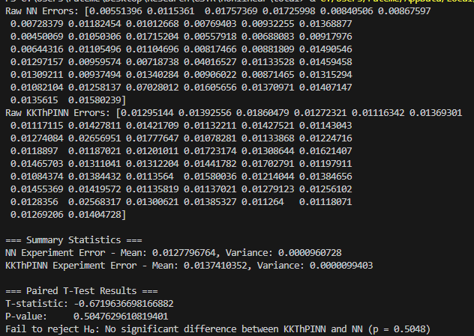
sample points = 500
Notes:
We have to find the optimal number of sample points in which KKT performs better than NN.

Slide 37
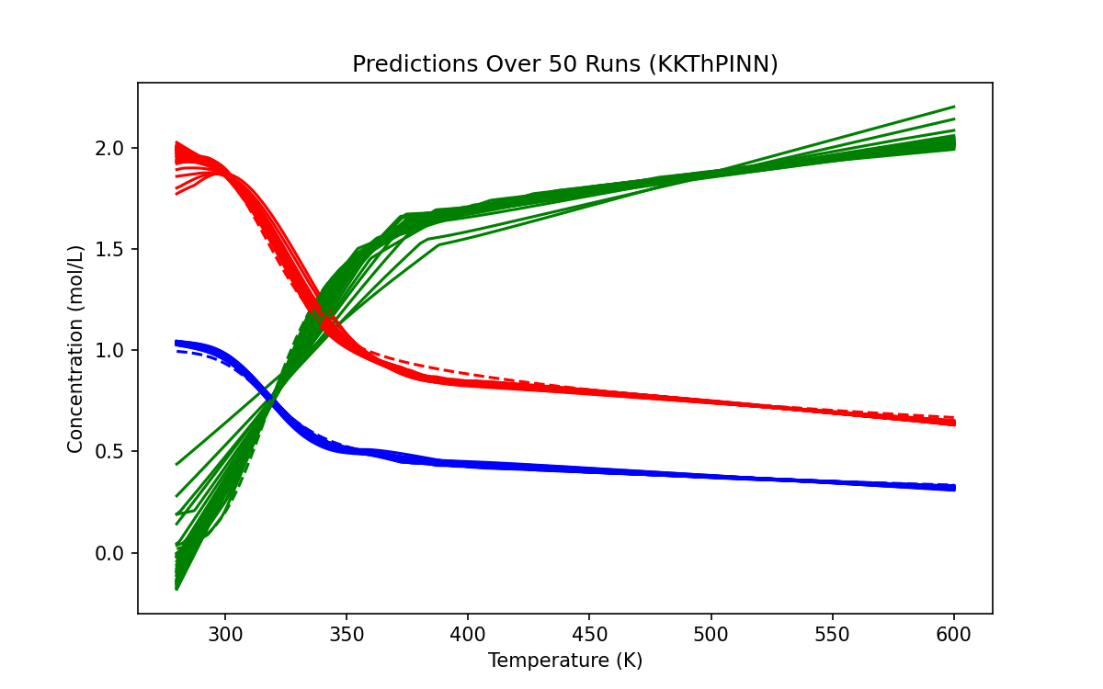
KKT – sample points = 400

Slide 38
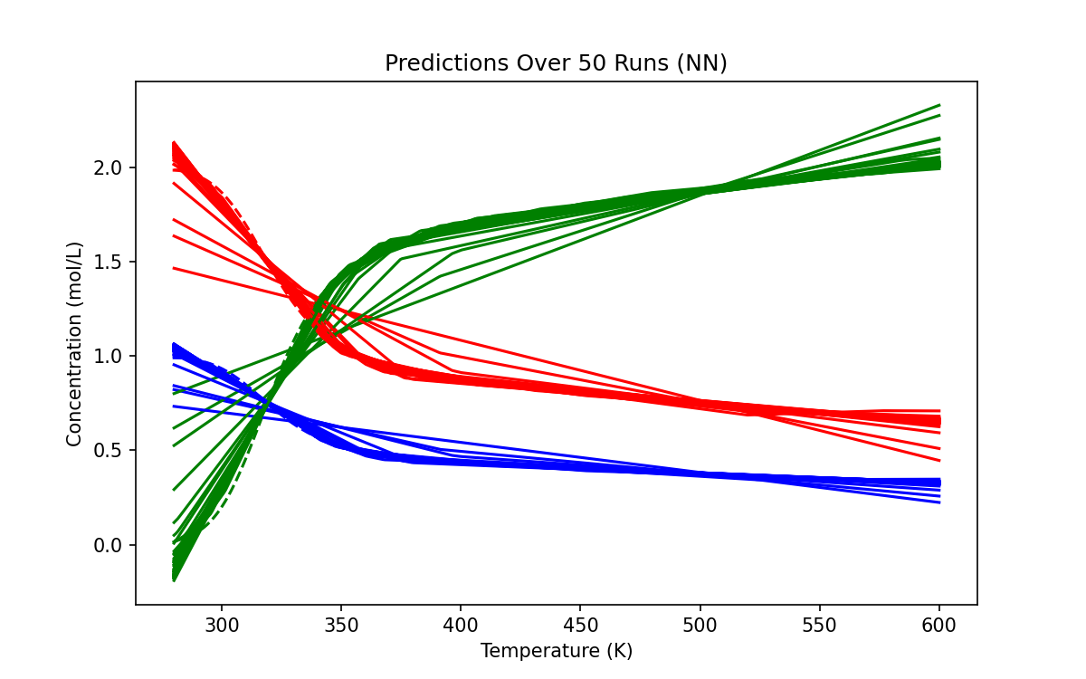
NN - sample points = 400

Slide 39
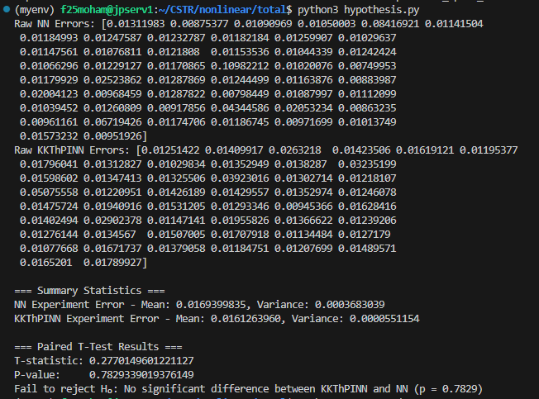
sample points = 400

Slide 40
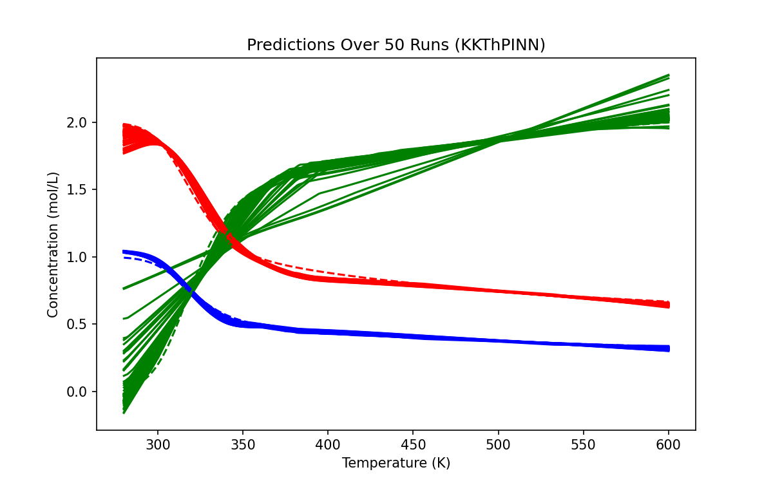
KKT - sample points = 300

Slide 41
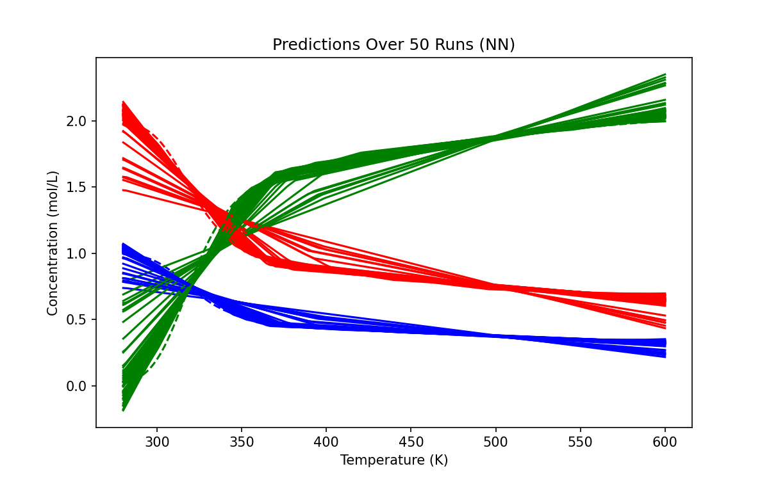
NN - sample points = 300

Slide 42
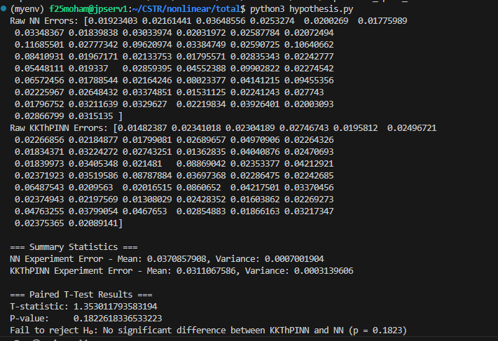
sample points = 300

Slide 43
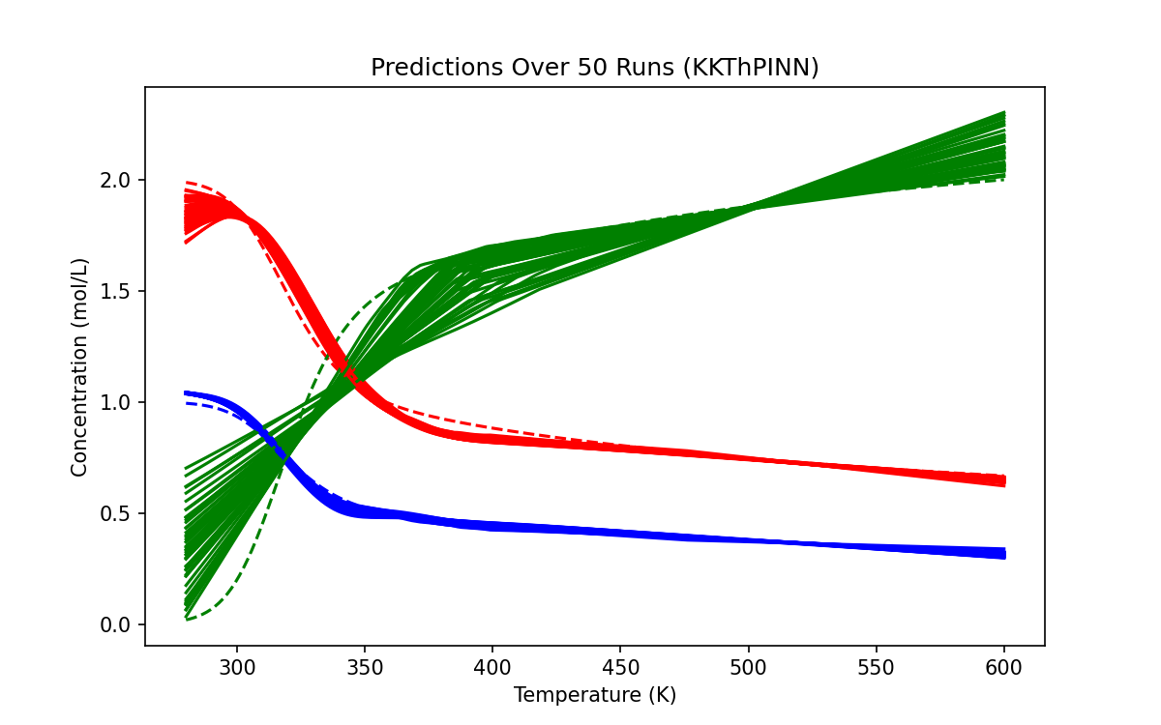
KKT - sample points = 200

Slide 44
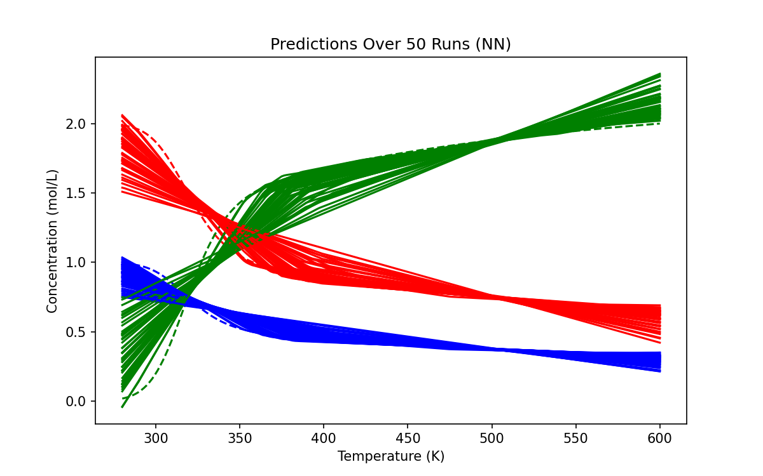
NN - sample points = 200

Slide 45
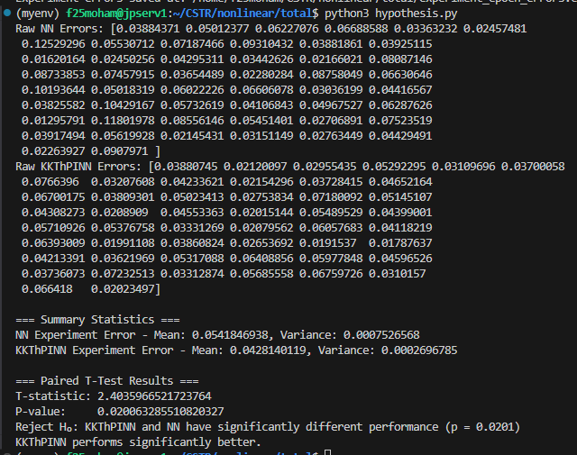
sample points = 200

Slide 46
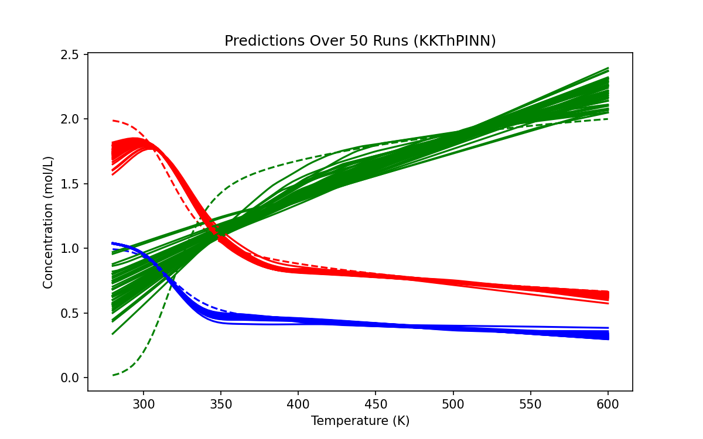
KKT - sample points = 100

Slide 47
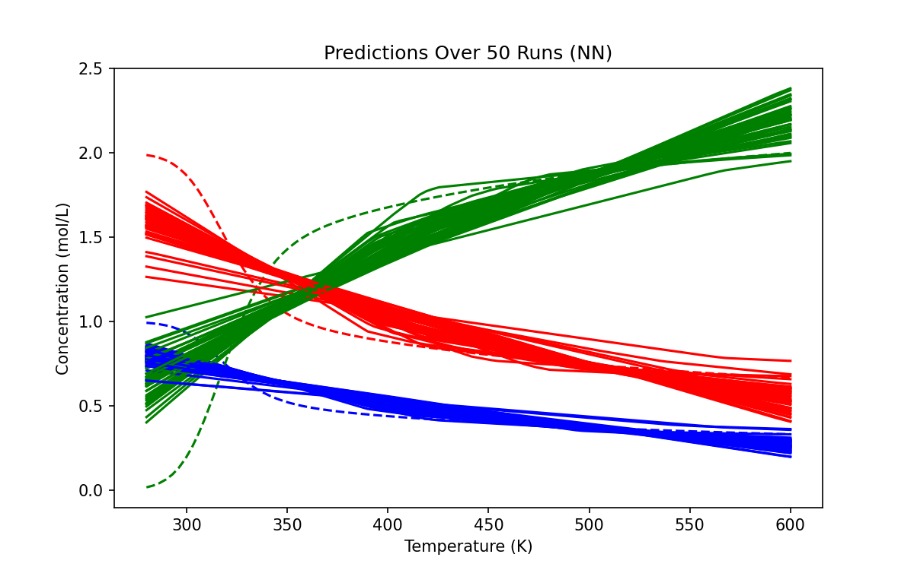
NN - sample points = 100

Slide 48
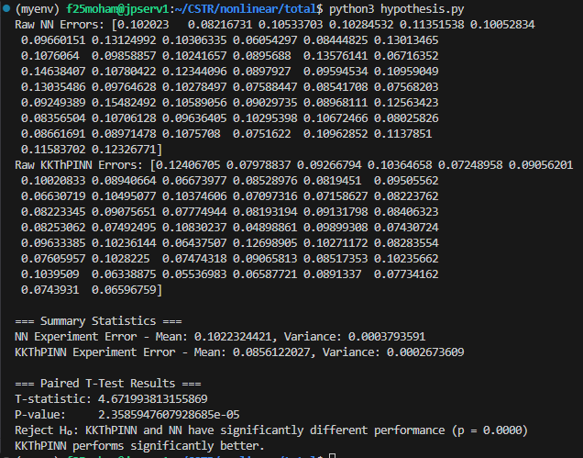
sample points = 100

Slide 49
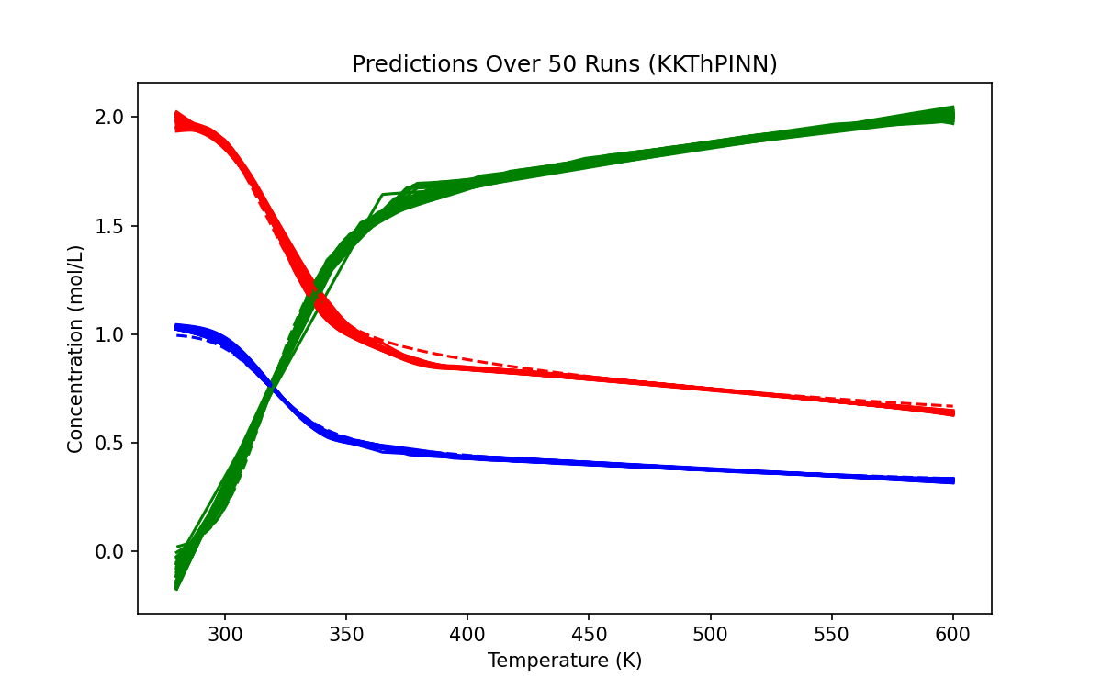
KKT - sample points = 600

Slide 50
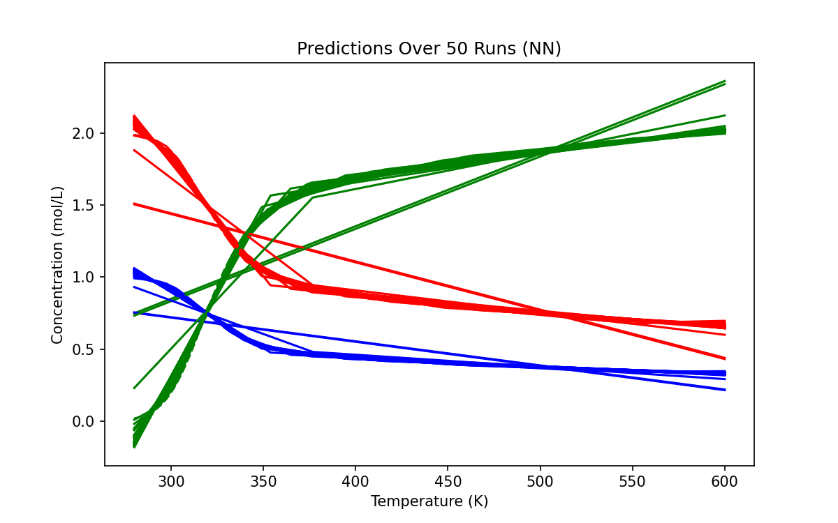
NN - sample points = 600

Slide 51
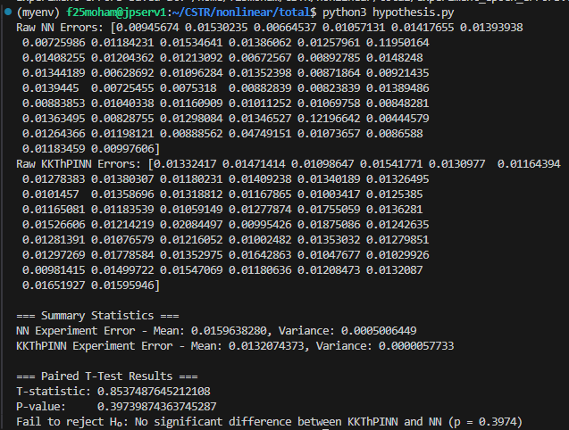
sample points = 600

Slide 52

KKT - sample points = 800

Slide 53

NN - sample points = 800

Slide 54

sample points = 800

Slide 55

Comparison of KKT and NN performance – Error vs n data points

Slide 56

Constraint vs Cb and T

