Slide 1
Research Progress Update
Fateme Mohammad Mohammadi, Chemical Engineering

Slide 2
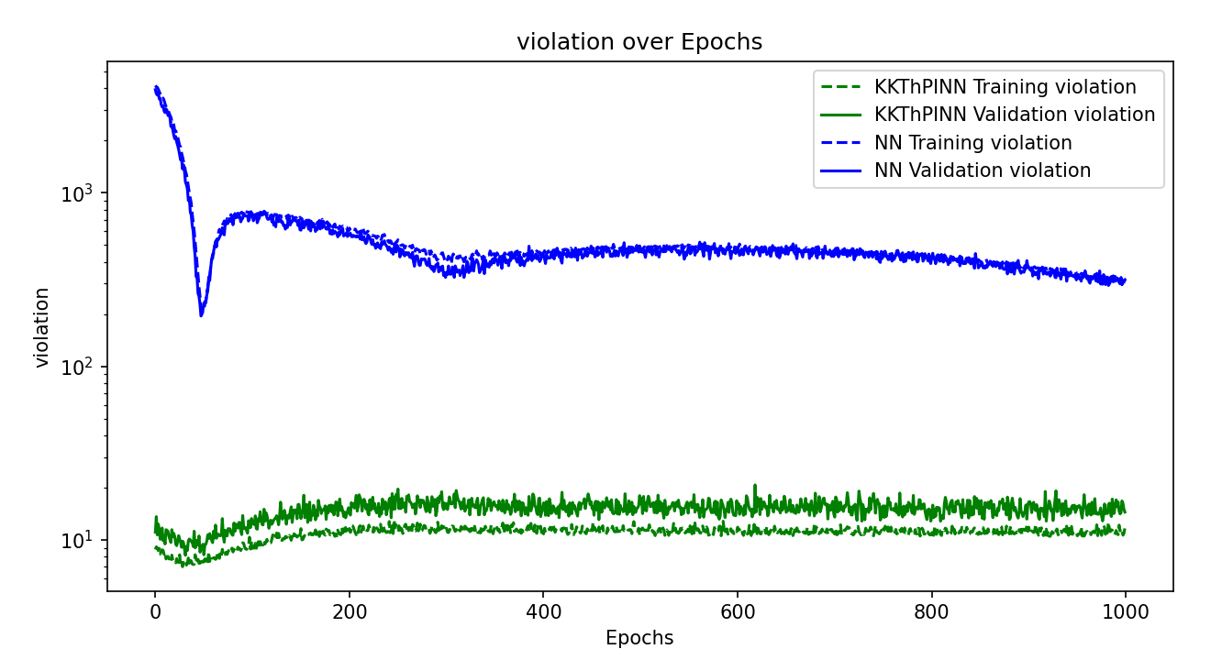
Violation – 200 sample points

Slide 3
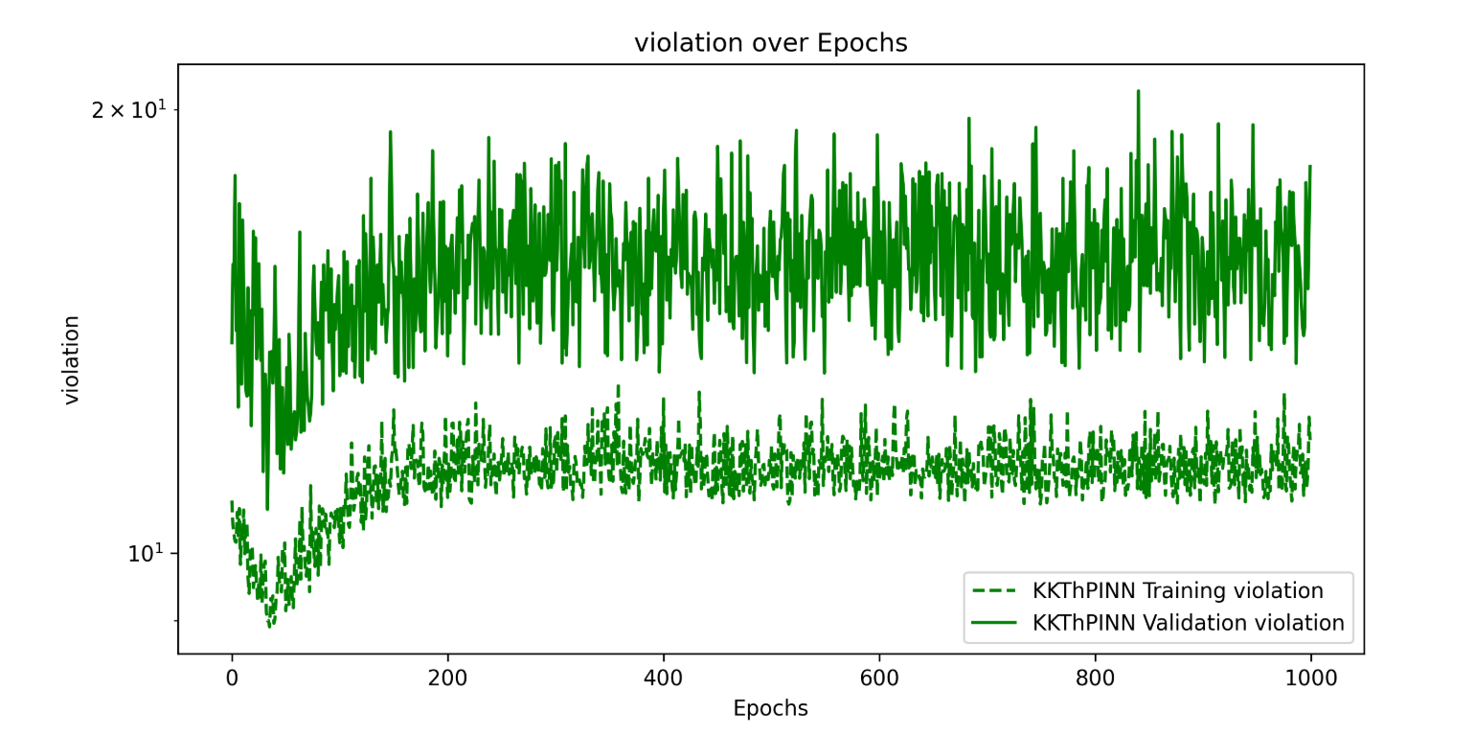

Slide 4
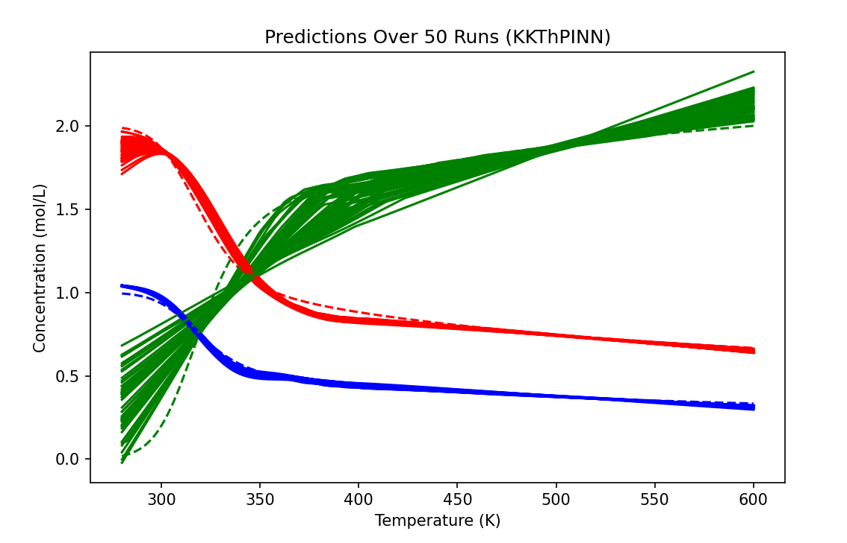

Slide 5
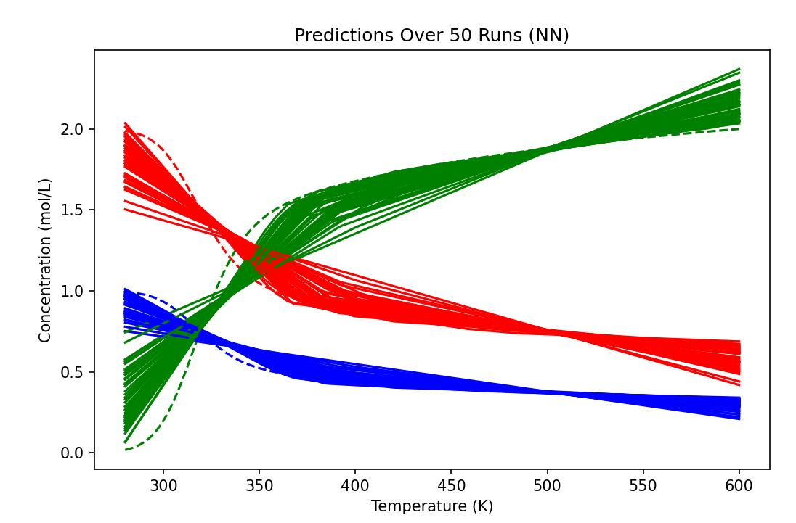

Slide 6
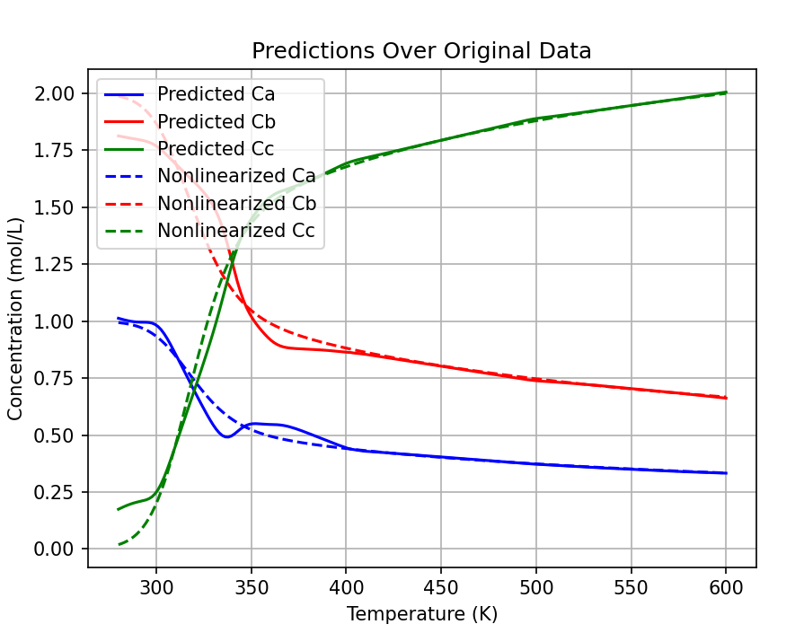
Add total mass balance, steepness=20000

Slide 7
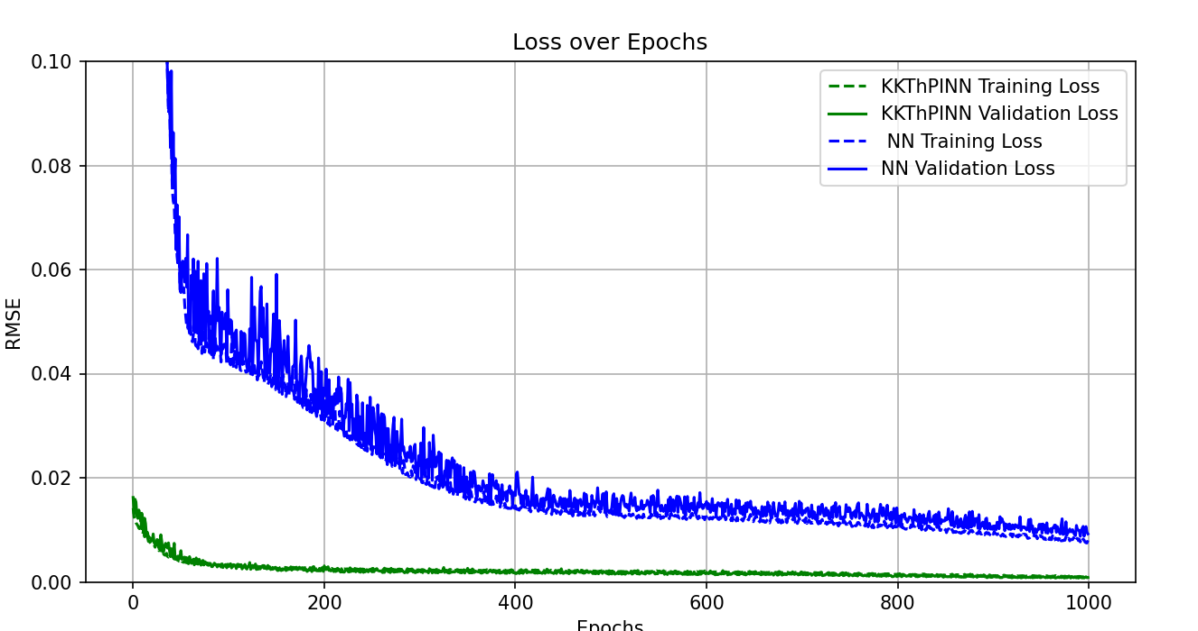
Add total mass balance

Slide 8
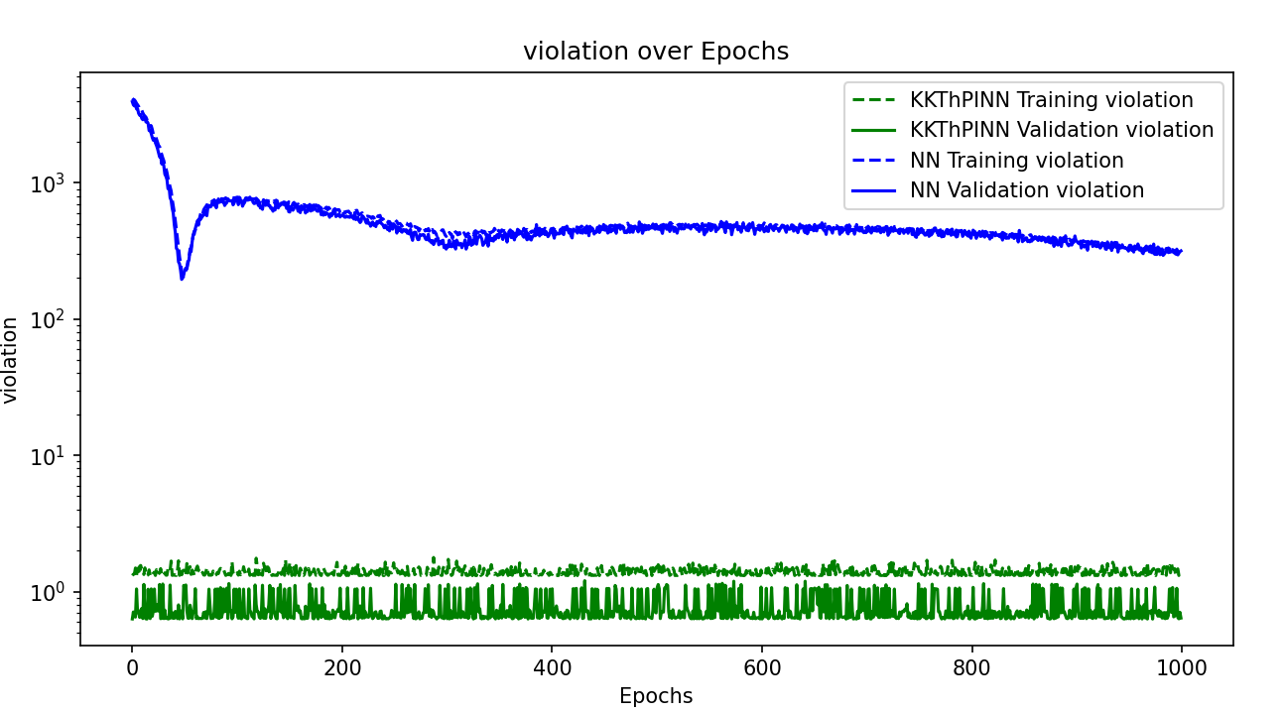
Add total mass balance

Slide 9
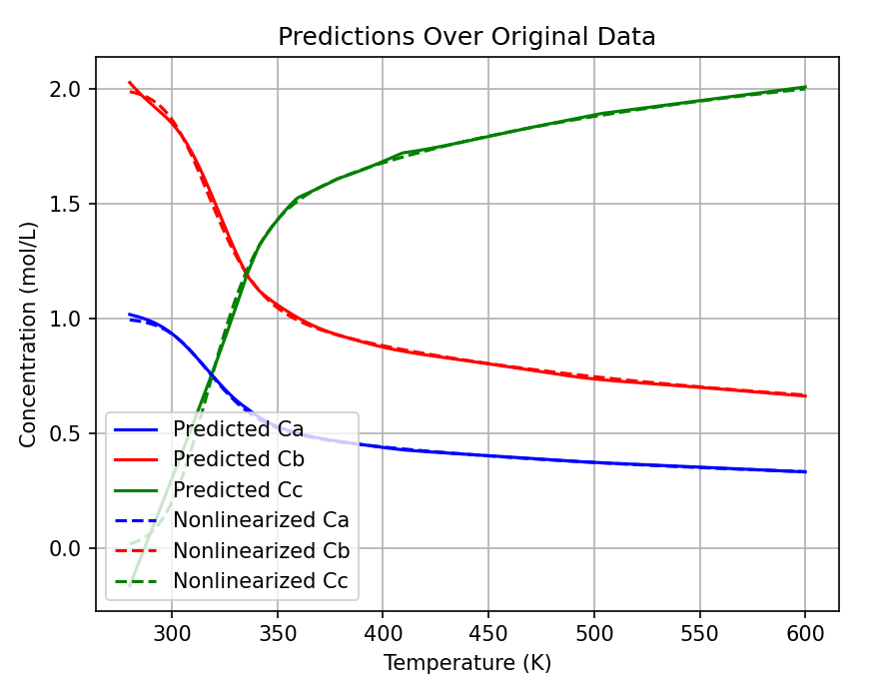
Steepness = 8000, KKT

Slide 10
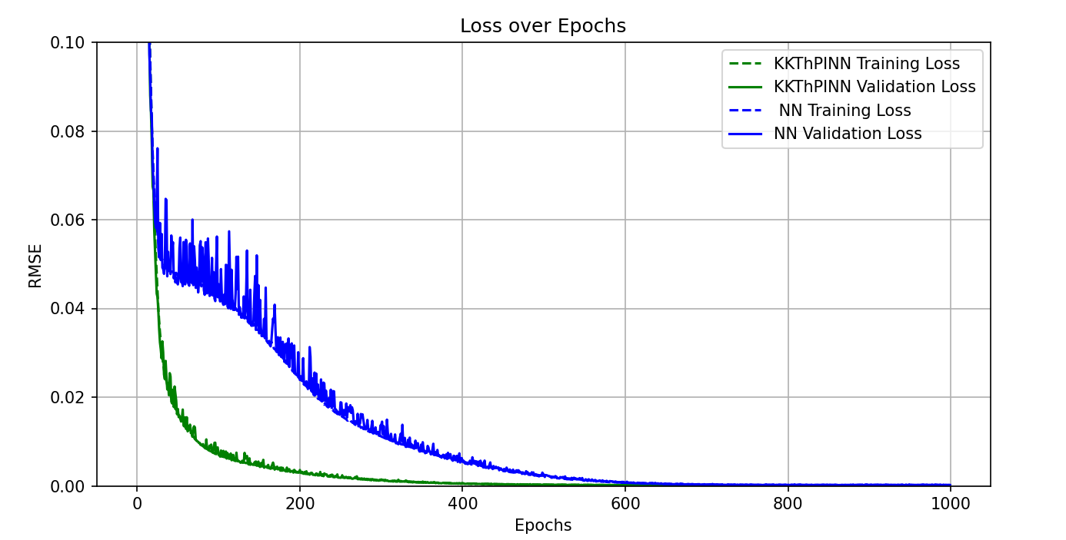
Steepness = 8000

Slide 11
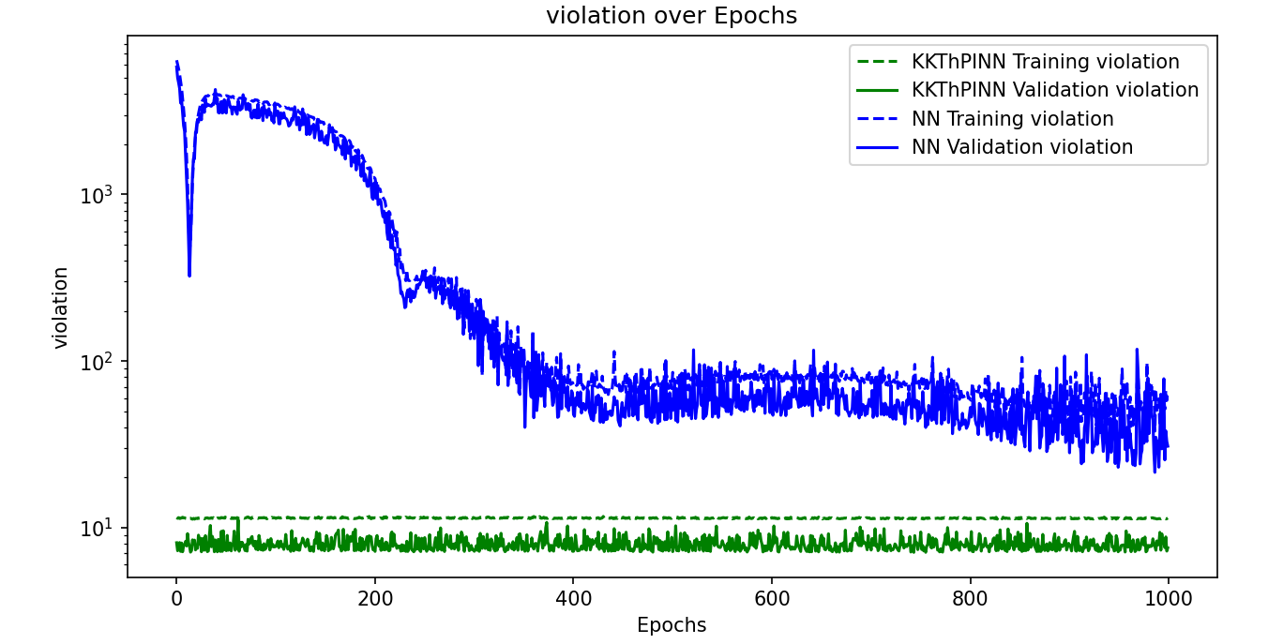
Steepness = 8000

Slide 12
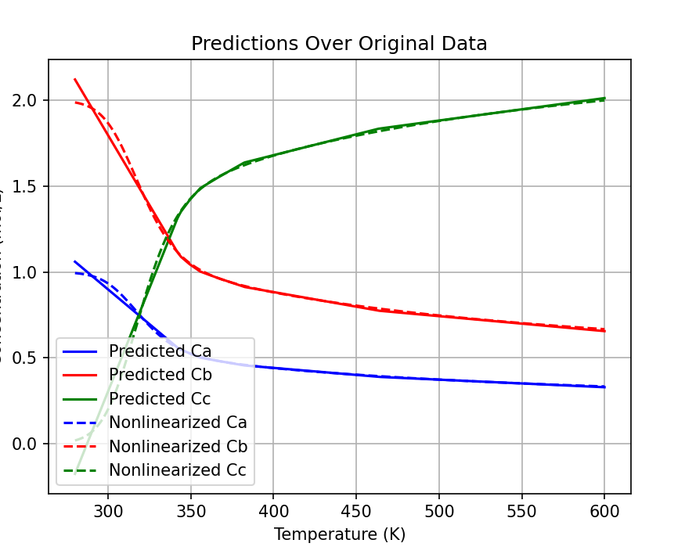
NN

Slide 13
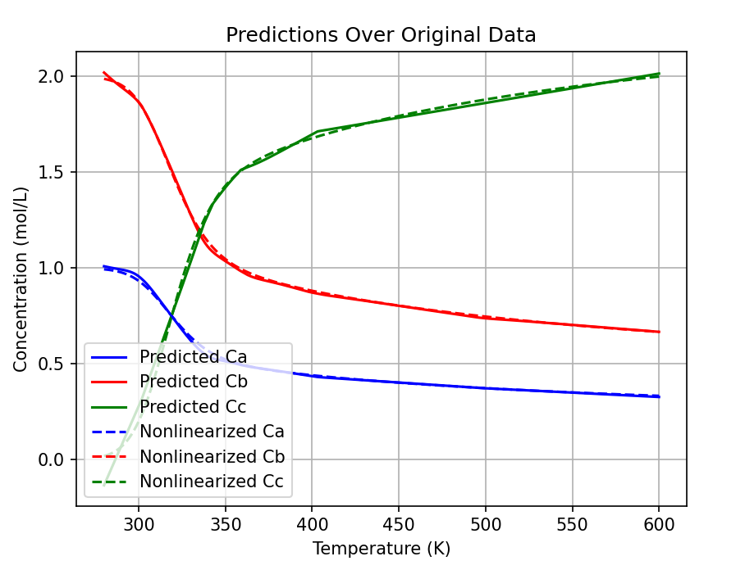
15000

