Slide 1
Research Progress Update
Fateme Mohammad Mohammadi, Chemical Engineering

Slide 2
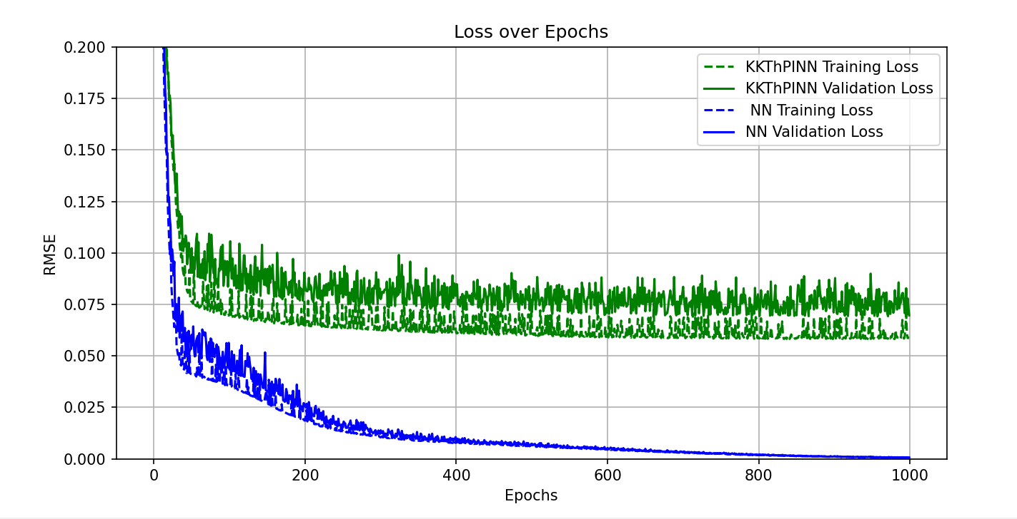
Loss – برای A, B, b مطابق با قسمت دوم خطی

Slide 3
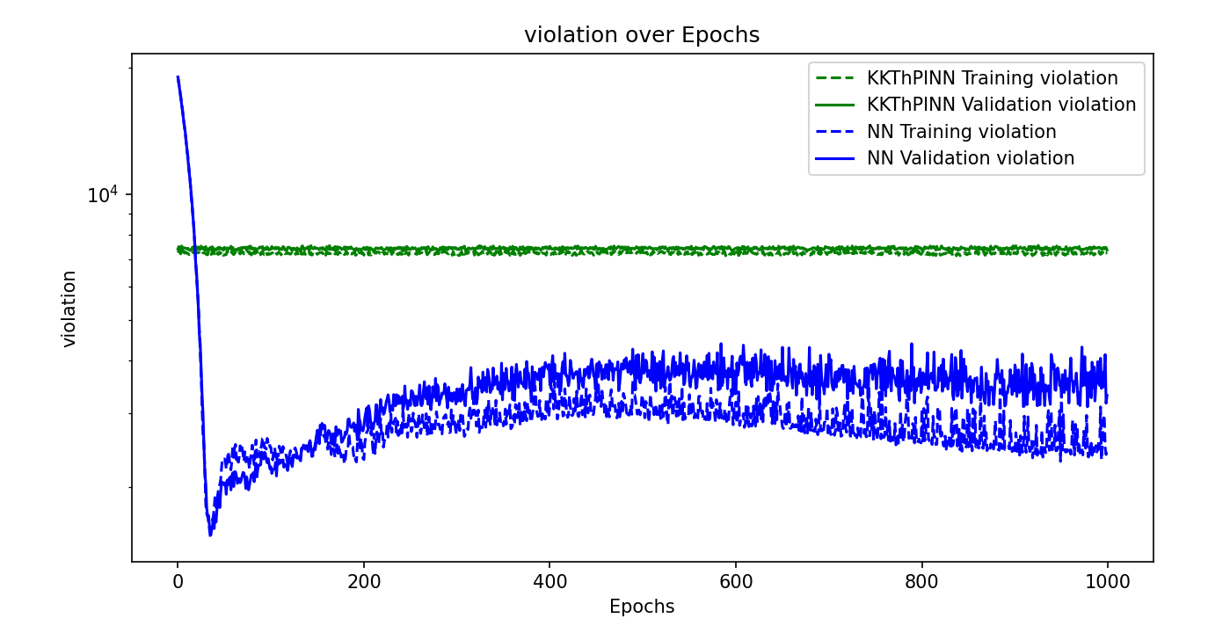

Slide 4
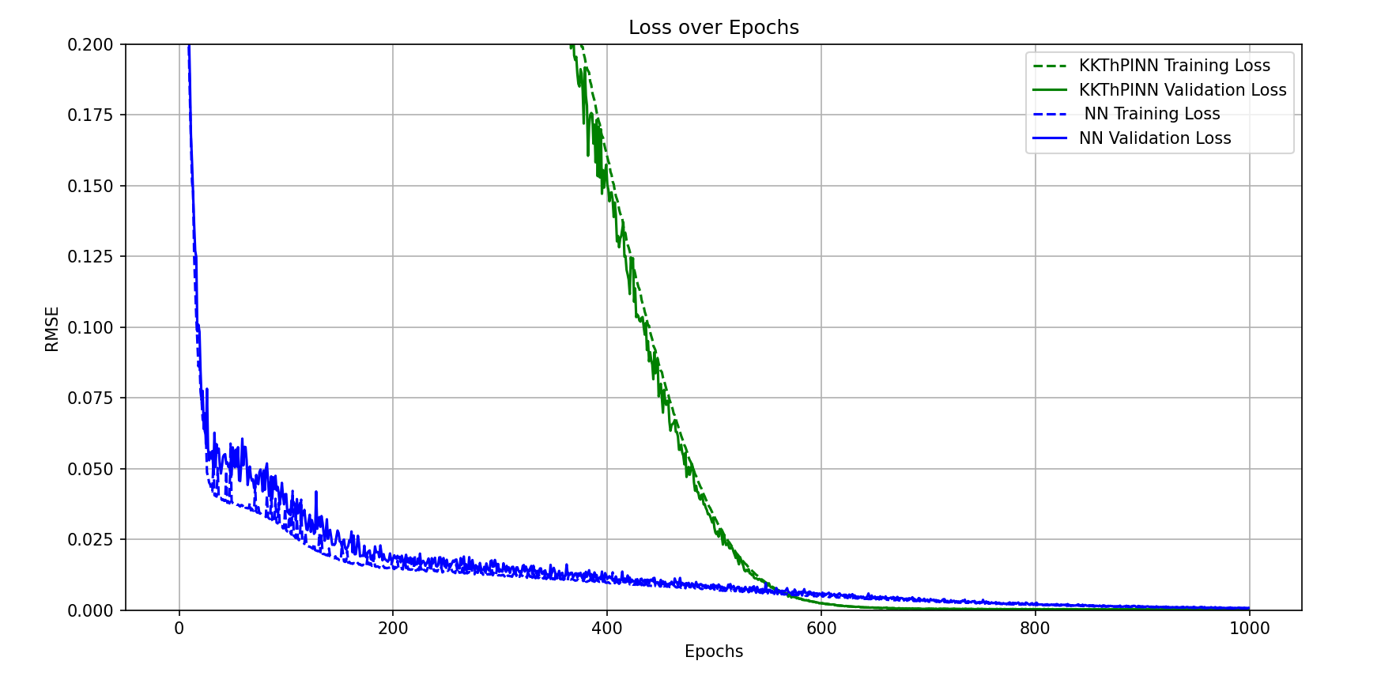
No use of sigmoid, use both linearized constraints for whole range

Slide 5
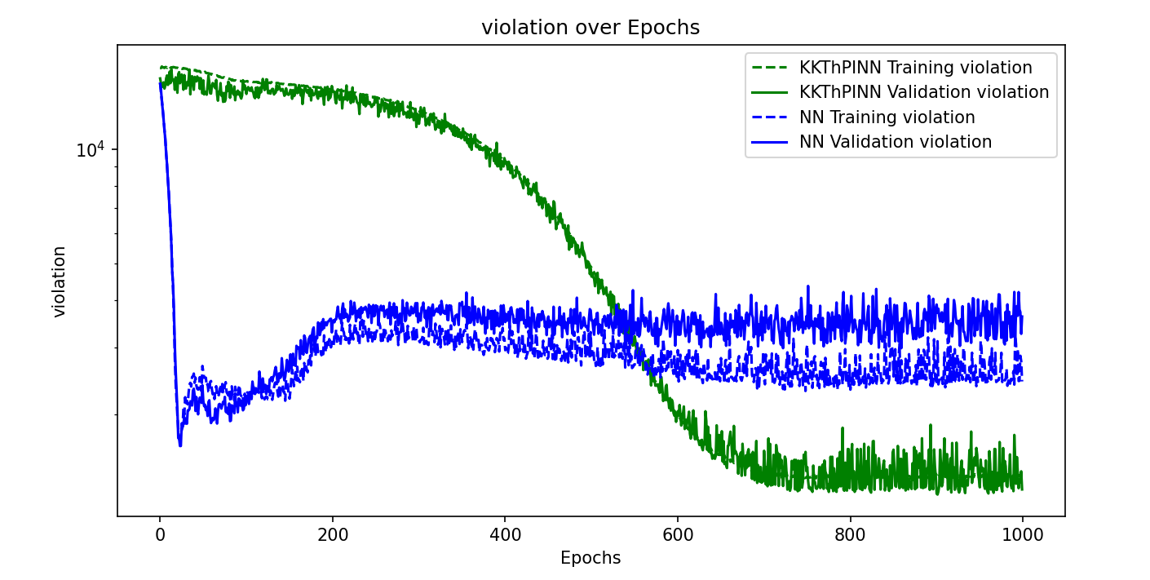
No use of sigmoid, use both linearized constraints for whole range
Notes:
High violation of constraints, because in each range we wanna enforce two constraints, however the loss function tries to minimize the loss with respect to original data, so the loss would be very small
So, no guarantee of enforment anymore! Which results in the optimal prediction, however it questions the guarantee of KKT method.

Slide 6
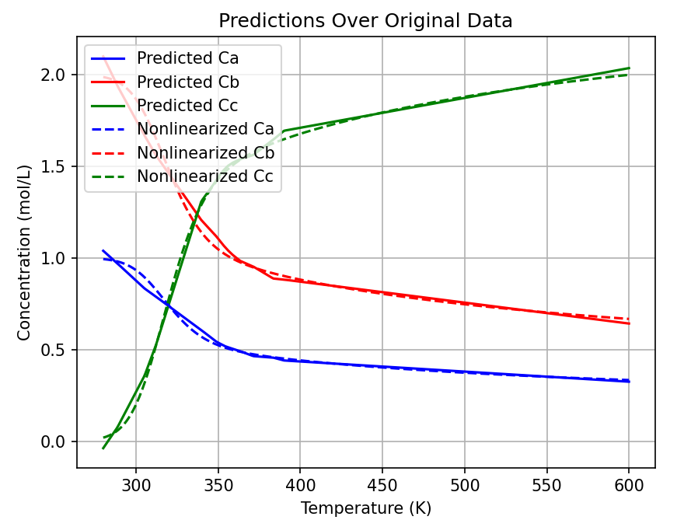
No use of sigmoid, use both linearized constraints for whole range

Slide 7
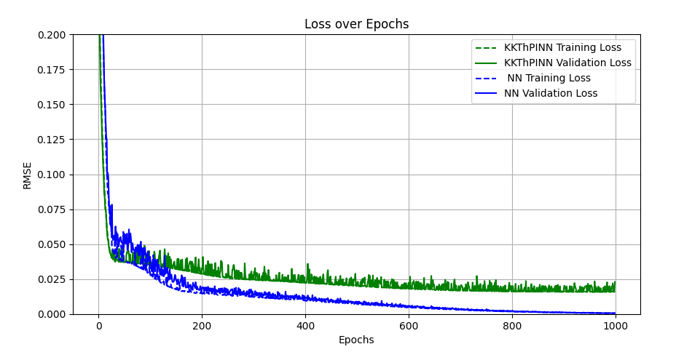
No use of sigmoid, use second half linearized constraint

Slide 8
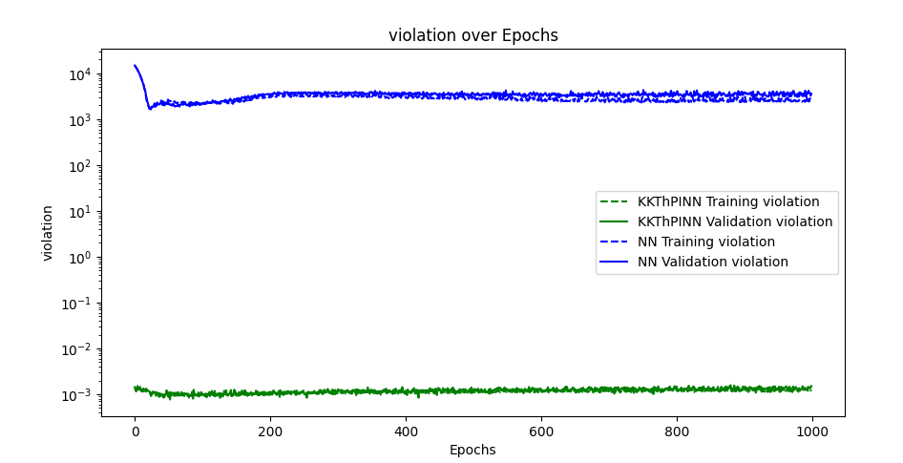
No use of sigmoid, use second half linearized constraint
Notes:
I think the reason that the violation is not that high is that, the x range for the first half is smaller than the second range. Although the constraint is violating the first half, it’d not that much.

Slide 9
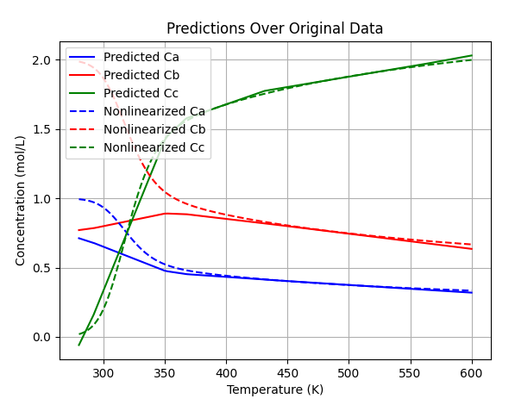
No use of sigmoid, use second half linearized constraint

Slide 10
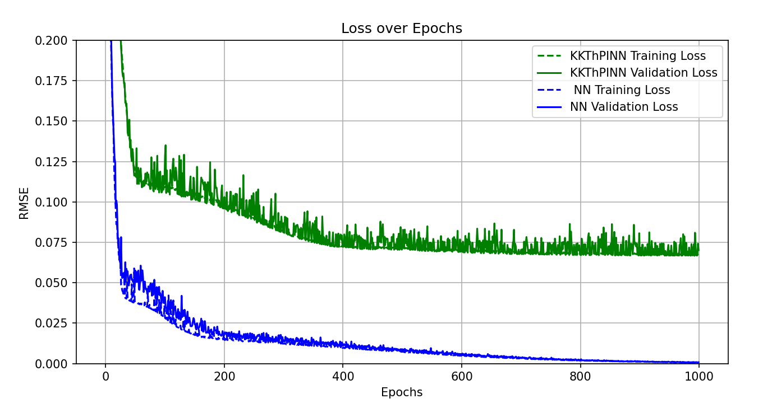
Use of sigmoid, use second half linearized constraint

Slide 11
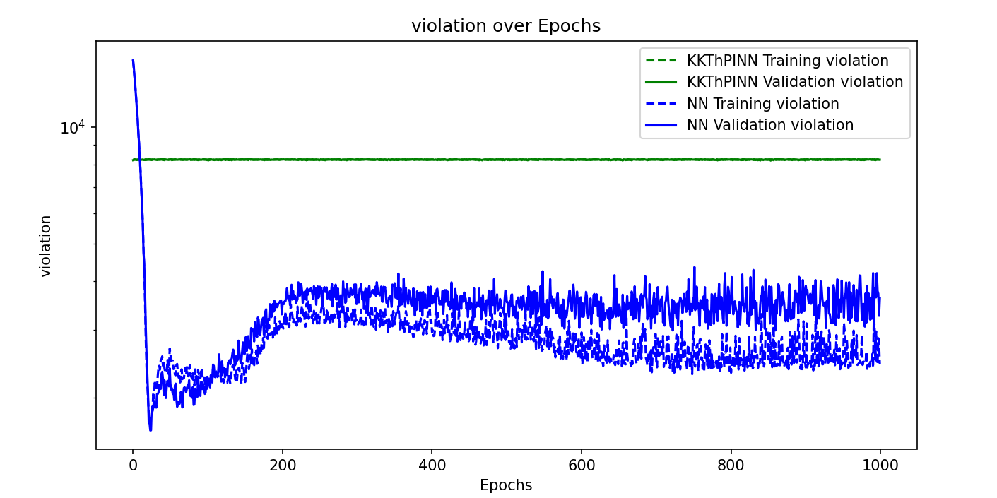
Use of sigmoid, use second half linearized constraint

Slide 12
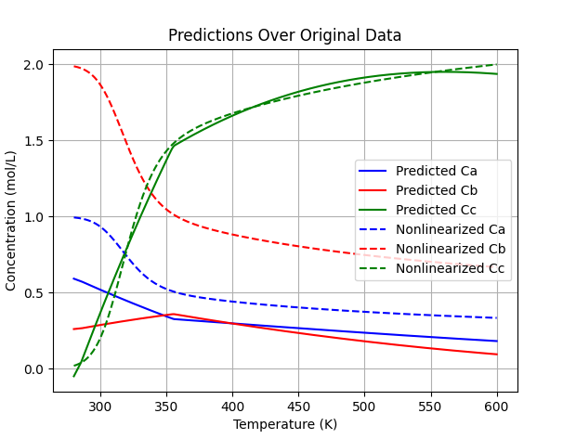
Use of sigmoid, use second half linearized constraint
Notes:
As only one sigmoid is applied (cause we only have one constraint), which is the inverse sigmoid for the first part, so the effect of second linearized constrain for second half is destroyed! Actually, if we defined the architecture of sigmoid functions in another way, it could work here for the second half.

Slide 13
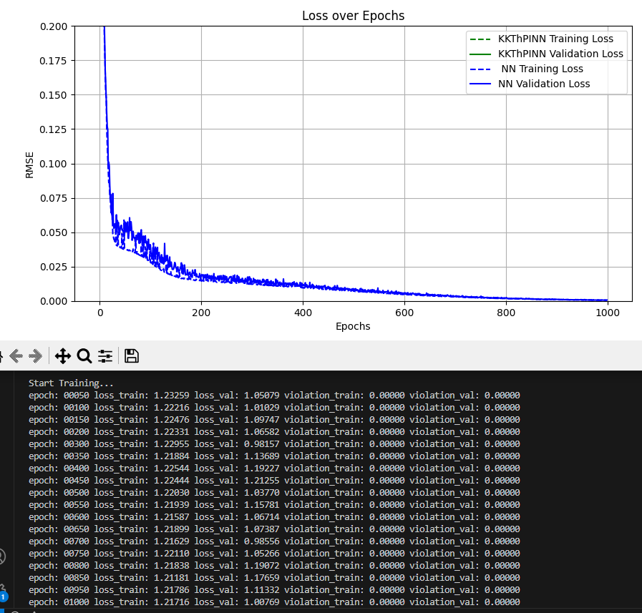
No use of sigmoid, use first half linearized constraint

Slide 14
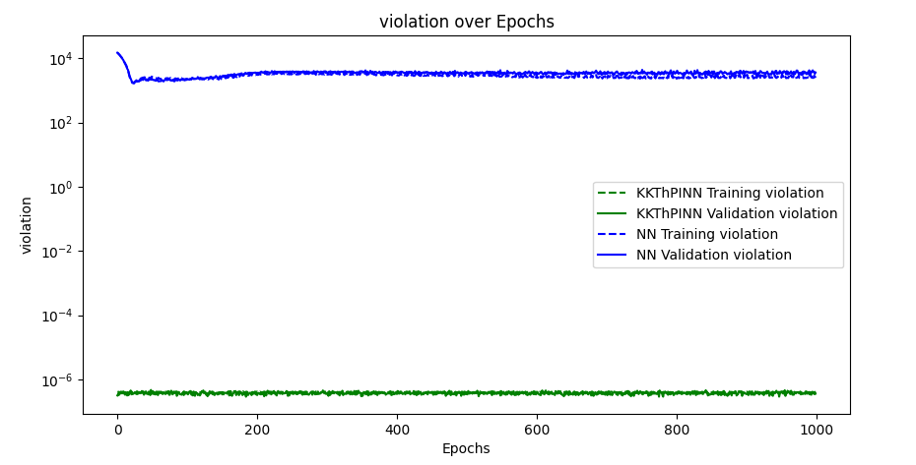
No use of sigmoid, use first half linearized constraint

Slide 15
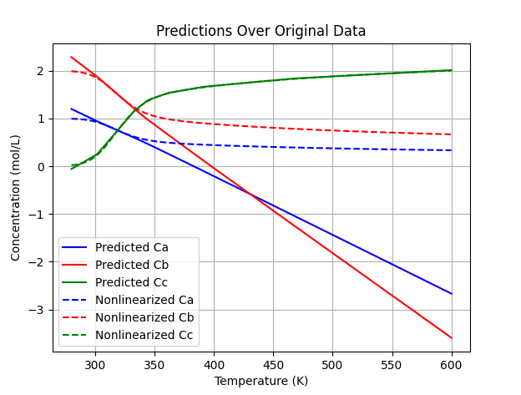
No use of sigmoid, use first half linearized constraint

Slide 16
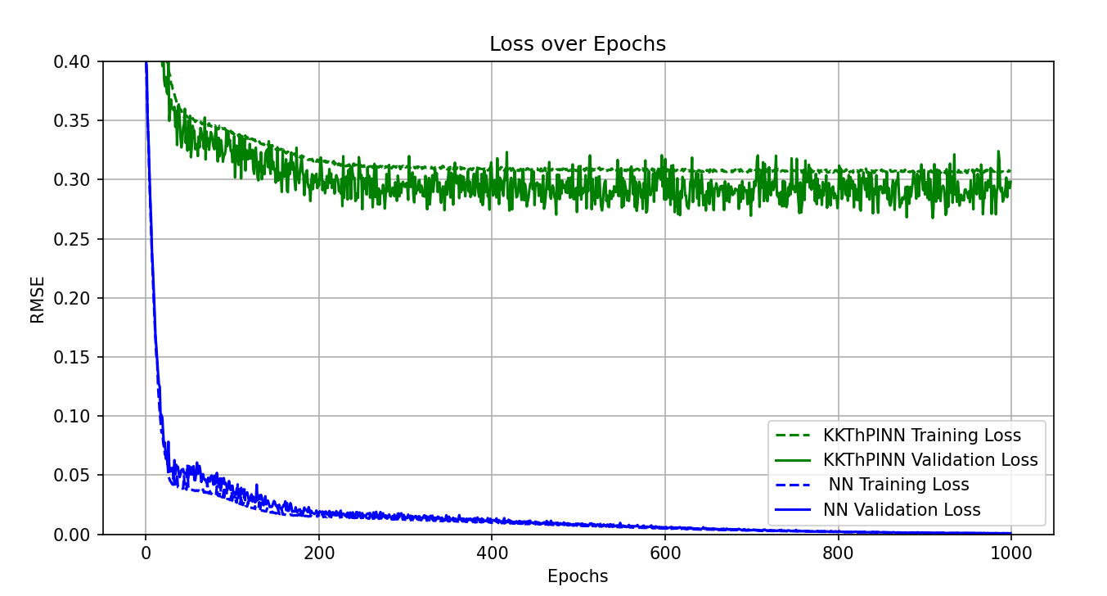
Use of sigmoid, use first half linearized constraint

Slide 17
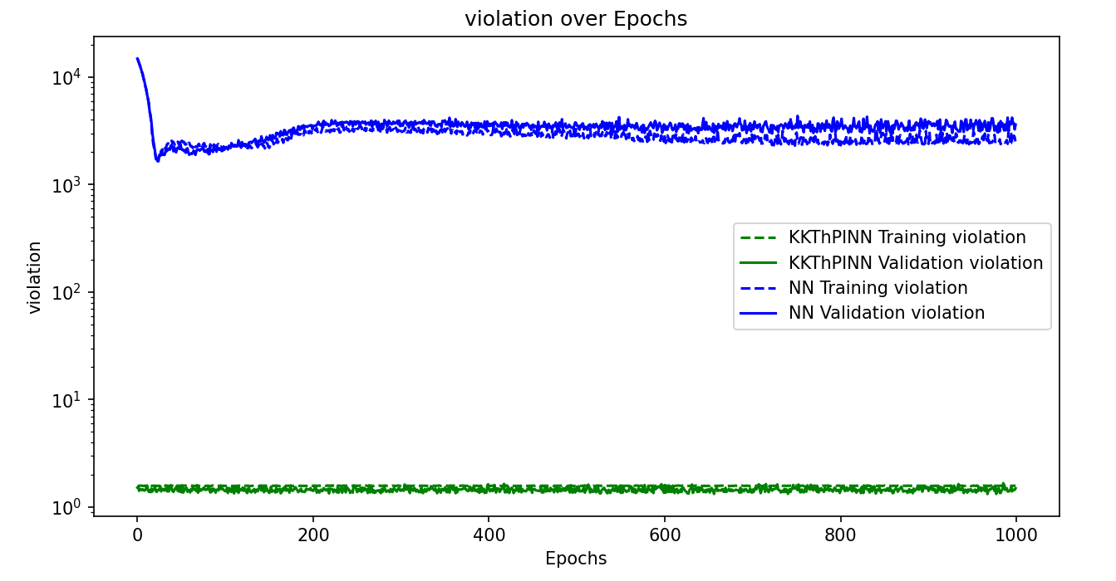
Use of sigmoid, use first half linearized constraint

Slide 18
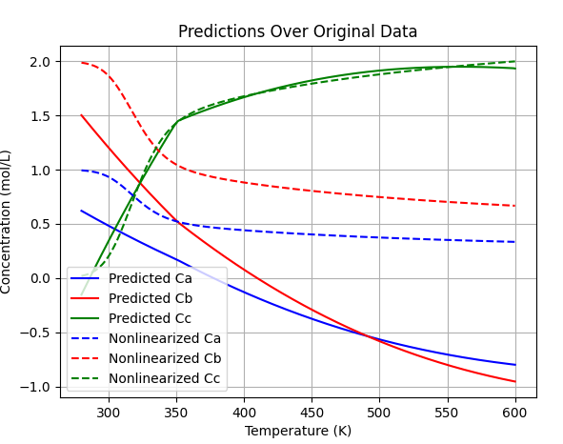
Use of sigmoid, use first half linearized constraint
Notes:
This result is strange. I didn’t expect that. I expected to see constraint enforcing for the first half, as we have the inverse sigmoid function for first half and constraint that is linearized for the first half.

Slide 19
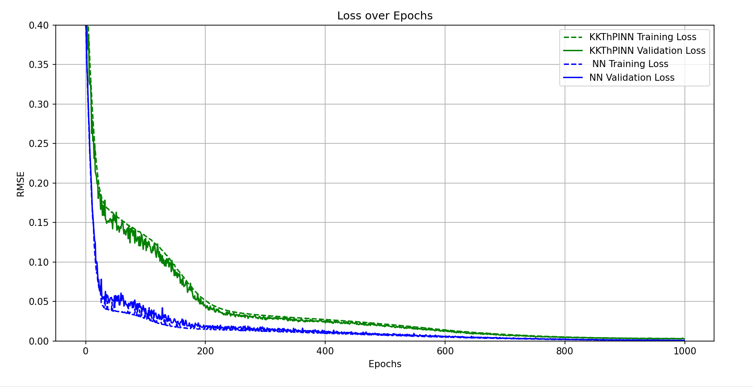

Slide 20
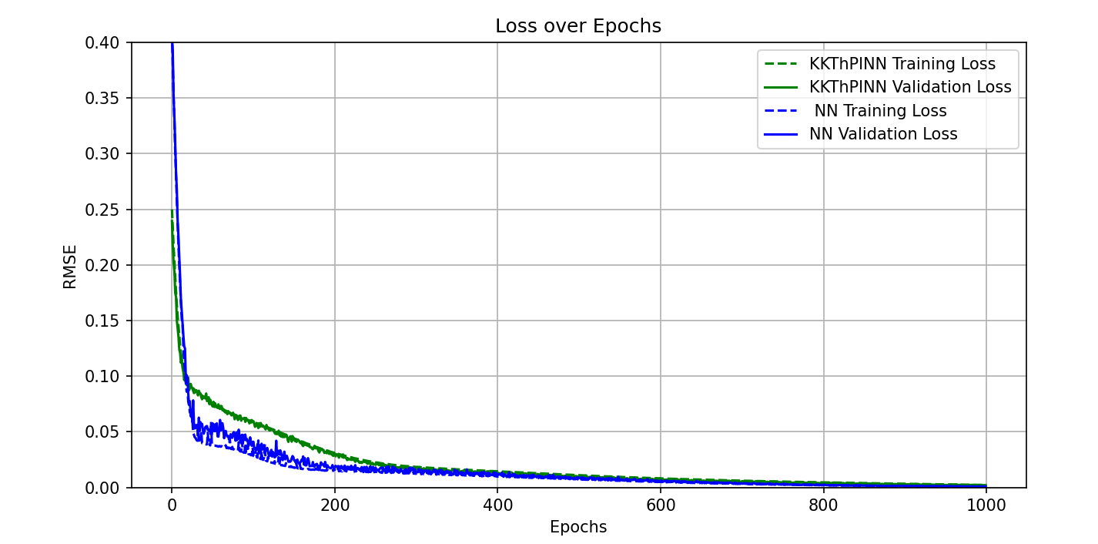

Slide 21
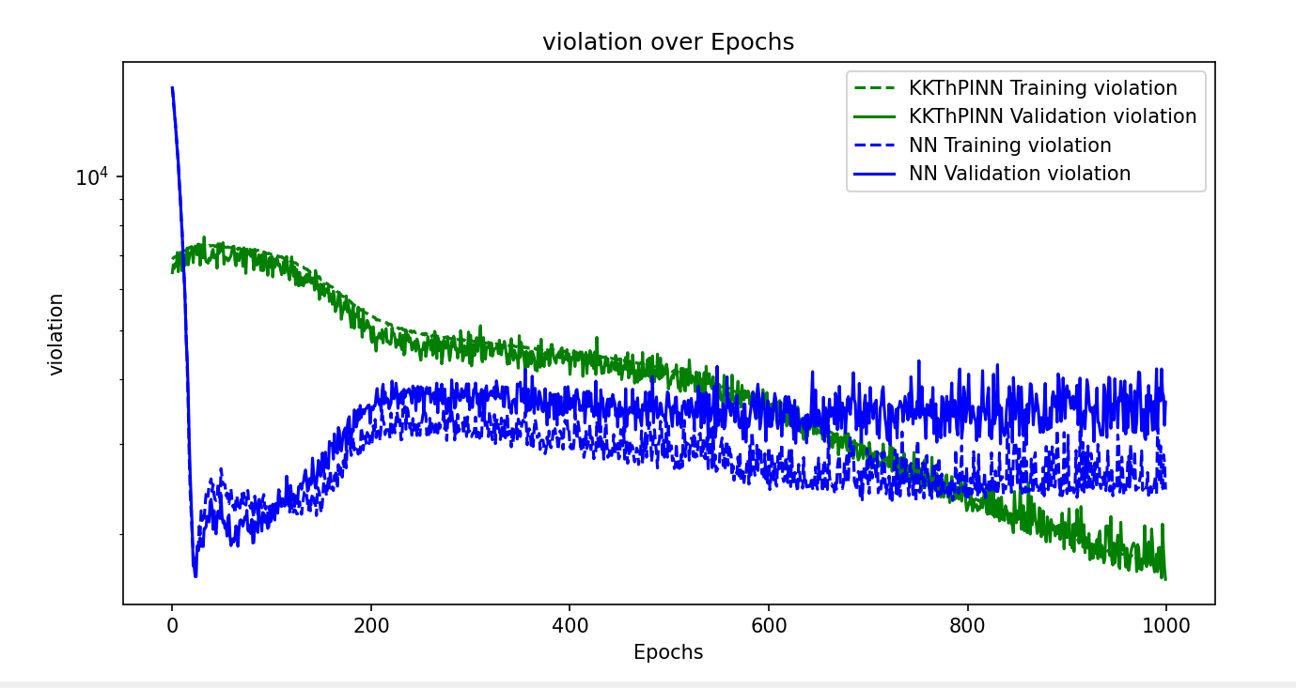

Slide 22
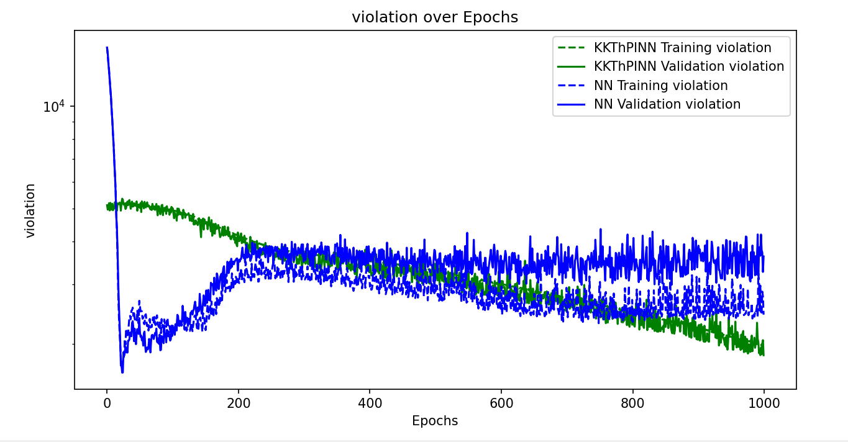

Slide 23
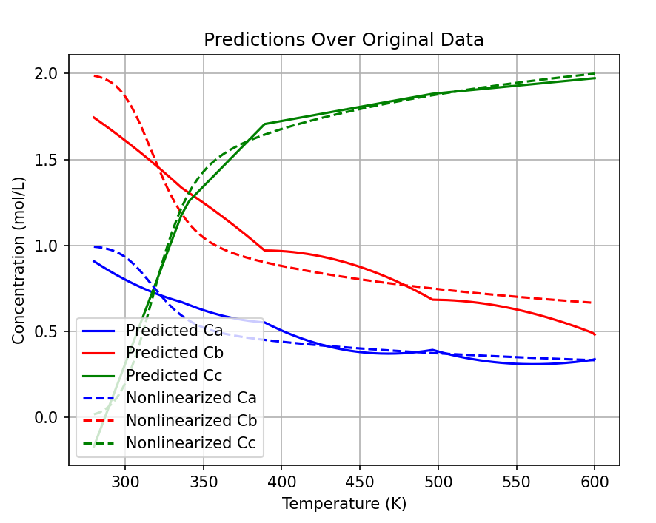

Slide 24
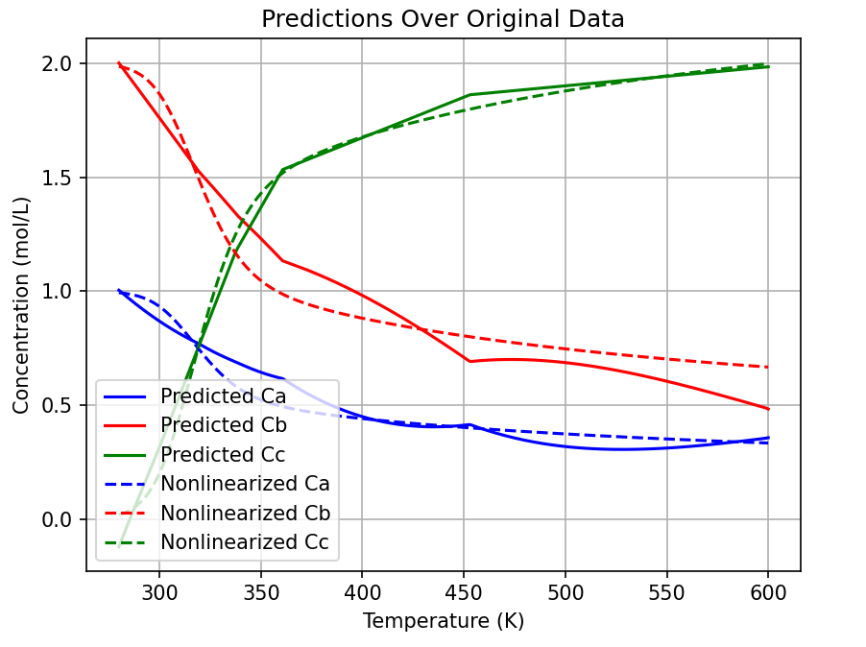

Slide 25
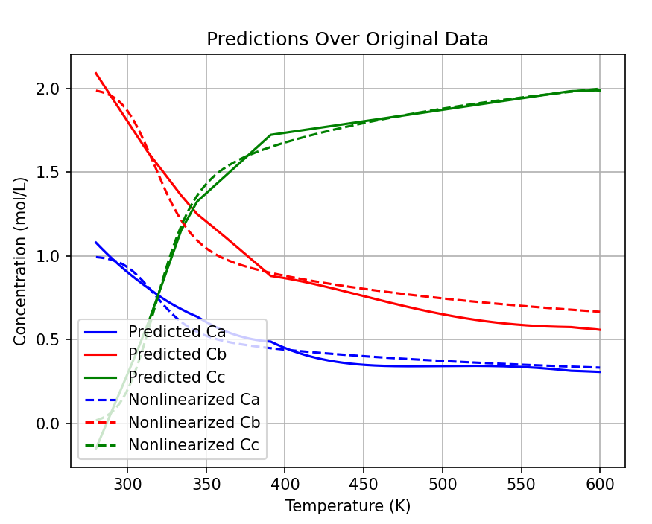
1000

Slide 26
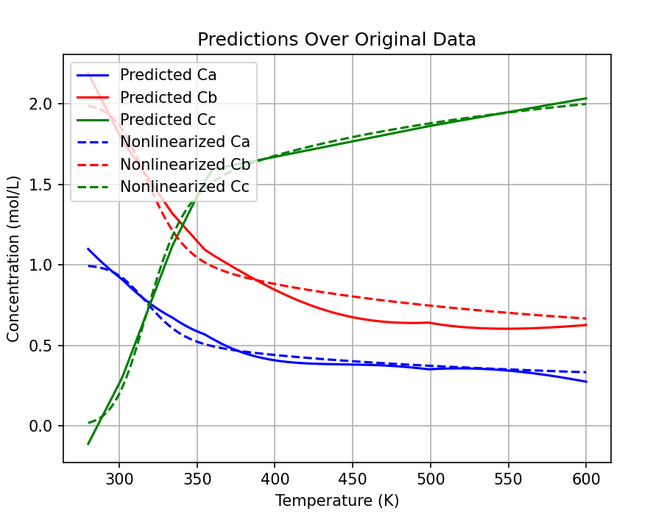

Slide 27
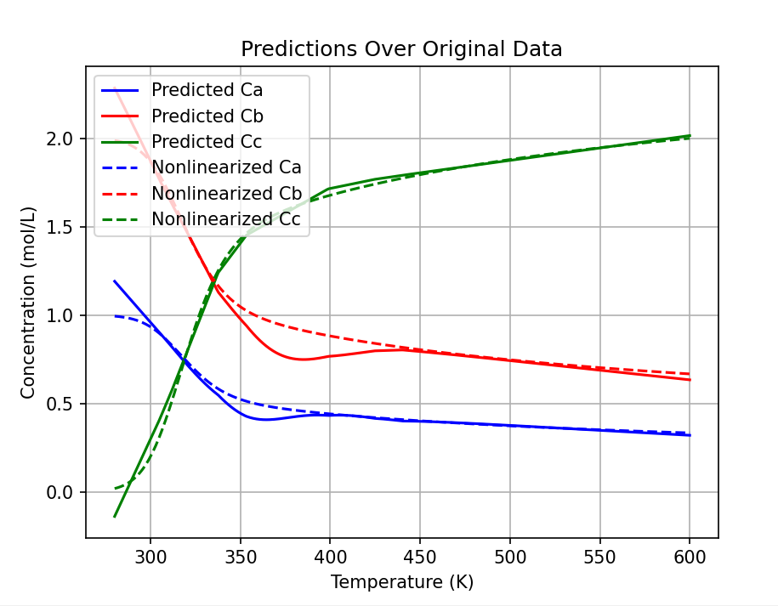
5000

Slide 28
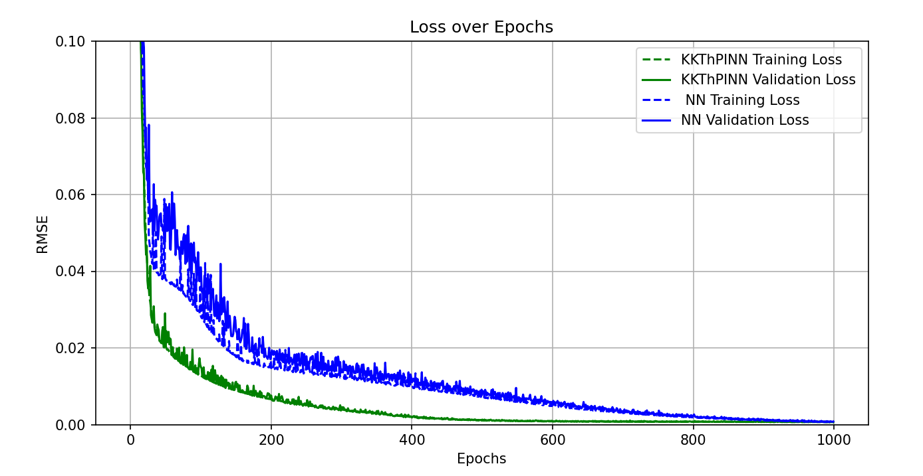
8000 – 3 lines

Slide 29
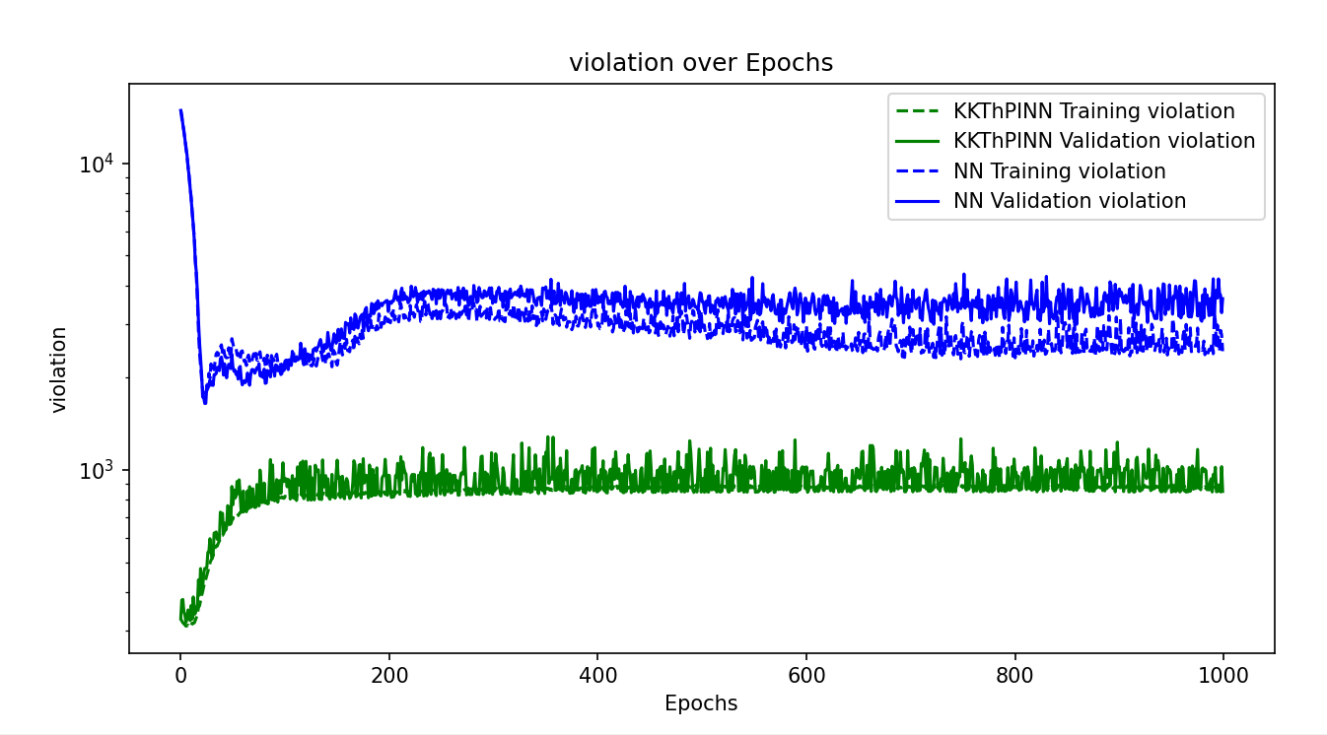
8000 – 3 lines

Slide 30
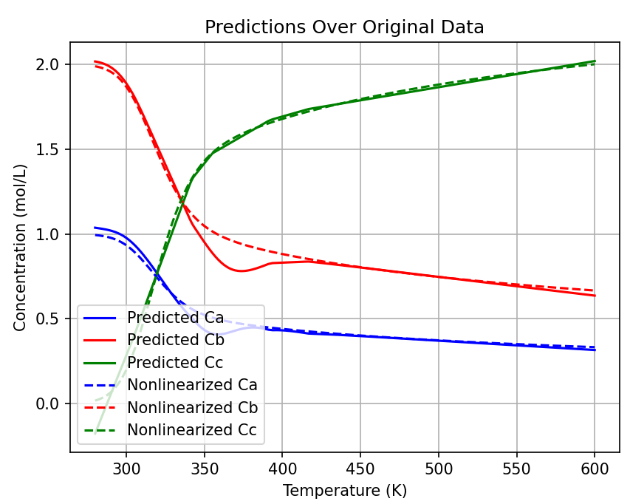
8000 – 3 lines

Slide 31
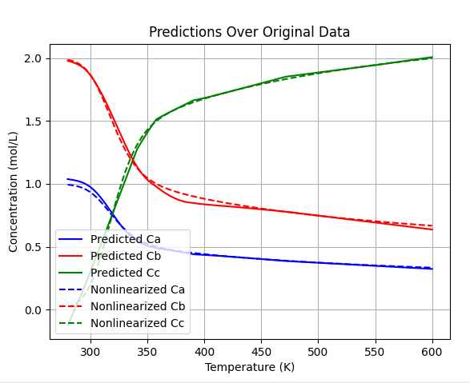
8000 – 4 lines

Slide 32
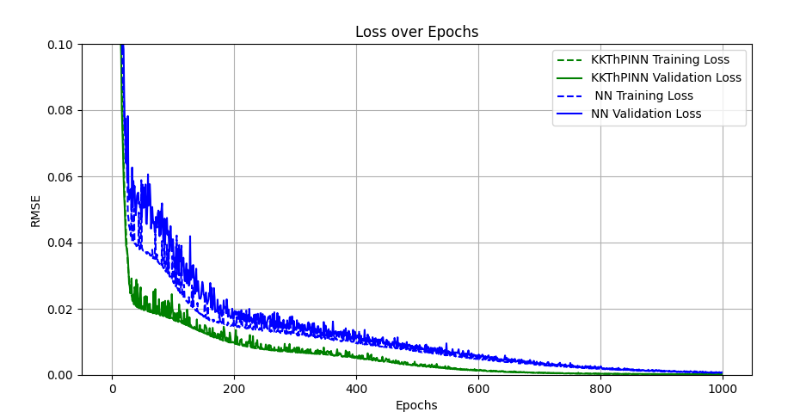
8000 – 4 lines

Slide 33
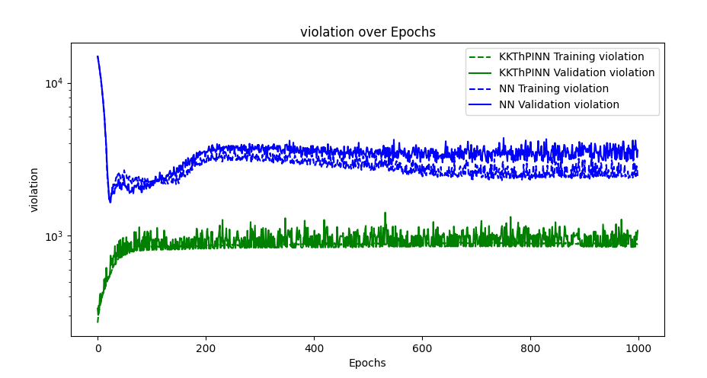
8000 – 4 lines

Slide 34
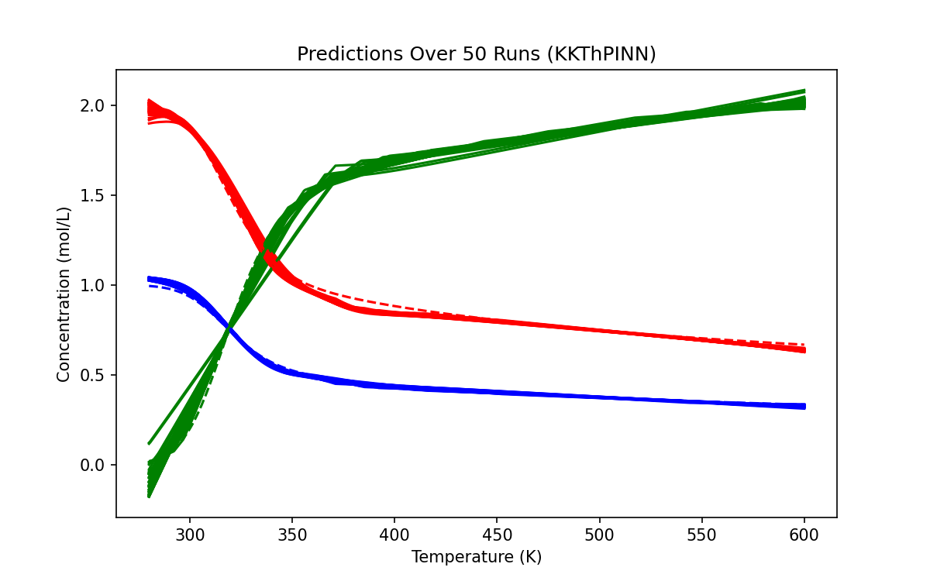
KKT - 500

Slide 35
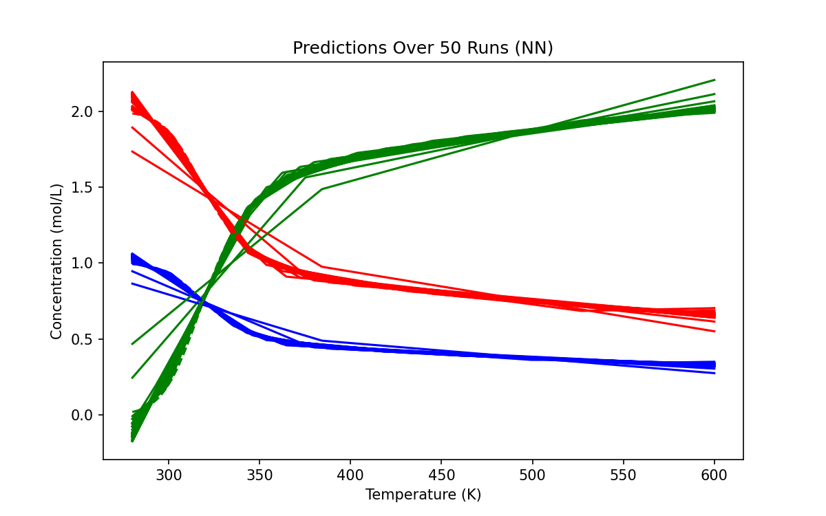
NN - 500

Slide 36
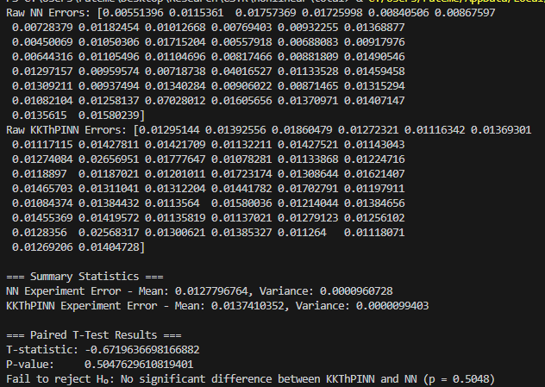
500

Slide 37
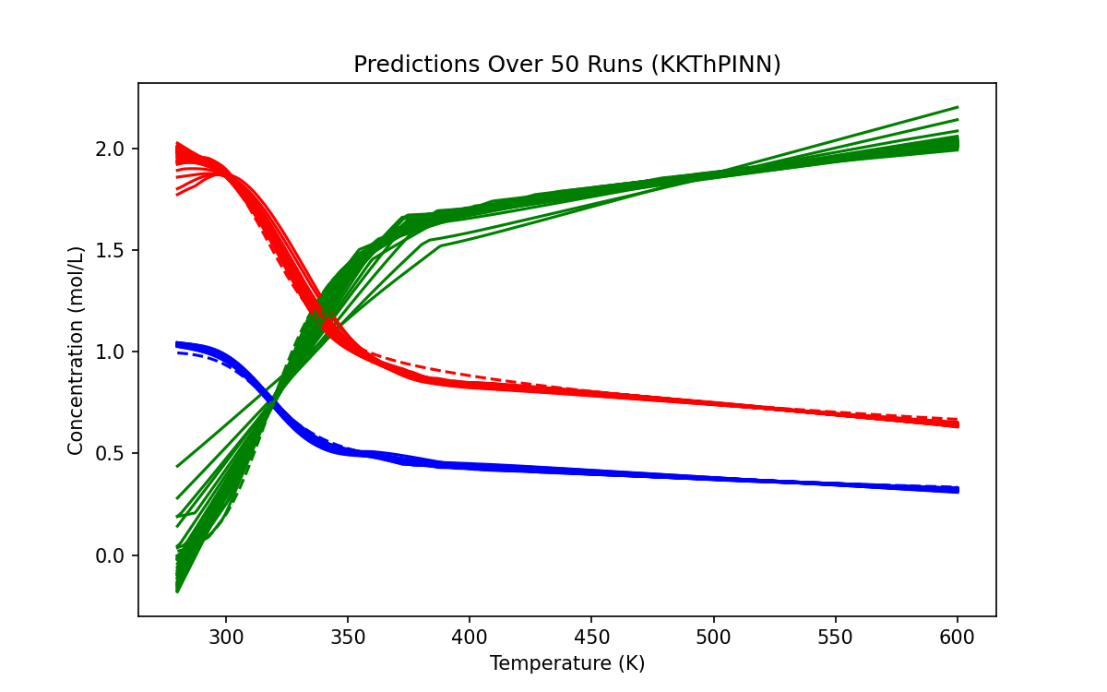
KKT - 400

Slide 38
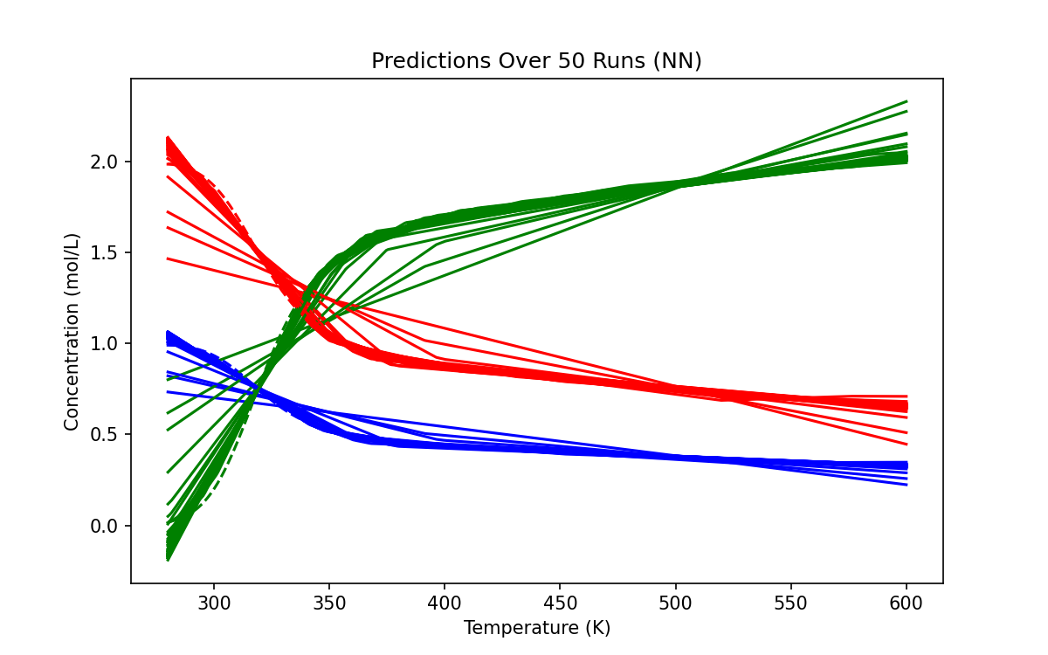
NN - 400

Slide 39
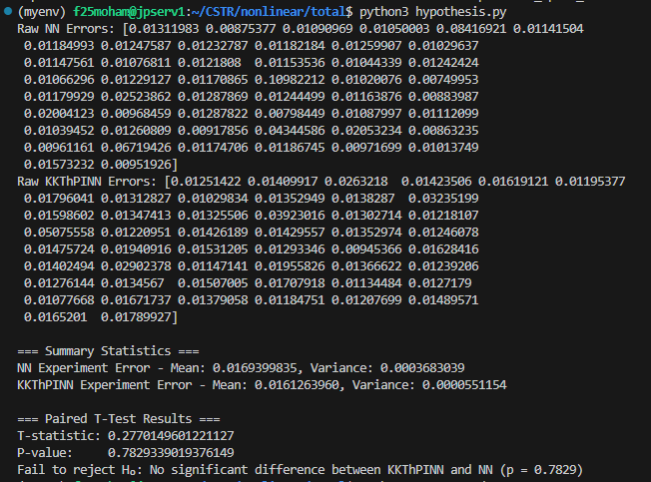
400 sample points

Slide 40
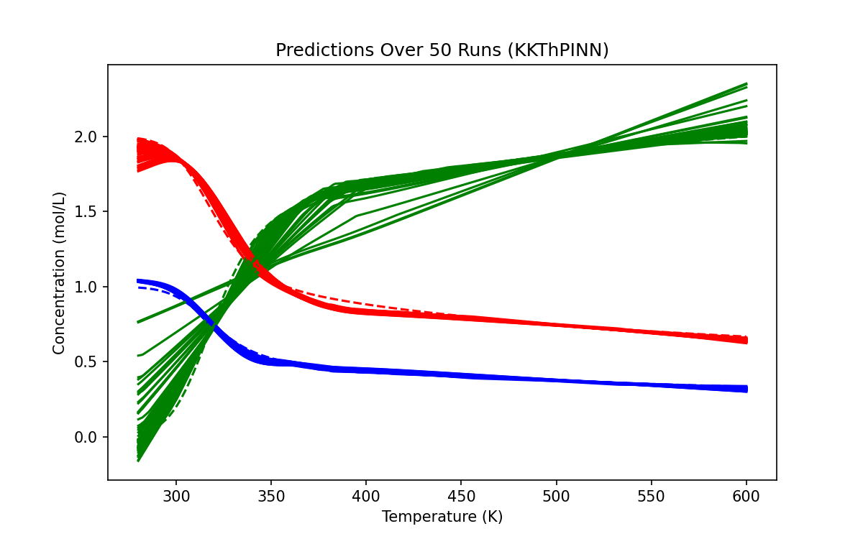
KKT - 300

Slide 41
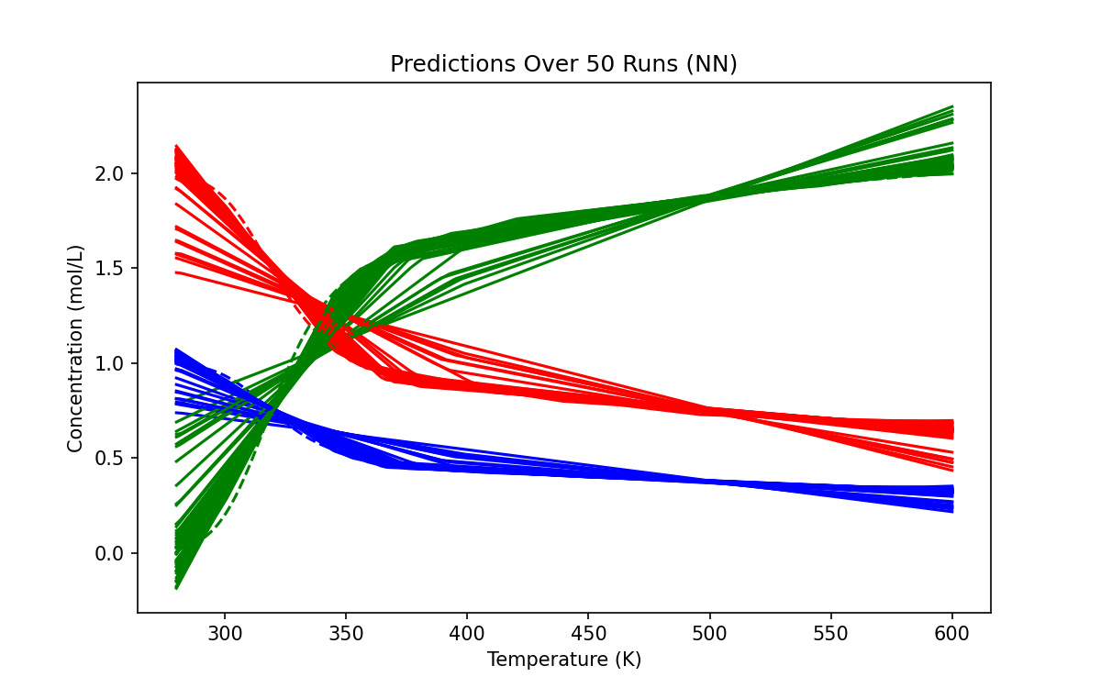
NN - 300

Slide 42
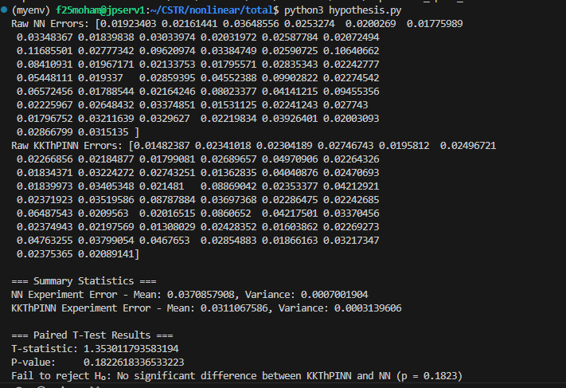
300

Slide 43
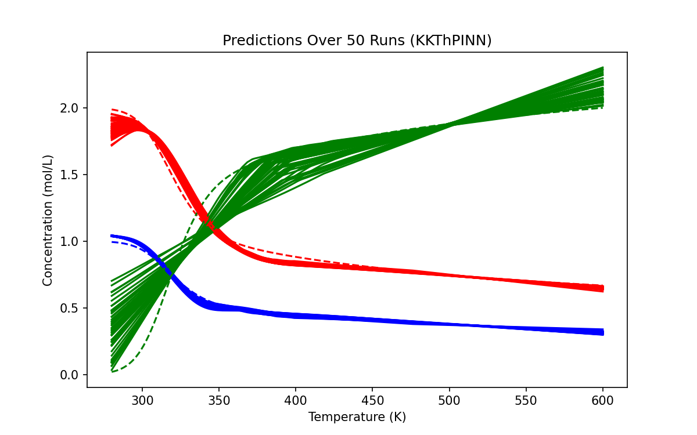
KKT - 200

Slide 44
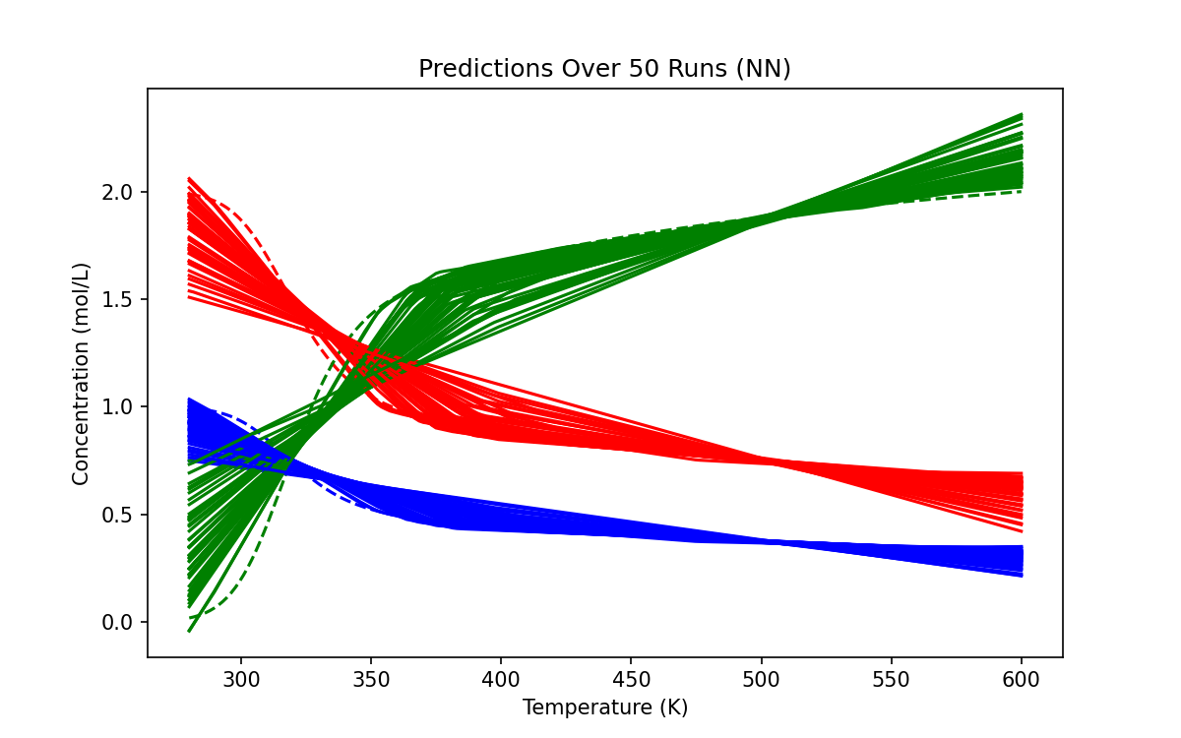
NN - 200

Slide 45
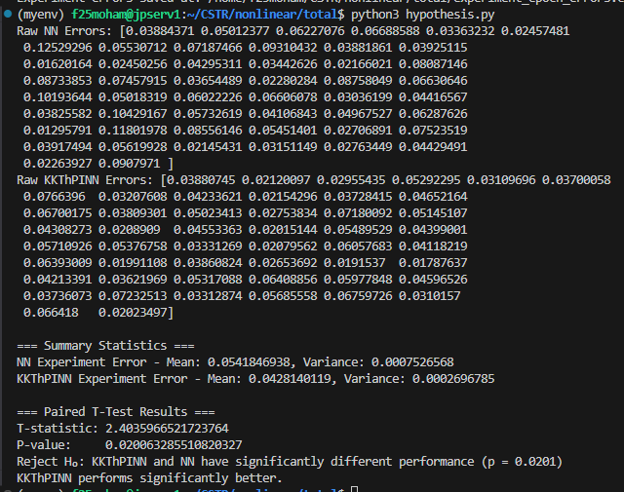
200

Slide 46
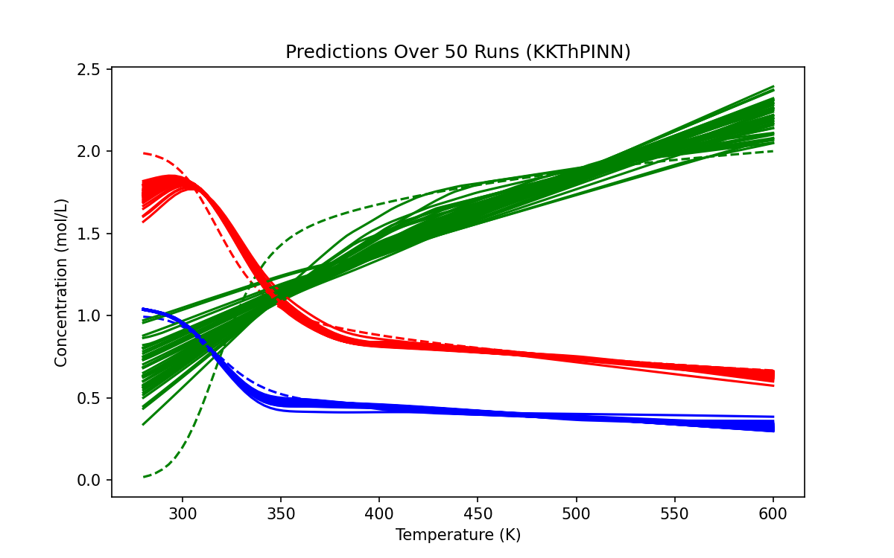
KKT - 100

Slide 47
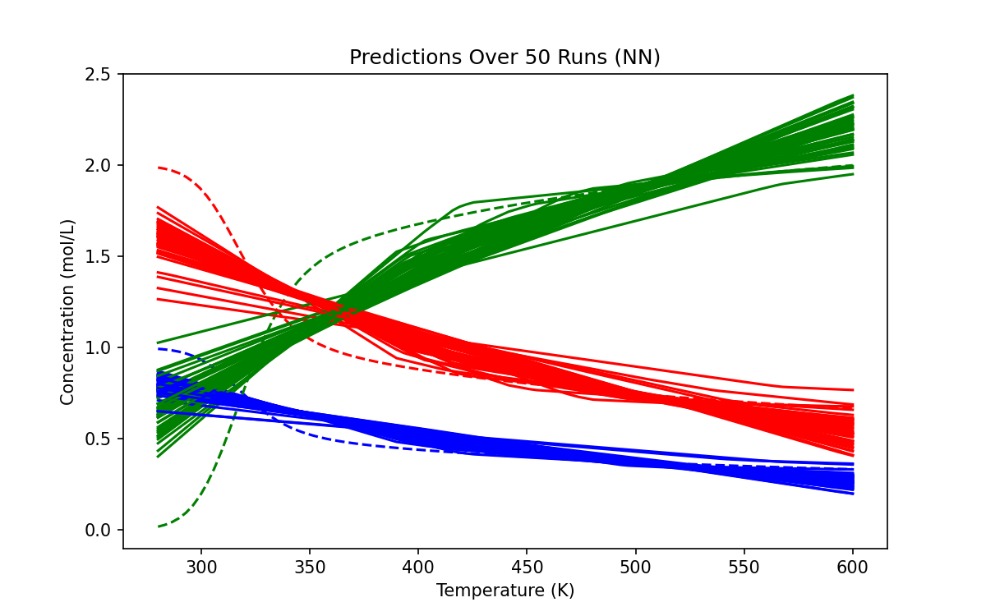
NN - 100

Slide 48
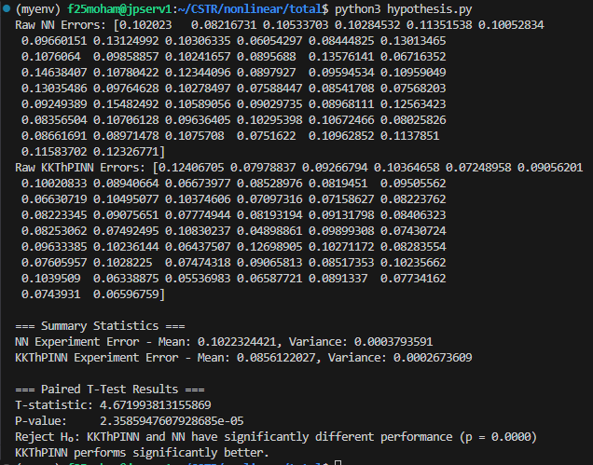
100

Slide 49
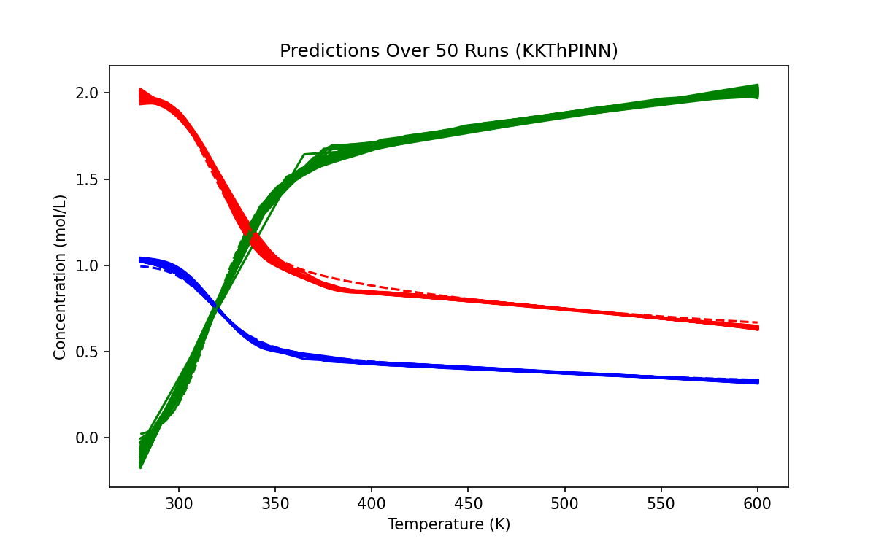
KKT - 600

Slide 50
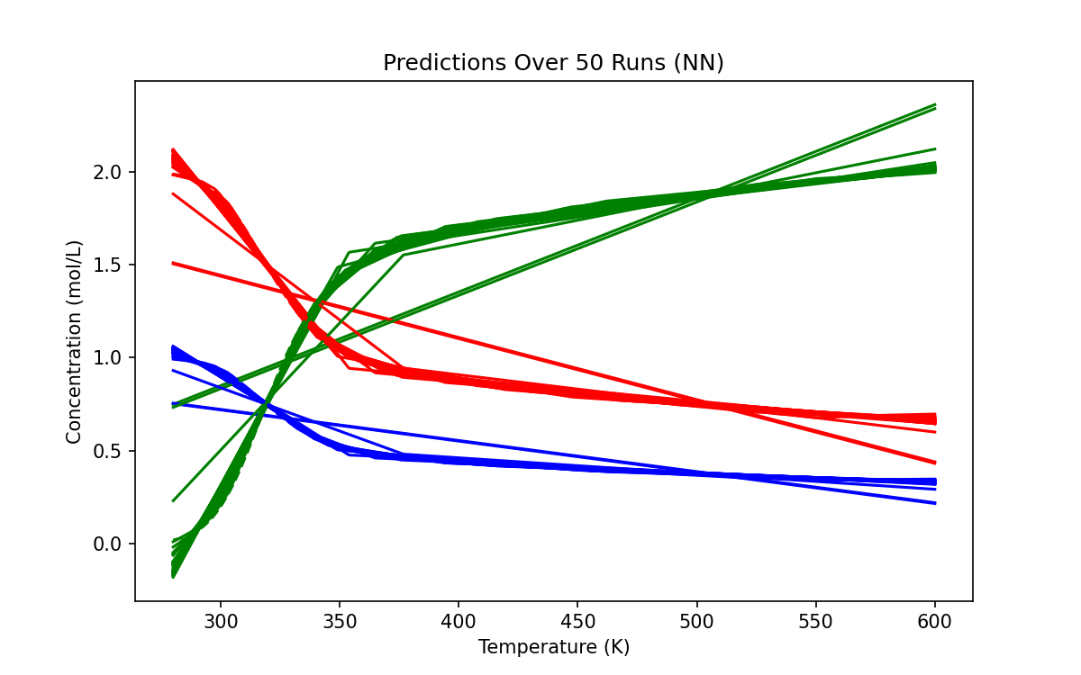
NN - 600

Slide 51
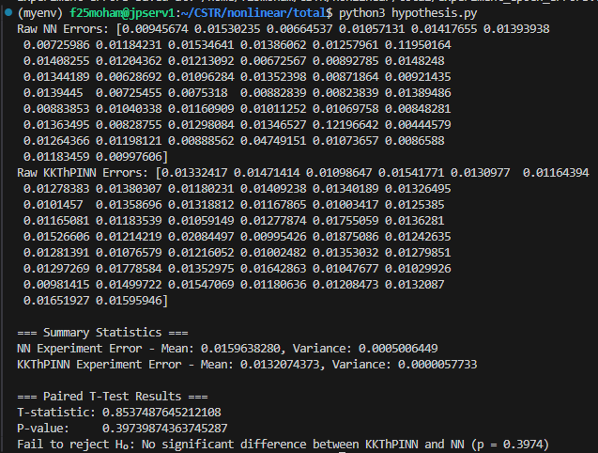
600

Slide 52

KKT - 800

Slide 53

NN - 800

Slide 54

800

