Slide 1
Hyperparameter Tuning
with Cross-Validation
Fatemeh Chitsaz
Mateus Machado Pedrosa
TK8117
29 September 2026

Slide 2
AGENDA
What we'll cover
The tuning problem
Parameters vs. hyperparameters, and what tuning can gain
01
Search strategy: how you spend your budget
Grid & random search, Bayesian optimization, successive halving / Hyperband
02
Validation: how you keep it honest
Nested CV, overtuning, and reshuffled splits
Wrap-up
Which strategy, when? And three take-home messages
TK8117 · Hyperparameter tuning with cross-validation
1

Slide 3
INTRODUCTION
Hyperparameter tuning: Defining the problem
Parameters are learned from the data during fitting (coefficients, loadings, weights)
Hyperparameters are set before fitting (number of components, learning rate, tree depth, regularization)
They control model complexity, so they strongly affect performance
Task: choose the hyperparameters that give the best performance on new data
Why it's hard
No formula for the best values: we can only try and compare
Each try means fitting and evaluating a model, which is costly
TK8117 · Hyperparameter tuning with cross-validation
2

Slide 4
WHY THIS MATTERS
Example: Tuning the UCI ML Wine dataset from scikit-learn
i
About the dataset
scikit-learn wine dataset
178 samples
13 chemical features
3 cultivars (classes)
Hyperparameter | Range | Role
learning_rate | 0.01 – 0.5 (log) | step size per boosting round
max_depth | 1 – 6 | complexity of each tree
min_samples_leaf | 1 – 20 | smoothing / regularization
subsample | 0.5 – 1.0 | row subsampling
max_features | 0.3 – 1.0 | column subsampling per split
Source: https://archive.ics.uci.edu/dataset/109/wine
TK8117 · Hyperparameter tuning with cross-validation
3

Slide 5
01
Search strategy:
how you spend your budget
TK8117 · Hyperparameter tuning with cross-validation
4

Slide 6
The two classic baselines
G
Grid search
R
Random search
Evaluate every combination on a fixed lattice
Cost grows as (levels)^(dimensions)
3 levels to the power of 5 hyperparameters is already 243 runs
Wastes evaluations on unimportant dimensions: varying a dimension that barely matters still multiplies the grid
Sample configurations independently at random, for a fixed budget of trials
Provably better coverage per trial than grid in high dimensions (Bergstra & Bengio, 2012)
Still memoryless: trial 200 ignores everything trials 1–199 already learned
TK8117 · Hyperparameter tuning with cross-validation
5

Slide 7
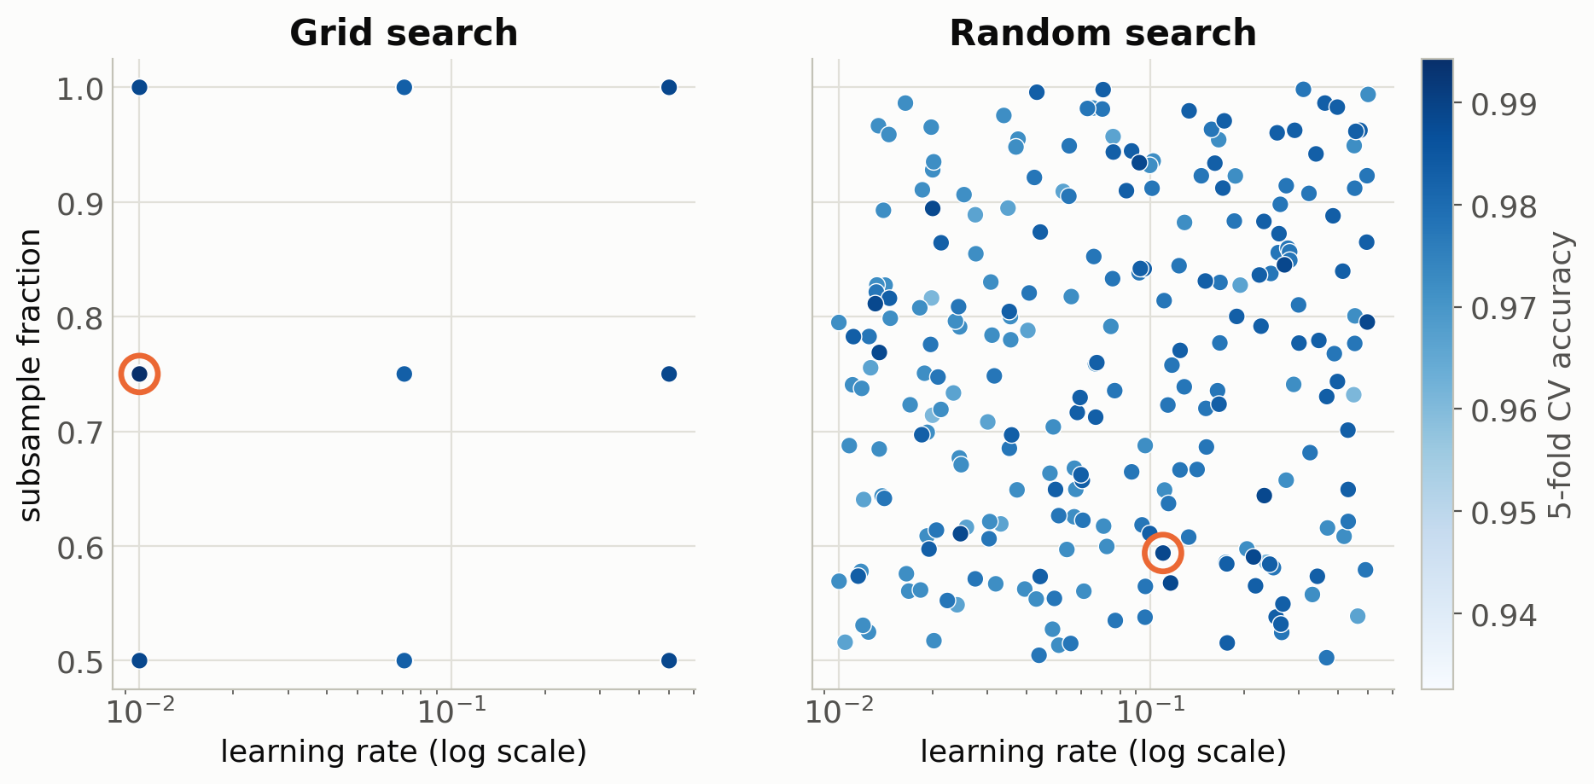
REAL DATA — WINE DATASET, GRADIENT BOOSTING
Where each strategy actually looks
Same trial budget (243 each)
grid's fixed lattice repeats itself: projected onto 2 of 5 dimensions, its 243 trials fall on only 9 distinct points
while random's continuously-sampled values almost never coincide
TK8117 · Hyperparameter tuning with cross-validation
6

Slide 8
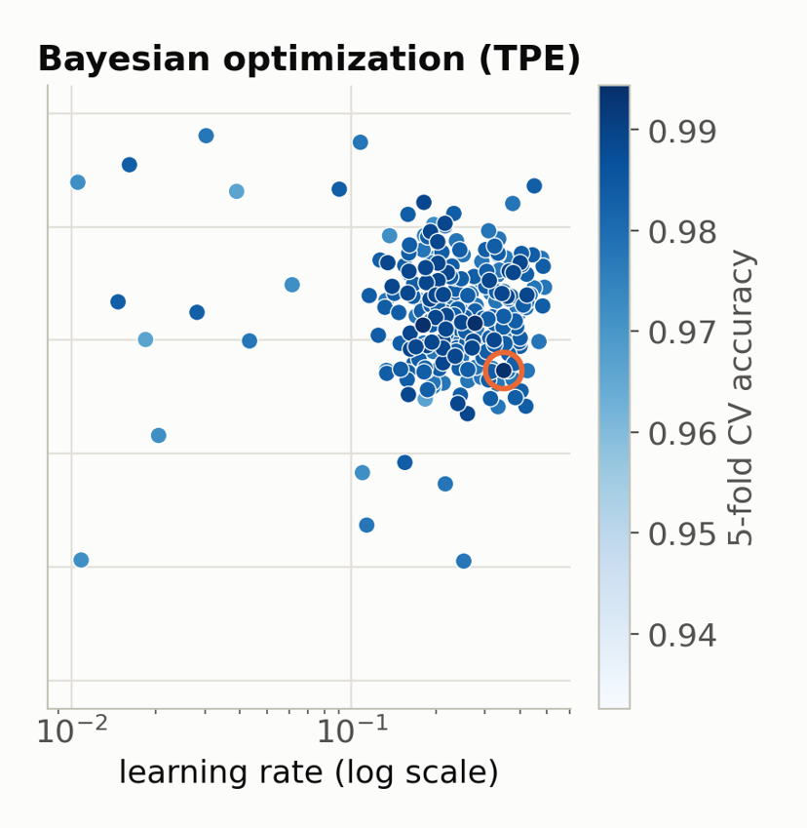
STRATEGY 3
Bayesian optimization: search with memory
CV is expensive: learn a cheap model of "CV score vs. configuration" and use it to decide where to try next.
  1. Fit a cheap surrogate model to all (configuration, CV score) pairs so far
  2. Choose the next configuration by balancing:
    exploration: where the surrogate is most uncertain
    exploitation: where the surrogate predicts a good score
  3. Run real CV on it, add the result, and repeat
Result: a good configuration with far fewer CV runs than grid or random search
TK8117 · Hyperparameter tuning with cross-validation
7

Slide 9
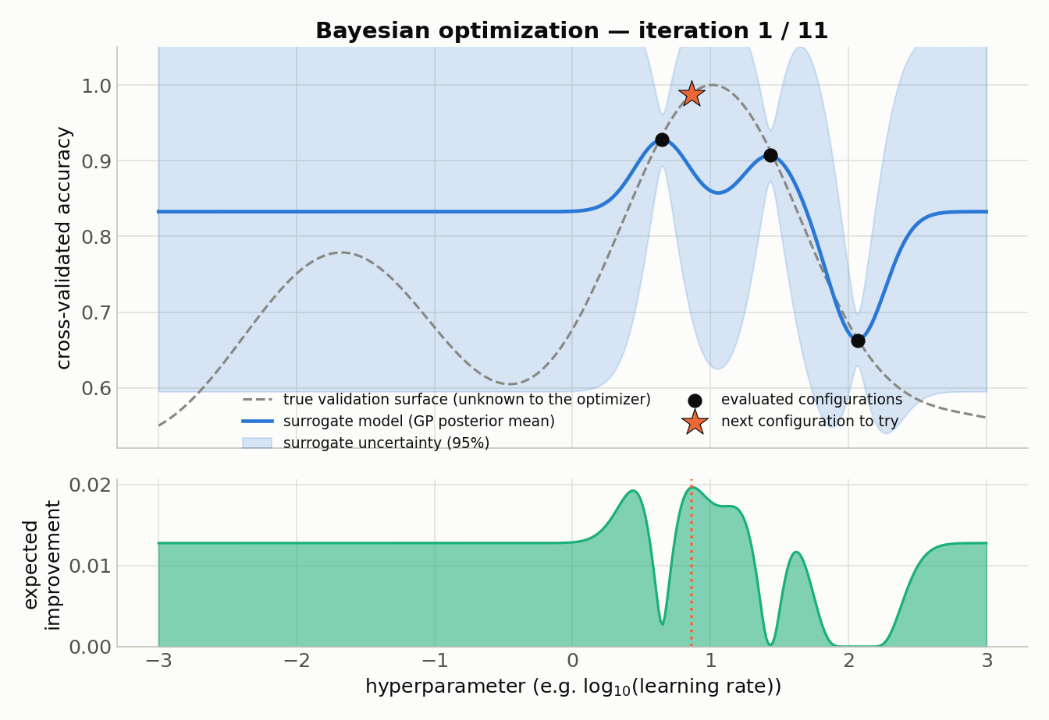
CLICK TO ADVANCE → STEP 1 OF 11
Bayesian optimization, iteration by iteration
Illustrative 1D surface — the real search space has 5 dimensions
8

Slide 10
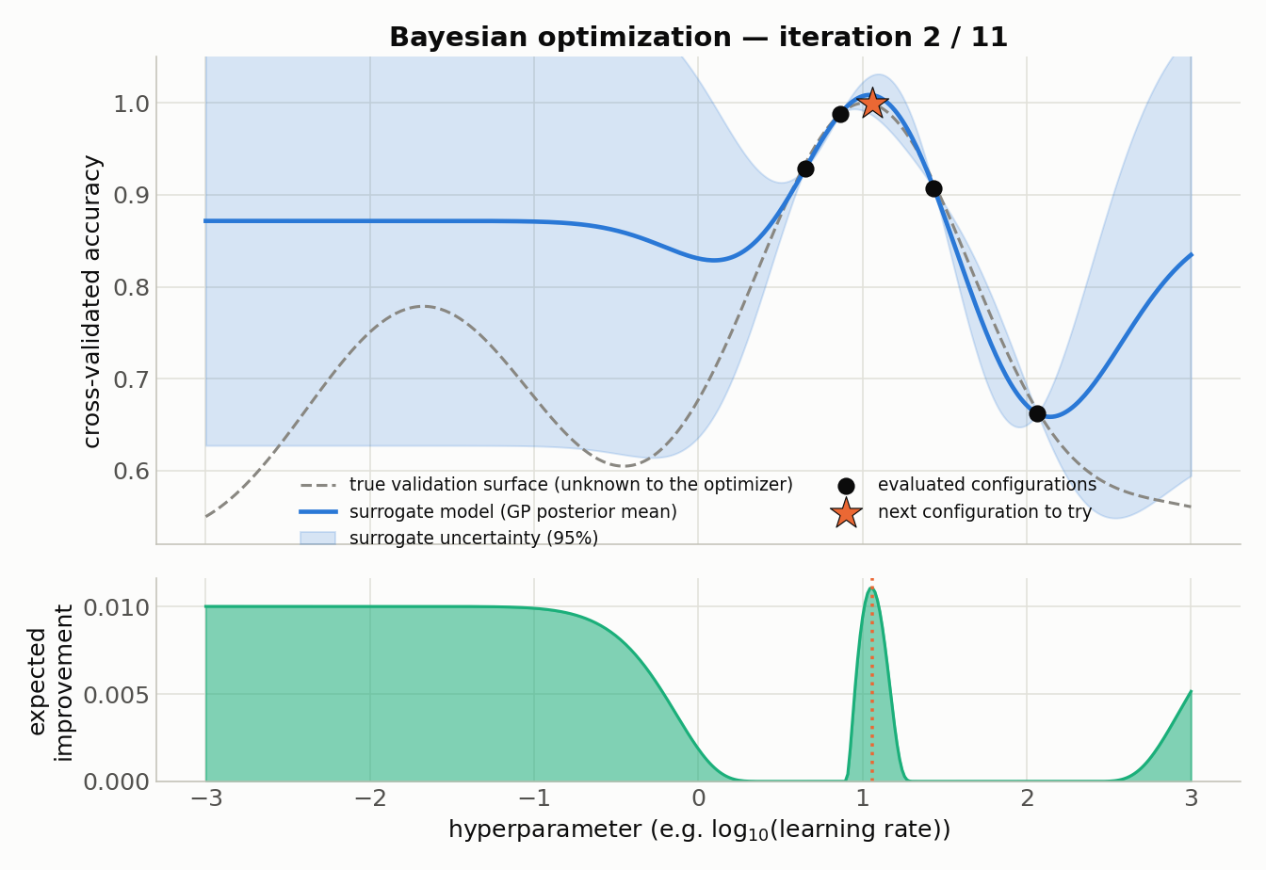
CLICK TO ADVANCE → STEP 2 OF 11
Bayesian optimization, iteration by iteration
Illustrative 1D surface — the real search space has 5 dimensions
9

Slide 11
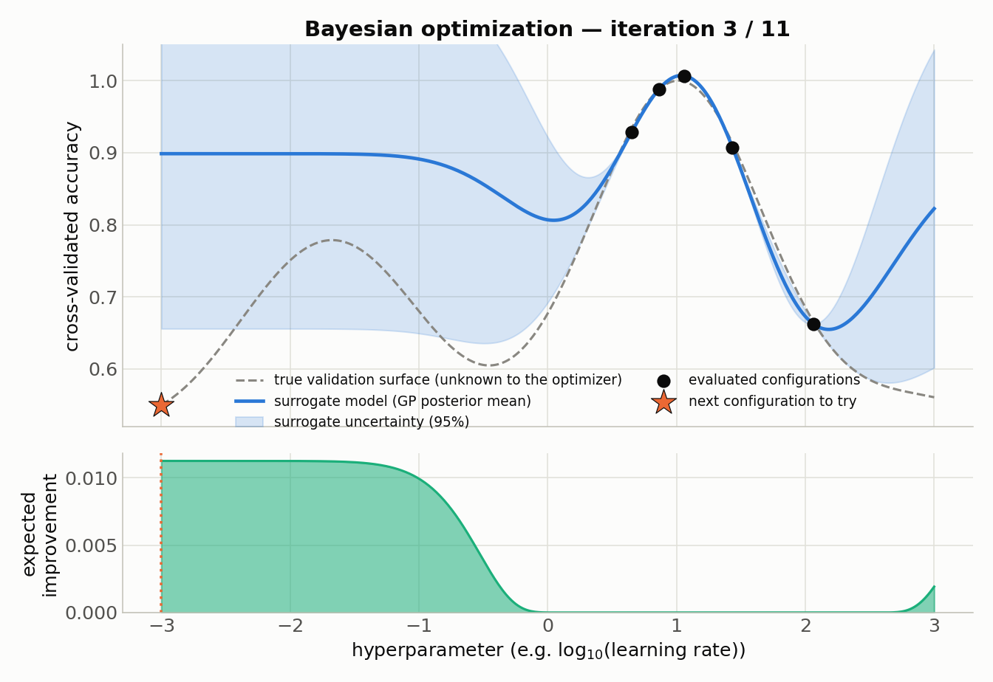
CLICK TO ADVANCE → STEP 3 OF 11
Bayesian optimization, iteration by iteration
Illustrative 1D surface — the real search space has 5 dimensions
10

Slide 12
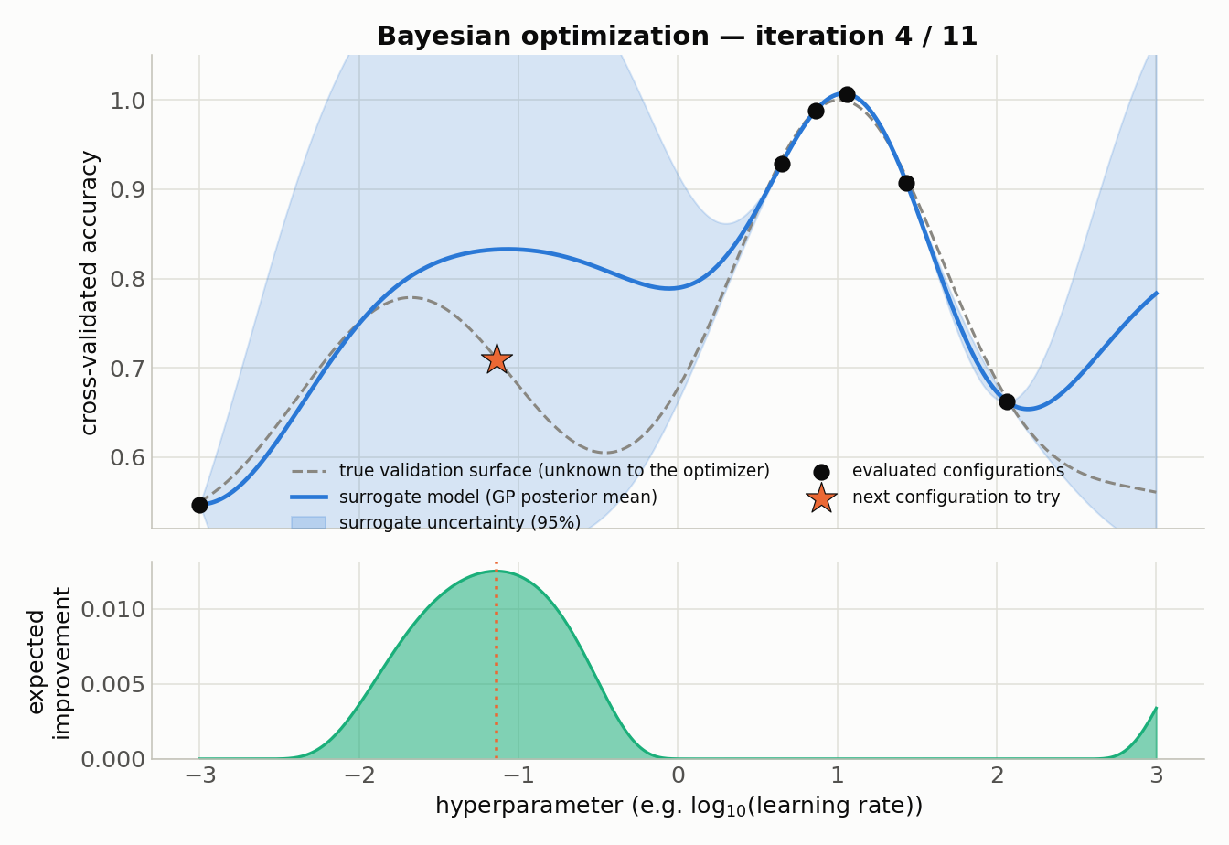
CLICK TO ADVANCE → STEP 4 OF 11
Bayesian optimization, iteration by iteration
Illustrative 1D surface — the real search space has 5 dimensions
11

Slide 13
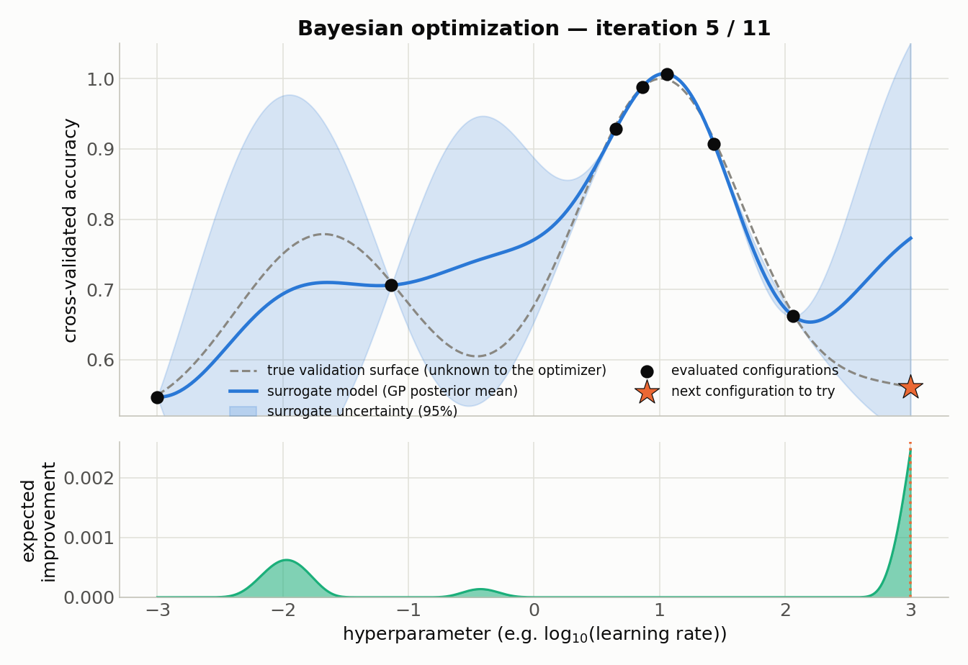
CLICK TO ADVANCE → STEP 5 OF 11
Bayesian optimization, iteration by iteration
Illustrative 1D surface — the real search space has 5 dimensions
12

Slide 14
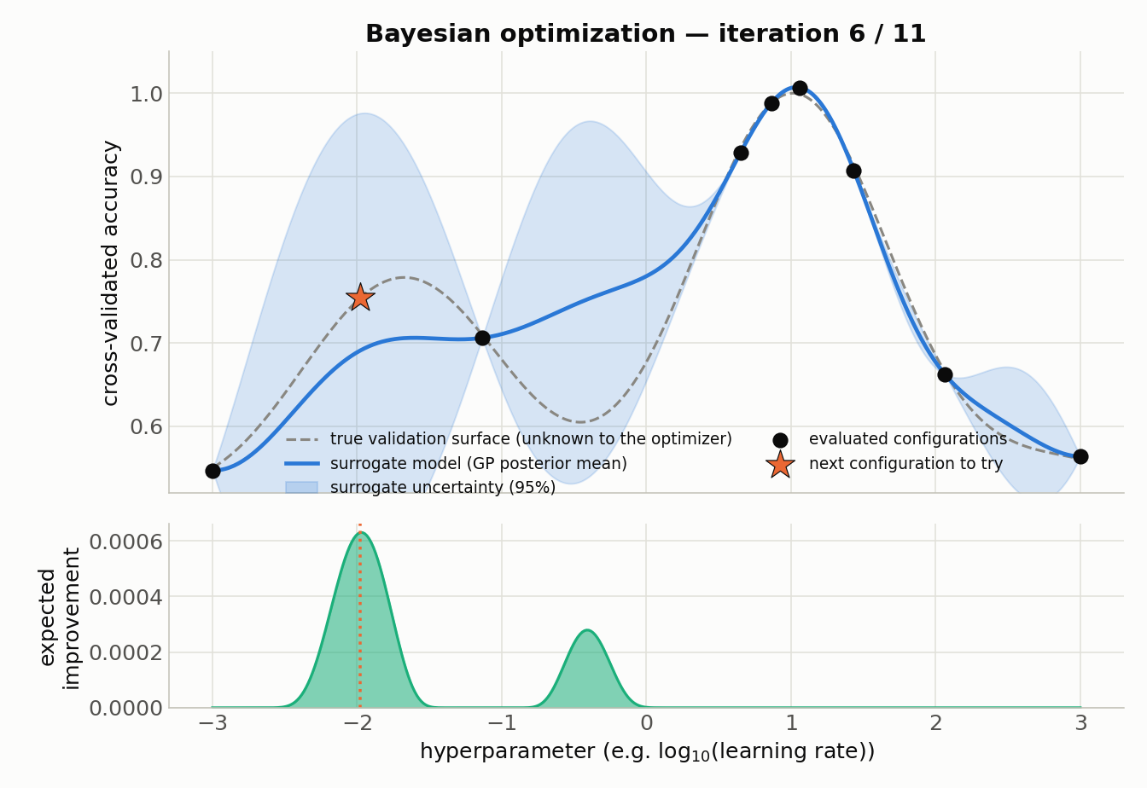
CLICK TO ADVANCE → STEP 6 OF 11
Bayesian optimization, iteration by iteration
Illustrative 1D surface — the real search space has 5 dimensions
13

Slide 15
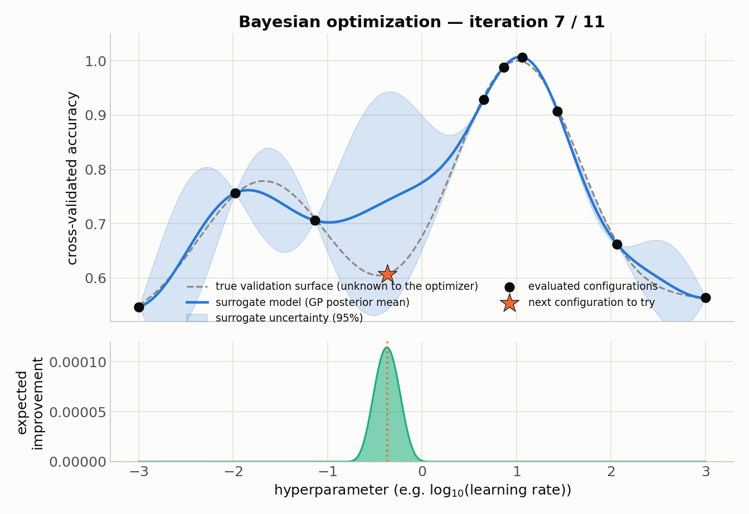
CLICK TO ADVANCE → STEP 7 OF 11
Bayesian optimization, iteration by iteration
Illustrative 1D surface — the real search space has 5 dimensions
14

Slide 16
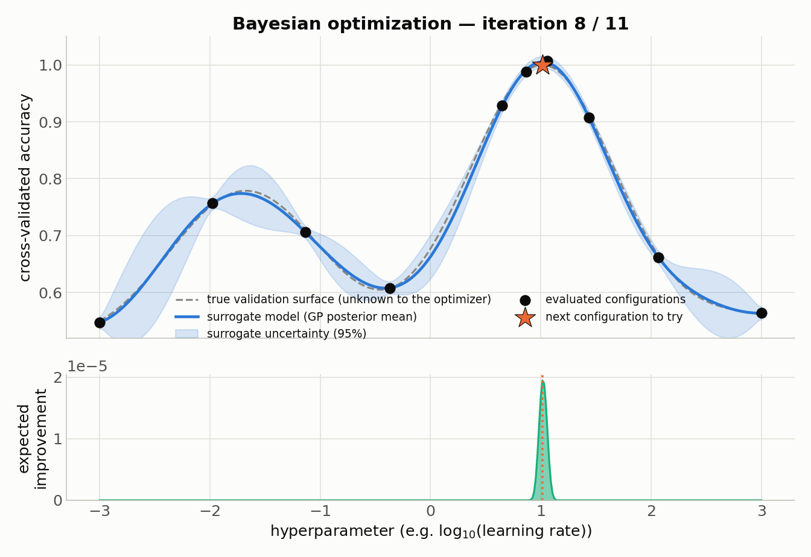
CLICK TO ADVANCE → STEP 8 OF 11
Bayesian optimization, iteration by iteration
Illustrative 1D surface — the real search space has 5 dimensions
15

Slide 17
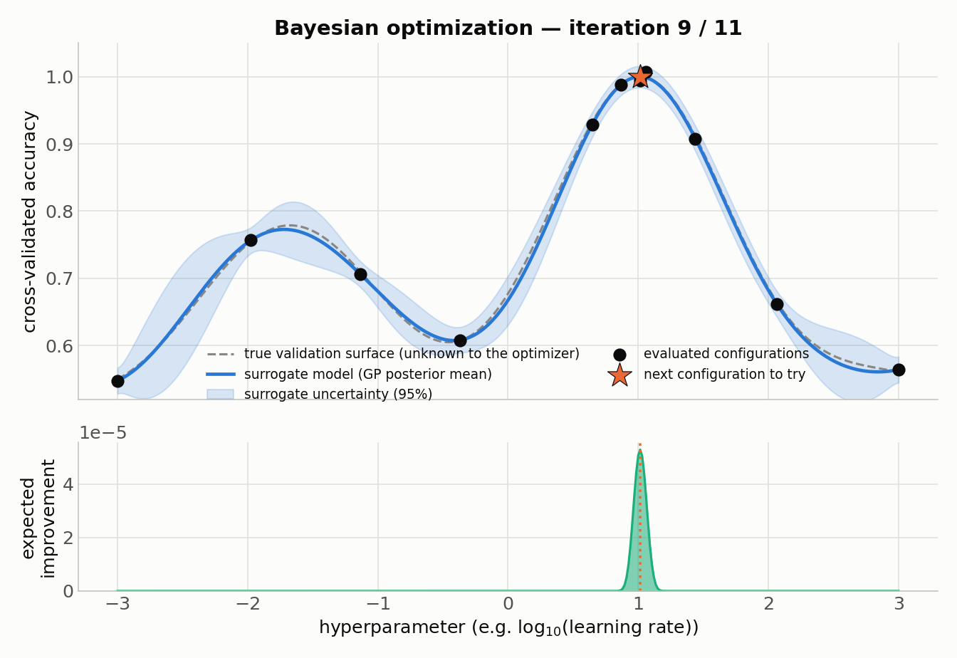
CLICK TO ADVANCE → STEP 9 OF 11
Bayesian optimization, iteration by iteration
Illustrative 1D surface — the real search space has 5 dimensions
16

Slide 18
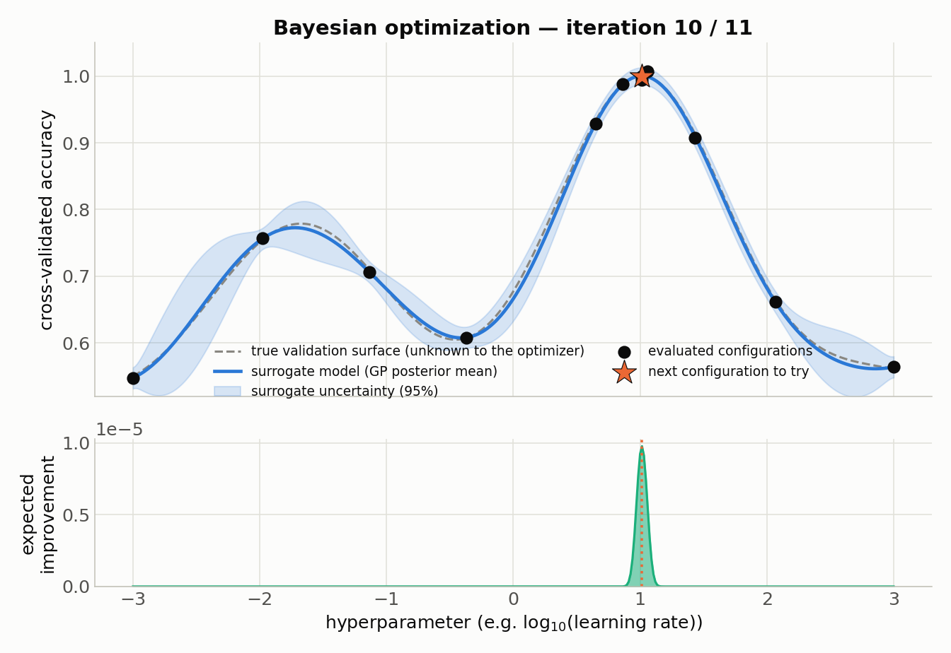
CLICK TO ADVANCE → STEP 10 OF 11
Bayesian optimization, iteration by iteration
Illustrative 1D surface — the real search space has 5 dimensions
17

Slide 19
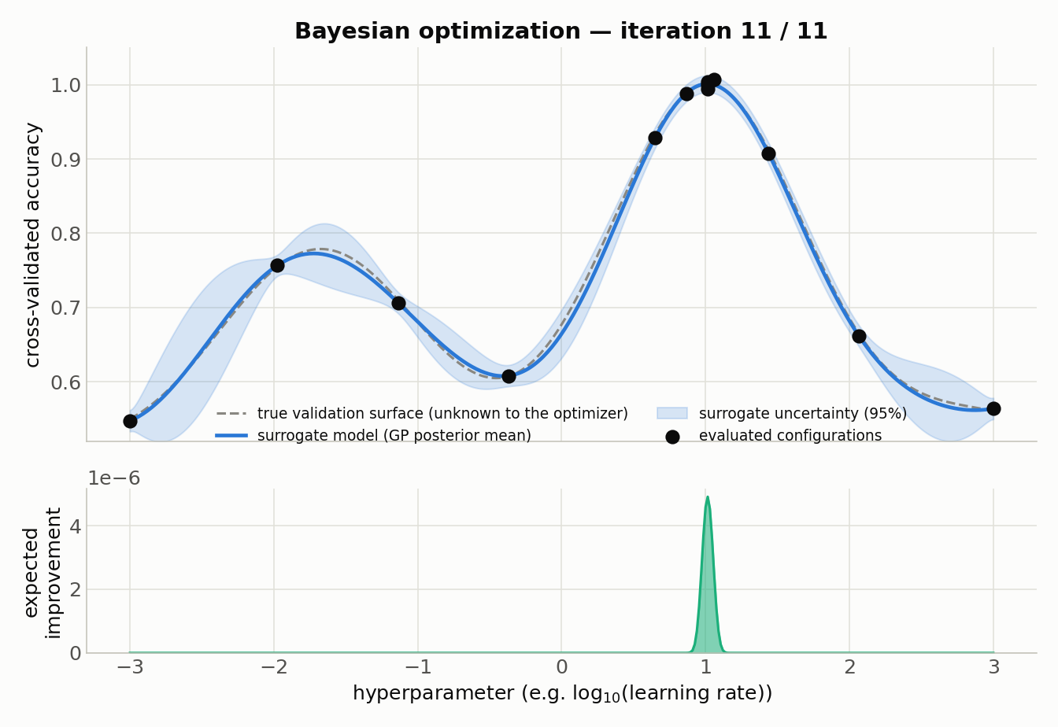
CLICK TO ADVANCE → STEP 11 OF 11
Bayesian optimization, iteration by iteration
Illustrative 1D surface — the real search space has 5 dimensions
18

Slide 20
STRATEGY 4
Multi-fidelity search: stop bad configs early
Key idea: most bad configurations already look bad after a small budget (few boosting rounds, few epochs)
Successive Halving: train many configs at a small budget, keep the top 1/η, promote them to a bigger budget, repeat.
Hyperband: runs several such brackets with different starting budgets, so it hedges against picking a bad budget schedule.
Our run (η = 3)
Rung | Configs | Budget
0 | 243 | 10 rounds
1 | 81 | 30 rounds
2 | 27 | 100 rounds
TK8117 · Hyperparameter tuning with cross-validation
19

Slide 21
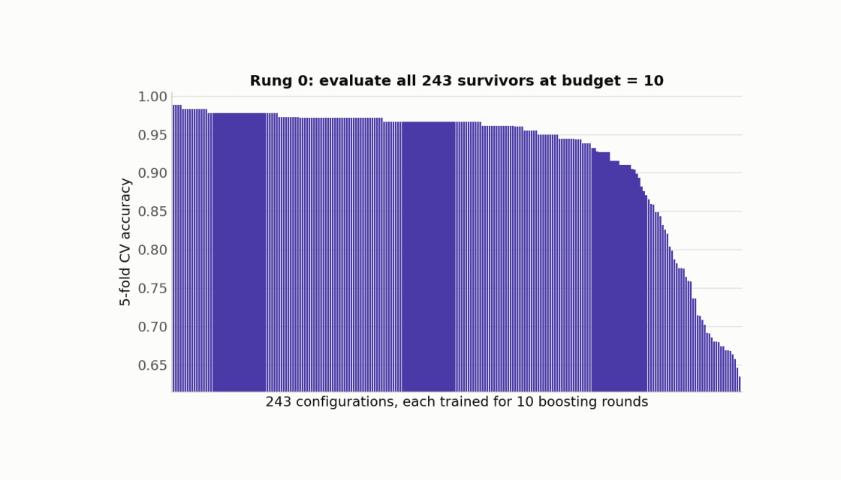
Successive halving on the wine dataset
Each frame uses the actual 5-fold CV scores from the wine-dataset run
20

Slide 22
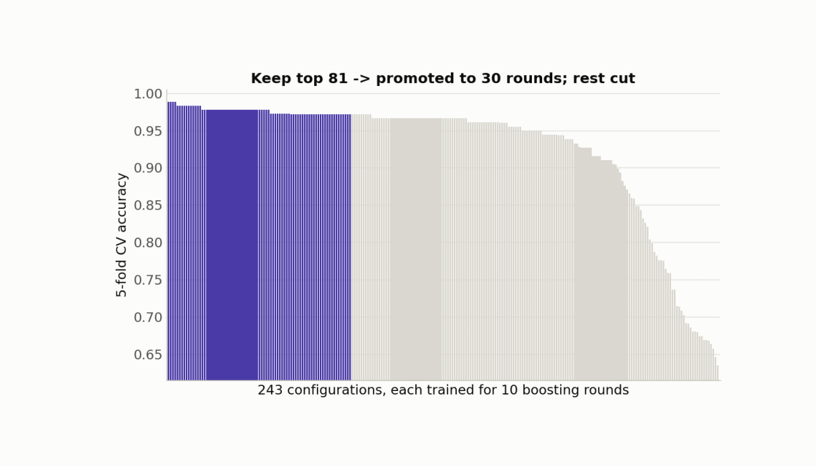
Successive halving on the wine dataset
Each frame uses the actual 5-fold CV scores from the wine-dataset run
21

Slide 23
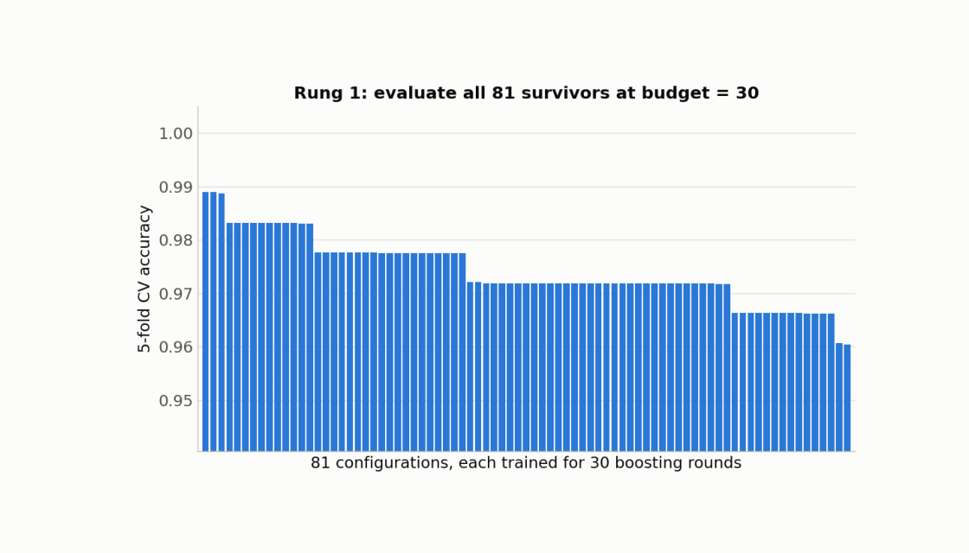
Successive halving on the wine dataset
Each frame uses the actual 5-fold CV scores from the wine-dataset run
22

Slide 24
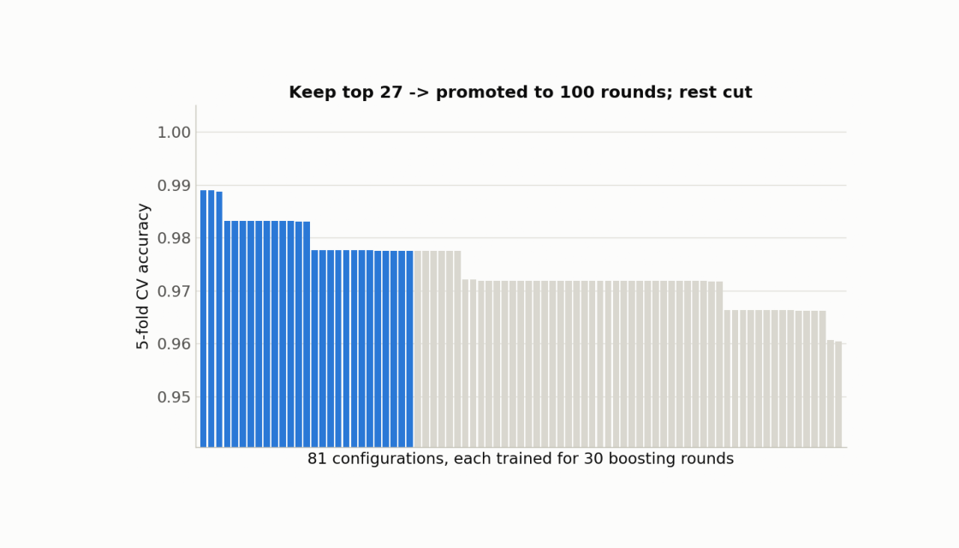
Successive halving on the wine dataset
Each frame uses the actual 5-fold CV scores from the wine-dataset run
23

Slide 25
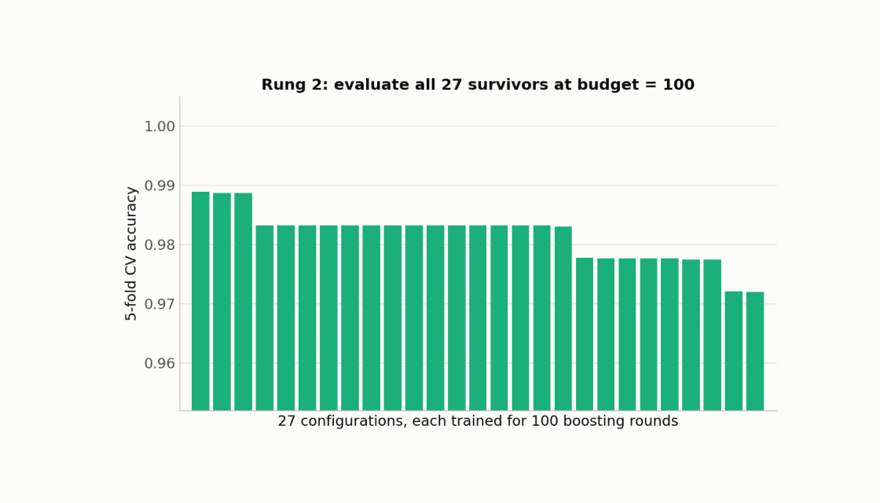
Successive halving on the wine dataset
Each frame uses the actual 5-fold CV scores from the wine-dataset run
24

Slide 26
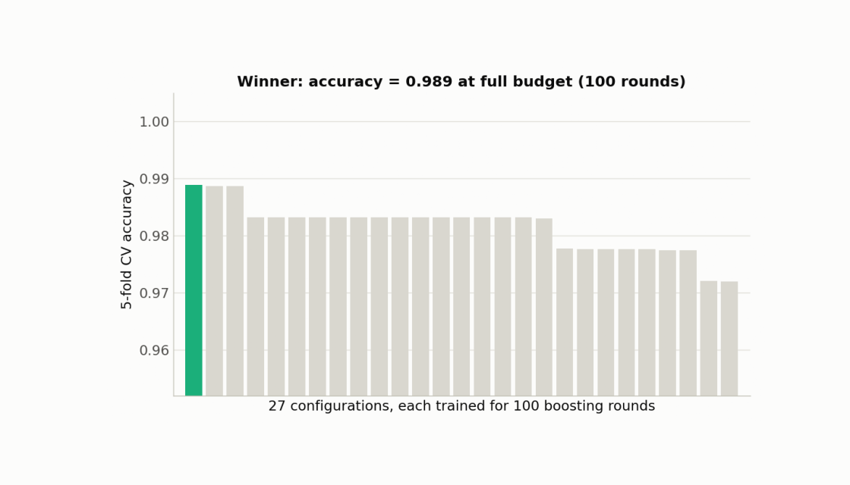
Successive halving on the wine dataset
TAKE-HOME #1
Grid and random search spend most of their budget on configurations that don't help. Budget-aware strategies (search with memory, or stopping bad configurations early) find a comparable configuration for a fraction of the compute.
Each frame uses the actual 5-fold CV scores from the wine-dataset run
25

Slide 27
02
Validation:
how you keep it honest
TK8117 · Hyperparameter tuning with cross-validation
26

Slide 28
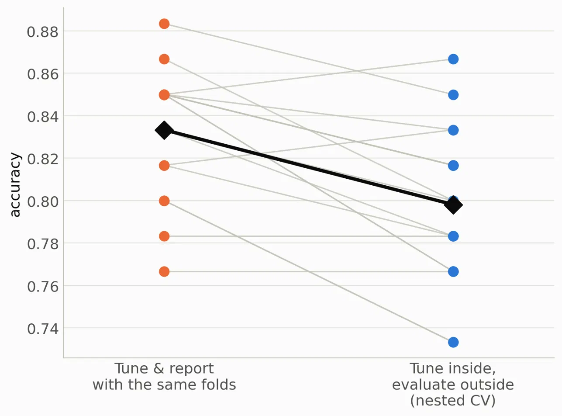
CAWLEY & TALBOT, JMLR 2010
The trap: reusing folds to tune AND to report performance
If you pick the hyperparameters that maximize a CV score, and then report that same score as “model performance”, you've let the winner's curse in.
The best of many noisy scores is optimistically biased
Nested CV separates the two jobs: an inner loop tunes, an outer loop evaluates the tuned model
TAKE-HOME #2
Cross-validation only makes tuning trustworthy if the folds that pick your hyperparameters are kept apart from the folds that report performance.
Plot: setup hardened to make the bias visible — 60 wine samples, 2 real + 150 pure-noise features, 14 configs, 18 repeats
27

Slide 29
SPOTLIGHT · AUTOML-CONF 2025
Tuning itself can overfit
“Overtuning”
The validation error you optimize is a noisy, finite-sample estimate of generalization error
Optimizing it harder doesn't just find better configs: it starts fitting the noise in that estimate.
Practical takeaway: track a held-out curve during tuning, and don't assume “more trials = strictly better” without checking.
Schneider, Bischl & Feurer (2025)
Overtuning in Hyperparameter Optimization
Even with nested CV done right, running HPO for too long can start to overfit the validation estimate itself.
Overtuning is more common than assumed, in ~10% of cases the “best” config found is worse than the default.
Worst in the small-data regime
TK8117 · Hyperparameter tuning with cross-validation
28

Slide 30
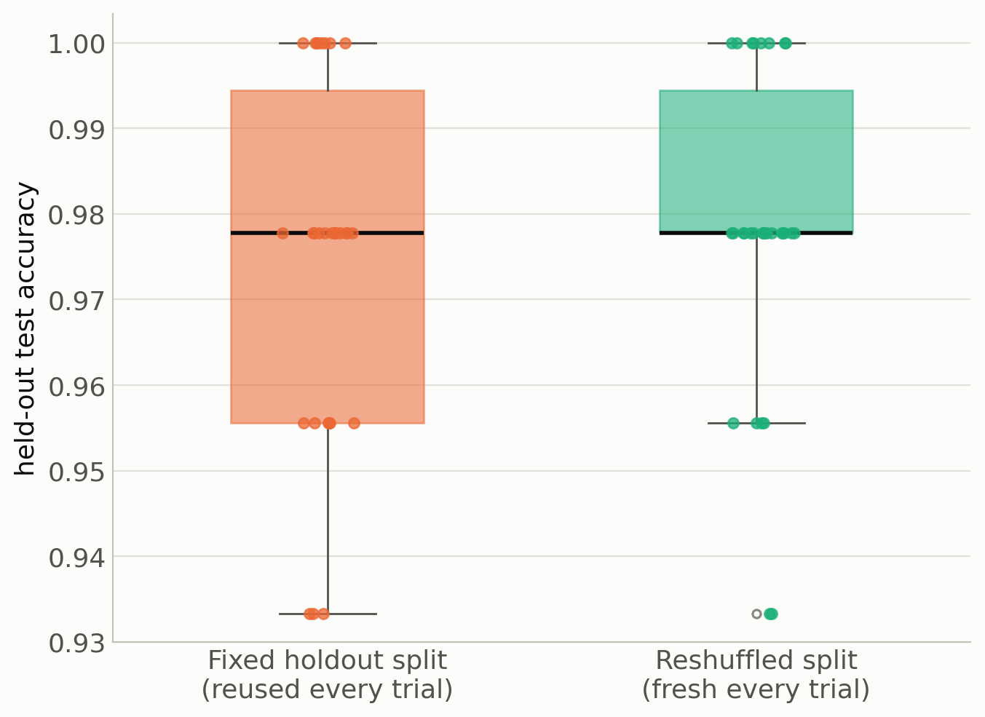
SPOTLIGHT · NEURIPS 2024
Even your fold assignment is a choice
Nagler et al. (2024), Reshuffling Resampling Splits Can Improve Generalization of Hyperparameter Optimization
Usual advice: fix the split (holdout or CV folds) once and reuse them for every configuration
Finding: a new split for every trial often generalizes better, because the optimizer can't overfit to one split
Effect is strongest for holdout, where reshuffling can make holdout competitive with k-fold CV.
TAKE-HOME #3
Hyperparameter tuning can overfit too!
Plot: our run on wine (30 repeats, 40 configs, holdout) — illustrative; difference not significant (Wilcoxon p = 0.39)
29

Slide 31
A PRACTICAL DECISION GUIDE
Which strategy, when?
Situation | Reach for
Few hyperparameters (≤3), cheap evaluations, want simplicity | Random search -> still a strong, honest baseline
Expensive evaluations, sequential compute, smooth response surface | Bayesian optimization (TPE / GP)
A natural budget knob exists (epochs, trees, rows, CV folds) | Hyperband
Any of the above, small or noisy dataset | Nested CV
TK8117 · Hyperparameter tuning with cross-validation
30

Slide 32
RECAP
Three things to take home
Grid and random search spend most of their budget on configurations that don't help. Budget-aware strategies (search with memory, or stopping bad configurations early) find a comparable configuration for a fraction of the compute.
1
Cross-validation only makes tuning trustworthy if the folds that pick your hyperparameters are kept apart from the folds that report performance.
2
Hyperparameter tuning can overfit too!
3
TK8117 — Hyperparameter tuning with cross-validation
31

Slide 33
Questions?
Thank you
TK8117 — Hyperparameter tuning with cross-validation
32

