Slide 1
Choosing the Number
of Principal Components
Fatemeh Chitsaz
Mateus Machado Pedrosa
Jakob Ingvar Utne Midtun
TK8117 · Multivariate Data Analysis
1
Notes:
The «algorithm» for doing PCA does not include an optimal cut-off point for your principal components, that is a choice that needs to be made on some grounds, preferably based on needs or criterias

Slide 2
Three take-home messages
1
PCA ranks directions by variance in X, not by usefulness for y.
2
The right number of PCs depends on the goal: compression, interpretation, or prediction.
3
For prediction, choose k by cross-validating the full PCA + model pipeline.
2
Notes:
As discussed in yesterdays lecture, the PCs with the largest Evs are not necessarily carrying the signal for your output

Slide 3
Three take-home messages
1
PCA ranks directions by variance in X, not by usefulness for y.
2
The right number of PCs depends on the goal: compression, interpretation, or prediction.
3
For prediction, choose k by cross-validating the full PCA + model pipeline.
3
Notes:
If your goal is to reduce noise, get your image to 2D or find an optimal dimmensionality recduction while still retaining all significant information in your model you will probably end up cutting remainding PCs at different points.

Slide 4
Three take-home messages
1
PCA ranks directions by variance in X, not by usefulness for y.
2
The right number of PCs depends on the goal: compression, interpretation, or prediction.
3
For prediction, choose k by cross-validating the full PCA + model pipeline.
4
Notes:
There is no general rule for which PCs contain the most predictive signal for your outcome. Cross-validating the PCA + model pipeline can therefore help determine how many PCs to retain, especially when PCA is used as preprocessing for a predictive model.

Slide 5
The talk has one question
How many PCs are enough?
useful k
Not enough
Too many
little reduction and more noise
lose relevant information
The answer depends on what “enough” means for the task.
5
Notes:
Explain the trade-off. This slide gives the audience a reason to care before listing methods.

Slide 6
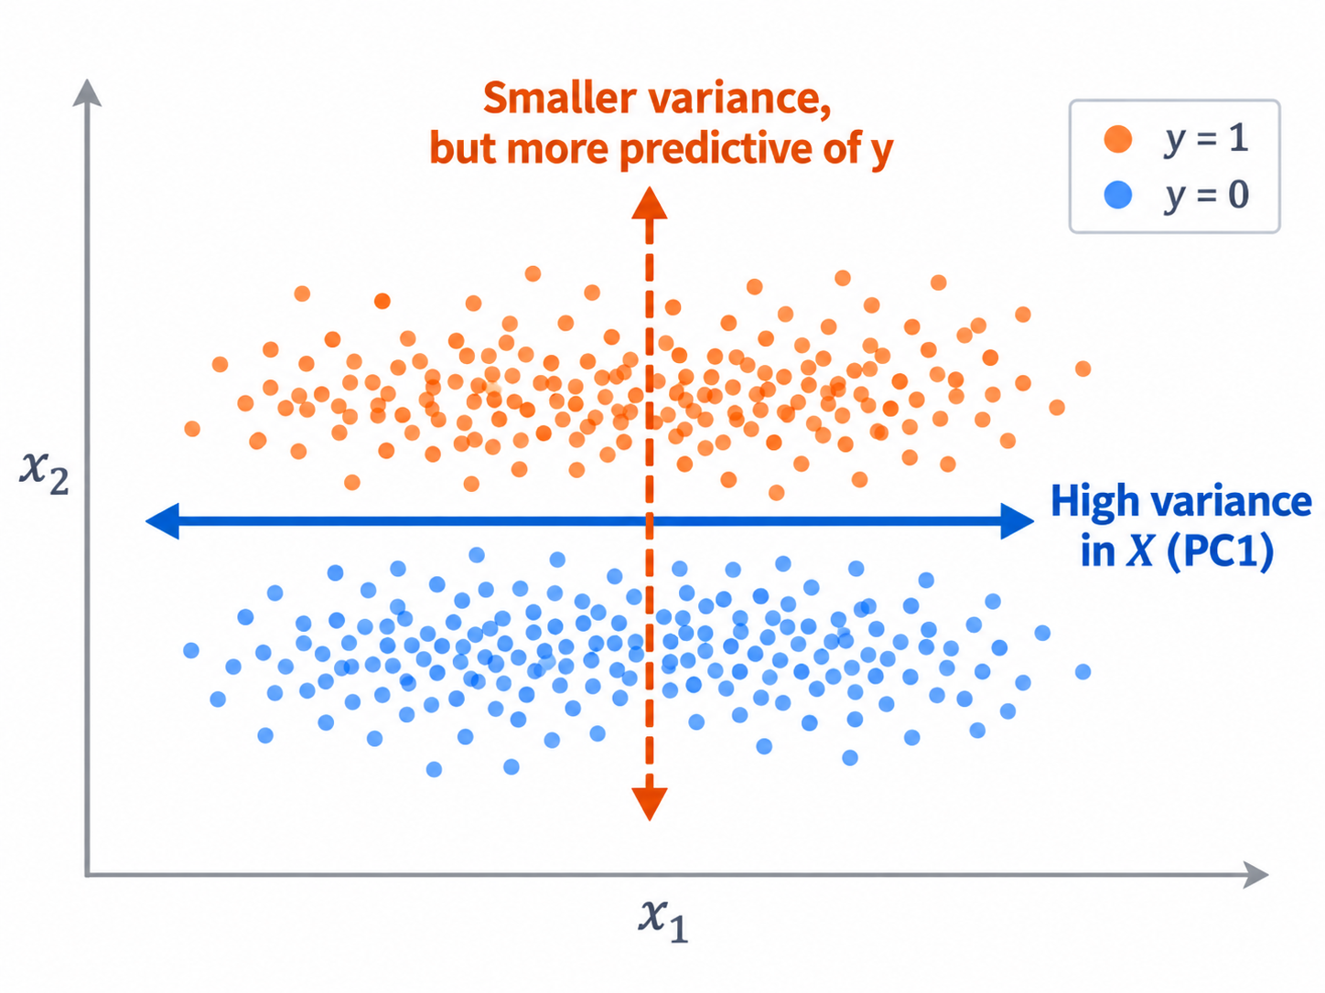
Message 1: variance is not usefulness
High-variance direction
Var ≈ 93.6
|corr(y)| ≈ 0.02
Predictive direction
Var ≈ 0.61
|corr(y)| ≈ 0.98
A low-variance PC can still carry the class signal.
Do not select k for prediction by variance alone.
6

Slide 7
Message 2: the goal decides the selection rule
What do you want PCA to do?
1
Compression
2
Interpretation
3
Prediction
Keep enough cumulative variance.
Look for a stable elbow or simple structure.
Cross-validate the full PCA + model pipeline.
The same dataset can justify different k values depending on the goal.
7

Slide 8
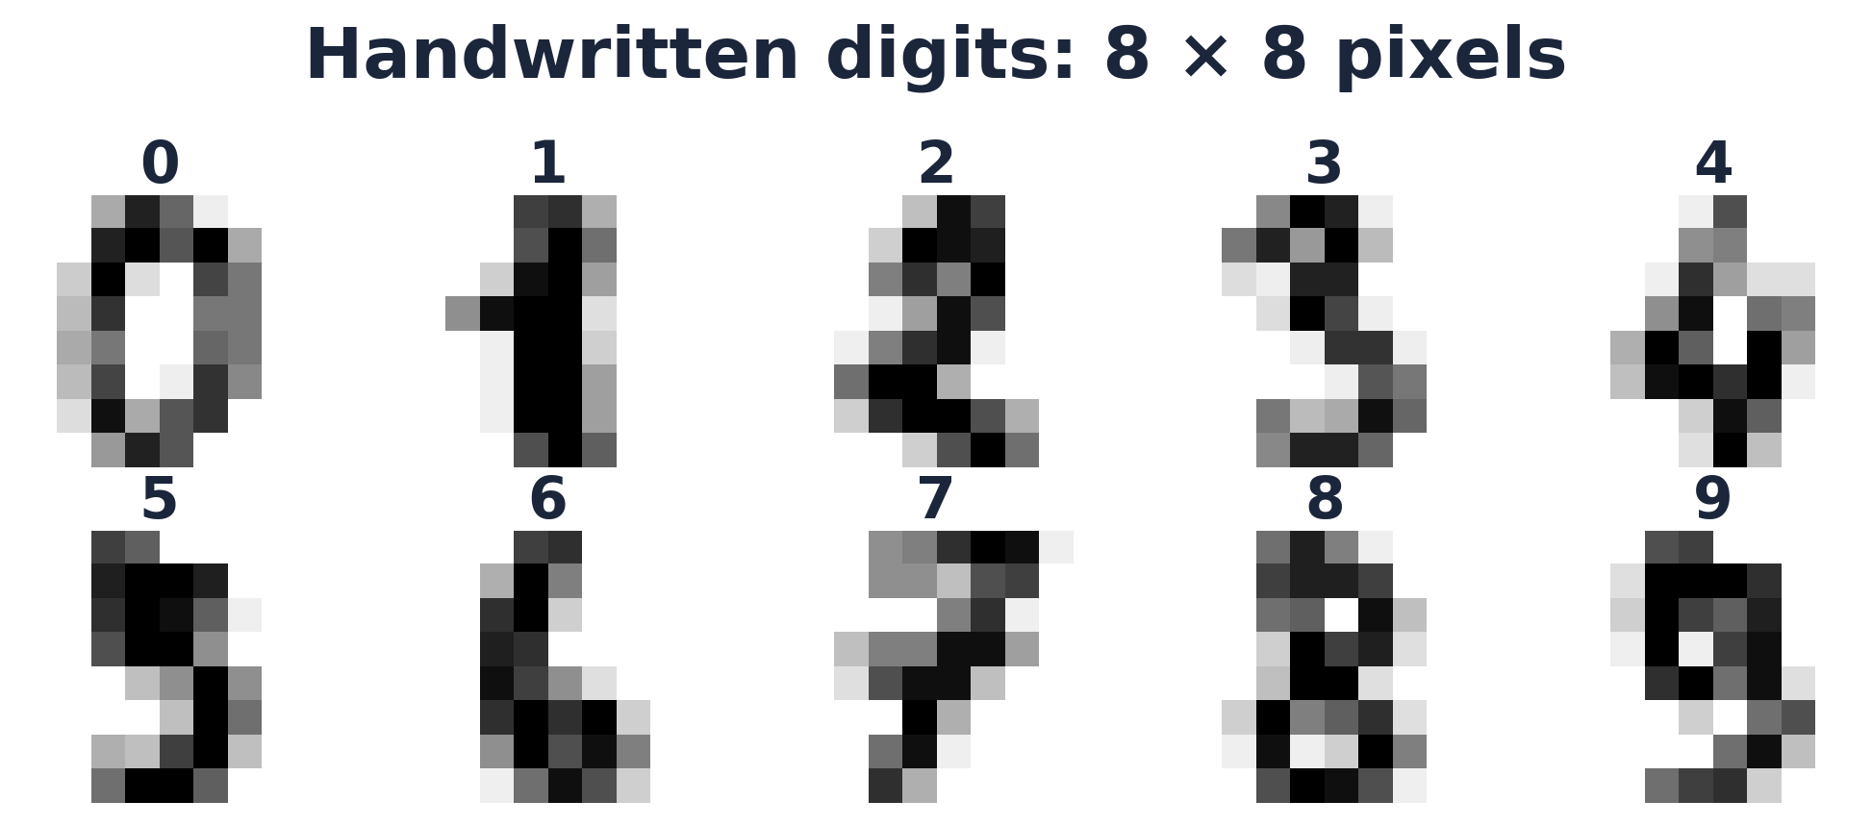
A case study: handwritten digits
1,797
samples
64
pixel variables
10
digit classes
Question: which k should we keep?
rank(X) = 61
So k can range from 1 to 61 non-zero components.
Same dataset, different goals, different k
5

Slide 9
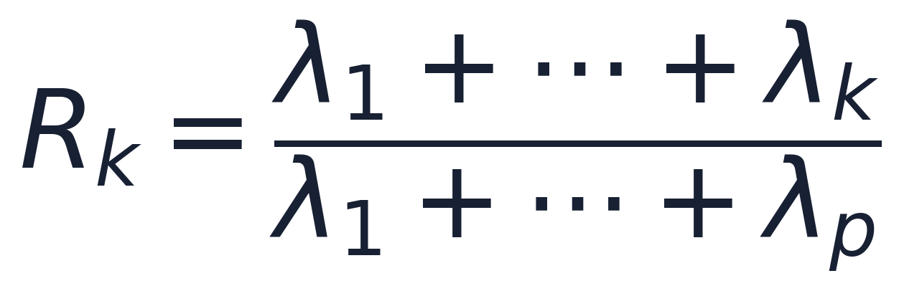
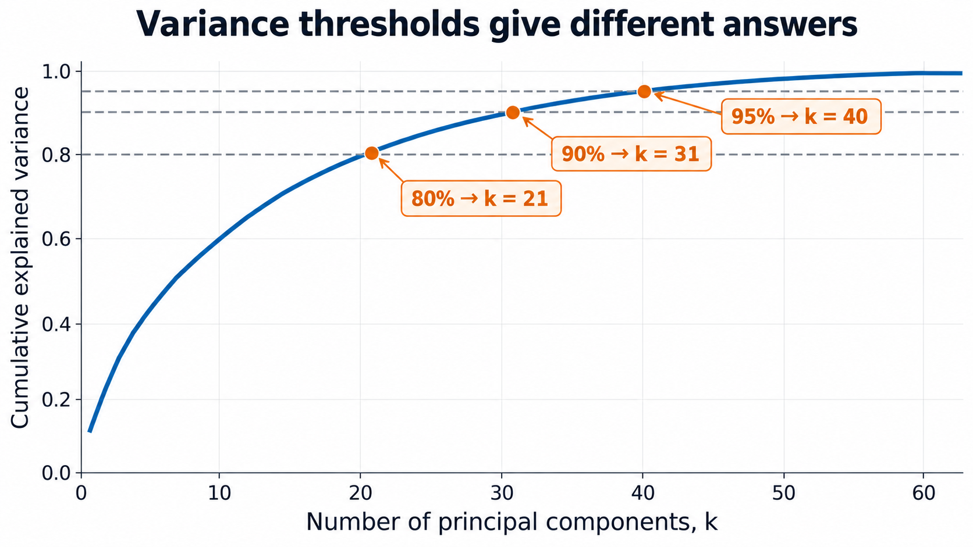
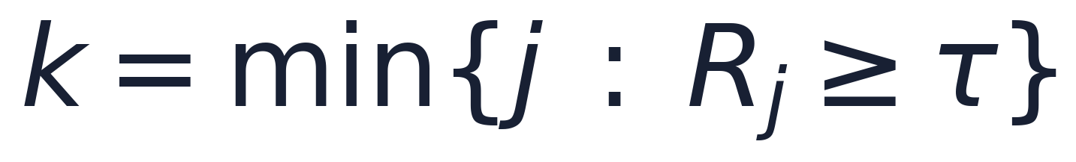
Compression: variance thresholds give different answers
It answers
“How much variance in X did we keep?”
It does not answer
“Is this enough for my task?”
8

Slide 10
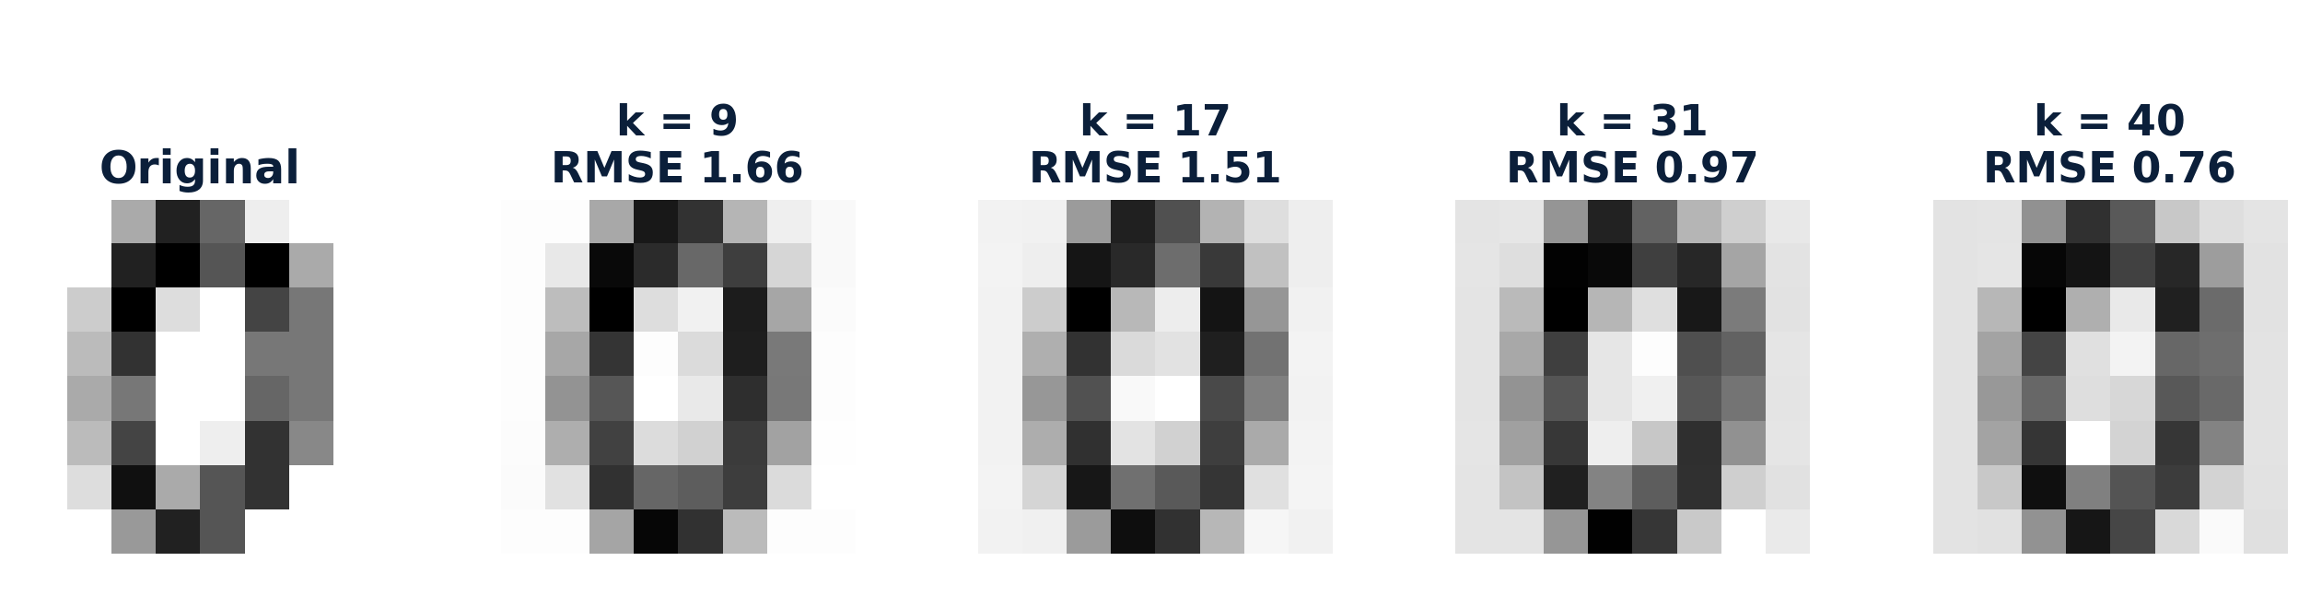
For compression, reconstruction is a sanity check
What reconstruction tells you
Can a smaller representation still preserve the object?
9

Slide 11
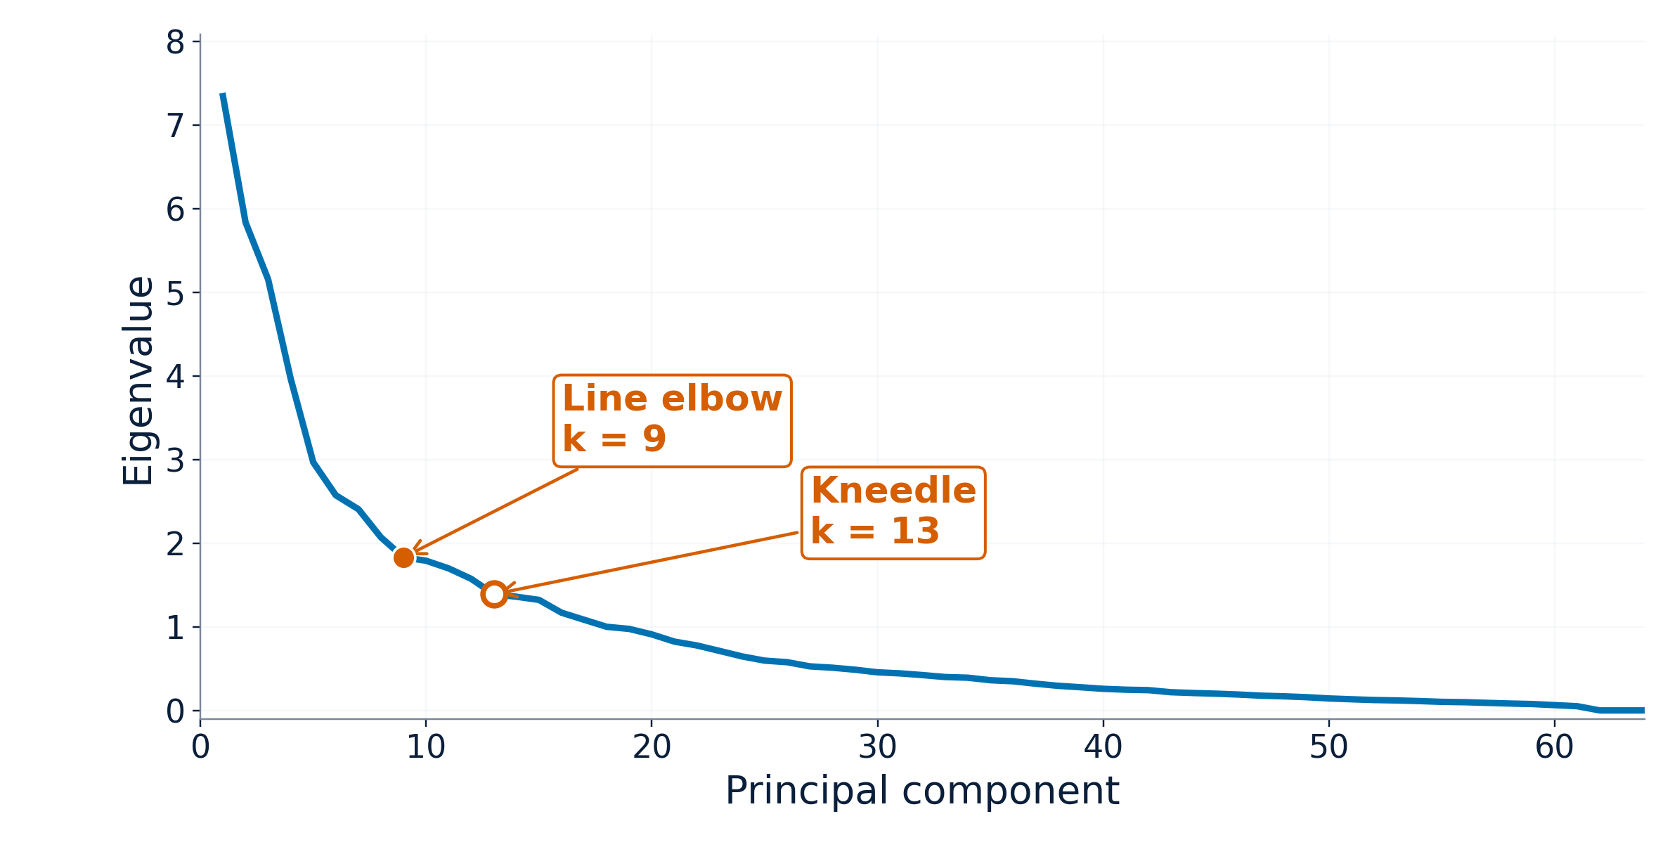
Interpretation : scree plot asks where the spectrum flattens
Idea
Look for the point after which extra PCs add little variance.
Why useful
It gives a small, explainable representation. The first PCs are assumed “signals” and the rest are noise.
But “the elbow” is not unique.
10

Slide 12
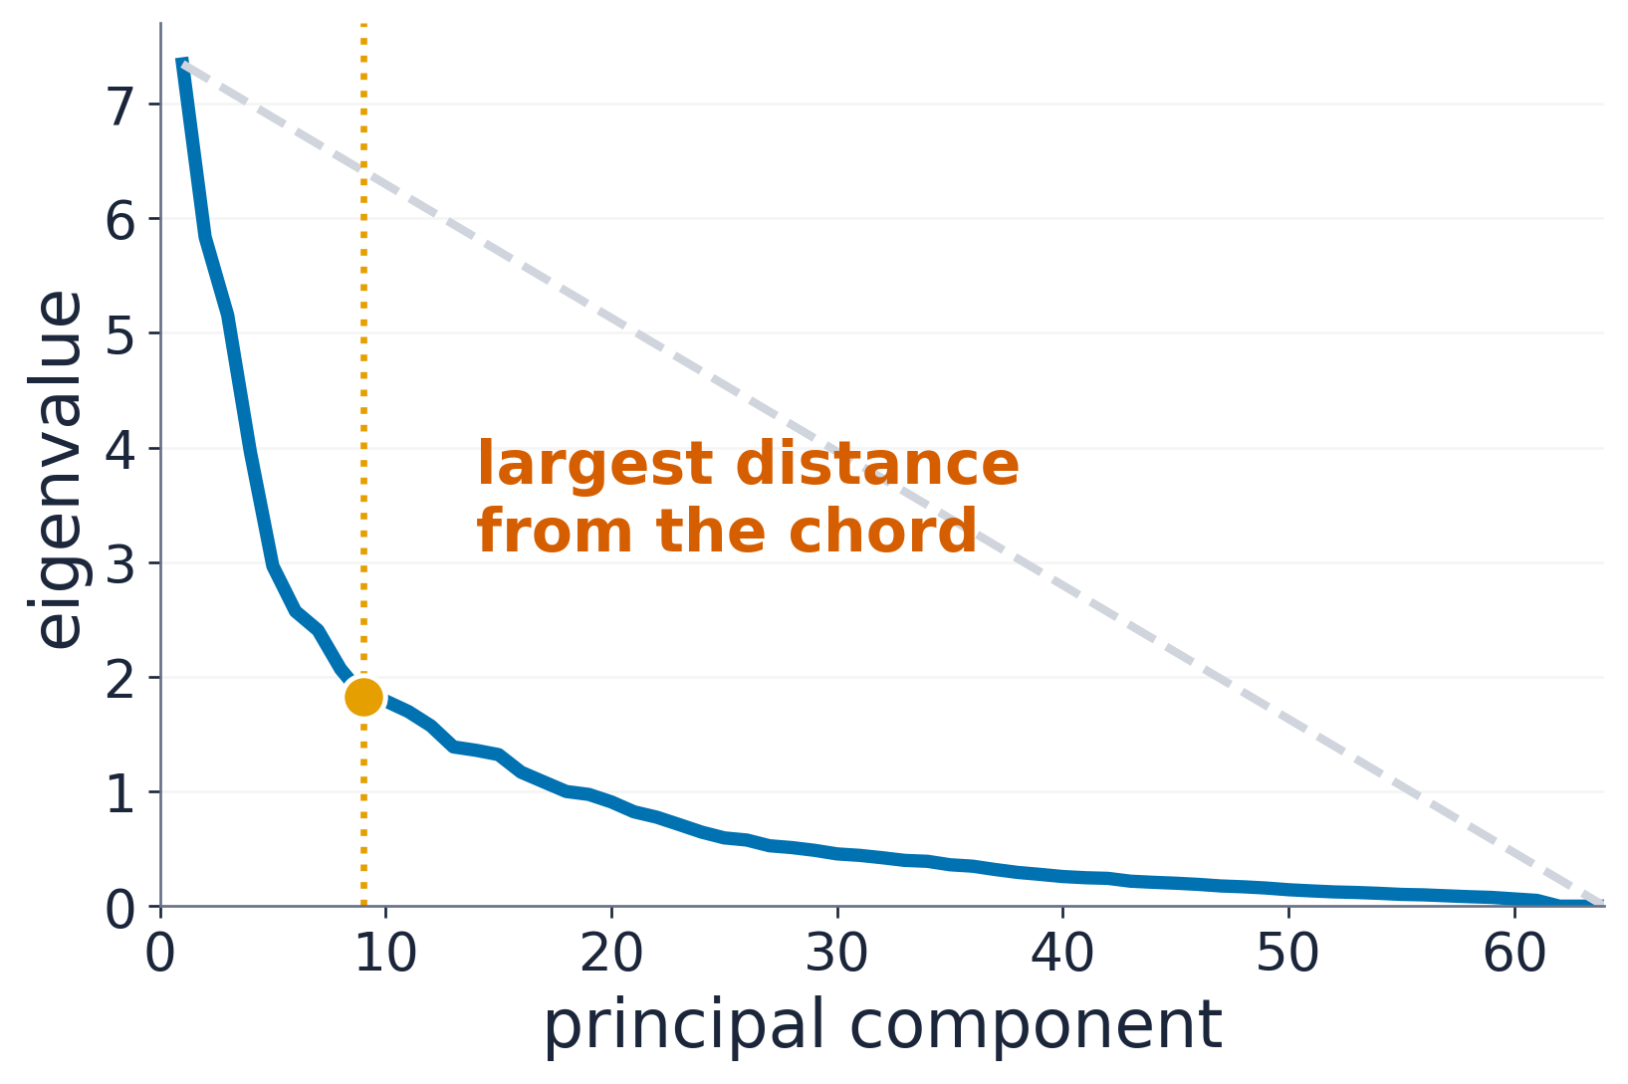

Interpretation : distance from the line
Pick the scree point farthest from the grey chord.
Digits result: k = 9
L= line through $\left(1,λ_{1}\right)$ and $\left(p,λ_{p}\right)$
$$d_{i}=\operatorname{dist}{(}\left(i , λ_{i}\right),ℒ)$$
$$k_{geo}=\arg{\max_{1≤i≤p}}d_{i}$$
11
Notes:
Keep this simple: the formula defines the farthest-distance point; the plot visually shows the same idea.

Slide 13
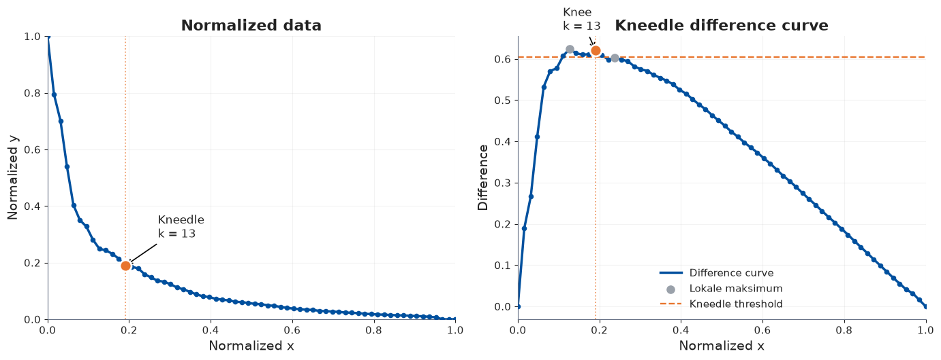
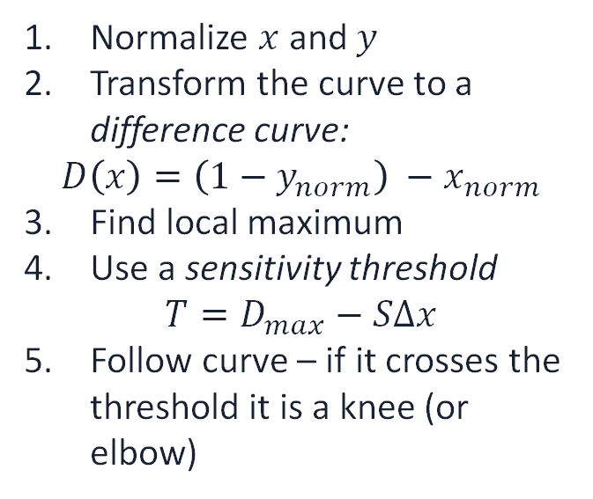
Interpretation : Kneedle method
Normalize $x$ and $y$
Transform the curve to a difference curve:
$$D\left(x\right)=\left(1−y_{norm}\right) −x_{norm}$$
Find local maximum
Use a sensitivity threshold
$$T=D_{max}−SΔx$$
Follow curve – if it crosses the threshold it is a knee (or elbow)
Digits result: k = 13
11
Notes:
Keep this simple: the formula defines the farthest-distance point; the plot visually shows the same idea.

Slide 14
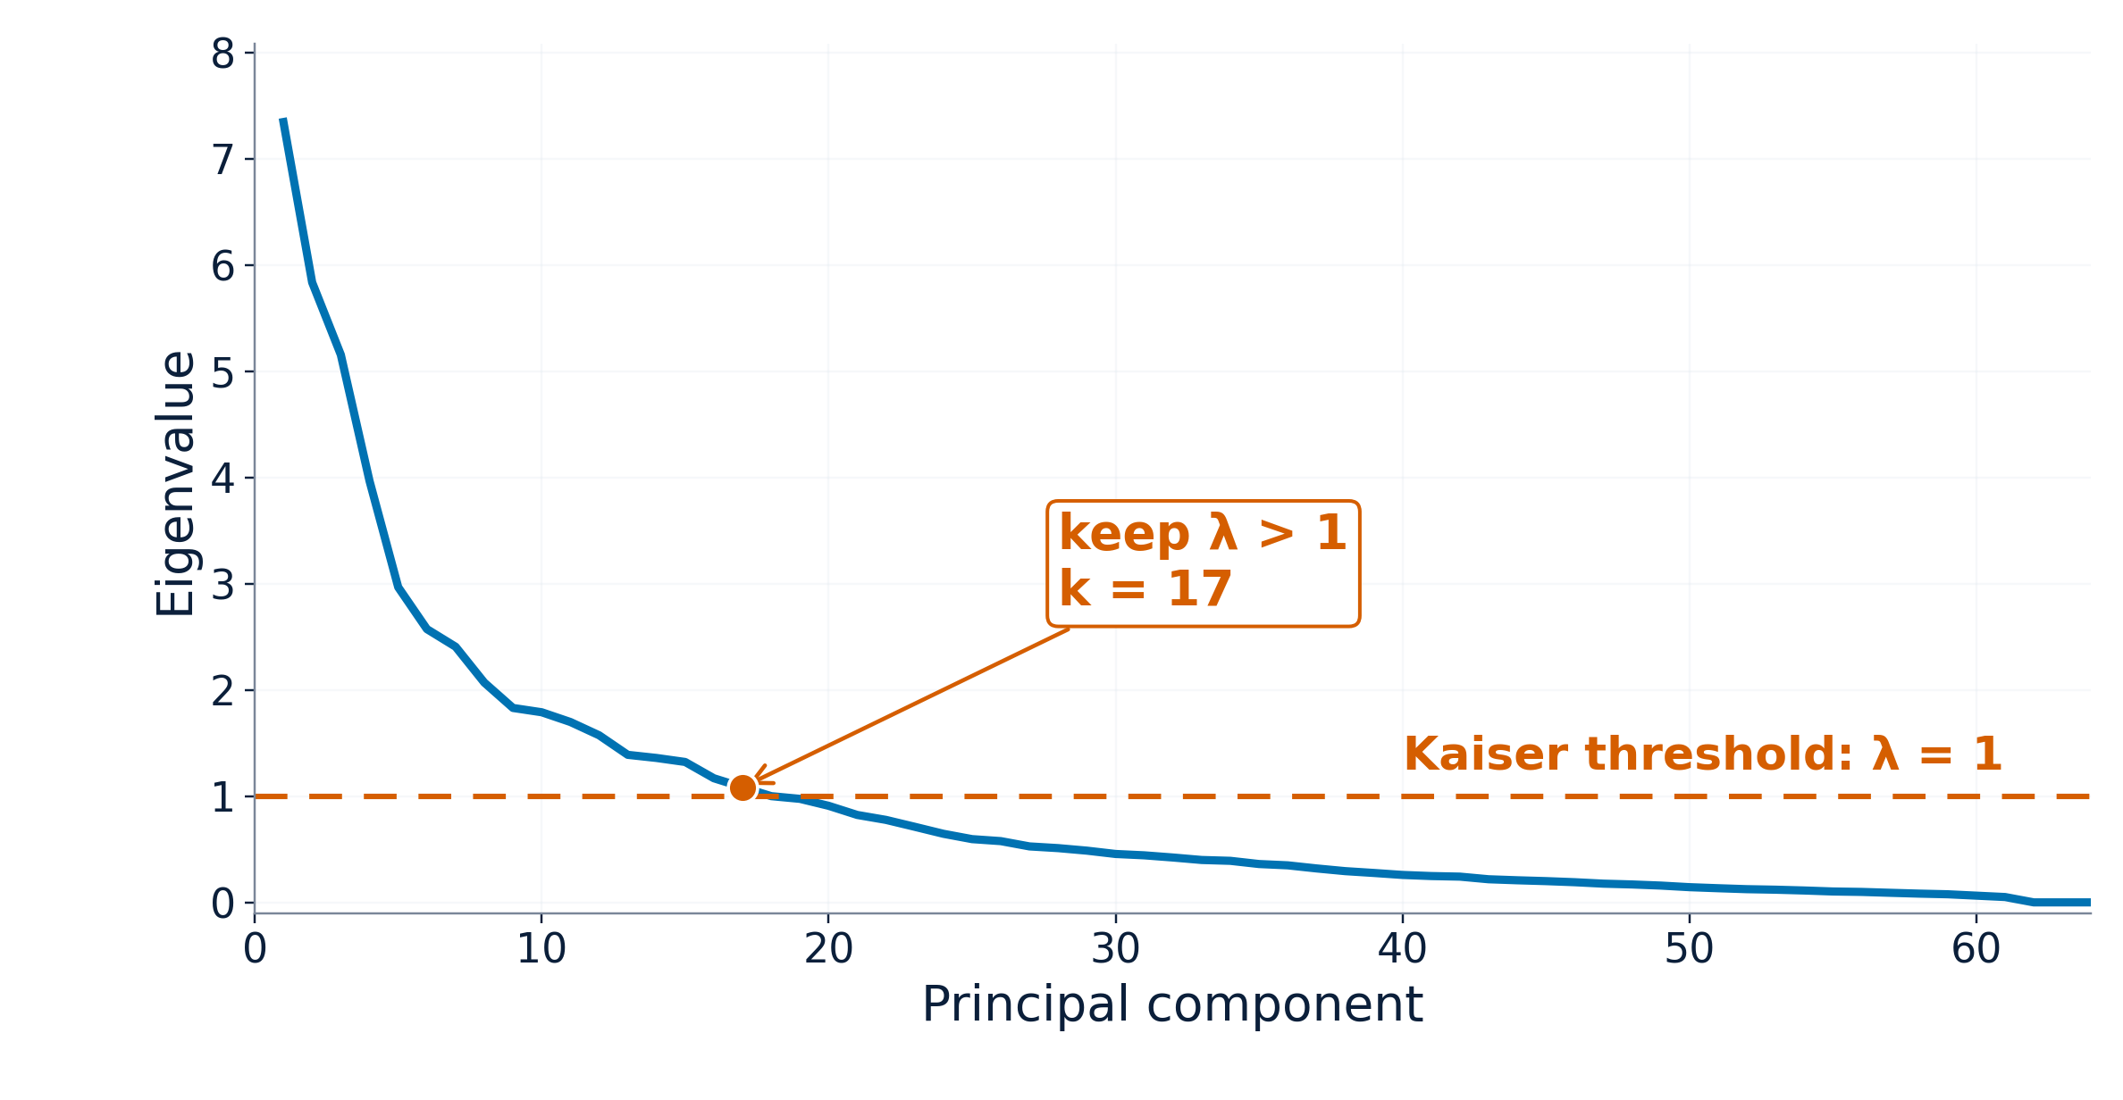
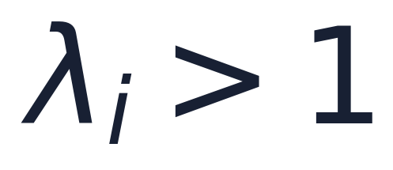
Interpretation: Kaiser keeps eigenvalues above one
Rule
Keep PC i if its eigenvalue is larger than one.
Why 1?
After standardization, each original variable has variance 1.
Digits result: k = 17
10

Slide 15
Summary and short-comings: cumulative explained
variance
Summary:
Selects k as the smallest number of components whose eigenvalues account for a chosen fraction τ of total variance in X.
Cons:
Threshold τ is arbitrary, not data-driven
Measures variance retained — not task relevance
No guarantee discarded variance was noise
10

Slide 16
Summary and short-comings: elbow methods
Summary:
Assumes the eigenvalue spectrum separates into a "signal" regime (steep decay) and a "noise" regime (flat tail), and selects k at the transition point.
Cons:
"Knee" only sharp under specific theoretical conditions
Different elbow methods often disagree
Descriptive, not optimality-based
10

Slide 17
Summary and short-comings: Kaiser criterion
Summary:
Retains components whose eigenvalue exceeds the average variance of a single standardized variable, under the reasoning that such a component explains "more than one variable's worth" of variance.
Cons:
Only valid for standardized data
Ignores sample size — no reliability check
Over-selects as dimensionality (p) grows
10

Slide 18
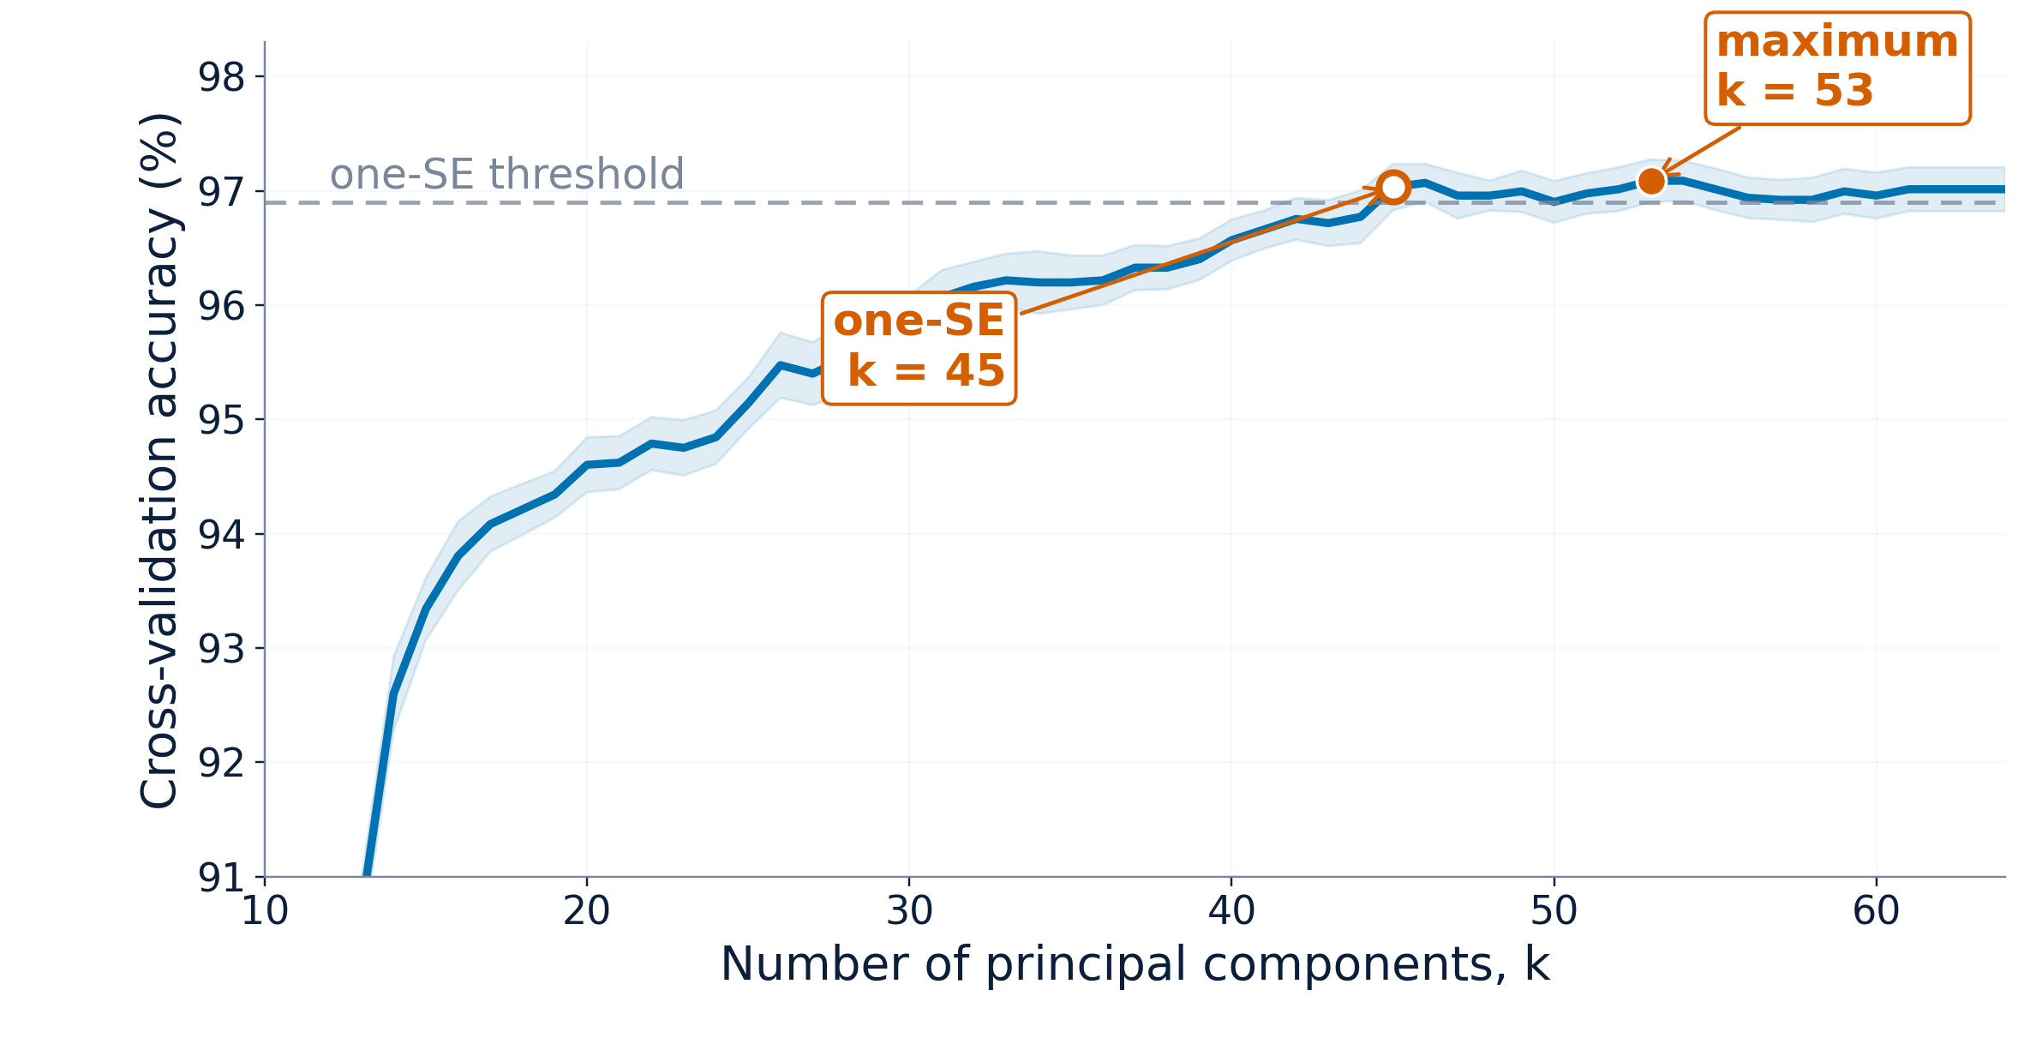
Message 3: validate the complete predictive pipeline
Training
fold
Scale
features
Fit
PCA(k)
Fit
classifier
Evaluate
validation fold
Repeat this for every candidate k and keep preprocessing inside each fold.
One-SE rule
Choose the smallest k whose score is still within one standard error of the best.
Maximum rule
Choose the k with the highest average validation score.
12

Slide 19
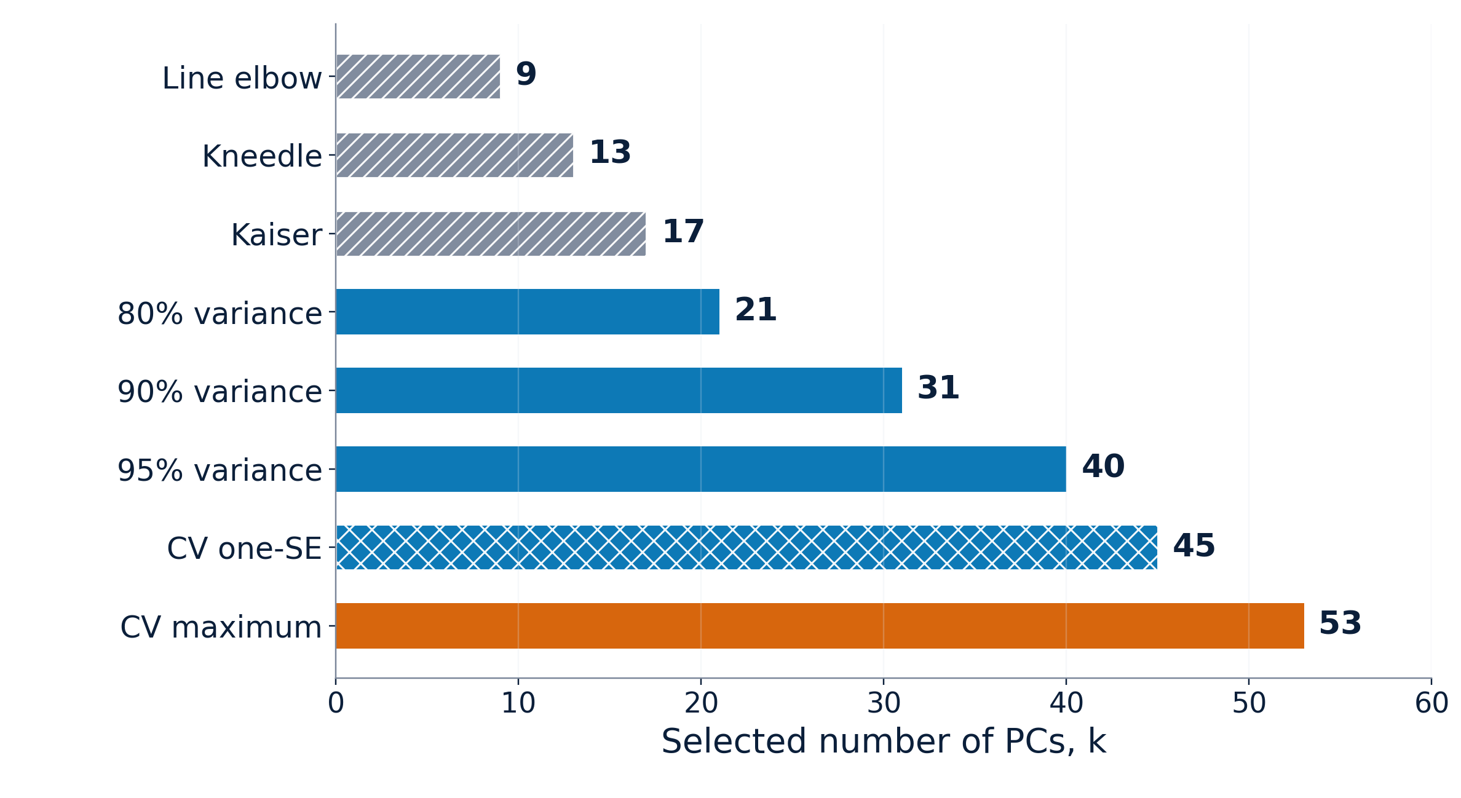
All rules on one scale
What the scale says
Interpretation methods favor smaller k (9 – 17)
Variance thresholds give medium k (21– 40)
Prediction prefers larger k (45 – 53)
13

Slide 20
Summary: ask “enough for what?”
1
Interpretation
Use scree / Kaiser as simple heuristics.
2
Compression
Choose an explicit variance threshold.
3
Prediction
Cross-validate the full PCA + model pipeline.
Take-home: the best k is the one that matches the job you want PCA to do.
14

Slide 21
Sources
Alpaydin, E. & Kaynak, C. (1998). Optical Recognition of Handwritten Digits [Dataset]. UCI Machine Learning Repository. https://doi.org/10.24432/C50P49
Pedregosa, F. et al. (2011). Scikit-learn: Machine Learning in Python. Journal of Machine Learning Research, 12, 2825–2830. https://jmlr.org/papers/v12/pedregosa11a.html
Scikit-learn developers. (2026). load_digits — scikit-learn documentation. https://scikit-learn.org/stable/modules/generated/sklearn.datasets.load_digits.html
Satopaa, V., Albrecht, J., Irwin, D. & Raghavan, B. (2011). Finding a “Kneedle” in a Haystack: Detecting Knee Points in System Behavior. 31st International Conference on Distributed Computing Systems Workshops, 166–171. https://doi.org/10.1109/ICDCSW.2011.20
Kneed developers. (2026). kneed — Knee-point detection in Python. https://kneed.readthedocs.io/
Scikit-learn developers. (2026). KNeighborsClassifier — scikit-learn documentation. https://scikit-learn.org/stable/modules/generated/sklearn.neighbors.KNeighborsClassifier.html
14

