Slide 1

Date: 07/08/2025
Building a QA Chatbot on
Ancient Greece Using Advanced AI Frameworks
By
Dr. Niraj Bagh

Slide 2
Outline
Workflow
Diversity-based chunking algorithm analysis
Document chunking
Embedding technique and storing vector data base
Retrieval system
LLM model and prompt engineering
Model evaluation
Retrieval system evaluation
Results and discussion
Challenges in the current chatbot
Future work
Conclusion

Slide 3
1. Workflow
The detailed steps for the proposed project are explained below:
Hybrid Retrieval and Re-ranking Technique: Perform both keyword-based retrieval (BM25) and dense vector similarity search. Select the top 5 relevant documents and re-rank them using a cross-encoder transformer.
Prepare LLM Input: Combine the processed query and the top 5 relevant documents for LLM input.
Configure LLMs and Prompts: Define both open-source (LLaMA, Mistral) and closed-source (OpenAI) LLMs along with appropriate prompt templates and parameters. The prompts are crafted to reduce hallucination and include source citations.
Generate LLM Response: Feed the processed query and relevant documents to the selected LLM. The model generates an answer along with source citations.
Evaluate System Performance: Evaluate the quality of the LLM-generated response and the retrieval system.
Load the Dataset: Load the dataset consisting of 60 individual text files.
Text Preprocessing: Apply preprocessing techniques to clean the text data by removing special characters, noise, stop words, etc.
Determine Optimal Chunking Parameters: Use a novel chunking technique to determine the optimal window size and overlap percentage for dividing text.
Chunk the Text: Split the documents into chunks using the identified optimal window size and overlapping strategy.
Generate Embeddings: Convert each text chunk into an embedding vector using the OpenAI Embedding. Store Embeddings Vector along with the metadata in a ChromaDB vector database.
Process User Query: Accept a user query and apply preprocessing steps.
Query Embedding: Generate the embedding for the processed query using the OpenAI Embedding.

Slide 4
RAG Pipeline
Greece
Dataset
Preprocessing
Select optimal window size
Apply
Chunking
With optimal window size
1
2
3
4
Chunk-1
Chunk-2
Chunk -N
Vector DB
Embedding
5
User Query
7
8
6
9
10
Response
LLM
Query + Relevant Document
12
11
Figure 1: RAG pipeline for Q & A Chatbot

Slide 5
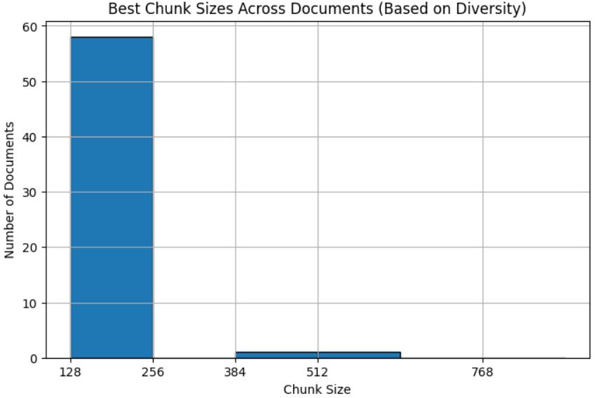
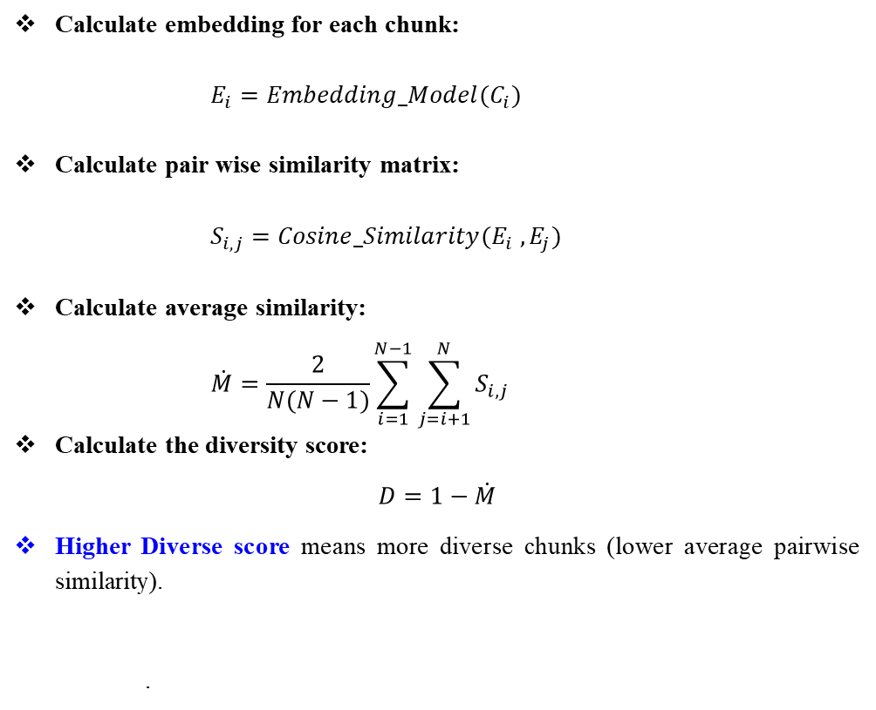
2. Diversity-Based Chunking Algorithm Analysis
This algorithm calculate the optimal chunk size and overlap using Diversity score.
Calculate embedding for each chunk:
$$E_{i}=Embedding_Model(C_{i})$$
Calculate pair wise similarity matrix:
$$S_{i,j}=Cosine_Similarity(E_{i} , E_{j})$$
Calculate average similarity:
$$\dot{M}=\frac{2}{N(N−1)}\sum_{i=1}^{N−1}{\sum_{j=i+1}^{N}{S_{i,j}}}$$
Calculate the diversity score:
$$D=1−\dot{M}$$
Higher Diverse score means more diverse chunks (lower average pairwise similarity).
.
Figure 2: Diversity-Based Chunking Algorithm
Optimal chunk size=256
Overlap=50

Slide 6
3. Document Chunking
The splitter is configured with a default chunk size of 256 tokens and an overlap of 50 tokens to preserve contextual continuity across chunks.
This chunking strategy was applied to all 60 files in the dataset, resulting in a total of 516 chunks.
4. Embedding Technique and Vector Database
Two embedding methods have been implemented: one open-source (SBERT) and the other closed source (OpenAI).
Due to its high dimensionality, rich semantic representation, and low latency, the OpenAI embedding is selected for further use.
The chunks are converted into vectors using the OpenAI embedding technique and stored in a vector database.
ChromaDB is used due to its seamless compatibility with popular embedding models (OpenAI, Sentence Transformers, Cohere), its ability to run locally without requiring an external server or database, and its efficient in-memory retrieval powered by optimized approximate nearest neighbours (ANN) algorithms.

Slide 7
5. Retrieval System
Vector DB
Query Embedding: Convert user query into an embedding vector using OpenAI embedding technique.
Dense Vector Search: Compute cosine similarity between the query embedding and document embeddings stored in the vector database. Retain documents with a similarity score above a predefined threshold (0.5).
BM-25 Keyword Search: Perform a keyword-based search using the BM25 algorithm to retrieve documents containing query-relevant terms.
Merge Results: Combine the results from both dense vector search and BM25 keyword search to create a candidate set of documents.
Semantic Filtering: Use a Sentence Transformer (bi-encoder) to encode the query and all candidate documents. Filter out documents with semantic similarity scores below the threshold.
Re-ranking Technique using Cross-Encoder: For each remaining (query, document) pair, use a cross-encoder model to assign a relevance score. Re-rank the documents based on these scores and return the top-k most relevant documents.
Query embedding
Vector search
Keyword search
Re-ranking(Cross-encoder)
Top-k relevant documents
Figure 3: Retrieval system

Slide 8
6. LLM Model and Prompt Technique
Open-source models (LLaMA 3.2:1B, Gemma:2B, and Mistral: latest) and OpenAI’s model (GPT-3.5-Turbo) are used for chatbot.
The result of GPT-3.5-Turbo was preferred due to its faster response time and consistent citation capabilities.
After experimenting with values in the range T = {0, 0.1, 0.2, 0.3, 0.4, 0.5}, it was found that T = 0.3 yielded the most balanced results with accurate and cited responses.
Since labelled data was not available, a zero-shot prompting approach was used.
Query and Relevant
Documents
LLM Mode
Prompt: {“You are a helpful assistant. Use the following sources to answer the question.
Always cite the source in the format [[SOURCE: name]]. If the answer is not found, say: "I don't have enough information."}
Response
Figure 4: Generation system

Slide 9
7. Model Evaluation
The following metrics used to evaluate the model:
RAGAS: ragas score, faithfulness, answer relevance
Hallucination detection
ROUGE score: ROUGE-1, ROUGE-2, ROUGE-L
BLEU score
Proxy question similarity score
8. Retrieval System Evaluation
The following metrics used to evaluate the retrieval system:
Semantic similarity scoring
Keyword coverage Score
Content density score

Slide 10
9. Result and Discussion
In order to evaluate the performance of the chatbot system in real-time, we provided two sets of questions.
Set A-Question (Related to the Dataset):
What purpose did the tales of ancient Greek heroes serve beyond entertainment?
How are Heracles's Twelve Labors interpreted symbolically?
Who were the main leaders of the Persian Empire during the Persian Wars?
Which Persian ruler led the full-scale invasion of Greece in 490 BCE?
What is one of the most enduring political contributions of Ancient Greece?
What were some areas that Aristotle contributed to?
Which Ancient Greek philosopher introduced the concept of "ideal forms"?
Which year the Alexander was born?
Set B-Questions (Not Related to the Dataset)
Explain the attention mechanism in transformers?
What are the key differences between generative AI and traditional AI?
What are foundation models, and why are they important in modern AI development?
Who is the CEO of SpaceX?
What is the current GDP of India?
How is AI being applied in financial fraud detection and risk analysis?
What are the advantages and risks of using Retrieval-Augmented Generation (RAG) in production systems?

Slide 11
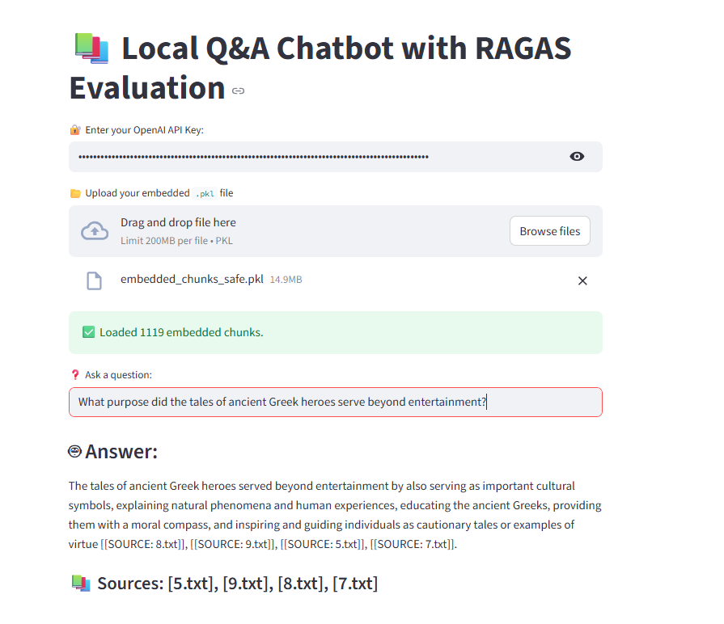
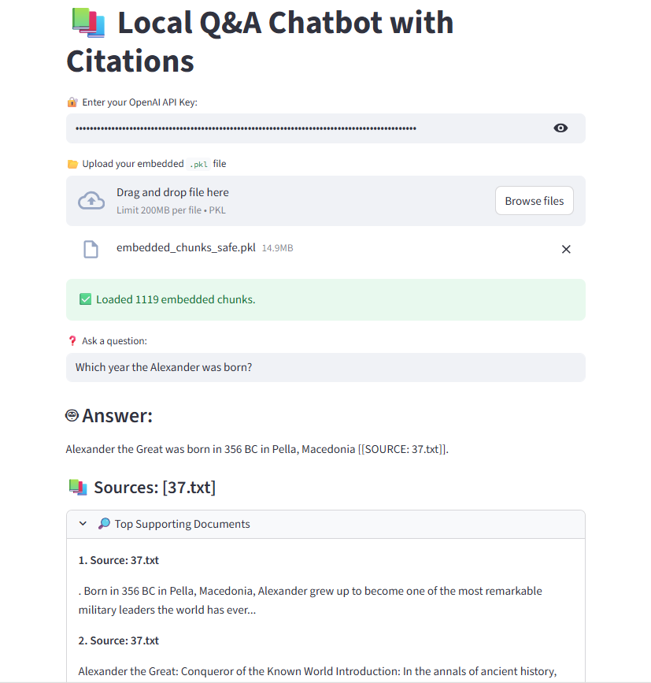
Output of Set-A Questions

Slide 12
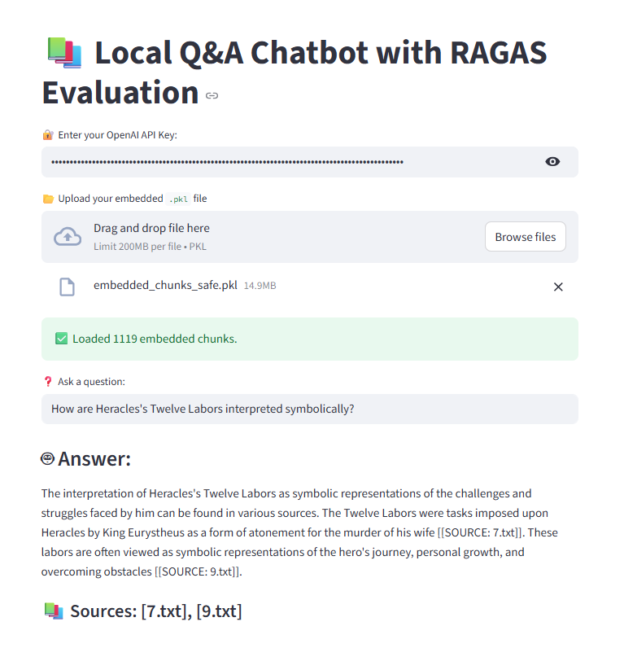
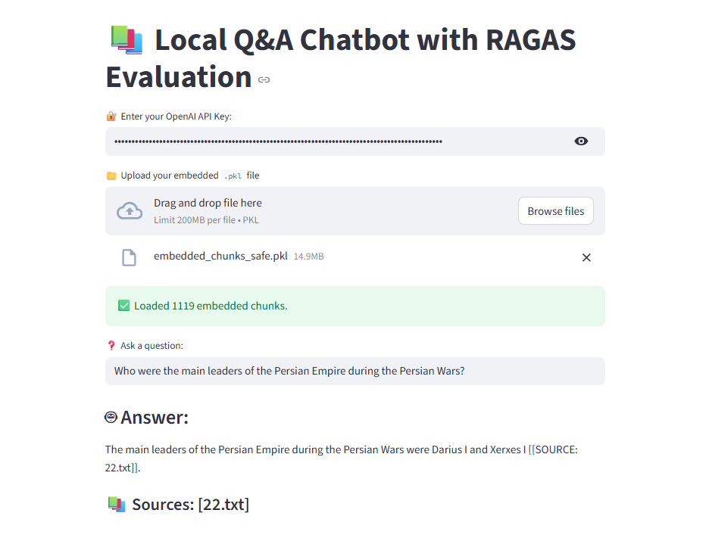
Output of Set-A Questions

Slide 13
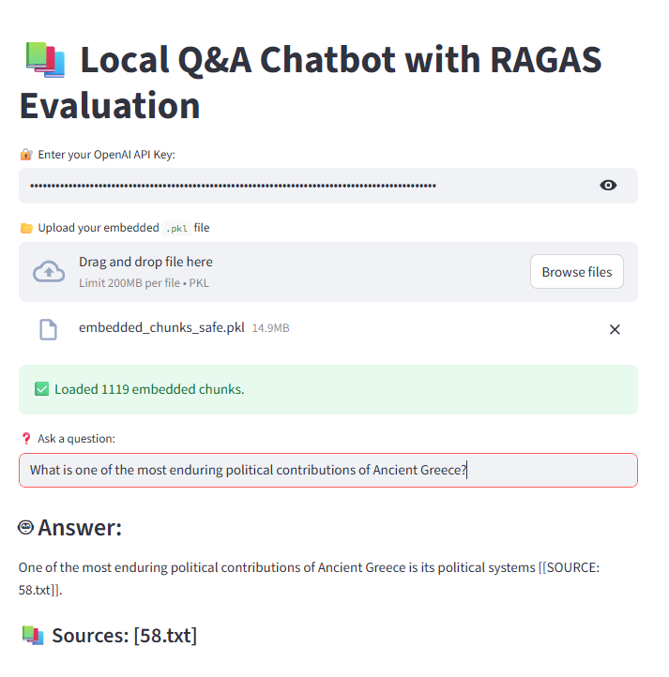
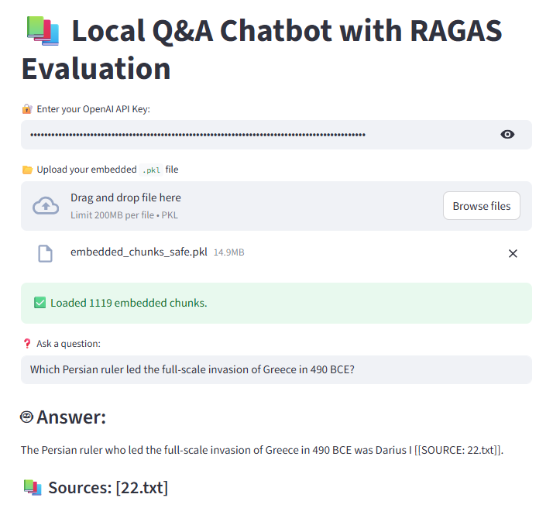
Output of Set-A Questions

Slide 14
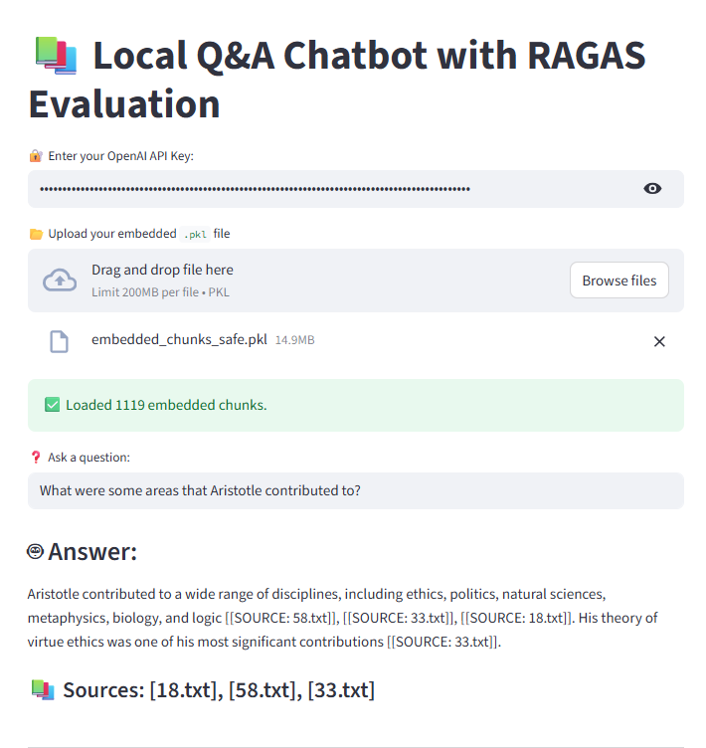
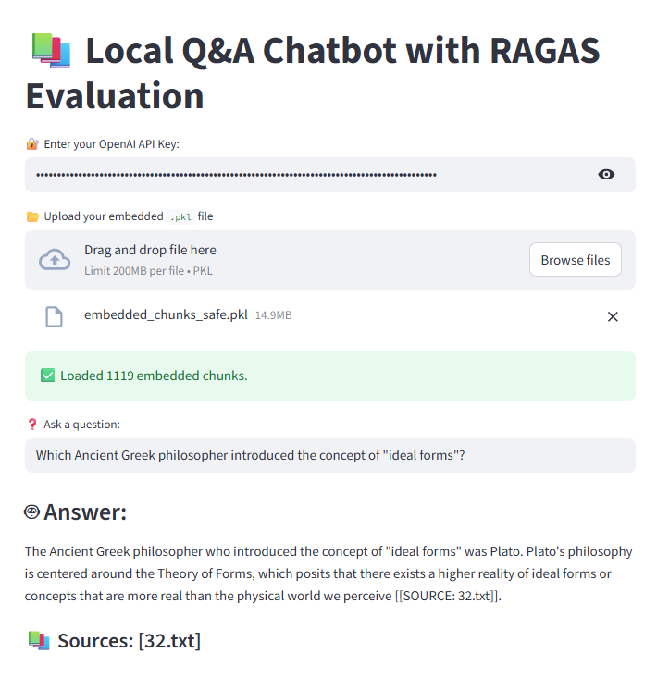
Output of Set-A Questions

Slide 15
Output of Set-A Questions
Table. 1: Evaluation of the model using few samples dataset.
Question No | Ragas score | Faithfulness | Answer relevance | Hallucination | Proxy question similarity score
1 | 0.95 | 1.0 | 0.92 | No | 0.84
2 | 0.65 | 0.5 | 0.96 | No | 0.83
3 | 1.0 | 1.0 | 1.0 | No | 0.82
4 | 0.97 | 1.0 | 9.95 | No | 0.86
5 | 0.97 | 1.0 | 0.95 | No | 0.65

Slide 16
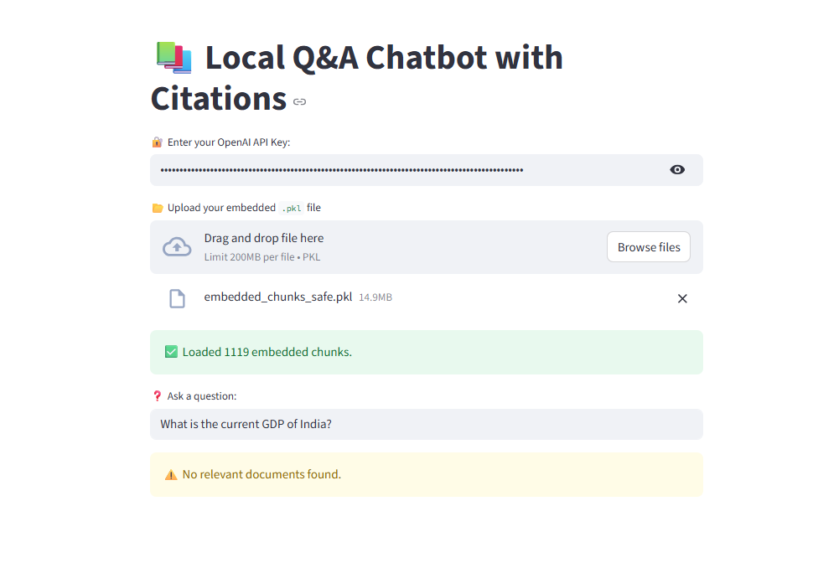
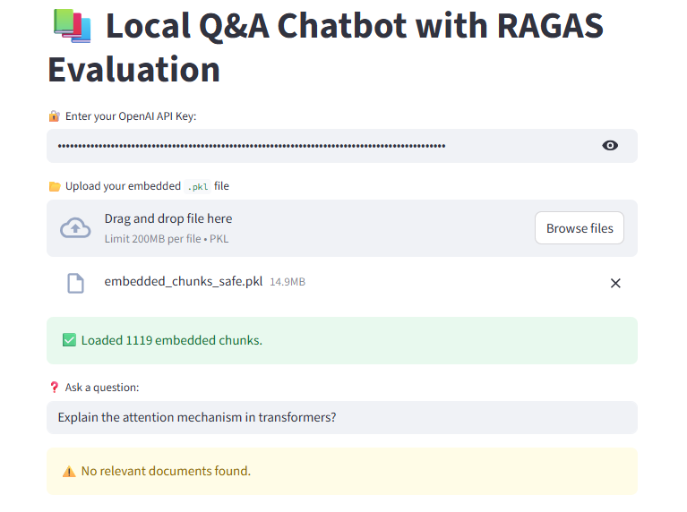
Output of Set-B Questions

Slide 17
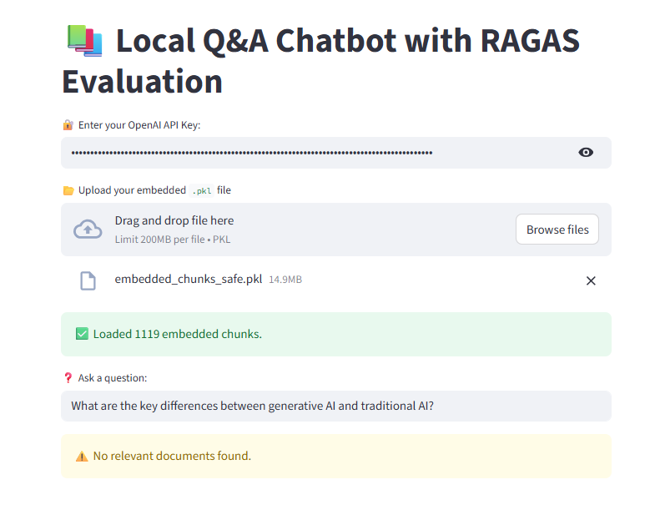
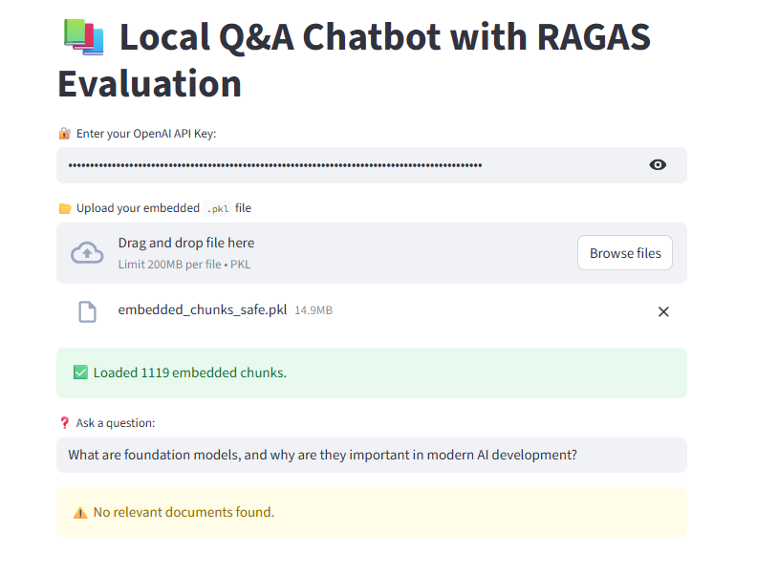
Output of Set-B Questions

Slide 18
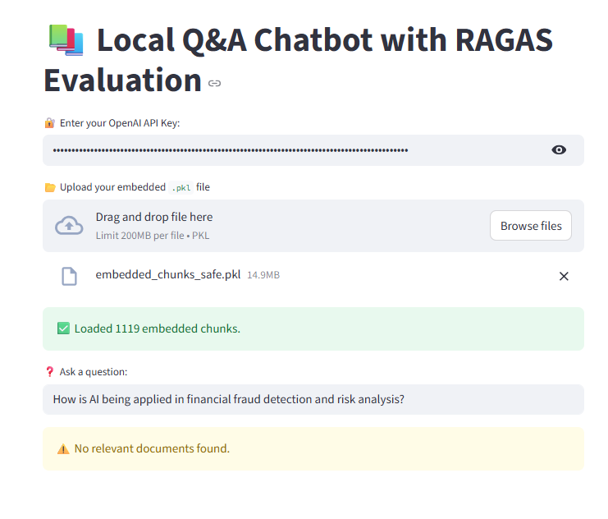
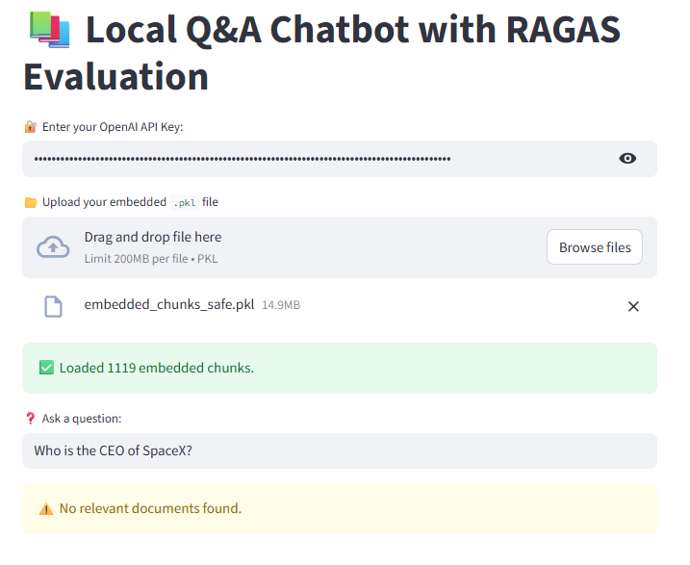
Output of Set-B Questions

Slide 19
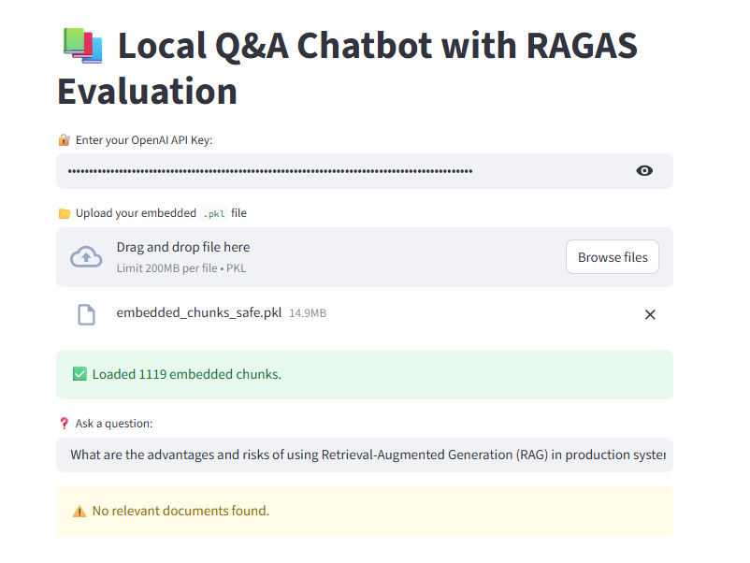
Output of Set-B Questions

Slide 20
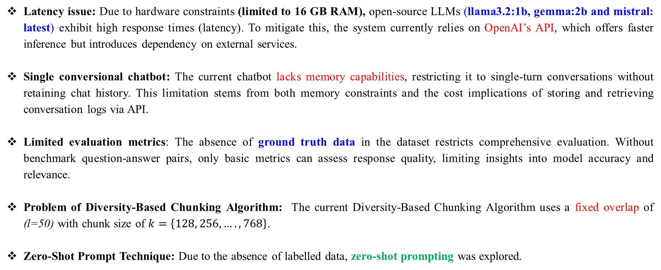
10. Challenges in the Current Chatbot
Latency issue: Due to hardware constraints (limited to 16 GB RAM), open-source LLMs (llama3.2:1b, gemma:2b and mistral: latest) exhibit high response times (latency). To mitigate this, the system currently relies on OpenAI’s API, which offers faster inference but introduces dependency on external services.
Single conversional chatbot: The current chatbot lacks memory capabilities, restricting it to single-turn conversations without retaining chat history. This limitation stems from both memory constraints and the cost implications of storing and retrieving conversation logs via API.
Limited evaluation metrics: The absence of ground truth data in the dataset restricts comprehensive evaluation. Without benchmark question-answer pairs, only basic metrics can assess response quality, limiting insights into model accuracy and relevance.
Problem of Diversity-Based Chunking Algorithm: The current Diversity-Based Chunking Algorithm uses a fixed overlap of (l=50) with chunk size of $k=\left\{128, 256, …., 768\right\}$.
Zero-Shot Prompt Technique: Due to the absence of labelled data, zero-shot prompting was explored.

Slide 21
11. Future Work
Incorporate Ground Truth Evaluation: In order to assess the quality of both the LLM responses and the retrieval system, ground truth data should be added to the dataset.
Implement Chatbot with Memory: Future iterations should integrate a memory mechanism or employ an AI agent capable of storing and referencing past interactions to improve contextual understanding and coherence.
Adopt Agentic RAG: To optimize retrieval and generation, an Agentic RAG framework can be implemented. This approach utilizes multiple AI agents to refine user queries, analyse retrieved documents, and dynamically invoke APIs or tools, thereby improving response accuracy and system efficiency.
Implement HyDE: The Hypothetical Document Embedding (HyDE) technique can enhance retrieval performance by generating a hypothetical answer to a query, embedding it, and using it for semantic similarity searches in the vector database. By combining the original query, hypothetical answer, and retrieved documents, the LLM can produce more accurate responses with reduced hallucination.
Optmize Diversity-Based Chunking Algorithm: A dynamic chunking approach should be explored, where varying chunk sizes {50, 100, 150, 200...} tokens are tested to identify the most optimal chunk size and overlap chunk for retrieval accuracy and computational efficiency.
Apply Fine Tuning Technique: To further enhance chatbot performance, fine-tuning methods such as LoRA (Low-Rank Adaptation) or QLoRA (Quantized LoRA) can be employed .
Better Prompting Technique: To improve the chatbot's performance, more effective prompting strategies such as few-shot prompting can be utilized.
Use LLM as Judge: To assess the performance of the chatbot, an additional LLM can be employed to evaluate its responses.

Slide 22
12. Conclusion
The RAG pipeline developed for the Q&A chatbot effectively answers queries related to the provided dataset, including proper source citations.
However, it correctly refrains from responding to questions outside the dataset's scope. This demonstrates that the chatbot is robust, with minimal hallucination.

Slide 23
Thank You

